Slide 1
Searching in HELM notations
Eva Bültel, quattro research GmbH
15.02.2018

Slide 2
Content
Why is searching in HELM notations interesting?
Goal
HELMSimilarityLibrary
Examples
Limitations
Summary

Slide 3
Why is searching in HELM notations interesting?
Check for uniqueness
Clustering
Find similarities
Check for subset

Slide 4
Find similarities
How similar are two notations?
RNA1{R(A)P.R(C)P.R(A)P}$$$$V2.0
RNA1{R(A)P.R(C)P.R(A)[sP]}$$$$V2.0
Returning every notation with at least X % similarity to a query notation:
RNA1{R(A)P.R(C)P.R(A)P}$$$$V2.0 (Query)
RNA1{R(A)P.R(C)P.R(A)[sP]}$$$$V2.0 70 %
RNA1{R(A)P.R(C)[sP].R(A)[sP]}$$$$V2.0 50 %
RNA1{R(C)P.R(G)[sP].R(A)P}$$$$V2.0 20 %

Slide 5
Check for subset (substructure filter)
Query: RNA1{R(A)P}$$$$V2.0
RNA1{R(C)P.R(C)P}$$$$V2.0
RNA1{R(G)P.R(C)P.R(G)P}$$$$V2.0
RNA1{R(C)P.R(A)P.R(G)P}$$$$V2.0
Query notation is a subset of the last notation found in database
Notations in database

Slide 6
Goal of HELMSimilarityLibrary
Input HELM notations
Similarity search through a set of notations
Query notation
Results: every notation with a specified similarity to the query
Substructure filter

Slide 7
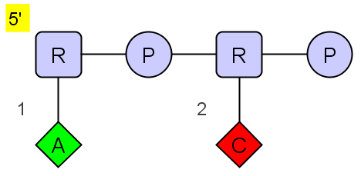
HELMSimilarityLibrary
Build molecule graph representation
Convert linear notation to a graph
Monomers = vertices
Connections = edges
RNA1{R(A)P.R(C)P}$$$$V2.0
HELM notation graph (HELMEditor v1.4)
Notes:
Used the API of HELMNotationParser to extract all of the important information of the notation

Slide 8
HELMSimilarityLibrary
Find paths
Depth-first-search through molecule graph
Finds every path of length between 1 and 6
RNA1{R(A)P.R(C)P}$$$$V2.0
Paths:
A CR PRP ARPRP
C PR ARPR
P ARP CRPR
R CRP PRPR
AR RPR ARPRC
HELM notation graph (HELMEditor v1.4)

Slide 9
HELMSimilarityLibrary
Find paths
Case: notation with non-natural monomer
RNA1{[LR](A)P}$$$$V2.0
Original paths:
A
[LR]
P
A[LR]
P[LR]
A[LR]P
Natural paths:
A
R
P
AR
PR
ARP

Slide 10
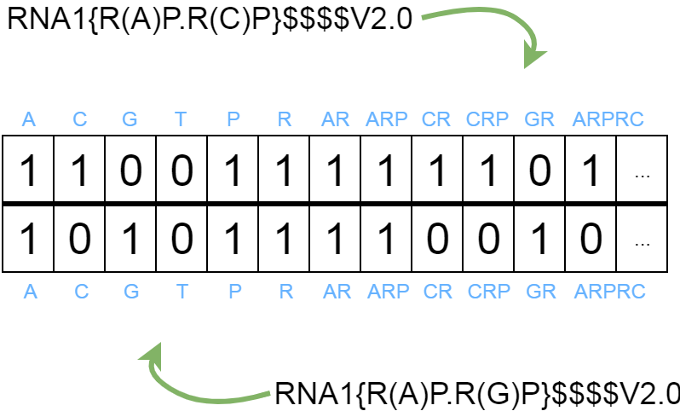
HELMSimilarityLibrary
Generate fingerprint
Notes:
One fingerprint for each notation
Comparison of helm notations via fingerprint

Slide 11
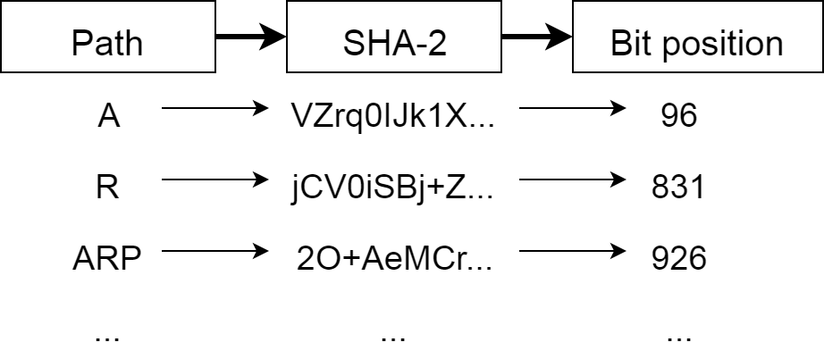
HELMSimilarityLibrary
Generate fingerprint
One fingerprint of length 1024 for each notation

Slide 12

HELMSimilarityLibrary
Calculate tanimoto
A
B
$$\sum{A=9}$$
$$\sum{B=7}$$
$$\sum{AB=5}$$
$$Tanimoto= \frac{5}{\left(9+7\right)−5}= \frac{5}{11}=0.4545=45.45 \% similarity$$

Slide 13
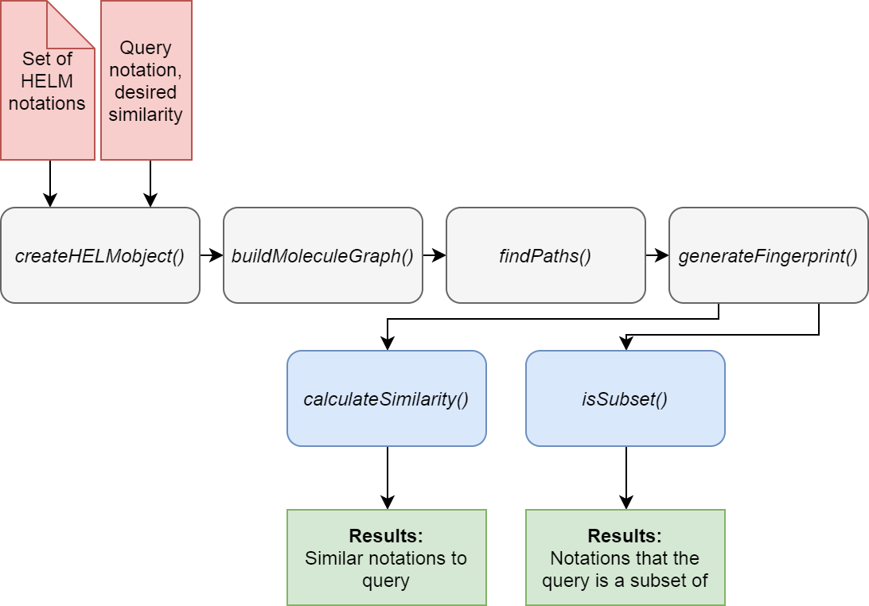
HELMSimilarityLibrary

Slide 14
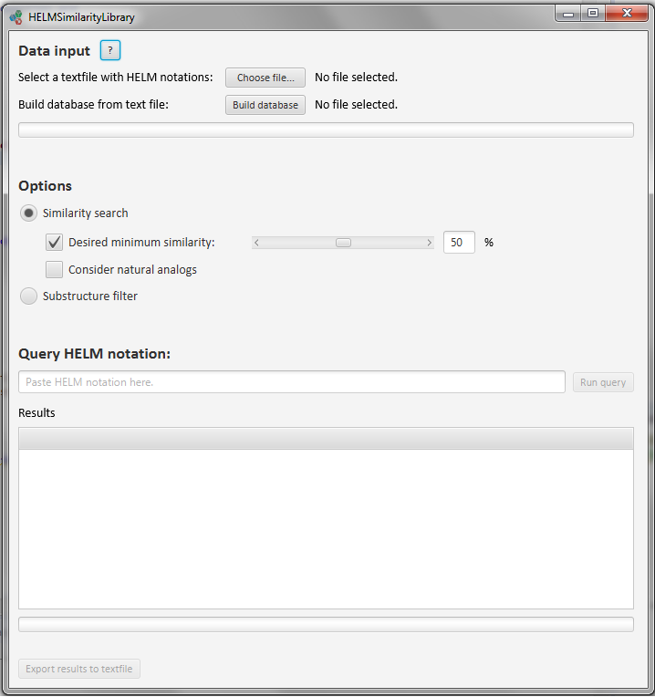
Examples

Slide 15
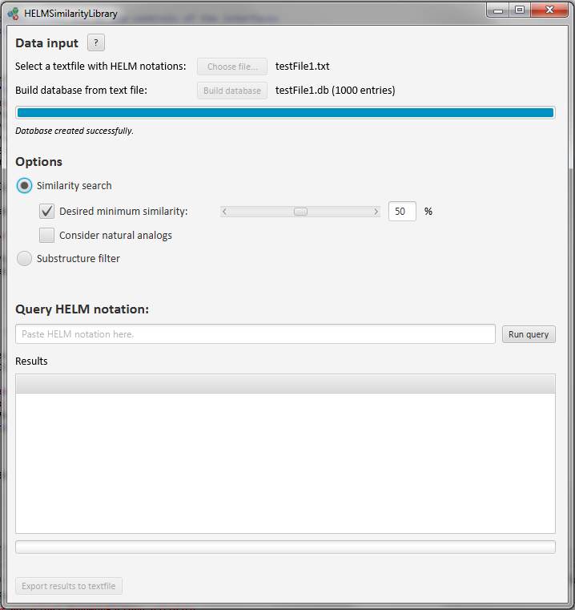

Slide 16
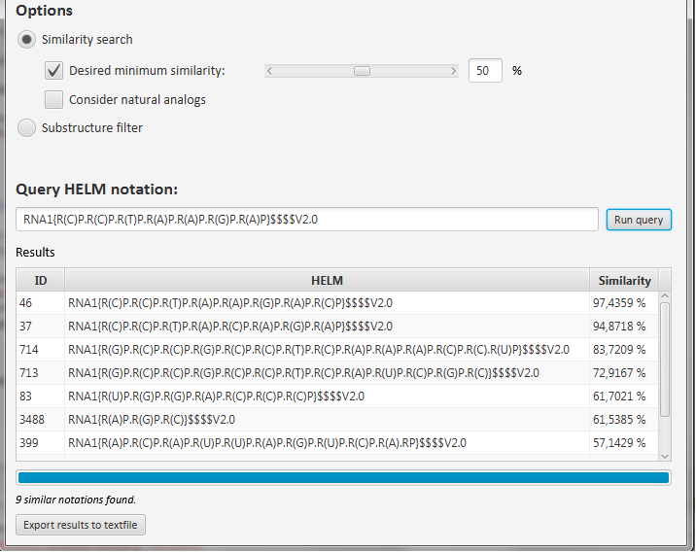

Slide 17
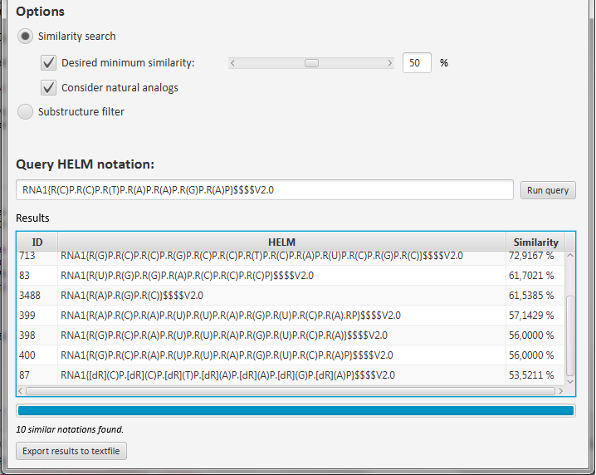

Slide 18
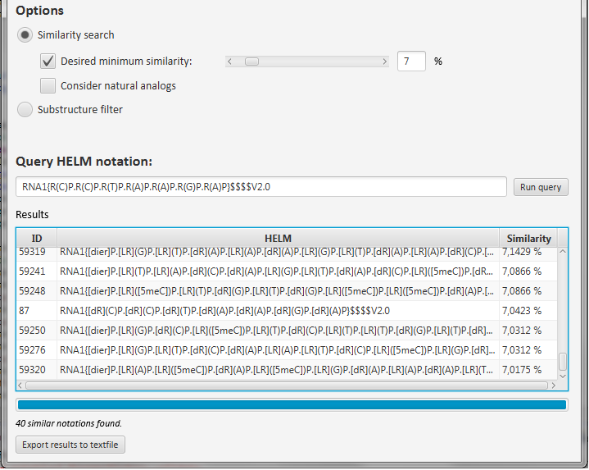

Slide 19
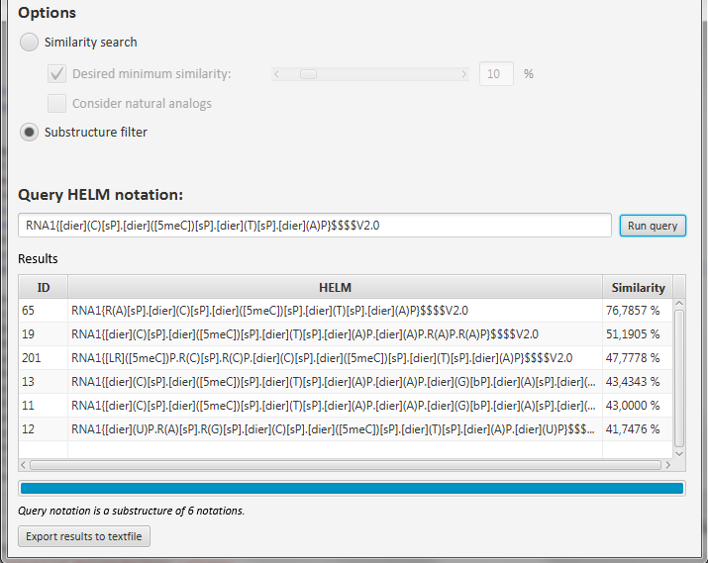

Slide 20
Limitations
In-line SMILES notations
Ambiguity
Pseudosimilarity due to finite number of bit positions

Slide 21
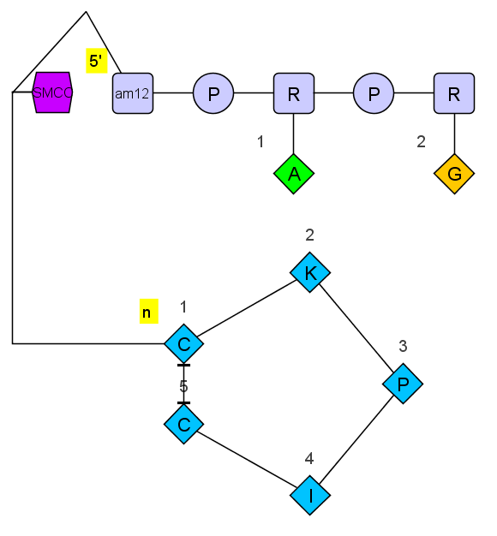
Summary
HELMSimilarityLibrary
A new algorithm for searching in HELM notations
Similarity search
Substructure filter
Export of results
Supports complex polymers
RNA1{[am12]P.R(A)P.R(G)}|PEPTIDE1{C.K.P.I.C}|
CHEM1{[SMCC]}$PEPTIDE1,PEPTIDE1,5:R3-1:R3|
PEPTIDE1,CHEM1,1:R1-1:R2|RNA1,CHEM1,1:R1-1:R1$$$
HELM notation graph (HELMEditor v1.4)

Slide 22
Thank you!

Slide 23
Acknowledgements
Thank you for input and feedback:
Dr. Anne Mund, quattro research GmbH
Dr. Markus Weisser, quattro research GmbH
Prof. Dr. Matthias Rarey, Center for Bioinformatics, University of Hamburg

