Slide 1
Biopolymer monomer coverage?
Amino acids
Nucleic acids (DNA, RNA)
Sugars?
Lipids?
How many monomers are viable?
When does chemical modification begin? When does monomer definitions end?

Slide 2
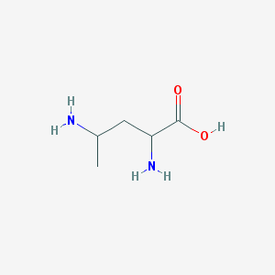
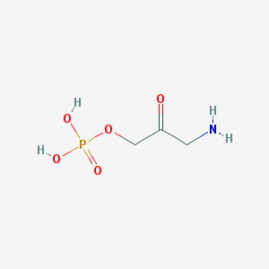
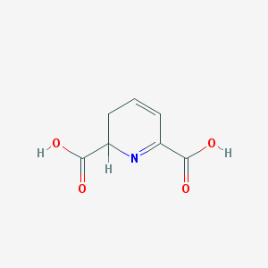
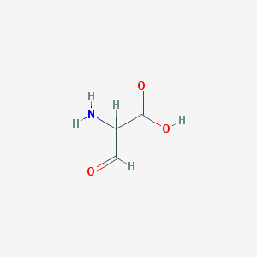
Many basic questions for monomers
AA-AA containing structures “C(C(=O)NCC=O)N” w/ +1M in PubChem after 41% searched
AA-AA-AA containing structures “C(C(=O)NCC=O)NC(CC)=O” w/ 918K in PubChem
What is a biopolymer monomer?
What is an amino acid (AA)?
C(C=O)N as most basic viable entity?
+1M AA after searching ~4% of PubChem
https://pubchem.ncbi.nlm.nih.gov/search/#query=C(C%3DO)N&tab=substructure&fullsearch=true
+10M AA containing structures in PubChem
Are those below all monomers?

Slide 3
How to define a monomer?
Histograms?
The ones that occur most frequently?
When does a monomer begin?
Atom environment based definitions?
Nearest neighbors
Best practices?
How to deal with canonicalization?
one monomer contained within another
Multiple definitions for same structure

