Slide 1
ChEMBL HELM implementation
Anna Gaulton, George Papadatos, Patricia Bento

Slide 2
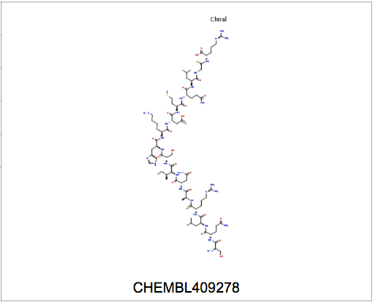
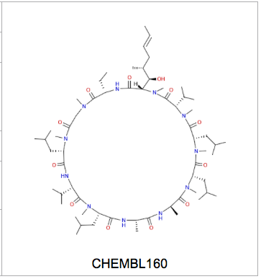
ChEMBL biotherapeutics
~24K peptides from medicinal chemistry literature
Stored as molfiles
16K linear peptides
4K cyclic peptides
~4K branched/complex peptides

Slide 3
Pistoia Alliance collaboration
Collaboration with the HELM project to implement HELM notation in ChEMBL_20:
Identify distinct amino acid monomers from peptide content of ChEMBL
Create a public library of these monomers
Convert ChEMBL med-chem peptide content from molfile format to HELM notation

Slide 4
Implementation
ChEMBL peptides fragmented to produce distinct set of monomers
Implemented as Pipeline Pilot protocol, using ChemAxon components
Fragmentation on peptide bonds and disulphide bonds only (differs from default toolkit implementation)
HELM toolkit used to match ChEMBL peptides against the created monomer library and create notation
Modified fragmentation and additional canonicalisation of input structures to match library monomers

Slide 5
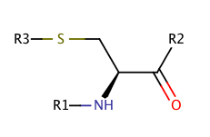
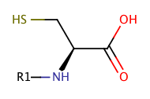
Issues addressed
Standardisation of monomers
InChI used internally to determine unique monomers
Tautomers (e.g., Arg) canonicalised both in the library and matching process in order to generate correct notation
Monomer with maximum observed number attachment points stored in library. Toolkit will allow matching of other forms e.g.,
Internal, SS-bonded Cys C-terminal, non SS-bonded Cys

Slide 6
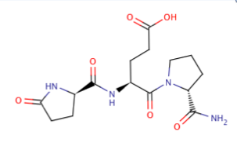
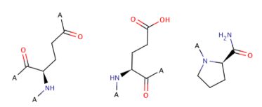
Issues addressed
Fragmentation rules
Made fragmentation more specific to peptide, rather than amide bonds
E.g., CHEMBL7003
Pyroglutamic acid ring opened

Slide 7
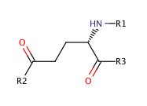
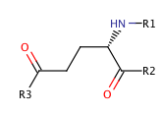
Issues addressed
Different monomers with same connectivity but different attachment points – match on SMILES
Not currently an issue for ChEMBL because only alpha amino acids in library, but may need to address in future
Ggu [*]N[C@@H](CCC([*])=O)C([*])=O |r,$_R1;;;;;;_R2;;;_R3;$|
E [*]N[C@@H](CCC([*])=O)C([*])=O |$_R1;;;;;;_R3;;;_R2;$|

Slide 8
Naming monomers
Needed to name the ~4500 monomers in the library before creating the final HELM notation
Aimed to use conventions for common amino acids e.g., Orn, Sec
Where no consistent convention existed, tried to apply systematic names e.g., Me, Ph, Ac, Cl to naming of caps/non-natural side-chains
For large, very unnatural monomers needed to apply largely arbitrary IDs to maintain readability of HELM notation (e.g., X123)
Feedback on existing naming conventions within project welcome

Slide 9
Results
Monomer library created containing 2851 monomers
Linear peptides (16K peptides) converted to HELM
Cyclic peptides (4K peptides) converted to HELM

Slide 10
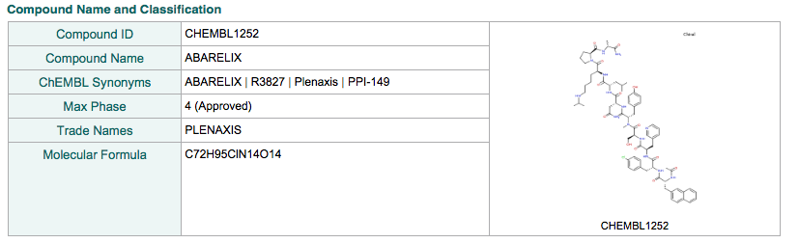
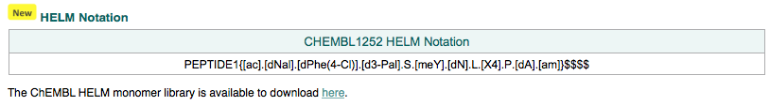
Availability
HELM notation for peptides included in ChEMBL from release 20 onwards e.g.,
https://www.ebi.ac.uk/chembl/compound/inspect/CHEMBL1252
Monomer library available on EBI FTP site:
ftp://ftp.ebi.ac.uk/pub/databases/chembl/ChEMBLdb/latest/chembl_24_1_monomer_library.xml

Slide 11
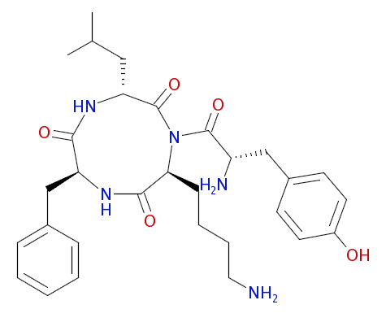
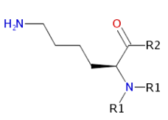
Caveats of ChEMBL implementation
Currently restricted to peptides with alpha amino acids (though beta/gamma not common in ChEMBL)
Not removing caps from monomers (apart from N-term acetyl and C-term amine) in library therefore Me-Ala monomer is distinct from Ala
Only fragmenting at peptide and disulphide bonds. Not defining possible side-chain attachment points unless SH
Currently excluding some problematic cases/branched peptides
e.g., monomers with two attachment points on backbone N
?

Slide 12
Concluding thoughts
More guidance/best practice information would be helpful in implementing the standard e.g.,
Best way to create a non-redundant library
Should caps be removed or not? And if so, amino acid monomers or CHEM?
Definition of side-chain attachment points, how to break side chains?
What standardisation should be done on monomer structures
What tools are available for different tasks
Naming conventions already used

Slide 13




Acknowledgements
EMBL-EBI
Patricia Bento
George Papadatos
Anna Gaulton
Pistoia/HELM
John Wise (Pistoia Alliance)
Claire Bellamy (Pistoia Alliance)
Roland Knispel (ChemAxon)
Sergio Rotstein (Pfizer)
Tianhong Zhang (Pfizer)
Matthias Nolte (BMS)

