Slide 1

HELM and monomers
Kick-off Meeting
HELM Manager: Claire Bellamy
HELM Domain Lead: Sergio Rotstein
7th September 2018
Notes:
Opening title slide

Slide 2
Monomer Kick-off meeting
Agenda
Introduction
History of HELM and monomers
Presentations from HELM users
Discussion and next steps

Slide 3
Monomer Kick-off meeting
Aim of this meeting
To build understanding of the work already done using HELM monomers inside and outside the project.
To build understanding of the drive to create an common external monomer set.
To decide whether we have the support to start a piece of work to define the principles of what makes a good HELM monomer set.
Gather together the questions and issues, so we can structure future discussions.
To agree next steps

Slide 4
This Webinar is being recorded

Slide 5
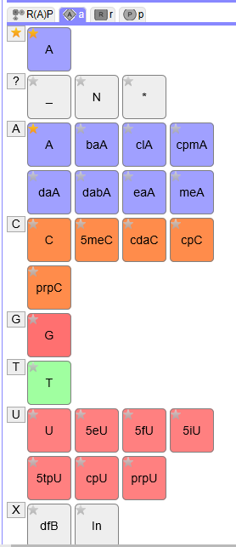
History
HELM tools and definition released in 2013.
Monomer set was derived from the Pfizer internal set and is used in the online demo HELM tools today.
Initial adopters were pharma companies who generally wanted to use their own monomer sets aligned with their research projects
To facilitate communication between groups, HELM developed:
In-line HELM – the ability to describe a monomer using SMILES within the HELM string and without fully registering it in the monomer set.
PEPTIDE1{A.[[*:2]C(=O)[C@H](C)N([*:1])C].A}$$$$
xHELM – an xml format that allows the user to bundle the monomers required to interpret the HELM strings in the file. The toolkit enables you to import xHELM into an existing set-up with your own monomer set.

Slide 6
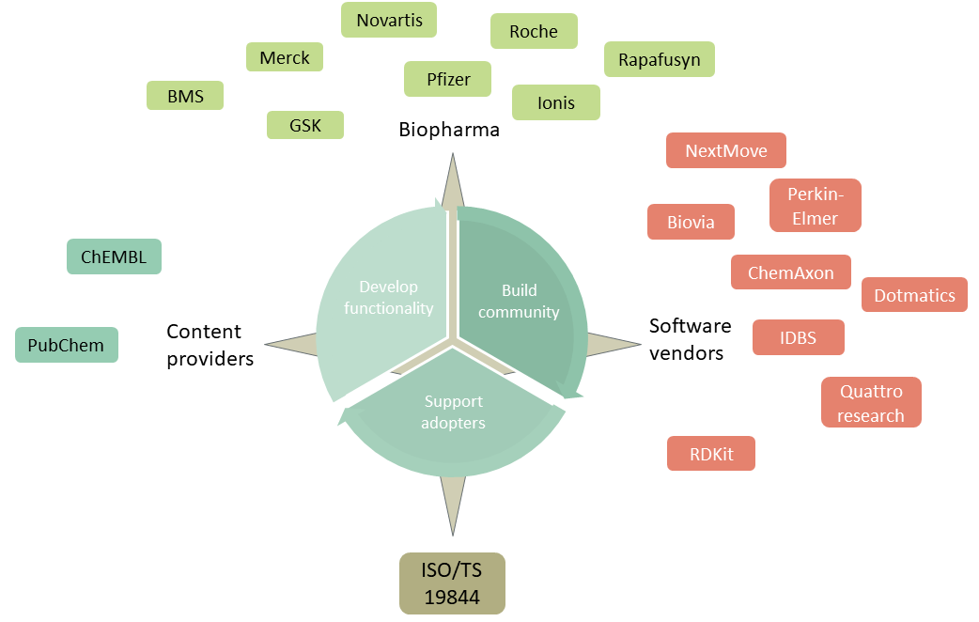
History
HELM has been adopted widely in the last 5 years and expanded beyond pharma companies.
In particular we now have content providers defining biologics using HELM:
ChEMBL
PubChem
Norine
And interest from more.
We also have small companies who would like a starter-pack monomer set that can be adopted easily and be aligned to the majority of other HELM users.

Slide 7
Public monomer sets
Monomer set | Size (approx.) | Comments
HELM 1 | 191 | Used in the HELM tools from the beginning
Ionis set (initial monomer.org set) | 553 | Enhanced nucleotide set. Documented approach to naming. Some differences with HELM1.
ChEMBL | 2851
Norine | 532 | Published in another form, but being converted into HELM
PubChem?
Novartis | 55 | Oligonucleotides only
A more published set of principles about what makes a good monomer set would help us create a common monomer set that all could adopt and give guidance to new adopters wanting to use their own.

Slide 8
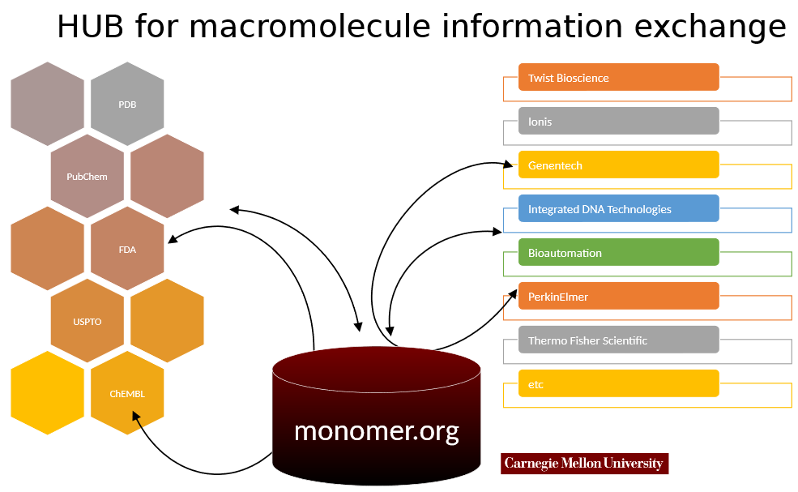
Monomer.org
Concept – a world-wide monomer reference
To include
a curated central set
A location where organizations can publish their own sets.
Monomer.org will allow translation between organizations

Slide 9
Monomer.org
Monomer.org is now part of Carnegie Mellon University which will be apply for grants to develop it on.
In the meantime the set developed within Ionis will be hosted at www.monomer.org. This includes a well curated set of nucleotide monomers and a more limited set of peptides.
There are many areas that need to be developed:
Governance structures
Technical architecture
Initial monomer set and guidelines for new monomers
Ongoing curation process

Slide 10
Monomer.org
Monomer.org is now part of Carnegie Mellon University which will be apply for grants to develop it on.
In the meantime the set developed within Ionis will be hosted at www.monomer.org. This includes a well curated set of nucleotide monomers and a more limited set of peptides.
There are many areas that need to be developed:
Governance structures
Technical architecture
Initial monomer set and guidelines for new monomers
Ongoing curation process

Slide 11
Questions..
Themes - where should we start?
What factors are most important when deciding on what a monomer is? Utility for the scientists and adherence to common usage? Theoretical purity and the ability to canonicalize using the monomer set? Adoption of a particular standard (which one?), reflection of the process by which the polymer was made? Something else?
When fragmenting polymers, how did you decide what a monomer was? Monomer vs dimer vs capping group.
How did you decide which polymer type various ‘ambiguous’ monomers were? E.g. in the current HELM test site Bua (butanoic acid) is a peptide monomer. Is this acceptable or should this be a CHEM?
How important is it, that capping groups reflect the chemistry? E.g. should different leaving groups be different monomers or is this not important? (think about protecting groups like BOC as well as H, OH etc.)
Should we maximize the number of connection points for flexibility? Or should different numbers of connection points be different monomers?
How should we decide what monomers are named?

Slide 12
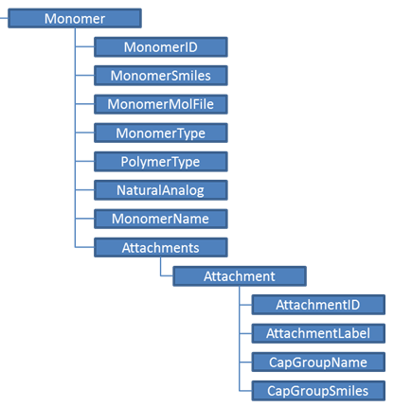
Discussion
Presentations from:
ChEMBL
Novartis
Norine
PubChem/Next Move
Short name
Chemical structure
Peptide, RNA, CHEM
Longer name
R groups
Leaving group structure

Slide 13
Next steps
Actions:
Future meeting times
Is this time once every 2 or 3 weeks OK for most people?
Can speakers send me their material? (including examples from Novartis)
Risk
This is an area where is will be easy to disagree and spend a lot of time discussing options and not making a decision.
I will set timelines for questions and it will be great to get timely feedback.
All offers to prepare proposals are very welcome.

Slide 14
Backup slides
Monomer Kick-off Meeting
7th September 2018
Notes:
Opening title slide

Slide 15
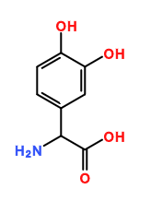
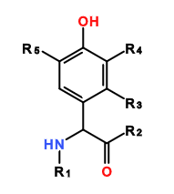
Tricky decisions…
How many attachment points?
Norine example
3,4-dihydroxyphenylalanine
diOH-Phe A
Is 5 enough or do we need more or fewer?
nC6o 6-aminohexanol
hxyno Hexynyl alcohol

