Slide 1

HELM and monomers
HELM Manager: Claire Bellamy
HELM Domain Lead: Sergio Rotstein
28th September 2018
Notes:
Opening title slide

Slide 2
This Webinar is being recorded

Slide 3
Monomer Guidelines Discussion
Agenda
Scope
Questions
Canonicalization
Variants
R groups
Next steps

Slide 4
Scope
Agree and publish a set of good practice guidelines for HELM Monomer Sets
Aim
To provide a framework for organizations to use when creating their own monomer sets.
To create rules to be used by monomers in any future public monomer set.
Risks
This is an area where is will be easy to disagree and spend a lot of time discussing options and not making a decision.
Please give timely feedback.
All offers to prepare proposals are very welcome.
We may not be able to come to a unanimous conclusion on every issue, but will need to move forward with a core set of recommendations.

Slide 5
What is a monomer?
This is too big a question to tackle as a whole.
I want to explore what issues that will affect our decisions – what do we need a monomers to do, and what is possible while ensuring the set can be constructed in a practical way.
Many of the decisions will require trade-offs. We need to weigh the consequences and decide which are worth living with.
Naming will be the last topic. We need to decide what we want in the monomer set, before we try to name them.
We may loop back during discussions if later considerations change our mind on earlier proposals. We will try to avoid this as far as possible, but it may happen.
We need as much input as possible, particularly from your experiences actually using or creating your own monomer sets.

Slide 6
Canonicalization

Slide 7
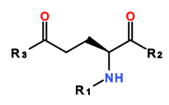
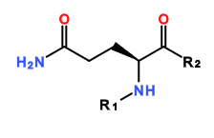

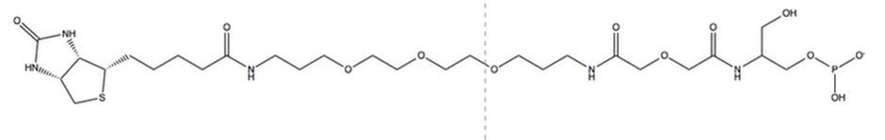
Canonicalization
For HELM to be canonicalizable all monomers must be orthogonal.
i.e. it must not be possible to create a monomer from 2 other monomers in the set
Issues:
The current set includes glutaminc acid, glutamine and an amino capping group…
There are also complex monomers containing a lot of functionality
E am Q

Slide 8
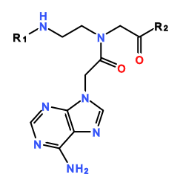
Canonicalization
And there are monomers that are obviously contain at least one other monomer
PMA adenine (pnA)
“Monomers” like this are in the set because they can be bought as building blocks and the scientists want to reflect their practice in the notation.
If you take a very theoretical view - are all alpha amino acids a variation on glycine?

Slide 9
Canonicalization
What does HELM do best? It provides:
A monomer level view for polymers.
The ability to search by monomer motifs.
Compound registration could be handled by converting into small molecule format e.g. InChI and performing uniqueness checks on that.
HELM
InChI, Mol, SMILES
Monomer view
Searching by monomer motifs
Atom/bond view
Searching by chemical moieties
Uniqueness checking

Slide 10
Canonicalization
QUESTION 1: must monomers be entirely independent of each other, so you can canonicalize HELM directly or should we rely on conversion to a small molecule representation for canonicalization?
Consider
What are the disadvantages of not being able to canonicalize HELM directly?
Issues
If there is no clear definition of a monomer, how can you fragment an existing large molecule?
If molecules are not orthogonal then how do you decide what is and isn’t a monomer? Are any of the following acceptable? (we may have to come back to this later)
Starting materials of the synthetic route taken to the final product. (this has some problems with multi-step syntheses)?
Common monomers available for purchase?

Slide 11
Exploding monomer sets

Slide 12
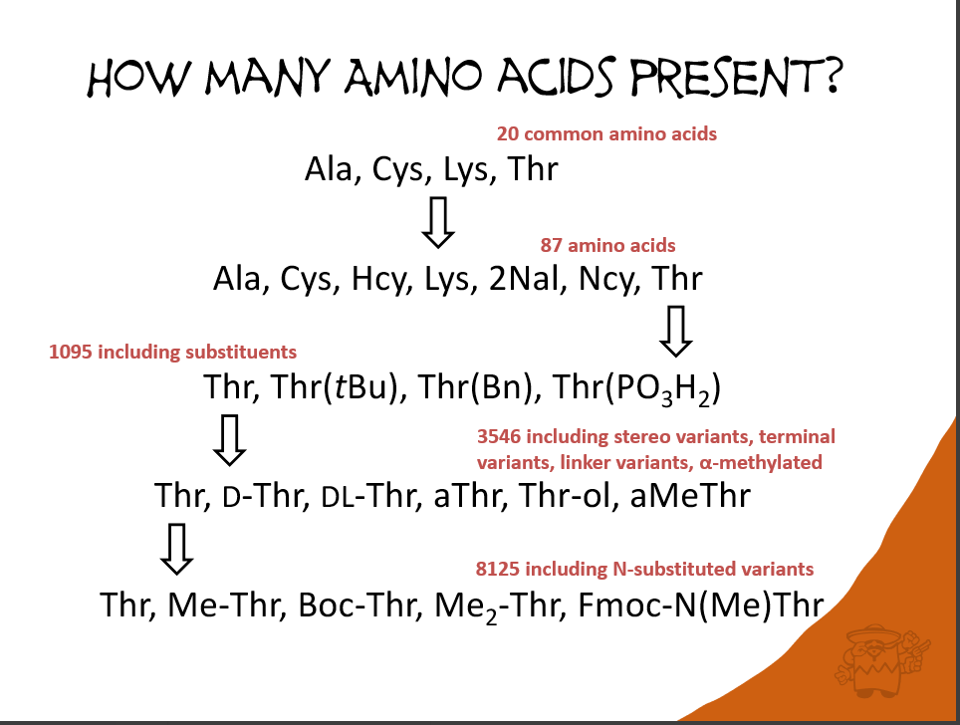
Exploding monomer sets?

Slide 13
Variations on amino acids
There are many monomers that are a minor variation on the naturally occurring set.
L amino acids
Stereoisomers – D, DL
Beta, homo, iso forms
N substitutions – Me, Et, Pr, Bu, tBu, Ac,
N and C terminal substitutions – all, or if not all, which ones? Boc, Fmoc, Tos
Alpha and other substitutions?
What else?

Slide 14
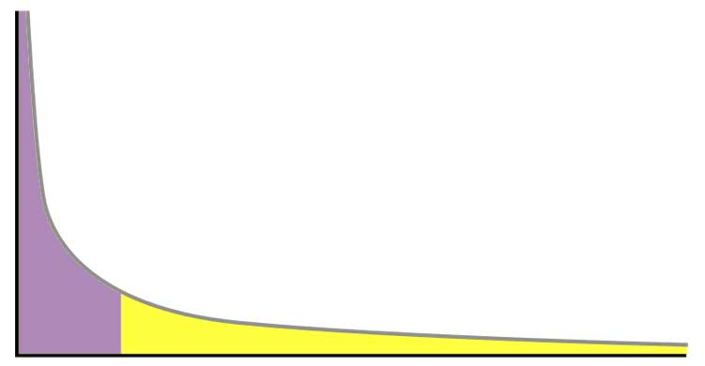
Variation and the exploding monomer set
Readability of the HELM string itself could be improved by allowing caps to be included:
1. PEPTIDE1{[meA].A}$$$$V2.0
Is easier to read than
2. PEPTIDE1{([Me]).A.A}$$$$V2.0 although not by much. (Note that I have made up the methyl peptide capping group [Me] for this example and it would require an R3 on the alanine nitrogen if the alanine were to be part of a continuing polymer.)
And the following is even less easy to read
3. CHEM1{[Me]}|PEPTIDE1{A.A}$CHEM1,PEPTIDE1,1:R1-1:R1$$$V2.0
But including all minor variations in monomers will result in a very large monomer set many of which will be in the long tail of usefulness.
They could also clutter up a user interface for the user.
Number of times used
Monomers

Slide 15
Variations on amino acids
Question 2: Which of these should be individual monomers and which substituted existing monomers?
L amino acids
Stereoisomers – D, DL
Beta, homo, iso forms
N substitutions – all, or if not all, which ones? Me, Et, Pr, Bu, tBu, Ac. Should we create a basic set of ‘core’ substituted monomers? If so, which ones?
N and C terminal substitutions – all, or if not all, which ones? Boc, Fmoc,
Alpha and other substitutions?
What else?
Considerations
Readability for the user
Flexibility of the set. Should an extra substitution really be an additional monomer?

Slide 16
R groups

Slide 17
R group variations
Are monomers with different numbers of R groups different monomers?
How many R groups should monomers have in a standard set?
Should we have different monomers for variants with different numbers of caps?
If R groups are not used in HELM then they are capped. Does this mean all monomers should have the ‘maximum’ number of R groups?
Considerations
Readability for the user
Flexibility of the set.
Norine example 3,4-dihydroxyphenylalanine diOH-Phe A

Slide 18
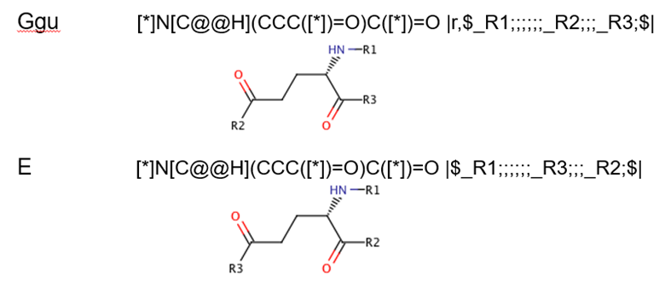
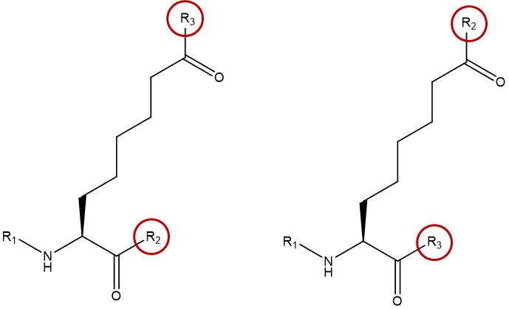
R group variations
What about monomers with different R group positions?
Both of these are amino acids (the second one is not in the current set).

Slide 19
R group variations
What about monomers with different caps?
 | Cap | Cap
R1 | H | H
R2 | OH | OH
R3 | H | OH
R4 | H | OH
R5 | H | H
We currently have the option of X. If we have many R groups on a single molecule, should this be allowed?
Should we include more complex capping groups – OMe, Ac, Tos, Boc etc…

Slide 20
Next steps
Actions:
Future meeting times
Fridays at this time every 2 weeks

Slide 21


Thank you

Slide 22
Backup slides
Monomer Kick-off Meeting
7th September 2018
Notes:
Opening title slide

Slide 23
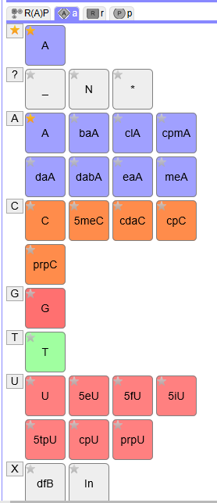
History
HELM tools and definition released in 2013.
Monomer set was derived from the Pfizer internal set and is used in the online demo HELM tools today.
Initial adopters were pharma companies who generally wanted to use their own monomer sets aligned with their research projects
To facilitate communication between groups, HELM developed:
In-line HELM – the ability to describe a monomer using SMILES within the HELM string and without fully registering it in the monomer set.
PEPTIDE1{A.[[*:2]C(=O)[C@H](C)N([*:1])C].A}$$$$
xHELM – an xml format that allows the user to bundle the monomers required to interpret the HELM strings in the file. The toolkit enables you to import xHELM into an existing set-up with your own monomer set.

Slide 24
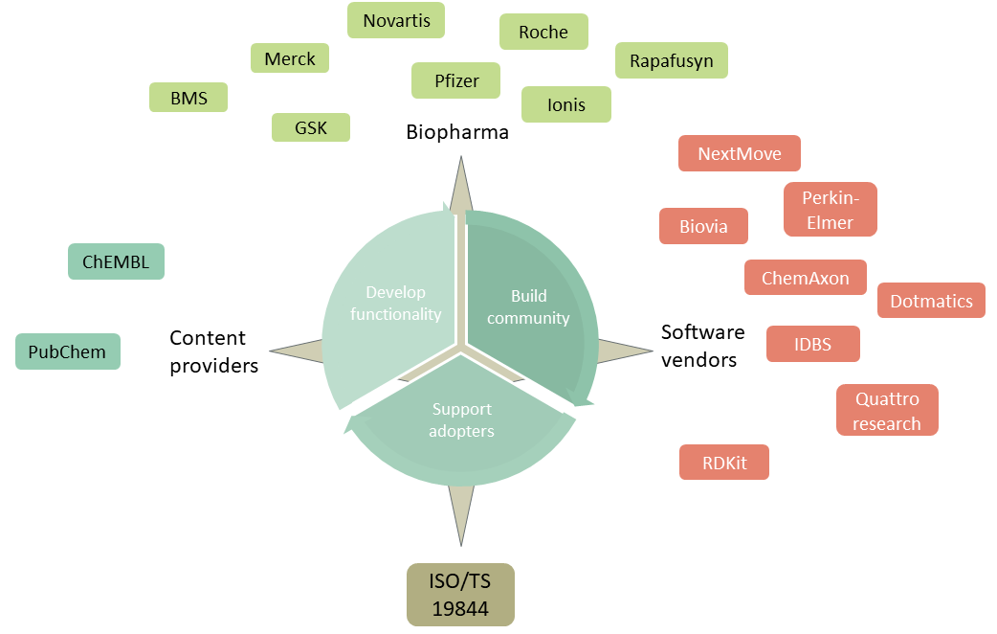
History
HELM has been adopted widely in the last 5 years and expanded beyond pharma companies.
In particular we now have content providers defining biologics using HELM:
ChEMBL
PubChem
Norine
And interest from more.
We also have small companies who would like a starter-pack monomer set that can be adopted easily and be aligned to the majority of other HELM users.

Slide 25
Public monomer sets
Monomer set | Size (approx.) | Comments
HELM 1 | 191 | Used in the HELM tools from the beginning
Ionis set (initial monomer.org set) | 553 | Enhanced nucleotide set. Documented approach to naming. Some differences with HELM1.
ChEMBL | 2851
Norine | 532 | Published in another form, but being converted into HELM
PubChem?
Novartis | 55 | Oligonucleotides only
A more published set of principles about what makes a good monomer set would help us create a common monomer set that all could adopt and give guidance to new adopters wanting to use their own.

