Slide 1
HELM and monomers
HELM Manager: Claire Bellamy
HELM Domain Lead: Sergio Rotstein
12th October 2018
Notes:
Opening title slide

Slide 2
This Webinar is being recorded

Slide 3
Monomer Guidelines Discussion
Agenda
Peptide
Substitutions
R groups
Future topics
Next steps

Slide 4
Scope
Agree and publish a set of good practice guidelines for HELM Monomer Sets
Aim
To provide a framework that organizations can choose to use when creating their own monomer sets.
To create rules to be used by monomers in future core public monomer set.
Risks
This is an area where is will be easy to disagree and spend a lot of time discussing options and not making a decision.
Please give timely feedback.
All offers to prepare proposals are very welcome.
We may not be able to come to a unanimous conclusion on every issue, but will need to move forward with a core set of recommendations.

Slide 5
Agreed rules
Canonicalization
The set we are creating will not be bound by rules on canonicalization.
A separate set could be created whose purpose is for canonicalization and computational analysis, but work to do this is outside the scope of this discussion.

Slide 6
Peptide Diversity

Slide 7
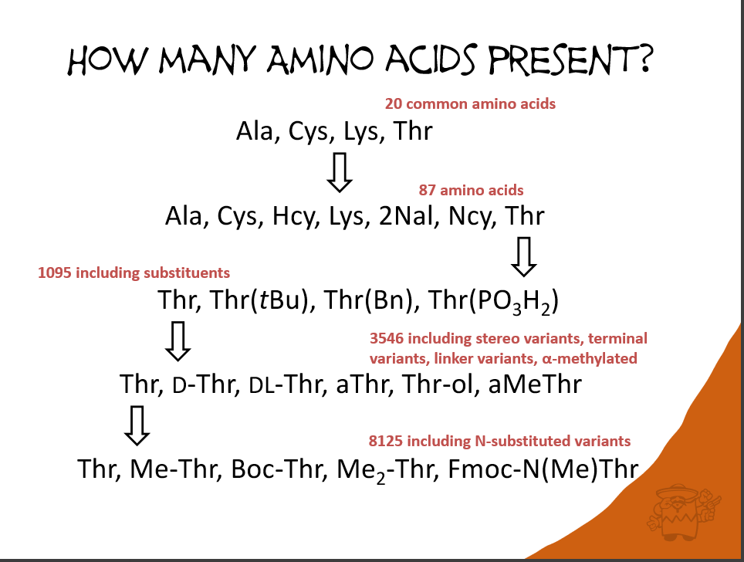
Exploding monomer sets?

Slide 8
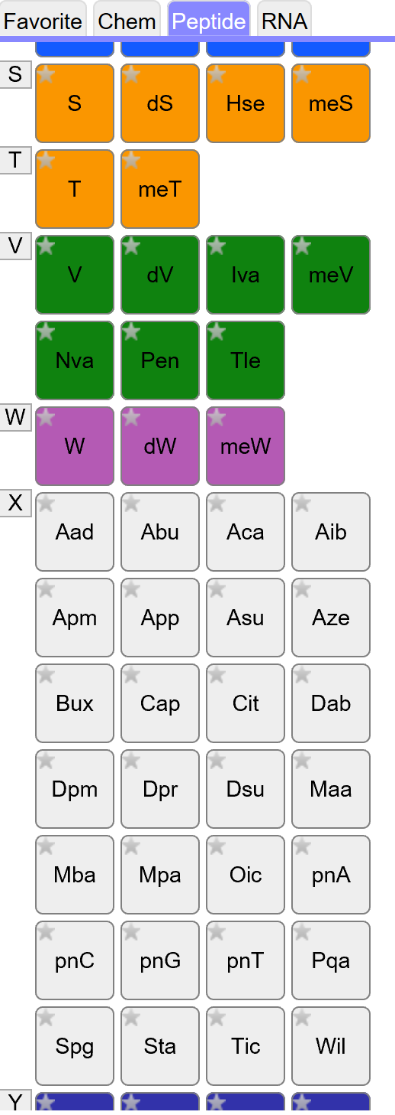
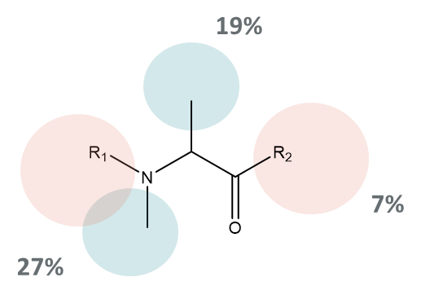
Peptide diversity
Peptides start from a different place than nucleotides. Rather than 5 bases, two sugars and a phosphate, they have 21 natural ones before anyone starts making synthetic modifications.
Large monomer sets are
difficult to navigate for the user.
Will make naming less meaningful
Analysing a sample of 200 monomers from the ChEMBL set, the
percentage of each substitution point is:
However the largest set are just different amino acids.

Slide 9
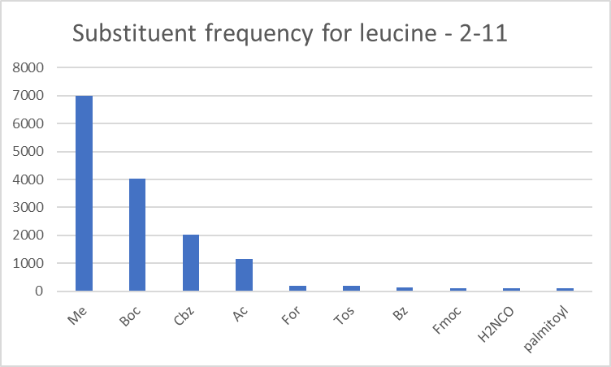
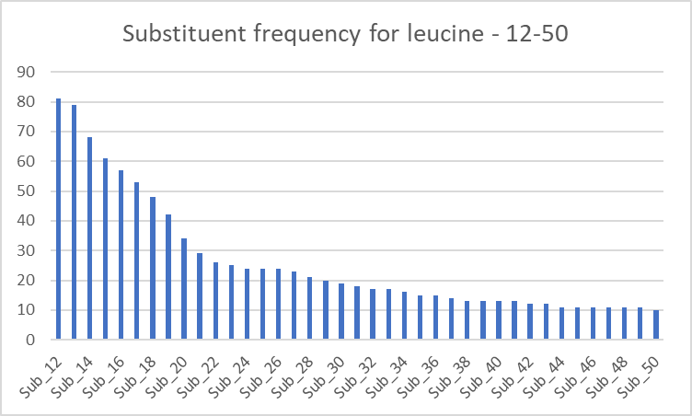

N substitutions
What actually occurs in practice?
H is the most frequent = 209258
Leu
H
Me
Boc
Cbz
Ac
For
Tos
Bz
Fmoc
H2NCO
palmitoyl
In total there are 166 substituents.
117 of them occur <10 times
Figures from Pubchem supplied by

Slide 10
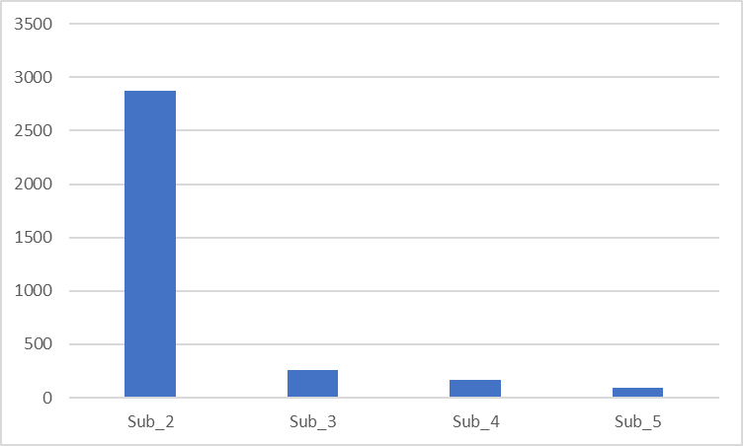
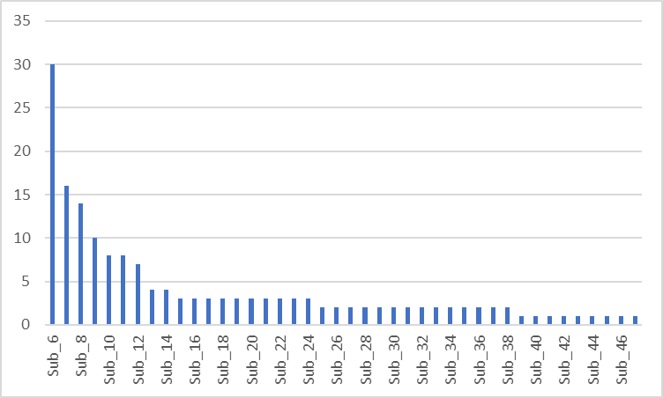
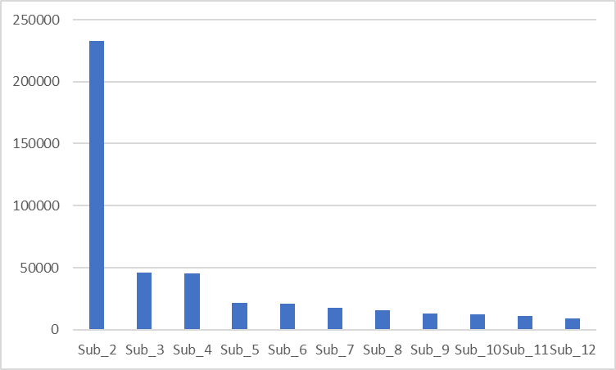
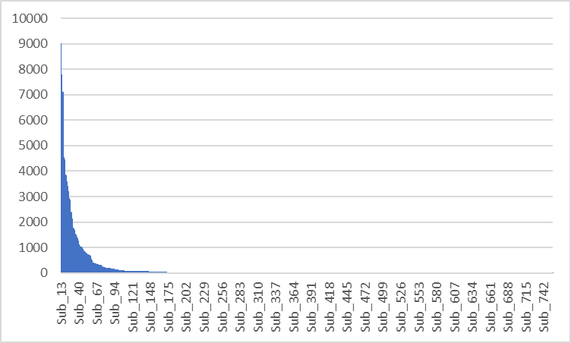
N substitutions
The smallest number of substituents is on Asn =47
The largest number of substituents are on Gly = 756
179 only occur once.
Figures from Pubchem supplied by

Slide 11
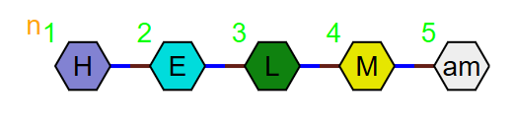

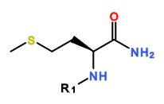
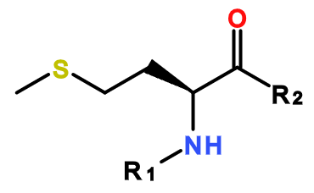

Options: C terminal substitutions
Create a new monomer for every substitution PEPTIDE1{H.E.L.[amM]}$$$$
Substitution defined in the main structure
R1=H
Substitution defined in the capping group
R1=H, R2 =NH2
Include the substituent as a separate monomer
PEPTIDE1{H.E.L.M.[am]}$$$$
CHEM1{[am]}|PEPTIDE1{H.E.L.M}$CHEM1,PEPTIDE1,4:R1-1:R1$$$V2.0

Slide 12
C terminal subs – edge cases
Aldehydes
X321 in the ChEMBL set
This was created as a new monomer, but could be a standard methionine with a H C-term monomer.

Slide 13
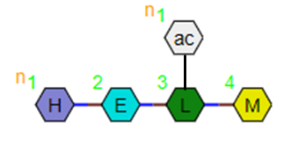
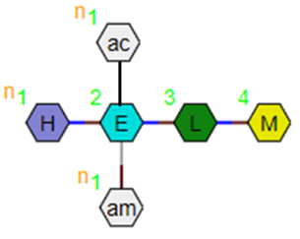
Options: N substitutions
N atoms have two potential substitution sites, so there
can be branching as well as terminal substitution.
Branching
PEPTIDE1{[ac]}|PEPTIDE2{H.E.L.M}$PEPTIDE2,PEPTIDE1,3:R3-1:R1$$$
Or should there be a new branching mechanism for peptides?
PEPTIDE1{H.E.L([ac]).M}$$$$
This would require the new monomers to be of ‘branch’ type. Should these branch types be the default for all capping groups?
Multiple substitution points?
What if there is substitution on the glutamic acid R3 as well as the nitrogen?
PEPTIDE1{H.E([ac])([am]).L.M}$$$$ ?
PEPTIDE1{[ac]}|PEPTIDE2{[ac]}|PEPTIDE3{H.E.L.M}$PEPTIDE3,PEPTIDE1,2:R3-1:R1|PEPTIDE3,PEPTIDE2,2:R1-1:R1$$$
Or should all of these be new monomers?

Slide 14
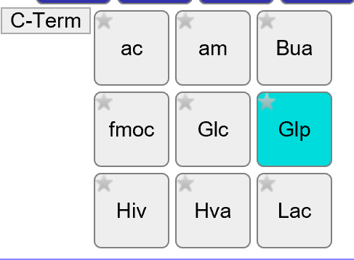
N capping – definition issue
Peptide chains are defined so the links are made between R1 and R2.
At present all the terminal monomers all use R1, so the connection point will be made to the carboxylic acid.
Even capping groups like Fmoc, where this makes no sense.
If we implement separate capping groups we need to define different ones for N and C connected groups and also a branch monomer type for N substitutions that are not terminal.
i.e. for methylation we will need:
Branch monomer?
Is this OK since the user will have to define where it attaches anyway?
C term substitution
N term substitution

Slide 15
More cases
Do we all agree that the following need to be monomers in their own right?
L amino acids
Stereoisomers – D, DL
Beta, homo, iso forms
Chain and alpha substitutions
To be handled in the same way as N substitutions?
Which ‘capping’ monomers should be defined in an initial list? (if we have agreed that they should be separated out)
Me, Et, Pr, Bu, tBu, Ac,
Boc, Fmoc, Tos
Could anyone take an action to create a list?

Slide 16
R groups

Slide 17
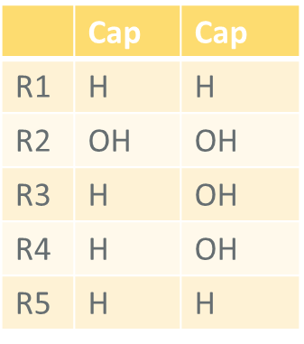
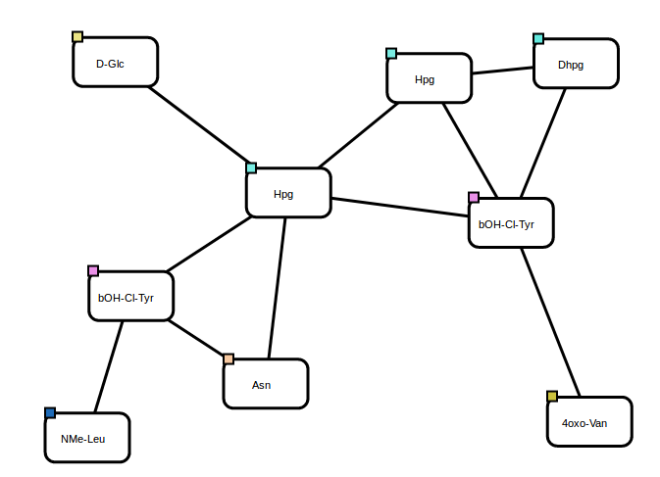
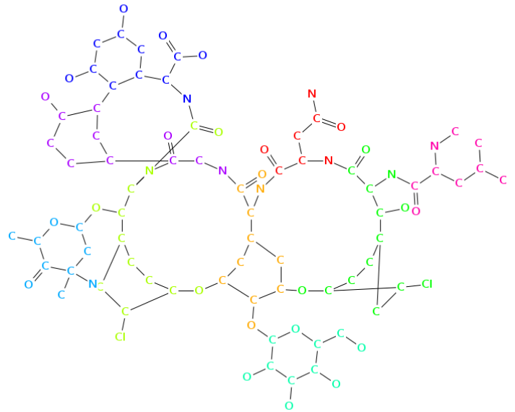
R groups – how many?
Some of the Norine examples need large numbers of R groups
Norine example 3,4-dihydroxyphenylalanine diOH-Phe A

Slide 18
R groups – how many?
Are monomers with different numbers of R groups different monomers?
How many R groups should monomers have in a standard set?
Should we have different monomers for variants with different numbers of R groups or should they be merged if a new monomer with a higher number of R groups is added to the set?
If R groups are not used in HELM then they are capped. Does this mean all monomers should have the ‘maximum’ number of R groups since it doesn’t affect other uses?
Norine example 3,4-dihydroxyphenylalanine diOH-Phe A

Slide 19
R groups – capping structures
Should R group caps reflect the chemistry that was used in the synthetic route?
R groups are currently H, OH, X, however, R groups caps are defined via SMILES, so they could be anything in theory.
OMe, Ac, Tos, Boc etc…
Should monomers with different caps be different monomers? (clue – yes)
Location | Cap
R1 | H
R2 | OH
R3 | OH, Cl, Br, OMe

Slide 20
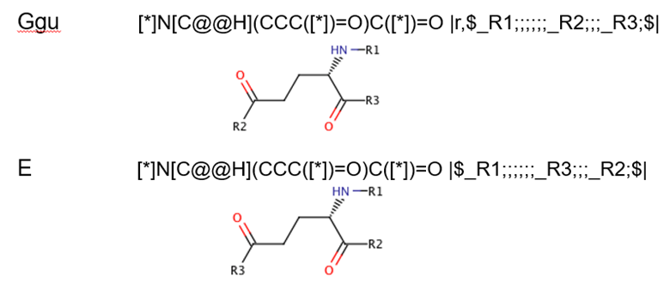
R groups – position differences
Monomers with different R group positions must be treated as different since they form different polymers when used.

Slide 21
Future Topics

Slide 22
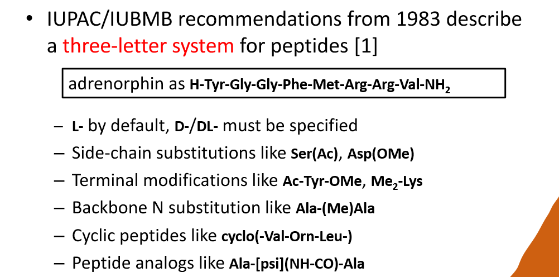
Naming
What conventions are available and what should we consider?

Slide 23
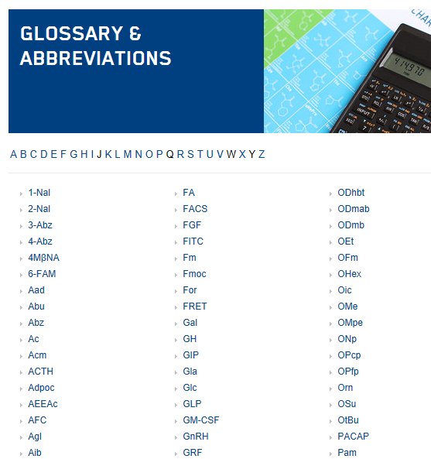
Naming
Should we adopt the approach used by companies and if so, which one?
This list is from
Bachem
Anyone have a standard
they would recommend?

Slide 24
When should in-line HELM be used?
Is it possible to make a decision for public monomer sets?
Possible criteria:
Used more than once (how could this be checked?)
Define a core set and everything else should be in-line HELM
Define everything as a new monomer

Slide 25
Next steps
Actions:
Future meeting times
Fridays at this time every 2 weeks

Slide 26


Thank you

Slide 27
Backup slides
Monomer Meeting
Notes:
Opening title slide

Slide 28
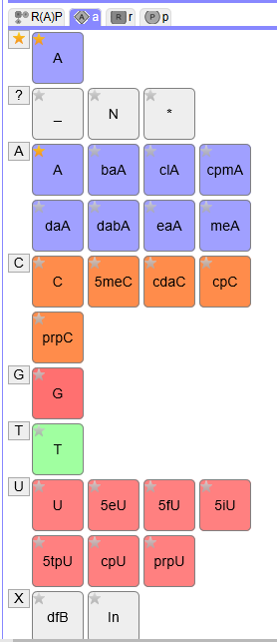
History
HELM tools and definition released in 2013.
Monomer set was derived from the Pfizer internal set and is used in the online demo HELM tools today.
Initial adopters were pharma companies who generally wanted to use their own monomer sets aligned with their research projects
To facilitate communication between groups, HELM developed:
In-line HELM – the ability to describe a monomer using SMILES within the HELM string and without fully registering it in the monomer set.
PEPTIDE1{A.[[*:2]C(=O)[C@H](C)N([*:1])C].A}$$$$
xHELM – an xml format that allows the user to bundle the monomers required to interpret the HELM strings in the file. The toolkit enables you to import xHELM into an existing set-up with your own monomer set.

Slide 29
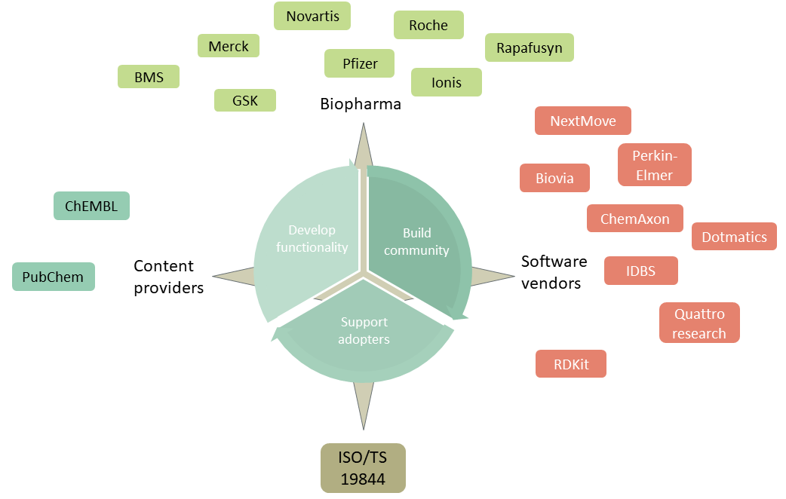
History
HELM has been adopted widely in the last 5 years and expanded beyond pharma companies.
In particular we now have content providers defining biologics using HELM:
ChEMBL
PubChem
Norine
And interest from more.
We also have small companies who would like a starter-pack monomer set that can be adopted easily and be aligned to the majority of other HELM users.

Slide 30
Public monomer sets
Monomer set | Size (approx.) | Comments
HELM 1 | 191 | Used in the HELM tools from the beginning
Ionis set (initial monomer.org set) | 553 | Enhanced nucleotide set. Documented approach to naming. Some differences with HELM1.
ChEMBL | 2851
Norine | 532 | Published in another form, but being converted into HELM
PubChem? | 109 | In-line HELM used for rarer monomers
Novartis | 55 | Oligonucleotides only
A more published set of principles about what makes a good monomer set would help us create a common monomer set that all could adopt and give guidance to new adopters wanting to use their own.

