Slide 1
HELM and monomers
HELM Manager: Claire Bellamy
HELM Domain Lead: Sergio Rotstein
26th October 2018
Notes:
Opening title slide

Slide 2
This Webinar is being recorded

Slide 3
Agenda
Progress Review
Peptide
Substitutions
R groups
Future topics
Next steps

Slide 4
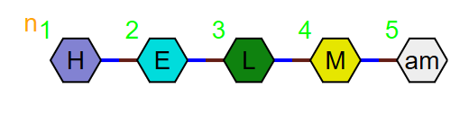
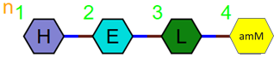
Agreed rules
Canonicalization
The set we are creating will not be bound by rules on canonicalization.
A separate set could be created whose purpose is for canonicalization and computational analysis, but work to do this is outside the scope of this discussion.
Capping
HELM should use capping monomers for C and N terminal substitutions and not create a new monomer for capped amino acids. i.e.
Capping monomers should be the same polymer type as the main chain of the polymer they are a part of to keep the HELM string as readable as possible.
All other types of monomer: i.e. non-terminal N substitutions and substitutions elsewhere on the amino acid, L, D and positional isomers should be defined as new monomers.
We will not define a new branch type monomer to handle peptide substitutions.
and not

Slide 5
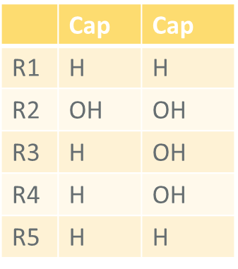
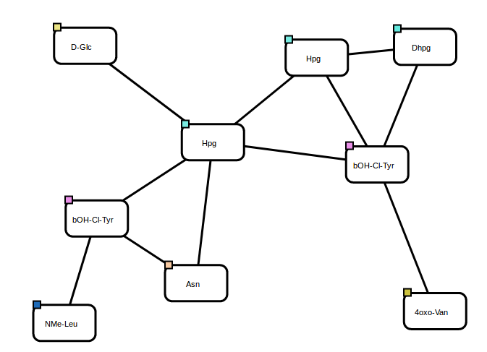
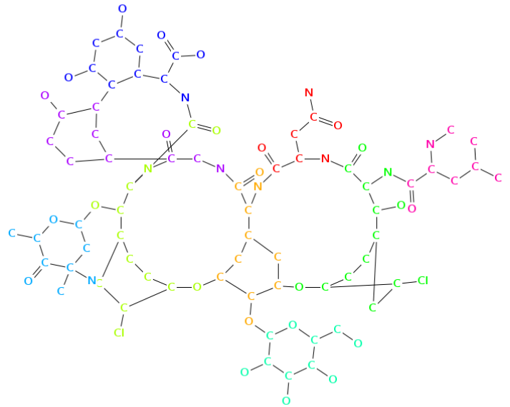
R groups – how many?
Some of the Norine examples need large numbers of R groups
3,4-dihydroxyphenylalanine
diOH-Phe A
Is our approach too rigid to cope with this?

Slide 6
Scope
Agree and publish a set of good practice guidelines for HELM Monomer Sets
Aim
To provide a framework that organizations can choose to use when creating their own monomer sets.
To create rules to be used by monomers in future core public monomer set.
Not to create the set itself, however…

Slide 7
Scope
When we consider naming and the use of in-line HELM, we should also think through what an ideal set of monomers should look like.
Core set
Rarer monomers
One-off monomers?
systematically named
numbered
fully defined
In-line HELM
Questions
Is it feasible to plan to change a numbered monomer into a named monomer?
How about an in-line HELM monomer to a named monomer?

Slide 8
Monomer frequencies

Slide 9
Monomer frequencies
Number of times a monomer is used | Monomers used this number of times | Percentage of the total number of monomers
1 | 1739 | 62%
2 | 326 | 12%
3 | 151 | 5%
4 | 86 | 3%
5 | 53 | 2%
6 | 50 | 2%
7 | 47 | 2%
8 | 27 | 1%
9 | 24 | 1%
10 | 17 | 1%
11 | 18 | 1%
12 | 18 | 1%
13 | 17 | 1%
14 | 8 | 0%
15 | 13 | 0%
16 | 6 | 0%
17 | 11 | 0%
18 | 7 | 0%
19 | 7 | 0%
20 | 5 | 0%
Total monomers | 2803
Percentage of monomers used 3 times or less | 79%
Percentage of monomers used 5 times or less | 84%
Percentage of monomers used 10 times or less | 90%

Slide 10
Monomer frequencies

Slide 11
Monomer frequencies

Slide 12
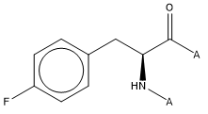
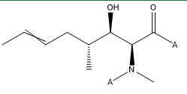
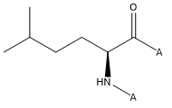
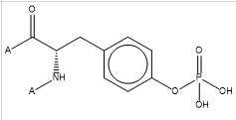
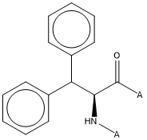
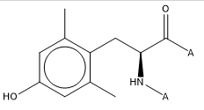
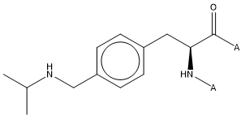
Monomer frequencies

Slide 13
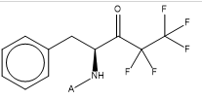
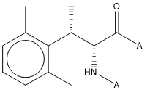
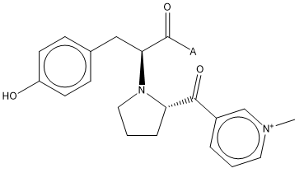
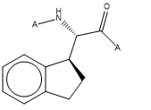
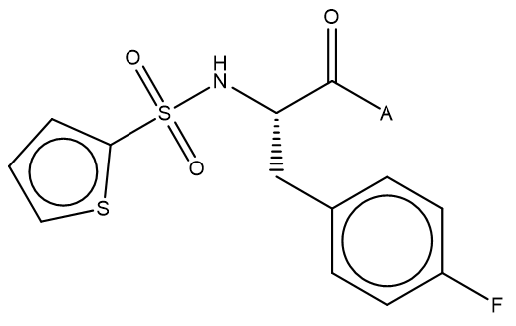
Monomers only used once
X1249
X2277
How far should a naming proposal go?
Is it acceptable to use a numbering system for more complex examples e.g. X111?

Slide 14
Public monomer set(s)?
Different sets for different purposes?
Core set: focused on the monomers that are used most frequently.
A basic starting set for new adopters
How many monomers?
Which ones?
Currently we have ChEMBL, Norine and PubChem – should we use all of these? Are there company sets we should/could look at?
Superset
A superset of everything that is in use in the public sphere?

Slide 15
Naming

Slide 16
Naming monomers – the ChEMBL way
Needed to name the ~2800 monomers in the library before creating the final HELM notation
Keep names from original HELM library
Aim to use existing names/conventions for common amino acids e.g., Orn, Sec, Sar
Where no consistent convention exists, try to apply systematic names e.g., Me, Ph, Ac, Cl to naming of caps/non-natural side-chains
For large, very unnatural monomers may need to apply largely arbitrary IDs to maintain readability of HELM notation (e.g., X123)

Slide 17
Naming rules/examples
Single letter abbreviations for natural amino acids
but three-letter used with side chain substitutions for clarity
‘d’ prefix for D-amino acids e.g., dF
Common three letter abbreviations e.g.,
Orn = Ornithine
Aib = 2-Aminoisobutyric acid
Nle = Norleucine
Underscores for N or C caps/substitutions e.g.,
Boc_D = glutamic acid with N-substituted tert-butyloxycarbonyl protecting group
F_OMe = phenylalanine with C-terminal methoxy group

Slide 18
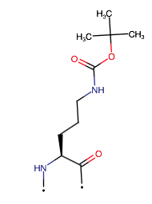
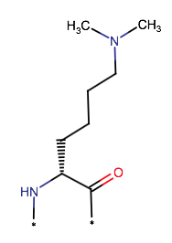
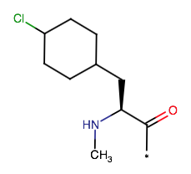
Naming rules/examples
Brackets to indicate sidechain substitutions e.g.,
Currently named 371 monomers
Others given placeholder name e.g., X123
Orn(Boc)
Me_Phe(4-Cl)
dLys(Me)2

Slide 19
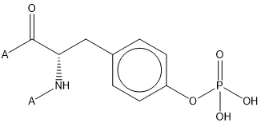
Naming - examples
Tyr(4-PO4)?
X2890
Phe(EtF5)?
How do you indicate the ketone?
X2885
N-(SO2-thiophene)-Phe(4-F)?
How far do we go?
X127

Slide 20
Naming – Norine approach
3 letter code to be able deal with the more than 40 amino acids that we have
a prefix describing the modification, separated by a -, when the modification is the addition of a functional group. When needed, we give the number of the atom on which the modification is done
addition of rare atoms are also mentioned by prefixes (Cl, Br, F)
followed by the number of added atoms.
we can combine several prefixes.
ex : NMe-Ser, NFo-Pro, Cl3-5OH-NMe-Leu
But, for some more complex modifications, we change the 3 letter codes.
- for the homoforms, the codes all start by H: ex : Hil = homoisoleucine, Hph = homophenylalanine
for the alcohol form of the amino acids, we add "ol" suffix to the 3 letters code.
ex : Valol, Ileol
- for the dehydro-form of an amino acid, we use 2 names (dh- or d):
ex : dh-Ala or NMe-dPhe
for the beta forms, we add b behind the name ex : bAla
Here is the main prefixes that we use :
D (stereo-isomer)
NMe, OMe (N or O methyl), bMe (beta-methyl) Nac, Oac (N or O acetyl) and sometimes Ac- for Nac OH (hydroxy), diOH (dihydroxy, pOH (para-hydroxy) NFo (N-formyl) PO (phosphate) Cl Br F

Slide 21
Naming
Systematic naming
would this be a good starting point?
Stereo - (N subs) parent three-letter code (backbone/sidechain subs)
E.g. D-N(Bu)Phe(4-Cl)
It is a modification of the ChEMBL approach which uses underscores for substitutions.
If we agree on this, then we need to extend to cover other situations. This could be an infinite exercise. I would like to concentrate on areas that give most value. (and ask for volunteers to help)
Common names
We have some established in the original HELM set already – can we propose that we keep these?
Other common names – any suggestions? IUPAC (obviously), Bachem approach? Others?

Slide 22
R groups

Slide 23
R groups – how many?
Some of the Norine examples need large numbers of R groups
Norine example 3,4-dihydroxyphenylalanine diOH-Phe A

Slide 24
R groups – how many?
Are monomers with different numbers of R groups different monomers?
How many R groups should monomers have in a standard set?
Should we have different monomers for variants with different numbers of R groups or should they be merged if a new monomer with a higher number of R groups is added to the set?
If R groups are not used in HELM then they are capped. Does this mean all monomers should have the ‘maximum’ number of R groups since it doesn’t affect other uses?
Norine example 3,4-dihydroxyphenylalanine diOH-Phe A

Slide 25
R groups – capping structures
Should R group caps reflect the chemistry that was used in the synthetic route?
R groups are currently H, OH, X, however, R groups caps are defined via SMILES, so they could be anything in theory.
OMe, Ac, Tos, Boc etc…
Should monomers with different caps be different monomers? (clue – yes)
Location | Cap
R1 | H
R2 | OH
R3 | OH, Cl, Br, OMe

Slide 26
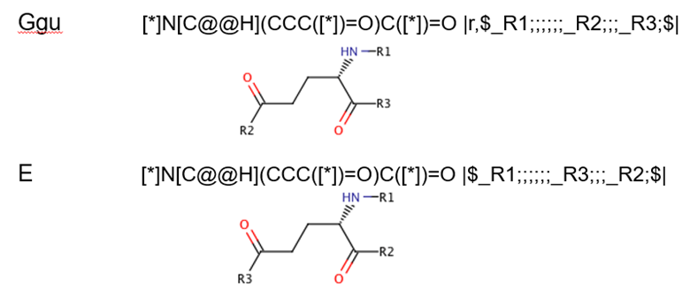
R groups – position differences
Monomers with different R group positions must be treated as different since they form different polymers when used.

Slide 27
Future Topics

Slide 28
Next steps
Actions:
Future meeting times
Fridays at this time every 2 weeks

Slide 29


Thank you

Slide 30
Backup slides
Monomer Meeting
Notes:
Opening title slide

Slide 31
Monomers have 3-part uniqueness
Structural check –
Tautomers are treated as identical
Different R group positions are different monomers
Capping group check – if R groups are not fully used in a particular HELM string then the capping group will change the structure.
Polymer type – the same monomer structure is allowed in different polymer types.

Slide 32
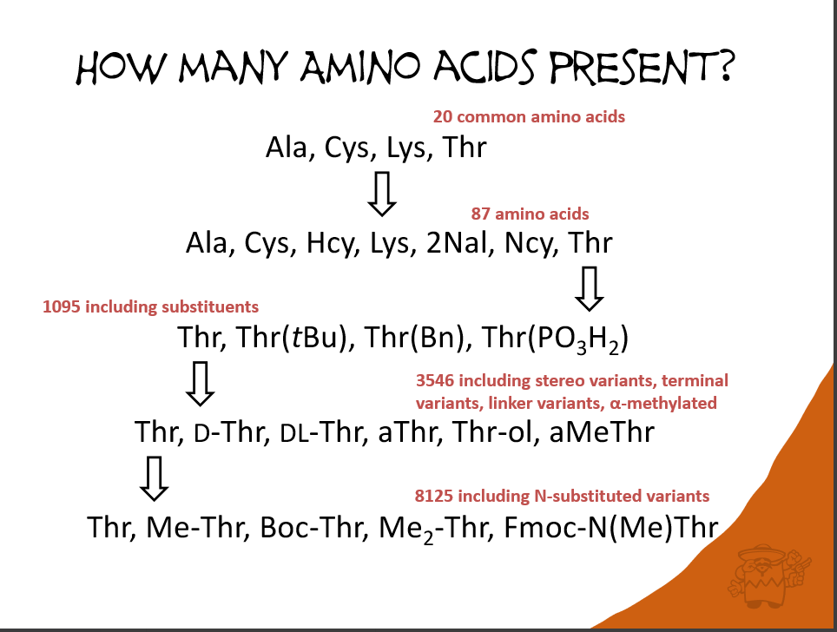
Exploding monomer sets?

Slide 33
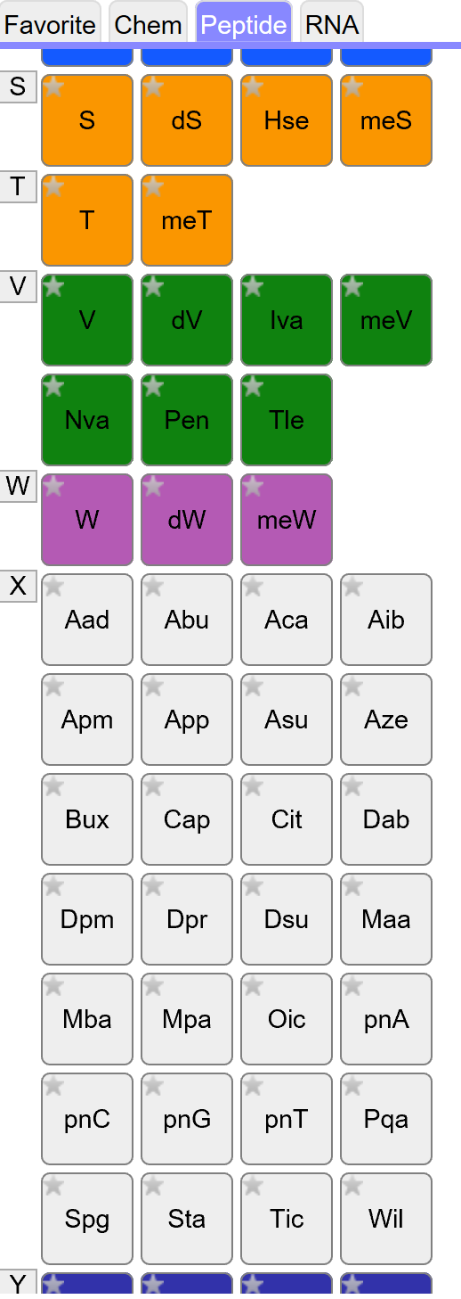
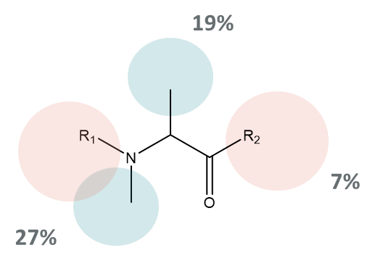
Peptide diversity
Peptides start from a different place than nucleotides. Rather than 5 bases, two sugars and a phosphate, they have 21 natural ones before anyone starts making synthetic modifications.
Large monomer sets are
difficult to navigate for the user.
Will make naming less meaningful
Analysing a sample of 200 monomers from the ChEMBL set, the
percentage of each substitution point is:
However the largest set are just different amino acids.

Slide 34
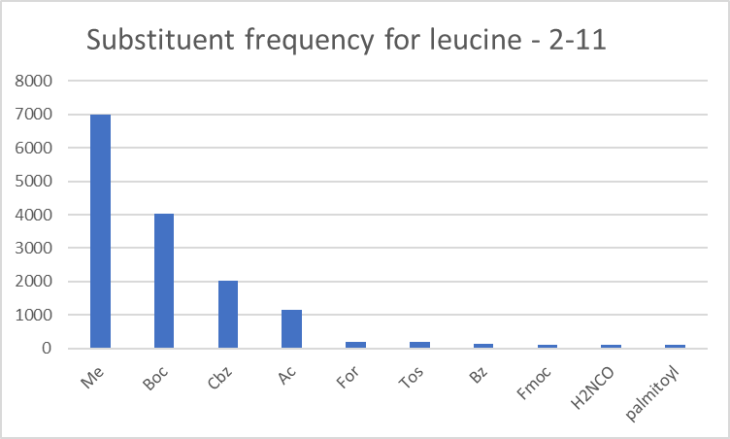
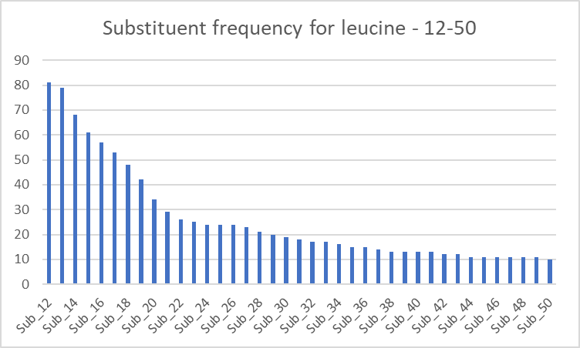

N substitutions
What actually occurs in practice?
H is the most frequent = 209258
Leu
H
Me
Boc
Cbz
Ac
For
Tos
Bz
Fmoc
H2NCO
palmitoyl
In total there are 166 substituents.
117 of them occur <10 times
Figures from Pubchem supplied by

Slide 35
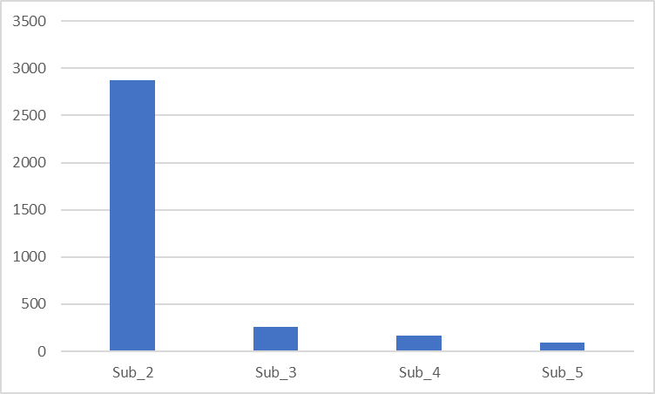
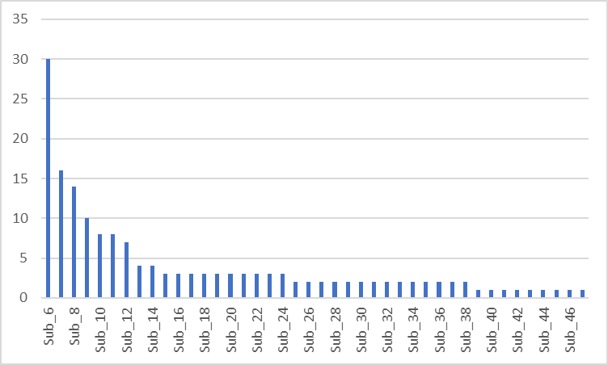
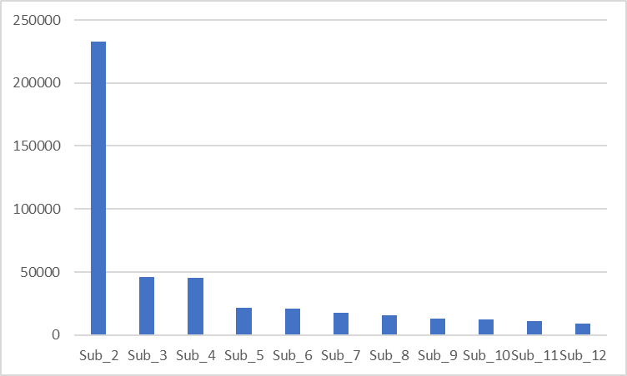
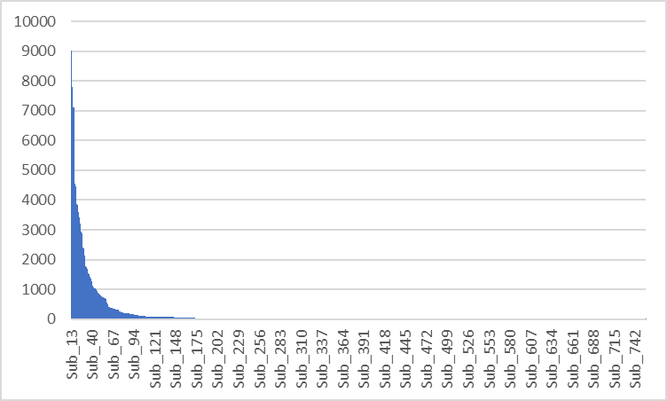
N substitutions
The smallest number of substituents is on Asn =47
The largest number of substituents are on Gly = 756
179 only occur once.
Figures from Pubchem supplied by

Slide 36

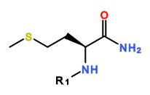
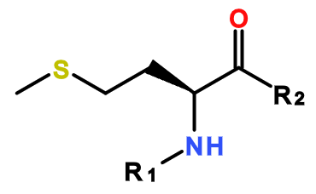

Options: C terminal substitutions
Create a new monomer for every substitution PEPTIDE1{H.E.L.[amM]}$$$$
Substitution defined in the main structure
R1=H
Substitution defined in the capping group
R1=H, R2 =NH2
Include the substituent as a separate monomer
PEPTIDE1{H.E.L.M.[am]}$$$$
CHEM1{[am]}|PEPTIDE1{H.E.L.M}$CHEM1,PEPTIDE1,4:R1-1:R1$$$V2.0

Slide 37
C terminal subs – edge cases
Aldehydes
X321 in the ChEMBL set
This was created as a new monomer, but could be a standard methionine with a H C-term monomer.

Slide 38
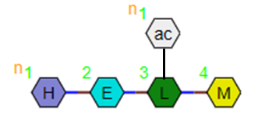
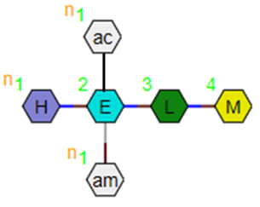
Options: N substitutions
N atoms have two potential substitution sites, so there
can be branching as well as terminal substitution.
Branching
PEPTIDE1{[ac]}|PEPTIDE2{H.E.L.M}$PEPTIDE2,PEPTIDE1,3:R3-1:R1$$$
Or should there be a new branching mechanism for peptides?
PEPTIDE1{H.E.L([ac]).M}$$$$
This would require the new monomers to be of ‘branch’ type. Should these branch types be the default for all capping groups?
Multiple substitution points?
What if there is substitution on the glutamic acid R3 as well as the nitrogen?
PEPTIDE1{H.E([ac])([am]).L.M}$$$$ ?
PEPTIDE1{[ac]}|PEPTIDE2{[ac]}|PEPTIDE3{H.E.L.M}$PEPTIDE3,PEPTIDE1,2:R3-1:R1|PEPTIDE3,PEPTIDE2,2:R1-1:R1$$$
Or should all of these be new monomers?

Slide 39
Public monomer sets
Monomer set | Size (approx.) | Comments
HELM 1 | 191 | Used in the HELM tools from the beginning
Ionis set (initial monomer.org set) | 553 | Enhanced nucleotide set. Documented approach to naming. Some differences with HELM1.
ChEMBL | 2851
Norine | 532 | Published in another form, but being converted into HELM
PubChem? | 109 | In-line HELM used for rarer monomers
Novartis | 55 | Oligonucleotides only
A more published set of principles about what makes a good monomer set would help us create a common monomer set that all could adopt and give guidance to new adopters wanting to use their own.

Slide 40
Risks
This is an area where is will be easy to disagree and spend a lot of time discussing options and not making a decision.
Please give timely feedback.
All offers to prepare proposals are very welcome.
We may not be able to come to a unanimous conclusion on every issue, but will need to move forward with a core set of recommendations.

Slide 41
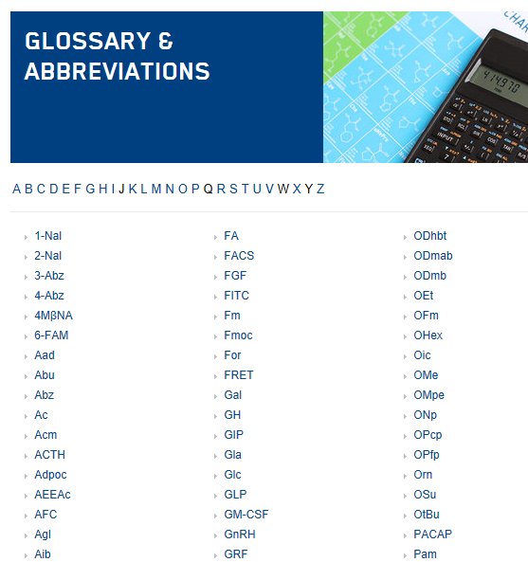
Naming
Should we adopt the approach used by companies and if so, which one?
This list is from
Bachem
Anyone have a standard
they would recommend?

