Slide 1

E-MOBILITY
APPLIED STATISTICS A.Y. 2019-2020
G. Bettini, A. Borra, P. Boschini, A. Cioffi, M. Ronconi
Politecnico di Milano

Slide 2



GROUP MEMBERS
Pietro Boschini, Marta Ronconi,
Andrea Cioffi, Andrea Borra, Giulio Bettini.

Slide 3



WHAT ABOUT OUR PROJECT
Data from 31-10-2018 to 1-02-2019.
ACN-Data collected from two Adaptive Charging Networks:
The Caltech ACN is open to the public and is often used by non-Caltech drivers.
The JPL campus is restricted only to employees.

Slide 4
DATASET: what are the variables?
General Data
User Inputs
connectionTime Time when the EV plugged in.
doneChargingTime Time of the last non-zero charging rate.
disconnectTime Time when the user unplugs.
kWhDelivered Measured Energy Delivered
chargingCurrent Time series of actual charging current of the EV.
userID Unique identiier of the user.
requestedDeparture Estimated time of departure.
kWhRequested Estimated energy demand.

Slide 5
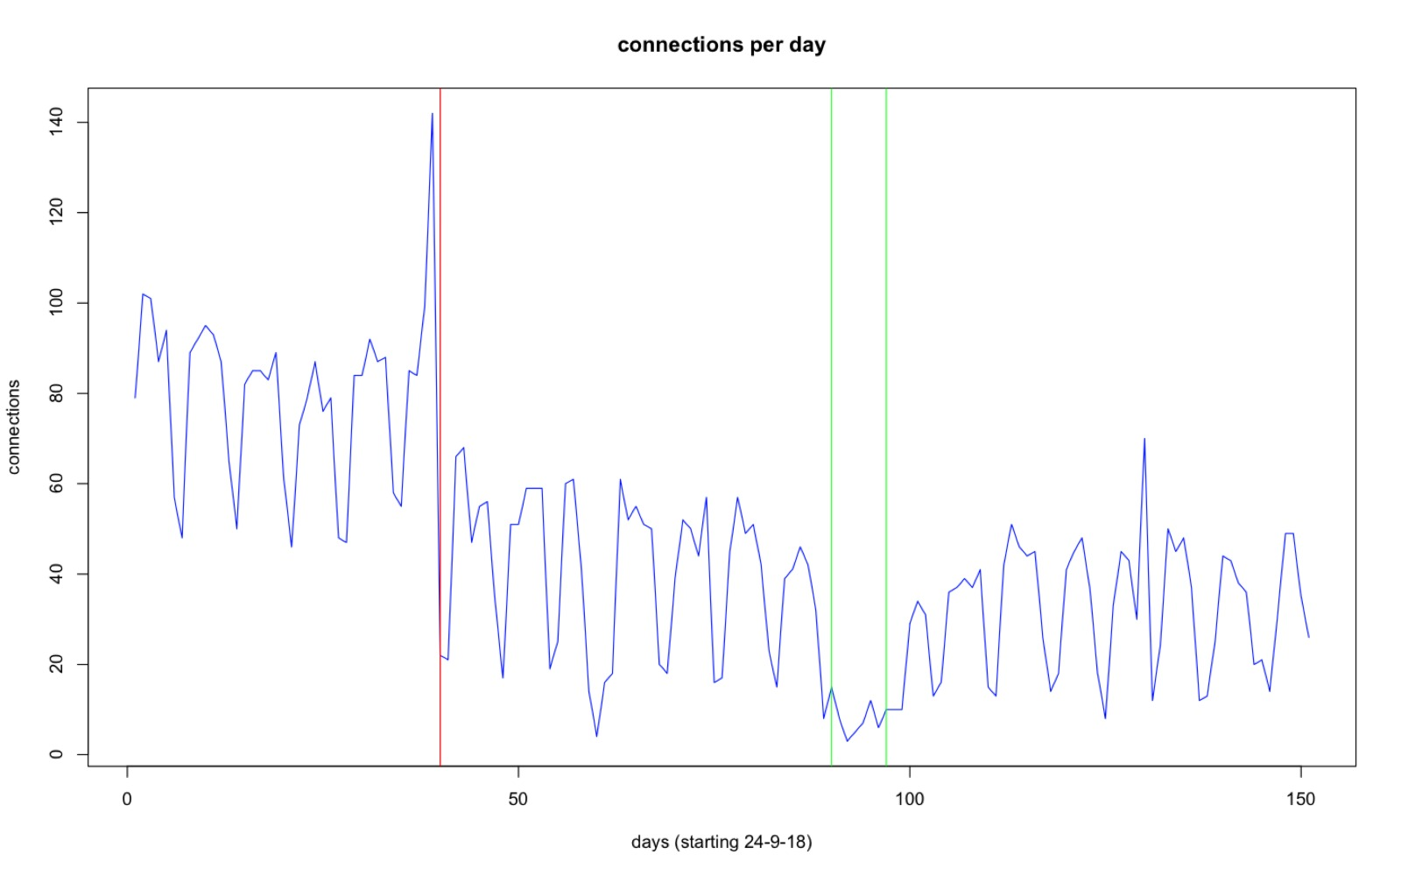
PLOTS
Dataset representing the number of connections per day. Red line represents the date when the service became no longer free (1-11-2018).
Green lines represent Christmas days.

Slide 6
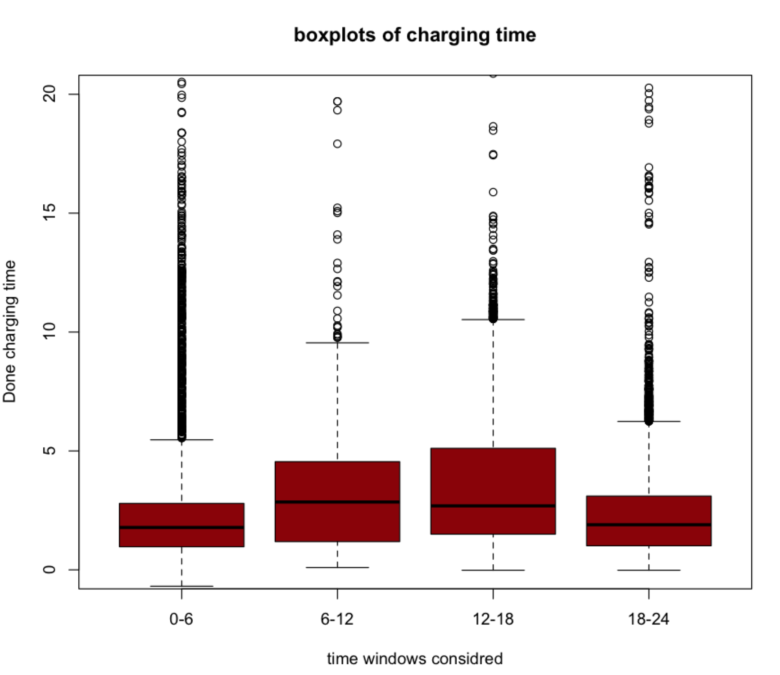

Slide 7
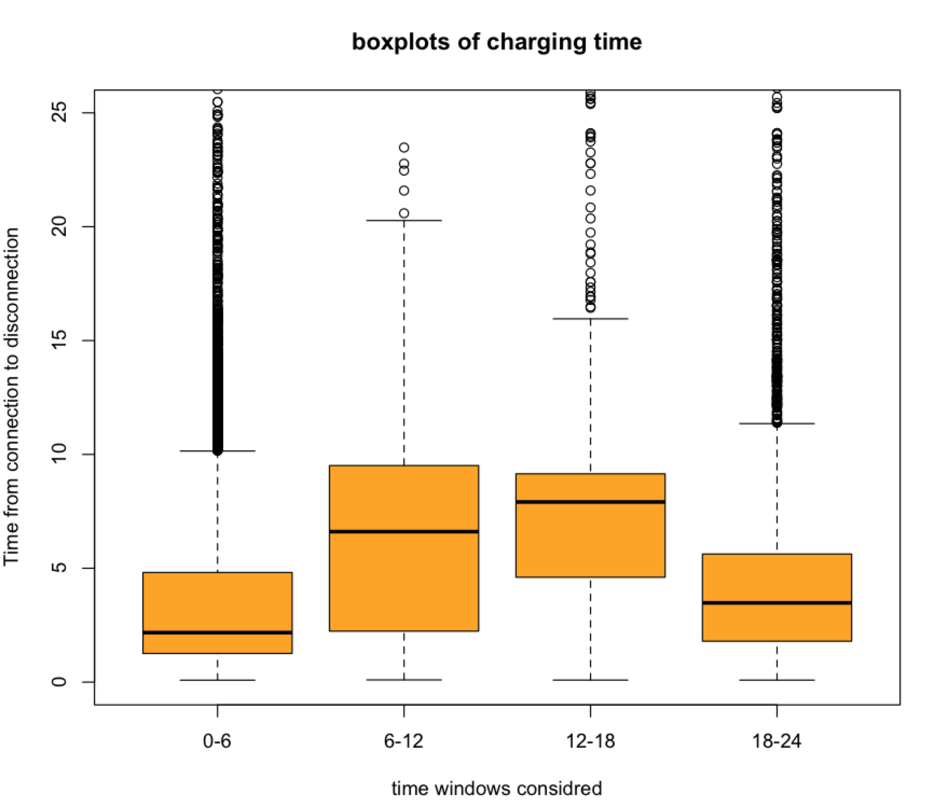

Slide 8
GOALS
Predict the disconnection time on the connection time
Individuate cluster of users
Inference on the energy demand during the day

