Slide 1
IBM CAPSTONE PROJECT – The Battle of Neighborhoods: Cluster Analysis of Melbourne Housing Market

Slide 2
Business Problem
How could we provide support to homebuyers clientele in to purchase a suitable real estate in Melbourne in this uncertain economic and financial scenario?

Slide 3
Solution
Clustering Melbourne suburbsin order to recommend venues and the current average price of real estate where homebuyers can make a real estate investment.

Slide 4
Data and Methodology
Data: merging data on London properties and the relative price paid and data on amenities and essential facilities surrounding such properties from FourSquare API interface.
Mehodology:
Collect Inspection Data;
Explore and Understand Data;
Data preparation and preprocessing;
Modeling

Slide 5
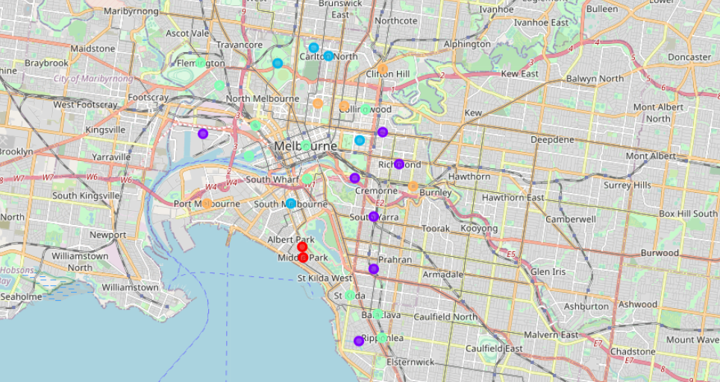
K-Means clustering

Slide 6
Outcome:
Examination of real estates by clusters
Clusters 2 and 4 offer more asian food and houses are at a lower price;
Clusters 1 and 3 have higher prices and offer more sport-related venues.

