Slide 1
Nepali Consonant Character Classification Using Artificial Neural Network
Team:
Ashok Subedi
Giridhari Paudel
Indra Paudel
Pitambar Mahato

Slide 2
Contents
Introduction
Literature Review
Requirement Analysis and Feasibility study
Methodology
Structuring System Requirements
Testing
Result and Analysis

Slide 3
Introduction
Nepali Character is one of the most spoken language in Nepal.
Artificial Neural Network provides classification and regression capabilities to the machine.
Backpropagation is the algorithm that was used during the training of the neural networks.

Slide 4
Problem Statement
To change the hardcopy into softcopy form is the time consuming task.
Without the classification or recognition of the characters it is not possible to make the OCR system.
So we are here to classify the nepali characters

Slide 5
Objective
To build a neural network model that can classify the scanned or handwritten isolated Nepali characters.
To classify the Nepali consonant characters.

Slide 6
Project Questions
Does ANN gives the optimum result for the classification of nepali characters?
What is the main purpose of that project?
What methods is going to be used for the achievement of the results in this project?

Slide 7
Scope and Limitations
Our system recognizes the nepali isolated scanned or handwritten character but in case of the joined set of characters our system can’t work.
Our system only works for the images of size 32×32 but in case of the images greater than that the system can’t work.

Slide 8
Applications
Banking
Legal
HealthCare
Other sectors

Slide 9
Literature Review
Related Works
Character Recognition (CR) is somewhat limited until 1980 due to lack of powerful hardware and data perception devices.
The periods from 1980-1990 witness a growth in CR system development due to rapid growth in information technology.
Research progress on the offline and on-line recognition during 1980 -1990.
After 1990, image processing technique and pattern recognition were combined using artificial intelligence.

Slide 10
Requirement Analysis and Feasibility Analysis
Operational Feasibility Analysis
Technical Feasibility Analysis
Economic Feasibility Analysis
Schedule Feasibility Analysis

Slide 11
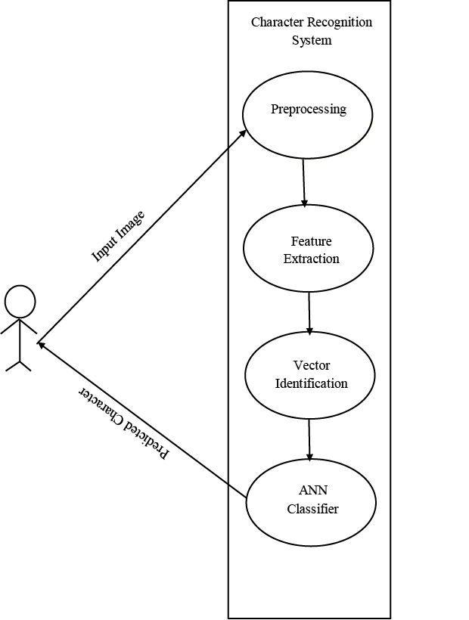
Use Case Diagram

Slide 12
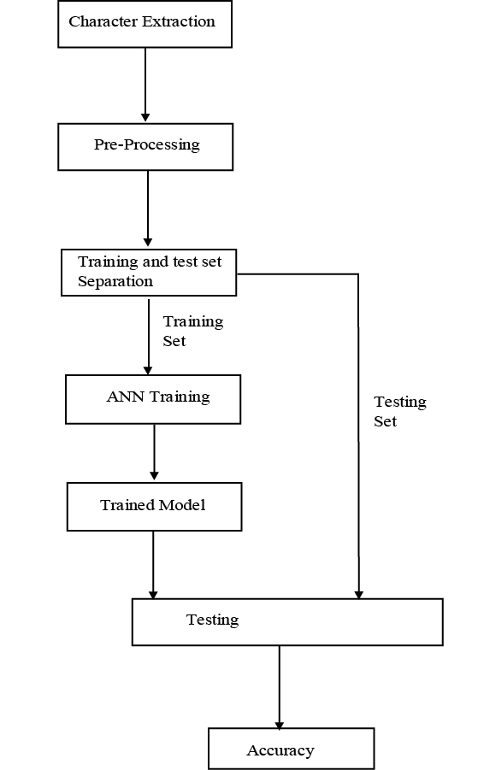
Methodology

Slide 13
Model Training
Input nodes: 1024 input neurons
Output nodes: 36 output nodes
Activation Function: Sigmoid
Number of Hidden layer: 1 hidden layer with 340 nodes
Learning Rate: 0.075
Training algorithm: Error Back Propagation(Mean Squared Error)

Slide 14
Algorithm of The System
Step 1: Start
Step 2: Train the Neural Network Model
Step 3: Load the model into the system
Step 4: Draw the character into the canvas
Step 5: Save the Drawn character into the .png(image) format
Step 6: Input the saved image into the system
Step 7: Feed the character to the Neural Network Model
Step 8: Display Output
Step 9: Stop

Slide 15
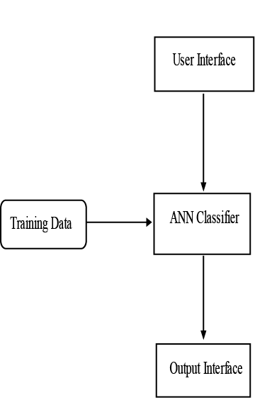
Structuring System Requirements
System Architecture

Slide 16
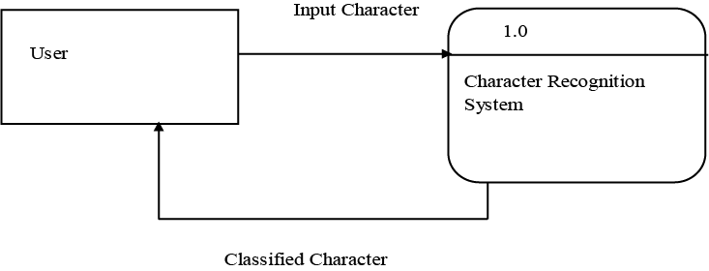
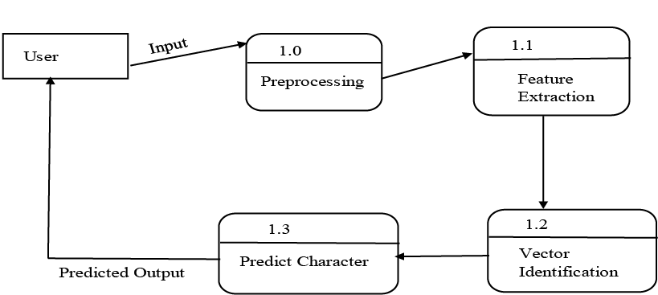
Data Flow Diagram
Level 0 DFD Level 1 DFD

Slide 17
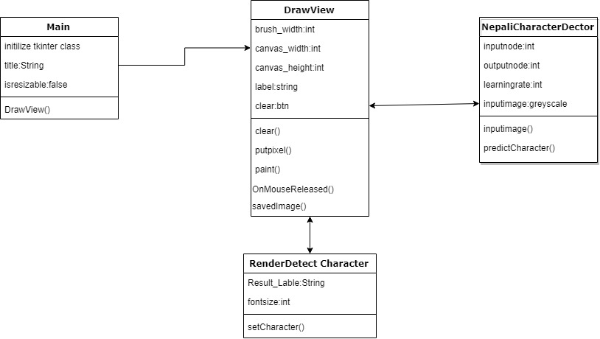
Class Diagram

Slide 18
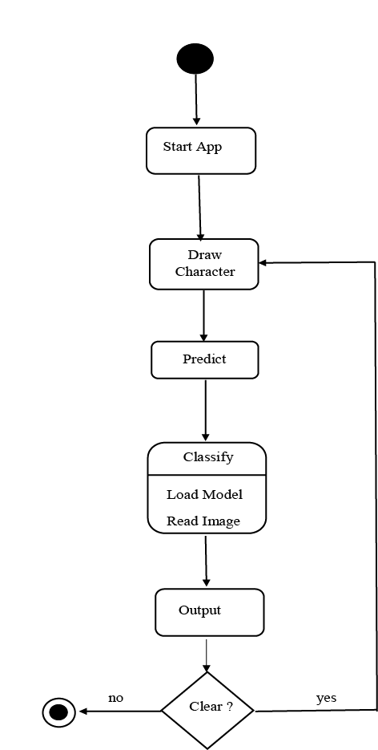
Activity Diagram

Slide 19
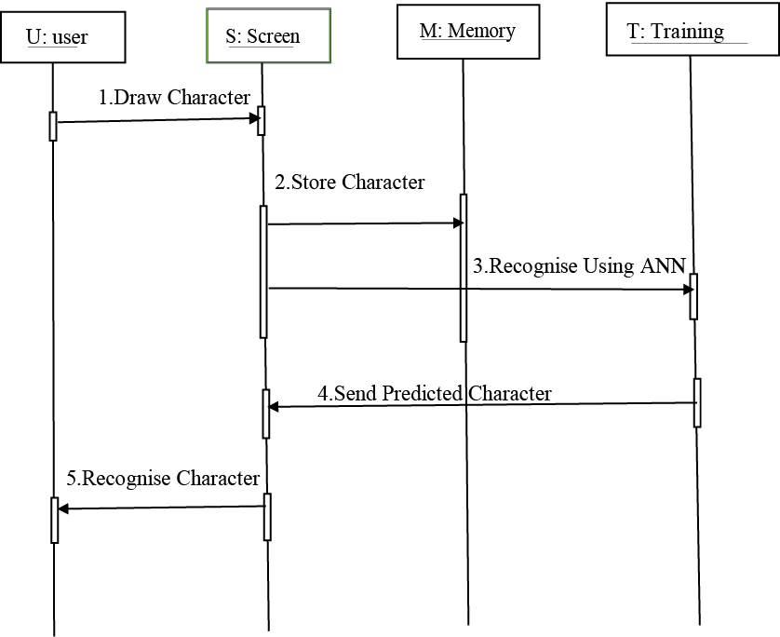
Sequence Diagram

Slide 20
Testing
Unit Testing
S.no. | Test Case | Input | Expected Result | Test Result
1. | Drawing Canvas | Character | Character Drawn | User Can draw on canvas
2. | Clear Button | Press clear button | Canvas clear | Canvas is clear
3. | Prediction label | Draw character | Drawn character should be predicted | The drawn character was predicted
4. | Preprocess data | Image Dataset | Reshape Dataset into 32*32 Image | Dataset was reshaped successfully
5. | Training Model | Training Dataset | Model Should be trained. | The model was trained.
6. | Recognize Nepali Character | Test Data | Predict the drawn character. | The character was predicted.
7. | Model Performance | Nepali character | Predicted in a second. | Got result in a second.

Slide 21
Integration Testing
System Testing
S.no. | Test Cases | Input | Expected Result | Test Result
1. | Load Model | Input test and training datasets | Model must load successfully | The model was loaded
2. | Prediction | Draw Character | Predict the drawn character | The character was predicted successfully
S.no. | Test Case | Input | Expected Result | Test Result
1. | Predict Drawn Character | Draw Character on the canvas | Prediction Label filled with the drawn character. | As expected.

Slide 22
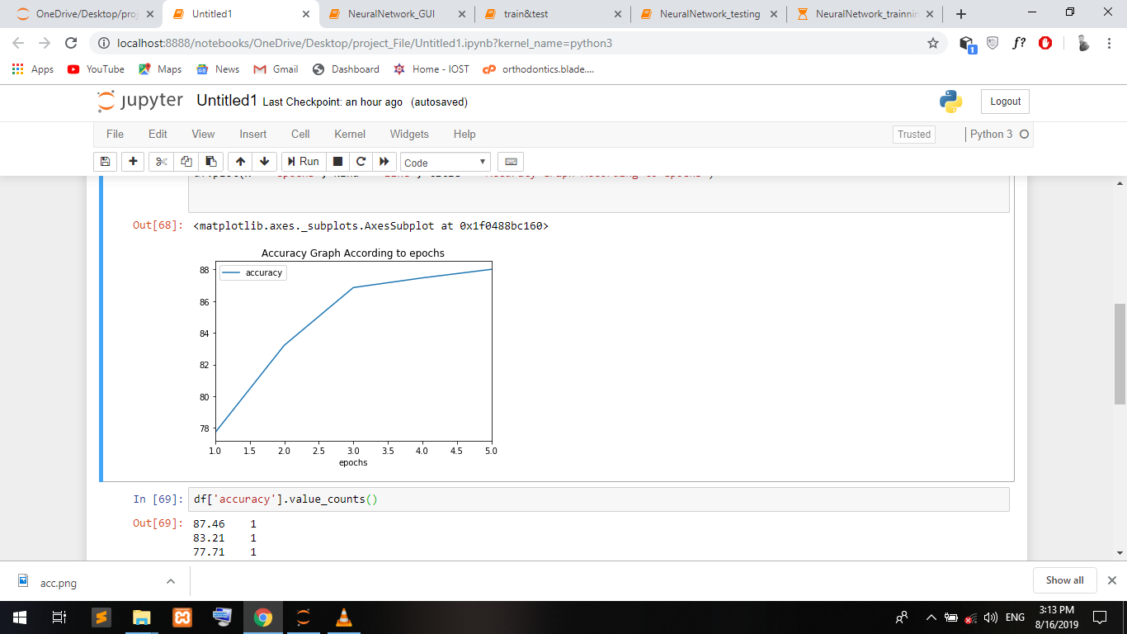
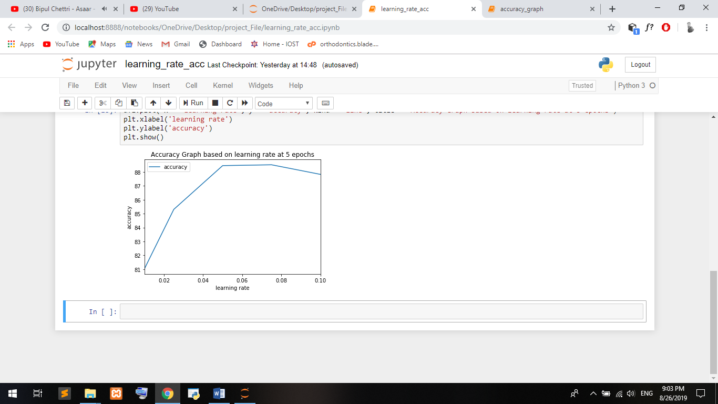
Analysis

Slide 23
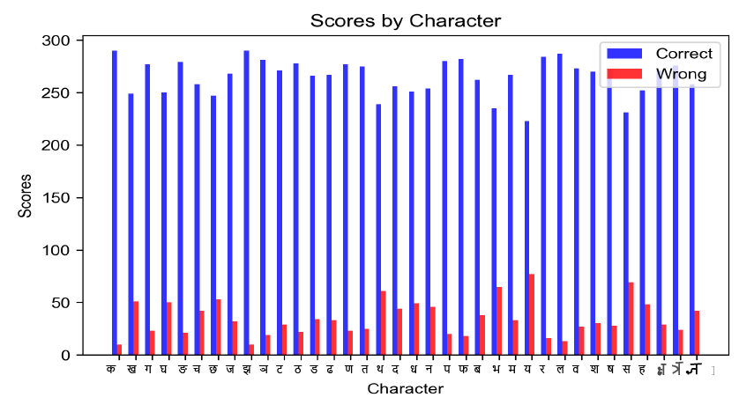

Slide 24
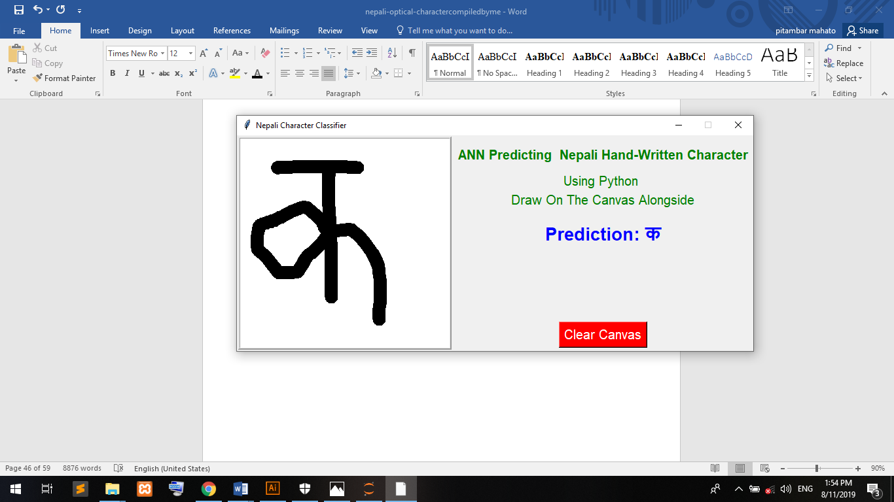
Output

Slide 25
Time Frame

Slide 26
References
[1] S. Acharya, "Deep Learning Based Large Scale Handwritten Devnagari Character Recognition," Kathmandu, 2015.
[2] Pranjali Pohankar, Namrata Taralkar, Snehalate Karmare, Smita Kulkarni, "Character Recognition using Artificial Neural Network," April, 2014.
[3] Anna Tigunova, "Detection of Textual Information Using Convolutional Neural Networks," November 10, 2017.
[4] Azmi Can Ozgen, "Text Detection in Natural and Computer-Generated Images," Istanbul, Turkey, 2011.
[5] "Skymind," [Online]. Available: https://skymind.ai/wiki/backpropagation.
[6] "MachineLearningMastery,"[Online].Available: https://machinelearningmastery.com/learning-rate-for-deep-learning-neuralnetworks/.
[7] Bal Krishna Bal, Rajesh Pandey, Samir Tuladhar, Shanti Shakya, "INTERIM REPORT ON NEPALI OCR," Kathmandu, Nepal.
[8] S. Shakya, A. Basnet, S. Sharma, A. Gurung, "Optical Character Recognition for Nepli, English Character and Simple Sketch Using Neural Network," Kathmandu, Nepal, 2016.
[9] Ahmed Muaz, "Urdu Optical Character Recognition System," Lahore, Pakistan .
[10] Chris J Maddison, Aja Huang, IIya Sutskever, David Silver, "Move evaluation in go using deep convolutional neural networks," 2014.
[11] Vasu Negi, Suman Mann, Vivek Chauhan, "Devanagari Character Recognition Using Artificial Neural Network".

Slide 27
Thank You

