Slide 1



ONESYS
ONE BAYANI, ONE SYSTEM
Version 2

Slide 2




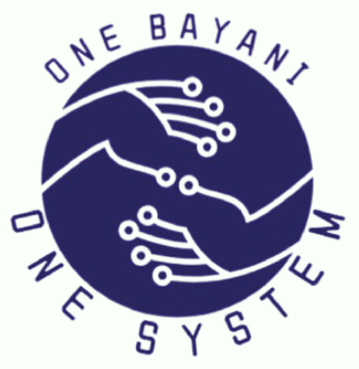



Slide 3
WHAT IS ONESYS?
  OneSys is a Barangay Management Information System designed to help make barangay operations faster, more organized, and more efficient.

Slide 4
HOW DOES IT BENEFIT THE BARANGAY?
  The system allows information to be easily recorded, accessed, and managed.

Slide 5
HOW CAN IT HELP WITH THEIR BARANGAY PROCESSES?
  Faster search of residents’ records.
  Prevents lost or misplaced files since everything is recorded in the system.

Slide 6
WHO ARE THE USERS OF THE SYSTEM?
  Barangay Secretary – to encode and manage residents’ records.
  Barangay Chairman/Captain – to view and monitor reports.
  Barangay Staff – to assist in processing certificate requests.

Slide 7
WHAT CAN THEY DO WITH THE SYSTEM?
  Encode and update residents’ information.
  Create and print barangay certificates.
  Generate reports for faster and better decision-making.

Slide 8
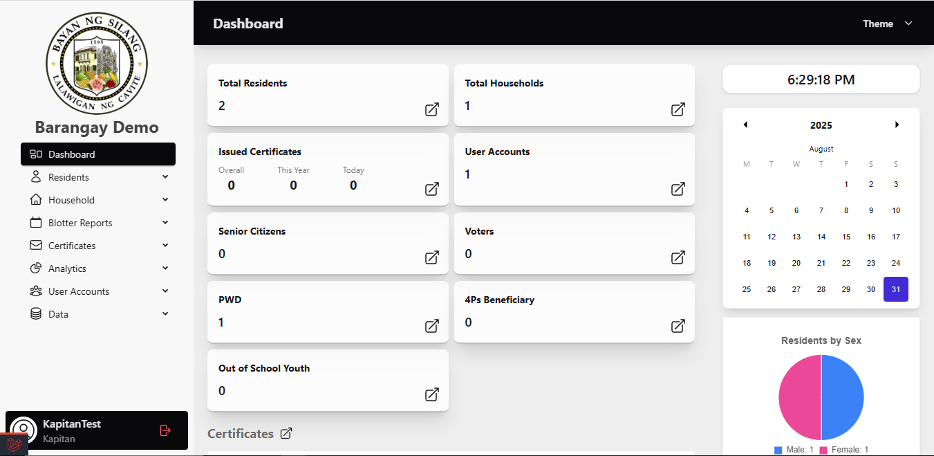
Dashboard
The quick overview of the sysytem

Slide 9
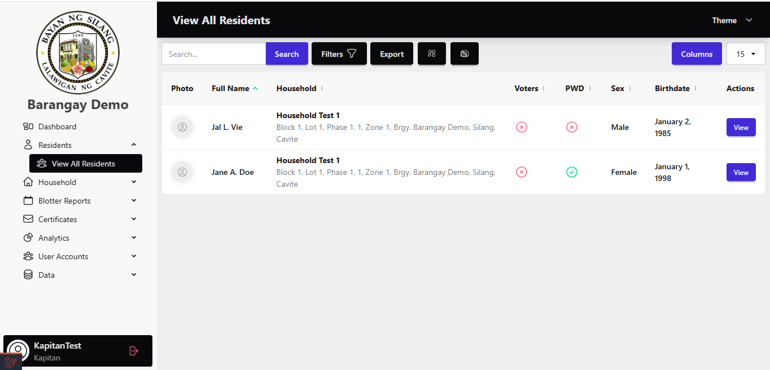
View All Residents

Slide 10
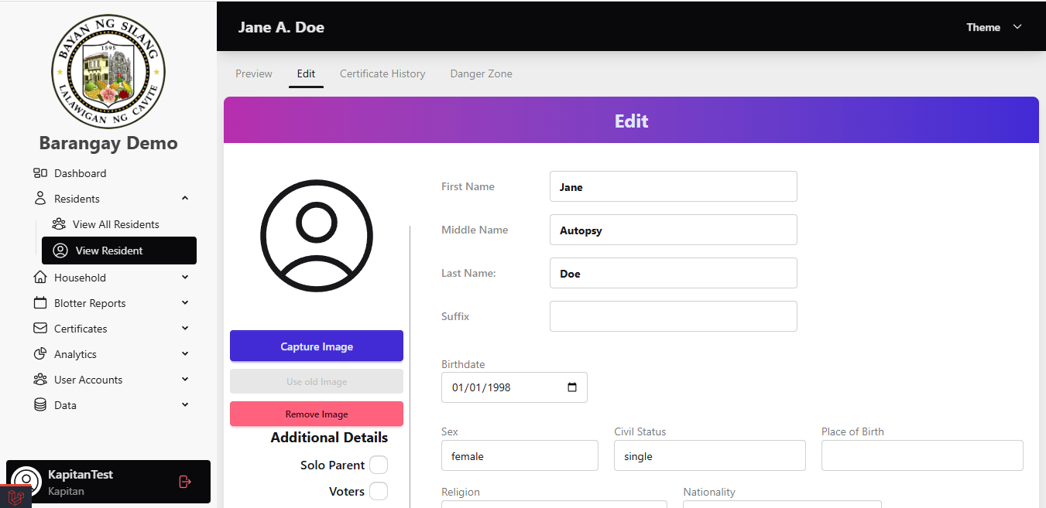
ONESYS UNIQUE FEATURES
Capture Image To Resident Profile

Slide 11

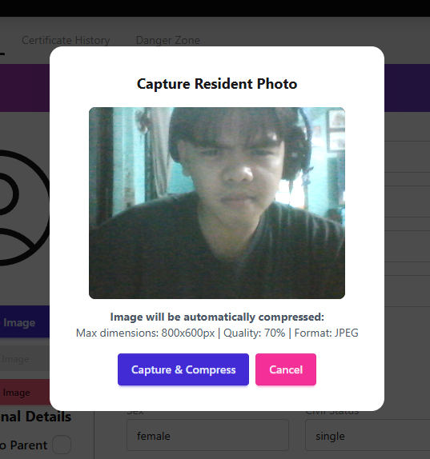


Slide 12
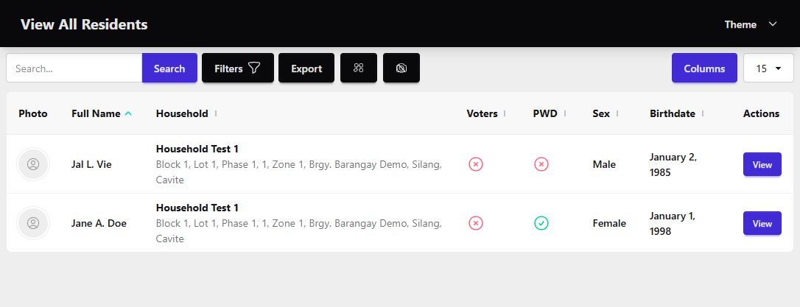

Slide 13
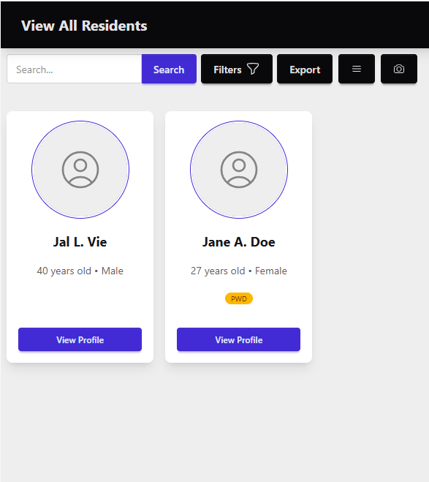

Slide 14
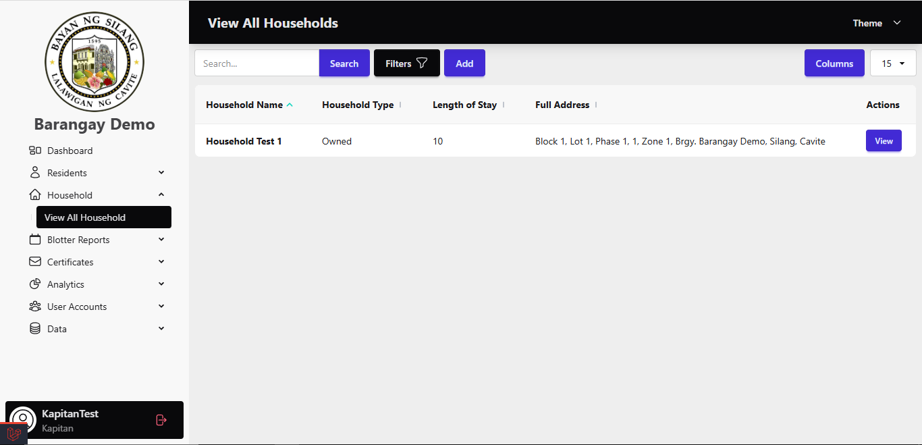
Household

Slide 15
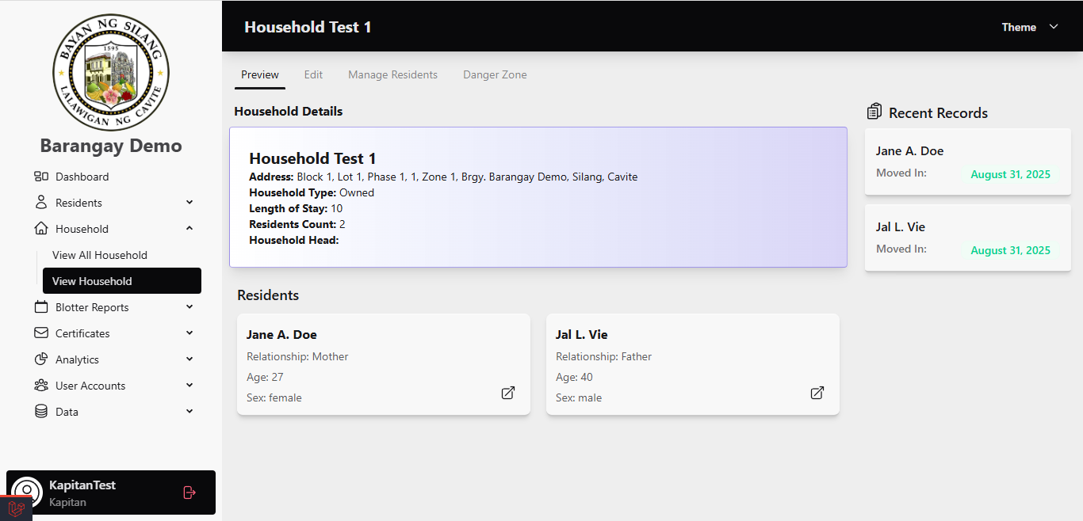
View Household

Slide 16
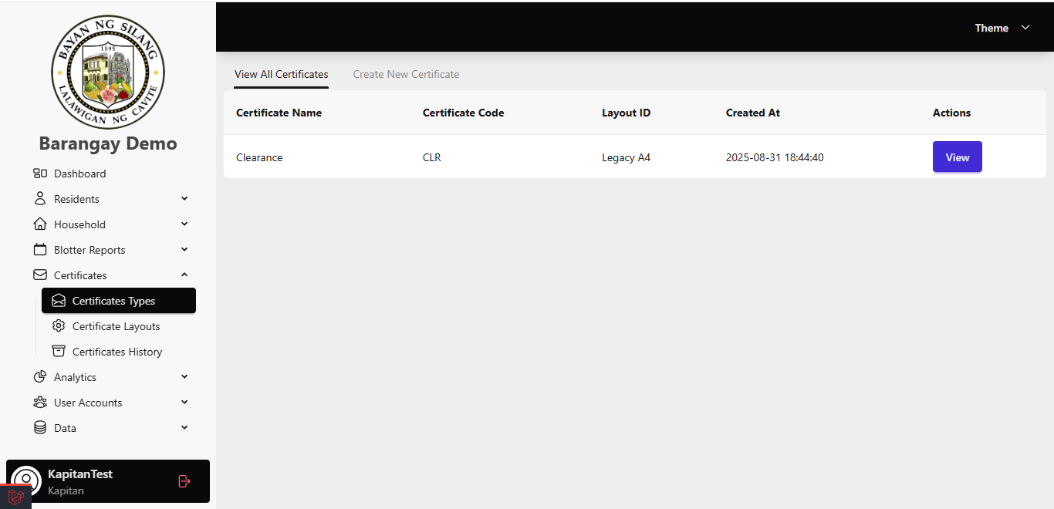
Certificates

Slide 17
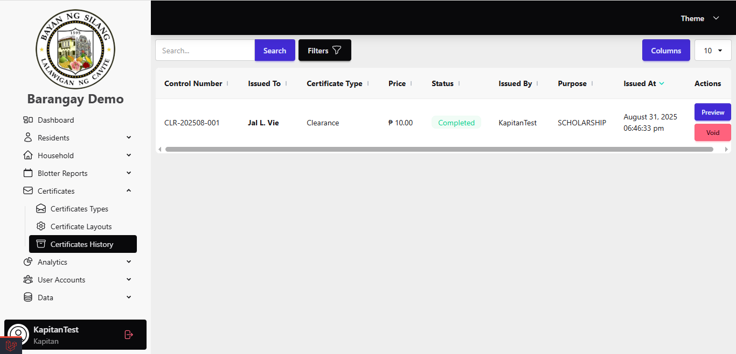
Certificate History

Slide 18
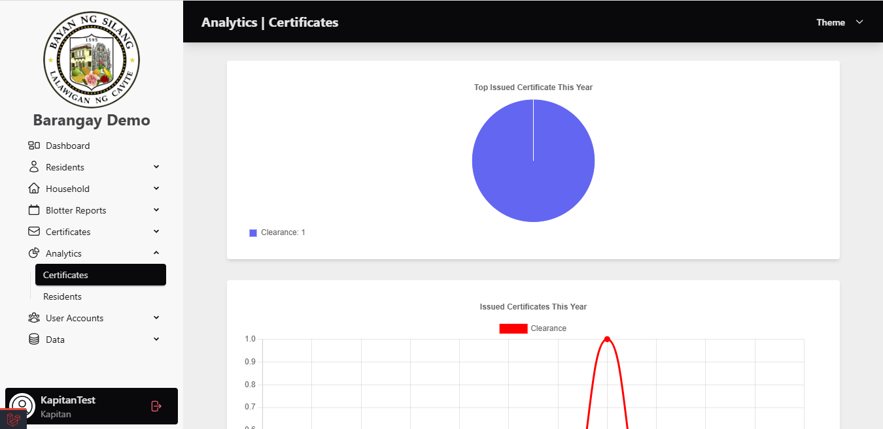
Analytics for Certificates

Slide 19
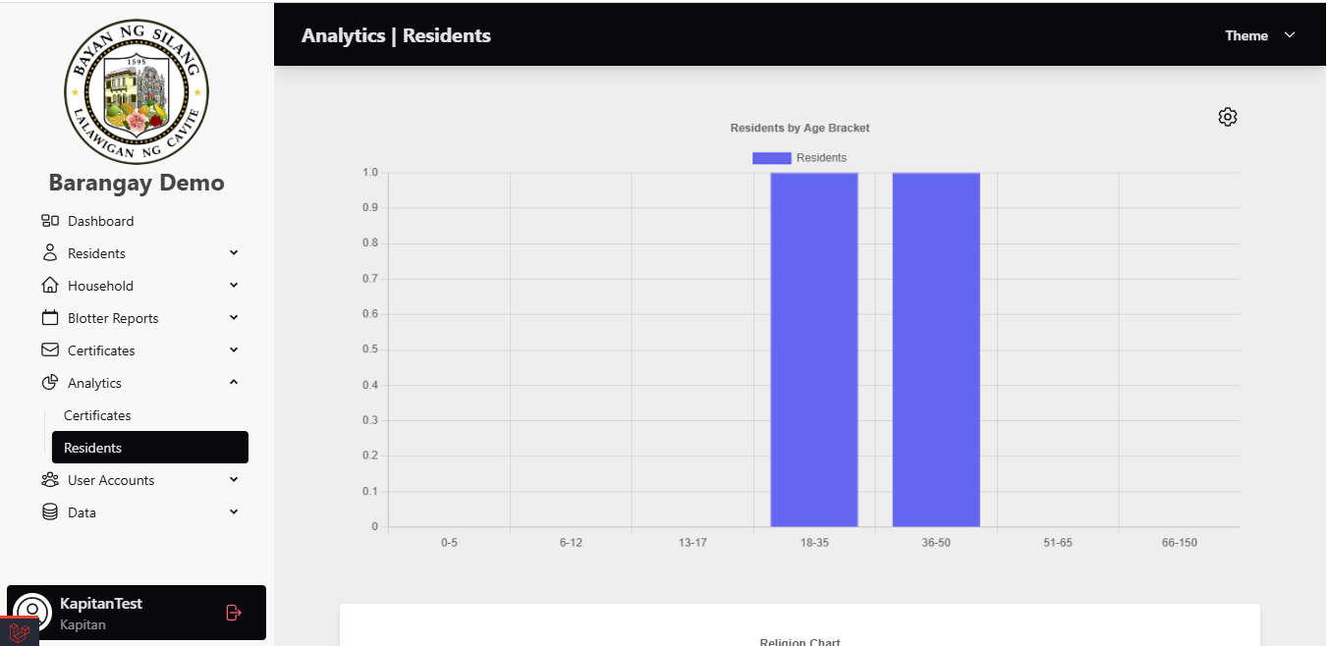
Analytics for Resident

Slide 20
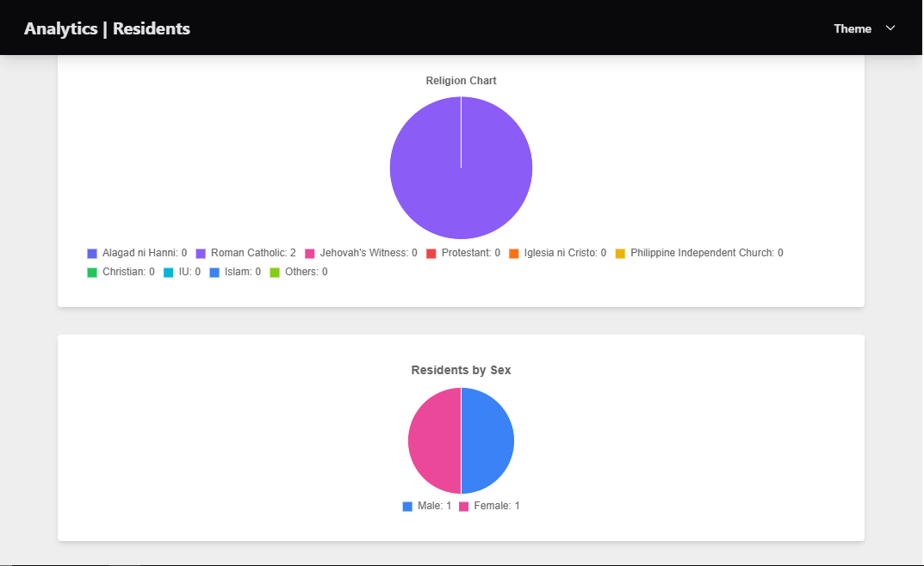
Analytics for Resident

Slide 21
PLANS TO DO FOR ONESYS V3
  Blotter Report
  Barangay Permit Clerance
  Payment’s Transaction
  Automated tracking of total daily revenue.

Slide 22
Q AND A

