Slide 1
CREATION OF COMPLETE SHELL FOR XV6

Slide 2
MEMBERS
S ABISHEK 17z302
ANUSHA SM 17z306
PITCHAPPAN P RM 17z336
A SURAJ SUBRAMANIAN 17z352

Slide 3
XV6
a Simple UNIX like teaching Operating System developed by MIT
modern reimplementation of sixth edition UNIX in ANSI C for multiprocessor x86 systems

Slide 4
OBJECTIVES
To improve the already existing basic XV6 shell with commands and code of our own and improve the basic functionalities of XV6

Slide 5
INBUILT SHELL COMMANDS IN XV6
cat
echo
grep
mkdir
rm
sh
ls

Slide 6
COMMANDS IMPLEMENTED
cp - copy contents of one file to another
mv - move contents of one file to another
head - display first n lines in a file
tail - display last n files in a file
editor - to create and modify files
ps - to display all running processes

Slide 7
DATA FLOW DIAGRAMS

Slide 8
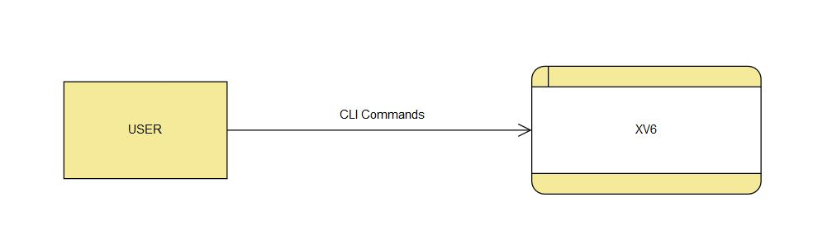
DFD - LEVEL 0

Slide 9
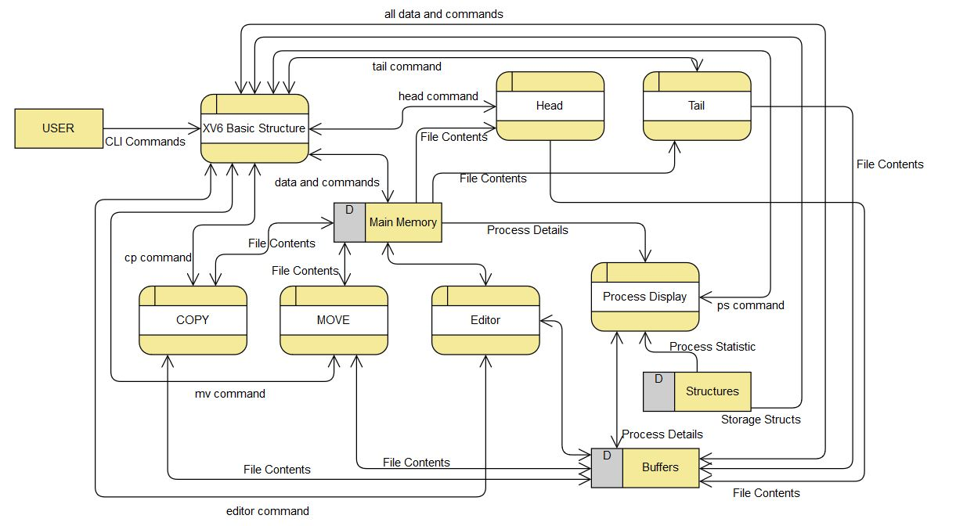
DFD - LEVEL 1

Slide 10
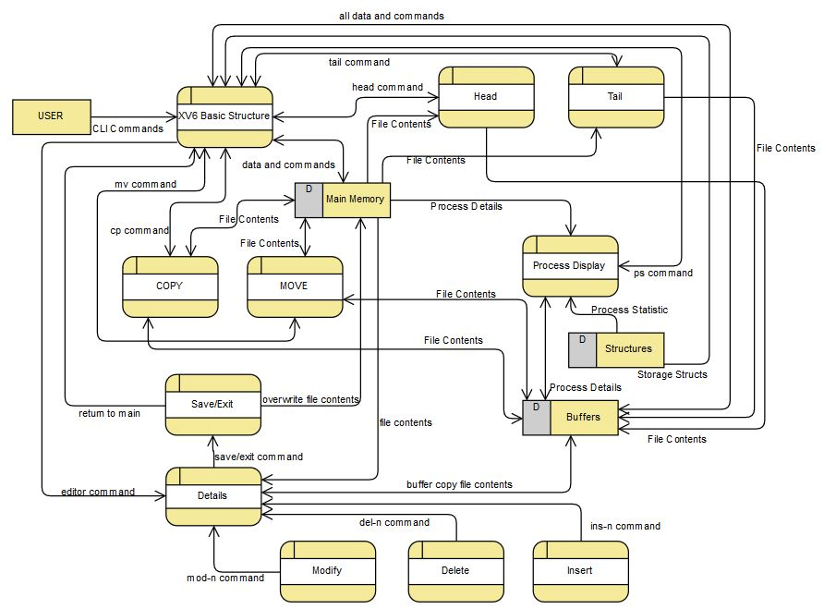
DFD - LEVEL 2

Slide 11
MODULE DESCRIPTIONS

Slide 12
cp - copy
SYNTAX : cp file1 file2
MANDATORY PARAMETERS : file1, file2
OPERATION : copies the contents of file1 to file2
INTERNAL WORKING : Contents of file1 is read in a buffer and written into file 2 from the buffer continuously until the end of file1.
Here the file2 is created if it doesn’t exist else it is overwritten on the existing file specified.
This module is based on command line arguments where the inputs are passed as arguments to the module when it is invoked.

Slide 13
mv - move
SYNTAX : mv file1 file2
MANDATORY PARAMETERS : file1, file2
OPERATION : moves the contents of file1 to file2
INTERNAL WORKING : Contents of file1 is read in a buffer and written into file 2 from the buffer continuously until the end of file1.
Here the file2 is created if it doesn’t exist else it is overwritten on the existing file specified.
This module is based on command line arguments where the inputs are passed as arguments to the module when it is invoked.

Slide 14
head
SYNTAX : head file1 n
MANDATORY PARAMETERS : file1
OPERATION : prints the contents at the start of the file
n specifies the number of lines to be printed, by default n is 10. So n is optional.
INTERNAL OPERATION :The contents of file1 is read through a buffer and written to the terminal.
This module is based on command line arguments where the inputs are passed as arguments to the module when it is invoked.

Slide 15
tail
SYNTAX : tail file1 n
MANDATORY PARAMETERS : file1
OPERATION : prints the contents at the end of the file
n specifies the number of lines to be printed, by default n is 10. So n is optional.
INTERNAL OPERATION :The contents of file1 is read through a buffer and written to the terminal.
This module is based on command line arguments where the inputs are passed as arguments to the module when it is invoked.

Slide 16
ps - process display
SYNTAX : ps
MANDATORY PARAMETERS : none
OPERATION : ps command is invoked when the user demands to see the currently running processes, memory allocation to each process, total run time of a process, starting address of a process, size of a process, total CPU utilization of a process, id of a process, parent id for each process, current state of the process, name of the process and total number flags used by a process.
INTERNAL OPERATION : It fetches the data it needs and then checks whether a process is “UNUSED” or not, if the former then the data is ignored and then the next set of data is fetched from the memory and checked else if it’s the latter then the details mentioned above will be written to the output buffer and then onto the terminal.

Slide 17
pwd - present working directory
SYNTAX : pwd
MANDATORY PARAMETERS : none
IMPLEMENTATION : We have used doubly linked list data structure where the contents are
String to hold the name,
Next to point to the next node,
Before to point to previous node. Each case was handled.

Slide 18
editor
SYNTAX : editor file1
MANDATORY PARAMETERS : file1
OPERATION : used to open a basic editor that can be used to create a new file or view and modify an existing file.
USE : The editor can be used to insert, modify or delete a particular line. The editor can also be used to add lines at end of the file. The editor displays the number of lines at each line and that can be used to specify after which line you need to insert or modify
WORKING : The editor goes to fetch the filename and if its non-existent, it then goes on to create a file of the given name. It then prints the whole text along with line numbers and then shows all possible options to choose from and execute. At the end, you can choose to exit with or without saving all changes.

Slide 19
MODIFICATIONS IN cd
PROBLEM :
cd command had a problem that relates with the path name
When the functions exec() is called the command name is passed as such with the assumption that the command file to execute the command was in the current directory
This was the problem when we move to another directory other than the root which is we lose the ability wield the bash commands
SOLUTION IMPLEMENTED :
In order to correct this we added a functionality called the strcat function in user.h so that it can be called and we concatenated the command name with. “/ “ so that it finds the command file to execute properly.

Slide 20
EXCITING FEATURES

Slide 21
clear
SYNTAX : clear
MANDATORY PARAMETERS : none
This is a simple program we implemented to clear the terminal. It’s to clear the clutter and keep you in the Zen zone.

Slide 22
MODIFICATIONS FOR .sh FILES
All of us have written shell scripts in Linux or batch files in windows at least once. Not many people will associate something like that with a basic OS like XV6 but we did just that. So when you want to write a shell script, use our editor to write it down and run it with ./<filename>.sh

Slide 23
TESTING

Slide 24
CODE AND DEMO

Slide 25
SUMMARY
We successfully created a basic XV6 shell with what our team believes to be necessary for a common usage. We learnt a lot from working with a basic Operating System and would like to thank everyone for this opportunity.

Slide 26
What I cannot create, I do not understand.
-Richard P Feynman

