Slide 1


From Framework to Practice: Google AI across AVIT
GOOGLE HIGHER Ed FACULTY AI FELLOWSHIP · IN-PERSON INSTITUTE
Track: Pedagogy & Academia
Dr. S. Pitchumani Angayarkanni · Professor, Department of CSE , Aarupadai Veedu Institute of Technology , Vinayaka Missions Research Foundation (DU), Chennai
Pedagogy & Academia · Google London, 23 October 2026
Notes:
Good morning. In June, at my Spark Session, I shared a six-pillar framework for AI-native higher education. Today I will show how AVIT is putting that framework to work with Google AI: NotebookLM, Google notebooks, Gemini Gems, Google Scholar and Co-Scientist.

Slide 2
Since the Spark Session
June: a six-pillar framework. Today: eight institution-level use cases, built with Google AI.
Notes:
The framework had six pillars, each aligned to OBE and accreditation: Teaching and Learning, Assessment Redesign, Research Integration, Faculty Development, AI Governance and Ethics, and Student Success. Each now has at least one working or piloted use case.

Slide 3
Six pillars, one use case each
Teaching & Learning
NotebookLM course hubs and the AVIT EduMentor AI Gem.
Assessment Redesign
Verify-AI tasks and Bloom-balanced question papers.
Research Integration
Scholar → NotebookLM → Co-Scientist research pipeline.
Faculty Development
Gem-building clinics: every FDP participant leaves with a working Gem.
AI Governance & Ethics
A NotebookLM helpdesk grounded in AVIT’s AI policy.
Student Success
Study notebooks: a diagnostic quiz, then a personalised path.
Notes:
Here is one use case per pillar. The next slides go through them, starting with teaching.

Slide 4
Teaching & Learning: hub plus co-teacher
NotebookLM course hub
Syllabus, CDP, textbook chapters and lab manuals in one notebook.
Students ask questions; every answer cites its source. Evidence: usage logs and student feedback.
Every core course gets two things: a faculty-curated NotebookLM hub, and the AVIT EduMentor AI Gem, approved by the department.
AVIT EduMentor AI (Gemini Gem)
Socratic, adaptive and hint-first, aligned to official COs, POs and PSOs.
Evidence: tutor transcripts showing student attempts before hints.
https://gemini.google.com/gem/1wHDMs4QrnULH47Z63ULfk7kf6g68mLgD?usp=sharing
Notes:
For teaching, each core course gets a NotebookLM hub built from the syllabus, course delivery plan, textbook and lab manuals, so students get cited answers. On top of it sits AVIT EduMentor AI, our co-teaching Gem, which asks students to try first and gives one hint at a time. Both are approved by the department before release.

Slide 5
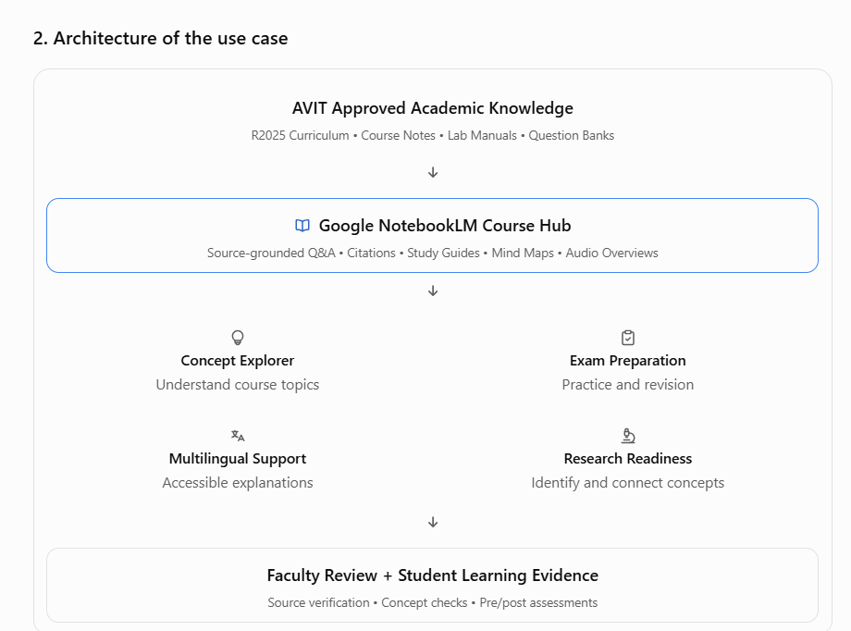
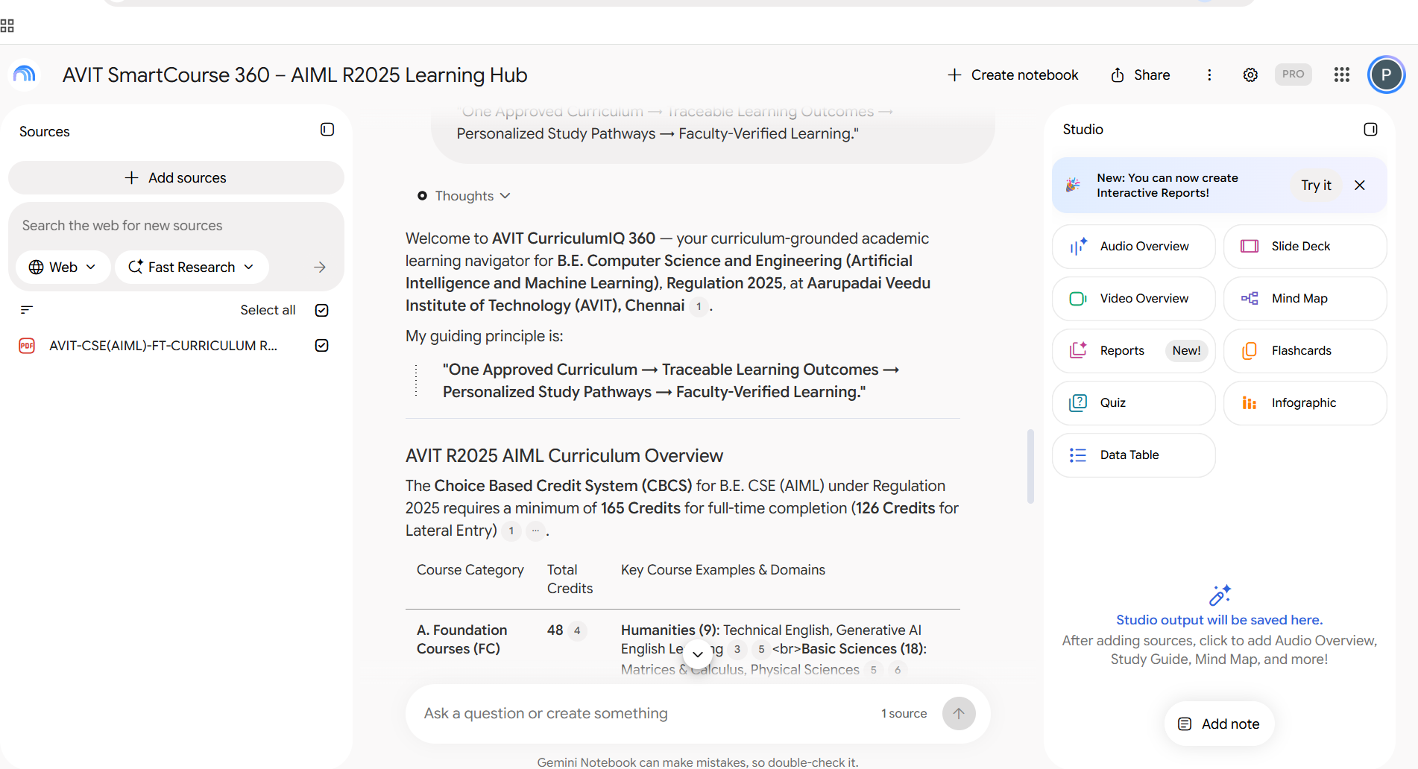
Prompt Link: https://docs.google.com/document/d/1jv1hKp59L0voAYZJaXVrUWy_zTrx8dCYwQCiKcCHyK4/edit?usp=sharing
https://notebook.google.com/notebook/9a281b1b-3ad3-4bb6-b593-9dd2e67133c7
Step 1 — Curriculum-grounded question
Identify the Machine Learning course in the uploaded AVIT R2025 AIML curriculum. Show its course code, Course Outcomes, Bloom's levels, and the syllabus topics covering classification and clustering. Cite the relevant source passages.

Slide 6
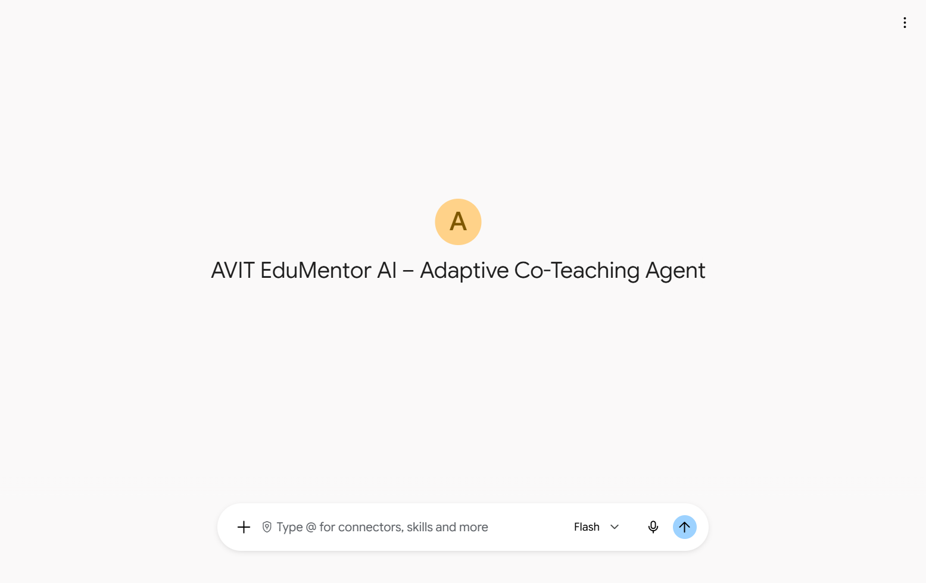
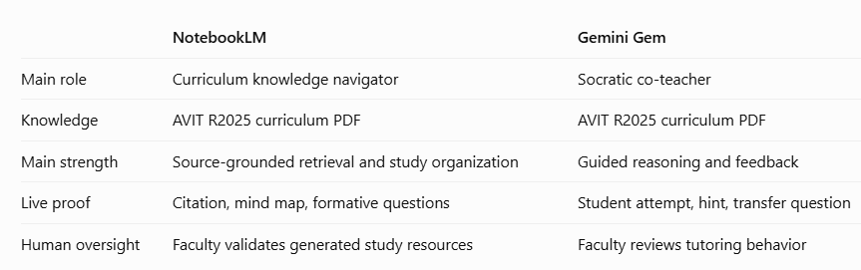
AVIT EduMentor AI: our co-teaching Gem
A Gemini Gem that co-teaches alongside faculty, never replacing them. Five principles:
Socratic learning: guide before revealing
Adaptive scaffolding: beginner to advanced
Bloom’s Taxonomy: Remember through Create
OBE: aligned to official COs, POs and PSOs
Mastery learning: verify before advancing
Knowledge: AVIT CSE (AIML) R2025 curriculum
Live in Gemini: AVIT EduMentor AI – Adaptive Co-Teaching Agent
https://gemini.google.com/share/d/1jf7u6ASuDYDoIoti_8f7iM4axmDqGjWu?usp=sharing
Pilot week first
Notes:
[Point to the screenshot] The Gem is already live in Gemini. This is AVIT EduMentor AI, the co-teaching Gem behind our teaching pillar. It works alongside faculty, never replacing them, on five principles: Socratic learning, adaptive scaffolding, Bloom’s Taxonomy, outcome-based education and mastery learning. Its knowledge base is our 441-page CSE (AIML) Regulation 2025 curriculum, covering semesters one to eight, course outcomes, CO–PO–PSO mappings and Bloom levels. The guiding line in its instructions: do not simply give students answers; help them discover, evaluate, implement and defend their own solutions.
Configuration: Name “AVIT EduMentor AI – Intelligent Co-Teacher”; default tool: none for version 1. Next knowledge files to prepare: a co-teaching pedagogy framework, faculty notes and worked examples, question banks with rubrics, lab practice files, and the academic delivery plan. Never upload identifiable student marks.

Slide 7

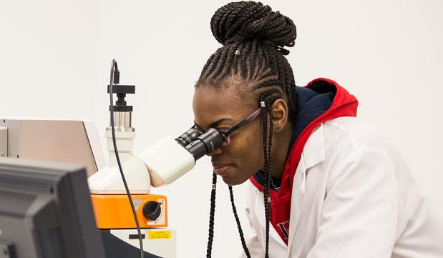

Adapts to each learner
01 Beginner
Simple terms, incremental steps and guided micro-tasks.
Bloom: Remember, Understand, Apply
02 Intermediate
Pseudocode, flowcharts, debugging and complexity analysis.
Bloom: Apply, Analyze, Evaluate
03 Advanced
Trade-offs, scalability, security and research-style challenges.
Bloom: Analyze, Evaluate, Create
Notes:
EduMentor diagnoses each learner with one short question, then adapts: beginners get simple language and micro-tasks; intermediate learners get pseudocode, debugging and complexity analysis; advanced learners are challenged on trade-offs, scalability and research. Levels change with demonstrated understanding, not self-reported confidence, and students are never permanently labelled.

Slide 8
Adaptive hint ladder: guide before revealing
Level 1 · Clue
One targeted conceptual hint.
Level 2 · Decompose
Break the task into logical steps.
Level 3 · Partial example
Pseudocode, a diagram or an incomplete fragment.
Level 4 · Targeted fix
Point to the line or logic, explain the cause.
Level 5 · Worked solution
Only after genuine attempts, with verification.
Faculty mode
Lesson plans, Bloom-aligned questions, rubrics and reference solutions.
Notes:
When a student asks for a full program, EduMentor climbs a hint ladder: a conceptual clue, then decomposition, then pseudocode or a partial example, then a targeted correction, and a complete worked solution only after genuine attempts. It never leaves a struggling student without useful help. In faculty mode it switches roles: lesson plans, Bloom-aligned questions, rubrics and reference solutions, delivered directly. It never invents syllabi, outcomes, marks or policies.

Slide 9
Every reply, the same shape
Student replies have three parts: Current Assessment (what is understood and what needs work), Co-Teacher’s Guidance (one concise hint or explanation), and Your Turn (exactly one checkpoint question).
Before release, faculty run four test prompts. Example: “write the full Apriori program” must get scaffolding, not a code dump.
4
test scenarios run by faculty before students use the Gem
Signed off
Notes:
Every student reply has the same three parts: a current assessment, the co-teacher’s guidance, and “your turn”, exactly one checkpoint question. That makes the agent predictable for faculty to audit. Before release we test four scenarios, including a request for a complete Apriori program, where the right behaviour is scaffolding, not a code dump, and a faculty request, where the right behaviour is to deliver directly. Next, the same framework becomes subject-specific Gems for Data Mining, R Programming, AI/ML and Cyber Security.
If the tests have not yet been run, say “we will test”.

Slide 10
Assessment Redesign
Verify-AI assessments
Students audit a seeded flawed answer, cite the source, test it in Colab, then defend a new problem without AI.
Most marks go to unaided transfer. Evidence: rubric scores for each CO and student outcome.
Bloom-balanced question papers
A question-paper Gem drafts Bloom-tagged items; our Bloom’s Taxonomy Analyzer checks the balance; faculty approve.
Evidence: blueprints and Bloom distribution reports.
Notes:
For assessment, two uses. First, verify-AI tasks: students audit a deliberately flawed answer, check the source, test it, and then solve a new problem without AI, which carries most of the marks. Second, a question-paper Gem drafts Bloom-tagged items, and the Bloom’s Taxonomy Analyzer from my Spark Session checks the balance before faculty approve.

Slide 11
Students, faculty and governance
Student Success
Study notebooks in Gemini: a diagnostic quiz, then a personalised path for each learner tier.
Faculty Development
Gem-building clinics: each FDP participant leaves with one course notebook and one peer-reviewed Gem.
AI Governance & Ethics
A NotebookLM helpdesk on the AVIT AI policy and UGC/AICTE guidelines answers, with citations, “Can I use AI for this?”
Notes:
For students, Gemini study notebooks start with a diagnostic quiz and build a personalised path, so slow, intermediate and advanced learners get different support. For faculty, our FDPs become Gem-building clinics: everyone leaves with a working notebook and Gem. For governance, a NotebookLM helpdesk built on our AI policy answers “can I use AI for this?” with citations.
Availability: study notebooks in Gemini were announced in Virtual Session 3 and are rolling out; say “piloting” or “plan to” if not yet in use.

Slide 12
Eight use cases at a glance
Pillar | Use case | Google tools | Institution-level practice | Evidence
Teaching | Course knowledge hubs | NotebookLM | A curated notebook per core course | Usage logs, cited answers
Teaching | AVIT EduMentor AI | Gemini Gem + R2025 curriculum | Socratic co-teacher, faculty-approved | Tutor transcripts
Assessment | Verify-AI assessments | Gemini, NotebookLM, Colab | Audit, cite, test, then defend unaided | Rubric scores per CO/SO
Assessment | Bloom-balanced papers | Gem + Bloom’s Analyzer | Gem drafts, Analyzer checks, faculty approve | Bloom distribution reports
Student Success | Personalised study paths | Google notebooks | Diagnostic quiz, then a tiered path | Pre/post gains per tier
Research | Literature to hypothesis | Scholar, NotebookLM, Co-Scientist | Five-stage pipeline with a human decision | Literature maps, ranked hypotheses
Faculty | Gem-building clinics | Gems, NotebookLM | Every FDP ends with a working Gem | Courses with approved Gems
Governance | AI policy helpdesk | NotebookLM | Cited answers from AVIT AI policy | Policy queries answered
Notes:
This table summarises all eight use cases, the Google tools behind each, how they run at institution level, and the evidence each produces for accreditation.

Slide 13
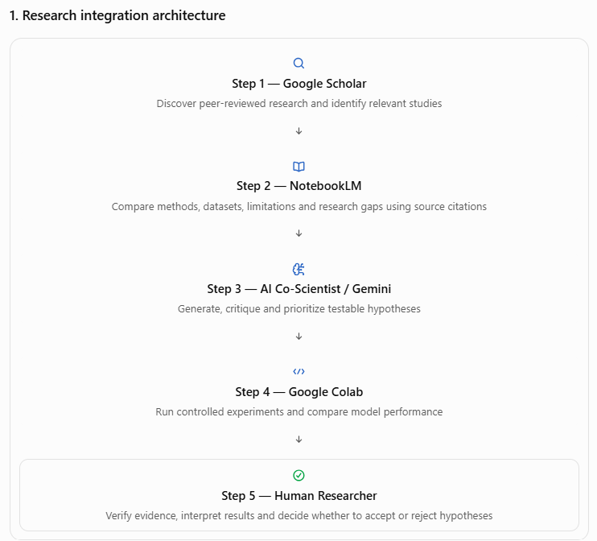
Research Integration
Notes:
Now the research pillar, and the tool many of you asked about: Co-Scientist.

Slide 14
How Co-Scientist works: Gemini agents, one supervisor
Generation
Proposes focus areas and novel hypotheses grounded in literature and data.
Reflection
A virtual peer reviewer: checks correctness, quality and novelty.
Ranking
Runs an Elo-based “idea tournament” of pairwise debates.
Proximity
Clusters hypotheses so the search space is explored widely.
Evolution
Refines and combines the top-ranked hypotheses.
Meta-review
Learns from the debates and writes the final proposal for the scientist.
Notes:
Co-Scientist is a multi-agent system built with Gemini, coordinated by a supervisor agent that acts as an adaptive planner. Generation proposes hypotheses grounded in literature. Reflection acts as a virtual peer reviewer. Ranking runs an Elo-based idea tournament of pairwise debates. Proximity clusters ideas so the search stays broad. Evolution refines the winners. Meta-review learns from the debates and writes the final proposal for the scientist to review. It has been validated in drug repurposing, target discovery and antimicrobial resistance, and it augments scientists rather than replacing them.
Source: Google DeepMind blog, “Co-Scientist: A multi-agent AI partner to accelerate research” (May 2026); Google Research blog and arXiv 2502.18864.

Slide 15
AVIT research pipeline: AI proposes, we decide
1 · Scan
Alerts, “Cited by” chains and related articles build a seed list
Google Scholar
2 · Ground
Ask which datasets and protocols each paper uses, with cited passages
NotebookLM
3 · Hypothesise
The idea tournament ranks candidate explanations
Co-Scientist
4 · Verify and decide
Check sources, run a quick test, keep, revise or reject
Gemini + Colab, then the researcher
Notes:
Our research pipeline has four steps. Scan: Google Scholar alerts, cited-by chains and related articles build a seed list; faculty Scholar profiles also feed our publication tracking for NIRF. Ground: the papers go into NotebookLM, where we ask which datasets and protocols each uses, with cited passages. Hypothesise: Co-Scientist ranks candidate explanations. Verify and decide: we check sources and run a quick test in Colab, and the researcher keeps, revises or rejects each hypothesis and records why.

Slide 16
Example: XAI for renal histopathology
Research goal: why do published biopsy-classification results fail to transfer across hospitals?
Co-Scientist ranks candidates such as stain variation, dataset overlap and labelling protocol. NotebookLM checks each cited paper’s dataset and protocol; Colab runs a quick test on public data. The same pipeline serves federated learning, explainable cyber-threat detection, PhD scholars and final-year projects.
Human decides
Notes:
Here is an example from my explainable-AI work on renal histopathology. The goal: why do published biopsy-classification results fail to transfer across hospitals? Co-Scientist ranks explanations such as stain variation, dataset overlap and labelling protocol; we verify each against the sources and a quick experiment. The same pipeline serves our federated-learning and cyber-threat work, PhD scholars and student projects.
IMPORTANT: Co-Scientist access (Hypothesis Generation, labs.google/science) is opening gradually. If you have not run it yet, say “we are piloting” or “we plan to”, and do not state results you have not obtained.

Slide 17
01
02
03
Verify-AI assessment
AVIT EduMentor AI Gem with a NotebookLM hub
Scholar to Co-Scientist research pipeline
Notes:
If you remember three things: the verify-AI assessment, our strongest demonstration; the AVIT EduMentor AI Gem with a NotebookLM hub, the most scalable across AVIT; and the research pipeline from Google Scholar to Co-Scientist. Three of six pillars have moved from framework to practice since June.

Slide 18
AI proposes. We verify.
Notes:
The principle across all eight: AI proposes; students, faculty and researchers verify.

Slide 19
Thank you
Seeking Fellows to co-build these use cases in their institutions
Dr. Pitchumani Angayarkanni · ORCID 0000-0001-9621-190X · [email]
Notes:
I would love to co-build these with fellow Fellows. Thank you.
Note: describe each tool at the stage actually reached (in use, piloting, or planned).

