Slide 1



AARUPADAI VEEDU INSTITUTE OF TECHNOLOGY
(Constituent College of Vinayaka Mission's Research Foundation – Deemed to be University)
Department of Computer Science and Engineering
Course Code: 35021P28
Course Title: R Programming
Category: CC | L-T-P: 3-0-0 | Credits: 3
COURSE INSTRUCTOR: Dr. S. Pitchumani Angayarkanni
Professor, Department of CSE, AVIT

Slide 2
COURSE OUTCOMES
On the successful completion of the course, students will be able to
CO1: To Understand the basics in R programming in terms of constructs, control statements, string functions | Understand & Apply
INTRODUCTION
Introducing to R – R Data Structures – Help functions in R – Vectors – Scalars – Declarations – recycling – Common Vector operations – Using all and any – Vectorized operations – NA and NULL values – Filtering – Vectorised if-then else – Vector Equality – Vector Element names

Slide 3
1.1 Introducing to R
R is a programming language and software environment that has become the first choice for statistical computing and data analysis.
Developed in the early 1990s by Ross Ihaka and Robert Gentleman, R has built to simplify complex data manipulation and create clear customizable visualizations.
Over time, it has gained popularity among statisticians, data scientists and researchers because of its capabilities and the vast array of packages available.
As data-driven decision-making has grown, R has established itself as an important tool in various industries, including finance and healthcare, due to its ability to handle large datasets and perform in-depth statistical analysis

Slide 4
Why Choose R Programming?
R is a unique language that offers a wide range of features for data analysis, making it an essential tool for professionals in various fields. Here’s why R is preferred:
Free and Open-Source: R is open to everyone, meaning users can modify, share and distribute their work freely.
Designed for Data: R is built for data analysis, offering a comprehensive set of tools for statistical computing and graphics.
Large Package Repository: The Comprehensive R Archive Network (CRAN) offers thousands of add-on packages for specialized tasks.
Cross-Platform Compatibility: R can work on Windows, Mac and Linux operating systems.
Great for Visualization: With packages like ggplot2, R makes it easy to create informative, interactive charts and plots.

Slide 5
Key Features of R
Cross-Platform Support: R works on multiple operating systems, making it versatile for different environments.
Interactive Development: R allows users to interactively experiment with data and see the results immediately.
Data Wrangling: Tools like dplyr and tidyr help simplify data cleaning and transformation.
Statistical Modeling: R has built-in support for various statistical models like regression, time-series analysis and clustering.
Reproducible Research: With R Markdown, users can combine code, output and narrative in one document, ensuring their analysis is reproducible.

Slide 6
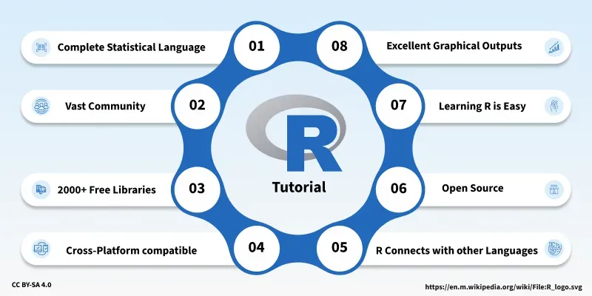

Slide 7
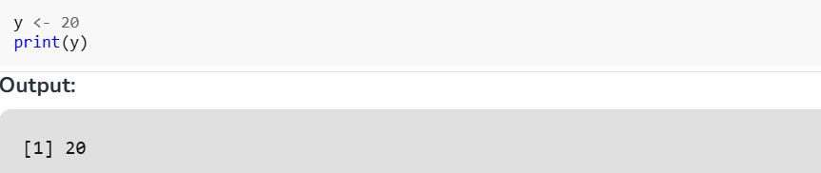
Assignment Operator in R
The "<-" Operator
The "<-" operator is the traditional assignment operator in R. It is specifically designed for assignment operations and is considered a best practice by many R programmers for regular variable assignments.

Slide 8

Basic Data Types
Basic data types in R can be divided into the following types:
numeric - (10.5, 55, 787)
integer - (1L, 55L, 100L, where the letter "L" declares this as an integer)
complex - (9 + 3i, where "i" is the imaginary part)
character (a.k.a. string) - ("k", "R is exciting", "FALSE", "11.5")
logical (a.k.a. boolean) - (TRUE or FALSE)
The implicit coercion hierarchy determines how data types are ordered and automatically converted in R when mixed together.

Slide 9
Feature | "=" Operator | "<-" Operator
Basic Use | Assigns values to variables | Assigns values to variables
Typical Context | Used within function calls | Used for general assignments
Usage Example | x = 10 | y <- 20
Function Arguments | Preferred | Not used`
General Assignment | Less preferred | Preferred
Readability | Less visually distinct | More visually distinct
Conventions | Less conventional in R | Widely accepted and promoted in R
Parsing and Evaluation | Subtle parsing differences | Standard parsing
Risk of Confusion | Can be mistaken for comparison operator (==) | Less risk of confusion
Best Practice | Can be mistaken for comparison operator (==) | Use for general assignments

Slide 10
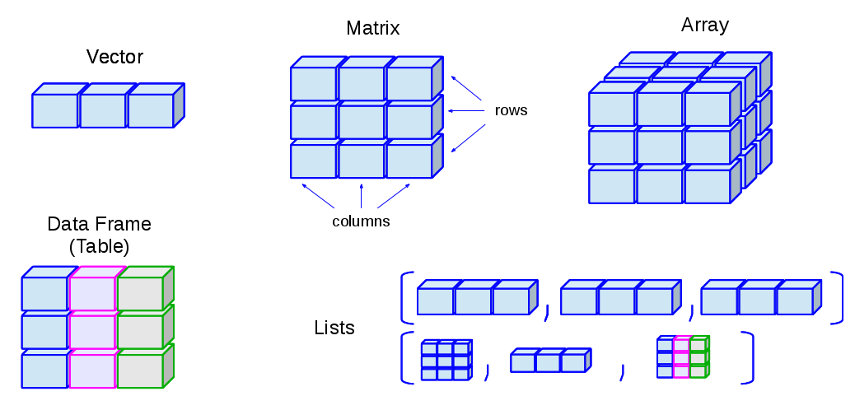
1.2 Data structures in R
Data Structures are the fundamental way R stores, organises, and manipulates data. Understanding data structures is essential because R is built around vectorised operations, and almost every program relies on these structures.
The primary data structures in R are:-
  Vectors
  Matrices
  Arrays
  Lists
  Data frames
  Factors (for categorical data)

Slide 11
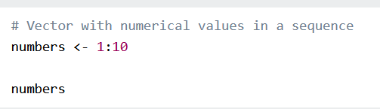
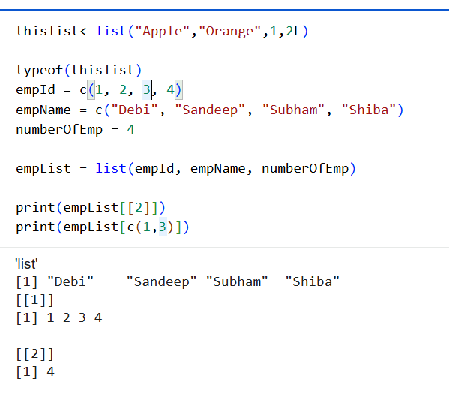
Vectors
A vector is the most basic data structure in R. It contains a list of items of the same type.
To combine the list of items to a vector, use the c() function and separate the items by a comma.
Example:
# Vector of strings
fruits <- c("banana", "apple", "orange")
# Print fruits
fruits
#Vector with Decimal numbers in sequence
Number1<-1.2:5.6
Lists
A list can hold different types of data in one structure.
You can combine numbers, strings, vectors, and
even other lists.
Example
# List of strings
thislist <- list("apple", "banana", 50, 100)
# Print the list
thislist

Slide 12
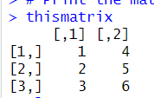
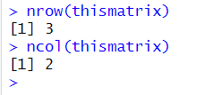
Matrices
A matrix is a 2D data structure where all elements are of the same type. It is like a table with rows and columns.
Example
# Create a matrix
thismatrix <- matrix(c(1,2,3,4,5,6), nrow = 3, ncol = 2)
# Print the matrix
thismatrix
Use nrow and ncol to control the size of the matrix.

Slide 13
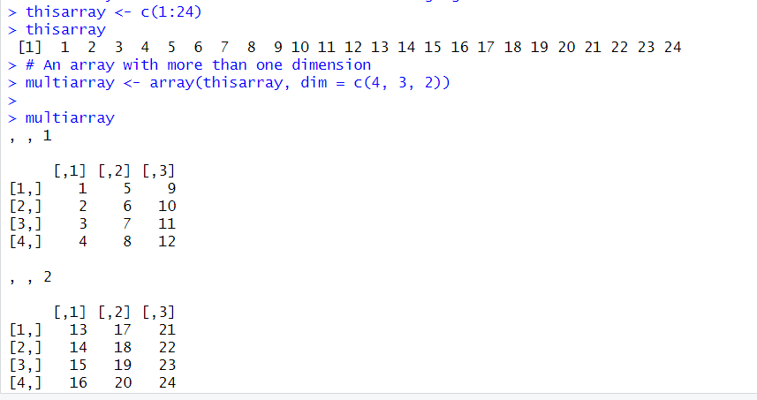
Arrays
Compared to matrices, arrays can have more than two dimensions.
We can use the array() function to create an array, and the dim parameter to specify the dimensions:
Example
# An array with one dimension with values ranging from 1 to 24
thisarray <- c(1:24)
thisarray
# An array with more than one dimension
multiarray <- array(thisarray, dim = c(4, 3, 2))
Access Array Items
You can access the array elements by referring to the index position.
You can use the [] brackets to access the desired elements from an array:
Example
thisarray <- c(1:24)
multiarray <- array(thisarray, dim = c(4, 3, 2))
multiarray[2, 3, 2]
The syntax is as follow: array[row position, column position, matrix level]
You can also access the whole row or column from a matrix in an array, by using the c() function:
Example
thisarray <- c(1:24)
# Access all the items from the first row from matrix one
multiarray <- array(thisarray, dim = c(4, 3, 2))
multiarray[c(1),,1]
# Access all the items from the first column from matrix one
multiarray <- array(thisarray, dim = c(4, 3, 2))
multiarray[,c(1),1]
A comma (,) before c() means that we want to access the column.
A comma (,) after c() means that we want to access the row.

Slide 14
Data Frames
Data Frames are data displayed in a format as a table.
Data Frames can have different types of data inside it. While the first column can be character, the second and third can be numeric or logical. However, each column should have the same type of data.
Use the data.frame() function to create a data frame:
Example
# Create a data frame
Data_Frame <- data.frame (
Training = c("Strength", "Stamina", "Other"),
Pulse = c(100, 150, 120),
Duration = c(60, 30, 45)
)
# Print the data frame
Data_Frame

Slide 15
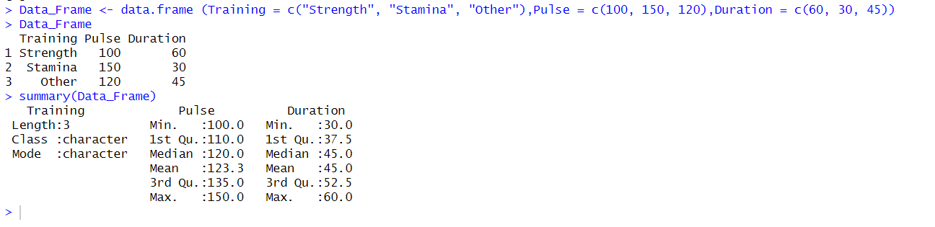
Summarize the Data
Use the summary() function to summarize the data from a Data Frame:
Example
Data_Frame <- data.frame (
Training = c("Strength", "Stamina", "Other"),
Pulse = c(100, 150, 120),
Duration = c(60, 30, 45)
)
Data_Frame
summary(Data_Frame)

Slide 16
The summary() function in R provides a quick statistical summary of each column in a data frame. It summarizes numeric columns differently from character (text) columns.
Meaning of each statistics
Statistic | Meaning
Min. | Smallest value in the column
1st Quartile (Q1) | 25% of values lie below this value
Median | Middle value (50th percentile)
Mean | Arithmetic average
3rd Quartile (Q3) | 75% of values lie below this value
Max. | Largest value

Slide 17
Access Items
We can use single brackets [ ], double brackets [[ ]] or $ to access columns from a data frame:
Example
Data_Frame <- data.frame (
Training = c("Strength", "Stamina", "Other"),
Pulse = c(100, 150, 120),
Duration = c(60, 30, 45)
)
Data_Frame[1]
Data_Frame[["Training"]]
Data_Frame$Training

Slide 18
Add Rows
Use the rbind() function to add new rows in a Data Frame:
Example
Data_Frame <- data.frame (
Training = c("Strength", "Stamina", "Other"),
Pulse = c(100, 150, 120),
Duration = c(60, 30, 45)
)
# Add a new row
New_row_DF <- rbind(Data_Frame, c("Strength", 110, 110))
# Print the new row
New_row_DF

Slide 19
Add Columns
Use the cbind() function to add new columns in a Data Frame:
Example
Data_Frame <- data.frame (
Training = c("Strength", "Stamina", "Other"),
Pulse = c(100, 150, 120),
Duration = c(60, 30, 45)
)
# Add a new column
New_col_DF <- cbind(Data_Frame, Steps = c(1000, 6000, 2000))
# Print the new column
New_col_DF

Slide 20
Remove Rows and Columns
Use the c() function to remove rows and columns in a Data Frame:
Example
Data_Frame <- data.frame (
Training = c("Strength", "Stamina", "Other"),
Pulse = c(100, 150, 120),
Duration = c(60, 30, 45)
)
# Remove the first row and column
Data_Frame_New <- Data_Frame[-c(1), -c(1)]
# Print the new data frame
Data_Frame_New
Amount of Rows and Columns
Use the dim() function to find the amount of rows and columns in a Data Frame:
Example
Data_Frame <- data.frame (
Training = c("Strength", "Stamina", "Other"),
Pulse = c(100, 150, 120),
Duration = c(60, 30, 45)
)
dim(Data_Frame)
You can also use the ncol() function to find the number of columns and nrow() to find the number of rows:
Example
Data_Frame <- data.frame (
Training = c("Strength", "Stamina", "Other"),
Pulse = c(100, 150, 120),
Duration = c(60, 30, 45)
)
ncol(Data_Frame)
nrow(Data_Frame)

Slide 21
Data Frame Length
Use the length() function to find the number of columns in a Data Frame (similar to ncol()):
Example
Data_Frame <- data.frame (
Training = c("Strength", "Stamina", "Other"),
Pulse = c(100, 150, 120),
Duration = c(60, 30, 45)
)
length(Data_Frame)
Combining Data Frames
Use the rbind() function to combine two or more data frames in R vertically:
Example
Data_Frame1 <- data.frame (
Training = c("Strength", "Stamina", "Other"),
Pulse = c(100, 150, 120),
Duration = c(60, 30, 45)
)
Data_Frame2 <- data.frame (
Training = c("Stamina", "Stamina", "Strength"),
Pulse = c(140, 150, 160),
Duration = c(30, 30, 20)
)
New_Data_Frame <- rbind(Data_Frame1, Data_Frame2)
New_Data_Frame

Slide 22
And use the cbind() function to combine two or more data frames in R horizontally:
Example
Data_Frame3 <- data.frame (
Training = c("Strength", "Stamina", "Other"),
Pulse = c(100, 150, 120),
Duration = c(60, 30, 45)
)
Data_Frame4 <- data.frame (
Steps = c(3000, 6000, 2000),
Calories = c(300, 400, 300)
)
New_Data_Frame1 <- cbind(Data_Frame3, Data_Frame4)
New_Data_Frame1

Slide 23
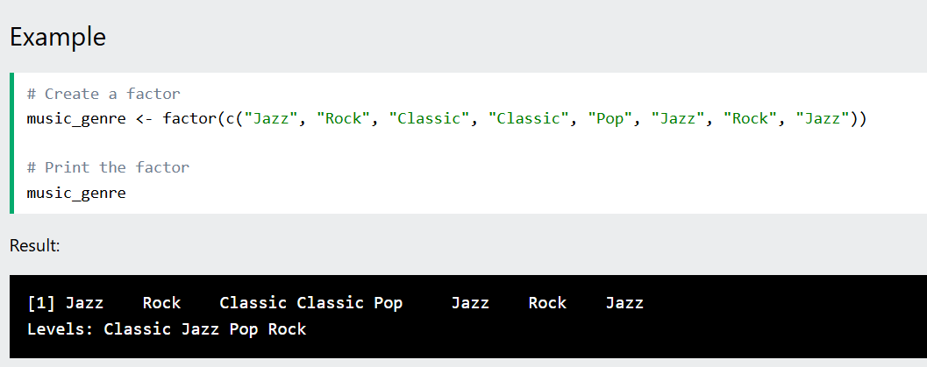
Factors
Factors are used to categorize data.
Examples of factors are:
  Demography: Male/Female
  Music: Rock, Pop, Classic, Jazz
  Training: Strength, Stamina
To create a factor, use the factor() function and add a vector as argument:

Slide 24
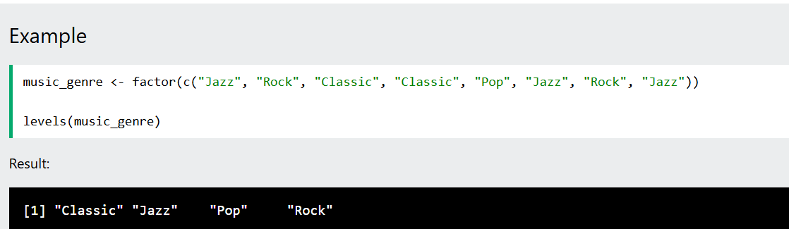
You can see from the example above that that the factor has four levels (categories): Classic, Jazz, Pop and Rock.
To only print the levels, use the levels() function:

Slide 25
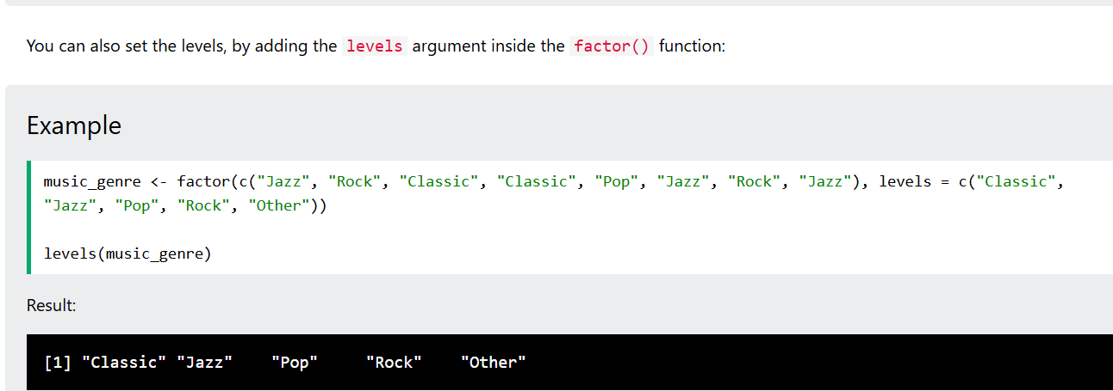

Slide 26
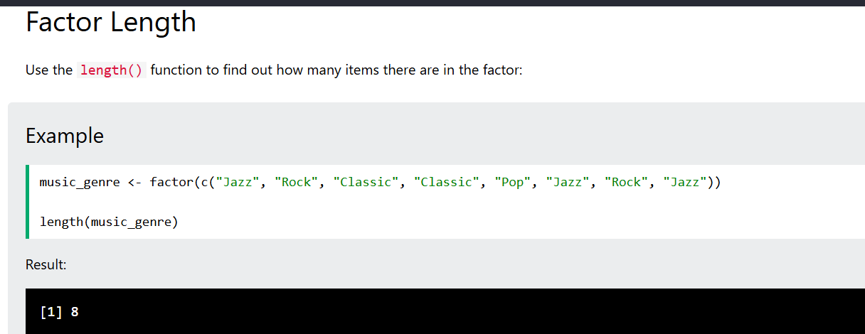

Slide 27
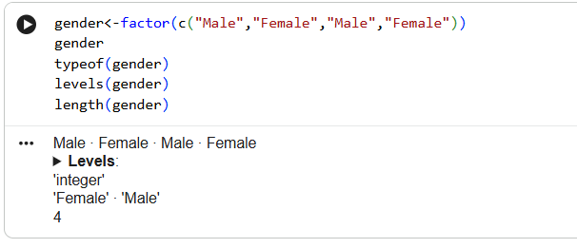
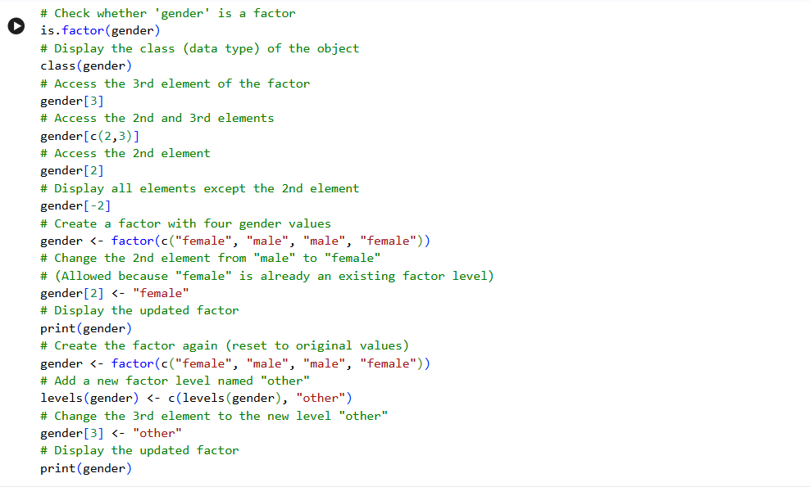

Slide 28
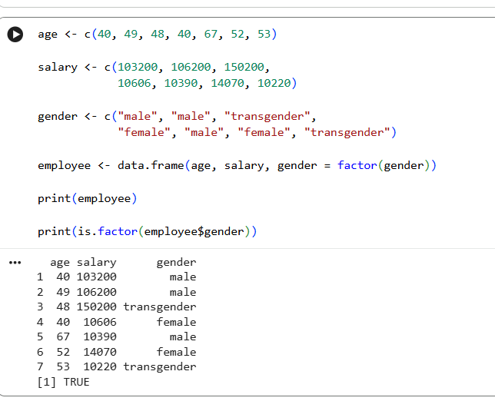

Slide 29
Vectors (1D, Homogeneous): A one-dimensional array containing elements of the same data type (e.g., numeric, character, logical).
Matrices (2D, Homogeneous): A two-dimensional rectangular data set where all columns contain the same mode of data.
Arrays (n-D, Homogeneous): An extension of matrices to more than two dimensions.
Lists (1D, Heterogeneous): A one-dimensional structure that can contain elements of different types, including other lists, vectors, or functions.
Data Frames (2D, Heterogeneous): The most common data structure for tabular data. It is a list of vectors of equal length. Each column can contain a different type of data (numeric, character, etc.), but within a single column, the data type must be the same.
Factors: A data structure used to handle categorical data, storing both the data values and the unique levels (categories) they belong to.

Slide 30
1.3 Help Functions in R
Navigating R's extensive documentation is a crucial skill for any programmer. R provides several built-in functions to access help files, documentation, and examples.
?function_name or help(function_name): Opens the official documentation page for a specific function. (e.g., ?mean or help(mean)).
??search_term or help.search("search_term"): Searches the documentation of all installed packages for a specific keyword if you don't know the exact function name. (e.g., ??regression).
example(function_name): Runs the examples listed at the bottom of the help documentation for a specific function. Extremely useful for seeing the code in action.
args(function_name): Displays the arguments (parameters) a function takes and their default values without opening the full help page. (e.g., args(read.csv)).
RSiteSearch("search_term"): Searches for the term in online R mailing lists, manuals, and CRAN packages. Opens the results in a web browser.
vignette(): Lists all available vignettes (detailed instructional documents/tutorials) for installed packages. Use vignette("dplyr") to read a specific one.

Slide 31
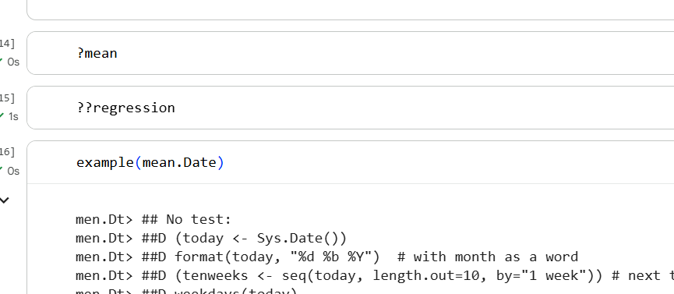

Slide 32
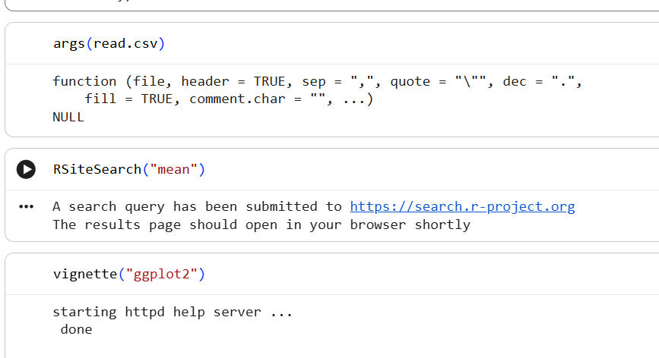

Slide 33
1.4 Vectors
Vectors are the most basic and arguably the most important data structure in R.
A vector is a collection of elements of the same basic data type (Atomic Vectors).
The primary atomic vector types are:
Logical: TRUE, FALSE
Integer: Whole numbers denoted with an 'L' (e.g., 5L, 10L)
Numeric (Double): Real numbers with decimals (e.g., 3.14, 10.0)
Complex: Complex numbers (e.g., 3 + 2i)
Character: Strings (e.g., "Hello", "Data")
If you attempt to mix different data types in a single vector, R will automatically coerce (convert) them into the most flexible type. Hierarchy of coercion: Logical -> Integer -> Numeric -> Complex -> Character.
R
mixed_vec <- c(TRUE, 5, "Hello")
# R coerces everything to character: "TRUE", "5", "Hello"

Slide 34
1.5 Scalars
In many programming languages, a "scalar" is a single data value (like the number 5 or the string "Hello"). In R, there is no true scalar data type. When you declare a single number in R, R treats it as a vector of length 1.
x <- 5
length(x) # Returns 1
is.vector(x) # Returns TRUE

Slide 35
1.6 Declarations
You cannot simply "declare" an empty variable without assigning something to it in R. Vectors are typically declared and instantiated using several functions:
1. The c() function (Combine/Concatenate): The most common way to create a vector.
my_numbers <- c(10, 20, 30, 40)
my_chars <- c("apple", "banana", "cherry")
2. The Colon Operator :: Generates a sequence of consecutive numbers.
one_to_ten <- 1:10 # Output: 1 2 3 4 5 6 7 8 9 10
countdown <- 5:-5 # Output: 5 4 3 2 1 0 -1 -2 -3 -4 -5
3. The seq() function: Generates a sequence with a specified step (increment).
# From 0 to 100, stepping by 20
by_twenties <- seq(from=0, to=100, by=20) # Output: 0 20 40 60 80 100
# Generating a specific length of numbers
five_nums <- seq(from=1, to=10, length.out=5) # Output: 1.00 3.25 5.50 7.75 10.00
4. The rep() function: Repeats a vector or element.
rep_thrice <- rep(c(1, 2), times=3) # Output: 1 2 1 2 1 2
rep_each <- rep(c(1, 2), each=3) # Output: 1 1 1 2 2 2
5. The vector() function: Initializes an empty vector of a specific mode and length. Pre-allocate memory for performance.
empty_vec <- vector(mode="numeric", length=5) # Output: 0 0 0 0 0 this mode can be logical, character etc.
7. Recycling
Recycling is a powerful, yet potentially dangerous, feature in R. When you perform operations on two vectors of unequal lengths, R automatically repeats (recycles) the elements of the shorter vector to match the length of the longer vector.

Slide 36
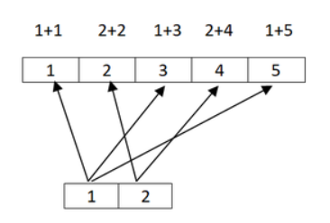
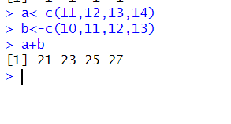
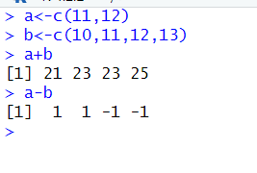
1.7 Vector Recycling
We can see vector recycling, when we perform some kind of operations like addition, subtraction. . . .etc on two vectors of unequal length.
The vector with a small length will be repeated as long as the operation completes on the longer vector.
If we perform an addition operation on a vector of equal length the first value of vector1 is added with the first value of vector 2 like that.
The image demonstrated operation on unequal vectors and operation on equal vector.
So, the repetition of small length vector as long as completion of operation on long length vector is known as vector recycling.
This is the special property of vectors is available in R language.

Slide 37
1.8 Common Vector Operations
Vectors are the most basic data types in R.
Even a single object created is also stored in the form of a vector.
Vectors are nothing but arrays as defined in other languages.
Vectors contain a sequence of homogeneous types of data.
If mixed values are given then it auto converts the data according to the precedence.
There are various operations that can be performed on vectors in R.

Slide 38
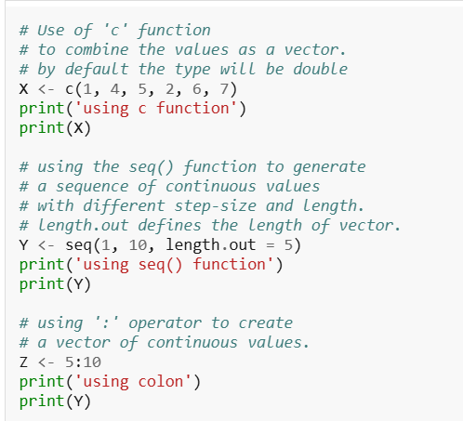
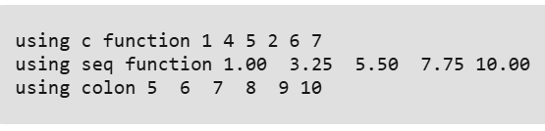
Creating a vector
Vectors can be created in many ways as shown in the following example. The most usual is the use of 'c' function to combine different elements together.

Slide 39
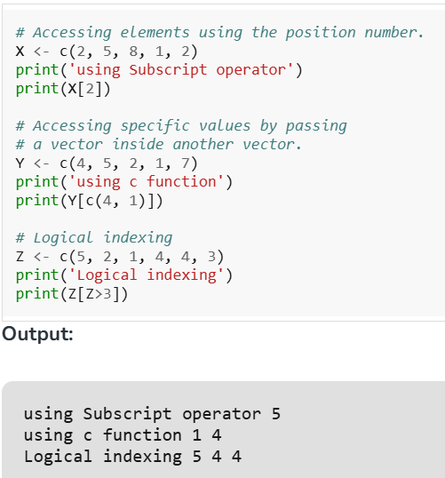
Accessing vector elements
Vector elements can be accessed in many ways. The most basic is using the '[]', subscript operator. Following are the ways of accessing Vector elements:

Slide 40
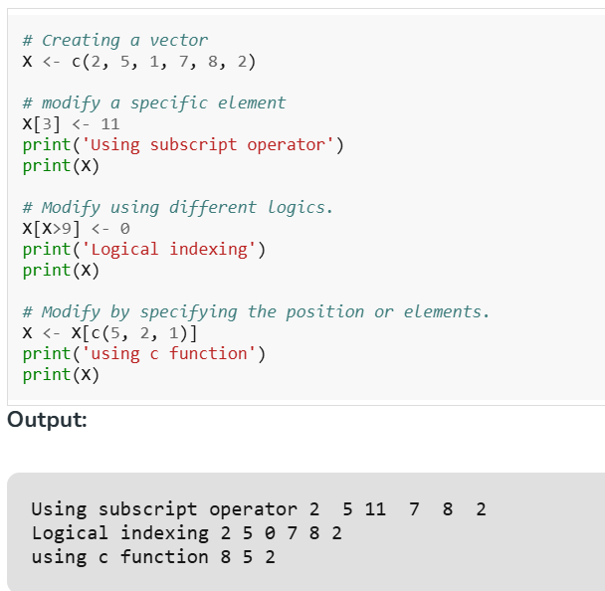
Modifying a vector
Vectors can be modified using different indexing variations which are mentioned in the below code:

Slide 41
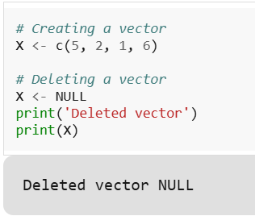
Deleting a vector
Vectors can be deleted by reassigning them as NULL. To delete a vector we use the NULL operator.

Slide 42
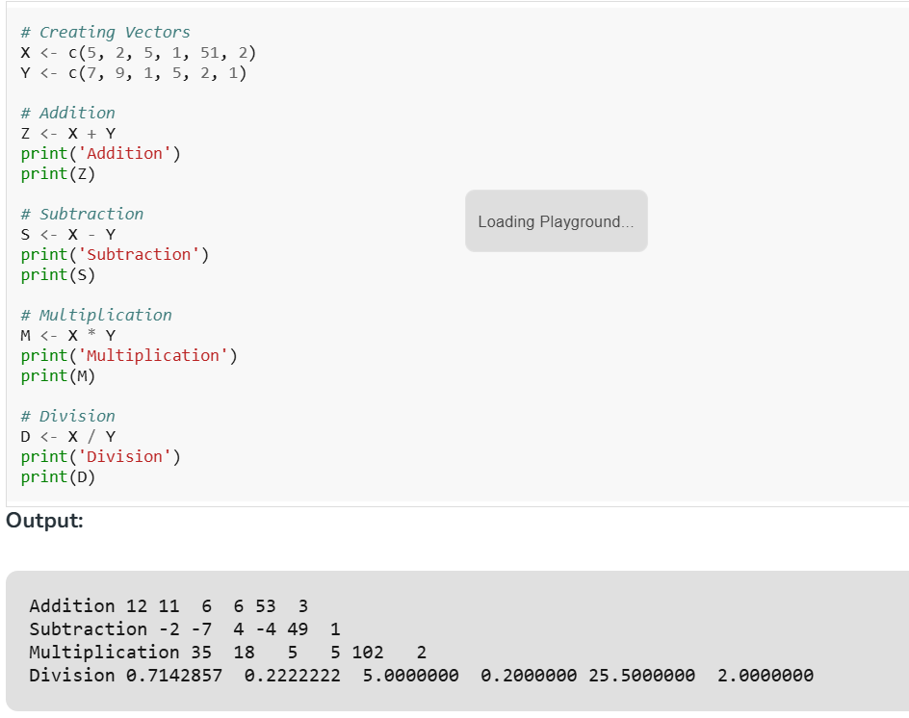
Arithmetic operations
We can perform arithmetic operations between 2 vectors. These operations are performed element-wise and hence the length of both the vectors should be the same.

Slide 43
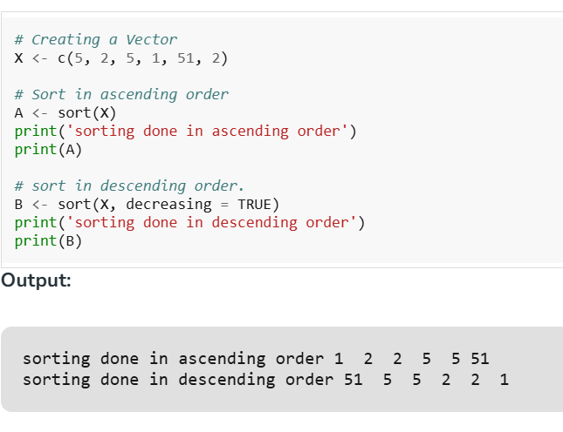
Sorting of Vectors
For sorting we use the sort() function which sorts the vector in ascending order by default.

Slide 44
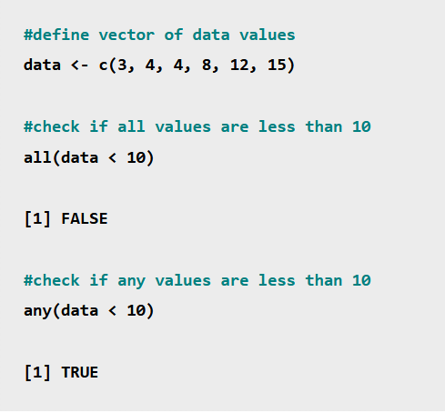
Using all and any
The all() and any() functions in R can be used to check if all or any values in a vector evaluate to TRUE for some expression.
We can use the following all() and any() functions to check if all or any values in a vector are less than 10:
The all() function evaluates to FALSE because not all values in the vector are less than 10.
The any() function evaluates to TRUE because at least one value in the vector is less than 10.

Slide 45
Vectorized operations
Suppose we have a function f() that we wish to apply to all elements of a vector x.
In many cases, we can accomplish this by simply calling f() on x itself.
This can really simplify our code and, moreover, give us a dramatic performance increase of hundreds fold or more.
One of the most effective ways to achieve speed in R code is to use operations that are vectorized, meaning that a function applied to a vector is actually applied individually to each element.
Vectorized Operations in R—which allow you to perform operations on entire datasets at once, without the need for explicit loops. Vectorization is a powerful feature in R that makes your code run faster, cleaner, and more efficient.

Slide 46
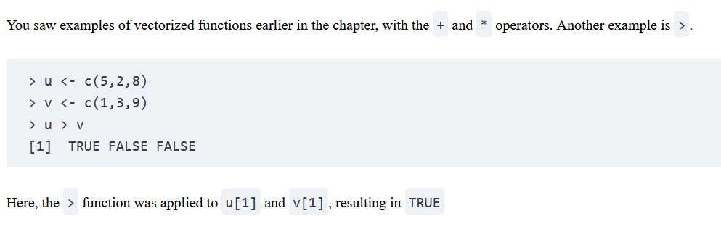
Vector In, Vector Out

Slide 47
Why Vectorization is Better Than Loops in R
1. Speed and Efficiency
R is designed to operate on entire vectors, matrices, and data frames at once. When you use vectorized operations, R processes the data in native C code, which is much faster than processing data element by element through loops.
2. Less Memory Usage
Loops create intermediate copies of objects at each iteration, which can consume a lot of memory, especially with large datasets. Vectorized operations avoid this by operating on entire objects without creating copies.
3. Cleaner, More Readable Code
Using vectorized operations makes your code more concise and easier to understand. It reduces the need for cumbersome for or while loops, leading to cleaner, more readable scripts.

Slide 48
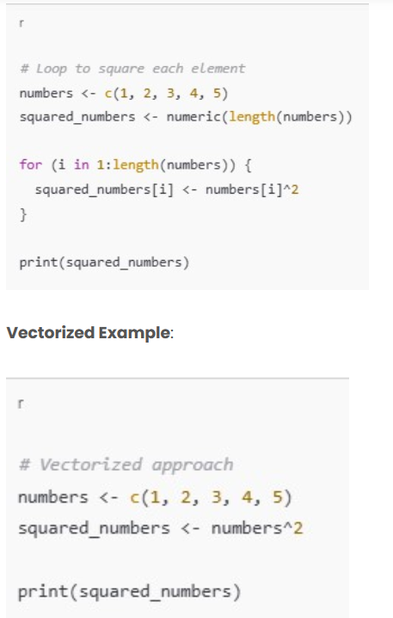
How to Avoid Loops with Vectorized Operations
1. Basic Arithmetic Operations
Instead of using a loop to perform an operation on each element of a vector, you can directly apply the operation to the entire vector.

Slide 49
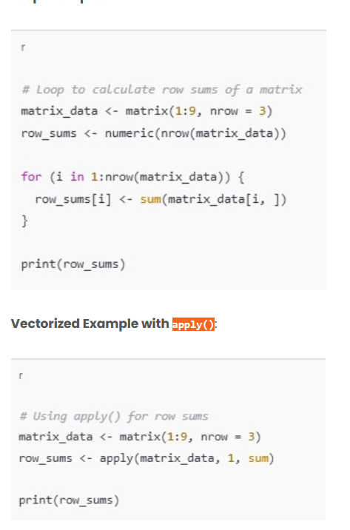
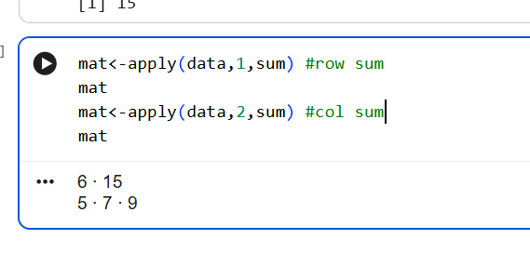
Using apply() Functions for Matrices and Data Frames
If you’re working with a matrix or data frame, the apply() function can help you avoid loops. It applies a function to the rows or columns of a matrix or data frame, providing a concise, efficient way to perform operations.

Slide 50
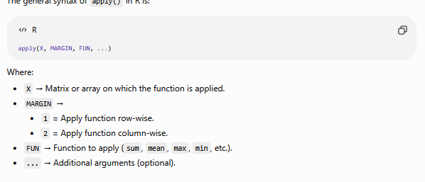

Slide 51
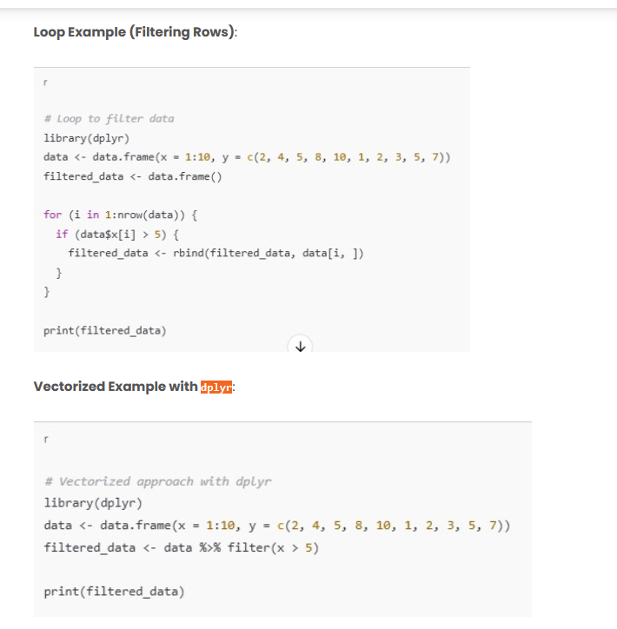
Using dplyr for Data Wrangling
For data manipulation tasks such as filtering, mutating, and summarizing data, dplyr provides a set of highly optimized functions that can replace loops.
The filter() function from dplyr performs the operation on the entire dataset at once, without the need for looping through rows.

Slide 52
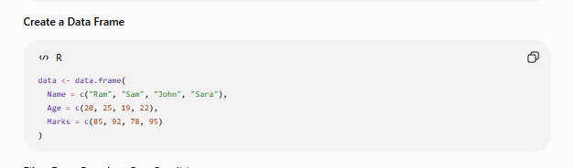

Slide 53
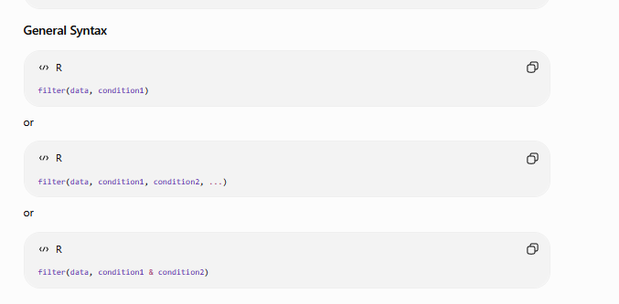

Slide 54
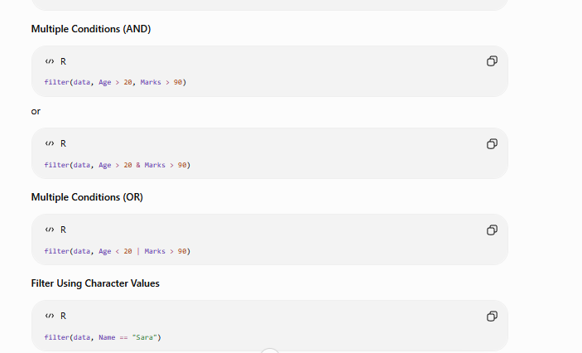

Slide 55
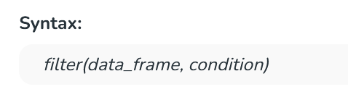
Filtering
Filtering is the act of choosing a subset of your current data that fits some criteria.
In R, this is the act of selecting/discarding certain rows from a dataframe.
The filter method in R is used to select specific rows from a data frame that meet certain conditions.
It helps us work with only the data we need, making analysis easier and faster.
We use it when we want to find rows that match some rules or values.

Slide 56
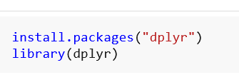
Implementation of filter Method
1. Install then load the dplyr package
We first install and then load the dplyr package to use the filter method.
install.packages: This function is used to install external R packages.
library: This is used to load an installed package so we can use its functions.
dplyr: A package in R that helps in data manipulation and filtering.

Slide 57
2. 2. Creating a sample dataset
We create a simple data frame of employees using basic R functions.
data.frame: Creates a table-like structure where we can store related data in columns.
c: Combines multiple values into a single vector or list.
print: Displays the data or output in the console.

Slide 58
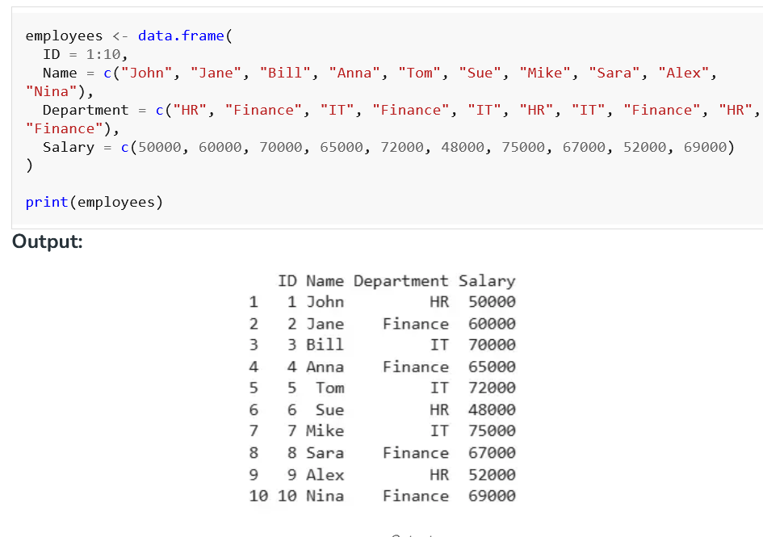

Slide 59
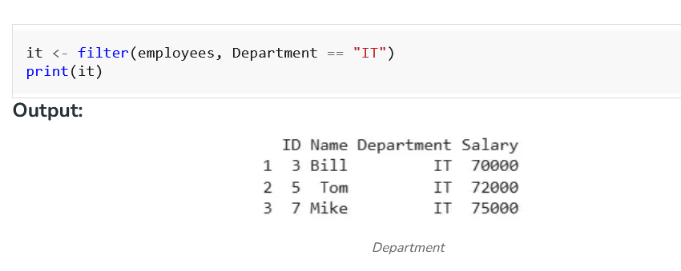
3. Filtering rows with one condition
We filter employees whose department is IT.
filter: Selects only the rows that match the condition we give.
==: Checks if two values are equal.

Slide 60
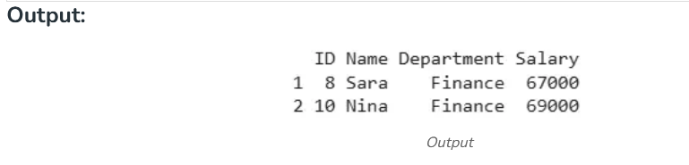
4. Filtering rows with multiple conditions
We filter employees from Finance who have a salary more than 65000.
&: Means both conditions must be true.
>: Checks if a value is greater than the given number.
high_paid_finance_employees <- filter(employees, Department == "Finance" & Salary > 65000)
print(high_paid_finance_employees)

Slide 61
5. Filtering with or and in
We filter employees who are in either HR or IT andalso use %in% for filtering multiple values.
|: Means either one of the conditions must be true.
%in%: Checks if a value exists in a list of values.
%>%: Passes the output of one function to the next function.

Slide 62
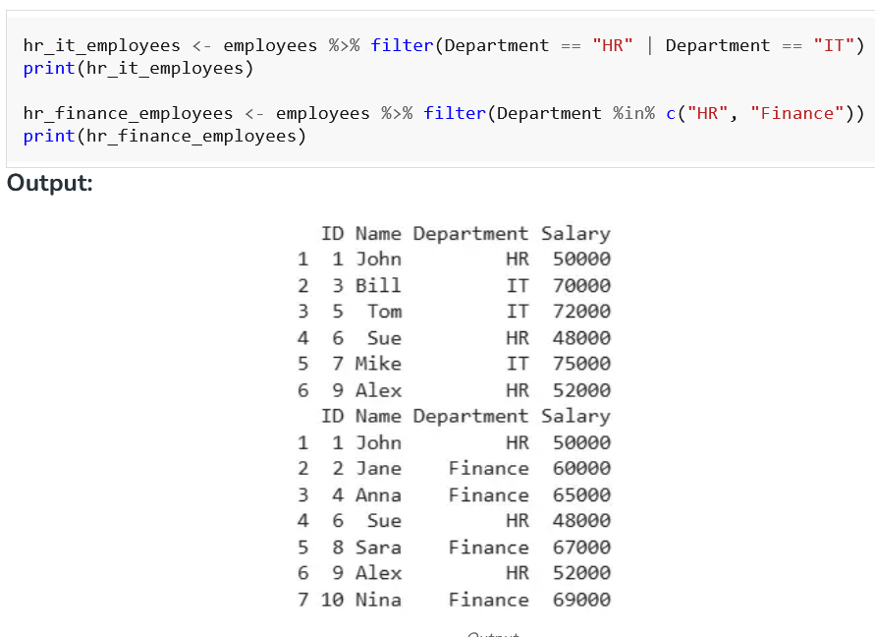

Slide 63
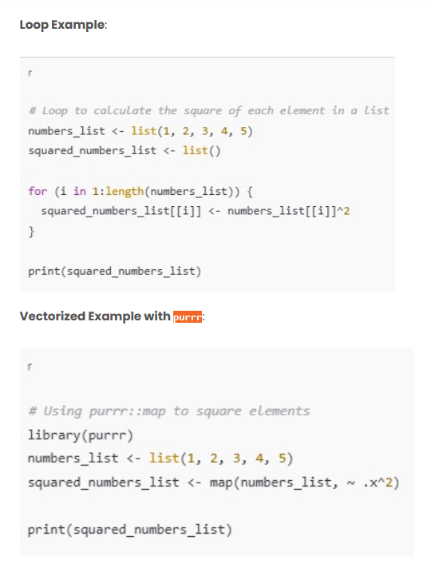
Using purrr for List Operations
The purrr package is part of the Tidyverse and provides a set of functions for functional programming. It is particularly useful for applying functions over lists or vectors in a concise, efficient manner.
purrr::map() is designed for this kind of task, and it internally uses Vectorized Operations in R, making the code more efficient and concise.

Slide 64
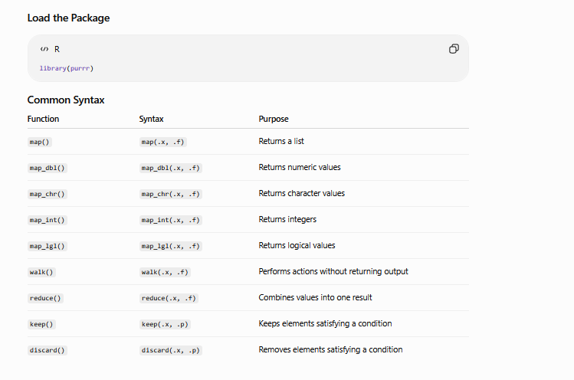

Slide 65
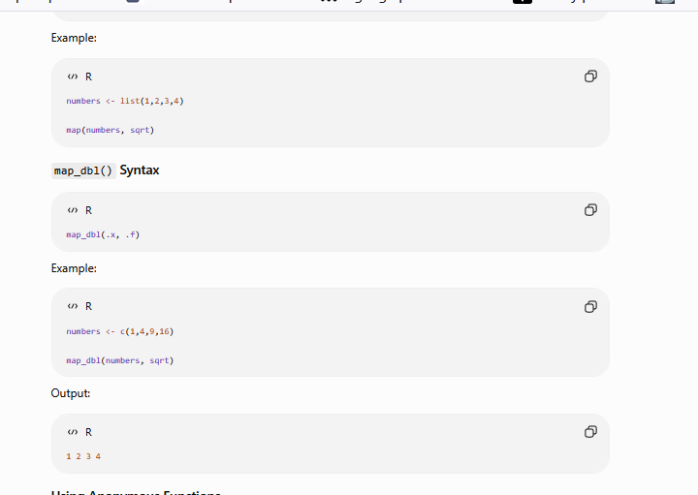

Slide 66
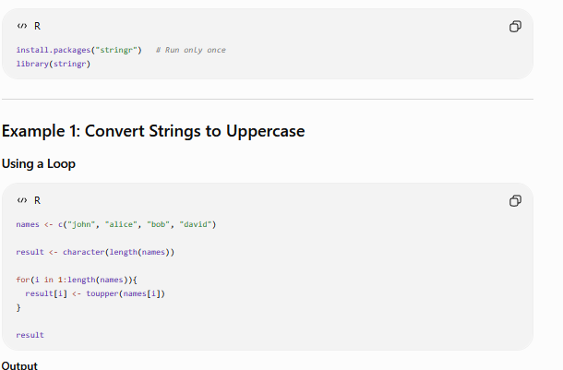
Vectorized String Operations with stringr
Another common use case where you might think of using loops is when working with strings.
The stringr package offers vectorized functions for string manipulation, making it easier to work with character data.
Why this is better: stringr handles the Vectorized Operations in R string operations internally, offering a simple and efficient way to manipulate strings.

Slide 67
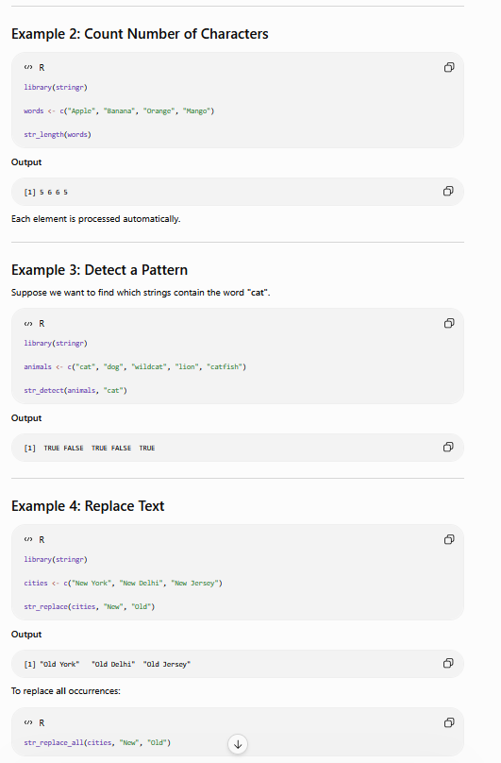

Slide 68
Function | Purpose
str_to_upper() | Convert text to uppercase
str_to_lower() | Convert text to lowercase
str_length() | Count characters
str_detect() | Find a pattern
str_replace() | Replace first occurrence
str_replace_all() | Replace all occurrences
str_extract() | Extract matching text
str_trim() | Remove leading/trailing spaces

Slide 69
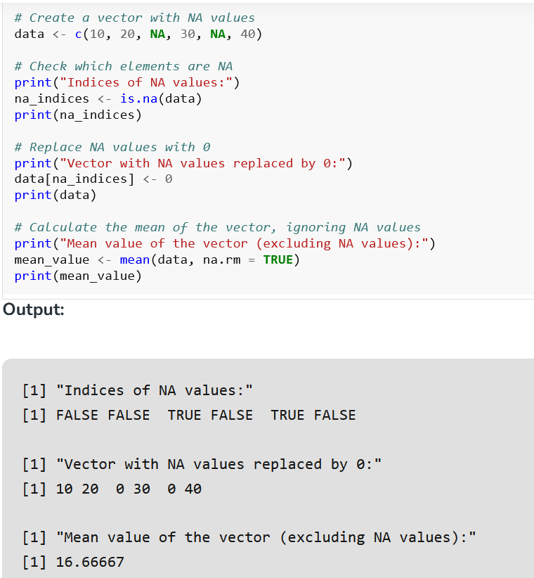
NA and NULL values
What is NA?
NA stands for "Not Available." It's like a placeholder for when data is missing or doesn't exist.
For example, suppose we're creating a list of students' ages, and one student hasn't provided their age.
In the dataset, that missing age would be marked as NA.

Slide 70

What is NaN ?
NaN stands for "Not a Number." It's used to show when a math operation doesn't give a meaningful result. For example, if we try to divide zero by zero or take the square root of a negative number, we'll get NaN.

Slide 71

Difference between NA and NAN
Aspect | NA | NaN
Definition | Not Available | Not a Number
Data Type | Any data type | Numeric
Meaning | Indicates missing data | Indicates an undefined numerical result
Usage | Used for missing or unavailable data | Used for invalid/undefined mathematical operations
Behavior in operations | Spreads through computations involving NA values | Spreads and contaminates numerical calculations
Example | x <- c(1, 2, NA, 4) | 0/0

Slide 72
Vectorized if-then else
Vectorized operations are a powerful feature that allows you to apply functions or operations over entire vectors at once, rather than looping through each element individually.
The ifelse() function is a primary tool for creating vectorized if statements in R
Used to create vectorized conditional statements. It applies a test condition across each element of a vector and returns one value for TRUE elements and another for FALSE elements.
Vectorization in R means that operations are applied element-wise across entire vectors or arrays without the need for explicit loops. This leads to more concise and efficient code.

Slide 73


Slide 74


Slide 75


Slide 76

Handling NA Values with ifelse()
ifelse() can also handle NA values in a vectorized manner.

Slide 77
The ifelse() function in R is a powerful tool for creating vectorized if statements, allowing you to apply conditional logic across entire vectors efficiently. It’s particularly useful for simple, element-wise checks and transformations. For more complex operations, alternative approaches like loops or lapply() might be more appropriate.

Slide 78

Vector Equality
Method 1: Using variance
We can say that all vector elements are equal if the variance is zero. We can find variance by using the var() function

Slide 79

Method 2: Using length() and unique() function
By using unique function if all the elements are the same then the length is 1 so by this way if the length is 1, we can say all elements in a vector are equal.

Slide 80
Vector Element names
The elements of a vector can optionally be given names. For example, say we have a 50-element vector showing the population of each state in the United States.
We could name each element according to its state name, such as "Montana" and "New Jersey".
This in turn might lead to naming points in plots, and so on.
We can assign or query vector element names via the names() function:

Slide 81


Slide 82


