Slide 1



AARUPADAI VEEDU INSTITUTE OF TECHNOLOGY
(Constituent College of Vinayaka Mission's Research Foundation – Deemed to be University)
Department of Computer Science and Engineering
Course Code: 35021P28
Course Title: R Programming
Category: CC | L-T-P: 3-0-0 | Credits: 3
COURSE INSTRUCTOR: Dr. S. Pitchumani Angayarkanni
Professor, Department of CSE, AVIT

Slide 2
COURSE OUTCOMES
On the successful completion of the course, students will be able to
CO2: To Understand the use of R for Big Data analytics | Understand & Apply
MATRICES, ARRAYS AND LISTS
Creating matrices – Matrix operations – Applying Functions to Matrix Rows and Columns – Adding and deleting rows and columns – Vector/Matrix Distinction – Avoiding Dimension Reduction – Higher Dimensional arrays – lists – Creating lists – General list operations – Accessing list components and values – applying functions to lists – recursive lists

Slide 3
R PROGRAMMING
Matrices, Arrays and Lists
Structures, operations, functionals, and recursive data in R
Matrices
Apply Functions
rbind / cbind
Arrays (N-D)
Lists
Recursion
Unit 2 • R Programming

Slide 4
ROADMAP
What We'll Cover
1
Creating matrices
7
Higher-dimensional arrays
2
Matrix operations
8
Lists — creation, access, apply, recursion
3
Applying functions to rows & columns
9
Type & membership checks, which()
4
Adding & deleting rows/columns
10
Map / Reduce / Filter
5
Vector / matrix distinction
11
Matrices vs arrays vs lists + worked programs
6
Avoiding dimension reduction
12
Big data & analytics use cases
R Programming | Unit: Matrices, Arrays & Lists
2

Slide 5
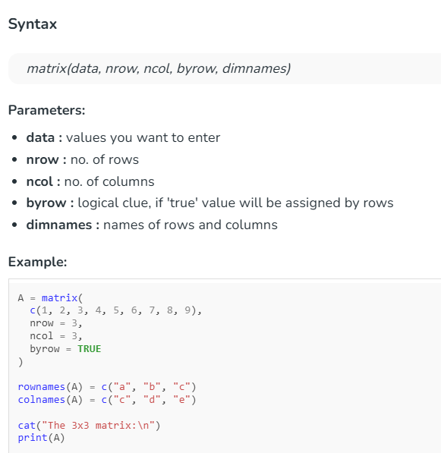
FUNDAMENTALS
Creating Matrices
A matrix is a two-dimensional array where every element shares the same data type.
Built with matrix(), or by giving a vector a dim attribute.
Default fill order is column-major; set byrow = TRUE to fill across rows instead.
nrow / ncol set shape; dimnames() names rows and columns.
> m <- matrix(1:6, nrow = 2, ncol = 3)
> m
[,1] [,2] [,3]
[1,] 1 3 5
[2,] 2 4 6
> m2 <- matrix(1:6, nrow = 2, byrow = TRUE)
> dim(m2) <- c(3, 2) # reshape via dim<-
> rownames(m) <- c('r1','r2')
> colnames(m) <- c('c1','c2','c3')
R Programming | Unit: Matrices, Arrays & Lists
3

Slide 6
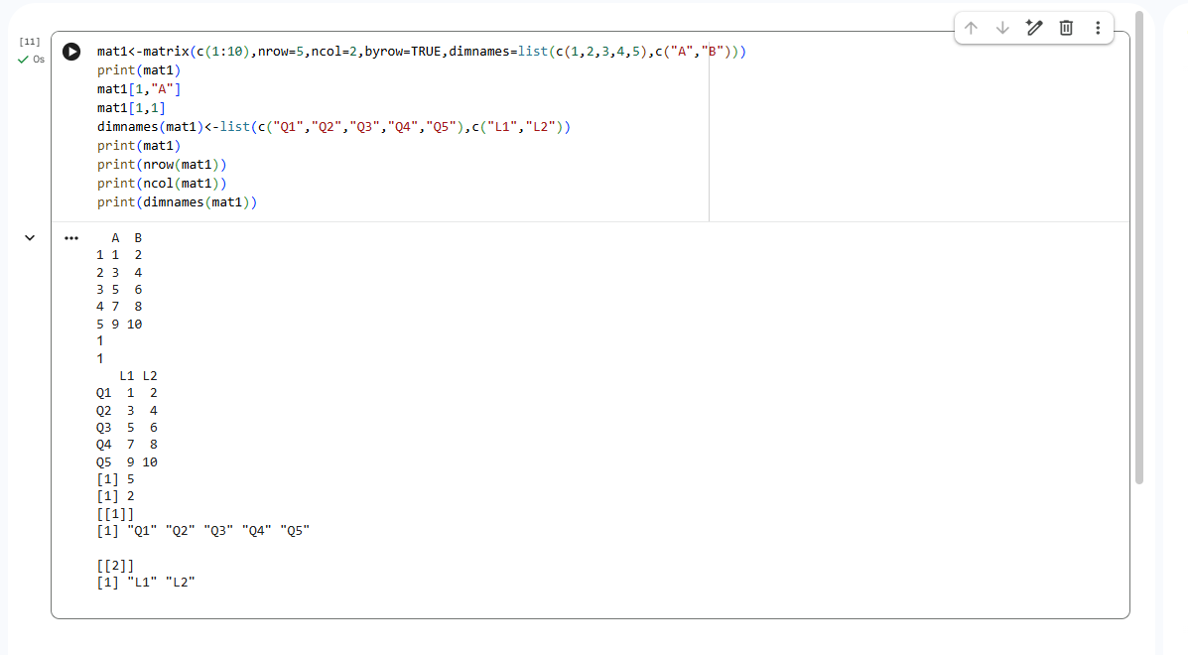

Slide 7
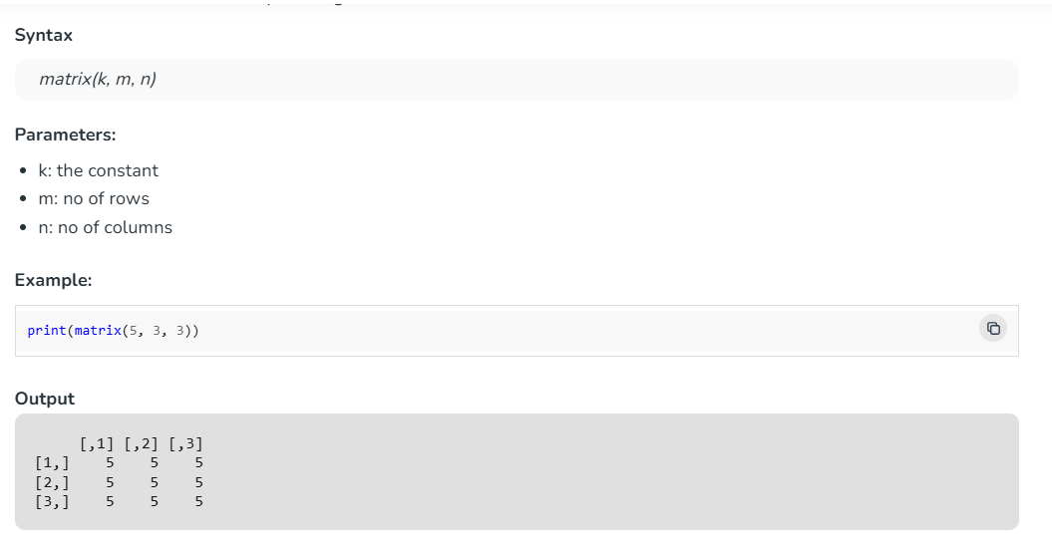
2.1 Matrix where all rows and columns are filled by a single constant 'k'

Slide 8
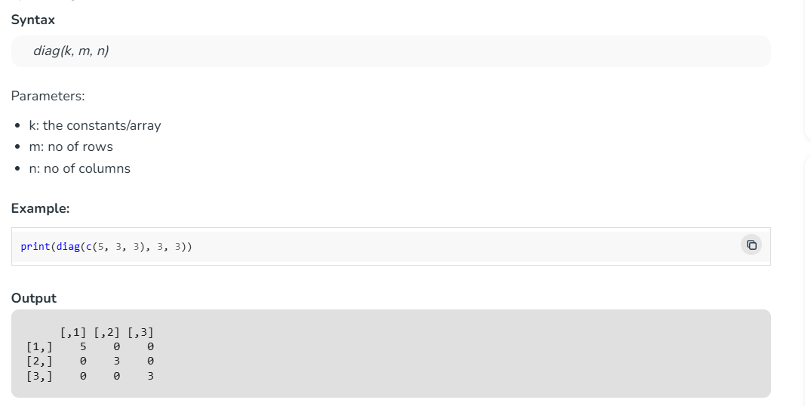
2.2 Diagonal matrix
A diagonal matrix is a matrix in which the entries outside the main diagonal are all zero. To create such a R matrix the syntax is given below:

Slide 9
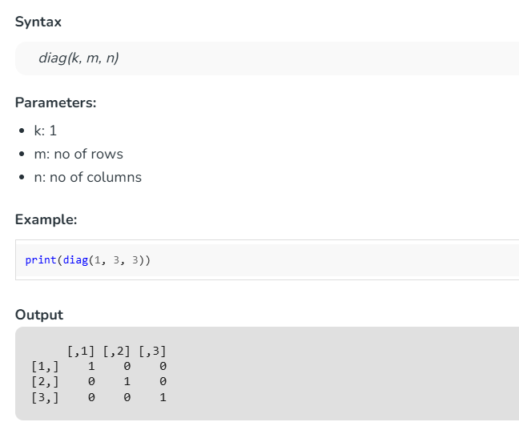
2.3 Identity matrix
An identity matrix in which all the elements of the principal diagonal are ones and all other elements are zeros. To create such a R matrix the syntax is given below:

Slide 10
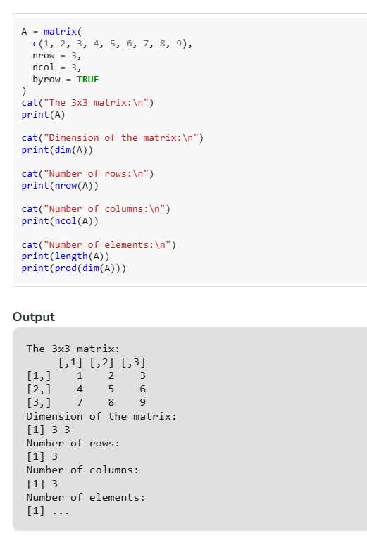
2.4. Matrix Metrics
Matrix metrics tell you about the Matrix you created. You might want to know the number of rows, number of columns, dimensions of a Matrix.
Below Example will help you in answering following questions:
How can you know the dimension of the matrix?
How can you know how many rows are there in the matrix?
How many columns are in the matrix?
How many elements are there in the matrix?

Slide 11
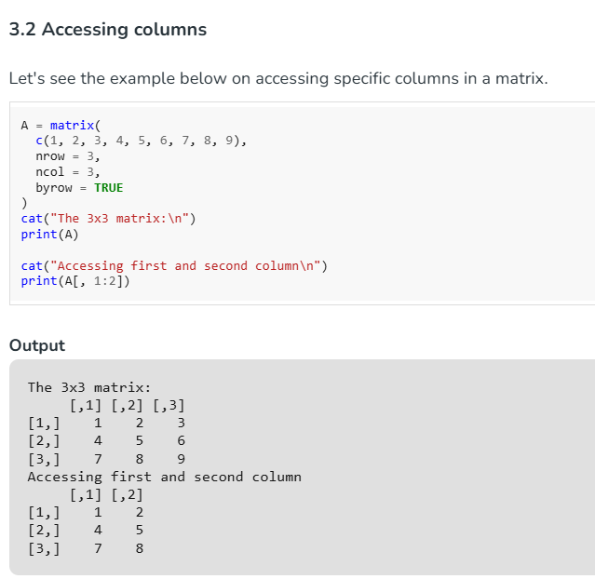
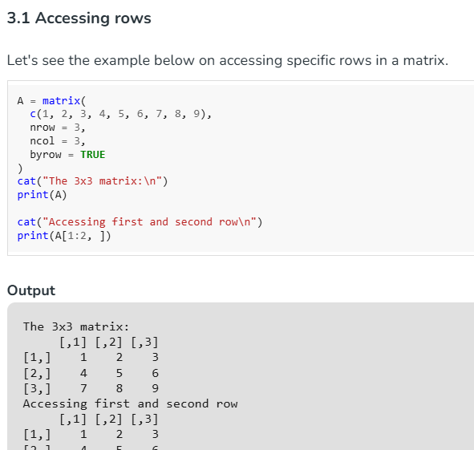
Accessing Elements of a Matrix
We can access elements in the R matrices using the same convention that is followed in data frames. So, we will have a matrix and followed by a square bracket with a comma in between array. Value before the comma is used to access rows and value that is after the comma is used to access columns.

Slide 12
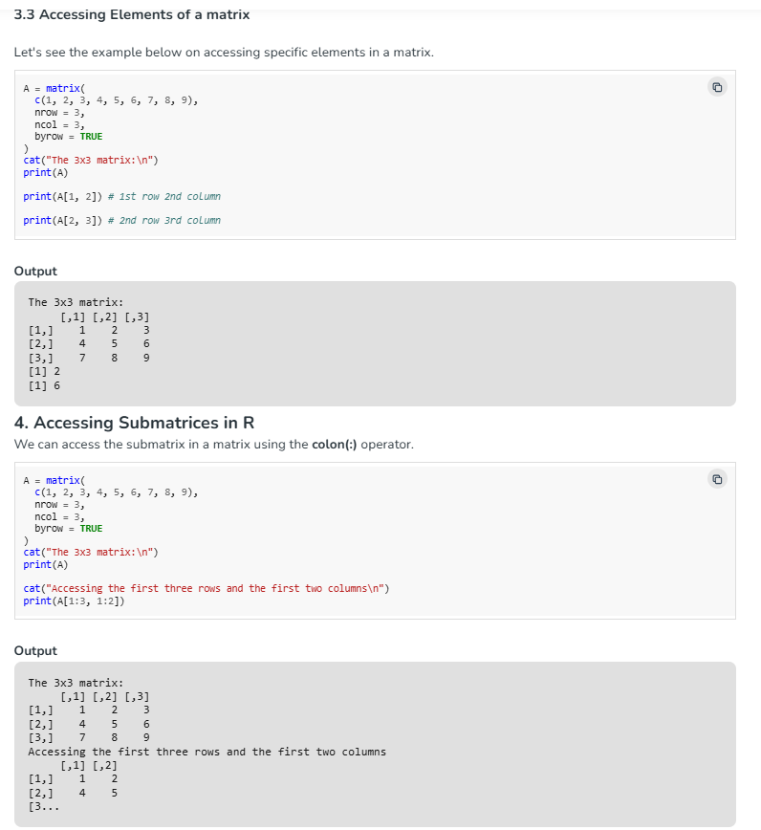
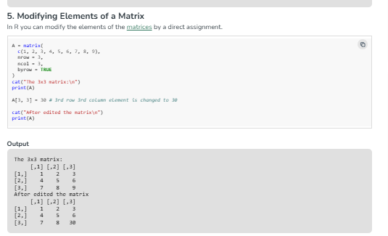

Slide 13
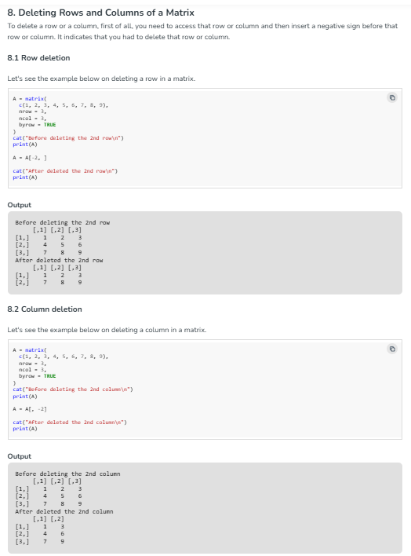

Slide 14
WORKING WITH MATRICES
Matrix Operations — Arithmetic
+ , - , *
> a <- matrix(1:4, 2, 2)
> b <- matrix(5:8, 2, 2)
> a + b # element-wise
> a %*% b # matrix product
> t(a) # transpose
> solve(a) # matrix inverse
> det(a) # determinant
> diag(a) # extract diagonal
> diag(3) # 3x3 identity matrix
> a == b # element-wise compare
Element-wise addition, subtraction, multiplication
%*%
True matrix (inner product) multiplication
t(m)
Transpose — rows become columns
m %o% n
Outer product of two vectors
R Programming | Unit: Matrices, Arrays & Lists
4

Slide 15
FUNCTIONALS
Applying Functions to Rows and Columns
apply(X, MARGIN, FUN, ...)
> m <- matrix(1:6, nrow = 2)
> apply(m, 1, sum) # row sums
[1] 9 12 15
> apply(m, 2, sum) # column sums
[1] 3 7 11
> apply(m, 1, function(x) x^2)
# convenience shortcuts:
> rowSums(m); colSums(m)
> rowMeans(m); colMeans(m)
•
MARGIN = 1 Apply FUN to each row
•
MARGIN = 2 Apply FUN to each column
•
MARGIN = c(1,2) Apply FUN to every element
Returns a vector, matrix, or list depending on what FUN produces for each margin.
R Programming | Unit: Matrices, Arrays & Lists
5

Slide 16
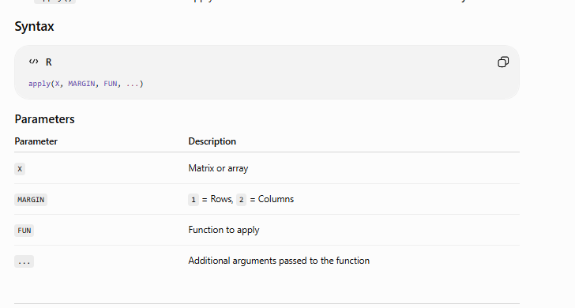

Slide 17
RESHAPING
Adding and Deleting Rows and Columns
Add
Key idea
> m <- rbind(m, c(7, 8, 9)) # add a row
> m <- cbind(m, c(10, 11)) # add a column
> m <- rbind(m, new = c(1,2,3))
> m <- cbind(m, total = rowSums(m))
rbind() and cbind() do not modify a matrix in place — they return a new matrix that must be reassigned.
Negative indices remove elements; there is no dedicated delete function.
rbind/cbind can combine matrices of matching dimensions, not just add a single row or column.
Growing a matrix repeatedly in a loop is inefficient — preallocate when the final size is known.
Delete
> m <- m[-1, ] # delete row 1
> m <- m[, -2] # delete column 2
> m <- m[-c(1,3), ] # delete rows 1 & 3
R Programming | Unit: Matrices, Arrays & Lists
6

Slide 18
UNDER THE HOOD
Vector / Matrix Distinction
A matrix is a vector
> v <- 1:6
> is.matrix(v)
[1] FALSE
> dim(v) <- c(2, 3)
> is.matrix(v)
[1] TRUE
> attributes(v)
$dim
[1] 2 3
> class(1:6) # "integer"
> class(matrix(1:6,2))# "matrix" "array"
In R, a matrix is simply an atomic vector with a dim attribute attached.
is.matrix(x) is TRUE only when dim has length 2.
attributes(m) reveals the dim (and dimnames) attribute behind the matrix.
R Programming | Unit: Matrices, Arrays & Lists
7

Slide 19
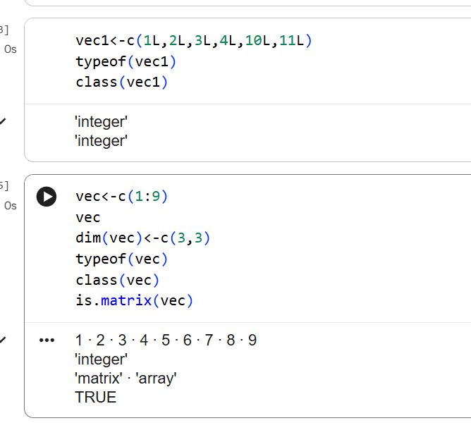

Slide 20
A COMMON GOTCHA
Avoiding Dimension Reduction
Extracting a single row or column drops the matrix down to a plain vector by default.
This is called dimension reduction and can silently break code expecting a matrix.
Fix it with drop = FALSE inside the [ ] index.
Same idea applies to data frames — [ , j] drops, [ , j, drop=FALSE] keeps shape.
> m <- matrix(1:6, nrow = 2)
> m[1, ]
[1] 1 3 5 # dropped to a vector
> is.matrix(m[1, ])
[1] FALSE
> m[1, , drop = FALSE]
[,1] [,2] [,3]
[1,] 1 3 5
> is.matrix(m[1, , drop = FALSE])
[1] TRUE
R Programming | Unit: Matrices, Arrays & Lists
8

Slide 21
BEYOND TWO DIMENSIONS
Higher-Dimensional Arrays
array() generalizes matrix() to any number of dimensions.
The dim argument is a vector giving the size of each dimension.
Elements are still stored in one contiguous vector, filled in column-major order across the first dimension, then the next.
Index with one comma per dimension: a[i, j, k].
> a <- array(1:24, dim = c(2, 3, 4))
> dim(a)
[1] 2 3 4
> a[1, 2, 3] # single element
> a[, , 1] # first 2x3 'slice'
> a[1, , ] # a 3x4 matrix
> apply(a, 3, sum) # sum each slice
> dimnames(a) <- list(
c('r1','r2'), c('c1','c2','c3'),
c('t1','t2','t3','t4'))
R Programming | Unit: Matrices, Arrays & Lists
9

Slide 22
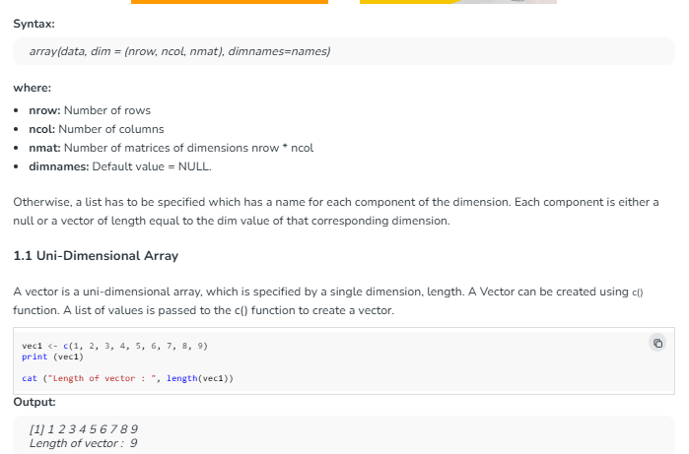
1. Creating an Array
An R array can be created with the use of array() the function. A list of elements is passed to the array() functions along with the dimensions as required.

Slide 23
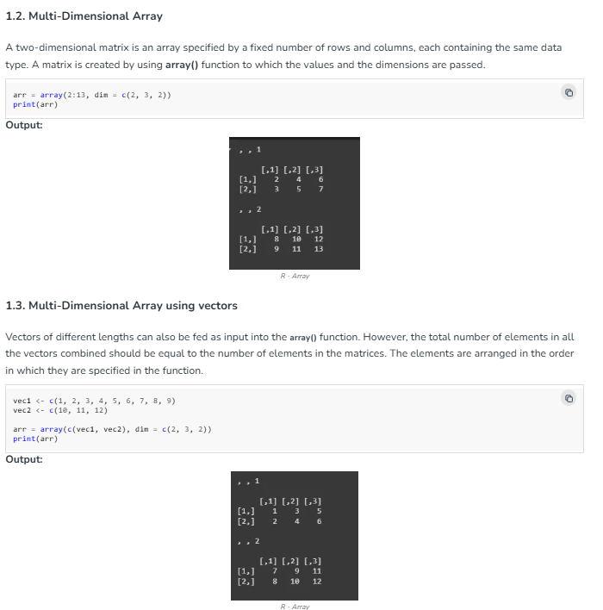

Slide 24
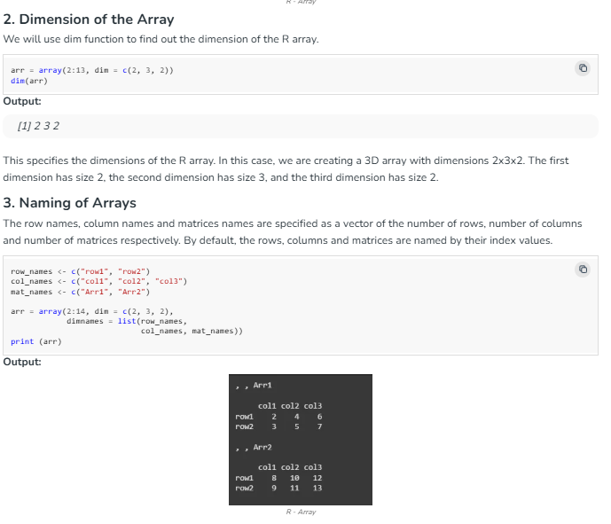

Slide 25
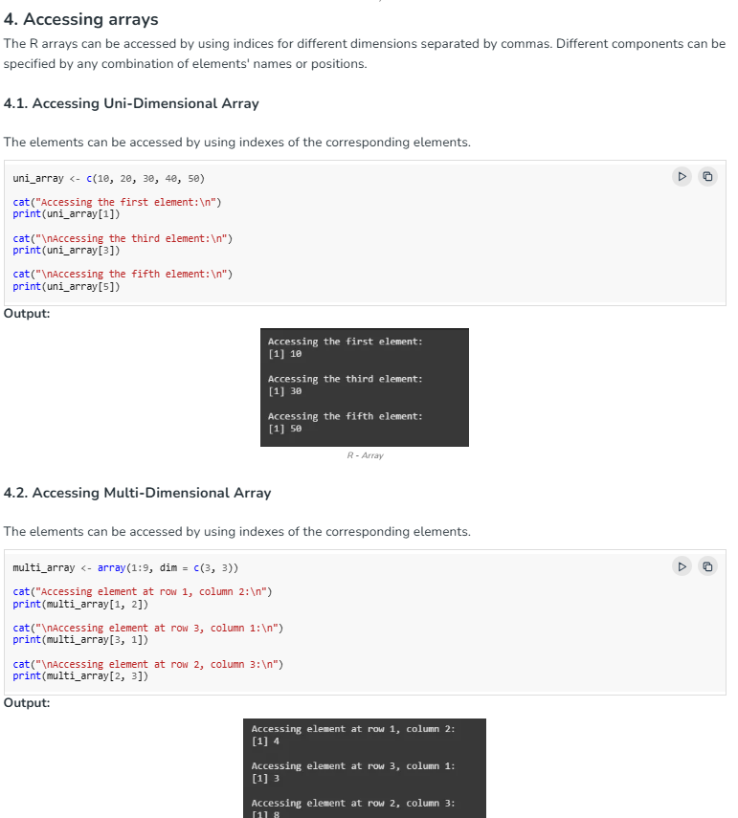

Slide 26
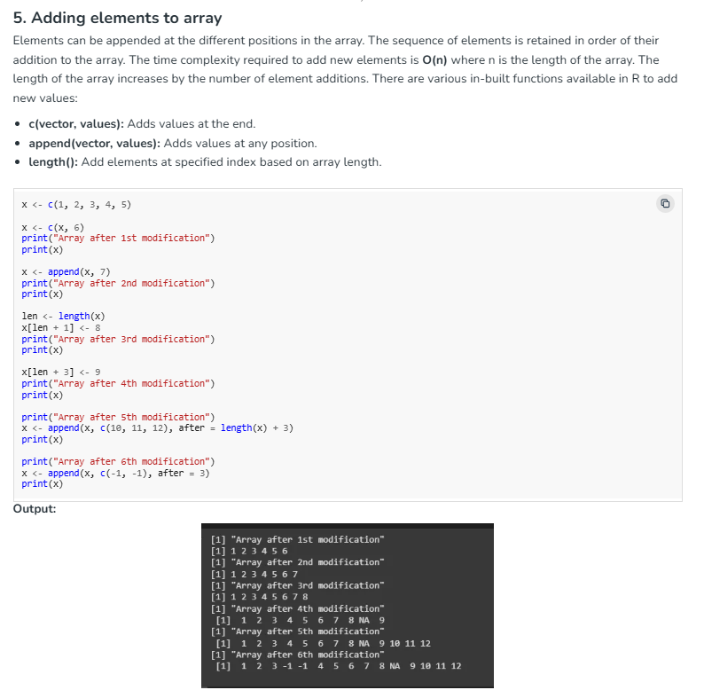

Slide 27
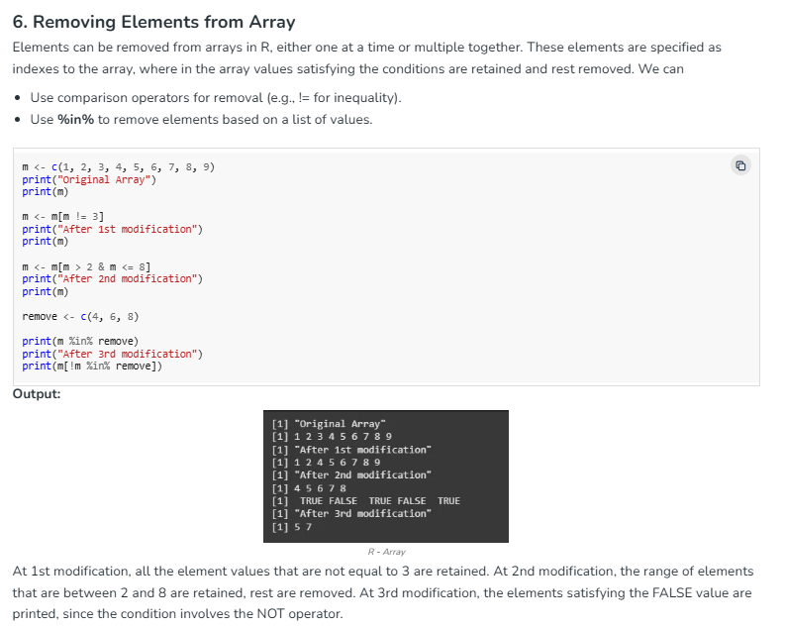

Slide 28
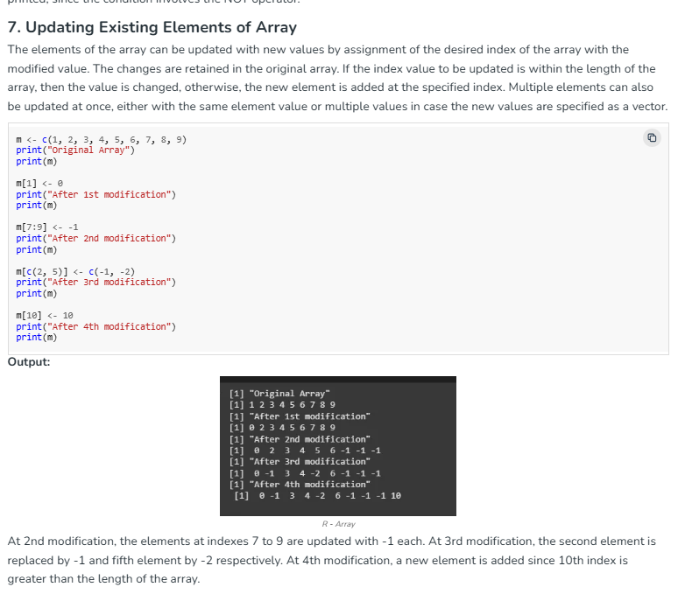

Slide 29
A NEW STRUCTURE
Lists — Creating Lists
A list is R's general-purpose container: each component can hold a different type and length.
Built with list(), optionally naming each component.
Components can themselves be vectors, matrices, functions, or other lists.
> mylist <- list(name = 'Aravind',
scores = c(88, 92, 79),
passed = TRUE)
> mylist
$name
[1] "Aravind"
$scores
[1] 88 92 79
$passed
[1] TRUE
> str(mylist) # compact structure view
A vector must hold one type; a list can mix types — that's the core distinction.
R Programming | Unit: Matrices, Arrays & Lists
10

Slide 30
WORKING WITH LISTS
General List Operations
length(lst)
Number of top-level components
> lst <- list(a = 1:3, b = 'x', c = TRUE)
> length(lst)
[1] 3
> names(lst)
[1] "a" "b" "c"
> lst$d <- list(1, 2) # add component
> lst$b <- NULL # remove component
> combined <- c(list(x=1), list(y=2))
> unlist(list(1, 2, 3))
[1] 1 2 3
names(lst)
Get or set component names
c(lst1, lst2)
Concatenate lists together
unlist(lst)
Flatten a list into a vector
rapply()
Recursively apply a function
R Programming | Unit: Matrices, Arrays & Lists
11

Slide 31
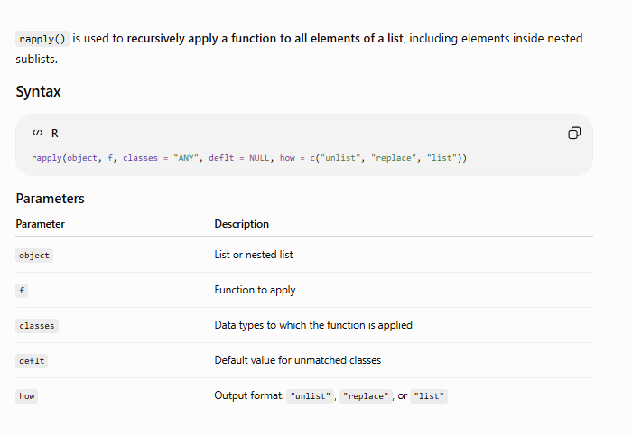

Slide 32
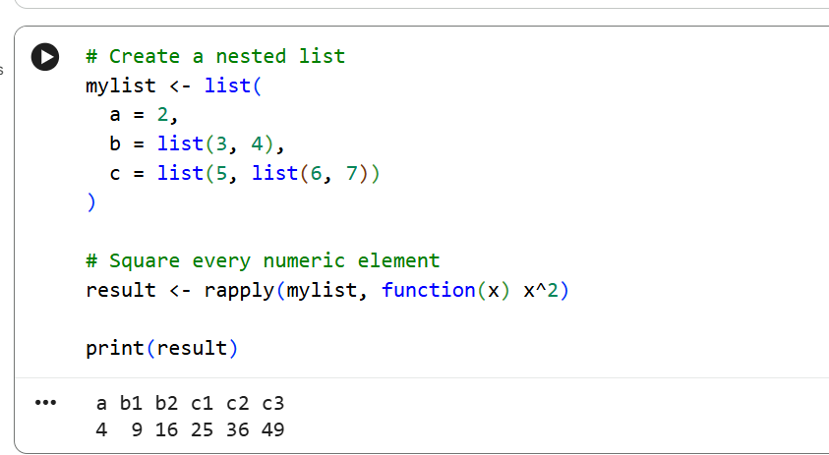

Slide 33
INDEXING RULES
Accessing List Components and Values
1
lst[i]
> lst <- list(name='R', ver=4.4, ok=TRUE)
> lst[1] # a list of length 1
$name
[1] "R"
> lst[[1]] # the character value
[1] "R"
> lst$ver # 4.4
> lst[["ver"]] # 4.4
> lst[c(1,3)] # multiple components
Single bracket — returns a sub-list
2
lst[[i]]
Double bracket — returns the value itself
3
lst$name
Dollar sign — returns the value by name
4
lst[["name"]]
Double bracket by name — same result as $
Single [ ] keeps list-ness; double [[ ]] unwraps to the content.
R Programming | Unit: Matrices, Arrays & Lists
12

Slide 34
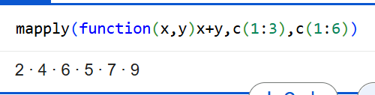
FUNCTIONALS FOR LISTS
Applying Functions to Lists
lapply(lst, FUN)
> lst <- list(a = 1:3, b = 4:6, c = 7:9)
> lapply(lst, sum)
$a [1] 6 $b [1] 15 $c [1] 24
> sapply(lst, sum)
a b c
6 15 24
> sapply(lst, range) # simplifies to matrix
> mapply(function(x,y) x+y, 1:3, 4:6)
Apply FUN to each element — always returns a list
sapply(lst, FUN)
Like lapply, but simplifies to a vector/matrix when possible
vapply(lst, FUN, T)
Like sapply, with an enforced return type/length
mapply(FUN, l1, l2)
Apply FUN over several lists in parallel
R Programming | Unit: Matrices, Arrays & Lists
13

Slide 35
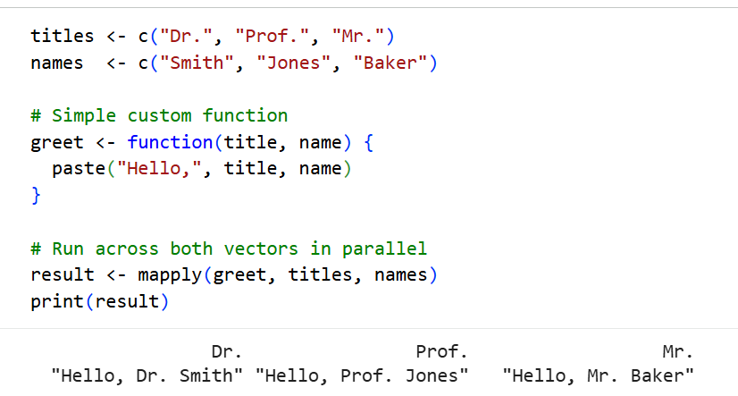

Slide 36
NESTING
Recursive Lists
Lists are recursive: any component may itself be a list, nested to any depth.
is.recursive(x) is TRUE for lists; is.atomic(x) is TRUE for vectors — the two are complementary.
Chain [[ ]] or $ to drill into nested components.
rapply(lst, FUN, how='unlist') walks a nested list and applies FUN at every leaf.
> nested <- list(
student = list(
name = 'Priya',
grades = list(math=90, sci=85)
),
active = TRUE
)
> nested$student$grades$math
[1] 90
> is.recursive(nested) # TRUE
> is.recursive(1:5) # FALSE
> rapply(nested, function(x) x,
how = 'unlist')
R Programming | Unit: Matrices, Arrays & Lists
14

Slide 37
GUARDING YOUR CODE
Checking Types and Membership
is.list(x)
> lst <- list(a = 1, b = 2, c = NULL)
> is.list(lst)
[1] TRUE
> is.null(lst$c) # c was set to NULL
[1] TRUE
> is.null(lst$a)
[1] FALSE
> "b" %in% names(lst)
[1] TRUE
> "score" %in% names(lst)
[1] FALSE
> if (!("score" %in% names(lst)))
lst$score <- 0 # safe default
TRUE if x is a list object
is.null(x)
TRUE if a component is NULL (often after removal)
"name" %in% names(lst)
TRUE if that name exists in the list
value %in% v
TRUE if value occurs anywhere in vector v
R Programming | Unit: Matrices, Arrays & Lists
15

Slide 38
SEARCH & POSITION
Locating Values — which(), which.min(), which.max()
which(condition) returns the indices where a logical vector is TRUE.
which.min(x) / which.max(x) return the position of the first minimum or maximum.
Combine with apply() to find the position of the min/max in every row or column of a matrix.
which(m == val, arr.ind = TRUE) returns row/column coordinates inside a matrix.
> v <- c(4, 9, 2, 9)
> which(v > 5)
[1] 2 4
> which.min(v)
[1] 3
> which.max(v)
[1] 2
> m <- matrix(c(9,2,5,1,8,3), nrow = 2)
> apply(m, 1, which.min) # per-row position
[1] 2 1
> which(m == 1, arr.ind = TRUE)
row col
[1,] 2 2
R Programming | Unit: Matrices, Arrays & Lists
16

Slide 39
FUNCTIONAL PROGRAMMING
Map(), Reduce(), and Filter()
Map(f, l1, l2, ...)
> nums <- list(1, 2, 3, 4, 5)
> Map(function(x, y) x + y,
list(1,2,3), list(10,20,30))
[[1]] 11 [[2]] 22 [[3]] 33
> Reduce(`+`, nums)
[1] 15
> Reduce(function(a,b) a*b, nums,
accumulate = TRUE)
[1] 1 2 6 24 120
> Filter(function(x) x %% 2 == 0, nums)
[[1]] [1] 2 [[2]] [1] 4
Apply f element-wise across one or more lists — like a multi-list lapply
Reduce(f, x)
Collapse a list/vector to one value by combining elements pairwise
combines or collapses elements of a list into a single value by iteratively applying a two-argument function
Filter(f, x)
Keep only the elements for which f(x) is TRUE
Chain them for a pipeline: Filter → Map → Reduce.
R Programming | Unit: Matrices, Arrays & Lists
17

Slide 40
COMBINING SAFELY
rbind() / cbind() — Type Coercion and Errors
rbind() and cbind() coerce every input to one common type — numeric + character becomes all-character.
Mismatched row/column counts raise an error rather than silently padding.
Short vectors are recycled to fit; if the shorter length doesn't divide evenly, R issues a warning.
Wrap risky binds in tryCatch() to handle dimension-mismatch errors gracefully.
> rbind(c(1,2), c('a','b'))
[,1] [,2]
[1,] "1" "2" # coerced to character
[2,] "a" "b"
> tryCatch(
rbind(matrix(1:4,2,2),
matrix(1:6,2,3)),
error = function(e)
cat('Error:', conditionMessage(e))
)
Error: numbers of columns of
matrices must match
R Programming | Unit: Matrices, Arrays & Lists
18

Slide 41
CHOOSING A STRUCTURE
Matrices vs. Arrays vs. Lists
Feature | Matrix | Array | List
Dimensions | Exactly 2 | Any number (N-D) | Flat or nested, no dims
Element type | One type only | One type only | Any mix of types
Created by | matrix() | array() | list()
Typical index | m[i, j] | a[i, j, k] | lst[[i]] or lst$name
Best for | Tables, linear algebra | Multi-way data (time × var × group) | Heterogeneous records
R Programming | Unit: Matrices, Arrays & Lists
19

Slide 42
WORKED PROGRAM 1
Student Grade Matrix — End to End
Build a 4-subject × 5-student matrix, then use rowSums/colMeans, rank students, add a rank column, and drop a subject.
> colMeans(marks)
S1 S2 S3 S4 S5
79.25 86.75 88.25 69.25 73.00
> total <- colSums(marks)
> rank(-total) # 1 = highest total
S1 S2 S3 S4 S5
3 2 1 5 4
> marks['Rank', ] # after rbind
S1 S2 S3 S4 S5
3 2 1 5 4
> marks <- matrix(
c(78,85,92,66,73, 88,79,95,70,60,
91,84,77,68,82, 60,95,89,73,77),
nrow = 4, byrow = TRUE,
dimnames = list(
c('Math','Phys','Chem','CS'),
paste0('S', 1:5)))
> colMeans(marks) # avg per student
> rowSums(marks) # total per subject
> total <- colSums(marks)
> rank <- rank(-total)
> marks <- rbind(marks, Rank = rank)
> marks <- marks[-2, ] # drop Physics row
R Programming | Unit: Matrices, Arrays & Lists
20

Slide 43
WORKED PROGRAM 2
Solving a System of Linear Equations
For Ax = b, solve(A, b) gives x directly; solve(A) alone gives the matrix inverse.
det(A) checks whether A is invertible — a zero determinant means no unique solution.
t(A) transposes A, useful for building normal equations such as t(A) %*% A.
> A <- matrix(c(2,1,1,3), nrow = 2,
byrow = TRUE)
> b <- c(5, 10)
> det(A)
[1] 5
> x <- solve(A, b) # solve for x, y
> x
[1] 1 3
> solve(A) # inverse of A
> t(A) %*% A # normal-equation form
Example system: 2x + y = 5, x + 3y = 10
R Programming | Unit: Matrices, Arrays & Lists
21

Slide 44
WORKED PROGRAM 3
Recursive List — University Structure
Model Department → Courses → Students as nested lists.
Chain $ or [[ ]] to reach any depth; the same pattern models a patient record (patient → visits → prescriptions).
Reassign a nested path to add or remove leaves without rebuilding the whole structure.
> univ <- list(
dept = 'CS',
courses = list(
list(name = 'R Programming',
students = list('Aravind',
'Priya')),
list(name = 'DBMS',
students = list('Karthik'))
))
> univ$courses[[1]]$students
[[1]] "Aravind" [[2]] "Priya"
> univ$courses[[1]]$students[[3]] <-
'Divya' # add a student
R Programming | Unit: Matrices, Arrays & Lists
22

Slide 45
WORKED PROGRAM 4
Library Catalogue with Lists
Represent each book as a small list; the catalogue itself is a list of books.
Add a book by appending with c(); remove by title using Filter().
Search by author with Filter(); summarize titles in one line with sapply().
> catalogue <- list(
list(title='R Basics', author='Rao'),
list(title='Data Sci', author='Iyer'))
> catalogue <- c(catalogue, list(
list(title='Stats 101', author='Rao')))
> catalogue <- Filter(
function(b) b$title != 'Stats 101',
catalogue) # remove by title
> Filter(function(b) b$author=='Rao',
catalogue) # search author
> sapply(catalogue, function(b) b$title)
R Programming | Unit: Matrices, Arrays & Lists
23

Slide 46
WORKED PROGRAM 5
3D Array — Multi-Year Survey Data
Model Regions × Questions × Years as one 3D array for a repeated survey.
a[, , k] slices out the full region-by-question table for year k.
apply(a, 3, mean) tracks how the overall average moves across years.
> survey <- array(
round(runif(60, 1, 5)),
dim = c(4, 5, 3), # 4x5x3
dimnames = list(
paste0('Region', 1:4),
paste0('Q', 1:5),
c('2023','2024','2025')))
> survey[, , '2024'] # 2024 slice
> apply(survey, 3, mean) # yearly trend
2023 2024 2025
2.95 3.10 3.35
R Programming | Unit: Matrices, Arrays & Lists
24

Slide 47
REAL-WORLD APPLICATIONS
Matrices in Big Data & Analytics
Document-term matrix
Rows = documents, columns = vocabulary terms; counts or TF-IDF weights power text mining and search
Correlation matrix
Pairwise correlations between numeric variables guide feature selection and multicollinearity checks
Sparse matrices (Matrix pkg)
Store mostly-zero big matrices compactly so million-row datasets fit in memory
crossprod() / parallel apply
t(A) %*% A via crossprod(A) is faster; apply-family functions parallelize with parallel/furrr
R Programming | Unit: Matrices, Arrays & Lists
25

Slide 48
SUMMARY
Key Takeaways
✓
Matrices are vectors with a dim attribute — same rules, extra structure.
✓
apply() drives row/column functionals; rbind/cbind reshape without mutating in place.
✓
Single-index subsetting drops dimensions unless drop = FALSE is set.
✓
array() extends matrices to any number of dimensions.
✓
Lists hold mixed types and nest recursively; [[ ]] unwraps, [ ] keeps list-ness.
✓
lapply / sapply / mapply apply functions idiomatically across list elements.
✓
is.list / is.null / %in% guard code; which.min/which.max locate positions.
✓
Map / Reduce / Filter and the worked programs show these ideas end to end.

