Slide 1

R PROGRAMMING | COURSE CODE 35021P28
UNIT V
Interfacing R and Statistics
Every Unit V function with its full syntax and argument reference, plus 21 complete, runnable R programs — one detailed slide per function, one or more slides per program.
Course Outcome CO5 — Learn Big Data and apply R for statistical and interfacing tasks
11 sections • 26 functions with syntax & arguments • 21 complete programs
Department of Computer Science and Engineering
1

Slide 2
UNIT V — SECTION 1 OF 11
Interfacing R to Other Languages
INTERFACING
Interfacing R to other languages – Parallel R – Basic Statistics – Linear Model – Generalized Linear models – Non-linear models – Time Series and Auto-correlation – Clustering
5 functions with syntax & arguments • 3 complete programs
R PROGRAMMING (35021P28) • UNIT V — INTERFACING R AND STATISTICS
2

Slide 3
Interfacing R to C & C++
R is an interpreted, high-level programming language well suited for data analysis, visualization, and statistical modelling. However, it may be inefficient when executing large loops or computationally intensive numerical operations.
C and C++ are compiled languages that operate closer to the hardware and provide:
Faster execution
Low-level memory control
Access to powerful external libraries
Interfacing R with C/C++ enables us to:
Combine R’s convenience with the performance of C/C++
Extend R using custom compiled code
Directly use existing C/C++ functions in R

Slide 4
Need for Interfacing
R may have performance limitations when processing computationally intensive tasks. Integrating R with C/C++ provides:
Faster loop execution
Improved memory utilization
Reuse of existing C/C++ algorithms
Better handling of complex data operations
Efficient processing of large datasets

Slide 5
Methods of Interfacing
Method | Description | Data Handling | Typical Use
.C() | A simple interface used to pass basic data types to compiled C functions | Passes vectors and other basic data by reference | Small and simple numerical functions
.Call() | Works directly with R’s internal object representation | Provides complete access to R objects | Developing efficient R packages and complex extensions
Rcpp | Provides a high-level interface between R and C++ with automatic conversions | Automatically converts common R and C++ data types | Modern and recommended approach for integrating R with C++
Simple comparison
.C() — easiest for basic data and simple C functions
.Call() — powerful but requires knowledge of R’s internal objects
Rcpp — user-friendly, efficient, and recommended for modern R–C++ integration

Slide 6

INTERFACING R TO OTHER LANGUAGES
.C()
SYNTAX
.C(.NAME, ..., NAOK = FALSE, DUP = TRUE, PACKAGE, ENCODING)
ARGUMENTS
Argument | Description
.NAME | Name of the compiled C function to invoke, as a character string (or native symbol).
... | Arguments passed to the C function — typically coerced with as.double()/as.integer(). Results return via these arguments (call-by-reference).
NAOK | Logical. If FALSE (default), NA/NaN/Inf in the arguments raises an error.
DUP | Logical; retained for compatibility — arguments are duplicated before being passed.
PACKAGE | Character string naming the package the C symbol belongs to.
Description: .C() is the simplest, oldest interface to compiled C code — every argument is a pointer and results come back through the argument list. Easy for simple numeric kernels but more overhead than .Call().
R PROGRAMMING (35021P28) • UNIT V — INTERFACING R AND STATISTICS
3

Slide 7
INTERFACING R TO OTHER LANGUAGES
.Call() and dyn.load()
SYNTAX
.Call(.NAME, ...) dyn.load(x, local = TRUE, now = TRUE)
ARGUMENTS
Argument | Description
.NAME | .Call(): compiled function registered as a .Call routine.
... | .Call(): R objects passed directly as SEXP pointers — no forced coercion/copy.
x | dyn.load(): path to the shared library to load, e.g. "add.so" or "add.dll".
Description: .Call() works directly with R's internal SEXP representation, avoiding .C()'s copy overhead and handling complex objects. dyn.load() loads the compiled shared library (built with R CMD SHLIB) before .C()/.Call() can find it.
R PROGRAMMING (35021P28) • UNIT V — INTERFACING R AND STATISTICS
4

Slide 8

INTERFACING R TO OTHER LANGUAGES
Program 1: Interfacing R with C — Vector Addition via .C()
Compile a C routine that adds two vectors element-wise, load it, and call it with .C().
/* File: add.c (compile: R CMD SHLIB add.c) */
void addVec(double *x, double *y, int *n, double *out) {
int i;
for (i = 0; i < *n; i++) out[i] = x[i] + y[i];
}
# ---- R script ----
dyn.load("add.so") # "add.dll" on Windows
x <- c(1.5, 2.5, 3.5, 4.5); y <- c(10, 20, 30, 40)
n <- length(x)
result <- .C("addVec", as.double(x), as.double(y),
as.integer(n), out = double(n))$out
print(result) # 11.5 22.5 33.5 44.5
dyn.unload("add.so")
Key point: R CMD SHLIB compiles add.c; dyn.load() exposes addVec() to R. .C() passes x, y, n and a pre-allocated out buffer; $out extracts the filled result. Big Data numeric kernels routinely see a 10-100x speed-up this way.
R PROGRAMMING (35021P28) • UNIT V — INTERFACING R AND STATISTICS
5

Slide 9
INTERFACING R TO OTHER LANGUAGES
cppFunction()
SYNTAX
cppFunction(code, depends = character(), includes = character(), plugins = character(), rebuild
= FALSE)
ARGUMENTS
Argument | Description
code | Character string containing the complete C++ source to compile and expose to R.
depends | Names of other R packages this code depends on (e.g. "RcppArmadillo").
includes | Extra C++ lines (such as #include) inserted before the function definition.
plugins | Rcpp plugins to enable, e.g. "cpp11".
rebuild | Logical; force recompilation even if a cached version exists.
Description: Rcpp is the modern, preferred R-C++ interface. cppFunction() compiles an inline C++ snippet into a callable R function; sourceCpp("file.cpp") does the same for // [[Rcpp::export]] functions in an external file. Rcpp auto-generates the .Call() glue and handles R ↔ C++ type conversion.
R PROGRAMMING (35021P28) • UNIT V — INTERFACING R AND STATISTICS
6

Slide 10
INTERFACING R TO OTHER LANGUAGES
Program 2: Rcpp — Fast Vector Sum and Squared-Distance Kernel (1/2)
Define two small C++ functions with Rcpp and call them from R.
library(Rcpp)
cppFunction("
double sumC(NumericVector x) {
double total = 0; int n = x.size();
for (int i = 0; i < n; i++) total += x[i];
return total;
}
")
R PROGRAMMING (35021P28) • UNIT V — INTERFACING R AND STATISTICS
7

Slide 11
INTERFACING R TO OTHER LANGUAGES
Program 2: Rcpp — Fast Vector Sum and Squared-Distance Kernel (2/2)
cppFunction("
NumericVector sqDiffC(NumericVector x, double center) {
int n = x.size(); NumericVector out(n);
for (int i = 0; i < n; i++) out[i] = pow(x[i]-center, 2);
return out;
}
")
set.seed(1); v <- runif(1e7)
system.time(sumC(v)) # near-zero overhead vs. sum(v)
head(sqDiffC(v, mean(v)))
Key point: cppFunction() compiles each block into a shared library the first time it runs (cached afterwards). For loops that can't be vectorised in R, Rcpp routinely gives 20-100x speed-ups — the standard choice for performance-critical Big Data kernels.
R PROGRAMMING (35021P28) • UNIT V — INTERFACING R AND STATISTICS
8

Slide 12
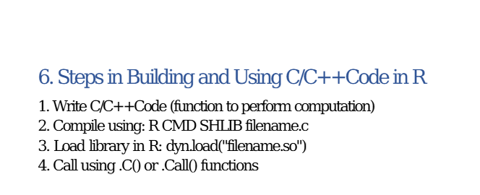

Slide 13
Using R from Python
Introduction
R and Python are two of the most widely used programming languages for data science, machine learning, and statistical computing.
R is particularly effective for statistical analysis, data visualization using packages such as ggplot2, and statistical modelling.
Python is widely used for general-purpose programming, artificial intelligence, and machine learning using libraries such as NumPy, pandas, and scikit-learn.
Combining the capabilities of both languages is useful in many projects. For example:
Using R statistical models within a Python application
Applying Python machine-learning tools to data generated or processed in R
Reusing existing R packages without rewriting them in Python
Integrating R-based analysis into Python workflows
This integration can be achieved through tools such as rpy2, file exchange, APIs, or subprocess execution. For the reverse direction—using Python from R—the reticulate package can be used.

Slide 14
Approaches to Combine R and Python
Direction/Approach | Interface or Tool | Description
R from Python | rpy2 | Allows Python to access R functions, packages, variables, and objects directly
Python from R | reticulate | Allows R programs to execute Python code and use Python modules
File exchange | CSV, XLSX, RDS, Feather or Parquet | Transfers data between R and Python through files
Subprocess | Python subprocess module | Executes an R script externally from Python
API integration | REST API using Plumber or Flask/FastAPI | Enables R and Python applications to communicate through web services

Slide 15
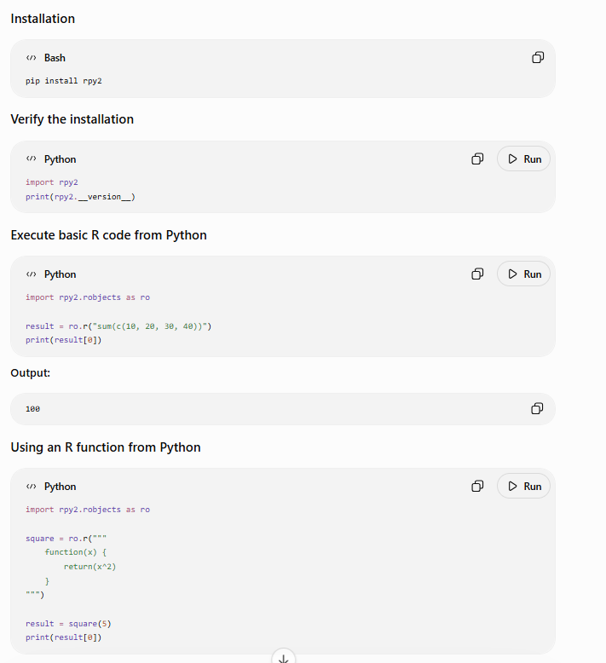
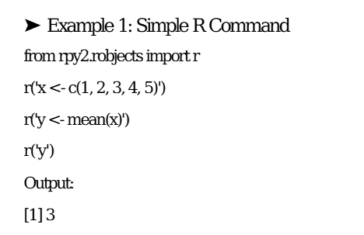

The rpy2 Interface
rpy2 provides an interface for running R code and accessing R objects directly from Python.
Prerequisite
R must be installed and accessible on the system before installing rpy2.

Slide 16
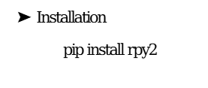
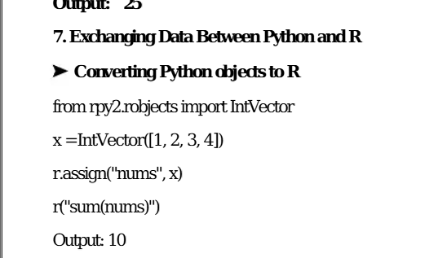
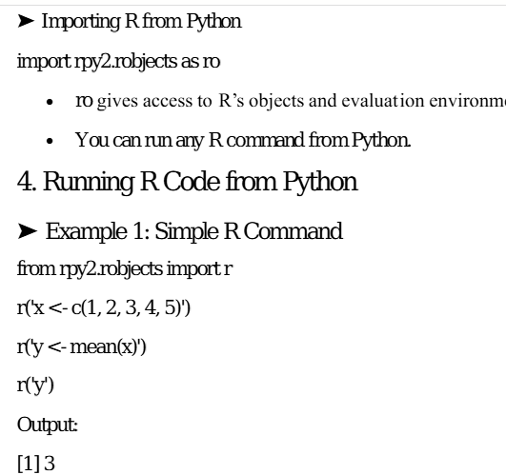

Slide 17
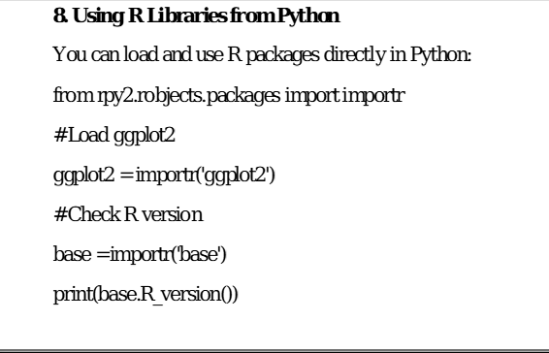
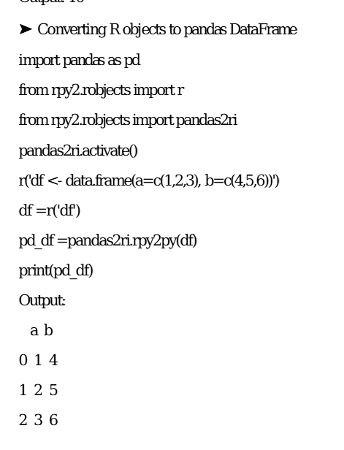
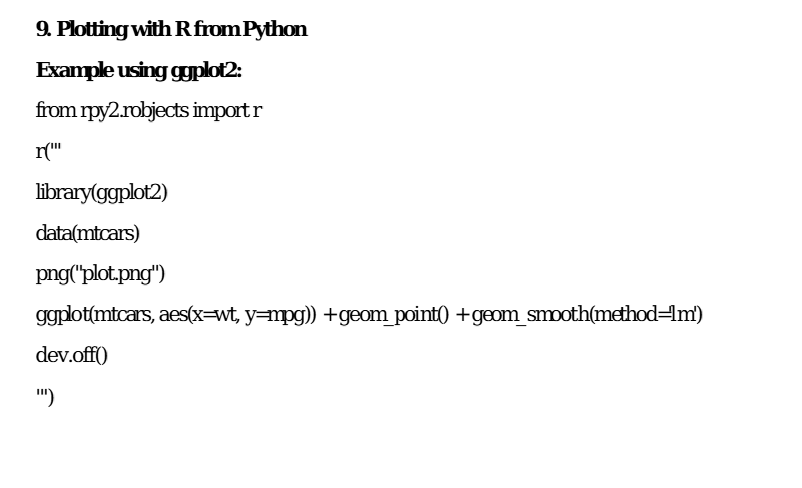

Slide 18
INTERFACING R TO OTHER LANGUAGES
import()
SYNTAX
import(module, as = NULL, convert = TRUE, delay_load = FALSE)
ARGUMENTS
Argument | Description
module | Name of the Python module to import, e.g. "numpy".
as | Optional local alias, e.g. np <- import("numpy", as = "np").
convert | Logical; whether returned Python objects auto-convert to R equivalents.
delay_load | Logical; defer loading until first used.
Description: reticulate embeds a Python interpreter inside R, so Python modules/functions/objects can be used directly from R, and R data can be passed to Python and back.
R PROGRAMMING (35021P28) • UNIT V — INTERFACING R AND STATISTICS
9

Slide 19
INTERFACING R TO OTHER LANGUAGES
source_python() / r_to_py() / py_to_r()
SYNTAX
source_python(file, envir = parent.frame()) r_to_py(x) py_to_r(x)
ARGUMENTS
Argument | Description
file | Path to a .py script; its top-level functions/variables become R objects after sourcing.
envir | R environment the sourced objects are assigned into.
x | The R object / Python object to convert to the other language's representation.
Description: source_python() is the most direct route to reuse an existing Python script as if it were native R. r_to_py()/py_to_r() explicitly convert a single object between representations.
R PROGRAMMING (35021P28) • UNIT V — INTERFACING R AND STATISTICS
10

Slide 20
INTERFACING R TO OTHER LANGUAGES
Program 3: reticulate — Calling a Python Function and NumPy from R
Source a Python model function into R and drive NumPy interactively.
# ---- model.py ----
def predict_price(area_sqft):
return 2500 + 120 * area_sqft
# ---- R script ----
library(reticulate)
source_python("model.py")
predict_price(1200) # 146500
np <- import("numpy")
arr <- np$array(c(4, 9, 16, 25))
np$sqrt(arr) # 2 3 4 5
pd <- import("pandas")
py_df <- r_to_py(mtcars)
back_df <- py_to_r(py_df)
Key point: source_python() makes predict_price() callable exactly like an R function; import() gives handle-style module access (np$sqrt() mirrors Python's np.sqrt()); r_to_py()/py_to_r() round-trip a full data frame between R and Python.
R PROGRAMMING (35021P28) • UNIT V — INTERFACING R AND STATISTICS
11

Slide 21

UNIT V — SECTION 2 OF 11
Parallel R
By default R executes on a single core. Parallel R spreads independent computations across CPU cores or machines, cutting wall-clock time roughly in proportion to the number of workers used. The parallel package offers forking (mclapply, Unix/macOS only) and socket clusters (makeCluster + parLapply, cross-platform).
4 functions with syntax & arguments • 2 complete programs
R PROGRAMMING (35021P28) • UNIT V — INTERFACING R AND STATISTICS
12

Slide 22
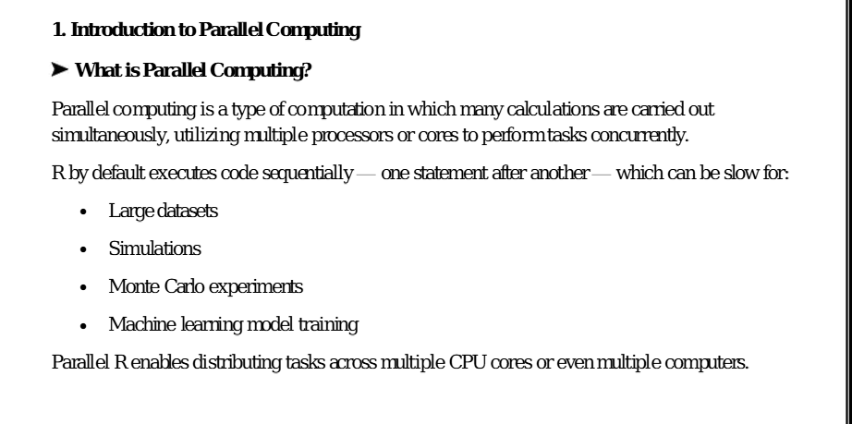

Slide 23
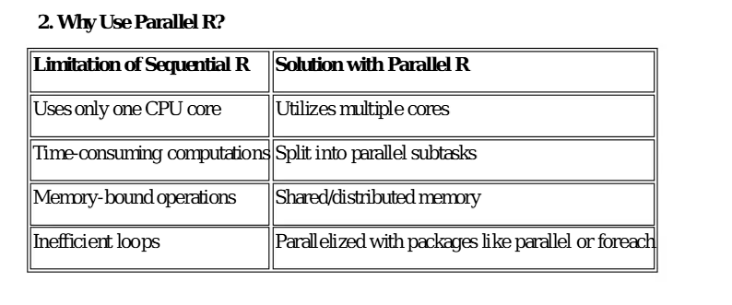

Slide 24
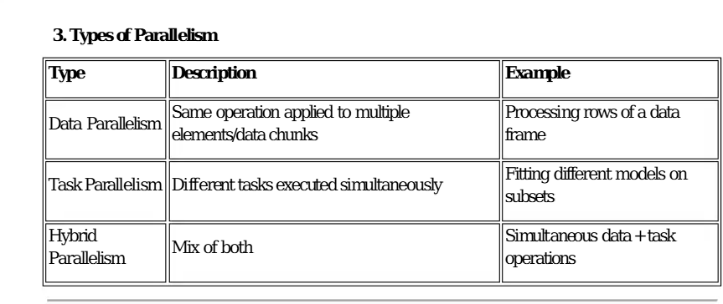
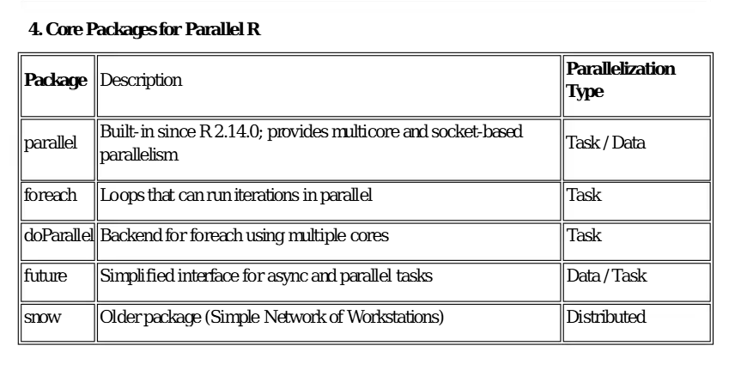

Slide 25
PARALLEL R
detectCores()
SYNTAX
detectCores(all.tests = FALSE, logical = TRUE)
ARGUMENTS
Argument | Description
all.tests | Logical; run extra heuristics on unusual platforms to determine core count.
logical | TRUE (default) counts logical/hyperthreaded cores; FALSE counts physical cores only.
Description: Returns the number of CPU cores available — normally used to decide worker count (commonly detectCores() - 1).
R PROGRAMMING (35021P28) • UNIT V — INTERFACING R AND STATISTICS
13

Slide 26
PARALLEL R
makeCluster() / stopCluster()
SYNTAX
makeCluster(spec, type = getClusterOption("type"), ...) stopCluster(cl)
ARGUMENTS
Argument | Description
spec | Integer number of local worker processes, or a character vector of remote machine names.
type | "PSOCK" (socket cluster, cross-platform, default) or "FORK" (Unix-only, shared memory).
cl | (stopCluster) The cluster object to shut down.
Description: makeCluster() starts worker R processes and returns a cluster object; stopCluster(cl) must always be called when done, to release resources.
R PROGRAMMING (35021P28) • UNIT V — INTERFACING R AND STATISTICS
14

Slide 27
PARALLEL R
parLapply() / parSapply()
SYNTAX
parLapply(cl, X, fun, ...) / parSapply(cl, X, FUN, ..., simplify = TRUE)
ARGUMENTS
Argument | Description
cl | The cluster object returned by makeCluster().
X | A vector or list; the function is applied once per element, in parallel.
fun / FUN | The function applied to each element of X.
simplify | (parSapply) Logical; simplify the result to a vector/matrix when possible.
Description: The parallel, cluster-based equivalents of lapply()/sapply(): the same function is applied to every element of X, distributed across the cluster's workers.
R PROGRAMMING (35021P28) • UNIT V — INTERFACING R AND STATISTICS
15

Slide 28
PARALLEL R
clusterExport() / mclapply()
SYNTAX
clusterExport(cl, varlist, envir = .GlobalEnv) mclapply(X, FUN, ..., mc.cores = 2L)
ARGUMENTS
Argument | Description
varlist | clusterExport(): character vector of variable/function names to copy to every worker.
envir | clusterExport(): environment those objects are looked up in.
mc.cores | mclapply(): number of cores (child processes) to fork.
Description: clusterExport() copies objects socket workers need (they start with an empty environment). mclapply() forks the current process instead — workers automatically share memory via copy-on-write, so no export is needed — but it only works on Unix/Linux/macOS.
R PROGRAMMING (35021P28) • UNIT V — INTERFACING R AND STATISTICS
16

Slide 29
PARALLEL R
Program 4: parLapply() — Parallel Squaring Across a Socket Cluster
Start a cluster, export what workers need, run in parallel, and clean up.
library(parallel)
no_cores <- detectCores() - 1
cl <- makeCluster(no_cores) # cross-platform socket cluster
square <- function(x) x ^ 2
clusterExport(cl, varlist = c("square"))
result <- parLapply(cl, 1:20, square)
print(unlist(result))
big_result <- parSapply(cl, 1:1e6, square)
cat('Length:', length(big_result), '\n')
stopCluster(cl) # always release workers
Key point: parLapply() returns a list; parSapply() simplifies to a vector/matrix. Forgetting clusterExport() is the most common bug — workers are separate processes and can't see square() otherwise.
R PROGRAMMING (35021P28) • UNIT V — INTERFACING R AND STATISTICS
17

Slide 30
PARALLEL R
Program 5: Benchmark — mclapply() (Forking) vs. Socket Cluster (1/2)
Estimate π via Monte Carlo sampling, comparing sequential, forked, and socket-cluster execution.
library(parallel)
mc_pi <- function(n) {
x <- runif(n); y <- runif(n)
4 * sum(x^2 + y^2 <= 1) / n
}
n <- 5e6; reps <- 8
R PROGRAMMING (35021P28) • UNIT V — INTERFACING R AND STATISTICS
18

Slide 31
PARALLEL R
Program 5: Benchmark — mclapply() (Forking) vs. Socket Cluster (2/2)
t_seq <- system.time(sapply(1:reps, function(i) mc_pi(n)))
t_fork <- system.time(mclapply(1:reps, function(i) mc_pi(n),
mc.cores = detectCores() - 1))
cl <- makeCluster(detectCores() - 1)
clusterExport(cl, varlist = c("mc_pi"))
t_sock <- system.time(parSapply(cl, 1:reps, function(i) mc_pi(n)))
stopCluster(cl)
cat('Seq:', t_seq[3], ' Fork:', t_fork[3], ' Sock:', t_sock[3], '\n')
Key point: mclapply() needs no clusterExport() (forked children inherit the parent's memory) and is fastest to launch on Linux/macOS, but is unavailable on Windows. Socket clusters work everywhere but need clusterExport() and have more overhead.
R PROGRAMMING (35021P28) • UNIT V — INTERFACING R AND STATISTICS
19

Slide 32

UNIT V — SECTION 3 OF 11
Basic Statistics in R
R ships with built-in functions for every core descriptive statistic, making it straightforward to profile a numeric variable before any modelling is attempted.
1 complete program
R PROGRAMMING (35021P28) • UNIT V — INTERFACING R AND STATISTICS
20

Slide 33

What is Statistics?
Statistics helps us collect, organize, summarize, analyze, interpret, and present data so we can make informed decisions.
In R, we can start with a small set of student marks:

Slide 34
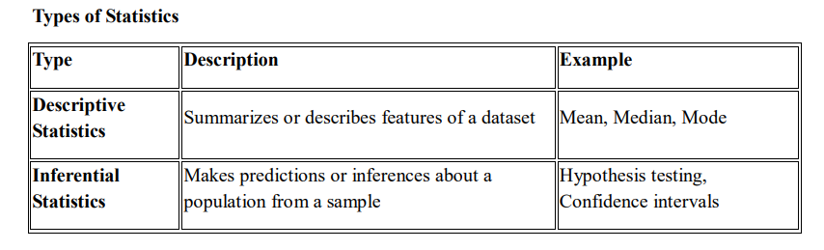
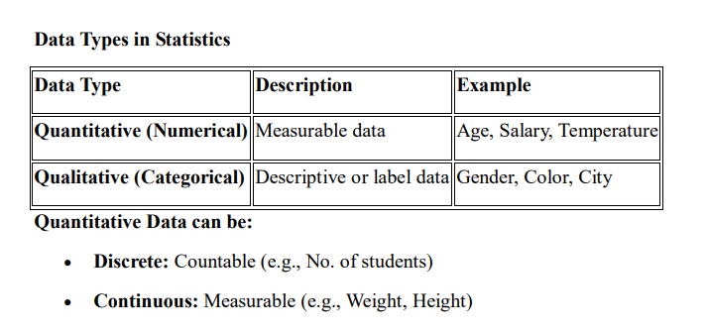
Statistics helps to make decisions based on data.

Slide 35
BASIC STATISTICS IN R
Basic Statistics in R
Measures of Central Tendency
Function | Purpose
mean(x, trim=0, na.rm=FALSE) | Arithmetic mean of x; trim removes a fraction of extreme values from each end.
median(x, na.rm=FALSE) | The middle value of x when sorted (50th percentile).
var(x, na.rm=FALSE) / sd(x, na.rm=FALSE) | Sample variance / standard deviation of x.
quantile(x, probs=seq(0,1,0.25)) | Sample quantiles at the given probabilities (default: min, Q1, median, Q3, max).
summary(object) | One-shot overview: min, Q1, median, mean, Q3, max.
cor(x, y, method="pearson") | Correlation coefficient; method: "pearson", "kendall" or "spearman".
R has no built-in mode() for the statistical mode — mode() returns an object's storage type instead. The mode of a vector is computed via table(), as shown below.
R PROGRAMMING (35021P28) • UNIT V — INTERFACING R AND STATISTICS
21

Slide 36
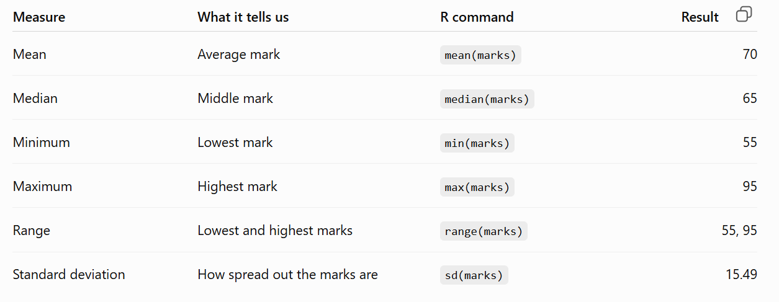

Slide 37
BASIC STATISTICS IN R
Program 6: Descriptive Statistics on a Numeric Vector
Compute every core descriptive statistic on a sample dataset.
scores <- c(72,85,90,65,88,76,90,95,60,82,90,77)
cat('Mean :', mean(scores), '\n')
cat('Median :', median(scores), '\n')
mode_val <- names(sort(table(scores), decreasing = TRUE))[1]
cat('Mode :', mode_val, '\n')
cat('Variance:', var(scores), '\n')
cat('Std Dev :', sd(scores), '\n')
print(quantile(scores))
print(summary(scores))
attendance <- c(88,92,95,70,91,80,93,98,65,85,94,79)
cat('Correlation:', cor(scores, attendance), '\n')
Key point: summary() is the fastest single call to profile a variable; cor() close to +1/-1 indicates a strong linear relationship, near 0 indicates little linear association.
R PROGRAMMING (35021P28) • UNIT V — INTERFACING R AND STATISTICS
22

Slide 38
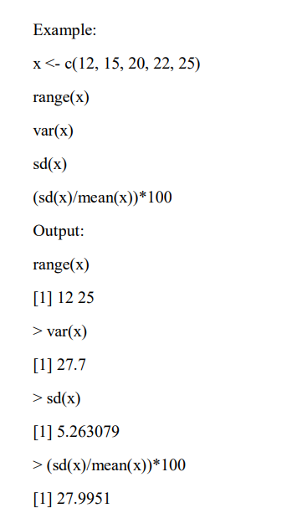
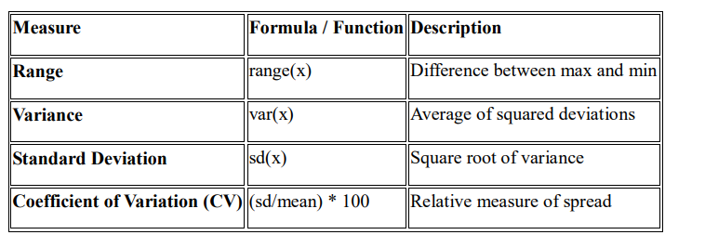
Measures of Dispersion (Spread)
These measure how data values vary.

Slide 39

UNIT V — SECTION 4 OF 11
Hypothesis Testing
Hypothesis testing is a statistical method for deciding whether sample data provide enough evidence to question a claim about a population.
3 functions with syntax & arguments • 2 complete programs
R PROGRAMMING (35021P28) • UNIT V — INTERFACING R AND STATISTICS
23

Slide 40
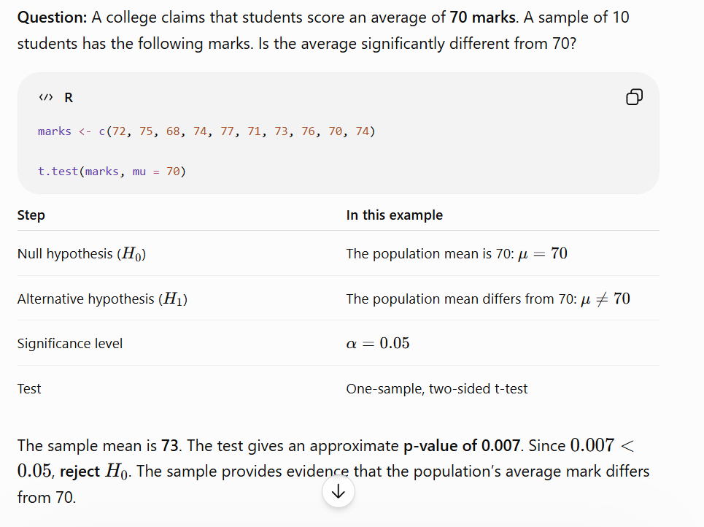

Slide 41
HYPOTHESIS TESTING
4.1 Core Concepts
Term | Meaning
Null hypothesis (H0) | The default claim of “no effect / no difference” that the test tries to disprove.
Alternative hypothesis (H1) | The claim accepted if H0 is rejected.
P-value | Probability of data this extreme if H0 were true; small p-value = evidence against H0.
Significance level (α) | Threshold (commonly 0.05) below which the p-value leads to rejecting H0.
Type I error | Rejecting H0 when it is actually true (“false positive”); probability = α.
Type II error | Failing to reject H0 when it is actually false (“false negative”); probability = β.
R PROGRAMMING (35021P28) • UNIT V — INTERFACING R AND STATISTICS
24

Slide 42
HYPOTHESIS TESTING
t.test()
SYNTAX
t.test(x, y = NULL, alternative = c("two.sided","less","greater"), mu = 0, paired = FALSE,
var.equal = FALSE, conf.level = 0.95)
ARGUMENTS
Argument | Description
x, y | Numeric vectors. If y is omitted, a one-sample test against mu is performed.
alternative | two-sided, or that the true mean is less/greater than mu.
mu | Hypothesised mean (one-sample) or mean difference (two-sample).
paired | Logical; perform a paired t-test.
var.equal | Logical; TRUE uses pooled-variance (Student's) test, else Welch's correction.
Description: Tests whether the mean of one sample differs from a fixed value, or whether the means of two samples differ.
R PROGRAMMING (35021P28) • UNIT V — INTERFACING R AND STATISTICS
25

Slide 43
HYPOTHESIS TESTING
chisq.test() / cor.test()
SYNTAX
chisq.test(x, y = NULL, correct = TRUE) cor.test(x, y, method =
c("pearson","kendall","spearman"))
ARGUMENTS
Argument | Description
x | chisq.test(): a factor or contingency table of counts. cor.test(): a numeric vector.
y | A second factor (chisq.test) or numeric vector (cor.test) to compare against x.
correct | Logical; apply Yates' continuity correction for 2×2 tables.
method | The correlation coefficient to compute and test.
Description: chisq.test() tests independence/association between categorical variables (or goodness-of-fit). cor.test() tests whether the correlation between x and y is significantly different from zero.
R PROGRAMMING (35021P28) • UNIT V — INTERFACING R AND STATISTICS
26

Slide 44
HYPOTHESIS TESTING
Program 7: t-test, Chi-square Test and Correlation Test
Apply all three tests with interpretation of each result.
set.seed(42)
class_A <- rnorm(30, 72, 8); class_B <- rnorm(30, 76, 9)
t_result <- t.test(class_A, class_B)
print(t_result)
gender <- sample(c('M','F'), 200, replace = TRUE)
purchase <- sample(c('Yes','No'), 200, replace = TRUE, prob = c(.4,.6))
tbl <- table(gender, purchase)
print(chisq.test(tbl))
study_hours <- c(2,4,6,8,3,5,7,9,1,6)
exam_score <- c(55,63,72,85,58,68,78,90,50,74)
print(cor.test(study_hours, exam_score, method = 'pearson'))
Key point: In every case: p-value < α (commonly 0.05) means the result is statistically significant, so H0 is rejected.
R PROGRAMMING (35021P28) • UNIT V — INTERFACING R AND STATISTICS
27

Slide 45

UNIT V — SECTION 5 OF 11
Linear Model — lm()
Linear regression models a numeric response as a weighted sum of predictors plus random error: simple regression uses one predictor (y = β0 + β1x + ε), multiple regression uses several.
2 functions with syntax & arguments • 1 complete program
R PROGRAMMING (35021P28) • UNIT V — INTERFACING R AND STATISTICS
30

Slide 46
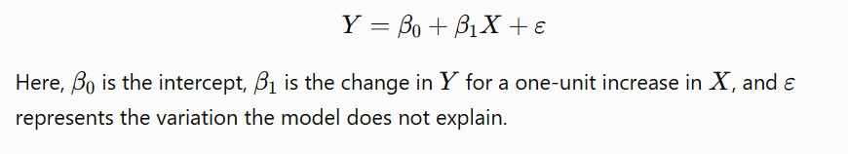
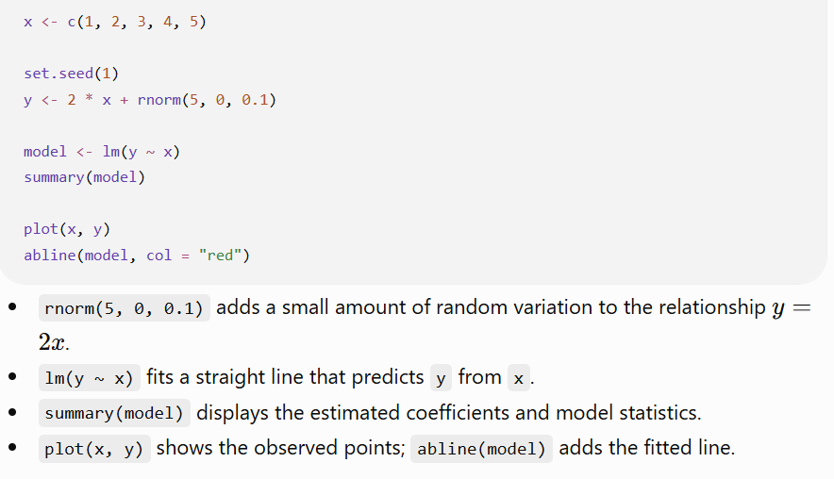
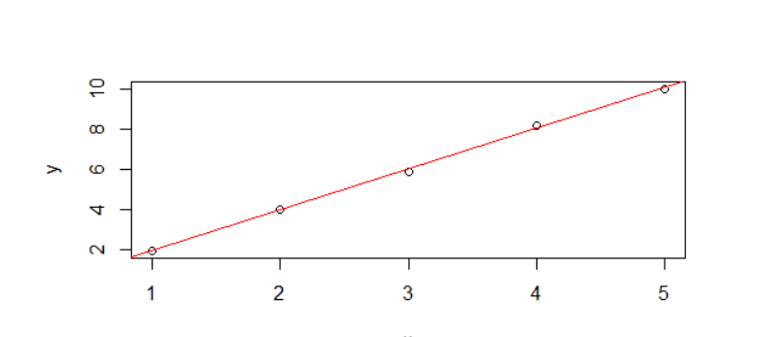
A linear model describes how a response variable $Y$changes with one or more predictor variables.
Simple linear regression equation:
Simple linear regression
Simple linear regression uses one predictor.

Slide 47
LINEAR MODEL — LM()
lm()
SYNTAX
lm(formula, data, subset, weights, na.action, method = "qr")
ARGUMENTS
Argument | Description
formula | e.g. y ~ x1 + x2 (multiple regression) or y ~ . (all other columns as predictors).
data | The data frame containing the variables in formula.
subset | Optional vector specifying a subset of rows to fit on.
weights | Optional vector of weights for weighted least squares.
na.action | How missing values are handled (default: drop incomplete rows).
method | The fitting method; "qr" (QR decomposition) is the default.
Description: Fits an ordinary least-squares linear model. The result supports summary() (coefficients, R², p-values), predict(), residuals() and plot() (diagnostics).
R PROGRAMMING (35021P28) • UNIT V — INTERFACING R AND STATISTICS
31

Slide 48
LINEAR MODEL — LM()
predict()
SYNTAX
predict(object, newdata, interval = c("none","confidence","prediction"), level = 0.95)
ARGUMENTS
Argument | Description
object | A fitted model, e.g. from lm() or glm().
newdata | A data frame of new predictor values.
interval | "confidence" (mean response) or "prediction" (a new observation).
level | Confidence level for the interval.
Description: Generates fitted/predicted values for new data, optionally with an interval expressing prediction uncertainty.
R PROGRAMMING (35021P28) • UNIT V — INTERFACING R AND STATISTICS
32

Slide 49
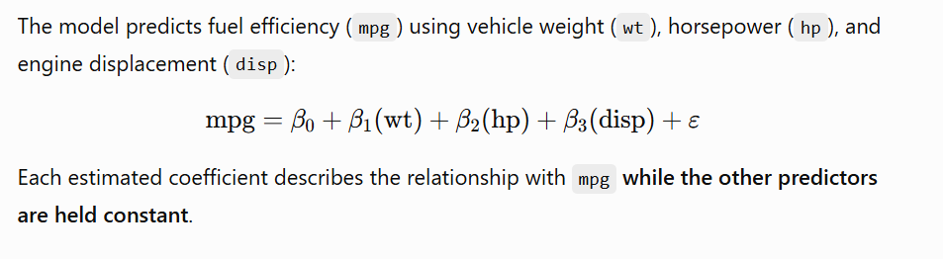
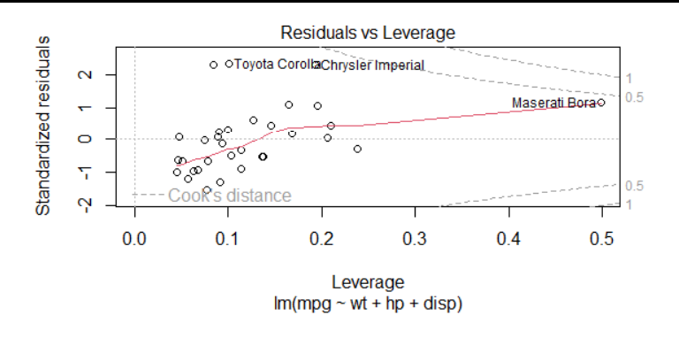

Multiple linear regression
Multiple linear regression uses more than one predictor. The uses R’s built-in mtcars dataset:
Diagnostic plots
R produces diagnostic plots that help examine whether a linear model is appropriate. In particular, inspect whether residuals show a pattern, whether their spread changes across fitted values, and whether a few observations have unusually strong influence.

Slide 50
LINEAR MODEL — LM()
Program 9: Multiple Linear Regression — Full Workflow
Fit, interpret, diagnose, and predict with lm() on the built-in mtcars dataset.
data(mtcars)
model <- lm(mpg ~ wt + hp + cyl, data = mtcars)
print(summary(model))
par(mfrow = c(2,2)); plot(model) # 4-panel diagnostics
new_car <- data.frame(wt = 3.0, hp = 120, cyl = 6)
print(predict(model, newdata = new_car, interval = 'confidence'))
RMSE <- sqrt(mean(residuals(model)^2))
R2 <- summary(model)$r.squared
cat('RMSE:', RMSE, ' R-squared:', R2, '\n')
Key point: Each coefficient's Estimate is the expected change in mpg per unit change in that predictor (others fixed); Pr(>|t|) < 0.05 marks a significant predictor; Multiple R-squared is the variance explained. plot(model) checks linearity, normality, variance, and influence.
R PROGRAMMING (35021P28) • UNIT V — INTERFACING R AND STATISTICS
33

Slide 51
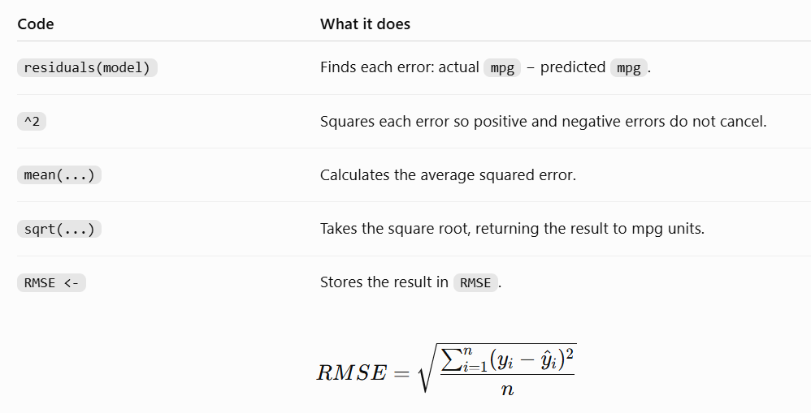

Slide 52
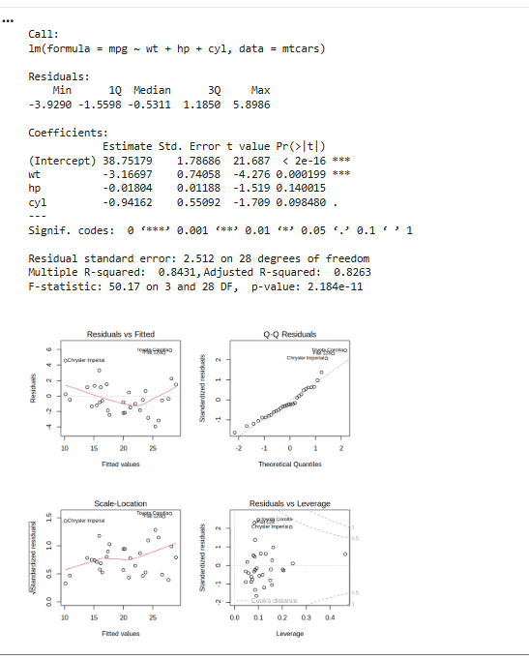

Slide 53
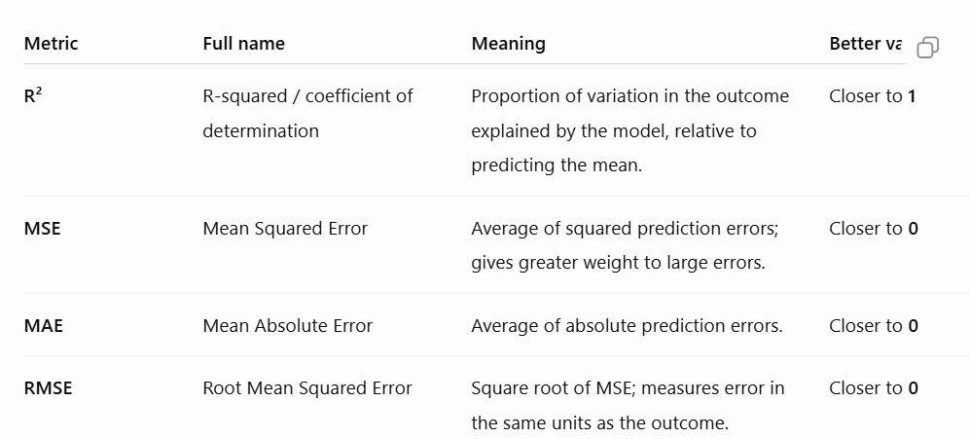

Slide 54

UNIT V — SECTION 6 OF 11
Generalized Linear Models (GLM)
GLMs extend linear regression to response variables that are not normally distributed (binary outcomes, counts, …) by relating the mean of the response to the predictors through a link function.
1 function with syntax & arguments • 2 complete programs
R PROGRAMMING (35021P28) • UNIT V — INTERFACING R AND STATISTICS
34

Slide 55
GENERALIZED LINEAR MODELS (GLM)
glm()
SYNTAX
glm(formula, family = gaussian, data, weights, subset, na.action)
ARGUMENTS
Argument | Description
formula | A model formula, e.g. y ~ x1 + x2.
family | binomial() for logistic regression, poisson() for count data, gaussian() (the lm() case), etc.
data | The data frame containing the variables in formula.
weights | Optional prior weights for the fit.
subset | Optional vector specifying a subset of rows.
Description: family = binomial(link="logit") fits logistic regression (predict(type="response") gives probabilities). family = poisson(link="log") fits Poisson regression for count outcomes.
R PROGRAMMING (35021P28) • UNIT V — INTERFACING R AND STATISTICS
35

Slide 56
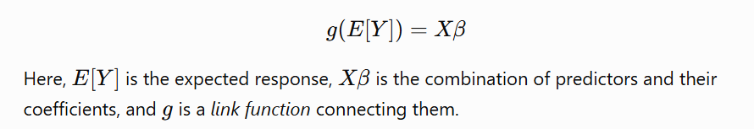
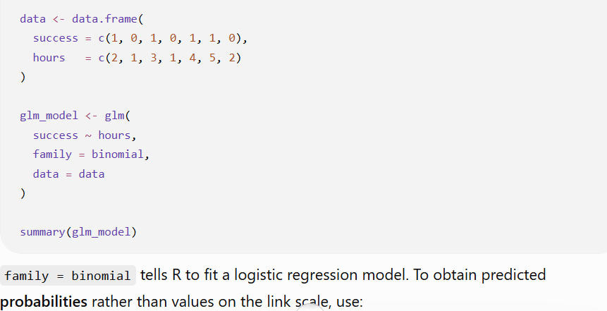

A generalized linear model extends linear regression to response variables that do not suit an ordinary linear model.
Logistic regression
The response success is either 1 or 0. The model examines its relationship with hours

Slide 57
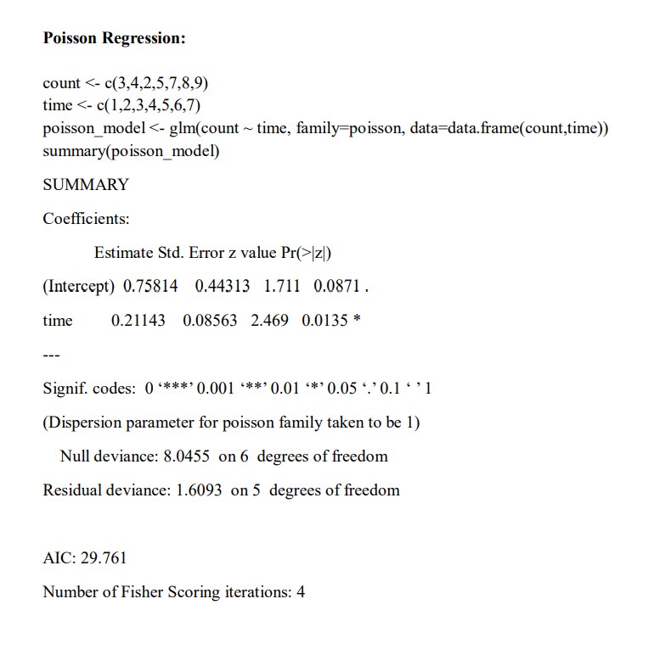
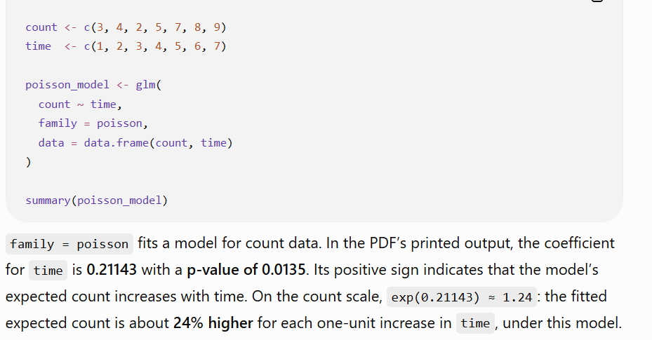
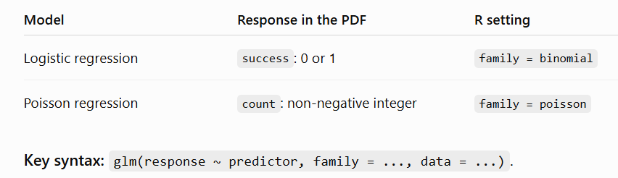
Poisson regression
The response count records a number of occurrences

Slide 58
GENERALIZED LINEAR MODELS (GLM)
Program 10: Logistic Regression — Classification, Confusion Matrix, ROC (2/2)
model <- glm(disease ~ age+bmi+glucose, data=train, family=binomial)
prob <- predict(model, newdata=test, type='response')
pred <- ifelse(prob > 0.5, 1, 0)
confusion <- table(Predicted=pred, Actual=test$disease)
print(confusion)
cat('Accuracy:', sum(diag(confusion))/sum(confusion), '\n')
library(pROC)
roc_obj <- roc(test$disease, prob)
cat('AUC:', auc(roc_obj), '\n')
Key point: family = binomial gives log-odds coefficients (exp(coef()) = odds ratios). The confusion matrix's diagonal is correct predictions; AUC close to 1 indicates a strong classifier (0.5 = no better than chance).
R PROGRAMMING (35021P28) • UNIT V — INTERFACING R AND STATISTICS
37

Slide 59

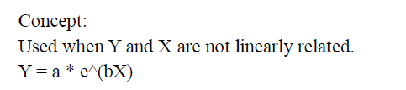
UNIT V — SECTION 7 OF 11
Non-linear Models — nls()
Some relationships cannot be expressed as a linear combination of parameters. nls() fits such models by non-linear least squares using the Gauss–Newton algorithm, which iteratively linearizes the model around current parameter estimates. Good starting values are essential for convergence.
1 function with syntax & arguments • 1 complete program
R PROGRAMMING (35021P28) • UNIT V — INTERFACING R AND STATISTICS
39

Slide 60
NON-LINEAR MODELS — NLS()
nls()
SYNTAX
nls(formula, data, start, control = nls.control(), algorithm = "default")
ARGUMENTS
Argument | Description
formula | A non-linear model formula, e.g. y ~ Asym/(1+exp((xmid-x)/scal)).
data | The data frame containing the variables in formula.
start | A named list giving the starting value for every parameter — critical for convergence.
control | An nls.control() object setting iteration limits, tolerance, etc.
algorithm | "default" (Gauss-Newton), "plinear" or "port".
Description: Fits a model non-linear in its parameters. The model shape must be given explicitly, and optimisation needs reasonable initial values to converge to the right solution.
R PROGRAMMING (35021P28) • UNIT V — INTERFACING R AND STATISTICS
40

Slide 61
NON-LINEAR MODELS — NLS()
Program 12: Logistic Growth Curve with nls()
Fit an S-shaped growth curve (population over time) and plot it.
year <- 2000:2020
population <- c(1000,1080,1170,1280,1400,1550,1720,1920,2150,
2400,2680,2980,3300,3620,3930,4220,4480,4700,4880,5010,5100)
growth_data <- data.frame(year, population)
growth_model <- nls(
population ~ Asym / (1 + exp((xmid - year)/scal)),
data = growth_data,
start = list(Asym = 5200, xmid = 2010, scal = 3)
)
print(summary(growth_model))
plot(growth_data$year, growth_data$population)
lines(growth_data$year, predict(growth_model), col='blue', lwd=2)
predict(growth_model, newdata = data.frame(year = 2025))
Key point: Asym is the estimated upper asymptote (carrying capacity), xmid the year of fastest growth, scal the steepness. summary() reports each parameter's estimate, standard error and significance, like lm().
R PROGRAMMING (35021P28) • UNIT V — INTERFACING R AND STATISTICS
41

Slide 62
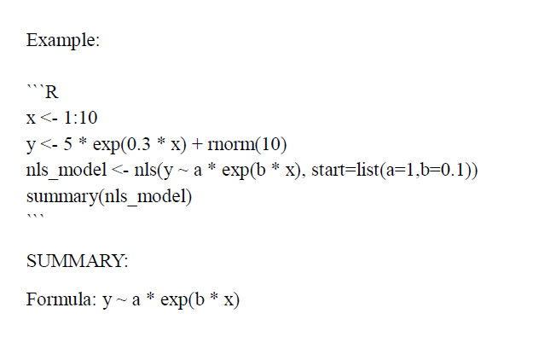

Slide 63

UNIT V — SECTION 8 OF 11
Time Series and Autocorrelation
A time series is a sequence of observations indexed in time order. R's ts() class attaches time information to a numeric vector; from there, decomposition, autocorrelation analysis and ARIMA modelling support trend/seasonality detection and forecasting.
4 functions with syntax & arguments • 4 complete programs
R PROGRAMMING (35021P28) • UNIT V — INTERFACING R AND STATISTICS
42

Slide 64
TIME SERIES AND AUTOCORRELATION
ts() / decompose()
SYNTAX
ts(data, start, end, frequency, deltat) decompose(x, type = c("additive","multiplicative"))
ARGUMENTS
Argument | Description
data | A numeric vector (or matrix) of observed values, in time order.
start | Time of the first observation, e.g. c(2020, 1) for January 2020.
frequency | Observations per unit of time — 12 monthly, 4 quarterly, 7 daily-weekly.
x | decompose(): a ts object with frequency > 1.
type | decompose(): additive or multiplicative seasonal effects.
Description: ts() wraps a plain vector with time metadata. decompose() splits a series into trend, seasonal and random components via moving averages — the standard first step before forecasting.
R PROGRAMMING (35021P28) • UNIT V — INTERFACING R AND STATISTICS
43

Slide 65
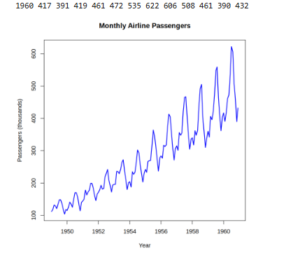
TIME SERIES AND AUTOCORRELATION
Program 13: Creating and Decomposing a Monthly Time Series
# 1. Load the built-in dataset
data("AirPassengers")
# 2. Create a monthly time series
monthly_ts <- ts(
as.numeric(AirPassengers),
start = c(1949, 1), # January 1949
frequency = 12 # 12 observations per year
)
# 3. Display the time series
print(monthly_ts)
# 4. Plot the original data
plot(monthly_ts,
main = "Monthly Airline Passengers",
xlab = "Year",
ylab = "Passengers (thousands)",
col = "blue",
lwd = 2)
# 5. Decompose the series
# Multiplicative model suits seasonal variation that grows with the level
result <- decompose(monthly_ts, type = "multiplicative")
# 6. Plot the components
plot(result)
# 7. Display individual components
print(result$trend)
print(result$seasonal)
print(result$random)
R PROGRAMMING (35021P28) • UNIT V — INTERFACING R AND STATISTICS
44

Slide 66
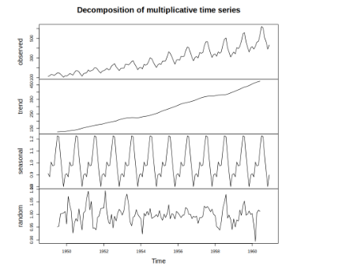

Slide 67
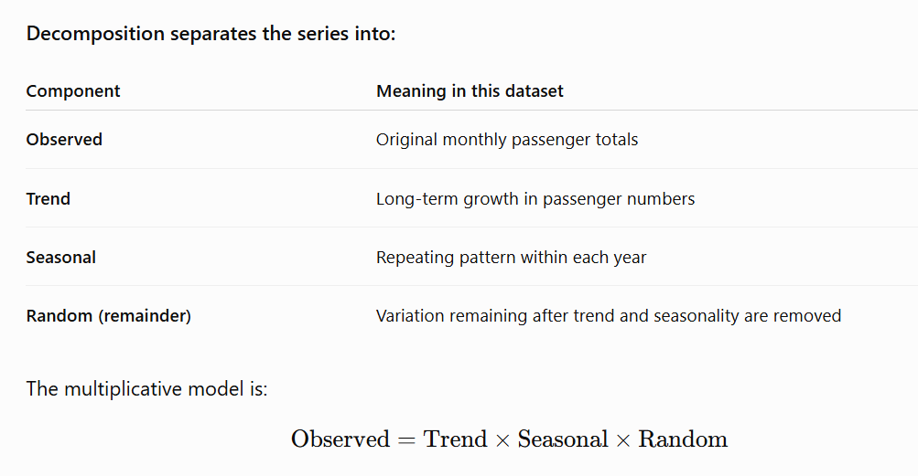
Interpretation: Passenger numbers increase over time, and seasonal fluctuations become larger as passenger totals grow. This makes multiplicative decomposition appropriate. NA values at the beginning and end of the trend and remainder are expected because the moving-average calculation requires neighbouring observations.

Slide 68
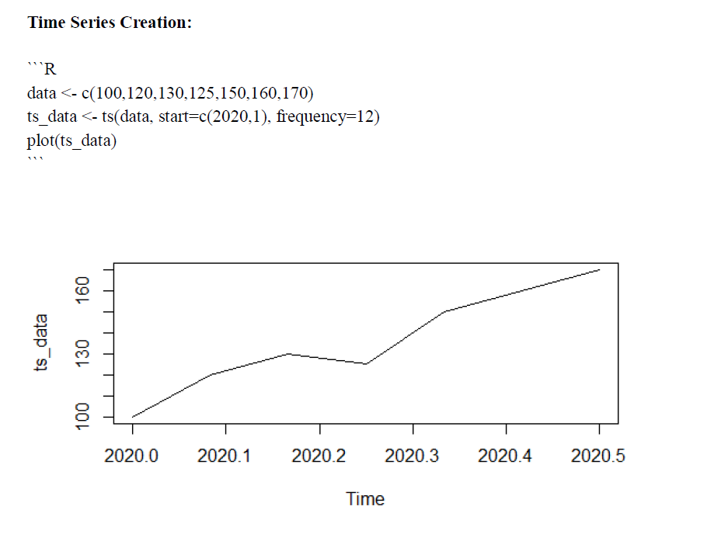

Slide 69
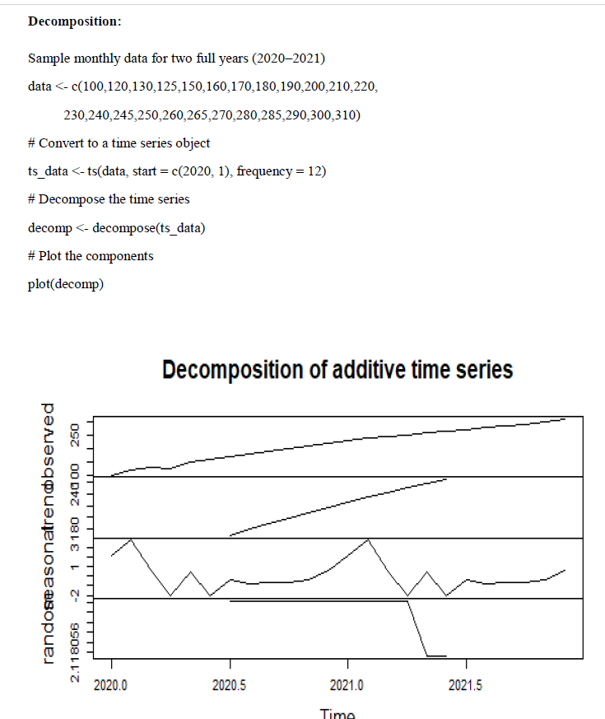

Slide 70
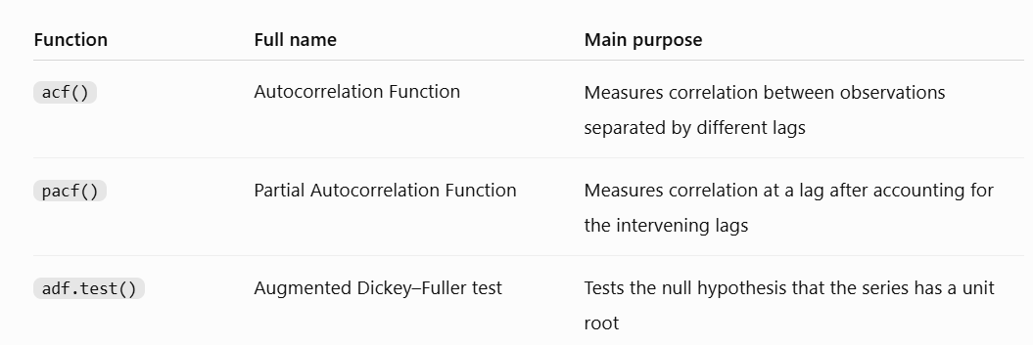
acf() / pacf() / adf.test()

Slide 71
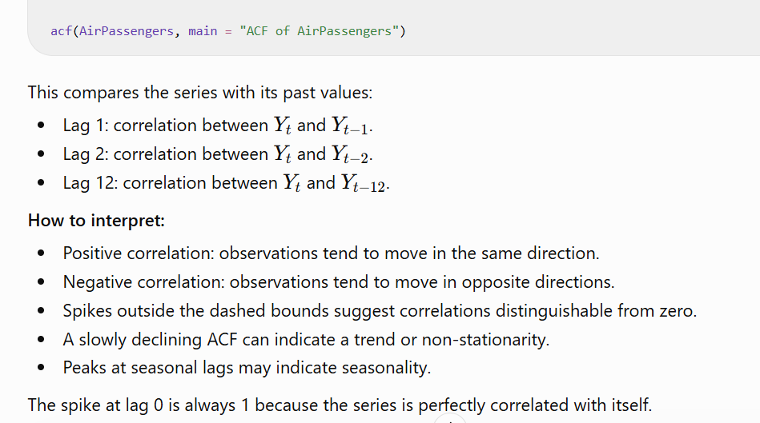

Slide 72
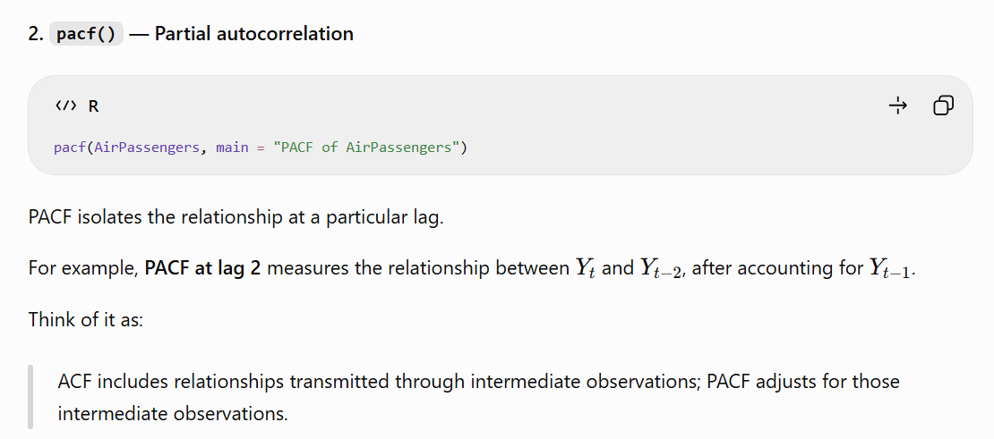

Slide 73
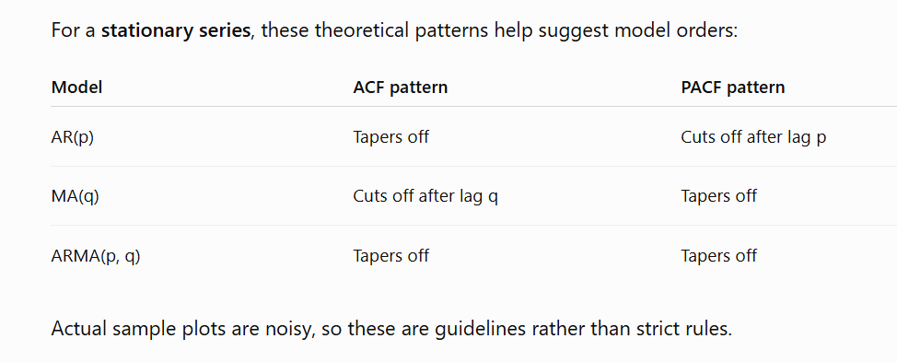

Slide 74
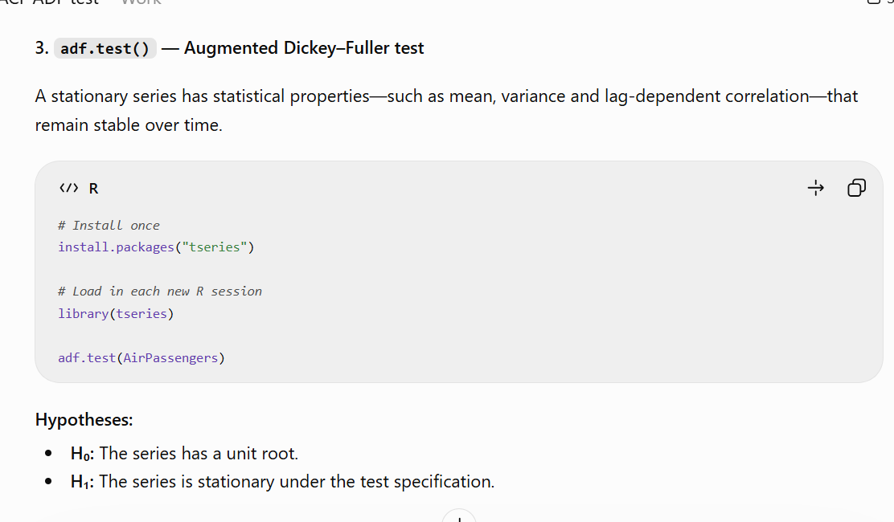

Slide 75
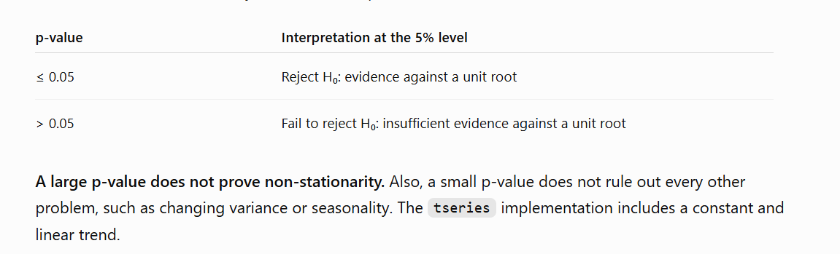

Slide 76
TIME SERIES AND AUTOCORRELATION
acf() / pacf() / adf.test()
SYNTAX
acf(x, lag.max=NULL, plot=TRUE) pacf(x, lag.max=NULL, plot=TRUE) adf.test(x,
alternative="stationary") [pkg: tseries]
ARGUMENTS
Argument | Description
x | A univariate time series.
lag.max | The maximum lag to compute/plot.
plot | Logical; draw the correlogram, or return numeric values if FALSE.
alternative | adf.test(): stationary (default) or explosive.
Description: acf() measures correlation with the series' own past values (suggests MA(q) order); pacf() measures correlation after removing shorter-lag effects (suggests AR(p) order). adf.test()'s H0 is non-stationary — p < 0.05 lets us reject H0 and treat the series as stationary.
R PROGRAMMING (35021P28) • UNIT V — INTERFACING R AND STATISTICS
45

Slide 77
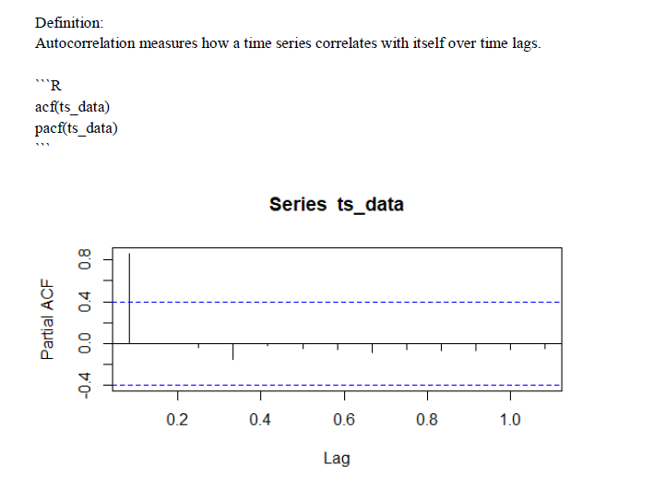
TIME SERIES AND AUTOCORRELATION
Program 14: Autocorrelation and Stationarity Check
Compute ACF, PACF, and test stationarity on the sales series from Program 13.
acf(ts_data, main = 'ACF of Sales')
pacf(ts_data, main = 'PACF of Sales')
library(tseries)
adf_result <- adf.test(ts_data)
print(adf_result)
if (adf_result$p.value > 0.05) {
sales_diff <- diff(ts_data)
print(adf.test(sales_diff))
} else cat('Series is stationary\n')
Key point: If the p-value is above 0.05, diff() removes the trend by first-differencing; the series is re-tested until stationary. The number of differences applied becomes ARIMA's "d" parameter.
R PROGRAMMING (35021P28) • UNIT V — INTERFACING R AND STATISTICS
46

Slide 78
TIME SERIES AND AUTOCORRELATION
auto.arima() / forecast() / accuracy()
SYNTAX
auto.arima(y, seasonal=TRUE, ic=c("aicc","aic","bic")) forecast(object, h=10) accuracy(f, x)
[pkg: forecast]
ARGUMENTS
Argument | Description
y / object | The time series / fitted model to forecast from.
seasonal | Logical; whether to consider seasonal (SARIMA) terms.
ic | Information criterion used to choose between candidate models.
h | forecast(): the horizon — how many future periods to predict.
f, x | accuracy(): the forecast object, and actual values to compare against.
Description: auto.arima() searches ARIMA(p,d,q) combinations and returns the model with lowest information criterion. forecast() produces point forecasts with prediction intervals; accuracy() reports RMSE/MAE/MAPE against actual data.
R PROGRAMMING (35021P28) • UNIT V — INTERFACING R AND STATISTICS
47

Slide 79
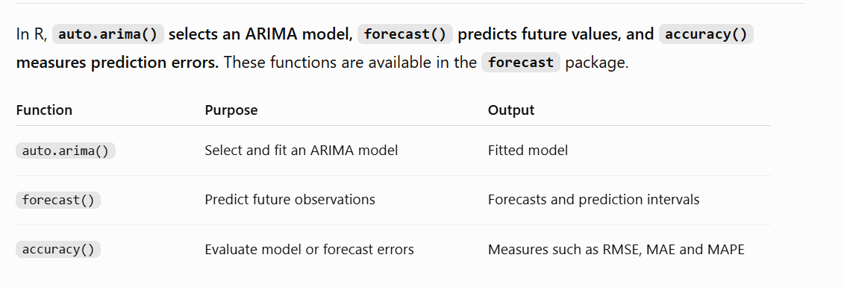

Slide 80
TIME SERIES AND AUTOCORRELATION
Program 15: Complete ARIMA Forecasting Workflow
Stationarity check, differencing, ACF/PACF, model fit, residual check, and forecasting — end to end.
library(forecast); library(tseries)
print(adf.test(sales_ts)) # 1. Stationarity check
sales_diff <- diff(sales_ts) # 2. Differencing
acf(sales_diff); pacf(sales_diff) # 3. ACF / PACF
fit <- auto.arima(sales_ts, seasonal = TRUE) # 4. Fit
print(fit)
checkresiduals(fit) # 5. Residual diagnostics
fc <- forecast(fit, h = 12) # 6. Forecast
plot(fc); print(fc)
Key point: auto.arima() determines d (and D for seasonal) automatically, so steps 1-2 are shown for understanding. checkresiduals() plots the residual ACF and runs a Ljung-Box test — a non-significant result (p > 0.05) confirms residuals are white noise.
R PROGRAMMING (35021P28) • UNIT V — INTERFACING R AND STATISTICS
48

Slide 81
TIME SERIES AND AUTOCORRELATION
ets()
SYNTAX
ets(y, model = "ZZZ", damped = NULL) [pkg: forecast]
ARGUMENTS
Argument | Description
y | The time series to model.
model | 3-letter code for (Error, Trend, Seasonal): A/M/N/Z per component; Z = auto-select (default).
damped | Logical; use a damped trend (NULL lets the function decide).
Description: Fits an Exponential Smoothing State-Space model, automatically choosing error/trend/seasonal components by AICc — an ARIMA alternative that's often simpler to tune and very competitive for business series.
R PROGRAMMING (35021P28) • UNIT V — INTERFACING R AND STATISTICS
49

Slide 82
TIME SERIES AND AUTOCORRELATION
Program 16: Comparing ETS and ARIMA Forecast Accuracy
Fit both model families on the same training data and compare accuracy on a held-out test window.
library(forecast)
train <- window(sales_ts, end = c(2023,6))
test <- window(sales_ts, start = c(2023,7))
fit_arima <- auto.arima(train)
fc_arima <- forecast(fit_arima, h = length(test))
fit_ets <- ets(train)
fc_ets <- forecast(fit_ets, h = length(test))
print(accuracy(fc_arima, test))
print(accuracy(fc_ets, test))
Key point: accuracy() reports RMSE/MAE/MAPE for both fits; the model with lower MAPE/RMSE on the held-out test window (out-of-sample) is preferred over relying on in-sample fit alone.
R PROGRAMMING (35021P28) • UNIT V — INTERFACING R AND STATISTICS
50

Slide 83

UNIT V — SECTION 9 OF 11
Clustering
Clustering groups unlabeled observations so points within a cluster are more similar to each other than to points in other clusters. R provides both partition-based (k-means) and hierarchical approaches.
Concept: Unsupervised learning method for grouping similar data points.
2 functions with syntax & arguments • 2 complete programs
R PROGRAMMING (35021P28) • UNIT V — INTERFACING R AND STATISTICS
51

Slide 84
CLUSTERING
kmeans()
SYNTAX
kmeans(x, centers, iter.max = 10, nstart = 1, algorithm =
c("Hartigan-Wong","Lloyd","Forgy","MacQueen"))
ARGUMENTS
Argument | Description
x | A numeric matrix/data frame of observations (typically scaled first).
centers | Number of clusters k, or a matrix of initial centers.
iter.max | Maximum iterations allowed for convergence.
nstart | Number of random initial configurations to try, keeping the best (lowest WSS).
Description: Partitions data into k clusters by iteratively assigning points to the nearest centroid, minimising total within-cluster sum of squares. $cluster gives assignments, $centers the centroids, $tot.withinss the WSS used by the elbow method.
R PROGRAMMING (35021P28) • UNIT V — INTERFACING R AND STATISTICS
52

Slide 85
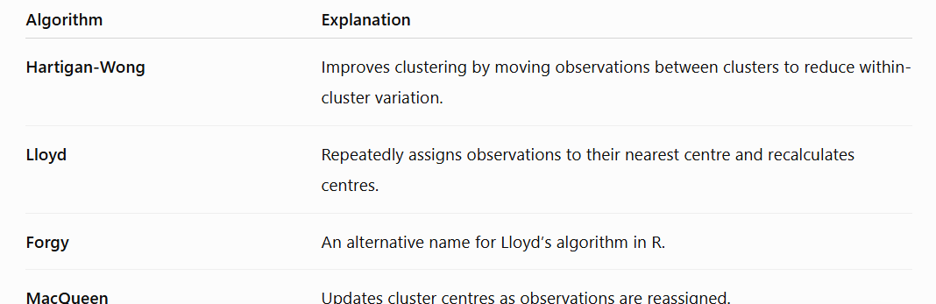

Slide 86
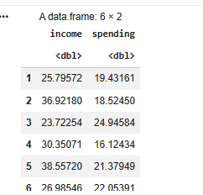
CLUSTERING
Program 17: k-means Clustering with the Elbow Method
Scale data, choose k via the elbow method, fit k-means, and visualise clusters.
set.seed(5)
customer_data <- data.frame(
income = c(rnorm(50,30,5), rnorm(50,60,6), rnorm(50,90,7), rnorm(50,45,5)),
spending = c(rnorm(50,20,5), rnorm(50,70,8), rnorm(50,30,6), rnorm(50,55,7))
)
scaled_data <- scale(customer_data)
wss <- sapply(1:10, function(k) kmeans(scaled_data,k,nstart=25)$tot.withinss)
plot(1:10, wss, type='b', xlab='k', ylab='WSS') # elbow method
km <- kmeans(scaled_data, centers = 4, nstart = 25)
print(table(km$cluster))
plot(scaled_data, col = km$cluster, pch = 19)
points(km$centers, col = 1:4, pch = 8, cex = 2)
Key point: The elbow method plots WSS against k; the point where WSS stops decreasing sharply is the optimal k. nstart=25 re-runs from 25 random starts, avoiding a poor local optimum.
R PROGRAMMING (35021P28) • UNIT V — INTERFACING R AND STATISTICS
53

Slide 87
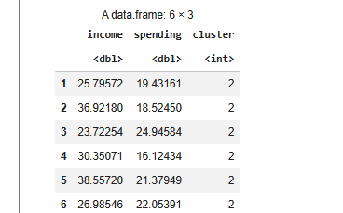



Slide 88


Slide 89
CLUSTERING
dist() / hclust() / cutree()
SYNTAX
dist(x, method = "euclidean") hclust(d, method = "complete") cutree(tree, k = NULL, h = NULL)
ARGUMENTS
Argument | Description
x / method (dist) | Data to measure; distance metric ("euclidean", "manhattan", ...).
d / method (hclust) | A distance matrix; linkage criterion ("complete", "average", "ward.D2", ...).
tree | cutree(): a fitted hclust object.
k / h | cutree(): desired number of clusters, or the height to cut at instead.
Description: dist() computes pairwise distances; hclust() builds a dendrogram by successively merging the closest clusters; cutree() cuts the dendrogram into flat cluster labels.
R PROGRAMMING (35021P28) • UNIT V — INTERFACING R AND STATISTICS
54

Slide 90
CLUSTERING
Program 18: Hierarchical Clustering with Dendrogram Visualisation
Build and cut a dendrogram on the same customer data used for k-means.
d <- dist(scaled_data, method = 'euclidean')
hc <- hclust(d, method = 'ward.D2')
plot(hc, labels = FALSE, main = 'Customer Dendrogram')
clusters <- cutree(hc, k = 4)
rect.hclust(hc, k = 4, border = 'red')
print(table(clusters))
print(table(kmeans = km$cluster, hierarchical = clusters))
Key point: Linkage methods (complete, average, ward.D2, single) change how inter-cluster distance is measured; ward.D2 tends to produce compact, evenly sized clusters. The final table shows how closely the two methods agree.
R PROGRAMMING (35021P28) • UNIT V — INTERFACING R AND STATISTICS
55

Slide 91



Slide 92
CLUSTERING
9.1 k-means vs. Hierarchical Clustering
Aspect | k-means | Hierarchical (hclust)
Approach | Partition-based; assigns points to k centroids | Builds a tree by successively merging clusters
Pre-specify k? | Yes -- via elbow / silhouette method | No -- k chosen later by cutting the dendrogram
Scalability | Efficient on large datasets | Expensive for very large n (distance matrix O(n²))
Output | Flat set of k clusters | Dendrogram showing nested cluster structure
Best for | Big, spherical clusters; Big Data segmentation | Small/medium data; exploratory analysis
R PROGRAMMING (35021P28) • UNIT V — INTERFACING R AND STATISTICS
56

Slide 93

UNIT V — SECTION 11 OF 11
Applied End-to-End Programs
These two programs combine the techniques above into complete, exam-ready workflows: a general predictive-analytics pipeline, and a full statistical analysis report.
2 complete programs
R PROGRAMMING (35021P28) • UNIT V — INTERFACING R AND STATISTICS
63

Slide 94
APPLIED END-TO-END PROGRAMS
Program 20: Predictive Analytics Pipeline in R
A complete six-step pipeline: load, preprocess, fit, evaluate, predict, and visualise.
data(mtcars); df <- na.omit(mtcars) # 1-2. Load & preprocess
df$cyl <- as.factor(df$cyl)
set.seed(1)
idx <- sample(1:nrow(df), .75*nrow(df))
train <- df[idx,]; test <- df[-idx,]
model <- lm(mpg ~ wt+hp+cyl, data=train) # 3. Fit
pred_test <- predict(model, newdata=test) # 4. Evaluate
RMSE <- sqrt(mean((test$mpg-pred_test)^2))
R2 <- 1 - sum((test$mpg-pred_test)^2)/sum((test$mpg-mean(test$mpg))^2)
cat('Test RMSE:', RMSE, ' R2:', R2, '\n')
new_car <- data.frame(wt=3.2, hp=150, cyl=factor(6, levels=levels(df$cyl)))
predict(model, newdata = new_car) # 5. Predict
plot(model, which = 1) # 6. Visualise residuals
Key point: This six-step design mirrors any supervised modelling task in R and generalises directly to glm() (classification), nls() (non-linear) or a clustering pipeline.
R PROGRAMMING (35021P28) • UNIT V — INTERFACING R AND STATISTICS
64

Slide 95
APPLIED END-TO-END PROGRAMS
Program 21: Complete Statistical Analysis Report
Descriptive statistics, normality check, correlation matrix, regression, and prediction with visualisation.
data(mtcars); df <- mtcars
print(summary(df)); sapply(df, sd) # (i) Descriptive stats
shapiro_result <- shapiro.test(df$mpg) # (ii) Normality test
print(shapiro_result)
cor_matrix <- cor(df) # (iii) Correlation matrix
print(round(cor_matrix, 2))
model <- lm(mpg ~ wt+hp+disp, data=df) # (iv) Regression
print(summary(model))
df$predicted <- predict(model) # (v) Prediction + visualisation
plot(df$mpg, df$predicted, xlab='Actual mpg', ylab='Predicted mpg',
pch=19, col='steelblue')
abline(0, 1, col='red', lwd=2)
Key point: shapiro.test() checks whether the response is approximately normal; the correlation matrix flags predictors strongly related to the response (or each other, indicating multicollinearity); the actual-vs-predicted plot with a 45° reference line gives a quick visual check of model fit.
R PROGRAMMING (35021P28) • UNIT V — INTERFACING R AND STATISTICS
65

Slide 96

QUICK REFERENCE
All Functions at a Glance (1/2)
Function | Package | Purpose
.C() / .Call() | base | Call compiled C code from R
dyn.load() | base | Load a compiled shared library
cppFunction() / sourceCpp() | Rcpp | Compile and call C++ code from R
import() / source_python() | reticulate | Call Python modules / functions from R
r_to_py() / py_to_r() | reticulate | Convert objects between R and Python
detectCores() | parallel | Number of CPU cores available
makeCluster() / stopCluster() | parallel | Start / stop a socket cluster
parLapply() / parSapply() | parallel | Apply a function in parallel (socket cluster)
clusterExport() / mclapply() | parallel | Export to workers / apply in parallel via forking
mean()/median()/var()/sd() | base/stats | Core descriptive statistics
quantile()/summary()/cor() | base/stats | Quantiles, overview, correlation
t.test() / chisq.test() / cor.test() | stats | Compare means / categorical association / correlation
aov() / TukeyHSD() | stats | ANOVA and post-hoc pairwise comparison
R PROGRAMMING (35021P28) • UNIT V — INTERFACING R AND STATISTICS
66

Slide 97
QUICK REFERENCE
All Functions at a Glance (2/2)
Function | Package | Purpose
lm() / predict() | stats | Fit / predict from a linear model
glm() | stats | Fit a generalized linear model (logistic, Poisson, ...)
nls() | stats | Fit a non-linear least-squares model
ts() / decompose() | stats | Create / decompose a time series
acf() / pacf() / adf.test() | stats/tseries | Autocorrelation, partial ACF, stationarity test
auto.arima() / forecast() / accuracy() | forecast | Fit ARIMA / generate & evaluate forecasts
ets() | forecast | Fit an exponential smoothing model
kmeans() | stats | Partition-based clustering
dist() / hclust() / cutree() | stats | Hierarchical clustering
data.table / fread() | data.table | Fast large-table manipulation
filter()/mutate()/summarise() | dplyr | Readable data transformation verbs
mapreduce() / keyval() | rmr2 (RHadoop) | Express a Hadoop MapReduce job in R
sparkR.session() / spark.lapply() | SparkR | Distributed computation via Apache Spark
R PROGRAMMING (35021P28) • UNIT V — INTERFACING R AND STATISTICS
67

