Slide 1
R PROGRAMMING • 35021P28 • BE AI & ML – III YEAR
UNIT III
Data Frames, Factors, Control Flow
& Functions in R
From tabular data to functional programming: data frames, factors and tables, control statements, scope and recursion, and simulation in R.
COURSE OUTCOME
Learn to apply R programming for Text processing
Course Outcome
PREPARED BY
CO3
Dr. S. Pitchumani Angayarkanni

Slide 2
UNIT III SYLLABUS
Syllabus Coverage Map
01
Data Frames
Creating data frames • matrix-like operations • merging • applying functions
02
Factors & Tables
Factors and levels • common factor functions • working with tables • other related functions
03
Control Statements
if/for/while/repeat • arithmetic & Boolean operators • Boolean values
04
Functions In Depth
Default arguments • functions as objects • environment & scope • writing upstairs • recursion • replacement functions • composing function code
05
Math & Simulation
Random distributions • set.seed() • sample() • Monte Carlo methods in R
Unit III Overview
R Programming • Unit III – Data Frames
2

Slide 3
1
SECTION 1 OF 5
Data Frames
R's core structure for tabular, mixed-type data — creation, matrix-like manipulation, merging and functional application.
Data Frames
R Programming • Unit III – Data Frames
3

Slide 4
DATA FRAMES
What Is a Data Frame?
A List of Equal-Length Vectors
A data frame is R's rectangular data structure: each column is a vector (its own type), and all columns share the same number of rows — like a spreadsheet or a database table.
Heterogeneous by Column
Unlike a matrix, different columns can hold different data types — numeric, character, logical, or factor — while every value within one column stays the same type.
Row and Column Names
Every data frame carries row names and column names, accessible with rownames() and colnames(), used for labelling and indexing.
Where It Fits
Data frames are the standard input format for statistical functions, machine-learning pipelines, and most real-world datasets imported via read.csv() or similar functions.
Data Frames
R Programming • Unit III – Data Frames
4

Slide 5
DATA FRAMES
Creating Data Frames
data.frame() builds a frame column by column from vectors of equal length.
R Console
students <- data.frame(
id = 1:4,
name = c("Asha","Ravi","Meera","Kabir"),
marks = c(78, 85, 92, 67),
passed = c(TRUE, TRUE, TRUE, FALSE)
)
str(students)
nrow(students); ncol(students)
stringsAsFactors defaults to FALSE in modern R — character columns stay character unless converted.
str() and summary() give a quick structural and statistical snapshot.
nrow(), ncol() and dim() report the frame's shape.
Output
'data.frame': 4 obs. of 4 variables
nrow = 4 ncol = 4
Data Frames
R Programming • Unit III – Data Frames
5

Slide 6
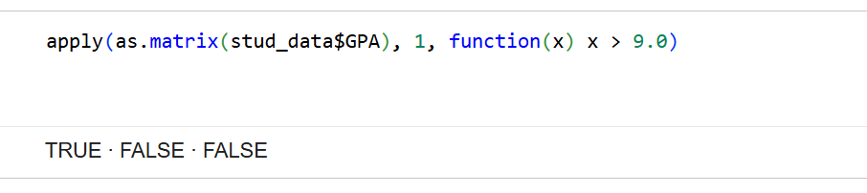
DATA FRAMES
Matrix-Like Operations in Data Frames
Data frames support [row, col] indexing just like matrices.
R Console
students[2, ] # 2nd row, all cols
students[, "marks"] # marks column
students[students$marks>75,]
new_row <- data.frame(id=5, name="Zoya",
marks=88, passed=TRUE)
students <- rbind(students, new_row)
colMeans(students["marks"])
rbind() adds rows; cbind() adds columns — both preserve column types.
Arithmetic works column-wise when columns are numeric; use sapply() for row/column summaries.
colSums(), rowSums(), colMeans() work directly on numeric-only frames.
Output
Filters rows where marks > 75
Appends Zoya as row 5
Mean marks returned
Data Frames
R Programming • Unit III – Data Frames
6

Slide 7
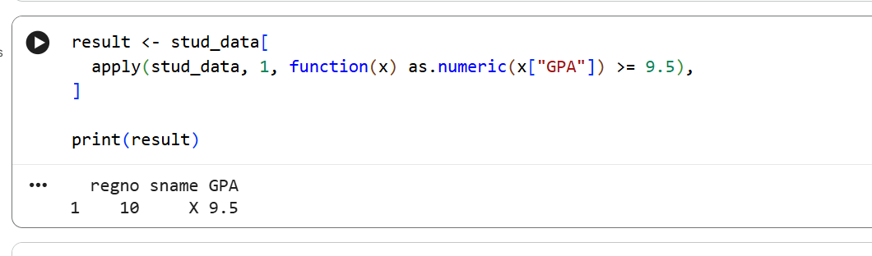
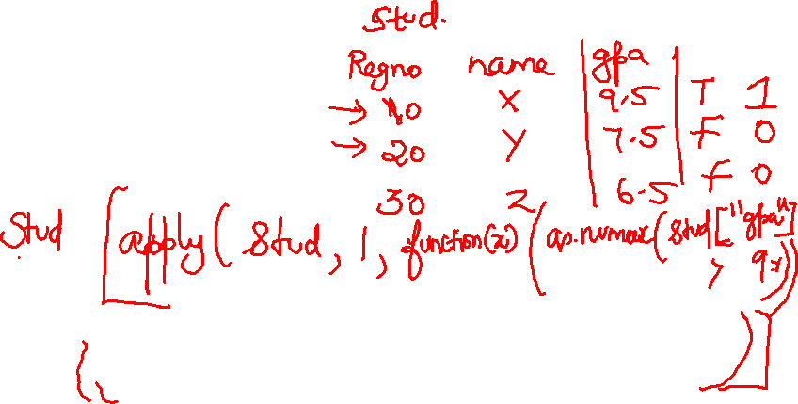

Slide 8
DATA FRAMES
Merging Data Frames
merge() combines two frames on a common key column, like a SQL join.
R Console
dept <- data.frame(id=c(1,2,3),
dept=c("CSE","AIML","ECE"))
merge(students, dept, by="id") # inner
merge(students, dept, by="id", all=TRUE) # outer
merge(students, dept, by="id", all.x=TRUE)# left
all=FALSE (default) performs an inner join — only matching keys are kept.
all=TRUE performs a full outer join; all.x=TRUE is a left join; all.y=TRUE is a right join.
Non-matching rows get NA filled in for columns from the other table.
Output
Inner: only ids 1–3
Outer: all ids, NA where unmatched
Left: all students, dept = NA if none
Data Frames
R Programming • Unit III – Data Frames
7

Slide 9
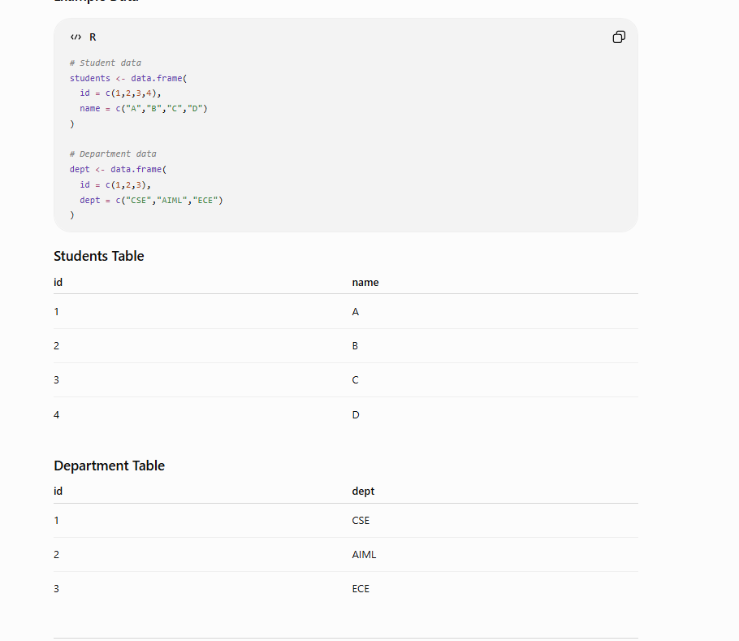

Slide 10
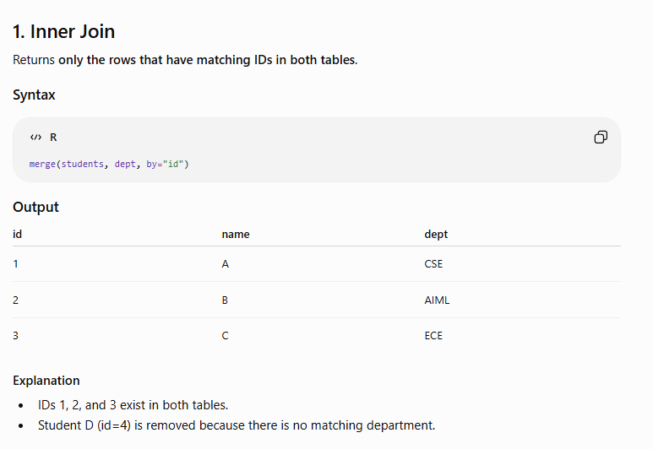

Slide 11
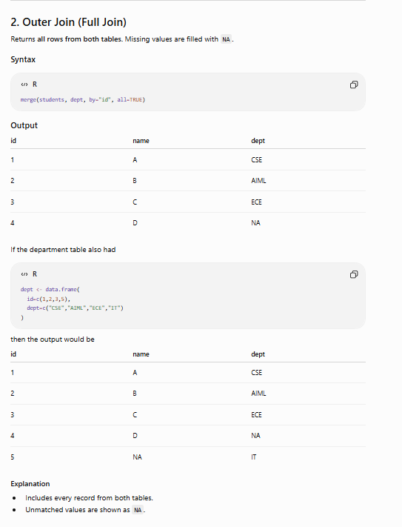
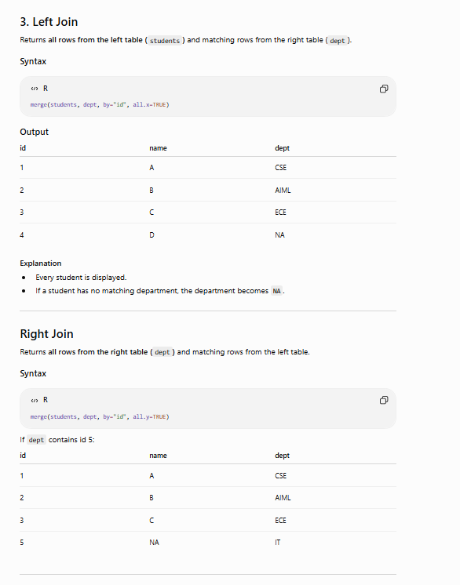

Slide 12
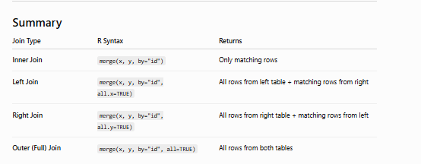

Slide 13
DATA FRAMES
Applying Functions to Data Frames
apply(df, MARGIN, FUN)
lapply(df, FUN)
Applies FUN across rows (MARGIN=1) or columns (MARGIN=2) of a data frame that is coercible to a matrix.
Applies FUN to each column and always returns a list — useful when column results differ in length or type.
sapply(df, FUN)
tapply(x, factor, FUN)
Applies FUN to each column and simplifies the result to a vector or matrix when possible.
Applies FUN to a vector x, split by the levels of a grouping factor — the bridge between data frames and factors.
Example: sapply(students[c("marks")], mean) → column-wise mean of numeric columns.
Data Frames
R Programming • Unit III – Data Frames
8

Slide 14
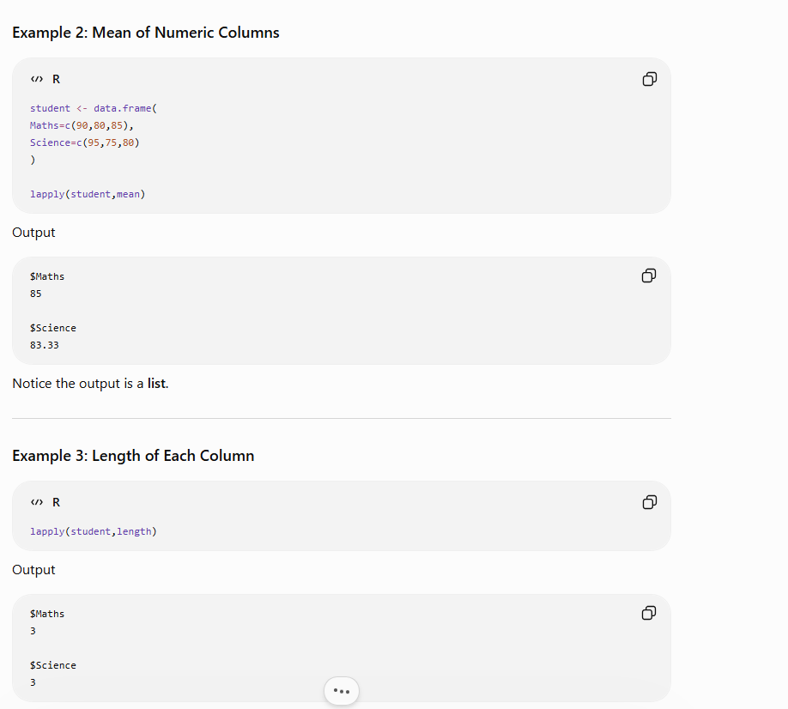
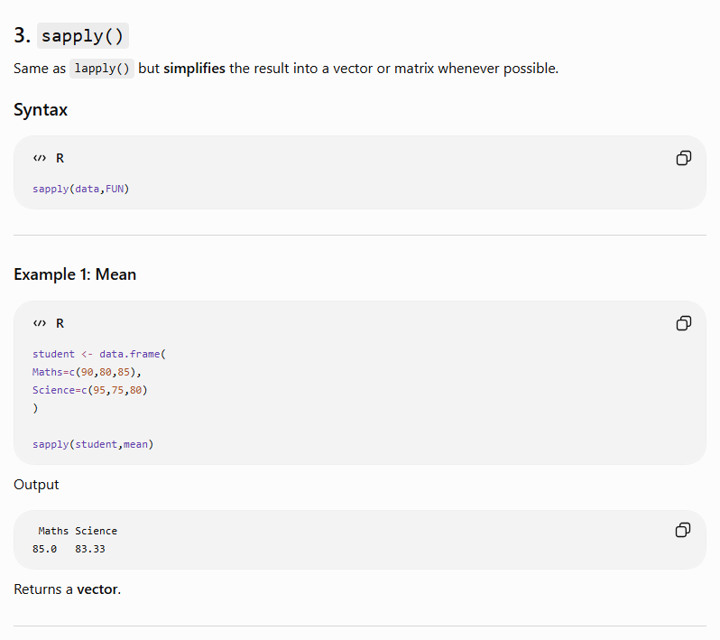
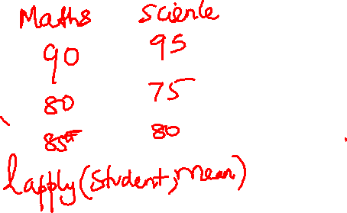

Slide 15
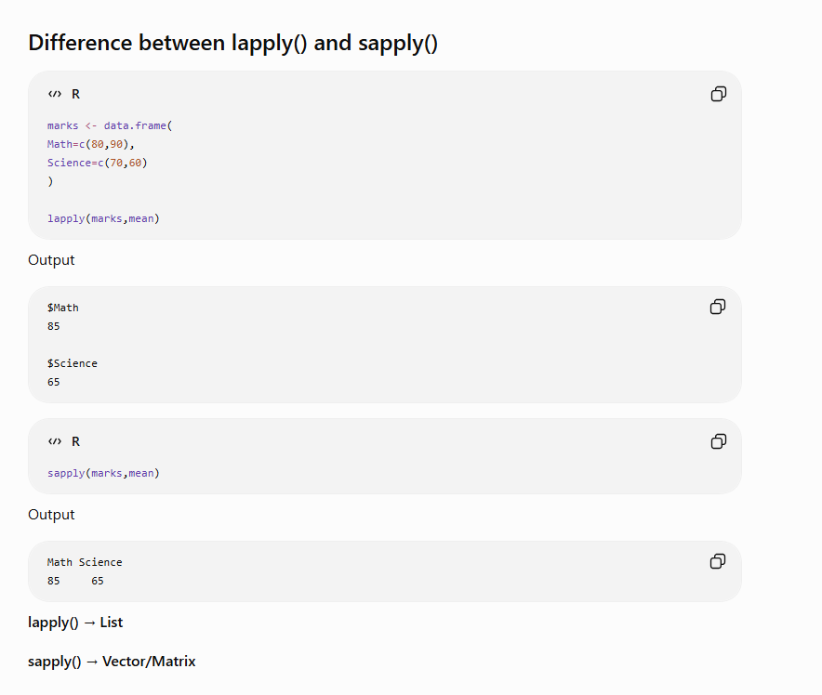
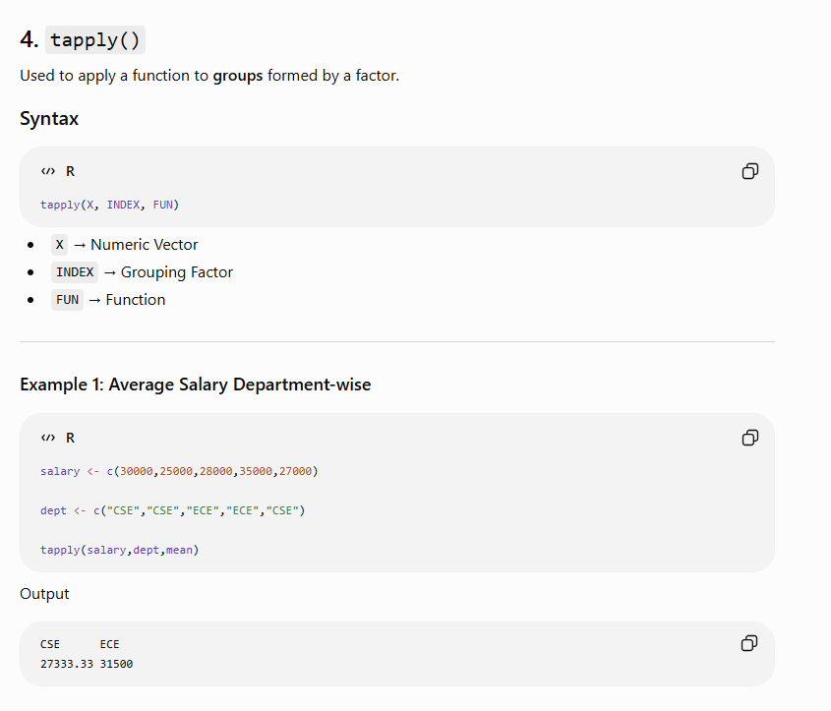

Slide 16
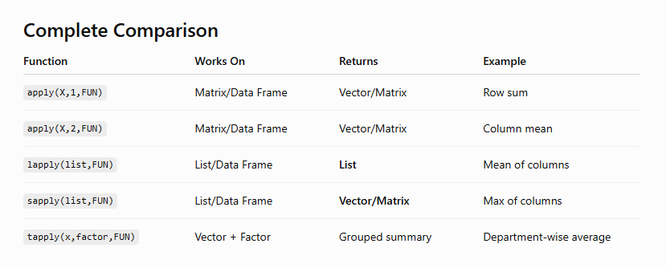

Slide 17
2
SECTION 2 OF 5
Factors and Tables
Encoding categorical data efficiently, and summarising it with frequency and cross-tabulation tables.
Factors and Tables
R Programming • Unit III – Data Frames
9

Slide 18
FACTORS & TABLES
Factors and Levels
A factor stores categorical data as integer codes with a levels attribute holding the category labels.
R Console
grade <- factor(c("Low","High","Low","Med"))
levels(grade)
as.integer(grade)
risk <- factor(c("Low","High","Med"),
levels=c("Low","Med","High"), ordered=TRUE)
risk[1] < risk[3] # TRUE: Low < High
factor() and as.factor() both create factors; as.factor() coerces an existing vector.
levels() returns the distinct category names, in the order R has assigned them (alphabetical by default).
Ordered factors (ordered=TRUE) additionally support comparison operators like < and >.
Output
levels(grade) -> "High" "Low" "Med"
risk[1] < risk[3] -> TRUE
Factors & Tables
R Programming • Unit III – Data Frames
10

Slide 19
FACTORS & TABLES
Common Functions Used With Factors
levels(f) / nlevels(f)
relevel(f, ref=)
Return the category labels, or a count of how many distinct levels exist.
Changes which level is treated as the baseline/reference, important for regression modelling.
table(f)
factor(f, labels=)
Builds a frequency count of each level — the most common way to summarise a factor.
Renames the levels of an existing factor without changing the underlying grouping.
droplevels(f)
is.factor(x) / as.character(f)
Removes unused factor levels after subsetting, so table() output stays clean.
Test whether an object is a factor, or convert factor levels back to plain text.
Factors & Tables
R Programming • Unit III – Data Frames
11

Slide 20
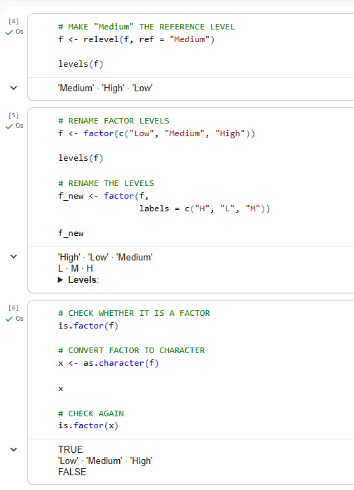
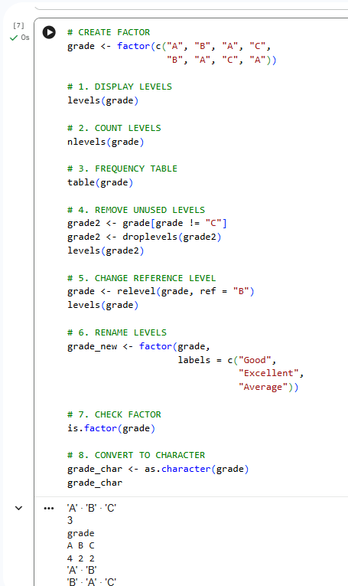
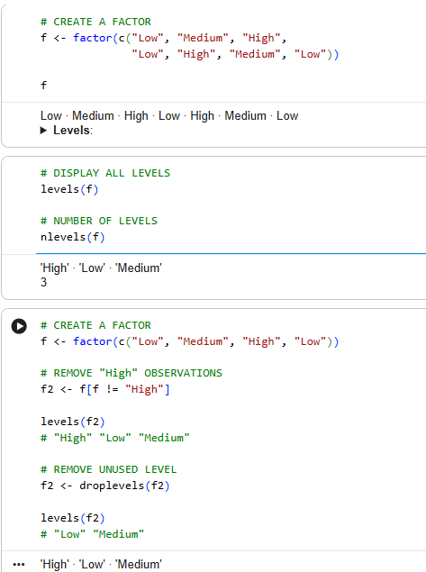

Slide 21
FACTORS & TABLES
Working with Tables
table() cross-tabulates one or more categorical vectors into a contingency table.
R Console
gender <- c("F","M","F","F","M","M")
result <- c("Pass","Pass","Fail","Pass","Fail","Pass")
t <- table(gender, result)
prop.table(t, margin=1) # row proportions
addmargins(t) # totals
Two-way tables reveal the joint distribution of two factors at once.
prop.table() converts raw counts into proportions (row-wise, column-wise, or overall).
addmargins() appends row and column totals to a table for quick reporting.
Output
result
gender Fail Pass
F 1 2
M 1 2
Factors & Tables
R Programming • Unit III – Data Frames
12

Slide 22
FACTORS & TABLES
Other Factor and Table-Related Functions
xtabs(~ f1 + f2, data)
Formula-based cross-tabulation, an alternative to table() that works directly with data frame columns — useful for multi-way tables.
cut(x, breaks)
Converts a continuous numeric vector into a factor of binned intervals, e.g. converting marks into grade bands.
tapply(x, INDEX, FUN)
Splits vector x by factor levels in INDEX and applies FUN to each group — a factor-aware apply.
summary(f) and plot(f)
summary() on a factor reports counts per level; plot() on a factor produces a quick bar chart of frequencies.
Factors & Tables
R Programming • Unit III – Data Frames
13

Slide 23
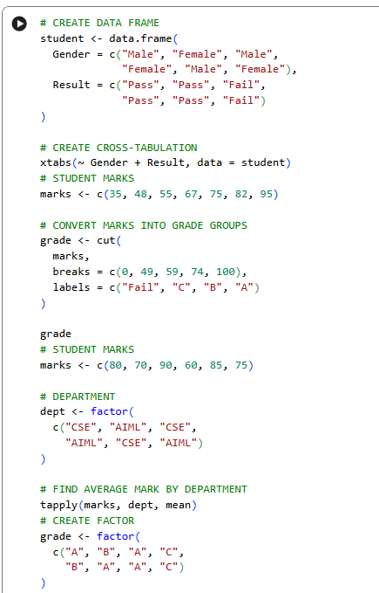
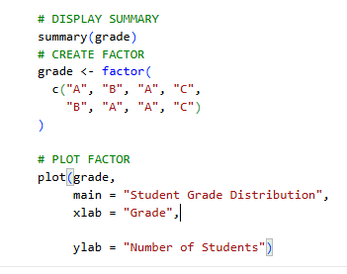
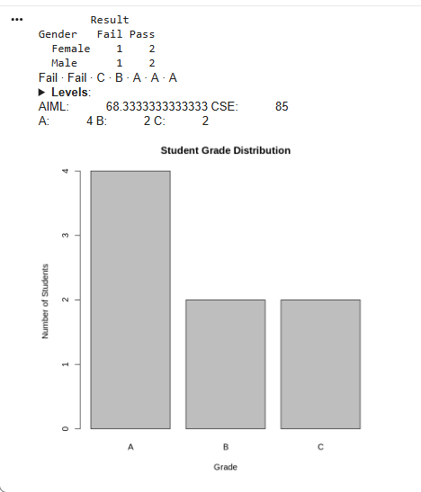

Slide 24
3
SECTION 3 OF 5
Control Statements, Arithmetic & Boolean Operators
Directing program flow with conditionals and loops, and evaluating logical expressions correctly.
Control Statements, Arithmetic & Boolean Operators
R Programming • Unit III – Data Frames
14

Slide 25
Control Statements in R Programming
Decision Making • Loops • Flow Control

Slide 26
What are Control Statements?
• Control statements determine the order in which R executes instructions.
• They help a program make decisions, repeat tasks and alter normal execution.
• Main categories: decision statements, loops and jump/transfer statements.
R Programming • Control Statements

Slide 27
Eight Important Control Statements in R
• if condition
• if–else condition
• for loop
• nested loops
• while loop
• repeat + break
• return statement
• next statement
R Programming • Control Statements

Slide 28
1. if Statement
Execute a block only when a condition is TRUE
• The condition is evaluated first.
• If TRUE, statements inside { } execute.
• If FALSE, the block is skipped.
x <- 100
if (x > 10) {
print(paste(x, "is greater than 10"))
}
# Output:
# "100 is greater than 10"
R Programming • Control Statements

Slide 29
2. if–else Statement
Choose between two alternative paths
• if block executes when the condition is TRUE.
• else block executes when the condition is FALSE.
• Useful for pass/fail, eligible/not eligible, high/low decisions.
x <- 5
if (x > 10) {
print("Greater than 10")
} else {
print("Less than or equal to 10")
}
# Output: Less than or equal to 10
R Programming • Control Statements

Slide 30
3. for Loop
Repeat a block for every value in a sequence or vector
• Best when the number of iterations is known.
• The loop variable takes one value at a time.
• Frequently used with vectors, lists and data frames.
x <- letters[4:10]
for (i in x) {
print(i)
}
# d e f g h i j
R Programming • Control Statements

Slide 31
4. Nested Loops
A loop placed inside another loop
• Outer loop controls one dimension.
• Inner loop processes another dimension.
• Useful for matrices, grids and combinations.
m <- matrix(2:15, nrow = 2)
for (r in seq_len(nrow(m))) {
for (c in seq_len(ncol(m))) {
print(m[r, c])
}
}
R Programming • Control Statements

Slide 32


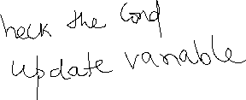


5. while Loop
Repeat while a condition remains TRUE
• Condition is tested before each iteration.
• The loop may execute zero times.
• Always update the controlling variable to avoid an infinite loop.
x <- 1
while (x <= 5) {
print(x)
x <- x + 1
}
# Output: 1 2 3 4 5
R Programming • Control Statements

Slide 33

6. repeat Loop and break
repeat continues indefinitely until explicitly stopped
• repeat has no condition in its header.
• break immediately terminates the loop.
• The exit condition is normally checked inside the loop.
x <- 1
repeat {
print(x)
x <- x + 1
if (x > 5) {
break
}
}
R Programming • Control Statements

Slide 34
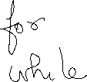

7. return Statement
Return a result from a function
• return() ends function execution at that point.
• The supplied value is sent back to the calling code.
• Useful when different conditions require different results.
check_num <- function(x) {
if (x > 0) return("Positive")
if (x < 0) return("Negative")
return("Zero")
}
check_num(1) # Positive
check_num(0) # Zero
check_num(-1) # Negative
R Programming • Control Statements

Slide 35
8. next Statement
Skip the rest of the current iteration
• next does not terminate the loop.
• It jumps directly to the next iteration.
• Useful for filtering unwanted values during iteration.
x <- 1:10
for (i in x) {
if (i %% 2 != 0) {
next
}
print(i)
}
# Output: 2 4 6 8 10
R Programming • Control Statements

Slide 36
Which Control Statement Should I Use?
Statement | Purpose | Typical Use
if / if–else | Decision making | Pass/fail, classification
for | Known repetitions | Process vector values
nested loops | Multi-level repetition | Matrix processing
while | Condition-controlled repetition | Repeat until threshold
repeat + break | Indefinite repetition | Stop when event occurs
next / return | Alter execution flow | Skip iteration / exit function
R Programming • Control Statements

Slide 37
Classroom Challenge
• Given marks <- c(78, 42, 91, 35, 66, 84), print only the marks ≥ 50.
• Use a for loop to inspect every mark.
• Use if to test whether the mark is below 50.
• Use next to skip failed marks.
• Extension: classify each printed mark as Pass, First Class or Distinction.
marks <- c(78, 42, 91, 35, 66, 84)
for (m in marks) {
if (m < 50) next
print(m)
}
# Output:
# 78 91 66 84
R Programming • Control Statements

Slide 38
Key Takeaways
• if and if–else → make decisions.
• for, while and repeat → perform repetition.
• nested loops → process multidimensional structures.
• break → terminate a loop; next → skip one iteration.
• return → send a result back from a function.
R Programming • Control Statements

Slide 39
CONTROL FLOW
Control Statements: if, for, while, repeat
if / else selects a branch based on a logical condition; ifelse() is its vectorised counterpart.
R Console
for (i in 1:5) print(i^2)
n <- 5
while (n > 0) { print(n); n <- n - 1 }
repeat {
print("runs once, then breaks")
break
}
for iterates over a fixed sequence — a vector, list, or range.
while repeats as long as a condition remains TRUE, checked before each iteration.
repeat loops indefinitely and guarantees at least one execution — it must be exited explicitly with break.
Output
for: 1 4 9 16 25
while: 5 4 3 2 1
repeat executes exactly once here
Control Statements
R Programming • Unit III – Data Frames
15

Slide 40
CONTROL FLOW
Loop Control: break and next
break immediately terminates the innermost loop — execution resumes after the loop.
R Console
for (i in 1:10) {
if (i == 6) break # stop entirely
if (i %% 2 == 0) next # skip even numbers
print(i)
}
next skips the rest of the current iteration and moves to the next one (R's equivalent of "continue").
Both work inside for, while, and repeat.
Careful placement avoids infinite loops, especially in while and repeat.
Output
Prints: 1 3 5
(loop stops before reaching 6)
Control Statements
R Programming • Unit III – Data Frames
16

Slide 41
CONTROL FLOW
Arithmetic and Boolean Operators
Arithmetic: + - * / ^ %% %/%
Element-wise: & and |
Standard operators plus %% (modulus) and %/% (integer division); all are vectorised element-wise.
Compare vectors position by position, returning a logical vector of the same length — used for subsetting.
Comparison: == != < > <= >=
Short-circuit: && and ||
Return logical vectors; used heavily inside if() and for filtering rows of a data frame.
Compare single values only and stop as soon as the result is determined — required inside if().
%in% tests membership; xor(a,b) returns TRUE only when exactly one of a, b is TRUE.
Control Statements
R Programming • Unit III – Data Frames
17

Slide 42
CONTROL FLOW
Boolean Values and Short-Circuit Evaluation
TRUE and FALSE (or T / F) are R's logical constants; they behave as 1 and 0 in arithmetic.
R Console
x <- numeric(0)
if (length(x) > 0 && x[1] > 5) {
print("safe: x[1] never evaluated")
}
is_even <- function(n) n %% 2 == 0
is_even(10)
&& and || evaluate left to right and stop early once the outcome is certain — the second operand may never run.
This makes && safe for guarding against errors, e.g. checking length before indexing.
Functions can explicitly return Boolean values for use directly inside if() conditions.
Output
No error — short-circuit prevents x[1]
is_even(10) -> TRUE
Control Statements
R Programming • Unit III – Data Frames
18

Slide 43
4
SECTION 4 OF 5
Functions, Scope and Recursion
Functions as first-class objects, R's scoping rules, recursion, replacement functions, and functional-programming tools.
Functions, Scope and Recursion
R Programming • Unit III – Data Frames
19

Slide 44
FUNCTIONS
Default Values for Arguments
Any parameter can be given a default value in the function definition using name = value.
R Console
greet <- function(name, greeting="Hello") {
paste(greeting, name)
}
greet("Meera")
greet("Meera", "Welcome")
power <- function(x, n=2) x^n
power(5) # square by default
If the caller omits that argument, R substitutes the default automatically.
Defaults can reference other parameters of the same function, evaluated lazily.
This supports flexible, backward-compatible function signatures.
Output
"Hello Meera"
"Welcome Meera"
power(5) -> 25
Functions & Scope
R Programming • Unit III – Data Frames
20

Slide 45
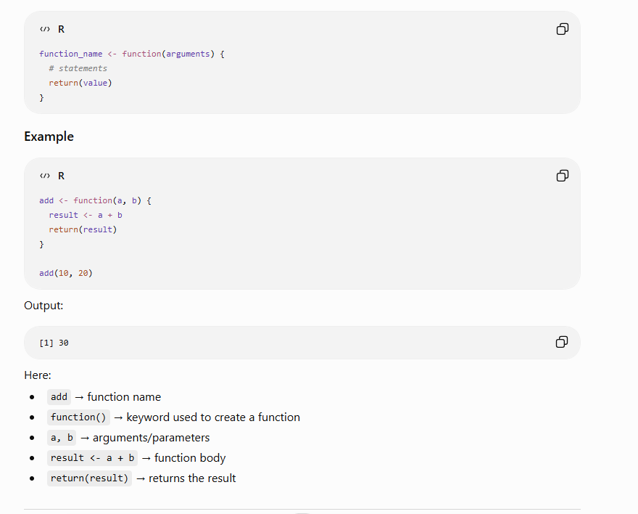

Slide 46
FUNCTIONS
Returning Boolean Values — Functions Are Objects
Returning Boolean Values
Functions Are Objects
A well-designed R function can return TRUE/FALSE directly (e.g. is_valid <- function(x) x > 0 & !is.na(x)), enabling it to be used straight inside if() or as a filter predicate.
In R, a function is a first-class value: it can be assigned to a variable, stored in a list, passed as an argument, or returned from another function.
Input Validation Pattern
Practical Effect
Robust functions check argument validity first and return FALSE or stop() with an informative message rather than failing silently.
This enables passing functions into apply()/sapply(), writing higher-order functions, and building function factories that return customised functions.
Functions & Scope
R Programming • Unit III – Data Frames
21

Slide 47
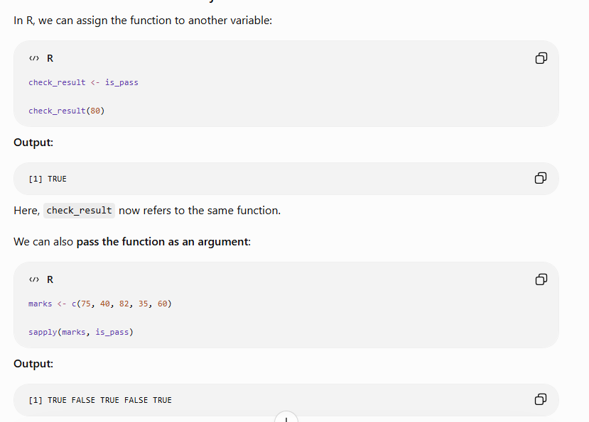
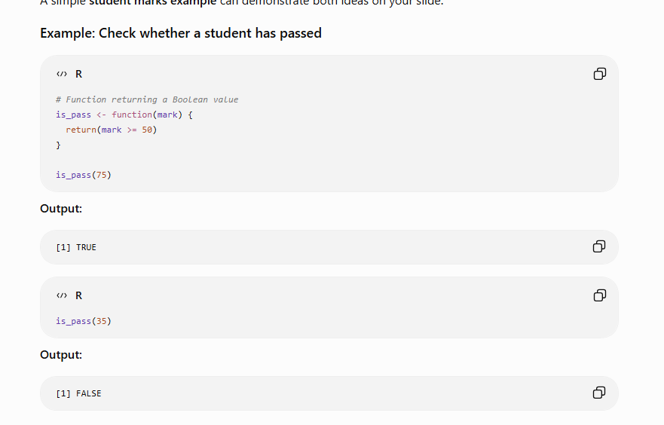

Slide 48
FUNCTIONS
Environment and Scope Issues
R uses lexical (static) scoping: a function looks for a free variable in the environment where it was defined, not where it is called.
R Console
x <- 10
f <- function() {
x <- 20
g <- function() print(x) # finds enclosing x
g()
}
f()
print(x) # global x unchanged
Each function call creates a new local environment; local variables vanish when the call ends.
If a name is not found locally, R searches enclosing environments up to the global environment, then the search path.
environment(f) reveals which environment a function is bound to.
Output
f() prints 20 (lexical scope)
global x remains 10
Functions & Scope
R Programming • Unit III – Data Frames
22

Slide 49
FUNCTIONS
Writing Upstairs: The <<- Operator
<<- is the superassignment operator: it assigns to a variable in an enclosing (parent/global) scope instead of the current one.
R Console
make_counter <- function() {
count <- 0
function() {
count <<- count + 1 # writes upstairs
count
}
}
counter <- make_counter()
counter(); counter(); counter()
If the variable does not exist in any enclosing scope, <<- creates it in the global environment.
This is the mechanism behind closures that retain and modify state, e.g. counters.
Use sparingly: it breaks strict function purity and can make code harder to reason about.
Output
Returns 1, then 2, then 3
(count persists between calls)
Functions & Scope
R Programming • Unit III – Data Frames
23

Slide 50
FUNCTIONS
Recursion
A recursive function calls itself with a smaller version of the problem until it reaches a base case.
R Console
factorial <- function(n) {
if (n <= 1) return(1) # base case
n * factorial(n - 1) # recursive case
}
factorial(5)
fib <- function(n) if (n<=1) n else fib(n-1)+fib(n-2)
sapply(0:6, fib)
Every recursive function needs a base case (stopping condition) and a recursive case that moves toward it.
R has a default call-stack limit (options("expressions")) — very deep recursion can exhaust it and error out.
Classic examples: factorial, Fibonacci, and Tower of Hanoi.
Output
factorial(5) -> 120
fib sequence -> 0 1 1 2 3 5 8
Functions & Scope
R Programming • Unit III – Data Frames
24

Slide 51
FUNCTIONS
Replacement Functions
A replacement function has a name ending in <- and modifies part of an object, e.g. names(x) <- v.
R Console
`second<-` <- function(x, value) {
x[2] <- value
x
}
v <- c(10, 20, 30)
second(v) <- 99
v
R rewrites x <- `names<-`(x, value) behind the scenes when you write names(x) <- value.
The last parameter must be named value, and the function must return the entire modified object.
Custom replacement functions let objects support the same assignment-style syntax as built-ins.
Output
v -> 10 99 30
(custom replacement function in action)
Functions & Scope
R Programming • Unit III – Data Frames
25

Slide 52
FUNCTIONS
Tools for Composing Function Code
do.call(fun, args_list)
Reduce(fun, x)
Calls a function using a list of arguments assembled at run time — useful when argument count or names are dynamic.
Successively combines the elements of x using a binary function, collapsing a vector to a single accumulated value.
Map(fun, x, y)
Filter(predicate, x)
Applies fun element-wise across one or more vectors/lists in parallel, returning a list.
Keeps only the elements of x for which the predicate function returns TRUE — a functional alternative to a for-loop with if.
Together these four functions let R code replace explicit loops with a concise, functional-programming style.
Functions & Scope
R Programming • Unit III – Data Frames
26

Slide 53
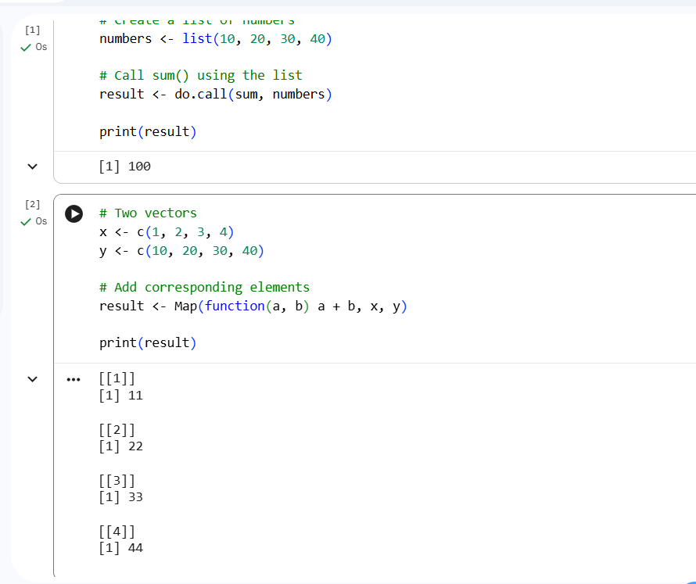
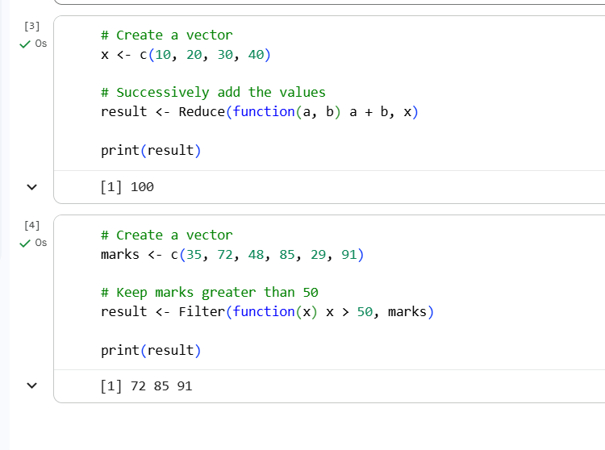

Slide 54
Function | Purpose | Think of it as
do.call() | Call a function with arguments stored in a list | Dynamic function call
Map() | Apply a function to corresponding elements | Element-by-element
Reduce() | Combine many values into one | Many → One
Filter() | Select values satisfying a condition | Keep matching values

Slide 55
5
SECTION 5 OF 5
Math and Simulations in R
Generating randomness, reproducibility with set.seed(), and using simulation to approximate real-world and mathematical quantities.
Math and Simulations in R
R Programming • Unit III – Data Frames
27

Slide 56
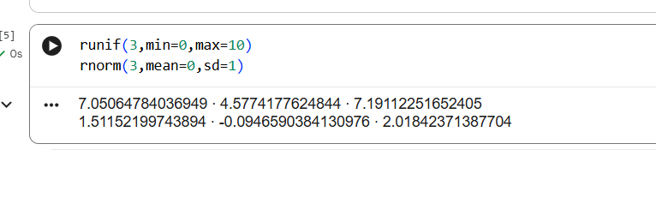
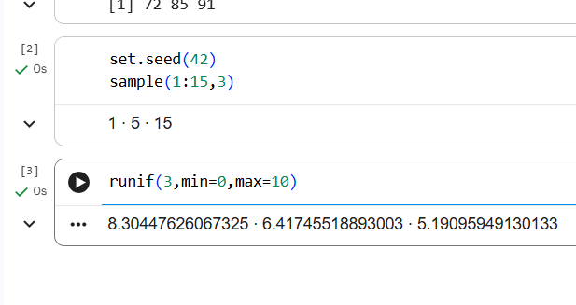
MATH & SIMULATION
Random Numbers and Distributions
runif(n) draws from a uniform distribution; rnorm(n) draws from a normal distribution.
R Console
set.seed(42)
sample(1:5, 3) # reproducible draw
runif(3, min=0, max=10)
rnorm(3, mean=50, sd=5)
rpois() and rbinom() generate counts from Poisson and Binomial distributions respectively.
set.seed(x) fixes R's random-number generator so results are exactly reproducible.
sample() draws a random subset from a vector, with or without replacement.
Output
sample -> same 3 values every run
runif/rnorm -> reproducible with seed
Math & Simulations
R Programming • Unit III – Data Frames
28

Slide 57
Distribution | Type | Main idea | Example
Uniform | Continuous or discrete | All values are equally likely | Random number from 1–6
Normal | Continuous | Values cluster around the mean | Heights, measurement errors
Binomial | Discrete | Number of successes in a fixed number of trials | Heads in 10 coin tosses
Poisson | Discrete | Number of events occurring in a fixed interval | Calls received per hour

Slide 58
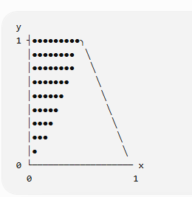
MATH & SIMULATION
Monte Carlo Simulation: Estimating π
Monte Carlo methods use repeated random sampling to approximate a numeric answer.
R Console
set.seed(1)
n <- 100000
x <- runif(n); y <- runif(n)
inside <- sum(x^2 + y^2 <= 1)
pi_est <- 4 * inside / n
pi_est
Points are scattered uniformly in a unit square; the fraction landing inside the inscribed circle approximates π/4.
Accuracy improves — error shrinks — as the number of simulated trials grows.
The same pattern (simulate → count → estimate) underlies coin-toss and random-walk simulations.
Output
pi_est ≈ 3.14 (converges as n grows)
Math & Simulations
R Programming • Unit III – Data Frames
29

Slide 59
APPLIED EXAMPLE
Case Study: Student Result Processing System
1. Build the Data Frame
Create a data frame of student marks with data.frame(); inspect it with str() and summary().
2. Compute Grades
Use ifelse() (a vectorised control statement) to assign a grade letter to every student based on marks.
3. Merge with Student Details
merge() the marks frame with a separate department/details frame on a common id column.
4. Summarise with Factors and Tables
Convert the grade column to a factor and use table() / tapply() to report the distribution of grades per department.
5. Sort and Display
Use order() to rank students by marks and apply() / sapply() to compute summary statistics for the final report.
This single workflow exercises every major topic in Unit III — exactly the pattern examined in Part C, Q3.37 and Q3.43.
Applied Example
R Programming • Unit III – Data Frames
30

Slide 60
UNIT III RECAP
Unit III at a Glance
Data Frames
Factors & Tables
Control Flow
Functions & Recursion
Math & Simulation
• data.frame()
• factor(), levels()
• if / for / while / repeat
• default arguments
• runif, rnorm, sample
• matrix-like ops
• ordered factors
• break / next
• lexical scope, <<-
• set.seed()
• merge() joins
• table(), prop.table()
• & vs && , | vs ||
• recursion
• Monte Carlo estimation
• apply / lapply / sapply / tapply
• xtabs(), cut()
• short-circuit logic
• replacement functions
• do.call/Map/Reduce/Filter
Unit III Recap
R Programming • Unit III – Data Frames
31

Slide 61
EXAM PREPARATION
Unit III Question Bank Coverage
Course Code 35021P28 – all questions mapped to CO3, with Bloom's Taxonomy levels
20
20
20
60
MCQs
Part B
Part C
Total Questions
1 Mark Each
6 Marks Each
10 Marks Each
All Mapped to CO3
Bloom's Level Distribution: Remember (L1) – foundational recall · Understand (L2) – concept explanation · Apply (L3) – program design and problem solving
The following slides list every question in the bank, organised by MCQs, Part B (6 Marks) and Part C (10 Marks).
Question Bank
R Programming • Unit III – Data Frames
32

Slide 62
QUESTION BANK – MCQ
Multiple Choice Questions (1–10 of 20)
Q.No | Question | Correct Answer | Bloom's
41 | Which function creates a data frame in R? | A: data.frame() | Remember (L1)
42 | What does the merge() function do by default (all=FALSE)? | B: Inner join | Understand (L2)
43 | Which function converts a character column to a factor in R? | C: Both A and B | Remember (L1)
44 | What does table(x) return? | B: A frequency table of x | Understand (L2)
45 | In R, what does the <<- operator do? | B: Assigns to a variable in the parent/global scope | Understand (L2)
46 | Which control statement is used to skip the current iteration in an R loop? | B: next | Remember (L1)
47 | What is the output of: is.function(mean) in R? | B: TRUE | Understand (L2)
48 | Which function applies a function across a factor's groups in a vector? | C: tapply() | Apply (L3)
49 | What is the result of: set.seed(42); sample(1:5,3)? | B: Always the same reproducible result | Understand (L2)
50 | Which function is used for cross-tabulation of two factors in R? | C: Both A and B | Apply (L3)
MCQ Bank
R Programming • Unit III – Data Frames
33

Slide 63
QUESTION BANK – MCQ
Multiple Choice Questions (11–20 of 20)
Q.No | Question | Correct Answer | Bloom's
51 | Which function returns the number of rows in a data frame? | A: nrow() | Remember (L1)
52 | What does levels(factor(c('Low','High','Low'))) return? | A: c('Low','High') | Understand (L2)
53 | Which loop structure guarantees at least one execution in R? | C: repeat | Remember (L1)
54 | What is a default argument in an R function definition? | B: An argument with a pre-set value used if not supplied | Understand (L2)
55 | What does the function do.call() do in R? | A: Calls a function using a list of arguments | Apply (L3)
56 | Which Boolean operator performs short-circuit evaluation on single values? | C: && | Understand (L2)
57 | Which function is used to apply a function over rows of a data frame? | A: apply(df, 1, FUN) | Apply (L3)
58 | What does an ordered factor in R allow that a regular factor does not? | B: Comparison operators like < and > | Understand (L2)
59 | Which function generates random numbers from a uniform distribution in R? | B: runif() | Remember (L1)
60 | What is the purpose of the Filter() function in R? | B: Select elements of a list/vector matching a predicate function | Apply (L3)
MCQ Bank
R Programming • Unit III – Data Frames
34

Slide 64
QUESTION BANK – PART B (6 MARKS)
Part B Descriptive Questions (1–10 of 20)
No. | Question | CO | Bloom's
11 | Explain the creation of data frames in R. Illustrate matrix-like operations on data frames with examples. | CO3 | Understand (L2)
12 | Describe the merge() function in R with examples for inner, outer, left, and right joins. | CO3 | Apply (L3)
13 | Explain factors in R: creation, levels, ordered factors, and conversion using as.factor() with examples. | CO3 | Understand (L2)
14 | Explain the table() function in R. How is it used for frequency tables and cross-tabulation? | CO3 | Apply (L3)
15 | Explain control statements in R: if-else, for, while, repeat, break, and next with examples. | CO3 | Apply (L3)
16 | Describe arithmetic and Boolean operators in R. What are short-circuit operators && and ||? | CO3 | Understand (L2)
17 | Explain default values for arguments in R functions. How does R handle missing arguments? | CO3 | Apply (L3)
18 | Explain environment and scope in R. What is lexical scoping? How does R resolve variable names? | CO3 | Understand (L2)
19 | Explain recursion in R with factorial and Fibonacci examples. What are the risks of deep recursion? | CO3 | Apply (L3)
20 | Describe Math and Simulations in R: rnorm(), runif(), set.seed(), sample(), and probability functions. | CO3 | Apply (L3)
Part B Bank
R Programming • Unit III – Data Frames
35

Slide 65
QUESTION BANK – PART B (6 MARKS)
Part B Descriptive Questions (11–20 of 20)
No. | Question | CO | Bloom's
21 | Explain how functions are objects in R. What does this mean for passing functions as arguments? | CO3 | Understand (L2)
22 | Describe 'writing upstairs' using <<- in R. Explain with a closure-based counter function example. | CO3 | Apply (L3)
23 | Explain replacement functions in R (e.g., names<-, dim<-). How are they defined and used? | CO3 | Understand (L2)
24 | Apply functions to data frames using apply(), lapply(), and sapply(). Give examples. | CO3 | Apply (L3)
25 | Describe tools for composing function code in R: do.call(), Reduce(), Map(), and Filter() with examples. | CO3 | Apply (L3)
26 | Explain ordered factors in R. How are they used in comparison and statistical analysis? | CO3 | Understand (L2)
27 | Write an R program using a while loop to compute factorial iteratively. Compare with recursive approach. | CO3 | Apply (L3)
28 | Describe the use of Boolean operators (!, &, |, xor) in data frame filtering with examples. | CO3 | Apply (L3)
29 | Explain cross-tabulation using table() and xtabs(). Create a two-way frequency table from a sample dataset. | CO3 | Apply (L3)
30 | Describe Monte Carlo simulation in R to estimate pi using uniform random numbers. Write the program. | CO3 | Apply (L3)
Part B Bank
R Programming • Unit III – Data Frames
36

Slide 66
QUESTION BANK – PART C (10 MARKS)
Part C Descriptive Questions (1–10 of 20)
No. | Question | CO | Bloom's
31 | Explain data frames in R comprehensively: creation, access, modification, matrix-like operations, merging, and applying functions. Provide examples for each operation. | CO3 | Understand (L2)
32 | Describe all join types using merge() in R (inner, outer, left, right). Write programs for each and explain when to use which join. | CO3 | Apply (L3)
33 | Explain factors and tables in R in detail: creation, levels, ordered factors, table(), prop.table(), and cross-tabulation. Provide examples. | CO3 | Apply (L3)
34 | Write a comprehensive R program demonstrating all control statements: if-else, for, while, repeat, break, next with a real-world scenario for each. | CO3 | Apply (L3)
35 | Explain R's scoping rules (lexical scoping) in detail. Illustrate environment, scope, <<-, and how R resolves free variables across nested functions. | CO3 | Understand (L2)
36 | Describe functions as first-class objects in R: passing functions as arguments, returning functions, anonymous functions, and replacement functions. Provide code examples. | CO3 | Apply (L3)
37 | Design a complete Student Result Processing System in R using data frames: input marks, compute grades using ifelse(), merge with student details, display frequency table and sorted output. | CO3 | Apply (L3)
38 | Explain recursion in R with examples: factorial, Fibonacci, Tower of Hanoi. Discuss stack depth limitations. | CO3 | Apply (L3)
39 | Explain Math and Simulation in R: distributions (rnorm, runif, rpois), set.seed(), sample(). Design a Monte Carlo simulation to estimate pi and compute error at each step. | CO3 | Apply (L3)
40 | Describe tools for composing function code in R: do.call(), Reduce(), Map(), Filter(). Build a functional data processing pipeline using these tools. | CO3 | Apply (L3)
Part C Bank
R Programming • Unit III – Data Frames
37

Slide 67
QUESTION BANK – PART C (10 MARKS)
Part C Descriptive Questions (11–20 of 20)
No. | Question | CO | Bloom's
41 | Explain default values and returning Boolean values from R functions. How do you design robust functions with input validation? Provide a validated statistical function. | CO3 | Apply (L3)
42 | Compare while, for, and repeat loops in R with respect to: syntax, use cases, break/next usage. Give a practical example for each. | CO3 | Understand (L2)
43 | Write an R program to: (i) create a data frame of 50 employee records, (ii) filter by department, (iii) compute salary statistics per department, (iv) merge with department data, (v) generate frequency table. | CO3 | Apply (L3)
44 | Describe replacement functions in R (names<-, levels<-, dim<-). Explain how they work internally. Design a custom replacement function. | CO3 | Understand (L2)
45 | Explain Boolean operators in R (&, |, !, &&, ||, xor). Explain short-circuit evaluation. Write a data validation function using multiple operators. | CO3 | Apply (L3)
46 | Explain the use of factors in data analysis. How do factor levels affect grouping operations in table() and tapply()? Provide examples. | CO3 | Apply (L3)
47 | Design an R program to simulate a coin-toss experiment 10,000 times using sample(). Compute empirical probability and compare with theoretical. Visualize with a histogram. | CO3 | Apply (L3)
48 | Explain the functional programming approach in R using Map(), Reduce(), and Filter(). Demonstrate a complete data pipeline replacing explicit loops. | CO3 | Apply (L3)
49 | Write an R program demonstrating: (i) writing upstairs with <<-, (ii) closure-based counter, (iii) memoization using environment. Explain closures in R. | CO3 | Apply (L3)
50 | Create a simulation in R to model a random walk of 1000 steps: track position, compute return probability, and plot the trajectory. Explain each step. | CO3 | Apply (L3)
Part C Bank
R Programming • Unit III – Data Frames
38

Slide 68
REVISION CHECKLIST
Ready for Unit III Assessment
1
Practice creating, indexing, and merging data frames by hand before checking output in R.
2
Be able to explain the difference between & / && and | / || with a short-circuit example.
3
Trace recursion and <<- examples step by step — draw the call stack / environment chain.
4
Write at least one program using each of do.call(), Map(), Reduce(), and Filter().
Dr. S. Pitchumani Angayarkanni • Department of CSE • AVIT, VMRF Deemed University

