Slide 1
R PROGRAMMING · UNIT IV
Object-Oriented Programming
& Working with Data in R
S3 & S4 Classes • Managing Objects • Input/Output • String Manipulation • Graphics
Course: R Programming (35021P28)
Programme: B.E. Computer Science and Engineering (CS)
Faculty: Dr. S. Pitchumani Angayarkanni, Professor, Dept. of CSE
Institution: Aarupadai Veedu Institute of Technology (AVIT), VMRF

Slide 2
ORIENTATION
Learning Objectives
By the end of this unit, students will be able to:
1
2
3
Design R classes
Manage the workspace
Handle Input/Output
Build and use S3, S4 and Reference-Class systems to model real-world entities in R.
Inspect, save, reload and clean up R objects and sessions confidently.
Read from the keyboard, files, connections, the internet and JSON APIs.
4
5
6
Manipulate strings
Build graphics
Apply skills together
Search, extract, replace, format and analyze text data using base R and stringr.
Create, customize, arrange, save and render 2D and 3D plots for data analysis.
Combine OOP, I/O, strings and graphics in an end-to-end R script.
R Programming — Unit V: OOP, I/O, Strings & Graphics
2

Slide 3
ROADMAP
Lesson Agenda
01
Object-Oriented Programming
S3, S4 & Reference Classes, dispatch, inheritance, OOP in statistical models
02
Managing Your Objects
Workspace inspection, exists/get/assign, saving, file connections
03
Input / Output
Keyboard, monitor, files, the internet and JSON APIs
04
String Manipulation
Building, trimming, pattern matching, replacing, formatting and text analytics
05
Graphics
Creating, customizing, arranging, saving and 3D plots
R Programming — Unit V: OOP, I/O, Strings & Graphics
3

Slide 4
SECTION 1
Object-Oriented Programming in R
Three class systems power OOP in R — this unit covers S3, S4 and Reference Classes

Slide 5
Object-Oriented Programming in R
Object-Oriented Programming (OOP) is a programming paradigm in which programs are organized around objects rather than only functions and procedures.
An object normally combines:
  data
  attributes describing the data
  operations/methods that work on the data.
R is different from traditional OOP languages such as Java, C++, and Python, but object orientation is still fundamental to R.
The important OOP concepts in R are:
Objects: Almost everything in R is an object—numbers, vectors, character strings, matrices, data frames, functions, models, etc.
Encapsulation: Related information can be packaged together into an object.
Polymorphism: The same function can behave differently depending on the class of the object.
Inheritance: A class can inherit properties and behaviour from another class.
The polymorphism: a call such as print() or plot() may dispatch to a class-specific method depending on the object supplied.
R has multiple OOP systems, but we focus on:
S3 classes
S4 classes

Slide 6
OOP IN R
Why Object-Oriented Programming in R?
R offers three OOP systems. Each trades simplicity for structure differently.
S3
S4
R5 / RC
Informal & lightweight
Formal & rigorous
Reference classes
Attach a class attribute to any object; dispatch by function name matching.
Declare classes with typed slots; strict validity checking and multiple dispatch.
Mutable, environment-based objects — closest to classic OOP (Java/Python style).
This unit focuses on S3 (e.g. lm(), data.frame print methods), S4 (used heavily in Bioconductor) and touches R5/Reference Classes for comparison.
R Programming — Unit V: OOP, I/O, Strings & Graphics
5

Slide 7
S3 CLASSES
S3 Classes — A Simple First Example
S3 is R's original and relatively simple object-oriented system.
Most built-in R classes traditionally use the S3 approach.
An S3 object is essentially an ordinary R object—often a list—to which a class attribute is attached
Creating an S3 Object
A common approach is to write a constructor function
# Step 1: make a list
student <- list(name = "Arun", marks = 88)
# Step 2: attach a class
class(student) <- "Student"
# Use it
class(student) # "Student"
student$name # "Arun"
Here:
student is initially a list.
"Student" is assigned as its class.
The object can now have class-specific methods.
R Programming — Unit V: OOP, I/O, Strings & Graphics
6

Slide 8
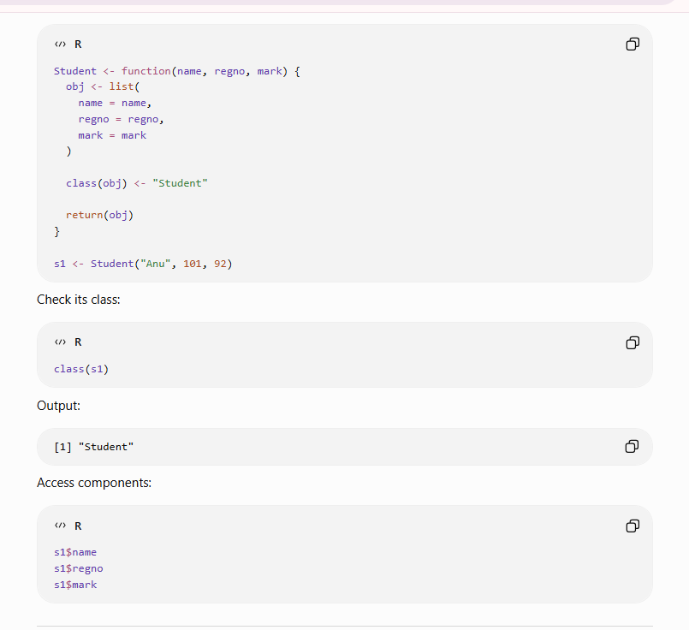

Slide 9
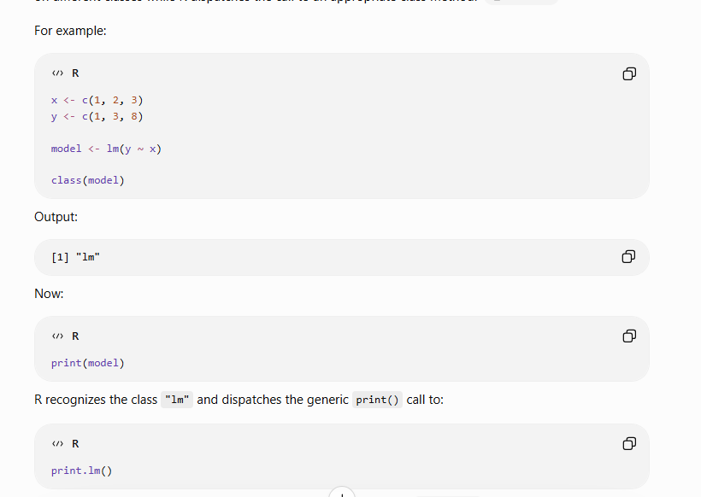
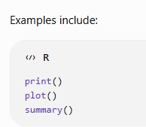
S3 CLASSES
S3 — Generic Functions & Method Dispatch
A generic function (e.g. print) checks the object's class.
UseMethod() hands control to the matching class method.
Naming convention: generic.className, e.g. print.Student.
This is single dispatch — dispatch on the first argument only.
print.Student <- function(x, ...) {
cat("Student:", x$name,
"| Marks:", x$marks, "\n")
}
print(student)
# Student: Arun | Marks: 88
# R automatically calls print.Student
# because class(student) == "Student"
x represents the object being printed. The ... allows additional optional arguments to be passed, which is standard practice for methods of generic functions.
R Programming — Unit V: OOP, I/O, Strings & Graphics
7

Slide 10
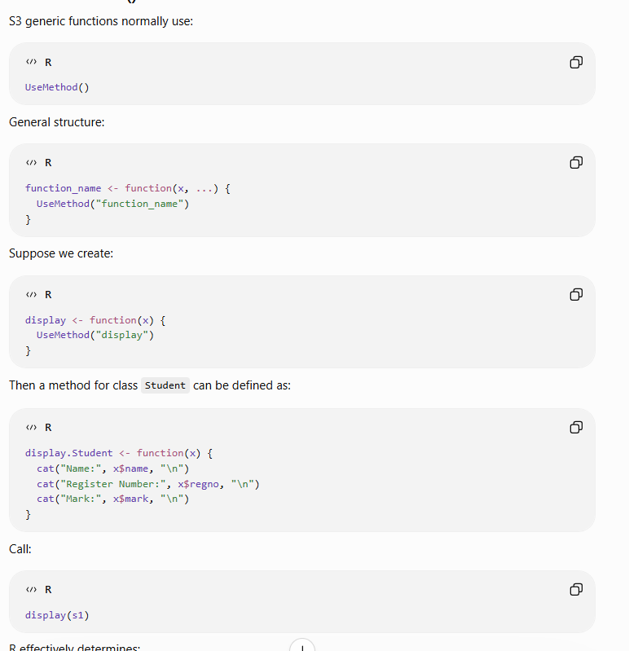

Slide 11
S3 CLASSES
S3 — Constructor Function Pattern
A constructor function standardises how objects are built.
Add a print method so the object displays meaningfully.
Validate inputs inside the constructor to avoid bad objects.
This pattern scales to bank accounts, shapes, employees, etc.
new_Student <- function(name, marks) {
obj <- list(name = name, marks = marks)
class(obj) <- "Student"
obj
}
s1 <- new_Student("Kavya", 90)
print(s1)
# Student: Kavya | Marks: 90
R Programming — Unit V: OOP, I/O, Strings & Graphics
8

Slide 12
S3 CLASSES
S3 — Inheritance (Vehicle → Car)
Inheritance is one of the concept in object oriented programming by which new classes can derived from existing or base classes helping in re-usability of code.
Derived classes can be the same as a base class or can have extended features which creates a hierarchical structure of classes in the programming environment.
A class VECTOR builds a hierarchy: c("Car","Vehicle").
R searches methods left-to-right along this class vector.
NextMethod() calls the method for the next class in line.
A subclass method can EXTEND, not just replace, the parent.
vehicle <- list(make = "Tesla")
class(vehicle) <- "Vehicle"
print.Vehicle <- function(x,...) cat(x$make,"\n")
class(vehicle) <- c("Car", "Vehicle")
print.Car <- function(x,...) {
cat("Car: "); NextMethod()
}
print(vehicle) # Car: Tesla
R Programming — Unit V: OOP, I/O, Strings & Graphics
9

Slide 13

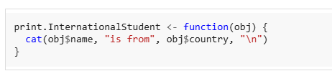
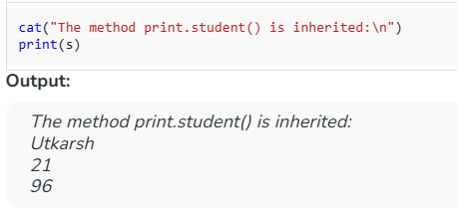
Overriding the print method for InternationalStudent
At this point, we define a new print method specifically for objects of the class "InternationalStudent". This method will print the student's name and their country, instead of just the name, age and roll number. This effectively overrides the previous print behavior when the object has the InternationalStudent class.
We then create a student object s by making a list with the student's name, age, roll number and country. After creating this list, we assign two classes to it: "InternationalStudent" and "student". The order of these classes matters because R will try to find the method in the first class and then fall back to the second if it doesn't find it. This is done by setting the class() attribute for the object.
Calling the print method on the student object
After defining the object s, we call print(s) to print its details. Since the print.student method is defined, it gets called. This method prints the name, age and roll number of the student as specified in the earlier code block.

Slide 14
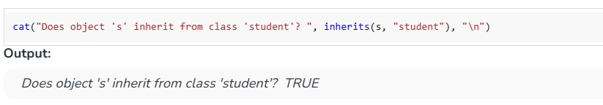
Checking if object s inherits from the student class:
Finally, we use the inherits() function to check if the object s is inherited from the student class. This function returns TRUE because the object s is indeed of class student (since student is part of the class hierarchy of s).

Slide 15
Advantages of S3
S3 is:
simple
flexible
easy to learn
easy to implement
suitable for lightweight object-oriented programming
widely used in traditional R code.
But that flexibility also means less strict checking.
For example, because an S3 object can simply be a list, accidental components can be added without necessarily generating an error.

Slide 16
S4 CLASSES
S4 Classes — A Simple First Example
S4 is a more formal OOP system than S3.
S4 explicitly defines the structure and allowed types of an object, helping prevent accidental creation or access of invalid components.
S4 terminology differs slightly:
class components are called slots
classes are explicitly declared
slot types are explicitly declared
objects are usually created with new()
slots are accessed using @.
S4 classes are declared with setClass() before use.
slots = c(...) fixes each field's name and required type.
new() creates an object; type-checking happens automatically.
This mirrors the student example, now made type-safe.
# Step 1: define the class
setClass("Student", slots = c(
name = "character",
marks = "numeric"
))
# Step 2: create an object
s <- new("Student", name = "John", marks = 88)
s@name # "John" (@ instead of $)
R Programming — Unit V: OOP, I/O, Strings & Graphics
10

Slide 17
S4 CLASSES
S4 — Slots & Validity Rules
Slots are accessed with the @ operator, not $.
setValidity() attaches a rule-checking function to the class.
Return TRUE if valid, or an error message string if not.
Invalid objects are rejected the moment new() runs.
setValidity("Student", function(object) {
if (object@marks < 0 || object@marks > 100)
return("marks must be between 0 and 100")
TRUE
})
new("Student", name = "X", marks = 150)
# Error: invalid class “Student” object:
# marks must be between 0 and 100
R Programming — Unit V: OOP, I/O, Strings & Graphics
11

Slide 18
S4 CLASSES
S4 — Generic Functions & Methods
setGeneric() declares a new generic function.
setMethod() defines its behaviour for a specific class.
signature= names which argument's class controls dispatch.
S4 supports multiple dispatch — more than one argument's class.
setGeneric("grade", function(obj)
standardGeneric("grade"))
setMethod("grade", "Student", function(obj) {
if (obj@marks >= 90) "A"
else if (obj@marks >= 75) "B"
else "C"
})
grade(s) # "B"
R Programming — Unit V: OOP, I/O, Strings & Graphics
12

Slide 19
S4 CLASSES
S4 — Inheritance with contains=
contains= names the parent class a new class extends.
A subclass automatically inherits all parent slots.
callNextMethod() invokes the parent's version of a method.
is() checks whether an object belongs to a class or ancestor.
setClass("GradStudent", contains = "Student",
slots = c(thesis = "character"))
g <- new("GradStudent", name = "Divya",
marks = 92, thesis = "AI in Health")
is(g, "Student") # TRUE
g@thesis # "AI in Health"
R Programming — Unit V: OOP, I/O, Strings & Graphics
13

Slide 20
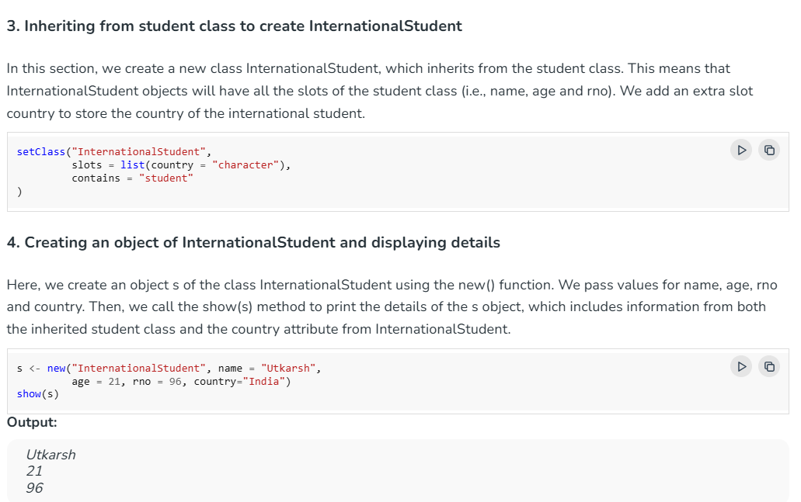

Slide 21
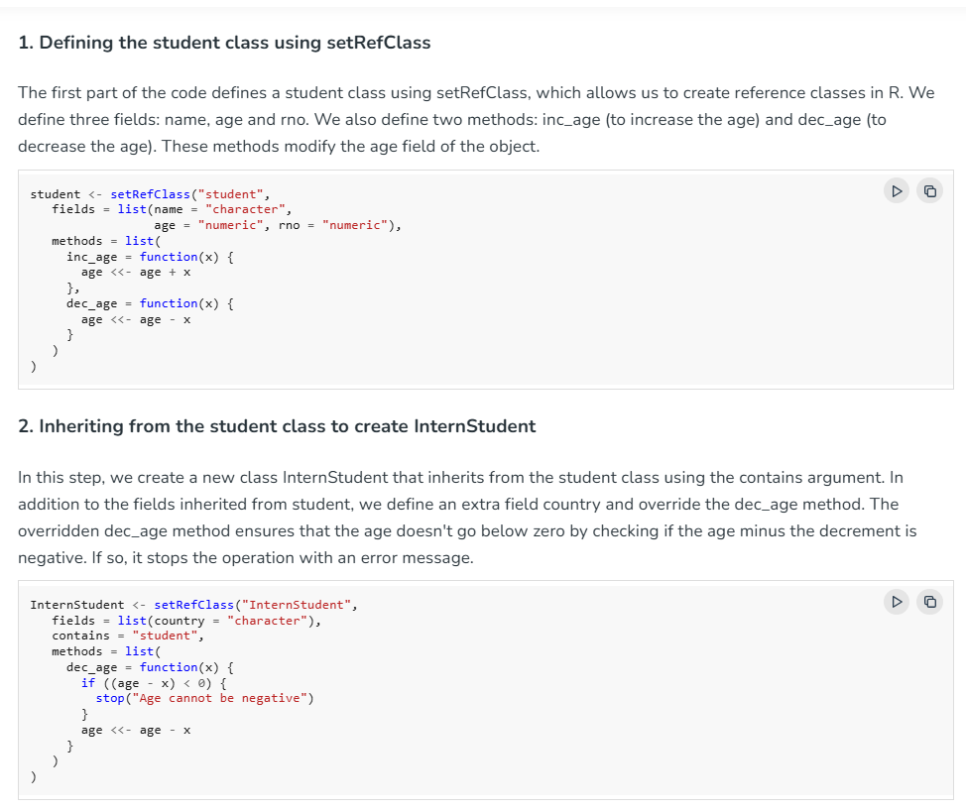

Slide 22
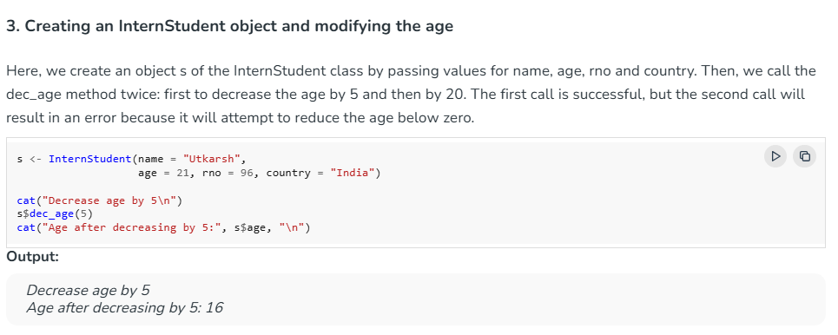

Slide 23
COMPARE
S3 vs S4 — Side by Side
Aspect | S3 | S4
Definition | Informal — no setClass() | Formal — declared with setClass()
Field access | x$field | x@slot
Type checking | None (unchecked) | Enforced at object creation
Method dispatch | Single (first argument) | Single or multiple dispatch
Method naming | generic.class() | setMethod("generic", "class")
Inheritance call | NextMethod() | callNextMethod()
Typical use | Quick, everyday objects | Robust packages needing validation
R Programming — Unit V: OOP, I/O, Strings & Graphics
14

Slide 24
COMPARE
S3 vs S4 vs R5 (Reference Classes)
Aspect | S3 | S4 | R5 / Reference Classes
Declared with | class() / structure() | setClass() | setRefClass()
Mutability | Copy-on-modify | Copy-on-modify | Mutable — modify in place
Field access | x$field | x@slot | x$field (via $methods)
Type checking | None | Enforced | Enforced
Dispatch | Single, by class attr. | Single or multiple | Method belongs to object
Best for | Quick, everyday objects | Validated package classes | Stateful objects
R Programming — Unit V: OOP, I/O, Strings & Graphics
15

Slide 25
OOP IN PRACTICE
OOP Meets Statistical Models in R
Model functions like lm() and glm() return an S3 object.
class(model) is set to "lm", carrying data + coefficients.
print(), summary(), predict() are all S3 generics.
The SAME function names work on completely different models.
fit <- lm(mpg ~ wt, data = mtcars)
class(fit) # "lm"
summary(fit) # calls summary.lm()
predict(fit, data.frame(wt = 3))
fit2 <- glm(am ~ wt, data = mtcars,
family = binomial)
class(fit2) # "glm" "lm"
R Programming — Unit V: OOP, I/O, Strings & Graphics
16

Slide 26
SECTION 2
Managing Your Objects
Inspecting, saving, reloading and connecting to the R workspace

Slide 27
MANAGING OBJECTS
Inspecting Objects & the Workspace
ls() lists every object in the workspace right now.
str() shows the internal structure of any object.
class() / typeof() report the class vs. storage type.
rm() removes objects; rm(list = ls()) clears everything.
ls() # list all objects
str(student) # structure of an object
class(student) # "Student"
exists("student") # TRUE
rm(s1) # remove one object
rm(list = ls()) # clear workspace
R Programming — Unit V: OOP, I/O, Strings & Graphics
18

Slide 28
MANAGING OBJECTS
Session State: exists(), get(), assign()
exists("name") checks whether an object is defined.
get("name") retrieves an object by its name as a string.
assign("name", value) creates a variable from a string name.
Together they let code build variable names dynamically.
# Create score1, score2, score3 dynamically
for (i in 1:3) assign(paste0("score", i), i * 10)
score2 # 20
# Safe dynamic lookup
get_or_default <- function(nm, default = NA) {
if (exists(nm)) get(nm) else default
}
get_or_default("score1") # 10
R Programming — Unit V: OOP, I/O, Strings & Graphics
19

Slide 29
MANAGING OBJECTS
Saving & Reloading Objects
save() writes one or more objects to a .RData file.
load() restores those objects, exactly as saved.
saveRDS()/readRDS() save a SINGLE object, unnamed.
save.image() saves the whole current workspace.
save(student, s1, file = "students.RData")
load("students.RData")
saveRDS(s1, "student.rds")
copy <- readRDS("student.rds")
save.image("session.RData")
R Programming — Unit V: OOP, I/O, Strings & Graphics
20

Slide 30
MANAGING OBJECTS
File Connections & Logging
file() opens an explicit connection to a file.
open()/close() control when the connection is active.
"a" (append) mode keeps adding without overwriting.
This pattern underlies simple timestamped log files.
con <- file("data.txt", open = "r")
lines <- readLines(con, n = 5)
close(con)
log_event <- function(msg, path = "app.log") {
con <- file(path, open = "a")
writeLines(paste(Sys.time(), "-", msg), con)
close(con)
}
log_event("Training started")
R Programming — Unit V: OOP, I/O, Strings & Graphics
21

Slide 31
SECTION 3
Input / Output in R
Keyboard, monitor, files, the internet and JSON APIs

Slide 32
I/O
Input/Output — The Big Picture
R programs exchange data with four kinds of endpoints:
1
2
3
4
Keyboard
Monitor
Files
Internet
readline(), scan()
print(), cat(), format()
read.csv(), write.csv()
url(), download.file()
Interactive input from the user at the console
Displaying results and formatted output
Persisting data to disk and loading it back
Fetching remote data over HTTP/HTTPS
R Programming — Unit V: OOP, I/O, Strings & Graphics
23

Slide 33
I/O
Accessing the Keyboard
readline() reads one line typed by the user (interactive).
readline() always returns a character string.
scan() reads several numeric values until a blank line.
name <- readline("Enter your name: ")
age <- as.integer(readline("Enter age: "))
cat("Hello", name, "- age", age, "\n")
marks <- scan(what = numeric(), n = 3)
mean(marks)
R Programming — Unit V: OOP, I/O, Strings & Graphics
24

Slide 34
I/O
Accessing the Monitor
print() shows R's default view of an object.
cat() prints without quotes — good for messages.
sprintf() gives C-style formatted output.
print(3.14159) # [1] 3.14159
cat("Score:", 88, "/100\n") # Score: 88 /100
sprintf("%-10s %6.2f", "Total", 85.5)
# "Total 85.50"
R Programming — Unit V: OOP, I/O, Strings & Graphics
25

Slide 35
I/O
Reading Data from Files
read.csv() imports a delimited text file as a data frame.
header = TRUE treats row 1 as column names.
readLines() reads a text file as a character vector.
df <- read.csv("marks.csv", header = TRUE)
head(df)
lines <- readLines("notes.txt")
length(lines)
if (file.exists("marks.csv")) df <- read.csv("marks.csv")
R Programming — Unit V: OOP, I/O, Strings & Graphics
26

Slide 36
I/O
Writing Data to Files
write.csv() exports a data frame to a text file.
row.names = FALSE avoids an unwanted index column.
sink() redirects console output into a file.
write.csv(df, "output.csv", row.names = FALSE)
writeLines(c("Line 1", "Line 2"), "notes.txt")
sink("log.txt")
print(summary(df))
sink() # stop redirecting
R Programming — Unit V: OOP, I/O, Strings & Graphics
27

Slide 37
I/O
Accessing the Internet
url() opens a connection to a web resource.
download.file() saves a remote file to local disk.
read.csv() can take a URL directly as its argument.
Wrap internet calls in tryCatch() — networks can fail.
u <- "https://example.com/data.csv"
df <- read.csv(u)
download.file(u, destfile = "local.csv")
tryCatch({
df <- read.csv(u)
}, error = function(e) message("Fetch failed"))
R Programming — Unit V: OOP, I/O, Strings & Graphics
28

Slide 38
I/O
Reading JSON from the Web
jsonlite is R's standard tool for JSON.
fromJSON() parses a URL/string directly into a data frame.
toJSON() converts an R object back into JSON text.
library(jsonlite)
data <- fromJSON("https://api.example.com/students")
head(data)
txt <- '{"name":"Arun","marks":88}'
obj <- fromJSON(txt)
obj$name # "Arun"
R Programming — Unit V: OOP, I/O, Strings & Graphics
29

Slide 39
SECTION 4
String Manipulation
Building, trimming, searching, replacing, formatting and analyzing text

Slide 40
STRINGS
Building & Inspecting Strings
paste() joins strings with a separator (space by default).
nchar() counts characters; substr() extracts a substring.
toupper() / tolower() change letter case.
paste("R", "Programming") # "R Programming"
paste0("Unit", 5) # "Unit5"
nchar("AVIT") # 4
toupper("hello") # "HELLO"
substr("R Programming", 3, 13) # "Programming"
R Programming — Unit V: OOP, I/O, Strings & Graphics
31

Slide 41
STRINGS
Trimming & Boundary Checks
trimws() strips leading/trailing whitespace.
startsWith(x, prefix) tests a string's beginning.
endsWith(x, suffix) tests a string's ending.
trimws(" padded text ")
# "padded text"
files <- c("report.csv", "notes.txt")
startsWith(files, "report") # TRUE FALSE
endsWith(files, ".csv") # TRUE FALSE
R Programming — Unit V: OOP, I/O, Strings & Graphics
32

Slide 42
STRINGS
Pattern Matching with Regular Expressions
grepl() returns TRUE/FALSE for a pattern match.
grep() returns the matching indices or values.
^ start, $ end, . any char, \\d digit, + one-or-more.
words <- c("apple", "banana", "grape")
grepl("an", words) # F T F
grep("^a", words, value = TRUE) # "apple"
regexpr("a", "banana") # position 2
R Programming — Unit V: OOP, I/O, Strings & Graphics
33

Slide 43
STRINGS
Extracting Matches & Validating Input
regmatches(x, m) pulls out the TEXT located by regexpr.
Anchors ^ $ plus {n} build strict validation patterns.
A mobile pattern: leading 6-9 digit then 9 more digits.
txt <- "Call 9876543210 for help"
pat <- "[6-9][0-9]{9}"
m <- regexpr(pat, txt)
regmatches(txt, m) # "9876543210"
grepl(paste0("^", pat, "$"), "9876543210")
# TRUE
R Programming — Unit V: OOP, I/O, Strings & Graphics
34

Slide 44
STRINGS
Replacing, Splitting & Formatting
sub() replaces the FIRST match; gsub() replaces ALL.
strsplit() splits a string around a delimiter.
sprintf() / format() control numeric display.
gsub(" ", "_", "R Programming")
# "R_Programming"
strsplit("a,b,c", ",")[[1]]
# "a" "b" "c"
sprintf("%05d", 42) # "00042"
R Programming — Unit V: OOP, I/O, Strings & Graphics
35

Slide 45
COMPARE
Base R vs stringr — Text Handling
Task | Base R | stringr
Length | nchar(x) | str_length(x)
Substring | substr(x, a, b) | str_sub(x, a, b)
Detect pattern | grepl(pat, x) | str_detect(x, pat)
Extract match | regmatches(x, regexpr(pat, x)) | str_extract(x, pat)
Replace all | gsub(pat, rep, x) | str_replace_all(x, pat, rep)
Split | strsplit(x, sep) | str_split(x, sep)
Pad / trim | formatC() / trimws() | str_pad() / str_trim()
R Programming — Unit V: OOP, I/O, Strings & Graphics
36

Slide 46
TEXT ANALYTICS
Text Pipeline I — Tokens & Frequency
tolower() normalises case before comparing words.
strsplit() on whitespace tokenizes a sentence.
A stopword list filters out low-information words.
table() + sort() ranks words by frequency.
txt <- "R is fun. R is easy to learn"
words <- tolower(gsub("[[:punct:]]", "", txt))
tokens <- strsplit(words, "\\s+")[[1]]
stop <- c("is","to")
clean <- tokens[!tokens %in% stop]
sort(table(clean), decreasing = TRUE)
R Programming — Unit V: OOP, I/O, Strings & Graphics
37

Slide 47
TEXT ANALYTICS
Text Pipeline II — TF-IDF & Sentiment
TF-IDF = Term Frequency × Inverse Document Frequency — highlights words distinctive to one document (formula: tf(w) * log(N/df(w))).
Simple sentiment: build a small positive/negative word lexicon.
Score = positive count − negative count; classify by its sign.
words <- c("r","is","great","and","fun")
pos <- c("great","fun","easy","good")
neg <- c("bad","hard","boring")
score <- sum(words %in% pos) - sum(words %in% neg)
if (score > 0) "Positive" else
if (score < 0) "Negative" else "Neutral"
R Programming — Unit V: OOP, I/O, Strings & Graphics
38

Slide 48
SECTION 5
Graphics in R
Creating, customizing, arranging, saving and building 3D plots

Slide 49
Creating Graphs in R Programming
R provides rich and versatile tools for data visualization,
allowing you to create charts, plots, and graphs to represent
data visually.
Types of Graphs in Base R
Type of Graph | Function | Purpose
Bar Chart | barplot() | Compare frequencies, counts or values across categories.
Histogram | hist() | Display the distribution of a numerical variable using intervals.
Pie Chart | pie() | Show proportions of a whole.
Line Graph | plot(..., type = "l") | Show changes over time or an ordered sequence.
Scatter Plot | plot() | Display the relationship between two numerical variables.
Boxplot | boxplot() | Visualize the median, spread and potential outliers.
Strip Chart | stripchart() | Show individual observations, especially for small datasets.
Dot Chart | dotchart() | Compare values across labelled categories using dots.
Why Use Graphics in R?
To summarize and understand data visually.
To spot trends, outliers, and patterns.
To make your analysis more interactive and
understandable.
To communicate results clearly in presentations or
reports

Slide 50
GRAPHICS
Creating Graphs
plot() draws scatter/line plots.
hist() draws a histogram; barplot()/pie() for categories.
boxplot() shows median, quartiles and outliers.
plot(1:10, (1:10)^2, type = "b")
hist(rnorm(200), main = "Distribution")
barplot(table(mtcars$cyl))
boxplot(mpg ~ cyl, data = mtcars)
R Programming — Unit V: OOP, I/O, Strings & Graphics
40

Slide 51
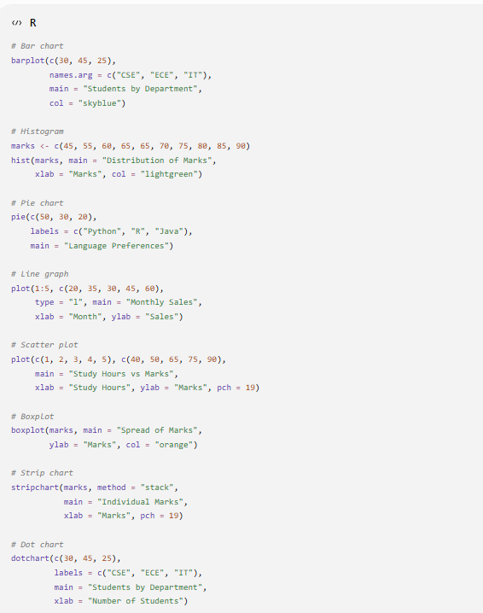
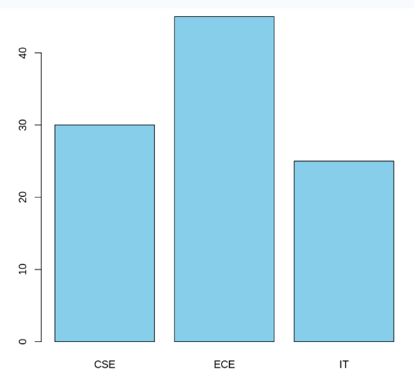
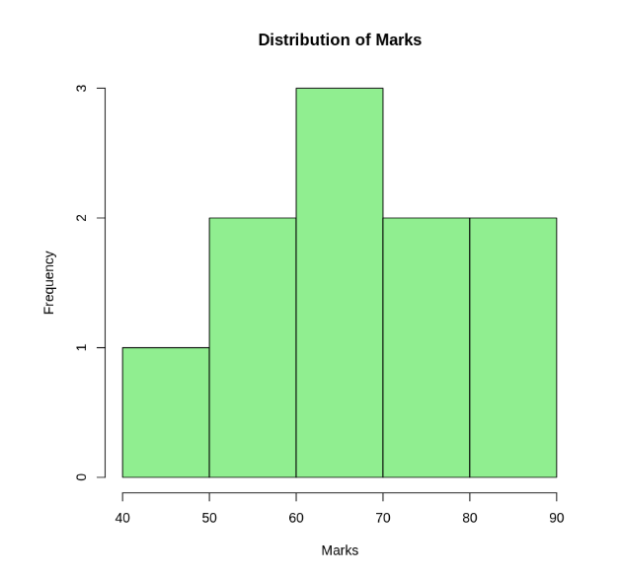
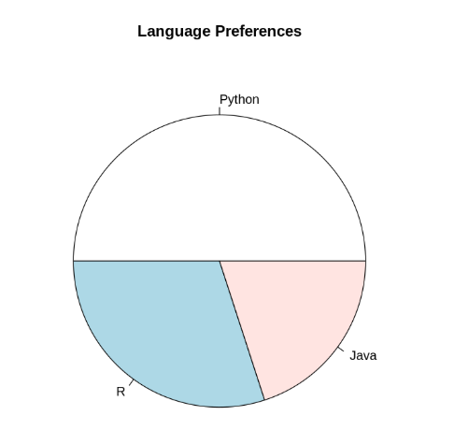
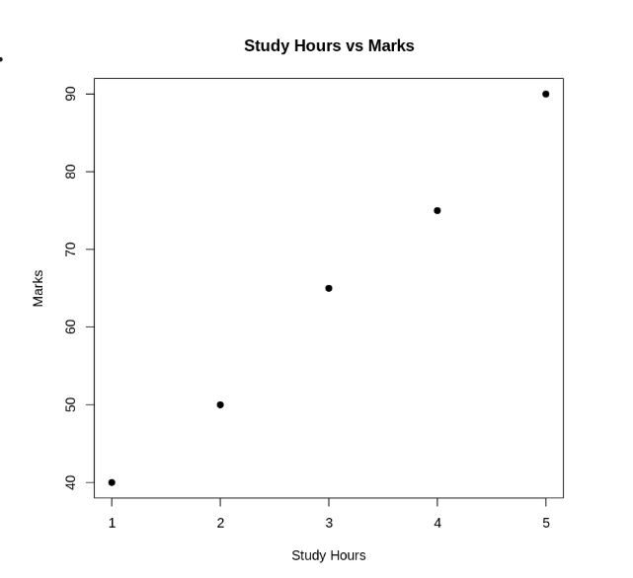
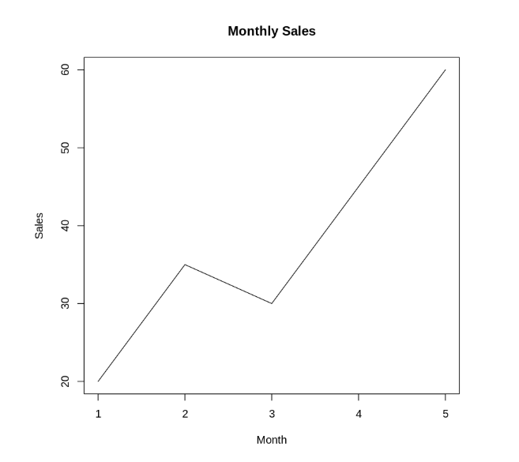
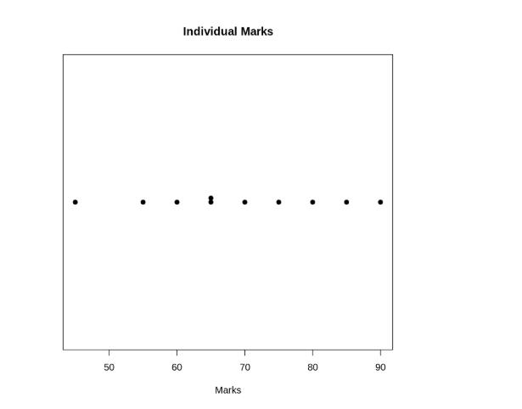
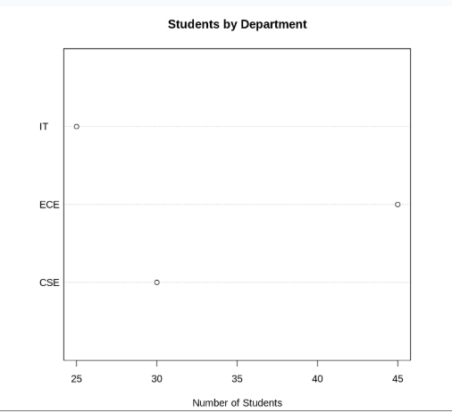
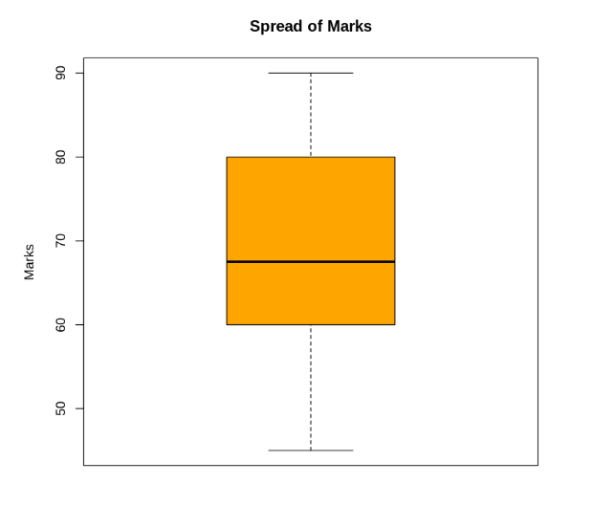

Slide 52
GRAPHICS
Customizing Graphs
main, xlab, ylab add a title and axis labels.
col, pch, lty control colour, point shape, line type.
legend() adds a key; abline() overlays a trend line.
plot(mtcars$wt, mtcars$mpg,
main = "Weight vs MPG", col = "steelblue", pch = 19)
abline(lm(mpg ~ wt, data = mtcars), col = "orange")
legend("topright", "Trend", col = "orange", lty = 1)
R Programming — Unit V: OOP, I/O, Strings & Graphics
41

Slide 53
Parameter | Purpose | Example
main | Set the main title | main = "Student Marks"
sub | Add a subtitle | sub = "Semester I"
xlab, ylab | Label the axes | xlab = "Hours"
col | Set colours | col = "blue"
pch | Choose point symbols | pch = 19
cex | Adjust point size | cex = 1.5
lty | Choose line style | lty = 2
lwd | Adjust line width | lwd = 2
xlim, ylim | Set axis limits | ylim = c(0, 100)
cex.main | Adjust title size | cex.main = 1.5
cex.lab | Adjust axis-label size | cex.lab = 1.2
las | Set axis tick-label orientation | las = 1

Slide 54
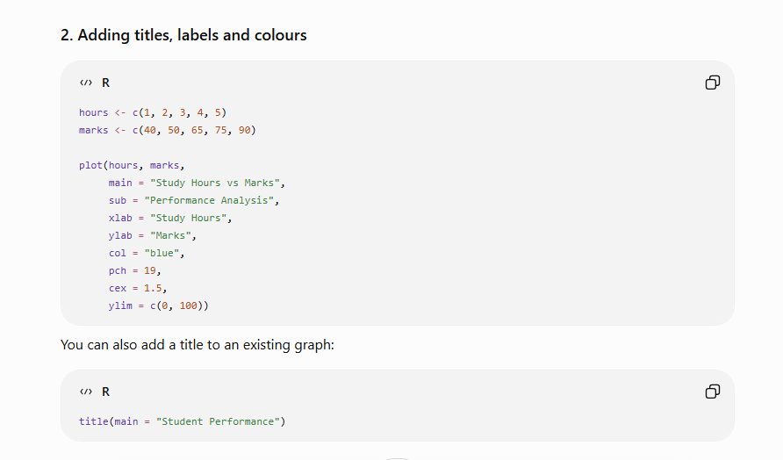

Slide 55
GRAPHICS
Multi-Panel & Composite Plots
Multi-panel plots display separate graphs within one graphics window. Composite plots combine graphical elements or arrange related plots into a single figure.
par(mfrow = c(rows, cols)) arranges an equal-sized grid.
layout() builds UNEQUAL panel sizes from a matrix.
Reset with par(mfrow = c(1,1)) once finished.
par(mfrow = c(2, 2))
hist(mtcars$mpg); boxplot(mtcars$mpg)
plot(mtcars$wt, mtcars$mpg); qqnorm(mtcars$mpg)
par(mfrow = c(1, 1)) # reset
m <- matrix(c(1,1,2,3), nrow = 2, byrow = TRUE)
layout(m) # wide top panel
R Programming — Unit V: OOP, I/O, Strings & Graphics
42

Slide 56
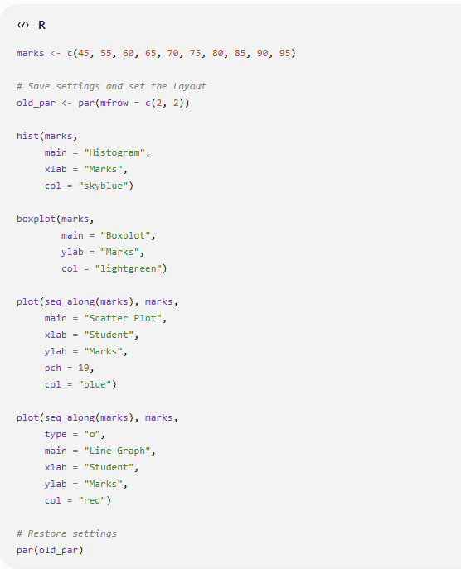
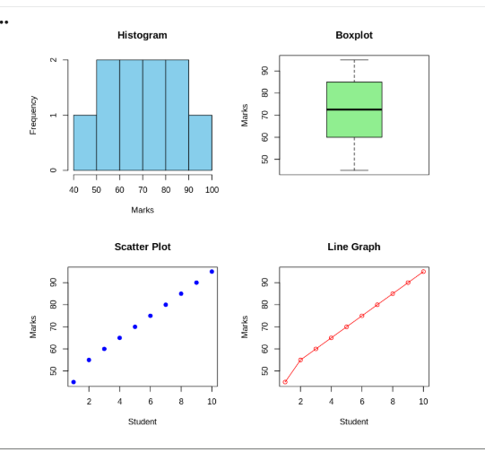

Slide 57
GRAPHICS
Saving Graphs to Files
Open a device (png, jpeg, pdf) BEFORE plotting.
Call dev.off() AFTER plotting to flush it to disk.
PDF output is vector-based — ideal for print quality.
png("scatter.png", width = 800, height = 600)
plot(mtcars$wt, mtcars$mpg)
dev.off()
pdf("report_plot.pdf")
hist(rnorm(500))
dev.off()
R Programming — Unit V: OOP, I/O, Strings & Graphics
43

Slide 58
x <- y <- seq(-5, 5, length = 30)
z <- outer(x, y, function(a,b) sin(sqrt(a^2+b^2)))
persp(x, y, z, theta = 30, phi = 20, col = "lightblue")
library(plot3D)
scatter3D(mtcars$wt, mtcars$hp, mtcars$mpg,
colvar = mtcars$mpg, pch = 19)
GRAPHICS
Creating Three-Dimensional Plots
Three-dimensional (3D) plots represent data along three axes: X, Y and Z. They help visualize relationships among three numerical variables or display surfaces.
persp() draws a 3D perspective surface (base R).
plot3D::scatter3D() adds colour ramps and shading.
rgl::plot3d() gives an INTERACTIVE, rotatable plot.
Plot Type | Function | Package | Purpose
Surface plot | persp() | Base R (graphics) | Display a surface defined by Z values over X and Y
3D scatter plot | scatterplot3d() | scatterplot3d | Display individual observations in three dimensions
Interactive 3D plot | plot3d() | rgl | Allow rotation and zooming of a 3D graph
R Programming — Unit V: OOP, I/O, Strings & Graphics
44

Slide 59
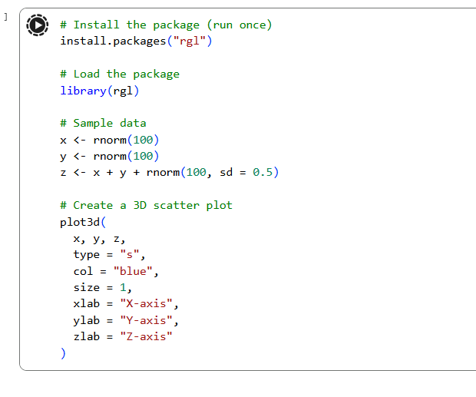
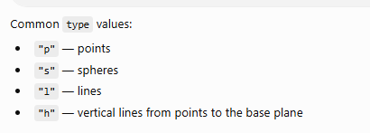

Slide 60
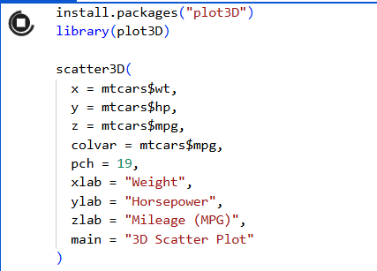
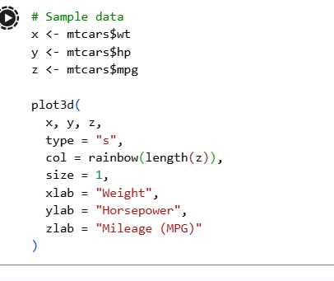
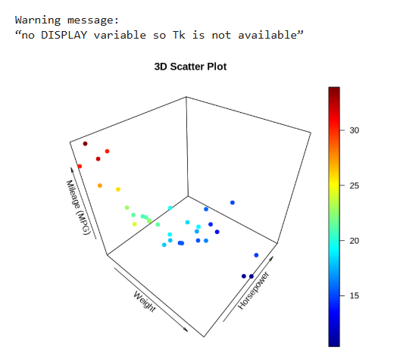
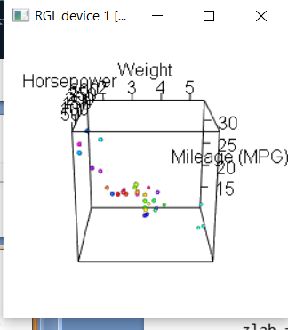
# Install rgl only once
install.packages("rgl”)
library(rgl)

Slide 61
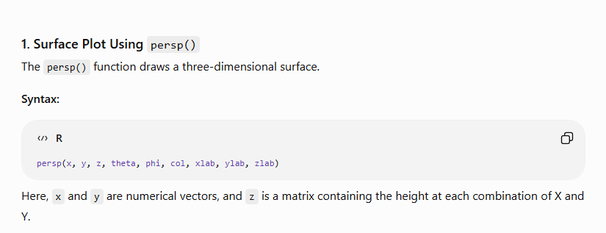
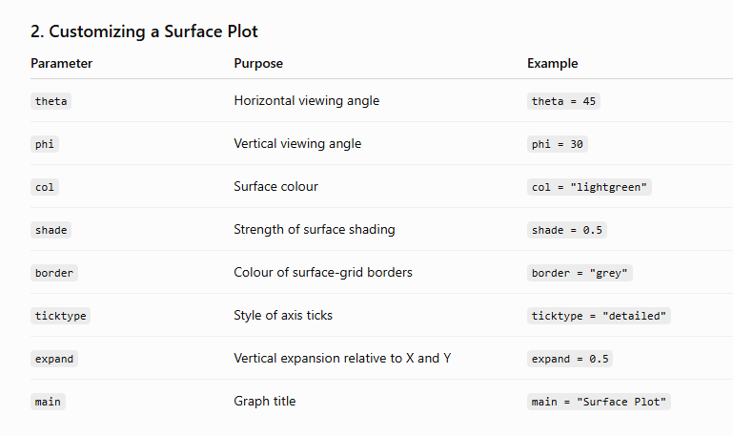
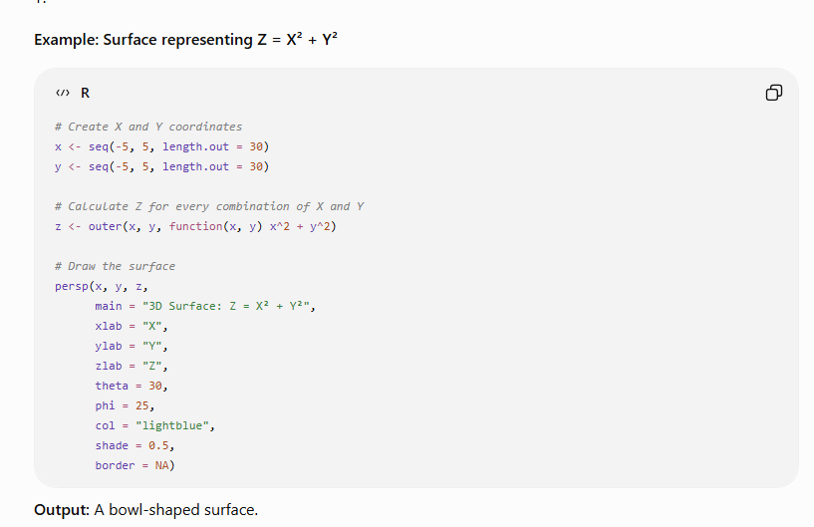
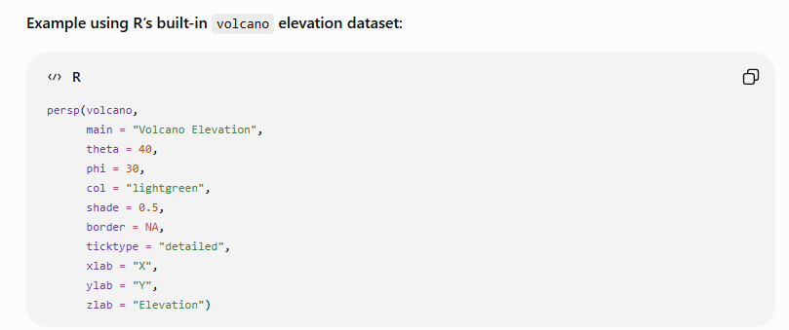

Slide 62
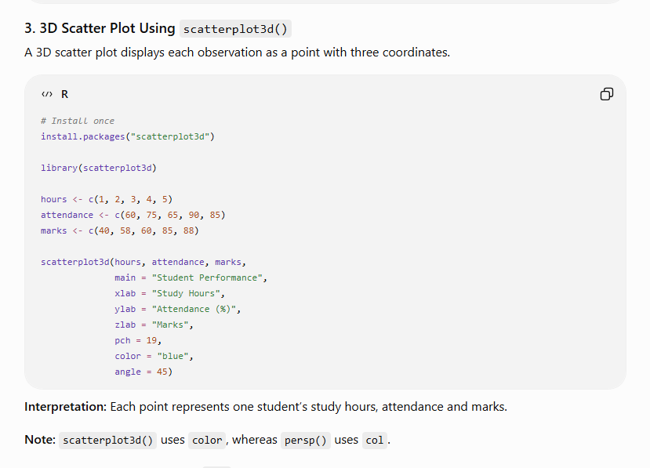

Slide 63
RECAP
Key Takeaways
1
2
3
4
OOP: S3, S4 & R5
Managing Objects
Input / Output
Strings & Graphics
S3 is quick/informal, S4 is formal & validated, R5 is mutable — and S3 powers lm()/glm()'s unified print/summary/predict interface.
ls(), str(), exists()/get()/assign(), save()/load() and file() connections keep a workspace organised and reproducible.
readline()/scan() for keyboard, cat()/print() for monitor, read/write.csv() for files, url()/jsonlite for the web.
trimws/grepl/regmatches/gsub build, validate & mine text; plot/hist + par()/layout() customize, and png()/pdf()/plot3D save 2D & 3D figures.
R Programming — Unit V: OOP, I/O, Strings & Graphics
45

Slide 64
Practice & Next Steps
Suggested Lab Exercises
Build an S3 “BankAccount” class with deposit/withdraw methods and a custom print method; redo it as S4 with slot validity.
Write a text pipeline: tokenize a paragraph, remove stopwords, compute word frequency and a simple sentiment score.
Read a JSON API response with jsonlite, clean text fields with gsub()/regmatches(), and write results to CSV.
Fetch a public dataset via url()/read.csv(), then build a 4-panel dashboard using layout() and save it as PNG.
Create a 3D surface or scatter plot of two numeric columns from mtcars using persp() or plot3D::scatter3D().
Thank you | Questions & Discussion

