Slide 1
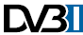

DVB-I at IBC 2019
Demonstration of “DVB-I” services
2019-06-28

Slide 2
Background
The DVB Project would like to showcase DVB-I at IBC 2019
Service Discovery and Low Latency are the visible functions that depict a DVB-I service
These specifications should be “mature enough” by September 2019 to “whet appetites” for DVB-I deployments
Targeted Advertising and Multicast ADR should be considered if appropriate – or keep in our “back pocket” for DVB-I2 at IBC 2020

Slide 3
Demonstrations
Be able to show the following on the terminal
Integrated service list (services 1-7)
DVB-I client should present a service list in such a way that the viewer can use the CH+ and CH- to switch through the services that are listed in the LCN table. The transition from an OTA service to an DVB-DASH service should be as seamless as possible
DVB-T services (4,5,6)
Demonstrates that the terminal can receive OTA services
DVB-I broadcast services (3)
Demonstrates that the terminal can receive DVB-DASH services
DVB-I OTT services (7)
Demonstrated that the terminal can receive a DVB-DASH service from a provider who is generally not providing tradition DVB services. An example of that provider could be DAZN
Simulcast services (1,2)
Demonstrates the ability to switch between the DVB-DASH delivery and the OTA delivery of the same service. This switch could be user initiated (that seems reasonable in the context of the show floor) or automatic based on signaled criteria such as available bandwidth getting to low
Integrated EPG (services 1-6 + 7)
The EPG information from each service should be integrated into a unified presentation. Information from the OTA service (ETI p/f) or DVB DASH service could be shown at during channel change of through the INFO button
A second DVB-I terminal could be used to show
IP delivered services only
Delay between OTT service (1,2) and LL DASH service (1,2)

Slide 4




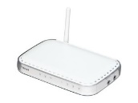
Schematic
OTA services
(1,2,3)
OTA services
(1,2,4,5,6)
Back Room
Booth
tuner(s)
encoder/ packager
DVB LL-DASH (service 1)
DVB LL-DASH (service 2)
HTTP cache
encoder/ packager
DVB-I Service
DVB-I Client
encoder/ packager
DVB LL-DASH (service 3)
service discovery
DVB-I Client
?
epg
Content
Provider
DVB LL-DASH (service 7)
“mobile” DVB-I Client

Slide 5
Schematic
OTA services
(4,5,6)
Back Room
Satellite reception
(feeds for services 1,2,3)
OTA services
(1,2,4,5,6)
DTT modulator
OTA services (1,2)
+
Encoder
Booth
tuner(s)
encoder/ packager
Encoder
DVB LL-DASH (service 1)
HTTP cache
encoder/ packager
DVB LL-DASH (service 2)
Hybrid DVB-I Client
encoder/ packager
DVB-I Services
(1,2,3,7)
DVB LL-DASH (service 3)
service discovery
DVB-I Client
?
epg
Content
Provider
DVB LL-DASH (service 7)
“mobile” DVB-I Client

Slide 6

Schematic
For this we should bring to the DVB booth an Encoder/Packager/Origin. This should still be discussed internally as we have a general policy to reduce equipments used on shows.
OTA services
(4,5,6)
Back Room
Satellite reception
(feeds for services 1,2,3)
OTA services
(1,2,4,5,6)
DTT modulator
OTA services (1,2)
+
Encoder
Booth
tuner(s)
encoder/ packager
Encoder
DVB LL-DASH (service 1)
HTTP cache
encoder/ packager
DVB LL-DASH (service 2)
Hybrid DVB-I Client
encoder/ packager
DVB-I Services
(1,2,3,7)
IP (preferred) or SDI inputs
DVB LL-DASH (service 3)
service discovery
DVB-I Client
?
epg
Content
Provider
DVB LL-DASH (service 7)
“mobile” DVB-I Client
we can deliver a LL CMAF stream we built either in our booth or in Rennes (France)

Slide 7
Schematic
OTA services
(4,5,6)
Back Room
Playout
(feeds for services 1,2,3)
OTA services
(1,2,4,5,6)
DTT modulator
OTA services (1,2)
+
Encoder
Booth
playout server
encoder/ packager
Encoder
DVB LL-DASH (service 1)
HTTP cache
encoder/ packager
DVB LL-DASH (service 2)
Hybrid DVB-I Client
encoder/ packager
DVB-I Services
(1,2,3,7)
DVB LL-DASH (service 3)
service discovery
DVB-I Client
?
epg
Content
Provider
DVB LL-DASH (service 7)
“mobile” DVB-I Client

Slide 8
Schematic
For this we should bring to the DVB booth an Encoder/Packager/Origin. This should still be discussed internally as we have a general policy to reduce equipments used on shows.
OTA services
(4,5,6)
Back Room
Playout
(feeds for services 1,2,3)
OTA services
(1,2,4,5,6)
DTT modulator
OTA services (1,2)
+
Encoder
Booth
playout server
encoder/ packager
Encoder
DVB LL-DASH (service 1)
HTTP cache
encoder/ packager
DVB LL-DASH (service 2)
Hybrid DVB-I Client
encoder/ packager
DVB-I Services
(1,2,3,7)
IP inputs
DVB LL-DASH (service 3)
service discovery
DVB-I Client
?
epg
Content
Provider
DVB LL-DASH (service 7)
“mobile” DVB-I Client
we can deliver a LL CMAF stream we built either in our booth or in Rennes (France)

Slide 9
Demonstrations (Backup plan)
Be able to show the following on the terminal
Integrated service list (services 1-n 7)
Simulcast services (1,2)
DVB-T services (4,5,6)
DVB-I broadcast services (1-n 3)
DVB-I OTT services (7)
Integrated EPG (services 1-n 1-6 + 7)
A second DVB-I terminal could be used to show
IP delivered services only
Delay between OTT service (1,2) and LL DASH service (1,2)

Slide 10
Schematic (Backup plan)
Back Room
Booth
playout server
DVB LL-DASH (service 1)
DVB LL-DASH (service 2)
HTTP cache
DVB LL-DASH (service n)
service discovery
DVB-I Service
DVB-I Client
epg
“mobile” DVB-I Client

Slide 11
DVB-I mABR
Revised: 2019 June 14

Slide 12


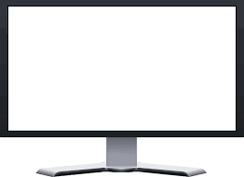
DVB-I mABR Schematic
From DVB-I service discovery
DVB-I mABR
Back Room
Booth
Harmonic
playout server
DVB (LL)-DASH (service 1)
encoder/ packager/
Origin
HTTP cache
DVB-I (mABR) Gateway
DVB-I (mABR) Client
DVB-I (mABR) Gateway
DVB-I (mABR) Client
Controller/ Rendez-vous
Cache Server
Network
Emulation
DVB LL-DASH (service 7)
DVB-I (mABR) Gateway
DVB-I (mABR) Client
Multicast Server
DVB-I (mABR) Gateway
In the backroom or possibly from Internet
Network
Emulation
DVB-I (mABR) Client
Monitor
Controller
Packager/
Origin

Slide 13
DVB-I mABR demo scenario 1
The first terminal establishes a streaming session that can be multicast
A session is established going through the Controller that redirects the request to the DVB-I mABR multicast gateway.
The second terminal establishes the same streaming session
The system automatically switches to the DVB compliant mABR service thanks to MooD (Multicast operation on Demand) releasing the pressure on the unicast infrastructure.
Packet loss are generated between the Multicast Server and Multicast Gateways
Reliability is done by using FEC
Terminal devices can still play the content without quality degradation, nor additional traffic in the upstream/downstream links
Monitoring tools show the bandwidth usage on unicast and multicast

Slide 14
DVB-I mABR demo scenario 2
The two terminals downstream the content through the content provider (CP) CDN in unicast (possibly over Internet) exhibiting scalability problem (the CDN is overloaded)
After an action, the two terminal streaming sessions are redirected to the DVB-I mABR compliant controller (Rendez-vous, hosted by the NSP) that itself redirects to the DVB-I multicast gateway (localized within the residential gateway).
The two terminals are now served in multicast releasing the pressure on the CP’s CDN infrastructure.
The multicast transport is reliably ensure through HTTP repair service

Slide 15
DVB-I mABR Equipment 1/2
Back Room
Booth
Harmonic
playout server
encoder/ packager/
Origin
DVB (LL)-DASH (service 1)
HTTP cache
DVB-I (mABR) Gateway
DVB-I (mABR) Client
Broadpeak Machine
DVB-I (mABR) Gateway
Controller/ Rendez-vous
DVB-I (mABR) Client
Multicast Server
Cache Server
Switch
DVB-I (mABR) Gateway
Enensys
machine
DVB-I (mABR) Client
Controller/ Rendez-vous
Multicast Server
DVB-I (mABR) Gateway
In the backroom or possibly from Internet
DVB-I (mABR) Client
Monitor
Controller
Packager/
Origin
DVB LL-DASH (service 7)
Broadpeak

Slide 16
DVB-I mABR Equipement 2/2
Broadpeak provides a mABR chain
Multicast server, Wifi multicast gateway (MSYNC compliant)
Network controller
2 Wifi ABR Terminals
Control application
Broadpeak provides a [possibly remote] CMAF low latency live feed
Emulate a Content Provider source
Enensys/Expway provides a mABR chain
Multicast server, Wifi multicast gateway: DVB compliant.
Network controller
2 wifi ABR terminals
Graphic tool to show the bandwidth consumed in unicast versus multicast

Slide 17
DVB-I mABR
End

Slide 18
Call for participants
This is the first, lightly conceived, material for this an IBC demo of DVB-I.
Logistics will be offered by DVB Project office,
Supporters and contributors to this activity are sought
Look to re-use as much of the V&V items as possible
This will run as a parallel track to current TM-IPI meetings
This should not disrupt our specification development

Slide 19
External Participants
from Akamai: “I have already committed in writing that Akamai will support this DVB LL demo at IBC with streaming services. @Joachim from our Munich office will be your point of contact to help with arrangements.”
Joachim is in CC. I propose you invite Joachim to the telco tomorrow.
From Amazon: “I don’t think that AWS Elemental will be able to provide the LL encoding/packaging component by that time, only the LL origination/delivery with MediaStore and CloudFront but it’s redundant with what Akamai is already providing. So I don’t think it makes sense to involve AWS in this demo, unless the DVB-I player would leverage multiple <BaseURL> tags, which seems a bit overkill for such a demo.”
Hence, I consider we do not need Amazon. If you believe differently, let me know
From Harmonic: “I couldn’t get a final green light from Harmonic but I think this is an interesting demo we might be able to contribute to. I will attend the call tomorrow and if a have a more firm status on our participation will update the group.”
Patrick is in CC

Slide 20
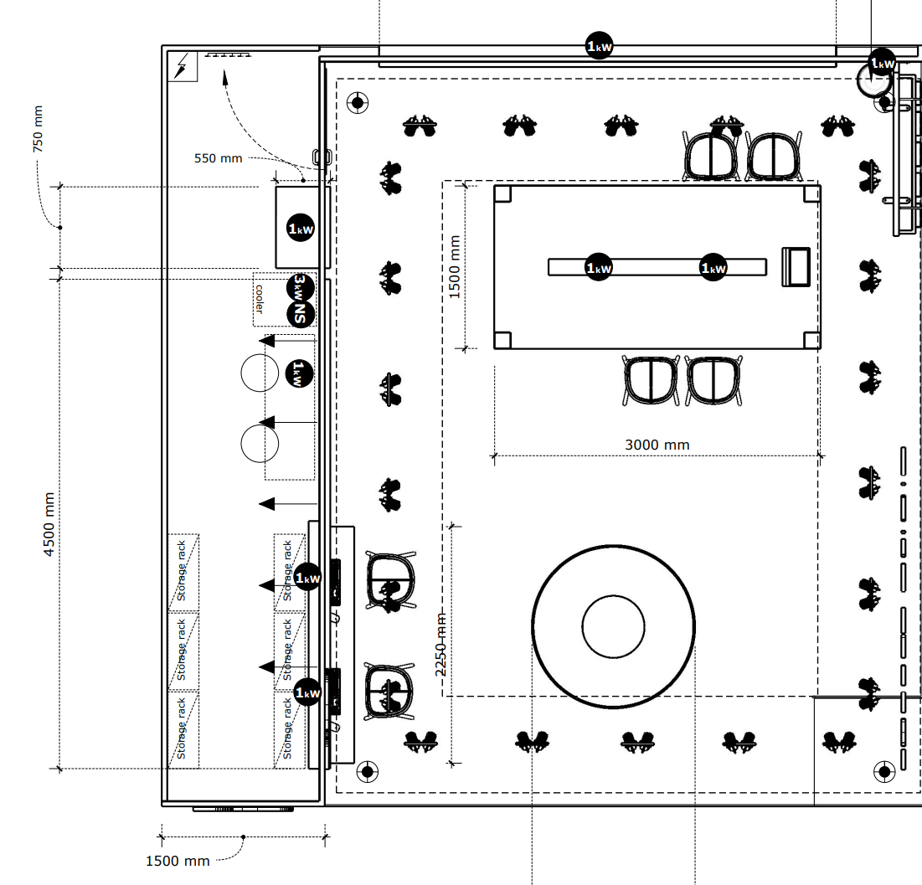
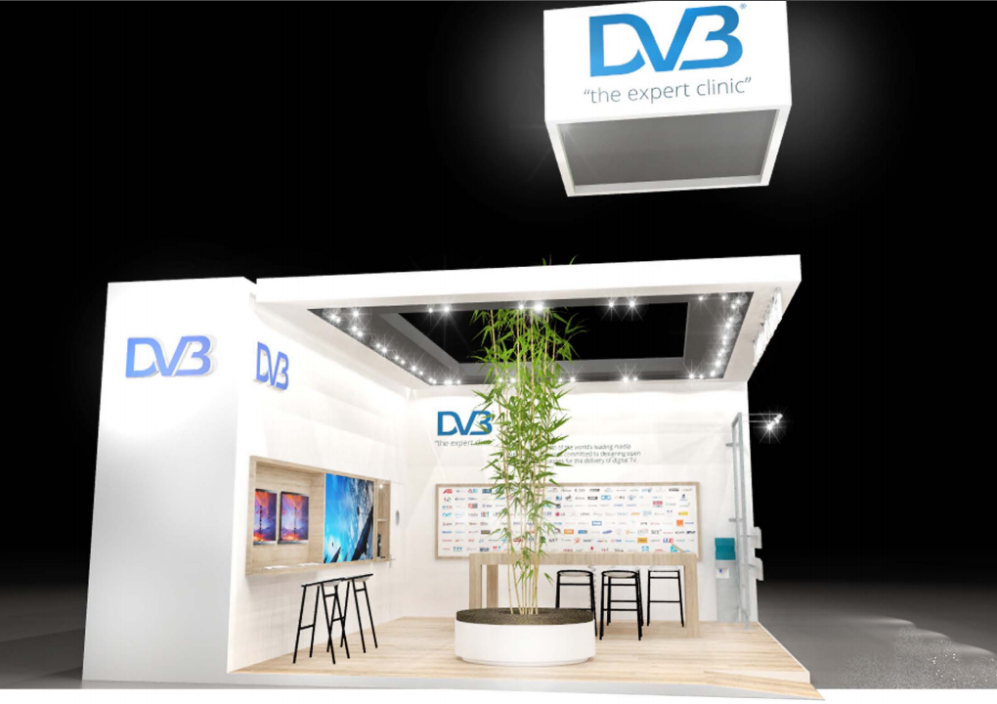
Booth

Slide 21
Integration Workplan
Proposed dates and availability at Rai
IBC Exhibition and Conference
13-17 September 2019
1-5/7 | Ok
8-12/7 | Ok
15-19/7 | Ok
22-26/7 | Limited support possible
29/7-2/8 | Not possible
5-9/8 | Limited support possible
12-16/8 | Not possible
19-23/8 | Limited support possible
26-30/8 | Ok
2-6/9 | Ok

Slide 22
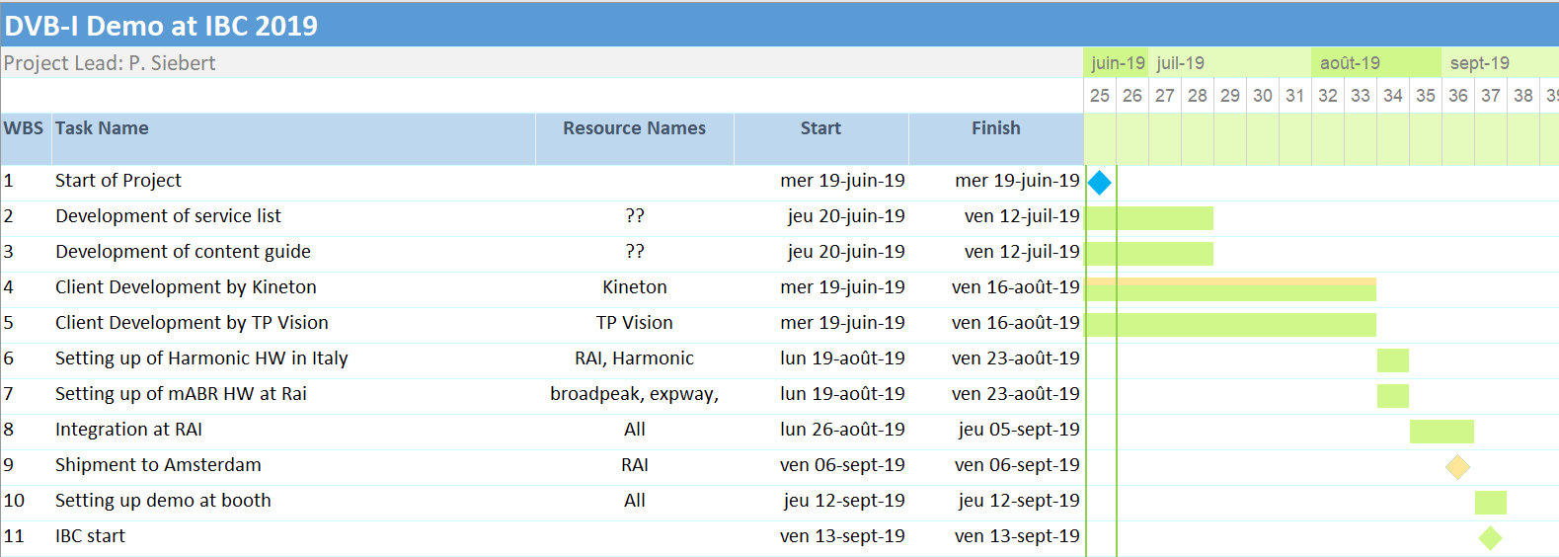
Timeplan

Slide 23
Call Notes (2019-05-03)
Paul provided an introduction on the planned demo with the help of a slide set (document id TM-IPI350). A more advanced and a more basic version of the potential demo were presented. One aspect that would be interesting to demonstrate would be the “switching” from an OTA service to the IP delivery of the same service (or vice versa) – but whether this can be accomplished in time remains to be seen. It was pointed out that a final go decision must be made by the end of May.
Jon Piesing informed he is working to convince his organisation to provide a HTML5 based DVB-I client reading the service-list, let the user select and play the service. Such a client would run on W3C/MSE enabled TV sets. He pointed out that for the time being his management has not confirmed support for such a demo. He hopes that by the end of May his company will have decided. He also stated that a potential demo support could take away TP Vision resources from the DVB-I specification work.
Confirmed availability of a decision on the service list format and a matching DASH.js player would increase the probability of a TP Vision commitment.
Thomas Stockhammer explained that DASH.js v3.0, being available soon, will support Low Latency (LL) DASH. In addition also FF MPEG may support LL although these may not be fully aligned with the DVB DASH specification. He will check with FF MPEG on the availability of LL DASH. AKAMAI could provide the streaming delivery environment consisting including packaging. Thomas will confirm their support. Encoders could be provided by Harmonic. Thomas will also reach out to Thierry Fautier or Patrich Gendron.
Signal sources for the demo could be Over the air feeds like satellite or terrestrial. Thomas recommended to use the broadcast signal feed before encoding in the broadcast headend. This would clearly demonstrate the performance of the LL solution. It was commented that such a feed may result in high data rate which is not practical in the tradeshow environment.
Eoghan suggested to also use a camera signal as demo input.
Paul recommended to combine OTA and IP channels in the demo,
Matt wondered whether Targeted Advertisement would enrich the demo and offered support from ITV.
Thomas and Peter S both stated that there must be an integrator who is responsible to bring all the components together before the event and checks interoperability and complete functionality. Such an integration environment could not only be relevant for IBC but also for further activities and supporting the standardisation process. For the time being there is no volunteer for this activity. Peter MacAvock will reach out to DVB members.
Tuan offered to provide an MABR demo. It was decided that such a demo could be added provided it has no negative effect on timeline and functionality of the DVB-I demo.
Participants are asked to update the demo diagram(s) with any changes they would like to bring to the activity as well as identify aspects they will support.
Peter MacAvock confirmed that also non-DVB members can participate in the IBC demo.
It was decided to have telcos every second Friday at 2pm CET. Peter Siebert and Paul Higgs will take care of the necessary project management.
Meeting invitations have been sent out to the tm@, cm@, tm-ipi@ and cm-i@ mailing lists.
Participants:
Paul Higgs (Huawei)
Matt Poole (ITV)
Jon Piesing (TP Vision)
Peter Lanigan (TP Vision)
Nicolas Frame (TP Vision)
Frederico Maria Pandolf (RAI)
Thomas Stockhammer (Qualcomm)
Tuan Tran (Expway)
Rufael Mekuria (Unified Streaming)
Martyn Lee (Sky)
Peter MacAvock
Eoghan O'Sullivan
Peter Siebert

Slide 24
Call Notes (2019-05-17)
Review of open issues from last meeting
It is still open whether TP Vision will provide a DVB-I client. Paul will discuss this with Jon next week. It was agreed that DVB and HbbTV members will be asked for support as well (A.I. P. Siebert)
Davide confirmed that RAI will support the demo integration with the understanding that all components will be provided by the demo partners.
Thomas Stockhammer confirmed by email that Akamai will support the demo by providing streaming services. Amazon EWS will not support the demo. Harmonic is considering providing encoder, packaging and origin server either remote and/or local. Patrick Gendron will follow up within Harmonic. Paul commented that the services provided by Akamai need to be specified in more detail. He will discuss this with Akamai directly at the upcoming DASH IF event. Guillaume offered to provide a packaging device from Broadpeak. Paul regards this as a good opportunity to demonstrate interoperability.
Discussions
Paul has provided a new version of the DVB-I demo slide set, document TM-IPI3540r2. Edits to this are available at TM-IPI3540r3
Davide provided a proposal for local live encoding for Over the Air (OtA) content (see slide set) based on a live signal received by satellite and re-encoded for IP and DTT distribution. This approach will guarantee a good alignment between the OTA and DTT signal. Connection between the relevant elements will be TS via ASI or IP. Peter S added that SES or Eutelsat could provide the content. Furthermore, he sees no problem to set up a local DTT distribution on the booth. If a remote feed is not available, the content can also be streamed locally from a TS streamer. Eoghan commented that if necessary DVB could cover the cost for bringing the satellite signal to the booth.
Guillaume introduced a proposal for adding mABR to the demo (see slide set). Peter commented that this approach would require a good internet connection and may be difficult to explain to visitors. Broadpeak together with Enensys and Expway will continue to work on concept and information material for a mABR demo. Peter confirmed that in principle non-DVB members can provide components for the demo. Paul added that the same playout server and encoders must be used for unicast and multicast delivery. In advance of the next meeting, it is desirable to have some “talking points” around any mABR demo.
Eoghan provided some first information about the booth design. He will provide a more detailed layout at the next telco. People should also prepare equipment lists for the “service room” and “booth area”
Peter asked potential equipment providers to deliver information about dimension, power and noise level of any demo equipment.
The next telco will take place on 31 May, 2.00 pm Geneva time. Please be sure to share relevant information in advance as a “go / no-go” is expected at this meeting. That decision should be supported with a reasonable demonstration/
Action items
Paul to discuss client availability with Jon
Paul to discuss details of offered streaming services with Akamai.
Peter to send out request for DVB-I Client support to DVB and HbbTV.
Broadpeak, Enensys and Expway to provide a more detailed proposal for mABR including potential marketing messages at booth.
Eoghan to provide more details about booth lay out.
Harmonic, Enensys, Expway, to provide basic information about power requirements, dimension and noise level for all local equipment.
Participants:
Paul Higgs (Huawei)
Peter Lanigan (TP Vision)
Frederico Maria Pandolf (RAI)
Davide Milanesio (RAI)
Tuan Tran (Expway)
Guillaue Bichot (Broadpeak)
Patrick Gendron (Harmonic)
William Tovar (Exway)
Eoghan O'Sullivan (DVB)
Peter Siebert (DVB)

Slide 25
Call Notes (2019-05-31)
Review of open issues from last meeting:
Paul to discuss client availability with Jon. -> Discussion did not take place but AI obsolete now,
Paul to discuss details of offered streaming services with Akamai. -> Further details need to be clarified pending response from Akamai.
Peter to send out request for DVB-I Client support to DVB and HbbTV. -> Done; as a result the company Kineton volunteered to provide the client. The organization will become a DVB member.
Broadpeak, Enensys and Expway to provide a more detailed proposal for mABR including potential marketing messages at booth. -> Done, results presented during telco.
Eoghan to provide more details about booth lay out. -> Partly open; Peter S. provided an update about the current booth design. There is space for 2 TVs and additional equipment.
Harmonic, Enensys, Expway, to provide basic information about power requirements, dimension and noise level for all local equipment. -> Still open.
Discussions
Paul has provided a new version of the DVB-I demo slide set, document TM-IPI3540r6. (see attached)
Patrick Gendron informed about the headend equipment provided by Harmonic. The server is capable of encoding several input signals provided by TS over IP. In addition, packaging and origin functionality is provided. Patrick still has to confirm with his organization that the hardware is available at IBC. In addition, services can also be streamed from the cloud. 3 Mbit/s is assumed to be sufficient for a HD service.
Matt Poolse (ITV) offered to provide ITV content for DTT reception, local playout or as a streamed IP service.
Enensys/Broadpeak presented the mABR approach for the demo. For the time being the two organizations provide different solutions. Mobile reception via wifi is assumed. Switching between multicast and unicast could be demonstrated. Thomas S commented that there should be no demonstration where DVB-I unicast is shown as not working. Paul added that a mobile client may not be available (at least it is not currently). Peter S pointed out that first priority is DVB-I combined with LL DASH. The mABR feature shall not negatively impact the marketing message not the technical implementation. Guillaue Bichot confirmed that the mABR components are independent of the main demo.
Pasqual (Kineton) confirmed that his organization will provide the necessary client as HbbTV app. He will also provide a mock-up for the user interface soon. He wondered to which extent LL DASH is already supported? Patrick will provide the URL of such a service. Also, Broadpeak can provide LL DASH signals.
The RAI participants confirmed the integration support. However, the group should be aware that August is a typical holiday time for Italy. In the next conference call, all parties contributing to the demo should agree on a time plan.
Peter Siebert will look into the OTA part of the demo.
Availability of a service list for testing is open.
The group agreed to go ahead with the demo.
Eoghan provided some first information about the booth design. He will provide a more detailed layout at the next telco.
Peter asked potential equipment providers to deliver information about dimension, power and noise level of any demo equipment.
The next telco will take place on 14 June, 2.00 pm Geneva time.
Open items for additional discussion:
Both an Mobile App and a TV App will be required. It would be preferable for the same Mobile App to be used for both the "regular" streaming demo and the MABR demos. The TV App will be based on HbbTV, it would be desirable for the Mobile App to use HTML5+media extensions. Hopefully both can make use of dash.js as the player
Action items:
Patrick to confirm availability of head end equipment on the booth.
Harmonic/Broadpeak to provide LL DASH content via internet for test purposes.
Kineton to provide a client mock-up.
Kineton to investigate on TV set to be used for demo.
Broadpeak/Enensys/Expway to give details on the control mechanism for stimulating impairments in on the multicast for FEC demo
Peter S to provide proposal for OTA part.
Paul to expand details/descriptions of the existing (non-MABR) demo options
Participants:
Paul Higgs (Huawei)
Matt Poole (ITV)
Jon Piesing (TP Vision)
Angelo Pettazzi (Mediaset)
Frederico Maria Pandolf (RAI)
Davide Milanesio (RAI)
Pasquale (Kineton)
Tuan Tran (Expway)
Guillaue Bichot (Broadpeak)
Patrick Gendron (Harmonic)
Rufael Mekuria (Unified Streaming)
Thomas Stockhammer (Qualcomm)
Peter Siebert (DVB)

Slide 26
Call Notes (2019-06-14)
Participants:
Paul Higgs (Huawei)
Jon Piesing (TP Vision)
Federico Maria Pandolfi (RAI)
Davide Milanesio (RAI)
Tuan Tran (Expway)
Guillaume Bichot (Broadpeak)
Patrick Gendron (Harmonic)
Eoghan O'Sullivan (DVB)
Review of open items from last meeting:
Patrick to confirm availability of head end equipment on the booth. -> Yes, has identified equipment to be used by DVB
Harmonic/Broadpeak to provide LL DASH content via internet for test purposes. -> Harmonic have provided a link to their low latency test service. Broadpeak still setting up some looped low latency content
Kineton to provide a client mock-up. -> Kineton not on the call today
Kineton to investigate on TV set to be used for demo. -> Kineton not on the call today
Broadpeak/Enensys/Expway to give details on the control mechanism for stimulating impairments in on the multicast for FEC demo -> See updated slides
Peter S to provide proposal for OTA part. -> No news
Paul to expand details/descriptions of the existing (non-MABR) demo options -> Not ready for this call.
Discussions:
The updated set of planning material is available at TM-IPI3540r8. This update includes additional details on the MABR demos and some initial thoughts on the booth layout.
Matt Poole has indicated that for "service 7" they can provide a contribution feed to Harmonic/Akamai based cloud processing. This could then be delivered/accessed at the staging and show floor.
Matt and Patrick should discuss offline on coordinating this.
The general layout of the booth, based on some initial renderings was discussed. There is one wall that features the technology, and this backs onto the area where equipment can be located. A clean looking "front of house" is desired.
Current renderings show two television sets for DVB-I services (the original thoughts showed one hybrid and one IP-only terminal).
We need to consider what equipment is needed "on booth" for any MABR demos. Gateways, mobile DVB-I clients and keyboard/mouse/monitor are likely required. Other equipment (switches, Multicast Server etc) goes in the back room
A possible schedule for staging/integration at RAI has been proposed. Seems like either the last week of August or the first week of September are recommended. First week of September seems likely to suit best and have everyone "back and running" after summer vacations. This material has been copied into a slide in TM-IPI3540r9
Kineton were not on the call (probably not yet in the necessary mailing lists), so aspects of the DVB-I could not be discussed. A seperate call should be held before the next planning call to get them in sync. Peter S to arrange a suitable time.
Technical considerations of the OTA parts are unknown.
The next call will take place on 28 June, 2:00pm Geneva time.
Action Items:
Kineton to provide a client mock-up.
Kineton to investigate on TV set to be used for demo.
Peter S to provide proposal for OTA part. -> No news
Paul to expand details/descriptions of the existing (non-MABR) demo options -> Not ready for this call.
Peter S in conjunction with the Project Office to determine "shipment" of demo equipment from Rai (Italy) to RAI (Amsterdam)
Peter S to arrange a call with Kineton regarding DVB-I client development.
Participants:
Paul Higgs (Huawei)
Jon Piesing (TP Vision)
Federico Maria Pandolf i(RAI)
Davide Milanesio (RAI)
Tuan Tran (Expway)
Guillaume Bichot (Broadpeak)
Patrick Gendron (Harmonic)
Eoghan O’Sullivan (DVB)

