Slide 1
Reinforcement Learning
AND
Linear Programming Optimization

Slide 2
Agenda
Introduction
Common Terms used in Reinforcement Learning
Multi-Armed Bandits
Model Free Learning
Advanced Model Free Learning
Basic Optimization: Linear Programming in Data Science

Slide 3
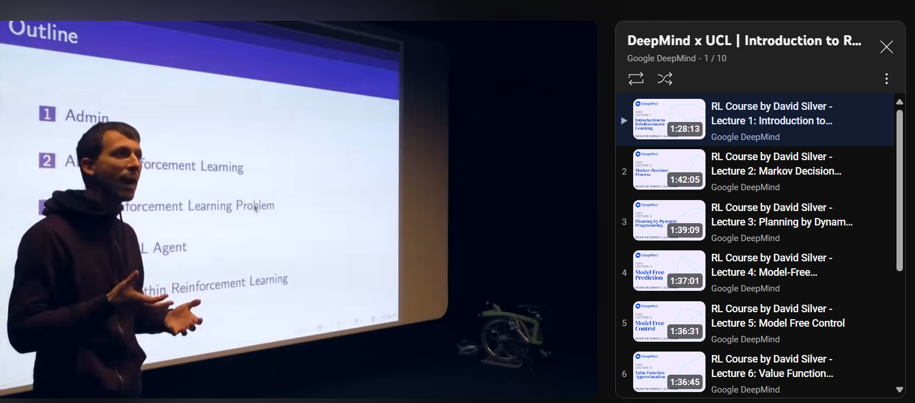
RL Full Course

Slide 4
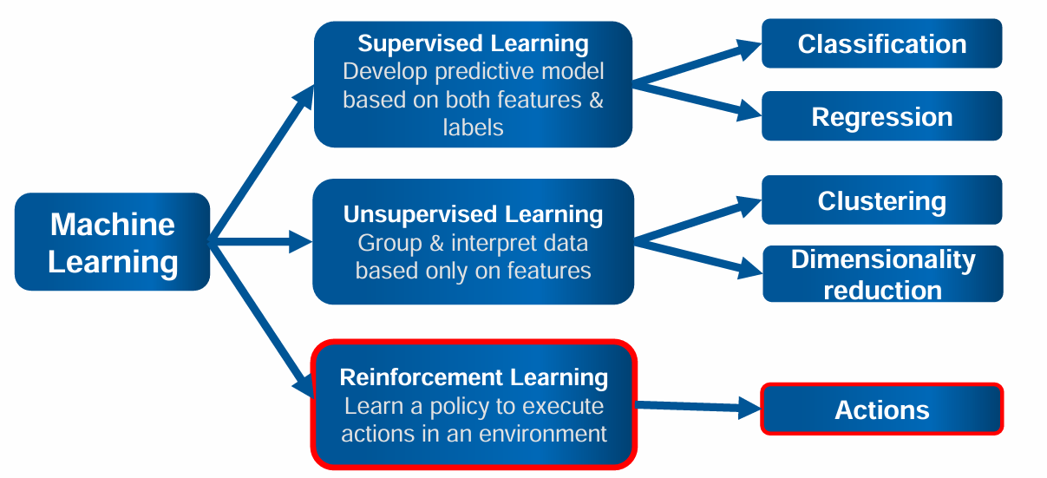
World of Machine Learning

Slide 5
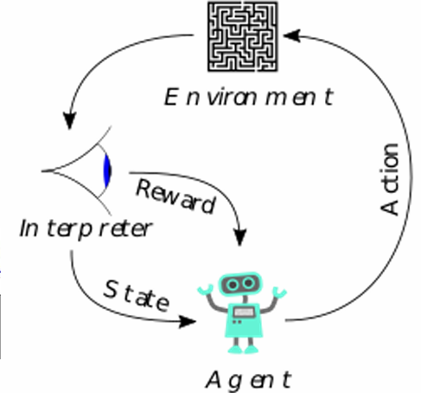
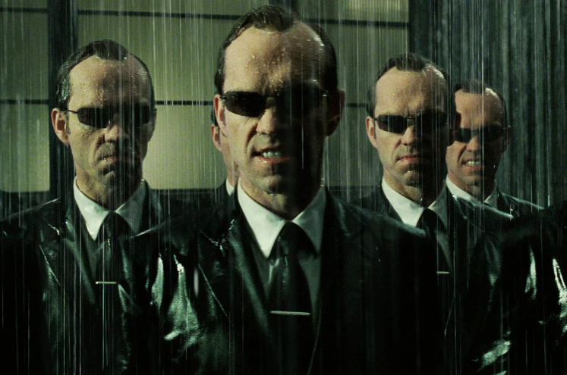
RL Common Words
Environment: The external system with which the agent interacts. It represents the problem space (e.g., a maze, a game, or a robotic environment). The environment responds to the agent's actions and provides the next state and a reward.
Agent: The decision-maker or learner in the RL setup.
The agent selects actions based on its policy and aims to maximize cumulative rewards.
State: A representation of the environment at a specific point in time. It provides the agent with information about the current situation, which it uses to decide on the next action.

Slide 6

RL Common Words
Reward: Feedback from the environment indicating the immediate value of an action. The agent's goal is to maximize the cumulative reward over time.
Policy: A strategy or rule the agent follows to determine its actions based on the current state.
Notes: Policies can be deterministic ( 𝜋(𝑠) = a ) or stochastic ( 𝜋 (𝑎∣𝑠) ).
Value: The expected cumulative reward of being in a particular state (state value) or performing a specific action in a state (action value). It's often denoted as: 𝑉(𝑠).
(State) Action Value: Q(s,a), it represents the expected reward for taking a specific action 𝑎 in a specific state 𝑠, considering future rewards.

Slide 7
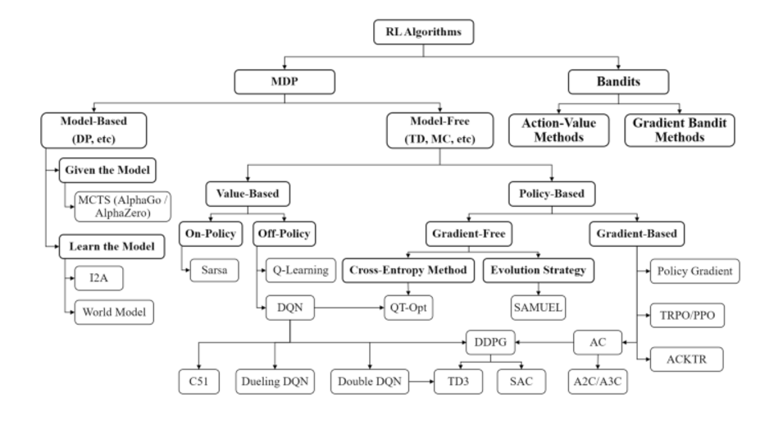
RL Taxonomy
Zhang, H. et al. (2020). Taxonomy of Reinforcement Learning Algorithms

Slide 8

RL Taxonomy
Zhang, H. et al. (2020). Taxonomy of Reinforcement Learning Algorithms

Slide 9

RL Taxonomy
Zhang, H. et al. (2020). Taxonomy of Reinforcement Learning Algorithms

Slide 10
Main Stream RL Approaches
Bandit problems do not involve states or transitions. The agent chooses actions (arms of a bandit), receives rewards, and aims to maximize cumulative rewards.
Model-free methods learn optimal policies or value functions directly from interactions with the environment without constructing or utilizing a model of the environment's dynamics.
Model-based methods learn or use a model of the environment's dynamics (state transitions and rewards) to plan and make decisions.

Slide 11
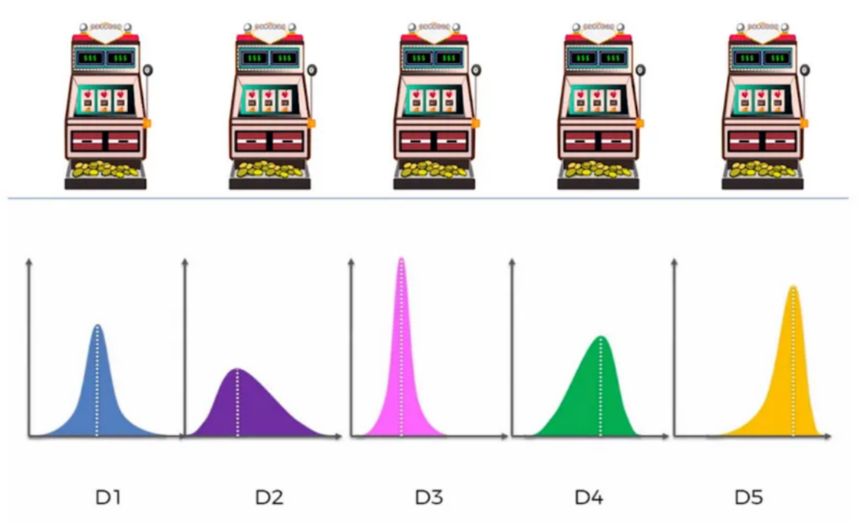
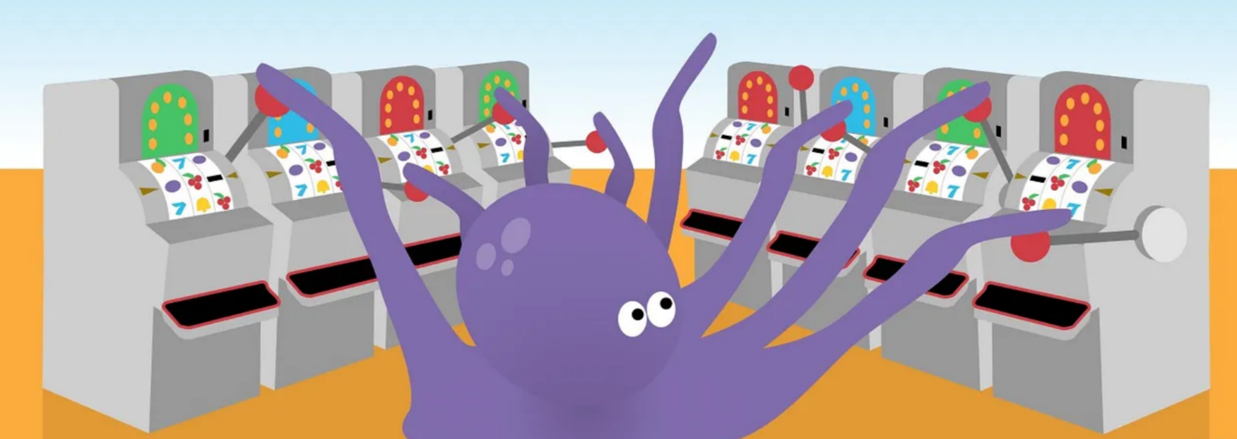
Multi-armed Bandits
multi-armed-bandits.ipynb - Colab
Reinforcement Learning — Multi-Arm Bandit Implementation | by Jeremy Zhang | Towards Data Science
unknown reward distribution for each arm
Building a Multi-Armed Bandit System from the Ground Up: A Recommendations and Ranking Case Study, Part I | by Austin Wang | Udemy Tech Blog | Medium

Slide 12
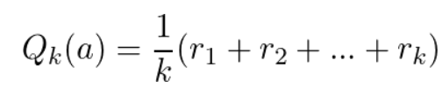
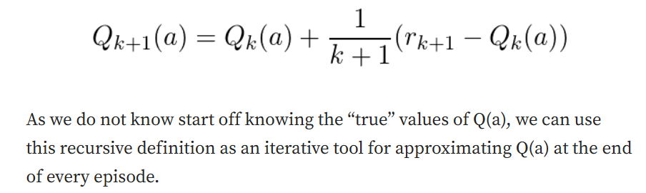

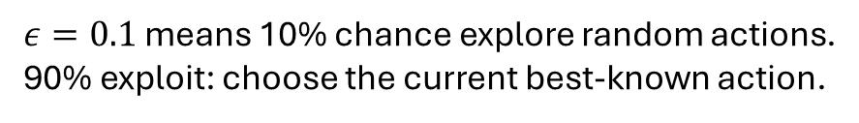
Learning Rules
Epsilon-Greedy
$ε=0.1$ means 10% chance explore random actions.
90% exploit: choose the current best-known action.

Slide 13
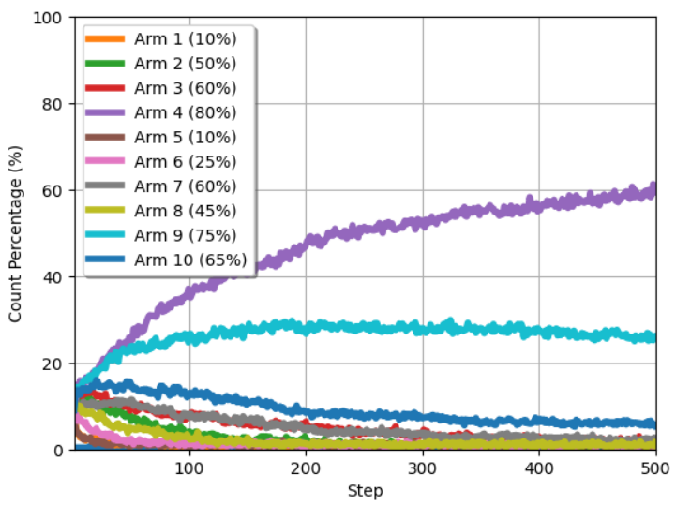
Proportion of Arm that the Agent often choose

Slide 14
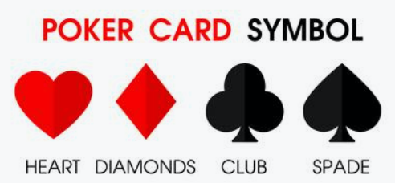
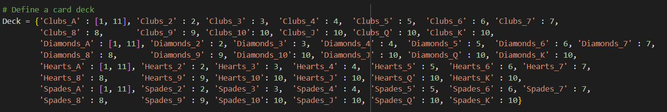
Model Free Method
Simple Blackjack Card Game
Infinite Deck Setting
Code: RL_Backjack.ipynb - Colab

Slide 15
Simplified Blackjack Settings
The cards numbered 2-10 are assigned their respective face values.
Face cards (J, Q, K) have a designated value of 10.
Aces have a fixed value of 11 unless the total sum in the hand exceeds 21, in which case they are valued at 1. When an ace is used with value 11 it is denoted a usable ace. For blackjack, the card's suit is not a determining factor for their value.
Actions: When a player hits a card is received from the dealer. If the player chooses to stick, the hand stops.
Hands: A hand means one cycle of the blackjack game. In this cycle, a player can either choose hit or stick. A cycle stops if one of these conditions are satisfied:
The player total hand value goes over 21.
2. The player chooses to stick.

Slide 16
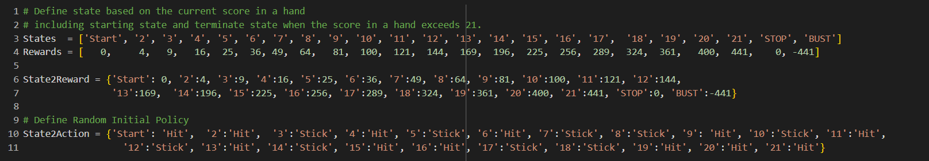
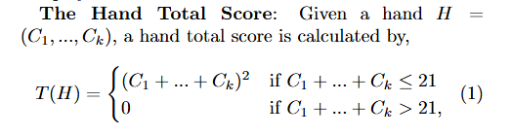
States and Rewards
The Goal is to find the policy that maximizes

Slide 17
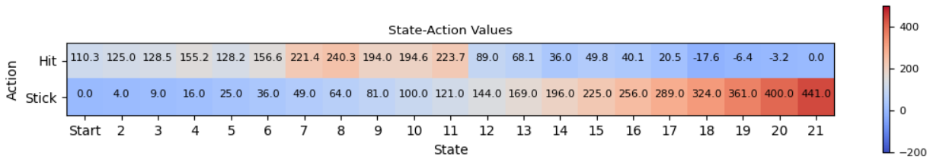
Calculate Action-Value Function
Monte-Carlo sampling

Slide 18
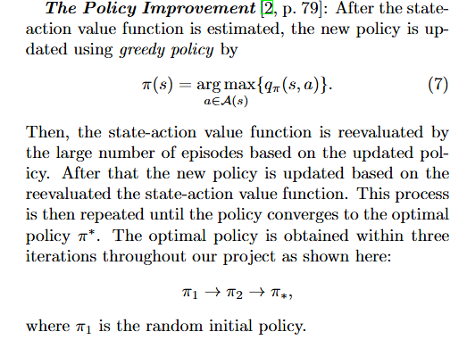
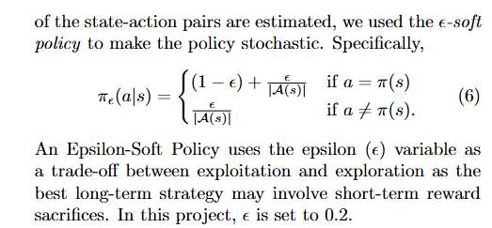
Stochastic Policy and Policy Improvement
Stochastic Policy or Epsilon-Policy

Slide 19
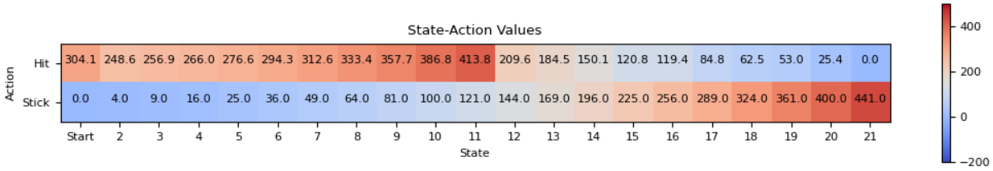



Action-Value Pairs
$$π_{1}$$
$$π_{2}$$
$$π^{∗}$$

Slide 20
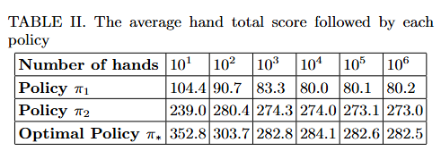
Results of Playing Games by each Policy

Slide 21
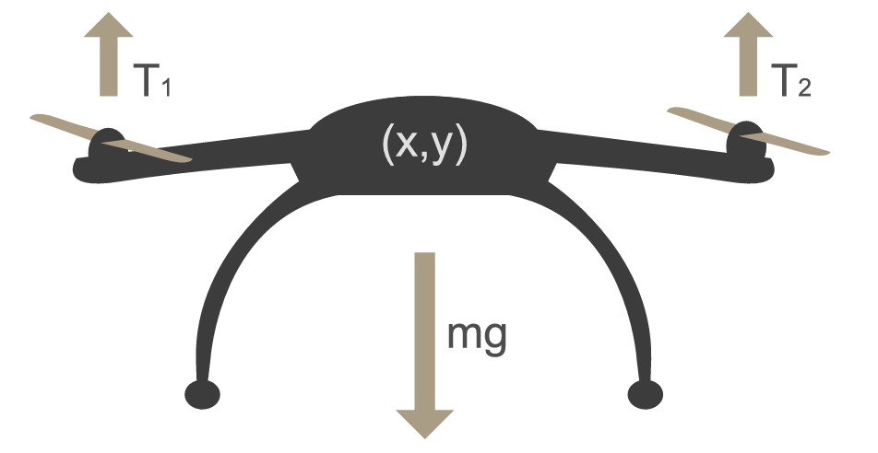
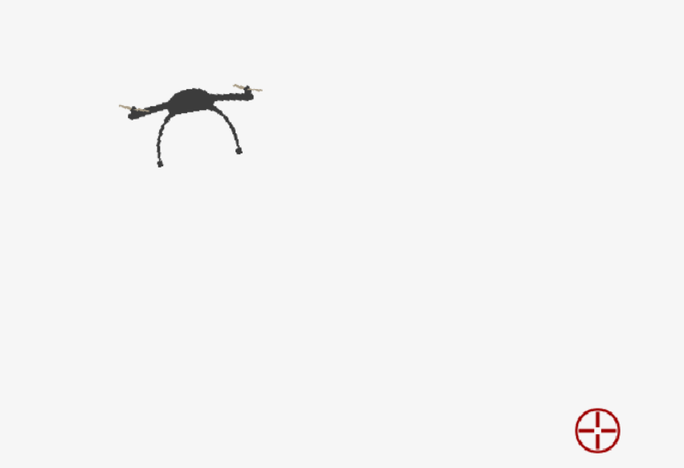
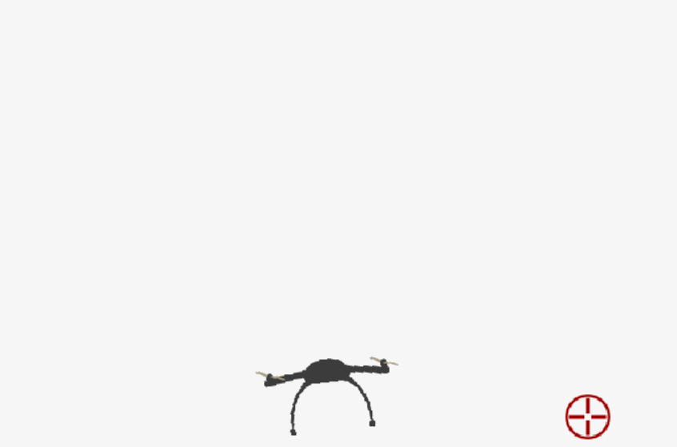
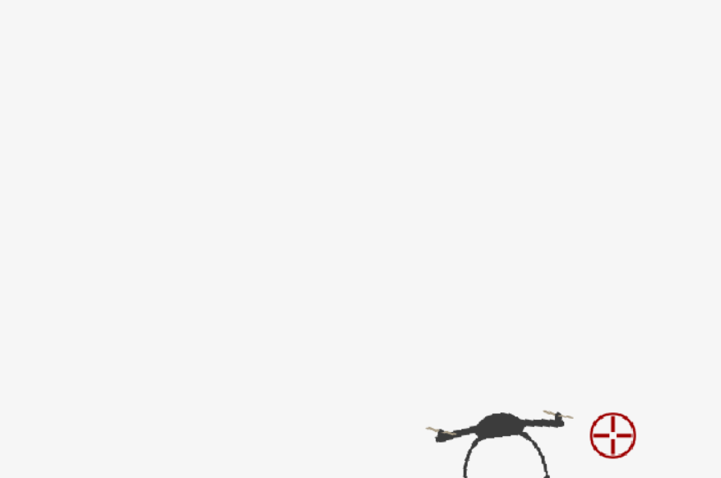
Advanced Model Free Learning

Slide 22
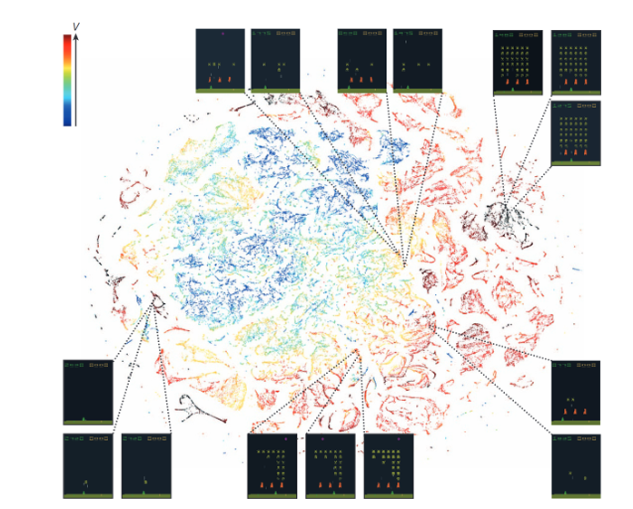
Complex Updating Reward/Policy Rules
Policy Gradient in Atari Games

Slide 23
Linear Programming in Data Science
Optimization and Linear Programming | by Anubhav Deep | CodeX | Medium

Slide 24
Common Words in Optimization
Decision variables represent the quantities that can be controlled or adjusted to solve an optimization problem.
Constraints are the restrictions or limitations that the decision variables must satisfy in an optimization problem.
Feasible Solutions are region on a graph where all the constraints of optimization problem are satisfied.
Objective function is the mathematical expression that defines the goal of the optimization problem.
Maximize (e.g., maximize profit, revenue, efficiency)
Minimize (e.g., minimize cost, time, waste)
Notes:
These variables define the outputs or actions that the optimization problem aims to determine in order to achieve the objective (e.g., maximize profit, minimize cost) while satisfying the given constraints (e.g., resource limits).

Slide 25
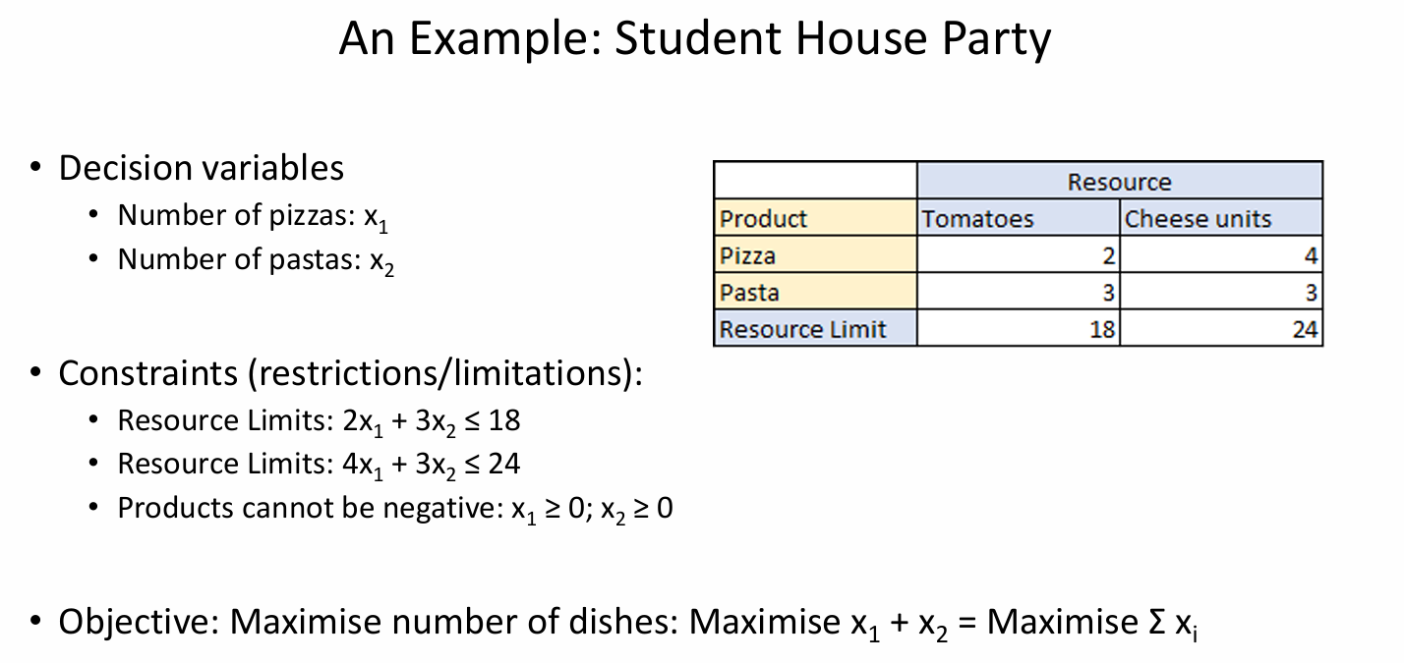

Slide 26
