Slide 1


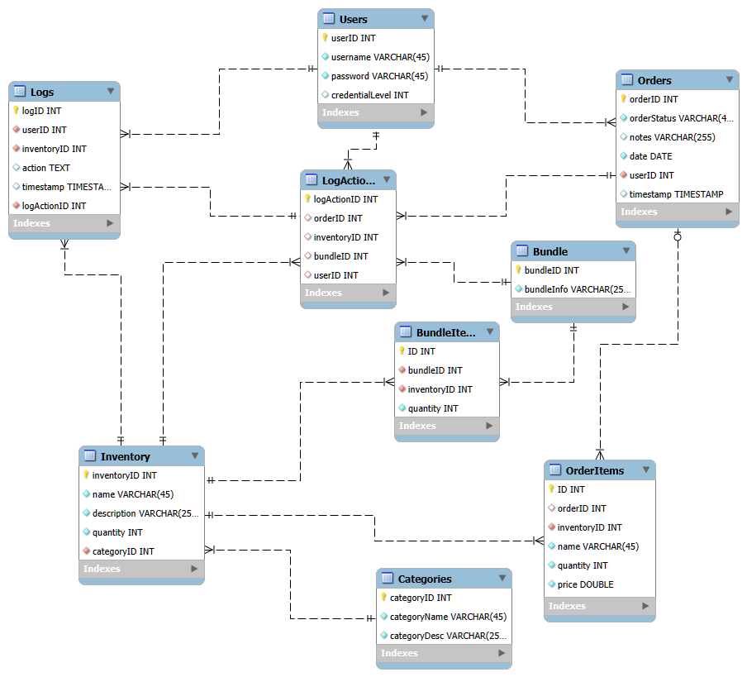
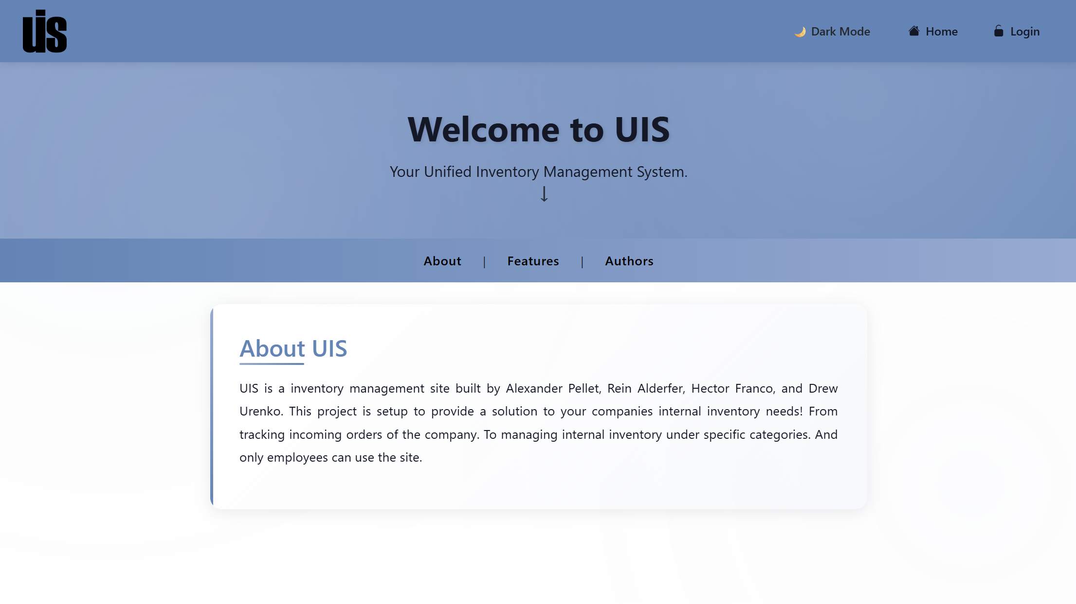
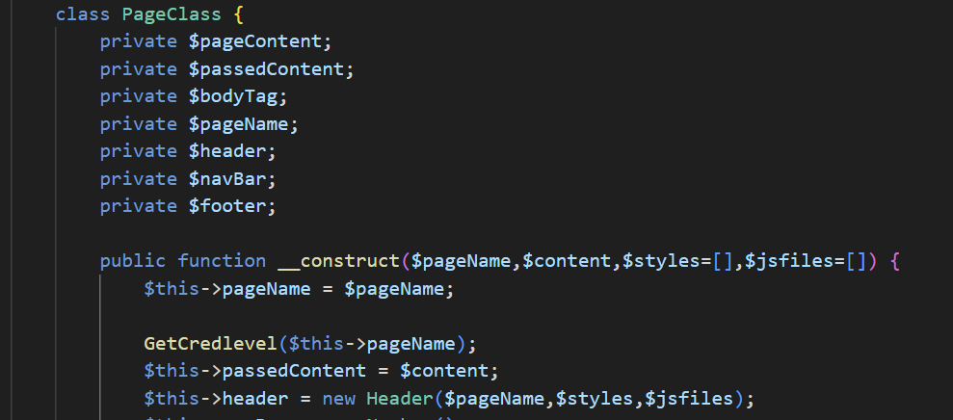
UIS
(UNIFIED INVENTORY SYSTEM)
Rein Alderfer, Alexander Pellet, Drew Urenko, Hector Franco
Professor Nancy Reddig
PURPOSE
UIS is an inventory management software solution. The website is built to accommodate a companies need to track orders and internal inventory.
Visit our demo at: uis.pitlug.com or __________ uis.etowndb.com
DATA MODEL/ERD
We have created an Entity Relationship Diagram (ERD) model for our database. This database consists of tables for orders, inventory items,
items in the orders, bundles, users, and logs for keeping track of changes to the database.
We have also utilized a Singleton design pattern to ensure that there is only one connection to the database.
We have
Site REQUIREMENTS
REQ1 - User can add inventory to the site.
REQ2 - A client can view inventory by category on the site.
REQ3 - A client can delete records in inventory
REQ4 - A client can edit records in inventory
REQ5 - A user can view currently on order items
REQ6 - Build a web server and host the site on the internet.
REQ7 - API that implements a singleton pattern for DB connection
REQ8 - Create standardized web elements
Figure 1: ERD Model
PROTOTYPE
The key features of our project are inventory management, user management, order management, and the UI of the site.
From the beginning we wanted to have a nice UI for the site, that could transition from light to dark mode.
We used a unifying page class to remove the concerns for standardization of the pages.
IMPACT
We have developed an easy-to-use inventory management system that businesses can implement into their operations.
TESTING & LESSONS LEARNED
Our team used Git version control and weekly stand-up meetings to manage work across all project requirements using a project board in GitHub to track tasks and coordinate how the front and back-end code fit together. Through testing our management system, we learned that the Singleton database connection kept things running smoothly and our reusable page template majorly reduced code. This process taught us that building one feature at a time and testing it individually before combining made debugging easier, along with team check-ins to improve features based on what worked best.
REFERENCES & ACKNOWLEDGEMENTS
We say thank you to:
John McGovern
Prof. Nancy Reddig
Software Engineering Project 2025
EDUCATE FOR SERVICE. ENGINEER FOR SOCIETY.
Notes:
Introduction. Include the student name, company name, internship location, internship position, and internship dates. Also note the course rubric and number, course title, and instructor(s). In addition, describe how you secured the internship.
Abstract. The abstract should provide a concise summary of what was done and learned in the internship and the course.
Learning Objectives. List 2 to 5 learning objectives that you had planned to achieve by completing the internship.
Description of Key Responsibilities. Summarize the major responsibilities, activities, and project(s) completed during the internship.
Application of VWU courses to the internship. Explain how your coursework helped with the internship. Link relevant courses, theories, and concepts to their applications within the internship.
Lessons Learned. Explain what you learned about the industry, the company, the career process, and yourself through the internship experience.
Acknowledgements. Recognize the people who helped you, including the internship site supervisor, the course instructor, and mentors. Include full titles in the acknowledgements. In addition, acknowledge funding sources.
Visuals. Incorporate visual aids to illustrate key points. Be sure to label all visuals. Include: names, dates, locations, and photographers. Do not include photographs of children unless you have secured approval from your site supervisor to use the children’s images.

