Slide 1

INFORMS Workshop: Python Programming 1
11 / 08 / 2023

Slide 2
Command Line Terminal
Mac:
Print environment variable:
echo $PATH
Display current directory:
pwd
List files and folders under current directory:
ls
Move to new directory:
cd [FULL_PATH_TO_NEW_DIRECTORY]
Windows:
Print environment variable:
echo %PATH%
Display current directory:
cd
List files and folders under current directory:
dir
Move to new directory:
cd [FULL_PATH_TO_NEW_DIRECTORY]

Slide 3
Command Line Terminal
Mac:
Create new folder (under current directory):
mkdir NEW_FOLDER_NAME
Create new file (under current directory):
touch FILE_NAME
vim FILE_NAME
nano FILE_NAME
Clear terminal output and commands:
clear
Windows:
Create new folder (under current directory):
mkdir NEW_FOLDER_NAME
Create new file (under current directory):
copy NUL FILE_NAME
notepad FILE_NAME
Clear terminal output and commands:
cls

Slide 4
Connect to remote server
Download Filezilla from https://filezilla-project.org/download.php?platform=win64
Download WinSCP from https://winscp.net/eng/download.php
Connect to server using command line:
ssh [HOST_SERVER]

Slide 5
Installing Python 3
Download python 3 from https://www.python.org/downloads/ based on your computer OS and architecture (Windows 32/64, Linux, Mac…)
Once the download is complete, double-click the package to start installing Python
Validate installation by running the following command in the terminal:
python3 –-version
If failure: Debug environment variable to see if python installation directory was added:
echo $PATH (Mac)
echo %PATH%

Slide 6
Running First Python Program
Create python script file:
vim hello_world.py (Mac)
nano hello_world.py (Mac)
notepad hello_world.py
Add the following code to the script file:
print(’Hello World’)
Save the file
Run the code from the terminal:
python3 hello_world.py

Slide 7
Basic Operations
New variable:
x = 3 , y = -1.9, text = ’hello’, array_numbers = [1, 2, 8, 9]
Converting string to integer:
text = ‘60’, x = int(text)
Converting integer to string:
x = 30, text = str(x)
Power:
x= 3 ** 2
Remainder of division:
x % y
Get current working directory:
import os
os.getcwd()
Change current working directory:
os.chdir(NEW_DIR_PATH)

Slide 8
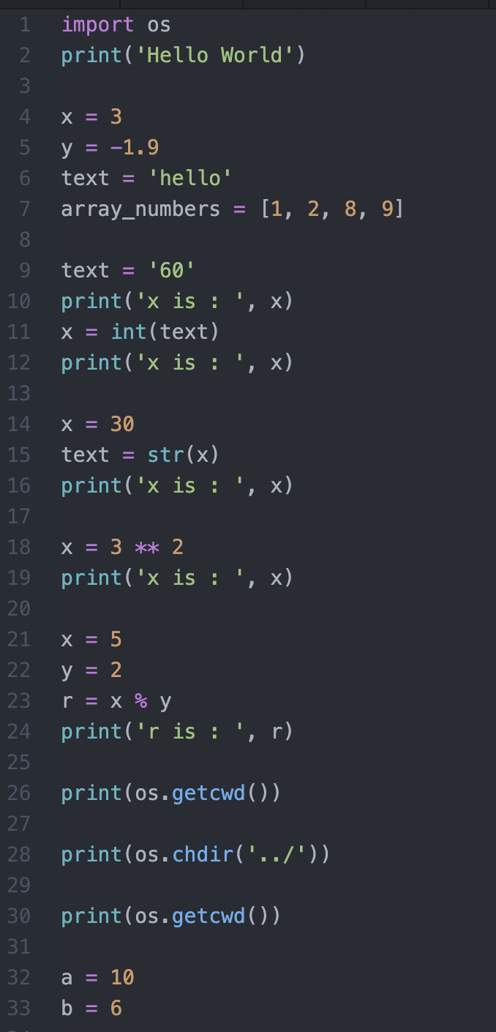

Slide 9
Setting up Atom for Python
Download atom from its official site https://atom.io
Once the download is complete, double-click the package to start installing atom
Open Atom>Preferences
Click "+" (install)
Search for a terminal package called "platformio-ide-terminal"
Click "install“
Open shell script by clicking on “+” in the left corner of your Atom IDE

Slide 10
Setting up VS Code for Python
Download VS Code from its official site https://code.visualstudio.com/download
Once the download is complete, double-click the package to start installing VS Code
Click Terminal on the left corner of your IDE
Check python installation by running the command:
python3 –-version

Slide 11
Installing Anaconda-Navigator
Download Anaconda from its official site https://docs.anaconda.com/anaconda/install/windows/

Slide 12
Creating a virtual environment
Run the command:
python3 –m pip install –user virtualenv
Create the virtual environment:
python3 –m venv [ENVIRONMENT_NAME]
Activate the virtual environment :
source [ENVIRONMENT_NAME]/bin/activate
which python
Leaving the virtual environment:
deactivate

Slide 13
Installing packages
Activate the virtual environment :
source [ENVIRONMENT_NAME]/bin/activate
which python
Run the command:
python3 –m pip install numpy pandas scipy hyperopt
Freezing dependencies: pip can export a list of all installed packages and their versions using the freeze command:
python3 –m pip freeze >> requirements.txt
Install the packages using requirements file:
python3 –m pip install –r requirements.txt

Slide 14
Jupyter Notebook in VS Code
Run the command:
python3 –m pip install jupyter
Create .ipynb file
Click on kernel in the upper right corner of your IDE
Select the Python environment: Python 3.11.6

Slide 15
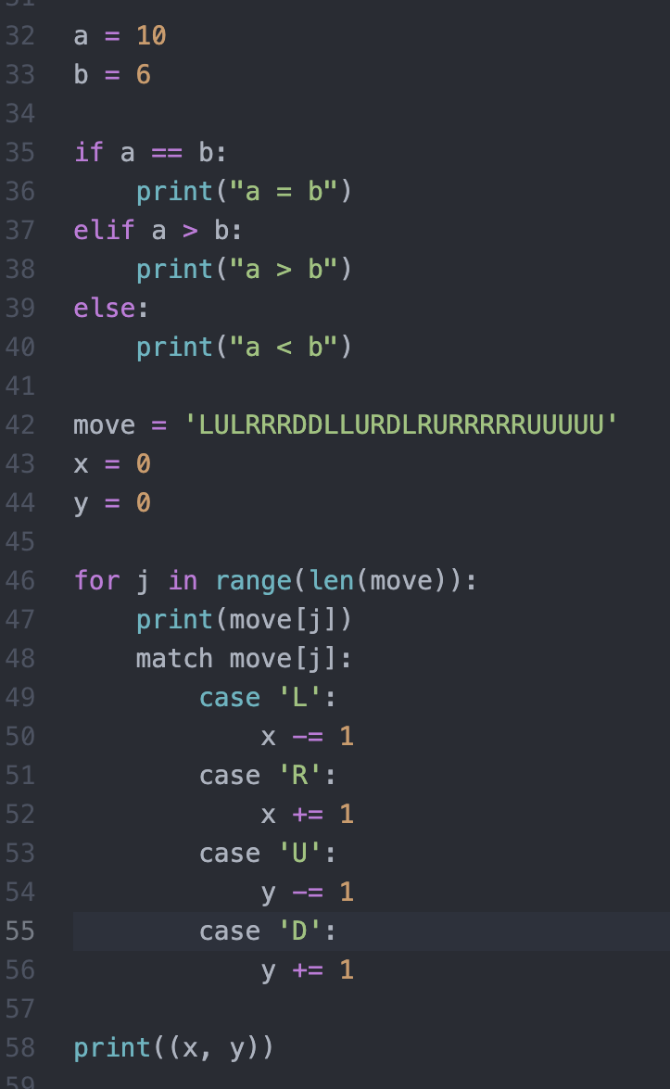
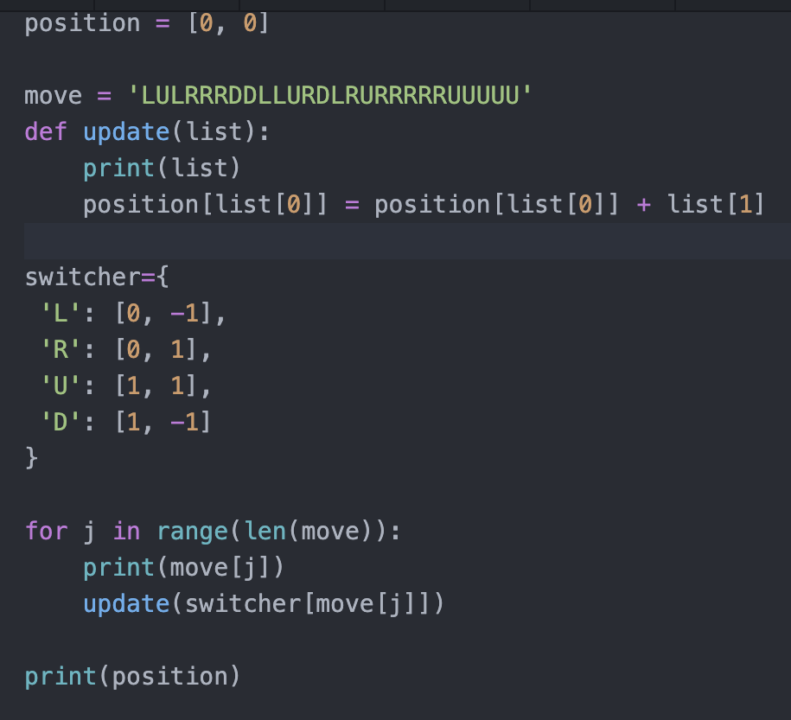
Control Flow Code

