Slide 1
Intro to Programming I: Intro to Python
June 20th, 2024

Slide 2

Motivation
Computer Programming: Creating a schedule of events for a computer to follow to complete a task.
Why learn programming?
To become a programmer
To think computationally
To apply computational tools to problems
Notes:
Briefly define programming
Motivation: Why learn programming?
to be a programmer
to apply computational tools to problems
to think computationally

Slide 3
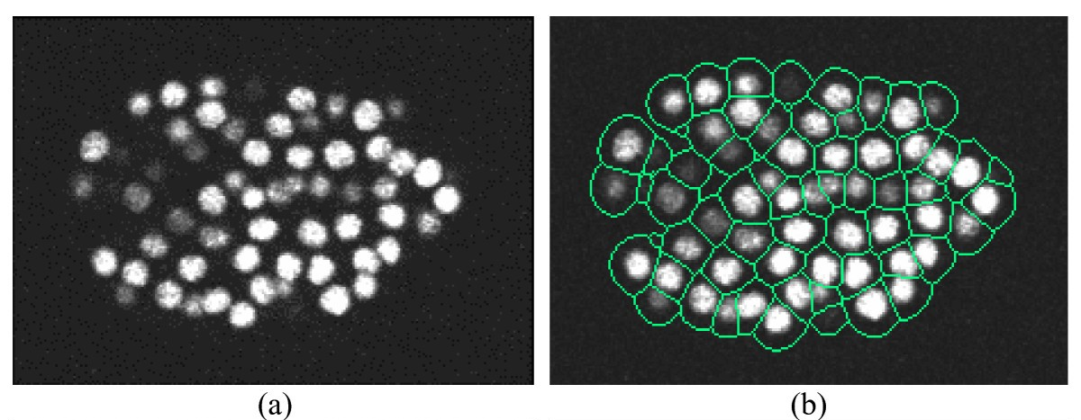
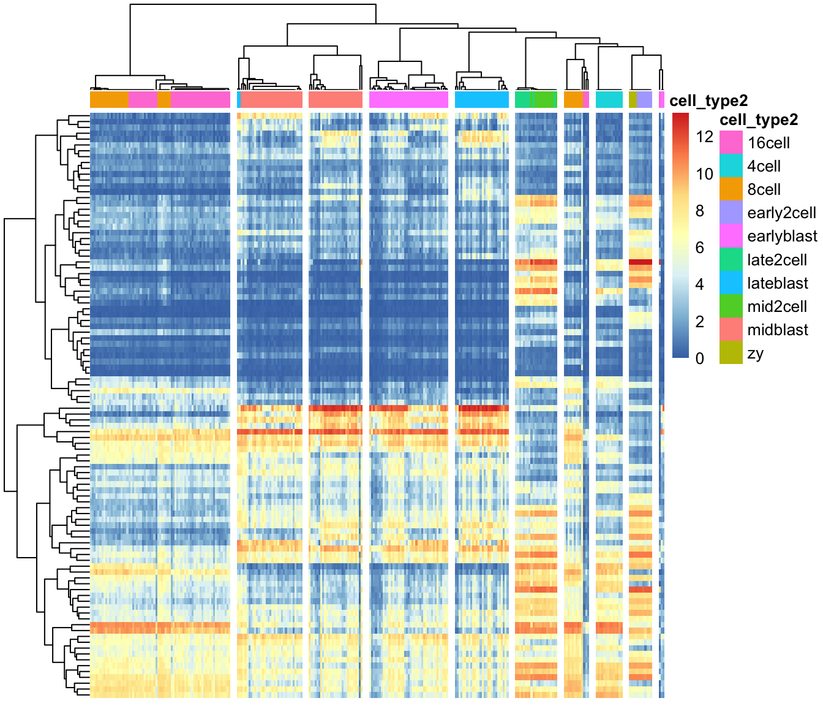
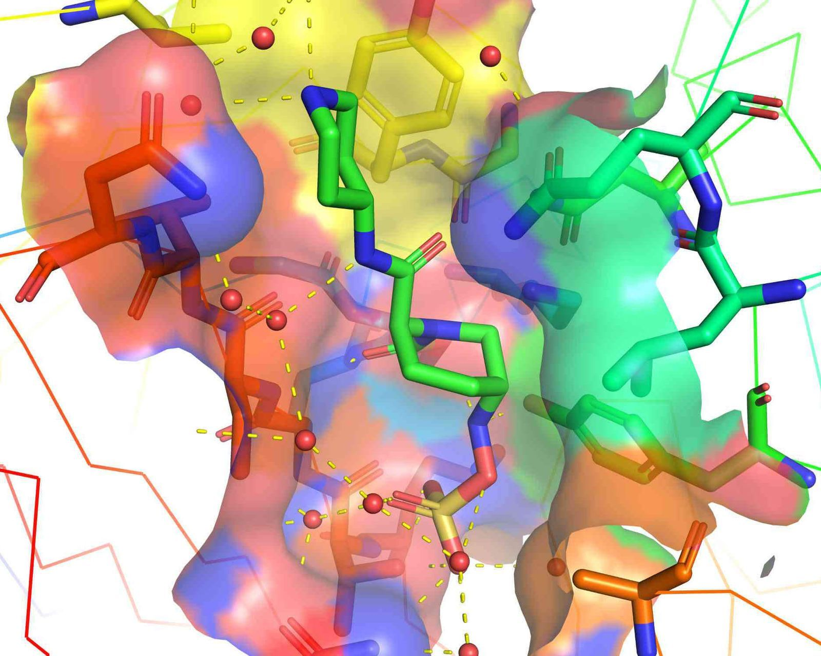

Motivation
What do you use programming for?
Notes:
Applications (and also, a bit of a course roadmap)
Plotting, data exploration, DNA/RNA sequencing data
Large-scale image processing
Simulations, machine learning, etc.

Slide 4
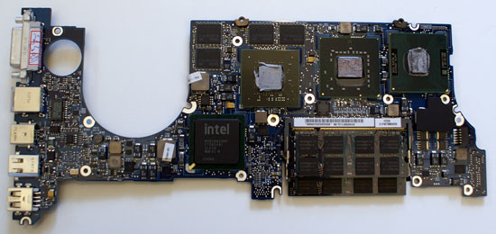

Python is a language
“01011110010101001010010010101
010101001110110010101111001010
101010100110010011011010010101
101010100101001010100101001001”
“Calculate the energy
of a protein in this
conformation.”
Notes:
A language…
…read by an interpreter…
…to create an output.
http://www.openbookproject.net/thinkcs/python/english3e/
https://docs.python.org/3/tutorial/

Slide 5
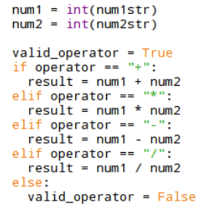
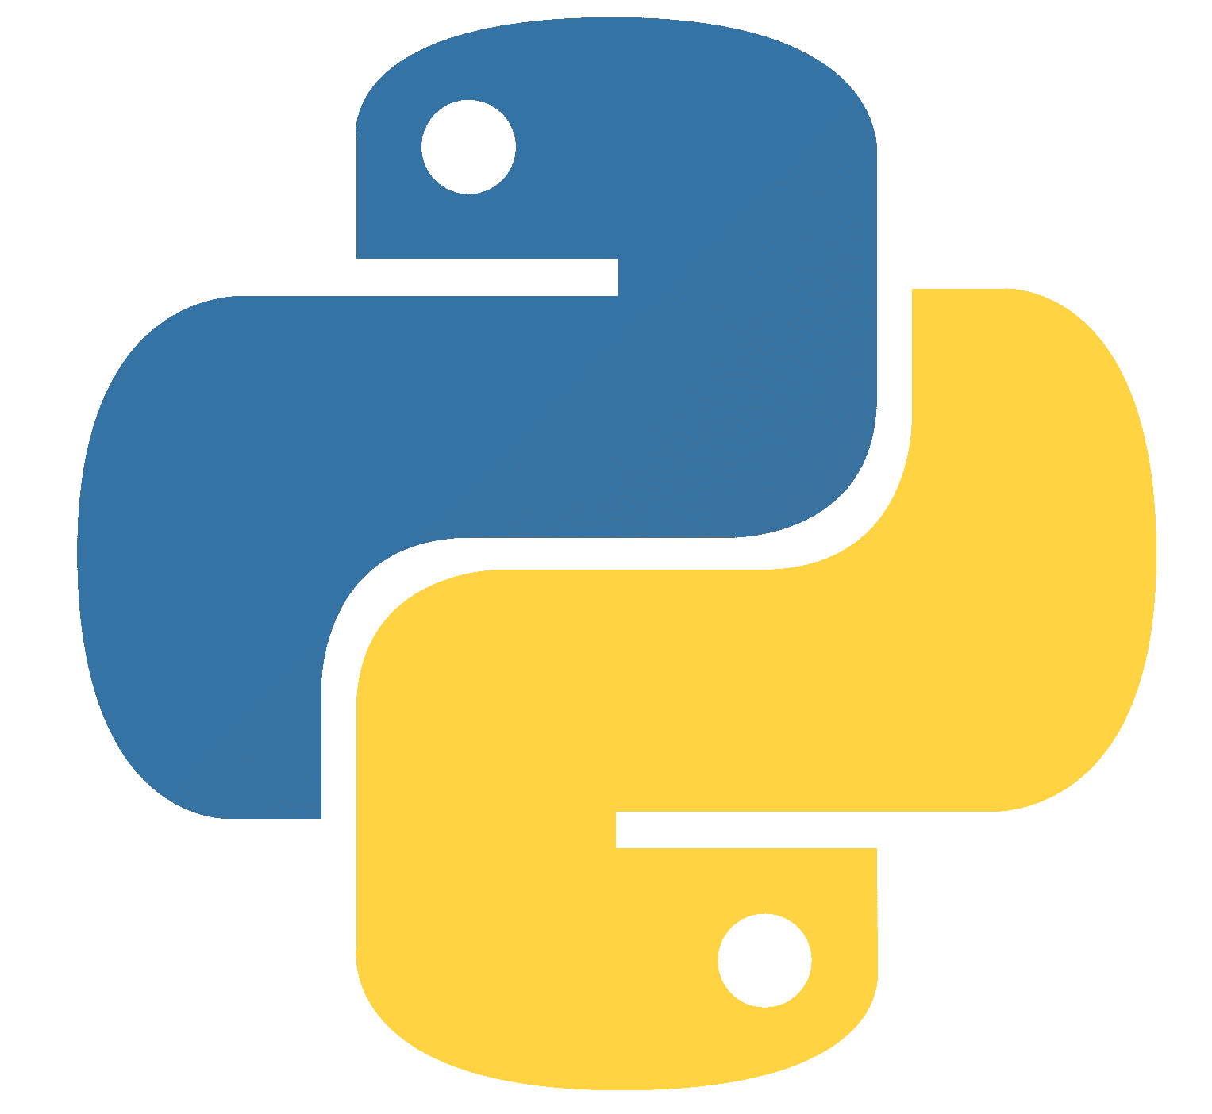

Python is a language
“Calculate the energy of a protein in this
conformation.”
“01011110010101001010010010101
010101001110110010101111001010
101010100110010011011010010101
101010100101001010100101001001”
(You are here)
Human Language > Programmer > Python > Python Interpreter > Machine Language
+ easy to pick up
- slower than other languages
Notes:
A language…
…read by an interpreter…
…to create an output.
Python --> programming language
then discuss different possible languages, pros and cons of python.
http://www.openbookproject.net/thinkcs/python/english3e/
https://docs.python.org/3/tutorial/

Slide 6
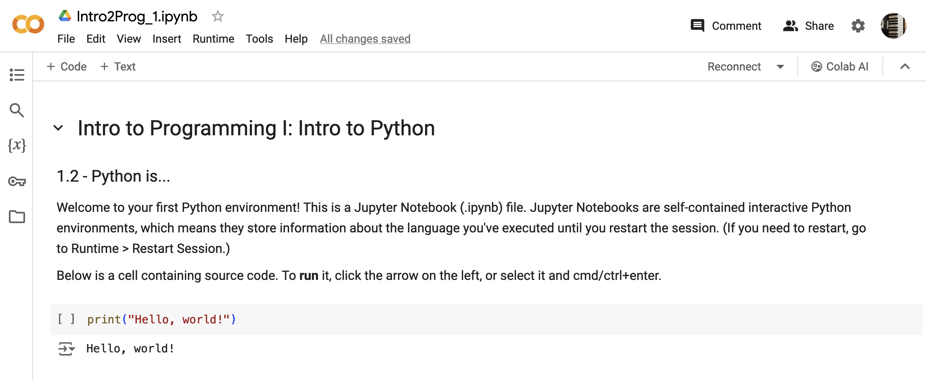
Let’s try Python!
Colab link

Slide 7
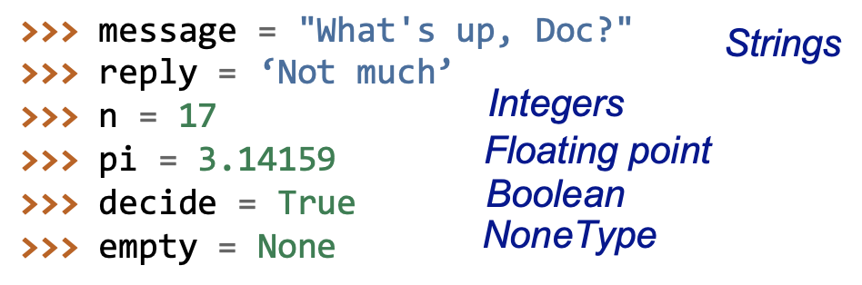
Variables
Now we can fix our bug!

Slide 8
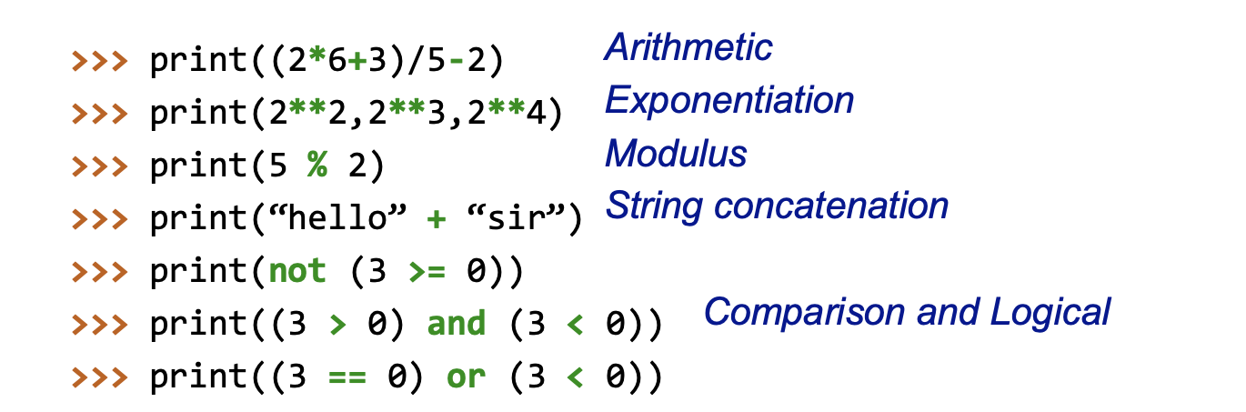
Operators
Notes:
This is too much information, show these things 1 by 1
Show math notation (Latec), then show the python version
1 slide and 1 CoLab cell per new operation
Variable type --> Operation on variable
PEMDAS
string addition + multiplication
Booleans --> Logical statements --> "show the logic table"
==

Slide 9
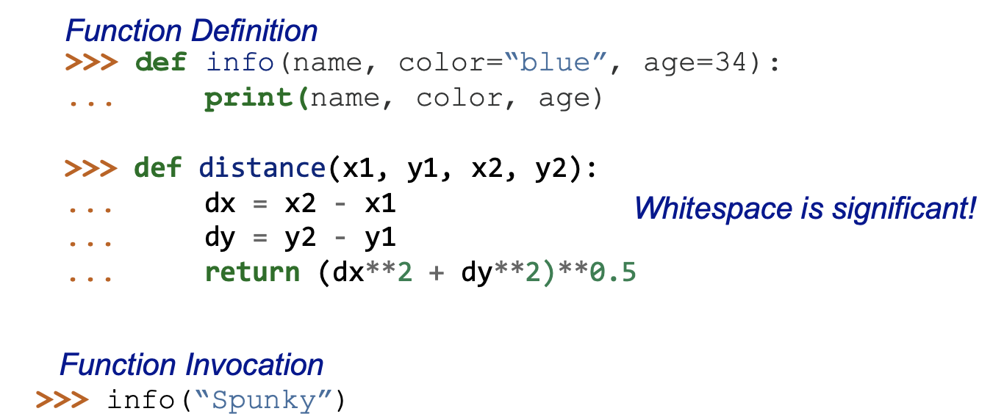
Functions
Can you predict what this line of code will do?
Notes:
start with a simpler function
def function_name():
print("The function just ran!")

Slide 10
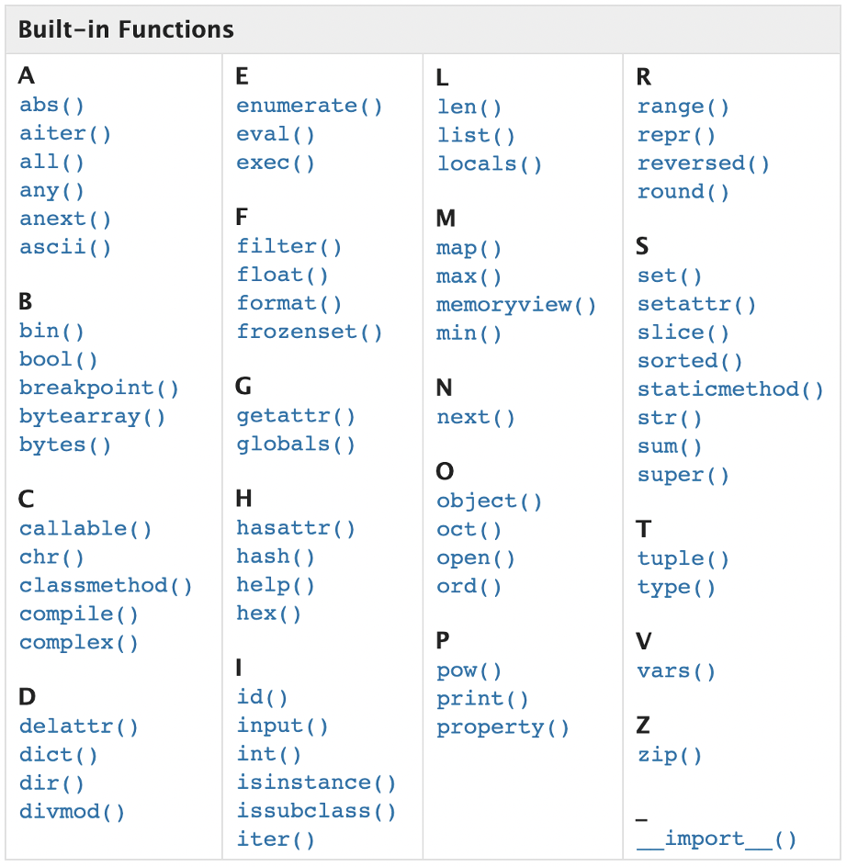
In-Built Functions

Slide 11
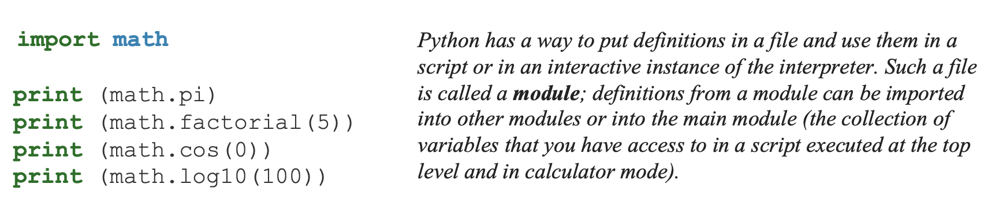
Modules
Notes:
import math
if you just want one thing:
from math import pi
get the cosin function and use it:

Slide 12
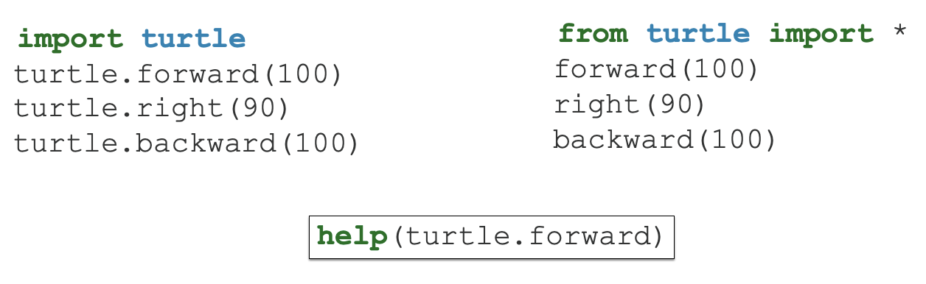
Turtles!!!
Back to colab!
Notes:
from time import sleep to make the turtle go slower

Slide 13
Intro to Programming II: Dataframes & Sequencing

Slide 14
1.0 – Review
We talked about
Variables
Operators
Functions
Modules

Slide 15
1.1 - Learning Objectives
RNA sequencing data

Slide 16
1.1 - Learning Objectives
RNA sequencing data
Understand conditional statements
Understand a common scientific data type: dataframes
Work with and plot real RNA sequencing data

Slide 17
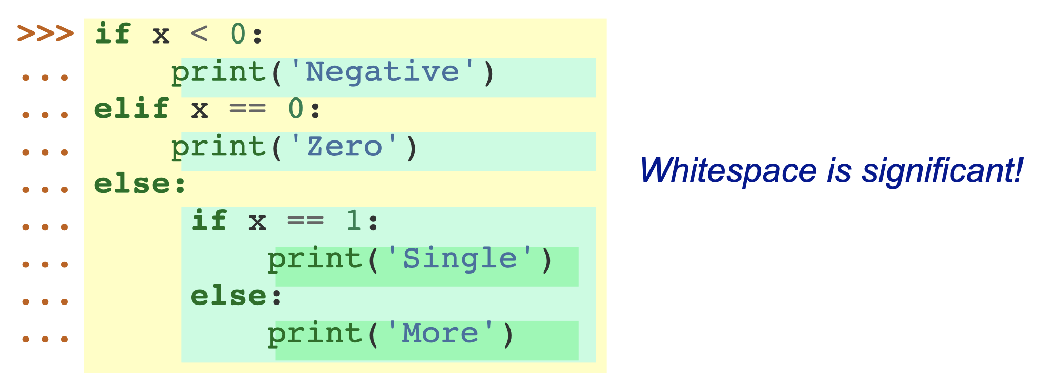
1.4 - Conditionals

Slide 18
1.4 - Conditionals
If statements
If statements take a boolean (True/False) value as an argument to decide whether the code inside is executed
The argument can be complex, as long as the result is Boolean
Co-lab

Slide 19
1.5 - Filtering
Filtering dataframes works like a series of if statements: check each row → calculate Boolean → if True/elif False

Slide 20
1.5 - Filtering
Use conditionals to filter outliers from data
Use conditionals to label certain elements of data
Volcano plot
Use function definition for filtering
For plotting multiple samples

Slide 21
1.2 - Pandas Dataframes
Kaggle dataset
Introduce dataset → dataset exploration
Plot data in Co-Lab
New Module: pyplot
How do we refine our plot?

Slide 22
1.3 - RNA Sequencing
Kaggle dataset
Introduce dataset
Plot data in Co-Lab
New Module: pyplot
How do we refine our plot?

