Slide 1
Intro to Programming I: Intro to Python
June 20th, 2024

Slide 2

1.1 - Motivation
Computer Programming: Creating a schedule of events for a computer to follow to complete a task.
Why learn programming?
To become a programmer
To think computationally
To apply computational tools to problems
Notes:
Briefly define programming
Motivation: Why learn programming?
to be a programmer
to apply computational tools to problems
to think computationally

Slide 3
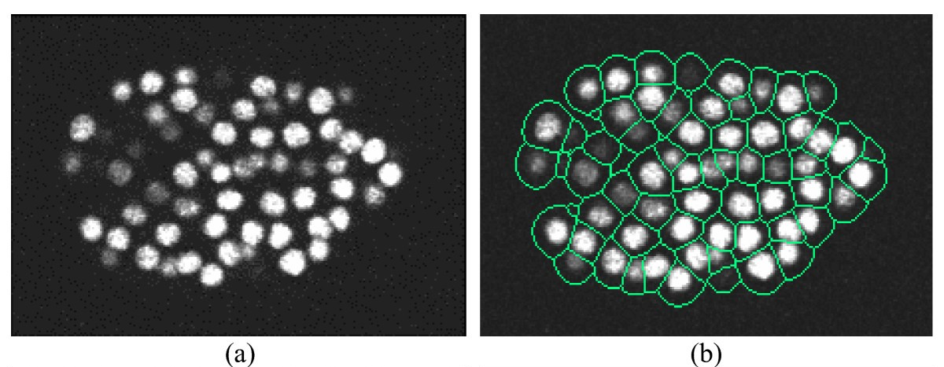
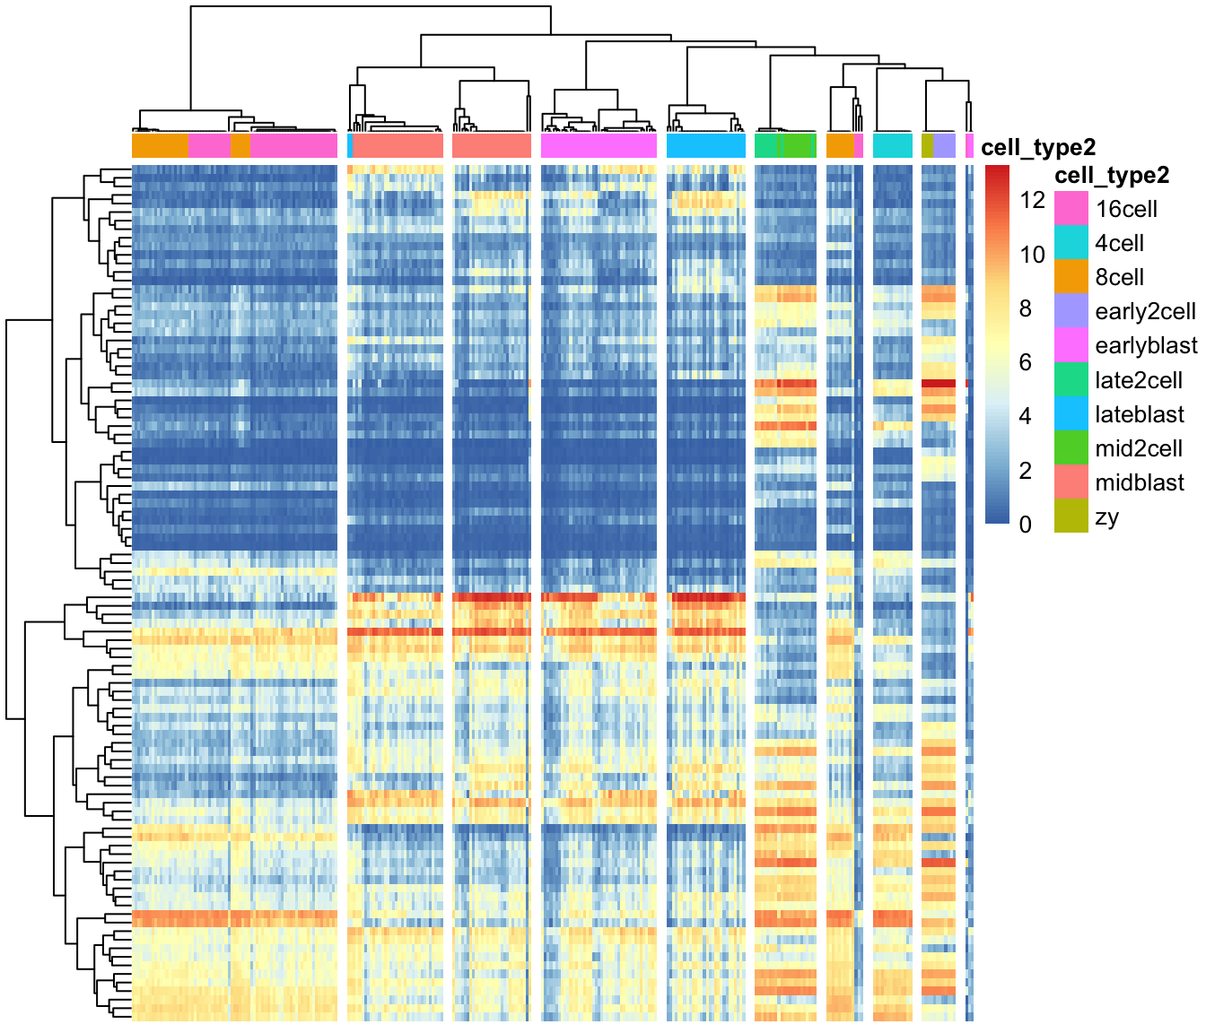
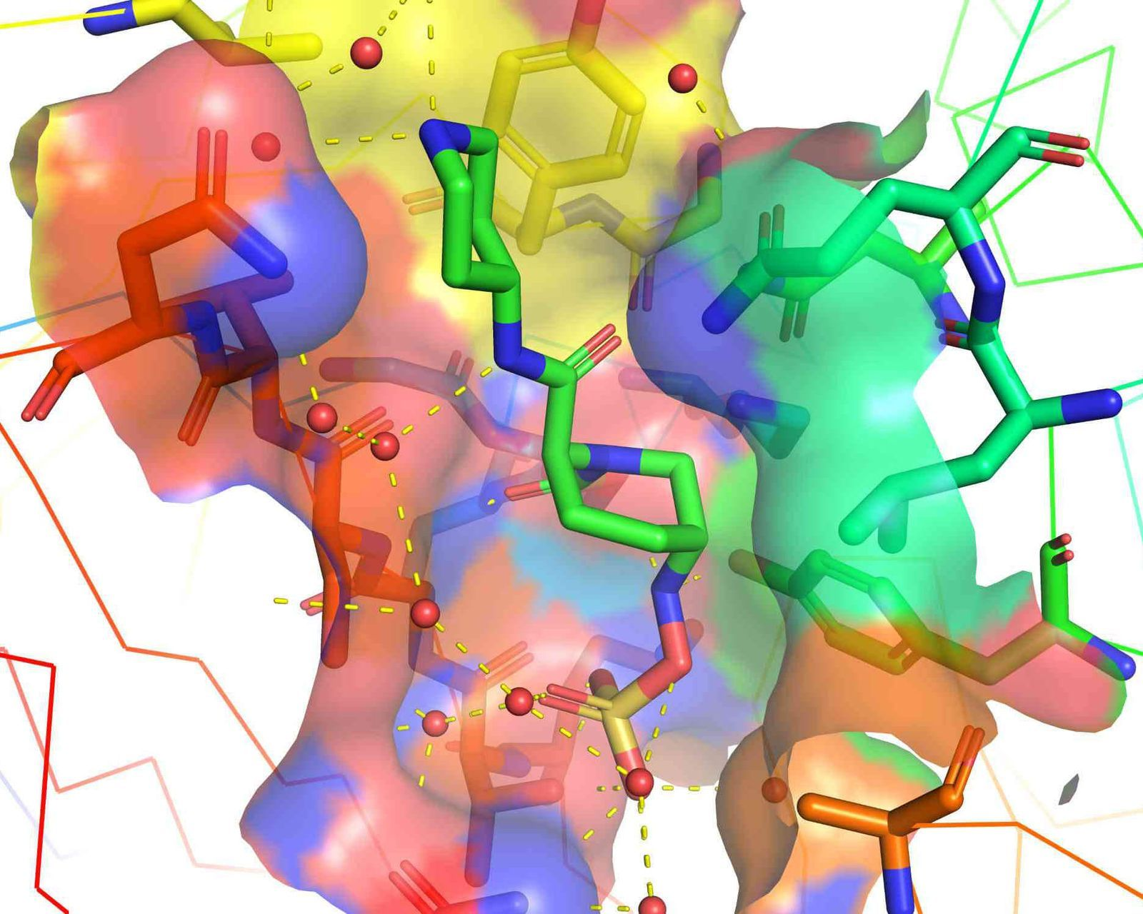

1.1 - Motivation
Notes:
Applications (and also, a bit of a course roadmap)
Plotting, data exploration, DNA/RNA sequencing data
Large-scale image processing
Simulations, machine learning, etc.

Slide 4
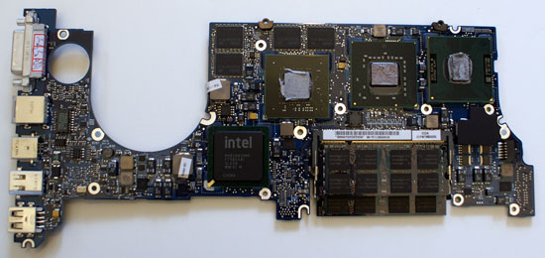

1.2 - Python is…
“01011110010101001010010010101
010101001110110010101111001010
101010100110010011011010010101
101010100101001010100101001001”
“Calculate the energy
of a protein in this
conformation.”
Notes:
A language…
…read by an interpreter…
…to create an output.
http://www.openbookproject.net/thinkcs/python/english3e/
https://docs.python.org/3/tutorial/

Slide 5
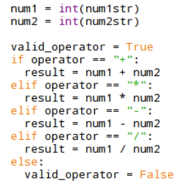
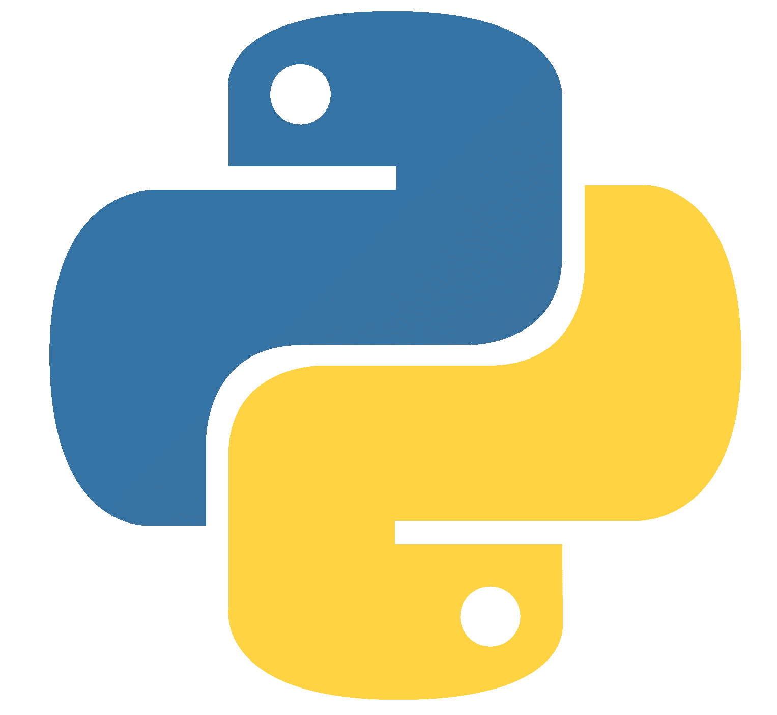

1.2 - Python is…
“Calculate the energy of a protein in this
conformation.”
“01011110010101001010010010101
010101001110110010101111001010
101010100110010011011010010101
101010100101001010100101001001”
(You are here)
Human Language > Programmer > Python > Python Interpreter > Machine Language
Notes:
A language…
…read by an interpreter…
…to create an output.
http://www.openbookproject.net/thinkcs/python/english3e/
https://docs.python.org/3/tutorial/

Slide 6
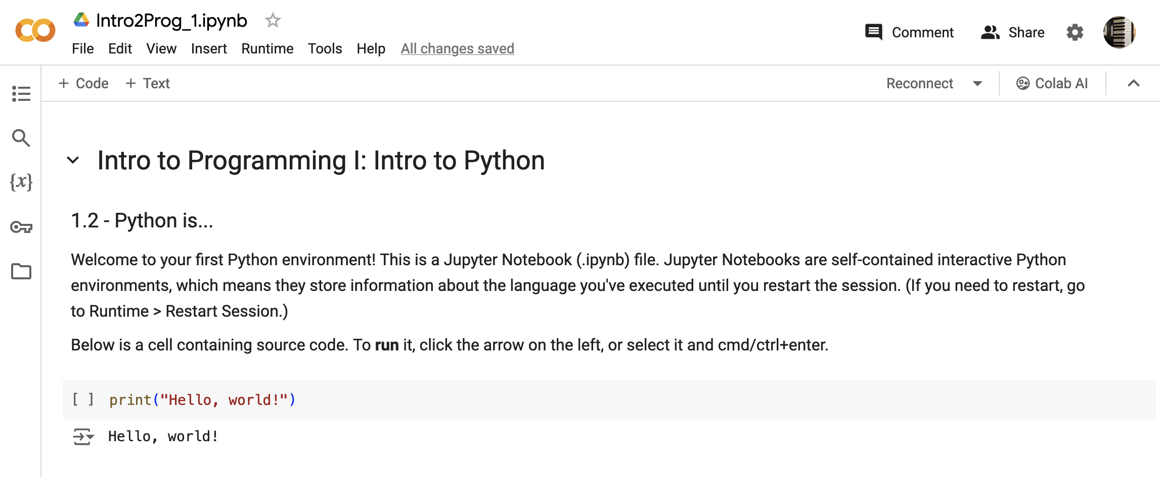
1.2 - Python is…
Colab link ← make a copy of this notebook

Slide 7
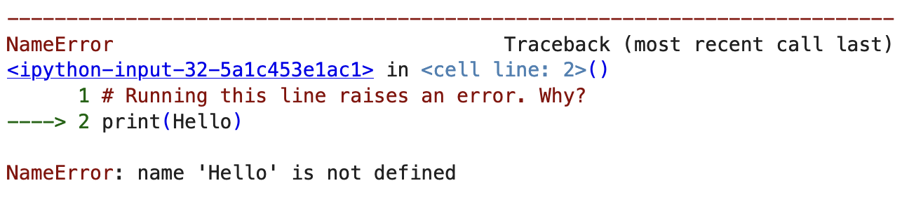
Our First Bug!
Python reads top to bottom, left to right
Python understands [print()]
Python does not understand [Hello]

Slide 8
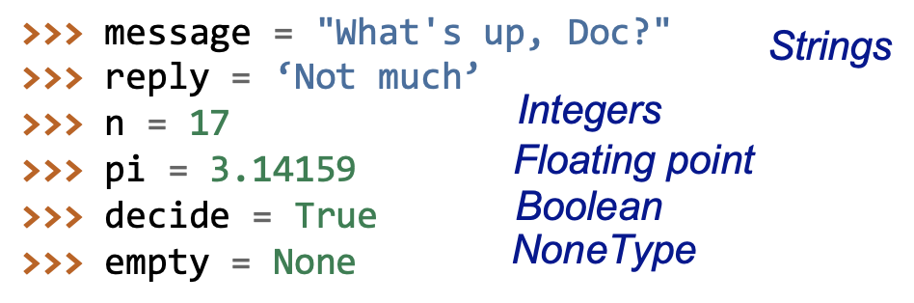
1.3 - Variables
Now we can fix our bug!

Slide 9
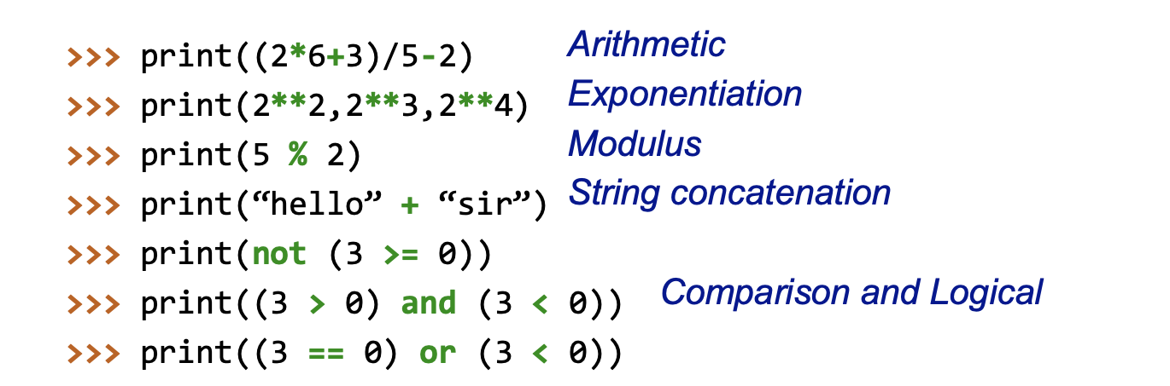
1.3 - Operators

Slide 10
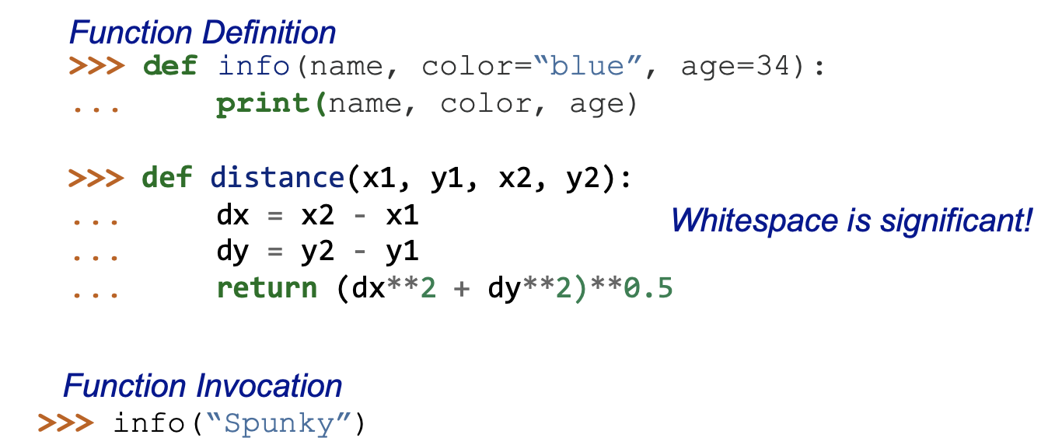
1.4 - Functions
Can you predict what this line of code will do?

Slide 11
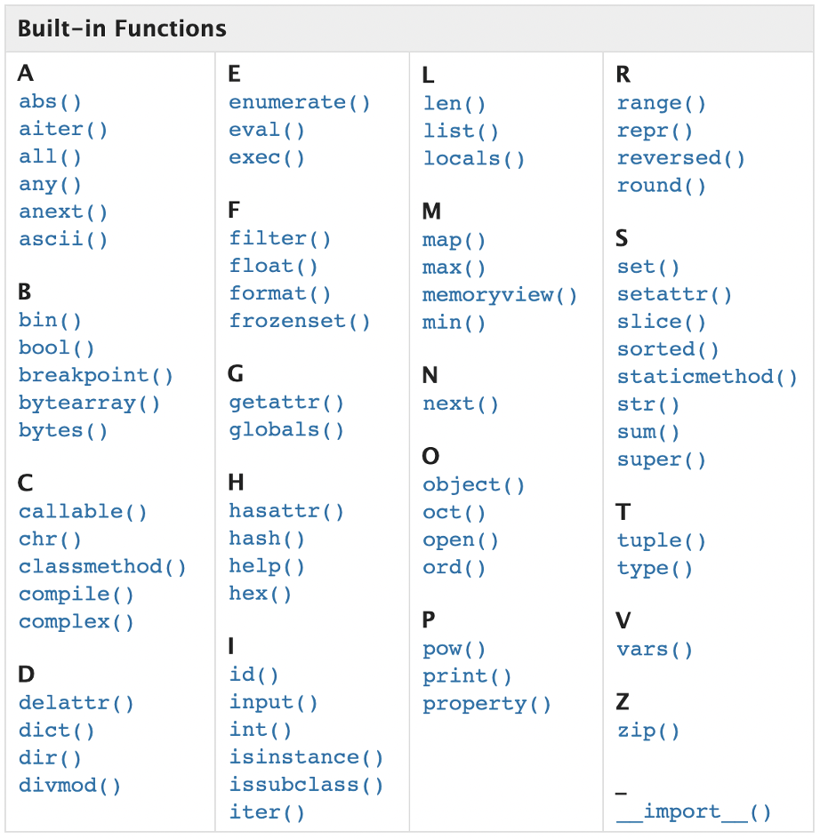
1.4 - Functions

Slide 12
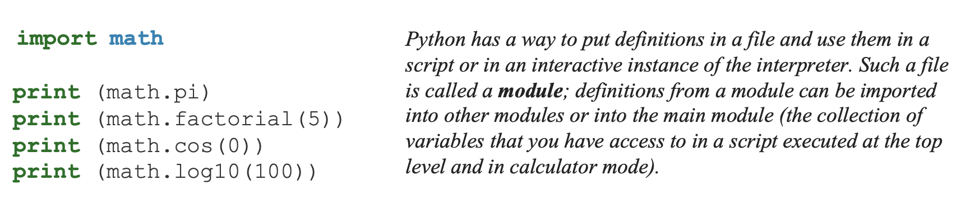
1.5 - Modules

Slide 13
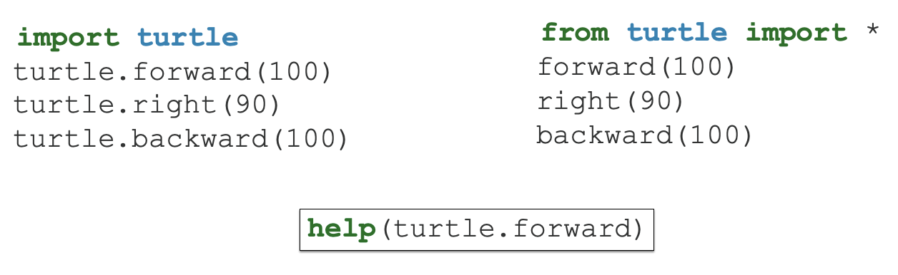
1.6 - Turtles
Back to colab!

Slide 14
Intro to Programming II: Dataframes & Sequencing

Slide 15
1.0 – Review
We talked about
Variables
Operators
Functions
Modules

Slide 16
1.1 - Learning Objectives
RNA sequencing data

Slide 17
1.1 - Learning Objectives
RNA sequencing data
Understand conditional statements
Understand a common scientific data type: dataframes
Work with and plot real RNA sequencing data

Slide 18
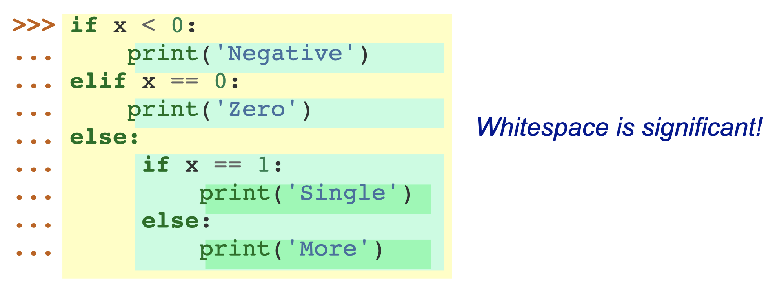
1.4 - Conditionals

Slide 19
1.4 - Conditionals
If statements
If statements take a boolean (True/False) value as an argument to decide whether the code inside is executed
The argument can be complex, as long as the result is Boolean
Co-lab

Slide 20
1.5 - Filtering
Filtering dataframes works like a series of if statements: check each row → calculate Boolean → if True/elif False

Slide 21
1.5 - Filtering
Use conditionals to filter outliers from data
Use conditionals to label certain elements of data
Volcano plot
Use function definition for filtering
For plotting multiple samples

Slide 22
1.2 - Pandas Dataframes
Kaggle dataset
Introduce dataset → dataset exploration
Plot data in Co-Lab
New Module: pyplot
How do we refine our plot?

Slide 23
1.3 - RNA Sequencing
Kaggle dataset
Introduce dataset
Plot data in Co-Lab
New Module: pyplot
How do we refine our plot?

