Slide 1




Slide 2
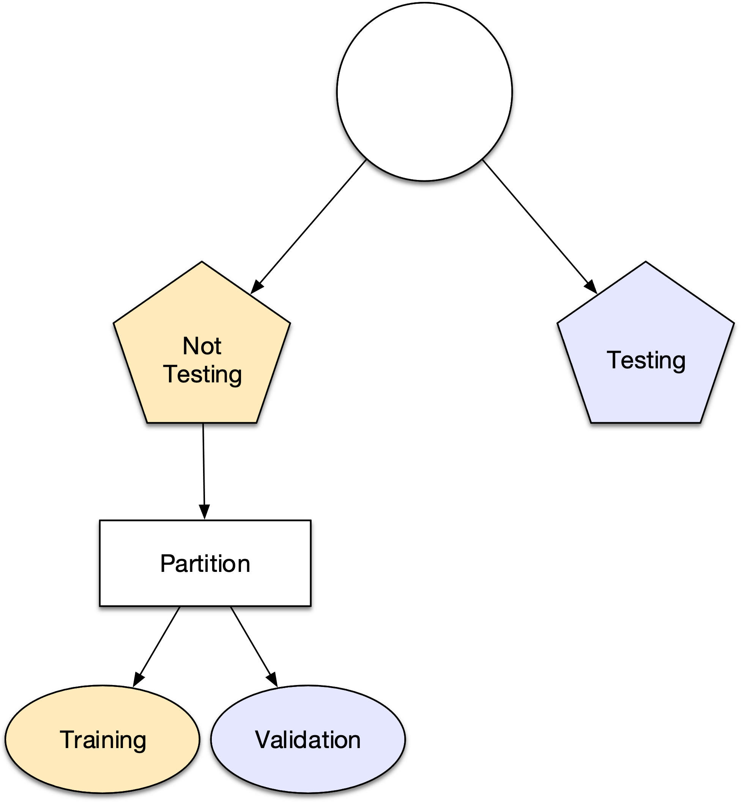
All Data
Not Testing
Testing
Training
Validation

