Slide 1





Slide 2





Slide 3







All Data
Training
Testing
Analysis
Assessment

Slide 4



Slide 5
Specify Model Details
Inspect Model Results
1
2
3
4
Fit Model
Make Predictions

Slide 6
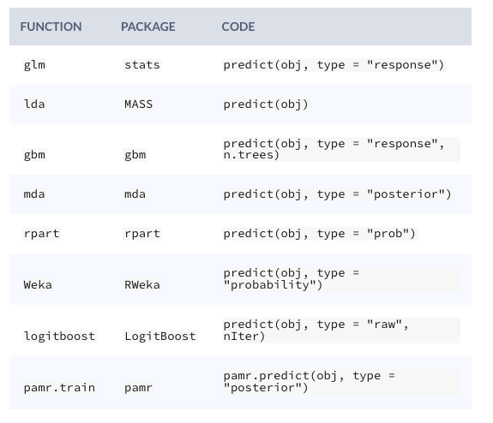

Slide 7
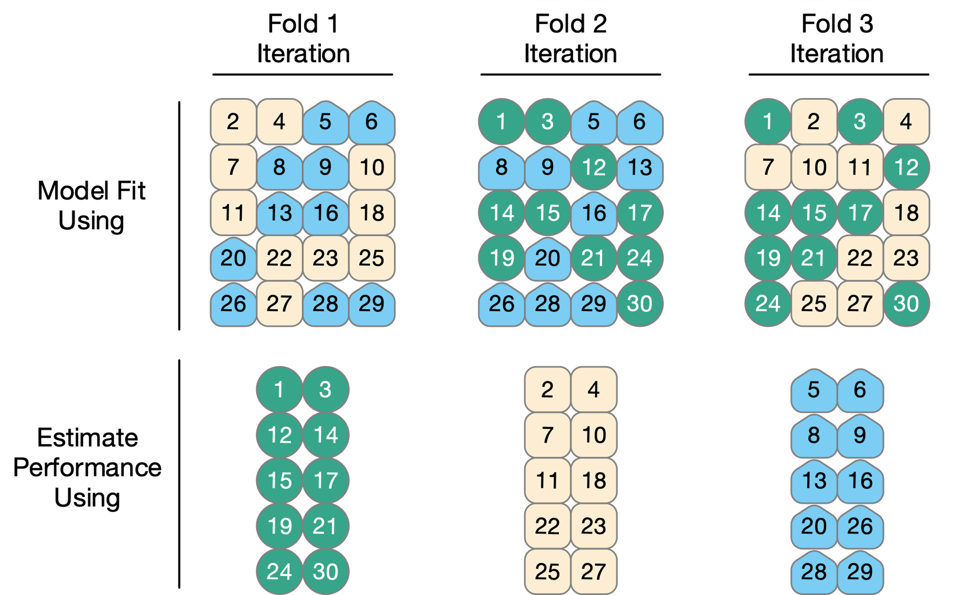

Slide 8
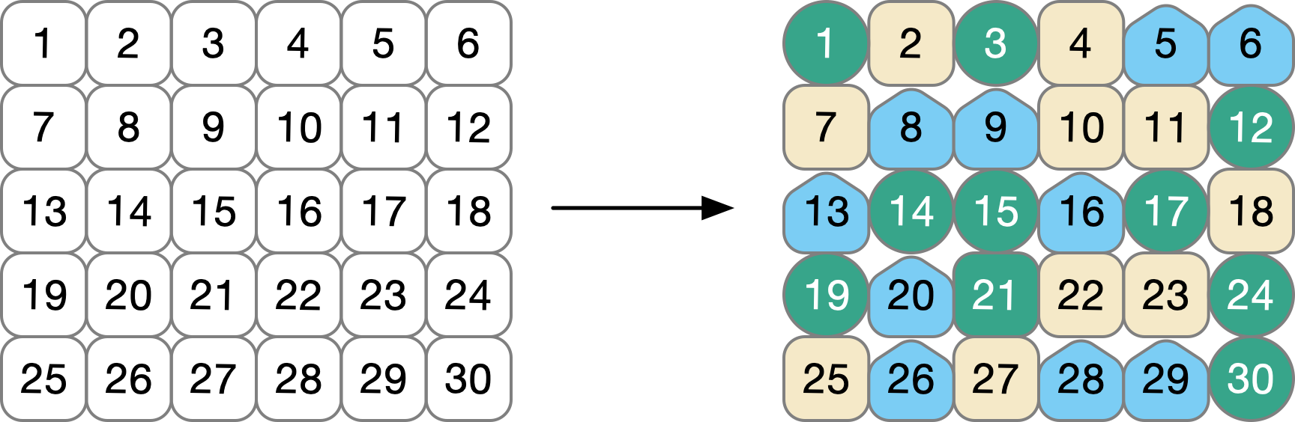

Slide 9
All Available Data
Final Model

Slide 10
All Available Data

Slide 11
All Available Data
Not Testing
Testing
Test Final Model
31
32
33
34
51
52
35
36
37
38
55
56
Final Model
39
40
41
42
59
60
43
44
45
46
63
64
47
48
49
50
67
68

Slide 12
All Available Data
Training
Testing
Fold 1 Iteration
Fold 2 Iteration
Fold 3 Iteration
Analysis (fit models)
31
32
33
34
51
52
35
36
37
38
55
56
39
40
41
42
59
60
43
44
45
46
63
64
47
48
49
50
67
68
Assessment (test models)
Test Final Model (on all Testing Data)
Fit Final Model (on all Training Data)

Slide 13
Outer Loop
Training
Test

Slide 14
Outer Loop
Training
Test
Inner Loop
Analysis
Assessment

Slide 15
Outer Loop
Training
Test
Inner Loop
Assessment

Slide 16
Outer Loop
Training
Test
Inner Loop
Assessment

Slide 17
Outer Loop
Training
Test
Inner Loop
Assessment

Slide 18
Outer Loop
Training
Test
Inner Loop
Assessment

