Slide 1
Applied Machine Learning in R A hands-on introduction for social and behavioral scientists
Pittsburgh Summer Methodology Series | July 19-23, 2021 | www.pittmethods.com

Slide 2
Workshop
Section 0, Day 1

Slide 3

Steps in the data science dance
Visualize
Import
Tidy
Transform
Communicate
Model
Program
https://r4ds.had.co.nz/introduction.html
Workshop [1 of 4]

Slide 4


The workshop roadmap
Monday: R for Data Wrangling
Program (AM)
Wrangle (PM)
Tuesday: R for Data Modeling
Visualize (AM)
Model (PM)
Materials available from:
osf.io/uy2fm
A copy of this presentation is at https://osf.io/7hmb2
Workshop [2 of 4]

Slide 5

The R speedometer
Our goal is to empower you with knowledge and confidence.
0 mph You know nothing (about R), John Snow.
20 mph You can do a few things in R but not enough (or not quickly enough) for it to be feasible.
40 mph There is still a lot that you don’t know. However, you have the foundation and motivation to learn.
60+ mph You comfortably use R for most data-related tasks. You know a lot and can learn whatever you need.
We'll get you moving! You'll need to build on this momentum.
Workshop [3 of 4]

Slide 6

Grow your investment
During the Workshop
Try to minimize distractions (email, phone, etc.)
Don't stay confused for long (ask for help/clarification)
Forgive your mistakes and celebrate your successes
Beyond the Workshop
Cultivate your curiosity and playfulness
Find colleagues to learn and practice R with
Commit to doing project(s) you care about in R
The #rstats hashtag on Twitter is a good place to chat about R.
Workshop [4 of 4]

Slide 7
Program
Section 1, Day 1

Slide 8
Steps in the data science dance
Visualize
Import
Tidy
Transform
Communicate
Model
Program
https://adv-r.hadley.nz/
Program [01 of 12]

Slide 9

Overview of Section 1
Think of R as a well-meaning but overly literal Genie
It has the power to grant almost any wish you desire…
…but you must phrase your wishes very carefully!
You will always get you what you asked for, but not always what you wanted.
Mastering the R language means learning...
How to phrase your commands
How to decipher the error messages
How to view code from R's perspective
How to detect and correct small mistakes
https://tvtropes.org/pmwiki/pmwiki.php/Main/LiteralGenie
Program [02 of 12]

Slide 10

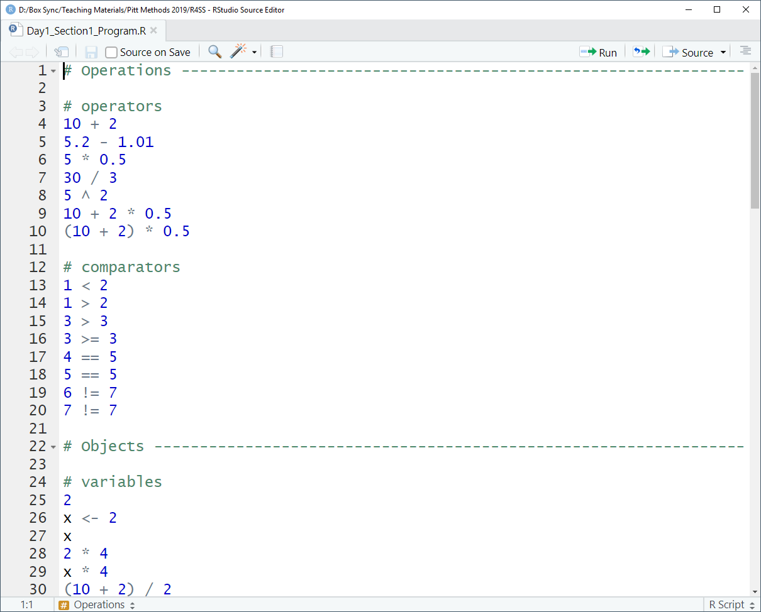
Live Coding: Program
Operations
Objects
Functions
Vectors
Strings
Packages
Part A
Part B
Part C
Follow along at https://osf.io/ensdc/
Program [03 of 12]

Slide 11
Live Coding Summary
Operations
Objects
Functions
Vectors
Strings
Packages
Operators |  |  | Comparators
+ | Add |  | < | Less
- | Subtract |  | <= | Less/Equal
* | Multiply |  | > | More
/ | Divide |  | >= | More/Equal
^ | Raise |  | == | Equal
( ) | Enclose |  | != | Not Equal
(10 - 2) / 3
(1 - 1/3) >= 0.5
https://www.statmethods.net/management/operators.html
Program [04 of 12]

Slide 12
Live Coding Summary
Operations
Objects
Functions
Vectors
Strings
Packages
Objects are created using <-
Object names have rules
Must start with a letter
Can only contain letters, numbers, and underscores (no symbols/spaces)
Are case-sensitive and unique
x <- 5
this_year <- 2019
in_x_years <- this_year + x
https://r4ds.had.co.nz/workflow-basics.html#whats-in-a-name
Program [05 of 12]

Slide 13

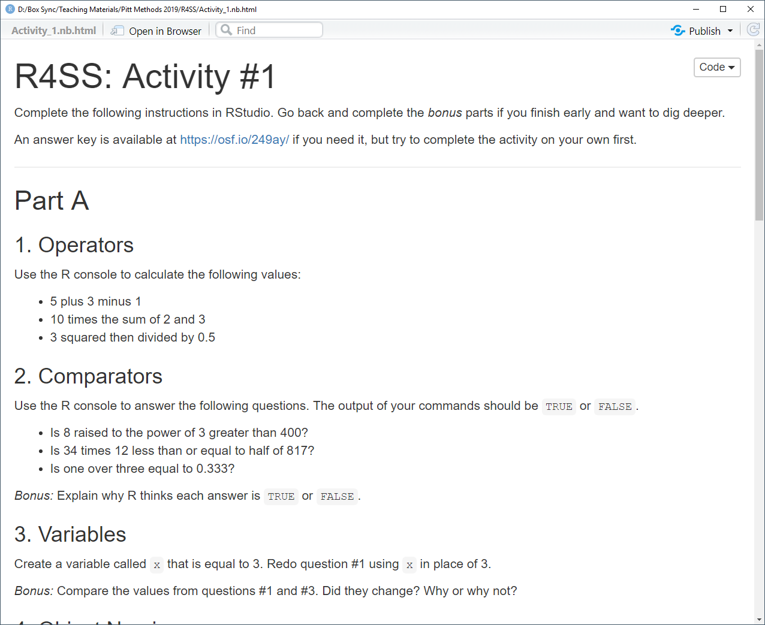
Activity #1A
Go to https://osf.io/3m5nd/
Click the Download button
Open the file in any web browser
Complete Part A (#1, 2, 3, 4)
Ask questions and take breaks
Answer key: https://osf.io/249ay/
Program [06 of 12]

Slide 14
Live Coding Summary
Operations
Objects
Functions
Vectors
Strings
Packages
Functions make operations easier
Nested functions are computed or "resolved" inside-then-outside
Arguments enable customization
Separate arguments with commas
sqrt(9)
round(sqrt(14))
round(2 / 3, digits = 4)
https://r4ds.had.co.nz/functions.html
Program [07 of 12]

Slide 15
Live Coding Summary
Operations
Objects
Functions
Vectors
Strings
Packages
Vectors collect multiple values
Numerical vectors collect numbers
Vectors are created using c()
Many functions transform vectors
Vectors can be subset using [ ]
x <- c(4, 2, 1, 9)
mean(x)
x[4]
https://r4ds.had.co.nz/vectors.html
Program [08 of 12]

Slide 16
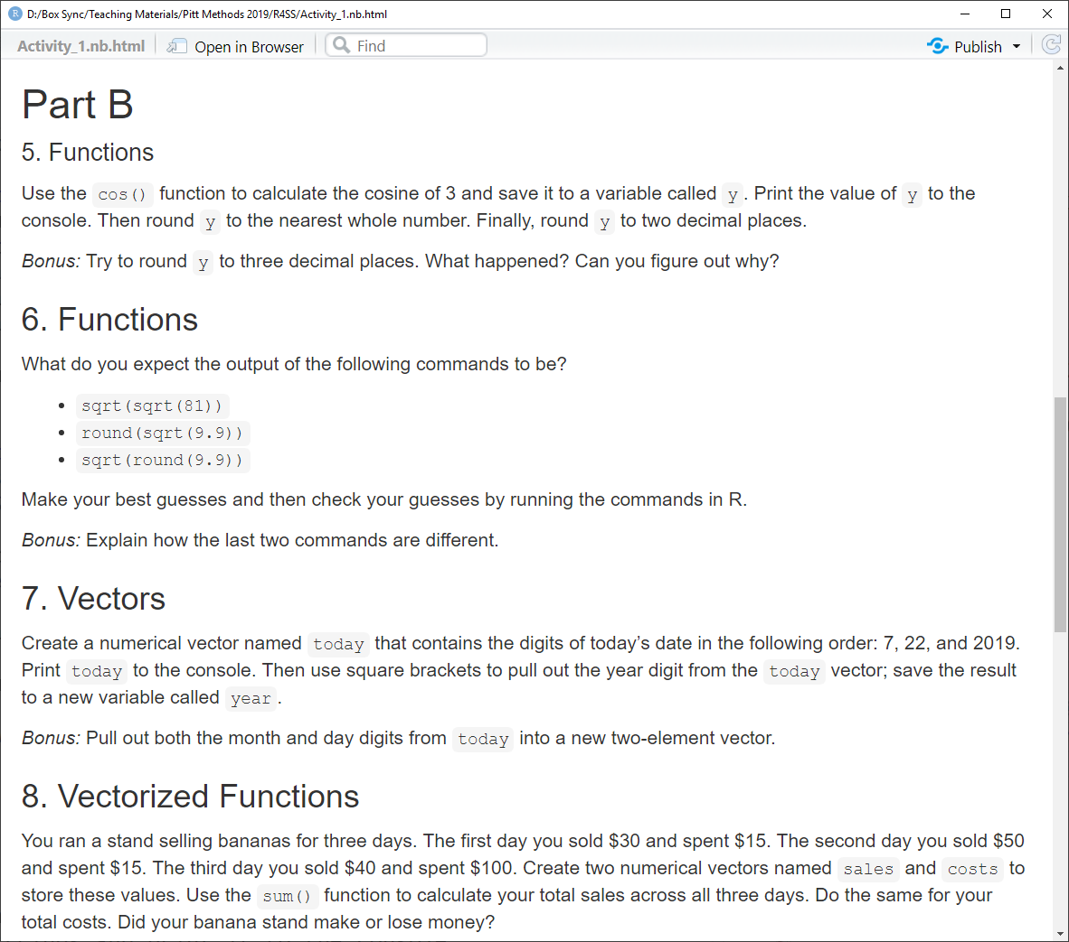
Activity #1B
Go to https://osf.io/3m5nd/
Click the Download button
Open the file in any web browser
Complete Part B (#5, 6, 7, 8)
Ask questions and take breaks
Answer key: https://osf.io/249ay/
Program [09 of 12]

Slide 17
Live Coding Summary
Operations
Objects
Functions
Vectors
Strings
Packages
Text can be stored as strings
Strings must be quoted as "text"
Character vectors collect strings
There are special string functions
ref <- "1. Ang & Yi (2019)"
y <- c("I", "LOVE", "R!")
tolower(y)
https://r4ds.had.co.nz/strings.html
Program [10 of 12]

Slide 18
Live Coding Summary
Operations
Objects
Functions
Vectors
Strings
Packages
Packages add new functions to R
Packages must be installed once
They must be loaded every session
Packages are user-created and free
Packages are frequently updated
install.packages("praise")
library(praise)
https://cran.r-project.org/
Program [11 of 12]

Slide 19
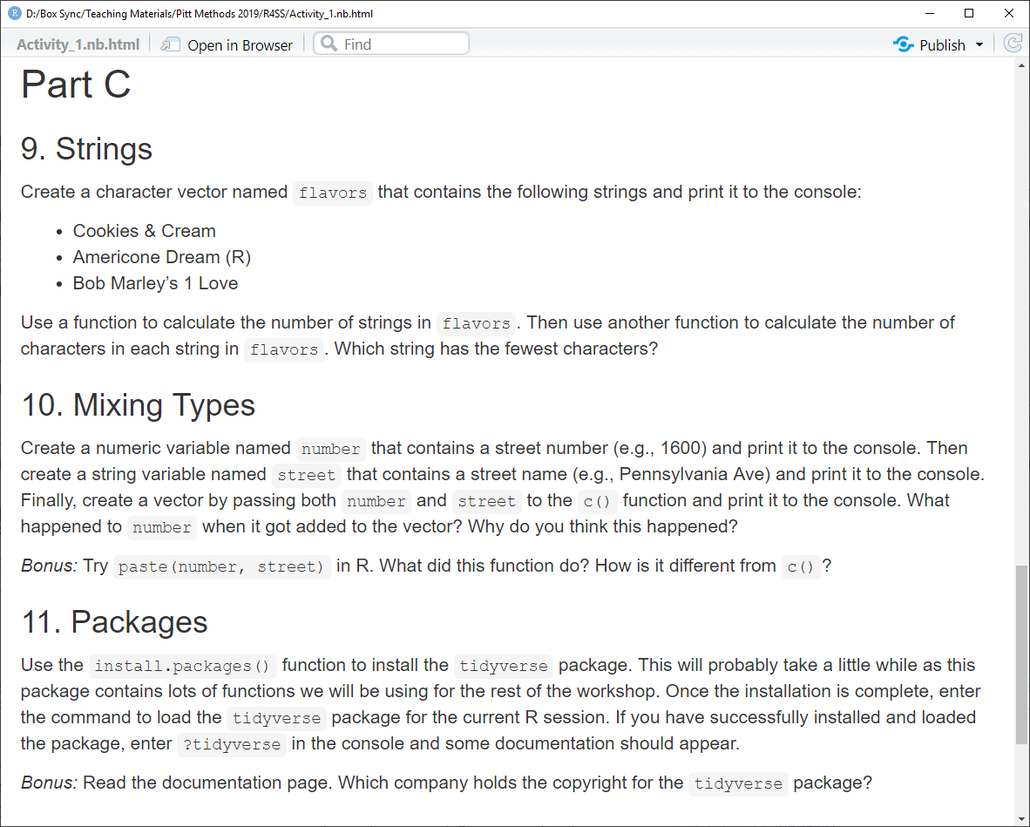
Activity #1C
Go to https://osf.io/3m5nd
Click the Download button
Open the file in any web browser
Complete Part C (#9, 10, 11, 12)
Ask questions and take breaks
Answer key: https://osf.io/249ay
Program [12 of 12]

Slide 20

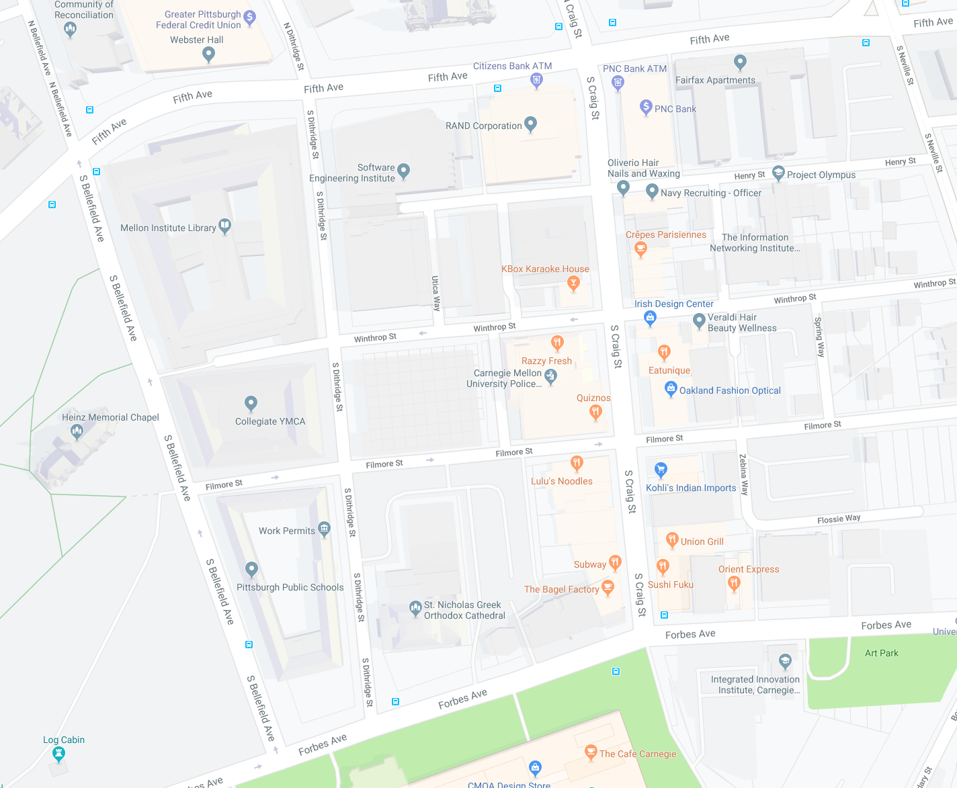
Food Options
Breakfast/Coffee
The Bagel Factory ($)
Starbucks ($$)
Crepes Parisiennes ($$)
Lunch/Quick Bites
Quiznos ($)
Chipotle ($)
Subway ($)
Sushi Fuku ($)
Eat Unique ($)
Dinner/Full Service
Lulu’s Noodles ($)
Lucca Ristorante ($$)
Ali Baba ($$)
Union Grill ($$)
Left on Bellefield, Left on Filmore, Explore Craig Street
Yelp Ratings of Restaurants: https://bit.ly/2NzkNwm

Slide 21
Wrangle
Section 2, Day 1

Slide 22

Steps in the data science dance
Visualize
Import
Tidy
Transform
Communicate
Wrangle
Model
https://r4ds.had.co.nz/
Wrangle [01 of 12]

Slide 23
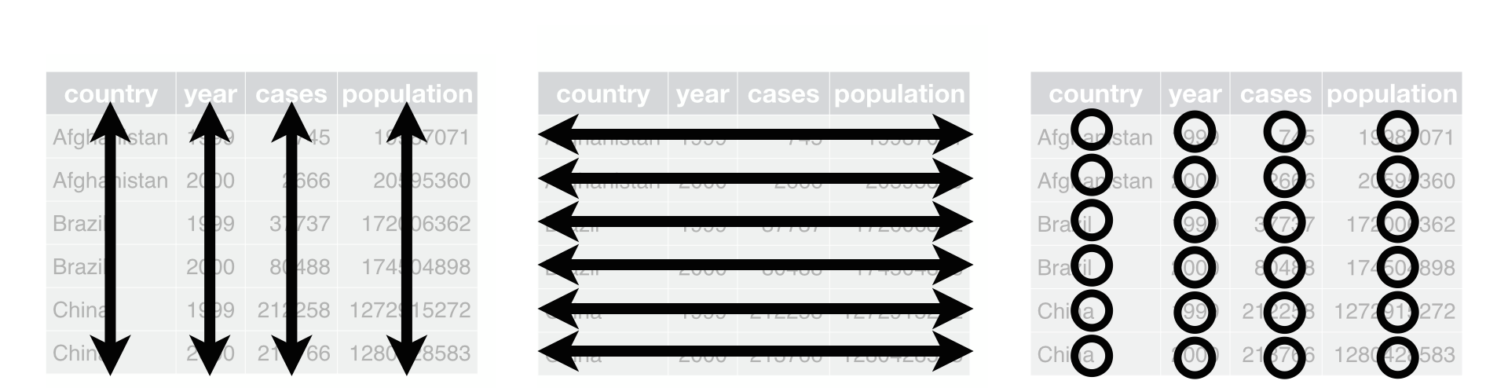
Overview of Section 2
In social science, you usually want your data in the "tidy" format
Keeping your data tidy will make it easier to analyze and visualize
Tidy data is rectangular
Each variable forms a column
Each observation forms a row
Each observational unit forms a table
Missing data is included and marked
Variables
Observations
Values
https://tidyr.tidyverse.org/articles/tidy-data.html
Wrangle [02 of 12]

Slide 24
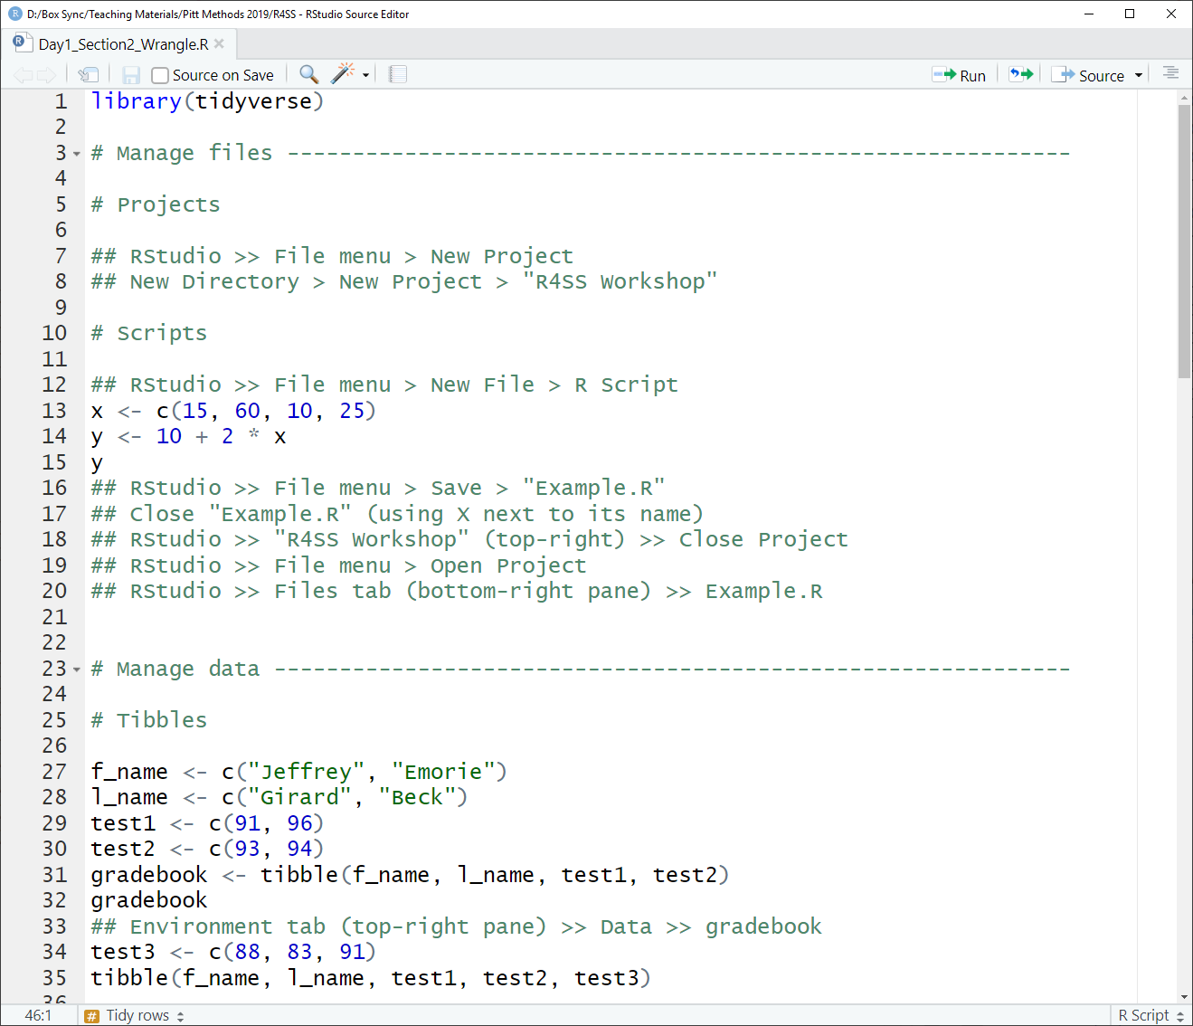
Live Coding: Wrangle
Manage files
Manage data
Tidy rows
Tidy columns
Transform data
Summarize data
Part A
Part B
Part C
Follow along at https://osf.io/d7s2q
Wrangle [03 of 12]

Slide 25
Live Coding Summary
Manage files
Manage data
Tidy rows
Tidy columns
Transform data
Summarize data
Projects let you organize all your files in a folder for easy access
Scripts save commands to a .R file that can be shared, edited, and run
Data can be imported from and exported to files in many formats
t <- read_csv("oldfile.csv")
write_csv(t, "newfile.csv")
https://r4ds.had.co.nz/data-import.html
Wrangle [04 of 12]

Slide 26
Live Coding Summary
Manage files
Manage data
Tidy rows
Tidy columns
Transform data
Summarize data
Tibbles are a special type of table or data frame from the tidyverse
Tibbles collect multiple vectors that all have the same length
A tibble can contain different types of vector (e.g., numeric and string)
numvec <- c(1, 2, 3)
strvec <- c("a", "b", "c")
t <- tibble(numvec, strvec)
https://r4ds.had.co.nz/tibbles.html
Wrangle [05 of 12]

Slide 27
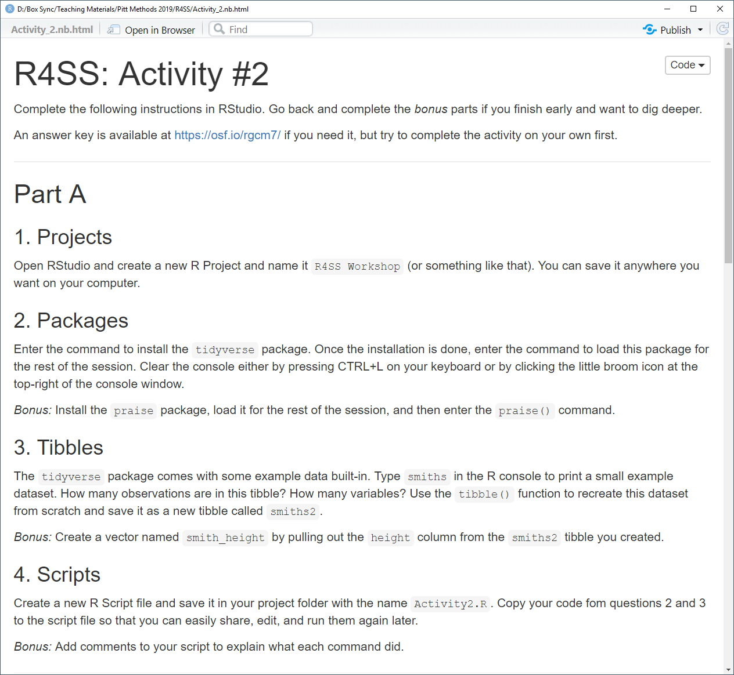
Activity #2A
Go to https://osf.io/m7396
Click the Download button
Open the file in any web browser
Complete Part A (#1, 2, 3, 4)
Ask questions and take breaks
Answer key: https://osf.io/rgcm7
Wrangle [06 of 12]

Slide 28
Live Coding Summary
Manage files
Manage data
Tidy rows
Tidy columns
Transform data
Summarize data
Arrange lets you sort rows (observations) using the values of one or more columns (variables)
Filter lets you pull out a subset of rows (observations) using the values of the columns (variables)
arrange(t, desc(y), z)
filter(t, grp == "a", y > 0)
https://r4ds.had.co.nz/transform.html
Wrangle [07 of 12]

Slide 29
Live Coding Summary
Manage files
Manage data
Tidy rows
Tidy columns
Transform data
Summarize data
Select lets you pull out a subset of columns (variables) by name
Select lets you reorder columns
Rename lets you change the name of columns (variables)
select(t, x1, x2, x3)
select(t, x2, x1, x3)
rename(t, new = old)
https://r4ds.had.co.nz/transform.html
Wrangle [08 of 12]

Slide 30
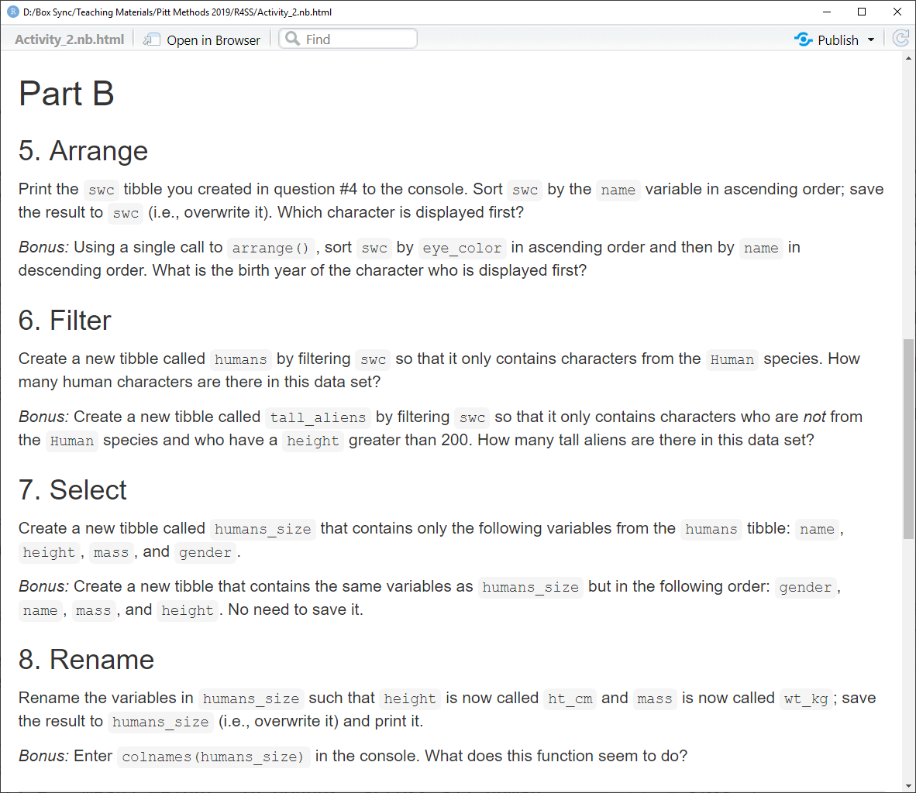
Activity #2B
Go to https://osf.io/m7396
Click the Download button
Open the file in any web browser
Complete Part B (#5, 6, 7, 8)
Ask questions and take breaks
Answer key: https://osf.io/rgcm7
Wrangle [09 of 12]

Slide 31
Live Coding Summary
Manage files
Manage data
Tidy rows
Tidy columns
Transform data
Summarize data
Mutate lets you create variables and edit values within a tibble
Transmute lets you create variables and edit values within a tibble but only keeps the modified variables
mutate(t, xsq = x ^ 2)
transmute(t, xsq = x ^ 2)
mutate(t, s = toupper(s))
https://r4ds.had.co.nz/transform.html
Wrangle [10 of 12]

Slide 32
Live Coding Summary
Manage files
Manage data
Tidy rows
Tidy columns
Transform data
Summarize data
Group_by is how you tell R that certain rows in a tibble should be transformed together
Ungroup removes grouping
Summarize creates new variables by collapsing all rows in a group
gt <- group_by(t, school)
summarize(gt, mx = mean(x))
https://r4ds.had.co.nz/transform.html
Wrangle [11 of 12]

Slide 33
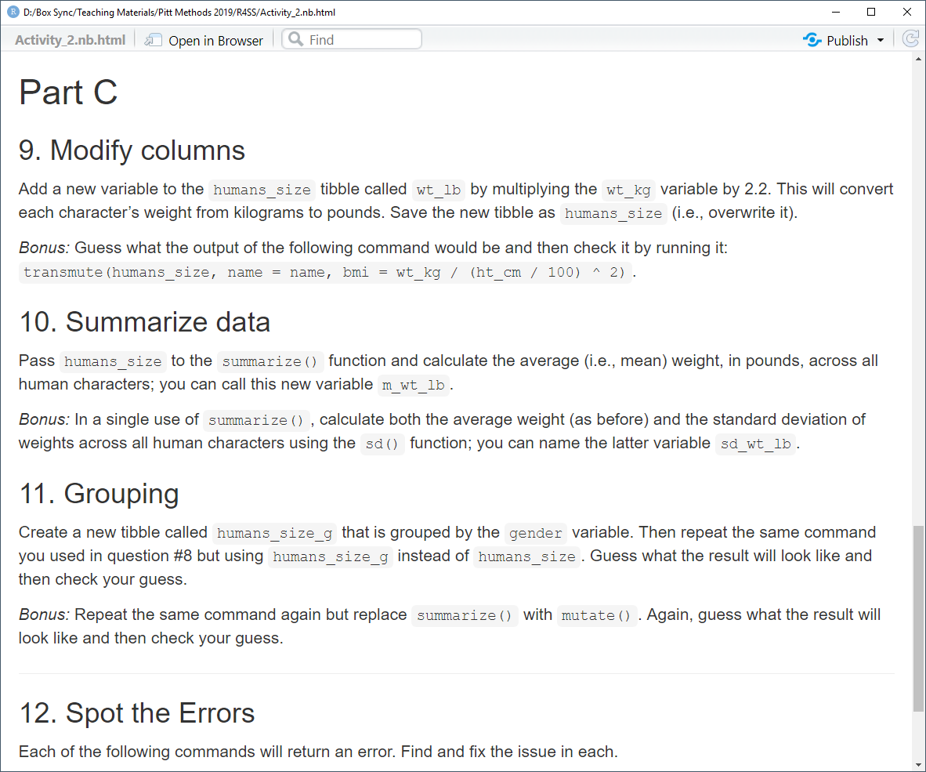
Activity #2C
Go to https://osf.io/m7396
Click the Download button
Open the file in any web browser
Complete Part C (#9, 10, 11, 12)
Ask questions and take breaks
Answer key: https://osf.io/rgcm7
Wrangle [12 of 12]

Slide 34
Free Swim

Slide 35

Free Swim
Check your Activity answers
Complete all "Bonus" questions
Practice what you learned today using your own data or using one of the following example datasets
Pick one or more content topics to read more about and practice
Ask questions and consult with us
Academic Achievement by State https://osf.io/ykz57
Personality Pathology https://osf.io/yca9v
World Health and Development https://osf.io/s8xec
Approval of American Presidents https://osf.io/ufh6e
Workshop materials are at osf.io/uy2fm
End of Day 1!

