Slide 1
REACTIVE SPRING

Slide 2
Introduction
A programming paradigm that promotes
  asynchronous, non-blocking, event-driven approach to data processing.
Thread per request model to more requests with few number of threads
  Prevent threads from blocking while waiting for I/O operations to complete

Slide 3
Subscription
Subscription made by the subscriber
With the publisher
  To fetch data.
  public interface Subscription {
  public void request(long n);
  public void cancel();
  }

Slide 4
Subscriber
Represents the consumer of the stream data.
  public interface Subscriber<T> {
  public void onSubscribe(Subscription s);
  public void onNext(T t);
  public void onError(Throwable t);
  public void onComplete();
  }

Slide 5
Publisher
Represents the data source
  database, external service, etc.
  public interface Publisher<T> {
  public void subscribe(Subscriber<? super T> s);
  }

Slide 6
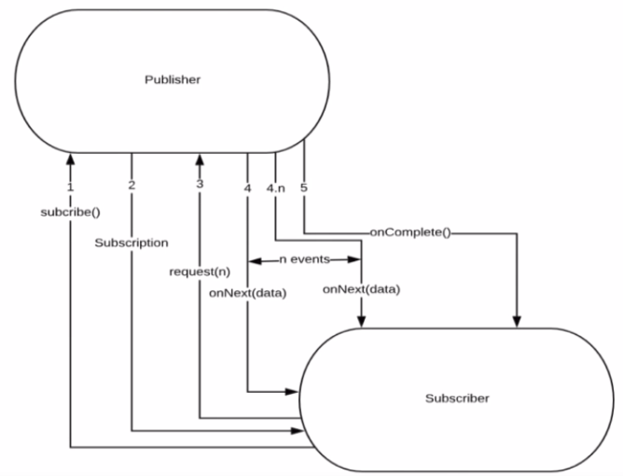
Flow Between Publisher and Subscriber

Slide 7
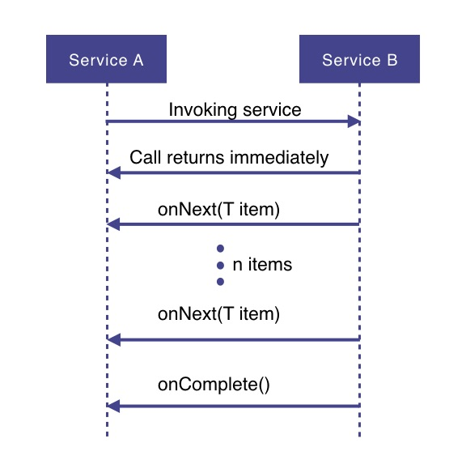
How Does it Work

Slide 8
How Does it Work
Service A wants to retrieve some data from service B.
Service A will make a request to service B which returns immediately
  Non-blocking and asynchronous.
Data requested will be made available to service A as a data stream,
  Service B will publish an onNext-event for each data item one by one.
When all the data has been published
  onComplete event is fired
In case of an error, an onError event would be published
  Items would not be emitted.

Slide 9
PROJECT REACTOR

Slide 10
Setting up a Project
Spring Boot application using Spring Initializr.
  Add Spring Reactive Web as dependecy
The spring-boot-starter-webflux dependency is added
  It will bring in the reactor-core dependency.
  The reactor-test has been added as a dependency.
Spring Webflux
  A reactive-stack web framework
  Runs on Netty, and Servlet 3.1+ containers.

Slide 11
Types of Publishers
Spring Webflux uses two Publishers
Mono
  To publish 0..1 element
  Mono is like the Optional type provided in Java 8.
  Mono to return a single object or VOid
Flux
  To publish 0..N element.
  Used to return lists.

Slide 12
Flux and Mono
They are both terminated either by a completion signal or an error
They call a downstream Subscriber's onNext, onComplete and onError methods.
Both provide a set of operators to support transformations, filtering, and error handling.

Slide 13
Creating Flux
Just (T... data)
  Overloaded method
  Create a new Flux that will only emit a single element then onComplete.
  Returns a new Flux
Flux<String> fluxColors = Flux.just("red", "green", "blue");
fluxColors.subscribe(System.out::println);

Slide 14
Mono
Emits at most one item and then optionally terminates with an onComplete signal or an onError signal.
  Mono noData = Mono.empty();
  Mono data = Mono.just(“ramesh”);

Slide 15
Mono and Flux
  public Mono<Book> bestBook(){
  Mono<Book> bestBook = Mono.just(bookList.get(1));
  return bestBook;
  }
  public Mono<Book> betterBook(){
  Mono<Book> betterBook = Mono.just(bookList.get(0));
  return betterBook;
  }
  public Flux<Book> fluxFromMono(){
  return Flux.concat(bestBook(),betterBook());
  }

Slide 16
SPRING WEBCLIENT

Slide 17
WebClient
Introduced from Spring 5
  Its a non-blocking client with support for Reactive Streams.
    It’s a replacement for RestTemplate .
    Its more functional and is fully reactive.
As of 5.0 “Rest Template “ is in maintenance mode, with only minor requests for changes and bugs to be accepted going forward.
consider using WebClient which has a more modern API and supports sync, async, and streaming scenarios
  https://docs.spring.io/spring-framework/docs/current/javadoc-api/org/springframework/web/client/RestTemplate.html

Slide 18
Web Client
  @Bean
  WebClient.Builder builder() {
  return WebClient.builder();
  }
  @Bean
  WebClient client(WebClient.Builder builderRef) {
  return builderRef.build();
  }

Slide 19
Http Methods
get()
  indicates that we are making a GET request.
  We know that the response will be a single object, so we're using a Mono as explained before.
  client.get()
  Client.post()

Slide 20
Rest Client - Controller
  @RestController
  public class ClientController {
  @Autowired
  private WebClient client;
  @GetMapping(path = "/hotels")
  public Flux<String> getAllHotels(){
  return client.get()
  .uri("http://localhost:7075/api/v1/hotels")
  .retrieve()
  .bodyToFlux(String.class);
  }
  }

Slide 21
Rest Client - Controller
  @PostMapping(path = "/hotels")
  public Mono<HotelDto> create(@RequestBody HotelDto dto)
  {
  return client.post()
  .uri(" http://localhost:7075/api/v1/hotels")
  .body(Mono.just(dto), HotelDto.class)
  .retrieve()
  .bodyToMono(HotelDto.class);
  }

Slide 22
Rest Client - Controller
  @DeleteMapping(path = "/hotels/{id}")
  public Mono<Void> removeHotelById(@PathVariable("id") int id){
  return client.delete()
  .uri(" http://localhost:7075/api/v1/hotels/{id}" ,id)
  .retrieve()
  .bodyToMono(Void.class);
  }
  }

Slide 23
Rest Client - Controller
  @GetMapping(path = "/hotels/{id}")
  public Mono<String> getHotelById(@PathVariable("id") int id){
  return client.get()
  .uri(" http://localhost:7075/api/v1/hotels /{id}",id)
  .retrieve()
  .bodyToMono(String.class);
  }

