Slide 1
Java Programming

Slide 2
Topics
Understand Java language basics
Understand the Object Model and Object-Oriented Programming
Understand and use classes, inheritance, polymorphism
Understand and use functional interfaces
Understand lambda expressions and method references
Understand and use the Stream API, parallel streams, new Date/Time API
Understand the core principles of Spring, and of Dependency Injection (DI)
Understand REST, and use Spring REST to build RESTful services
Understand the various key components and develop Microservices

Slide 3

K.Srivatsan - vatsank@gmail.com
IT Trainer Since 1991
Conducting Java Training Since 2004
About 60+ Corporate Clients

Slide 4
History of Java
A General-purpose and Object-Oriented Programming language
  Originally designed for interactive television,
    But was too advanced for the digital cable television industry at the time
  Developed in the year 1991 at Sun Microsystems
  Initially called as Oak
Platform-independent language
  No limitation to any particular hardware or operating system.
  It provides users the facility to ‘write once, run anywhere’.

Slide 5
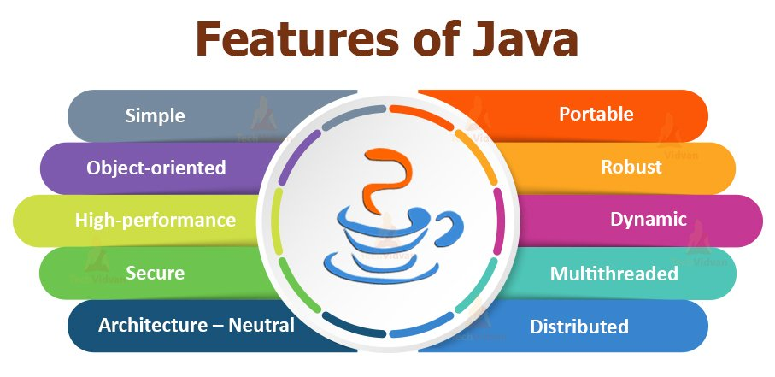

Slide 6
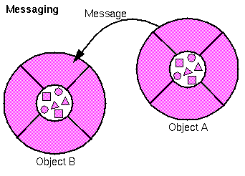
Object Oriented
A Programming pattern based on the concept of Object which can contain both data and the code
  Data in the form of fields known as attributes or properties
    Data, is given the priority.
  Code in the form of methods
Data and Methods are packed into a single unit
  Objects communicate through methods

Slide 7
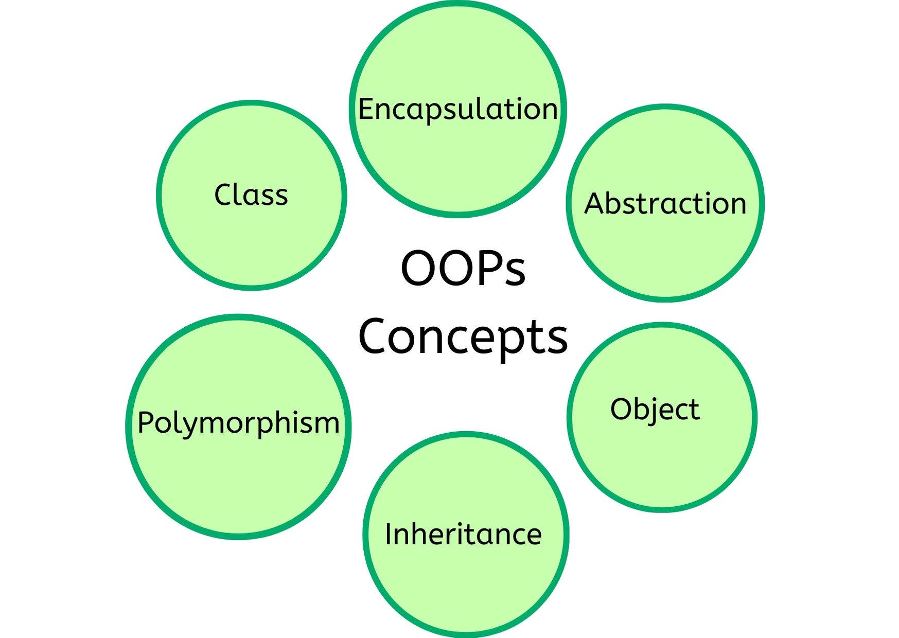
OOPS Concepts

Slide 8
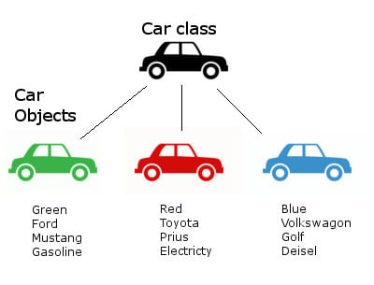
Class and Objects

Slide 9

Objects
Object is something (a thing or a concept) that has a well-defined role in the application domain
  It has an identity, state and behavior and is something to which actions are directed
Its state encompasses its properties
  Attributes and relationships and their values
Its behavior is how it acts and reacts
Creating an object from a class is called instantiation
An object is a concrete instance of a particular class

Slide 10
Objects
Software objects model real-world objects or abstract concepts
  E.g. dog, bicycle, queue
How do software objects implement real-world objects?
  Use variables/data to implement states
  Use methods/functions to implement behaviors
Real-world objects have states and behaviors
  Dogs' states: name, color, breed, hungry
  Dogs' behaviors: barking, fetching, sleeping

Slide 11
The Java Virtual Machine
Executes instructions that a Java compiler generates.
A runtime environment, embedded in web browsers, servers, and operating systems
Imaginary machine that is implemented by emulating software on a real machine
Reads compiled byte codes that are platform-independent
Bytecode
  a special machine language that can be understood by the JVM independent of any particular computer hardware,
  Java Runtime Environment (JRE) is an implementation of the JVM”.
  “JVM becomes an instance of JRE at runtime”.
    A runtime instance of JVM will born when .class file starts its execution

Slide 12
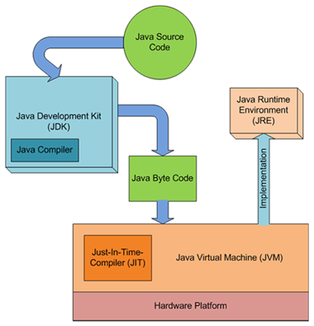
JDK,JVM and JRE

Slide 13
JVM Tasks
Loads code
  Loads all classes necessary for the execution of a program
  Maintains classes of the local file system in separate namespaces
Verifies code (Bytecode Verifier)
  The code adheres to the JVM specification.
  The code does not violate system integrity.
  The parameter types for all operational code are correct.
  No illegal data conversions have occurred.

Slide 14
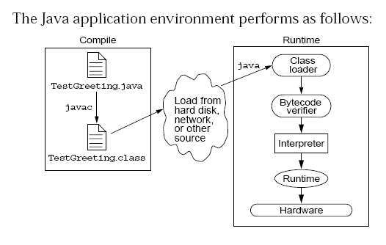
Java Run Time Environment

Slide 15
Java language syntax

Slide 16
Objectives
Identify the basic parts of a Java program
Differentiate among Java literals, primitive data types,
variable types ,identifiers and operators
Develop a simple valid Java program using the concepts learned in this chapter

Slide 17
Program structure
A program in Java consists of one or more class definitions
One of these classes must define a method main(), which is where the program starts running
Java programs should always end with the .java extension.
There can be More than one Class Definition in a class ,but only one public class
Source Filenames should match the name of the public class.

Slide 18
Source File Layout
Basic syntax of a Java source file is:
[<package_declaration>]
<import_declaration>*
<class_declaration>+

Slide 19
Software Packages
Packages help manage large software systems.
Packages can contain classes and sub-packages.
package <top_pkg_name>[.<sub_pkg_name>]*;
Specify the package declaration at the beginning of the source file.
Only one package declaration per source file.
If no package is declared, then the class is placed into the default package.
Package names must be hierarchical and separated by dots.

Slide 20
The import Statement
import <pkg_name>[.<sub_pkg_name>]*.<class_name>;
import <pkg_name>[.<sub_pkg_name>]*.*;
import java.util.List;
import java.io.*;
import shipping.gui.reportscreens.*;
The import statement does the following:
  Precedes all class declarations
  Tells the compiler where to find classes

Slide 21
Comments
Java supports three forms of comments
  // single line comments
  /* multi
    line
    comment
    */
  /** a
    * Javadoc
    * comment
    */

Slide 22
Example
  package com.training;
  public class Greeting {
  public String getMessage() {
  return "Welcome to Java Programming";
  }
  }

Slide 23
Example
  package com.training;
  public class TestGreeting {
  public static void main(String[] args) {
  Greeting grtObj = new Greeting();
  System.out.println(grtObj.getMessage());
  }
  }

Slide 24
The System Class
Its part of the java.lang package
The classes in this package are available without the need for an import statement
This class contains several useful class fields and methods.
It can’t be Instantiated
It also Provides facilities for
  Standard Input
  Standard Output
  Error Output Streams
  Access to externally defined properties

Slide 25
Finding Classes
Keep the following points in mind:
  Class represents set of objects with the same behavior
    Entities with multiple occurrences in problem
    description are good candidates for objects
    Find out what they have in common
    Design classes to capture commonalities
  Represent some entities as objects, others as primitive types
    Should we make a class Address or use a String?
  Not all classes can be discovered in analysis phase
  Some classes may already exist

Slide 26
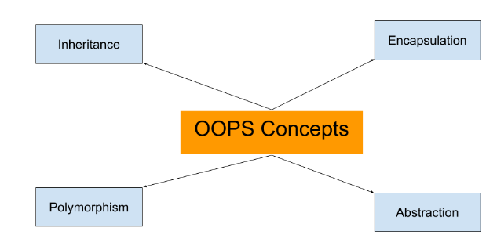
OOPS Concepts

Slide 27
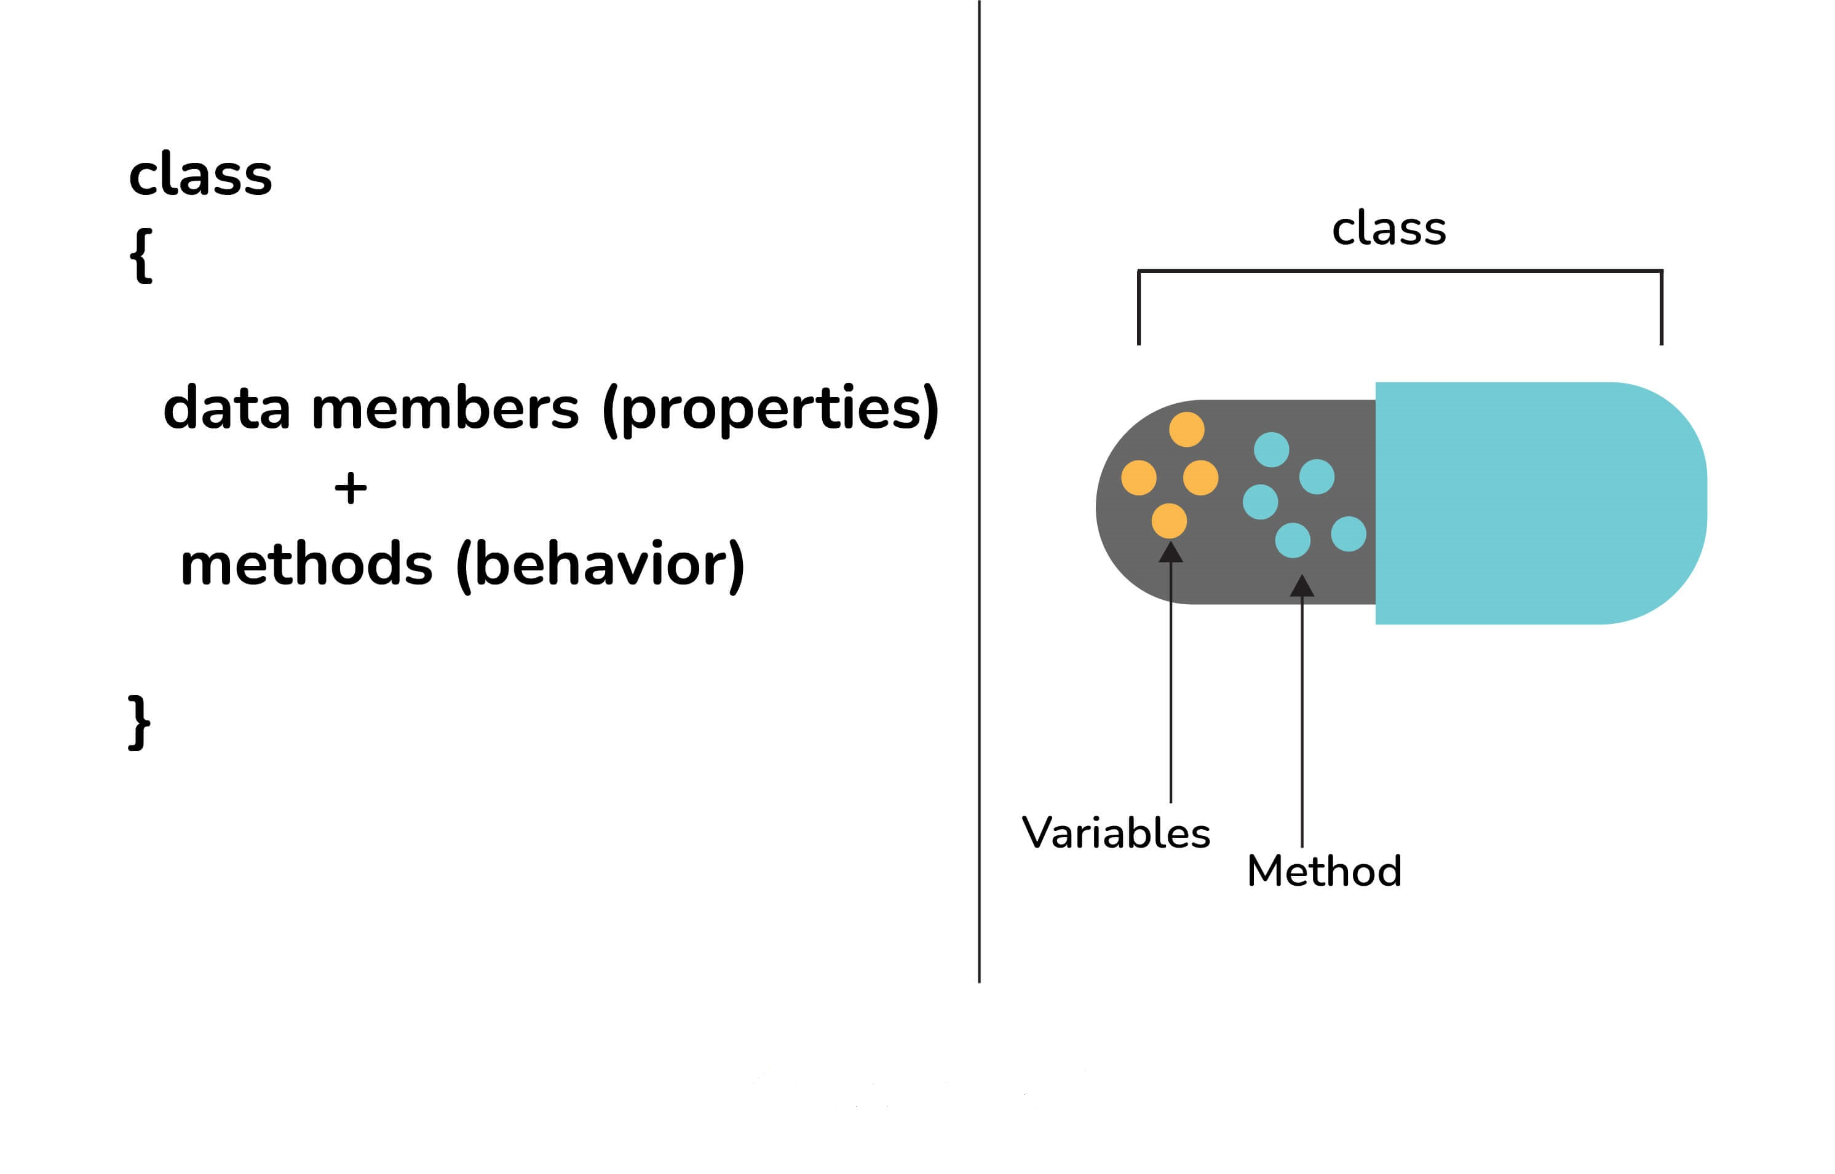
Encapsulation
Encapsulation - Enforces Modularity
  Encapsulating the data and behavior into a single object is of primary importance in OO development.
  A single object contains both its data and behaviors and can hide what it wants from other objects.

Slide 28
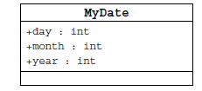
Information Hiding
Client code has direct access to internal data
(d refers to a MyDate object):
d.day = 32; // invalid day
d.month = 2; d.day = 30; // plausible but wrong
d.day = d.day + 1; // no check for wrap around

Slide 29
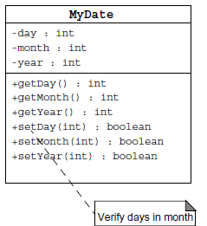
Encapsulation
Hides the implementation details of a class
Forces the user to use an interface to access data
Makes the code more maintainable

Slide 30
Declaring Java Technology Classes
Basic syntax of a Java class:
  <modifier>* class <class_name> {
  <attribute_declaration>*
  <constructor_declaration>*
  <method_declaration>*
  }
Define an attribute:
<modifier>* <type> <name> [ = <initial_value>];

Slide 31
Declaring Methods
Basic syntax of a method:
<modifier>* <return_type> <name> ( <argument>* ) {
<statement>*
}
  public int getWeight() {
  return weight;
  }
  public void setWeight(int newWeight) {
  if ( newWeight > 0 ) {
  weight = newWeight;
  }
  }

Slide 32
Accessing Object Members
The dot notation is: <object>.<member>
  used to access object members, including attributes and methods.
d.setWeight(42);
d.weight = 42; // only permissible if weight is public

Slide 33
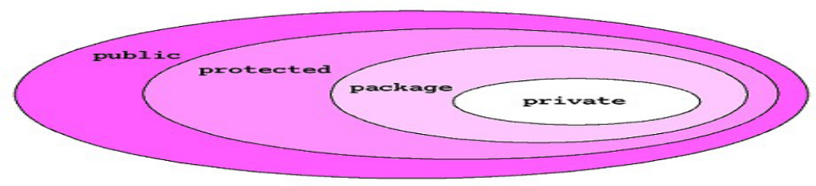
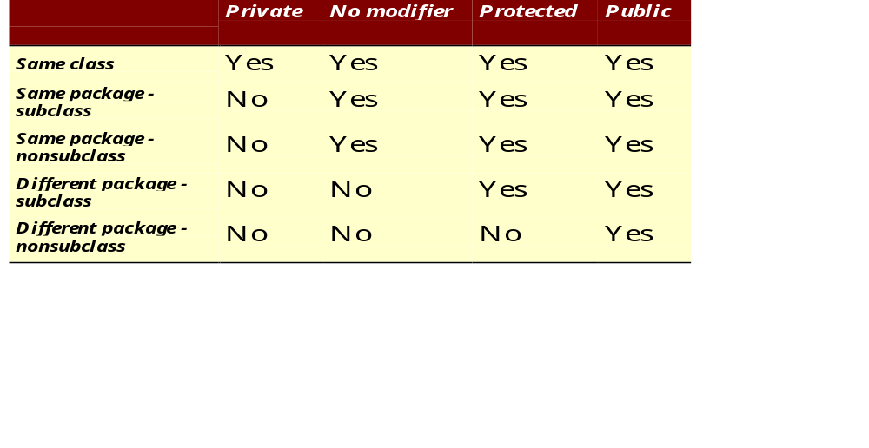
The 4 Access Levels and 3 Modifiers

Slide 34
Classes
Top-level classes can be declared as
  public
    a public class is globally accessible.
    a single source file can have only one public class or interface
  abstract
    an abstract class cannot be instantiated
  final
    a final class cannot be subclassed
  Default
    With any Modifier
They can’t be declared as protected and private

Slide 35
Constructors
Have no return type
Have the same name as the class
If we don't’ put a constructor the compiler puts a default one
  The default constructor has the same access modifier as the class.
  The default constructor has no arguments.
  The default constructor is always a no-arg constructor, but a no-arg constructor is not necessarily the default constructor
  The default constructor includes a no-arg call to the super constructor (super()).
They are not inherited and hence they are not overridden
It can be Overloaded
It can have any of the Four Access Modifies
It cannot be synchronized
It can have throws clause

Slide 36
Instantiation with new
It is the process by which individual objects are created.
  Class objectReference = new Constructor();
Declaration
  Employee empObj;
Instantiation
  empObj = new Employee()
Declaration and Instantiation
  Employee empObj = new Employee()
  new operator allocates memory for an object.

Slide 37
Constructor Overloading
One constructor can call another overloaded constructor of the same class by using this keyword.
this() is used to call a constructor from another overloaded constructor in the same class
The call to this() can be used only in a constructor ,and must be the first statement in a constructor
A constructor can call its super class constructor by using the super keyword.
A constructor can have a call to super() or this() but never both

Slide 38
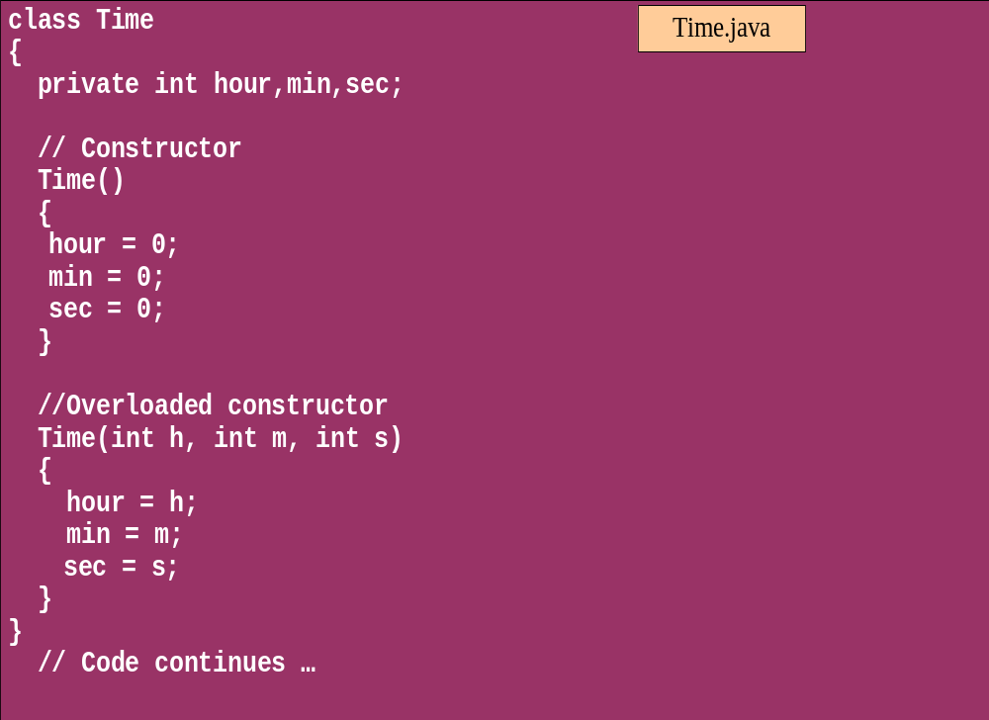
Overloaded Constructor

Slide 39
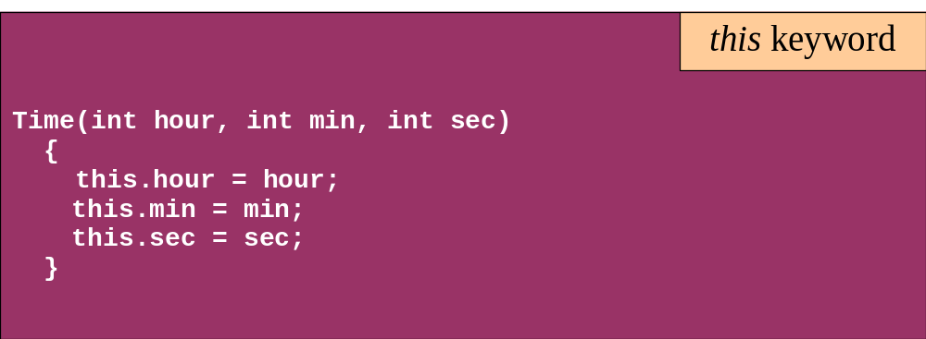
this keyword
Is a reference to the object from which the method was invoked

Slide 40
Variables and Methods
A variable, which corresponds to an attribute, is a named memory location that can store a certain type of value.
Variable is a kind of special container that can only hold objects of a certain type.
Primitive type Variable
    Basic, built-in types that are part of the Java language
    Two basic categories
      boolean
      Numeric
        Integral - byte, short, int, long, char
        Floating point - float, double

Slide 41
Instance Variables and Methods
Variables and methods can be associated either with objects or their classes
  An object that is created using a class is said to be an instance of that class.
  The variables that the object contains are called instance variables.
  The methods that the object contains are called instance methods.
Instance Variable can have one of the four access levels
  Three access modifies – private, public , protected
  They have a default value
A class variable (or class method) is a variable (or method) that is associated with the class itself.

Slide 42
Example for Variables
  public class VariableTypes {
  private int inst_empid;
  private static String cls_empName
  public void getData() { }
  public static void getSalary() { }
  public void showData(int a)
  {
  int localVariable ;
  }
  }
Instance Variable
Class Variable
Parameter Variable
Local Variable

Slide 43
Identifiers
Identifiers are used to name variables, methods, classes and interfaces
Identifiers
  start with an alphabetic character
  can contain letters, digits, or “_”
  are unlimited in length
Examples
  answer, total, last_total, relativePoint, gridElement, person, place, stack, queue

Slide 44
Local Variable needs to Be Initialized
  public class LocalVariable {
  private String name;
  public void display()
  {
  int age;
  System.out.println("Age"+age);
  System.out.println("Name"+name);
  }
Age Should be Initialized before Use

Slide 45
Instance Variable have Default Values
class Values
{
private int a;
private float b;
private String c;
public void display()
{
System.out.println("integer"+a);
System.out.println("float"+b);
System.out.println("String"+c);
}
public class DefaultVales {
public static void main(String[] args) {
Values v = new Values();
v.display();
}
}

Slide 46
Assignment of reference variables
int x = 7;
int y = x;
String s = “Hello”;
String t = s;
x
y
s
t
7
7
0x01234
0x01234
Hello

Slide 47
Pass-by-Value
The Java programming language only passes arguments by value for primitive data types.
When an object instance is passed as an argument to a method, the value of the argument is a reference to the object
The contents of the object can be changed in the called method, but the object reference is never changed
For primitives, you pass a copy of the actual value.
For references to objects, you pass a copy of the reference
You never pass the object. All objects are stored on the heap.

Slide 48

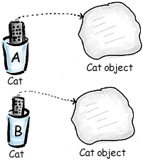
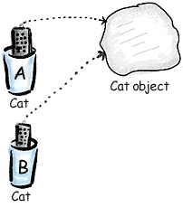
Pass By Value

Slide 49
Casting Primitive Types
Casting creates a new value and allows it to be treated as a different type than its source
JVM can implicitly promote from a narrower type to a wider type
To change to a narrow type explicit casting is required
Byte -> short -> int -> long -> float -> double

Slide 50
Casting Primitive Types
  public static void main (String [] args){
  int x = 99;
  double y = 5.77;
  x = (int)y; //Casting
  System.out.println("x = "+ x);
  double y1 = x; //No Casting
  int i =42;
  byte bt;
  bt= (byte)i;
  System.out.println("The Short number"+ bt);
  }

Slide 51
Wrapper Classes
Primitives have no associated methods
Wrapper Classes are used encapsulate primitives
They also provide some static utility methods to work on them
Primitive Type | Wrapper class
-boolean | Boolean
-byte | Byte
-char | Character
-double | Double
-float | Float
-int | Integer
-long | Long
short | Short

Slide 52
Wrapping Primitives
Wrapping a value
  int i = 288
  Integer iwrap = new Integer(i);
unWrapping a value
  int unwrapped = iwrap.intValue();
Methods In Wrapper Class
  parseXxx()
  xxxValue()
  valueOf()

Slide 53
Wrapper Class Method
Convert String to Numbers
public static void main(String args[])
{
int ino=Integer.parseInt(args[0]);
float fno = Float.parseFloat(args[1]);
double dno = Double.parseDouble(args[2]);
Long lno = Long.parseLong(args[3]);
System.out.println("Integer value" +ino );
String strIno = Integer.toString(ino);
System.out.Println(“String Value”+strIno);
}
}

Slide 54
Auto Boxing
Java 5.0 provided autoboxing
Integer n = new Integer(123) Int m = n.intValue() m++; n=new Integer(m); System.out.println(n); | Integer n = new Integer(123); n++; System.out.println(n);

Slide 55
Auto Boxing
public class ABoxing {
  public void show(int a, float b)
  {
  System.out.println("Integer"+a*2);
  System.out.println("Float"+b*2);
  }
  public static void main(String[] args) {
  ABoxing abObj =new ABoxing ();
  Integer a = 10;
  Float b =20f;
  abObj.show(a,b);
  }
  }

Slide 56
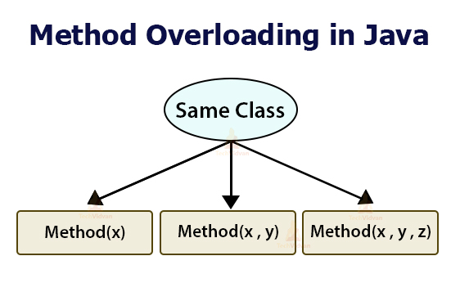

Slide 57
Method Overloading
Methods of a class have the same name but different signatures
  Similar behavior but for different data types.
Signature
  Name of the method and the number and types of formal parameters in particular order.
They are independent methods of a class
  Can call each other just like any other method.
A method can be overloaded in the same class or in a subclass.

Slide 58
Overloading Methods
Overloaded methods MUST change the argument list.
Overloaded methods CAN change the return type.
Overloaded methods CAN change the access modifier.
Overloaded methods CAN declare new or broader checked exceptions.

Slide 59
Overloading and AutoBoxing
public class Overloading {
public Integer add(Integer a , Integer b)
{
Integer c = a+b;
return c+100;
}
public int add(int a , int b)
{
return a+b;
}

Slide 60
Application
  public static void main(String[] args) {
  Overloading olObj = new Overloading();
  System.out.println(olObj.add(45, 55));
  }
  Output will be 100 and Not 200

Slide 61
Static Variables and Methods
A static method belongs to a class and not to its instance objects and hence they are shared between Objects
Static Methods can not be overridden
They can only call other static methods
They can access only static variables and not instance Variables
They cannot refer to this or super
Instance variable : 1 per instance and Static variable : 1 per class
Static final variables are constants
main( ) is defined to be a static method so as to be invoked directly

Slide 62
Static Method access only static
  public class StatClass {
  private int id;
  private static String name;
  private void instMethod()
  {
  staticMethod();
  System.out.println(id);
  System.out.println(name);
  }
  private static void staticMethod()
  {
  System.out.println(id);
  System.out.println(name);
  instMethod();
  }
  }
Can Access Static from Instance Method
Cannot Access Instance Variable From Static
Cannot Access Instance Method From Static

Slide 63
java.util.Scanner Class
A simple text scanner which can parse primitive types and strings using regular expressions.
A Scanner breaks its input into tokens using a delimiter pattern, which by default matches whitespace.
The resulting tokens may then be converted into values of different types using the various next methods.
  Scanner sc = new Scanner(System.in);
  int i = sc.nextInt();
  sc.close();

Slide 64
java.util.Scanner Class
  Scanner sc = new Scanner(System.in);
  System.out.println("Enter The Number");
  int number = sc.nextInt();
  System.out.println("Enter the Name");
  String name = sc.next();
  System.out.println(number + ":"+name);

Slide 65
java.util.Scanner Class
  public static void main(String[] args) {
  String line="Java,is,in,OOP,Language";
  Scanner sc1 = new Scanner(line);
  sc1.useDelimiter(",");
  while (sc1.hasNext())
  {
  System.out.println(sc1.next());
  }
  }

Slide 66
Self Study Resources
Javaworld
  News, useful tutorials, to keep you up to date
Java Code Geeks
  Resource center with educational tutorials, articles, and tips
DZone
  Articles and guides for beginners and experienced developers
Javarevisited
  Blog which covers numerous Java learning topics

