Slide 1

Volume Expander
By ElectroSQuad
BALASOORIYA BAPI 220054N
Dewasumithra MPO 220112R
Dineshara MC 220128V
Diunugala CH 220143L

Slide 2
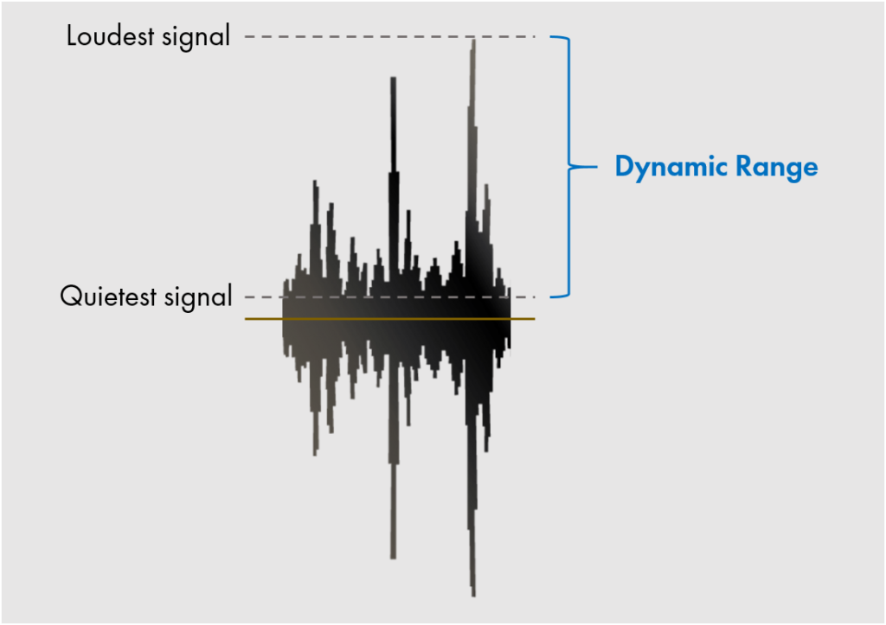
VOLUME EXPANDER
An audio expander increase the dynamic range of the audio signal by amplifying and attenuating the quite sounds and amplifying the louder sounds above a particular threshold.

Slide 3
Expander parameters
Threshold
Gain
Determines the input level at which the expander will activate.
This happens when the signal is loud enough to cross this threshold level (upward expansion) or quiet enough to fall below it (downward expansion).
An expansion of 1:x amplifies the signal to a level of x dB above the threshold for every 1 dB it crosses.

Slide 4
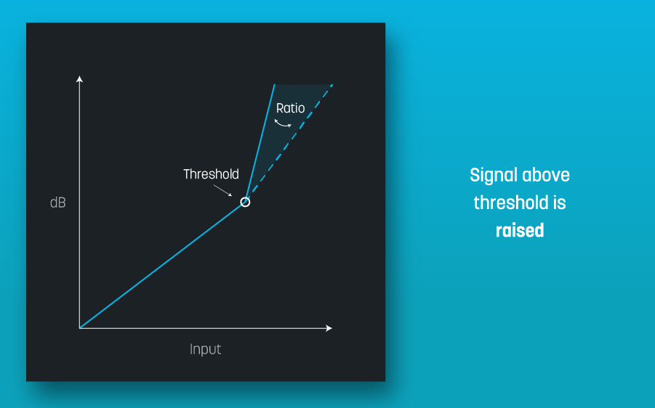
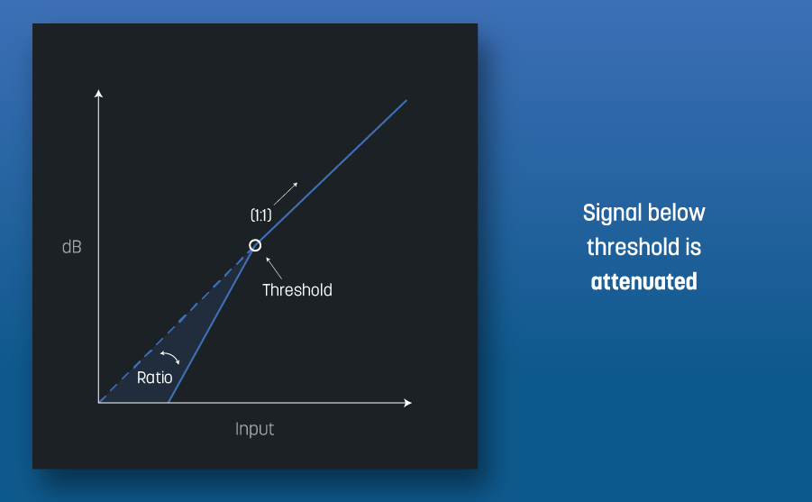
UPWARD EXPANDER
DOWNWARD EXPANDER
Amplify the level of signal that passes the threshold
It affects the louder part of a signal as it crosses above a threshold
Attenuates signal that drops below the threshold.
when a signal drops below a set threshold, the downward expander pulls it even farther down toward the noise floor.

Slide 5
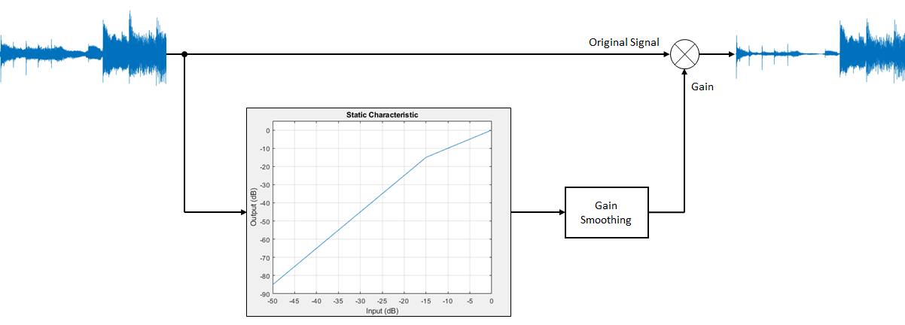
INPUT
Expanded audio out
We are using envelope of the audio signal to generate control voltage for the voltage-controlled amplifier.
(Control voltage Processor)

Slide 6
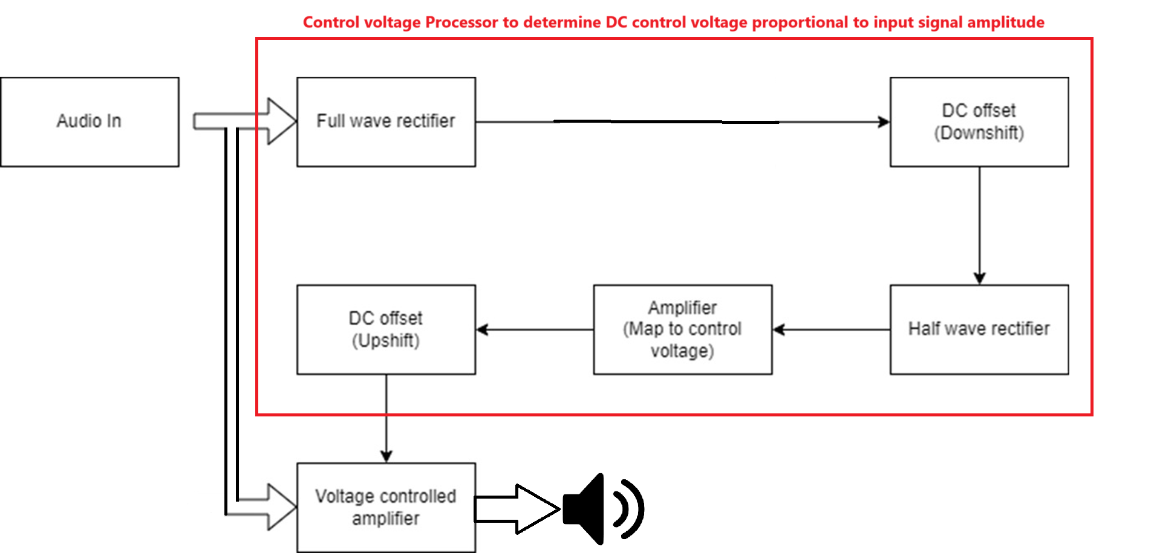
Block Diagram

Slide 7
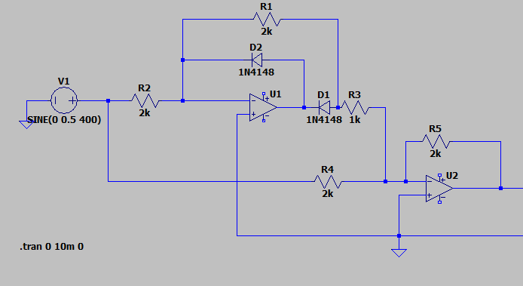
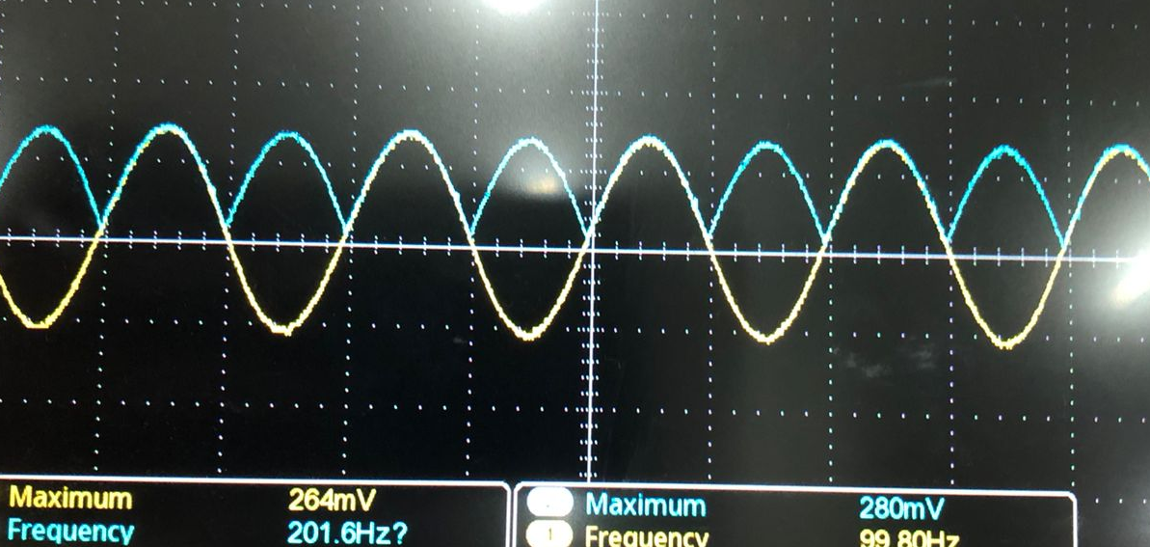
Full Wave precision Rectifier
First, we need to capture the waveform of the input signal.
To that we need to use a precision full wave rectifier.
It rectifies the input audio signal (both positive and negative halves of the waveform) while maintaining precision, ensuring even low-amplitude signals are accurately rectified.

Slide 8
Full Wave precision Rectifier
Why a Precision Rectifier?
Standard diode-based rectifiers have a forward voltage drop (e.g., ~0.7V for silicon diodes), making them unsuitable for low-amplitude signals.
A precision rectifier overcomes this limitation by using an operational amplifier to eliminate the voltage drop, allowing accurate rectification of signals as small as a few millivolts.

Slide 9
Component selection
Component | Selected Option | Advantages Over Alternatives | When to Use an Alternative
OP-Amp | TL-072 | High slew rate (13 V/μs) - prevents distortion. Low Power consumption(1.4 mA) High input impedance Low Noise | OPA2134 - ultra-low noise but higher cost. NE5532 - low noise and higher drive capability.
Diode | UF4007 | Consistent voltage drop (~0.7v) over the current range Ultra-fast Reverse recovery time (~75 ns) suitable for audio-frequency signals. | Schottky diodes - for ultra-low forward voltage drop (~0.2V) N4148 - low-cost, less robust for low current circuits

Slide 10
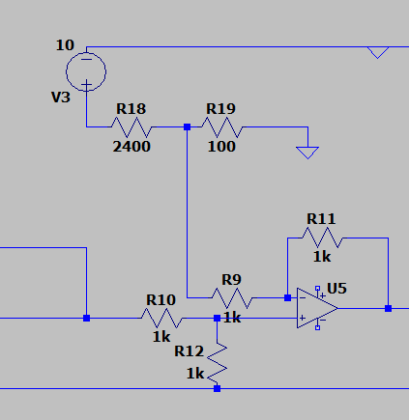
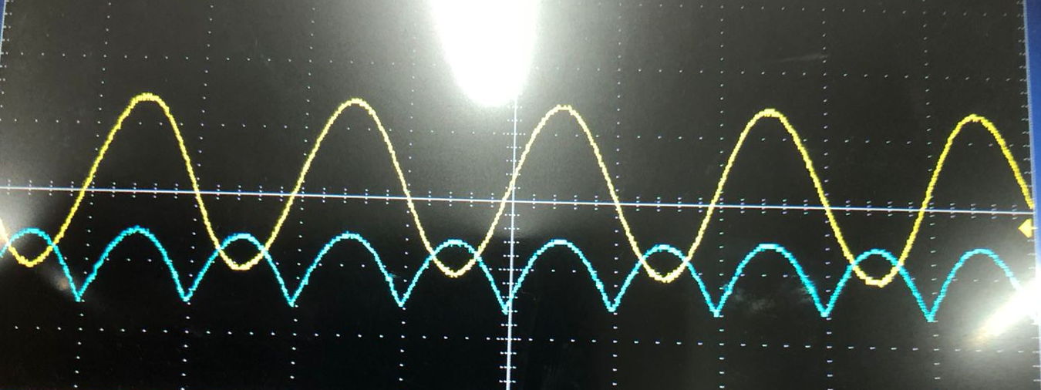
DC OFFSET (DOWNSHIFT)
Rectified signal is downshifted to a reference voltage which is in the level of of unity gain of VCA.
This Reference voltage depends on the threshold value that we control.

Slide 11
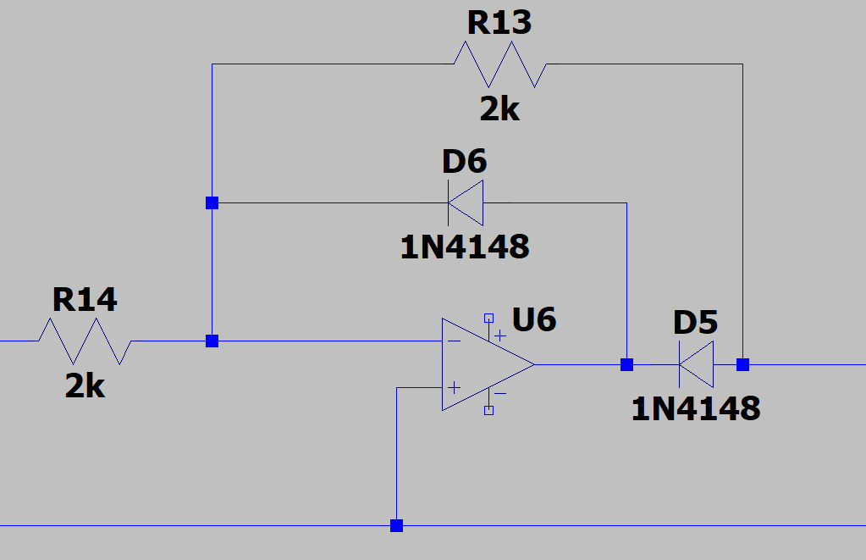
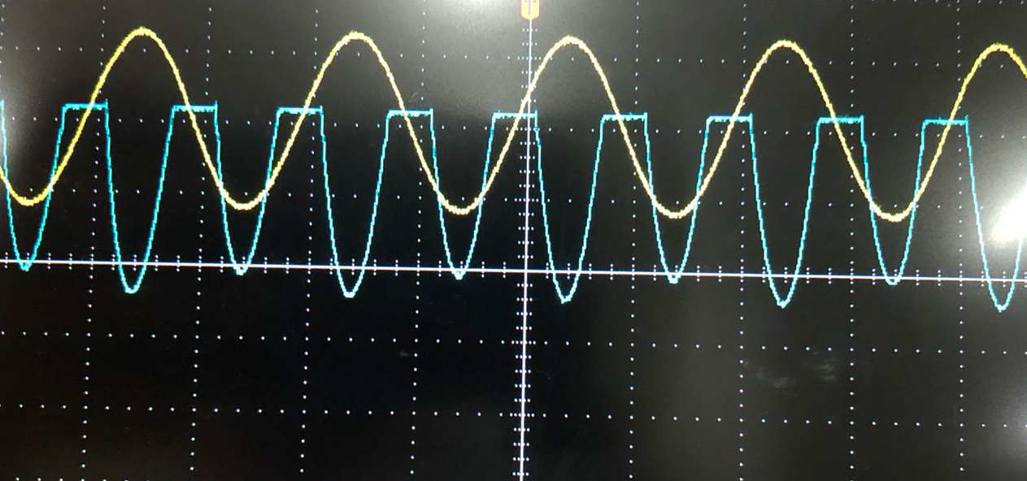
Half Wave Precision Rectifier
To cutoff the signal that lies below the threshold level and extract accurate envelope.
The resulting waveform represents the instantaneous amplitude of the signal above the threshold.
Using a half wave precision rectifier to rectify signals with amplitudes as low as a few millivolts.

Slide 12
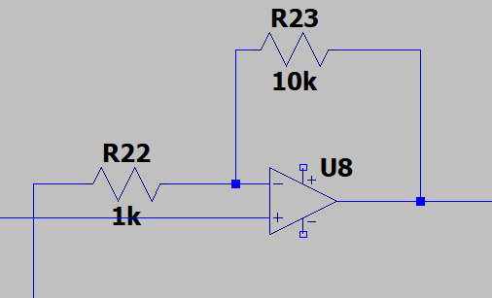
Non-Inverting Amplifier
Controlling the gain of VCA.
potentiometer in the feedback loop used to adjust the gain and scale the control voltage.
This ensures the VCA responds according the required gain and envelope voltage.

Slide 13
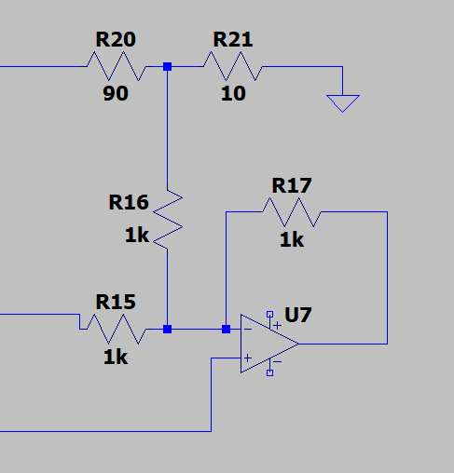
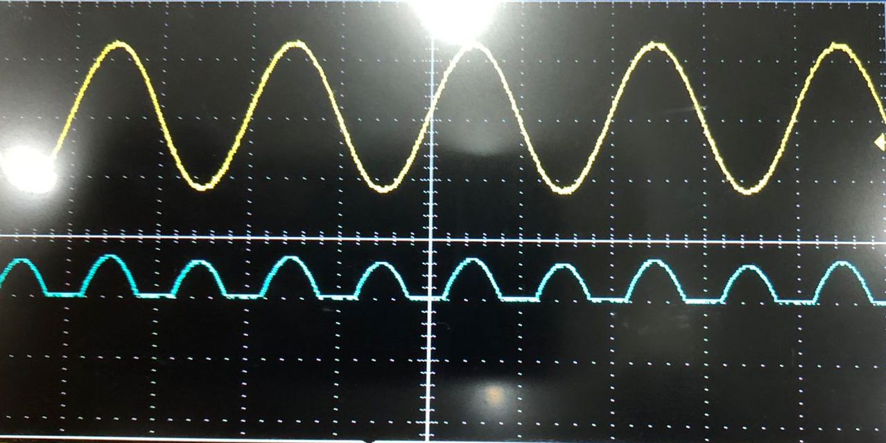
DC Offset Upshift
To map the zero voltage level of the control voltage to the unity gain voltage of the VCA.
Unity gain control voltage of VCA = 1 V
This outputs the control voltage to VCA.

Slide 14
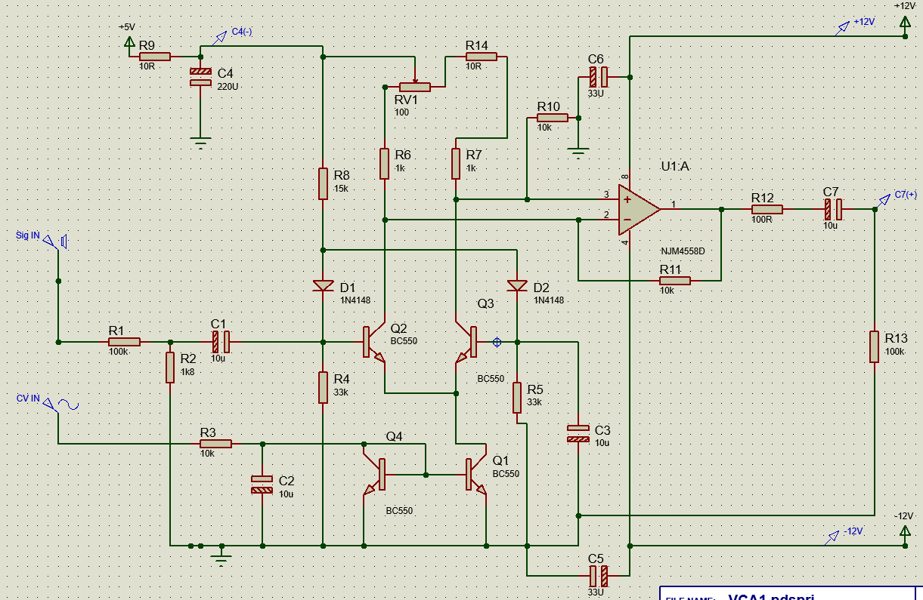
Voltage Controlled Amplifier
Amplifying the original audio signal based on the processed controlled voltage.
Dynamic range expansion using VCA
Low control voltage→ Low gain.
High Control voltage → High gain.

Slide 15



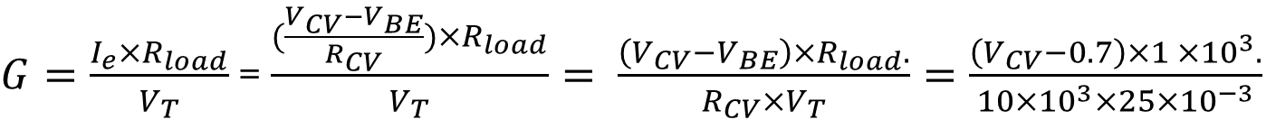
Gain of VCA
Gain of the VCA is proportional to the emitter current of the differential amplifier.
$G= \frac{I_{e}×R_{load}}{V_{T}}$
Emitter current is generated by the control voltage through resistor Rcv
$$I_{E}= \frac{V_{CV}−V_{BE}}{R_{CV}}$$
$G=\frac{I_{e}×R_{load}}{V_{T}}$ = $\frac{(\frac{V_{CV}−V_{BE}}{R_{CV}})×R_{load}}{V_{T}}= \frac{\left(V_{CV}−V_{BE}\right)×R_{load}.}{R_{CV}×V_{T}}=\frac{\left(V_{CV}−0.7\right)×1 ×{10}^{3}.}{10×{10}^{3}×25×{10}^{−3}}$
$G=\left(V_{CV}−0.7\right)×4$
Maximum gain possible – 9 to 10 dB
Required gain according to criterion – 3 to 4 dB

Slide 16
Component selection
Component | Purpose in the circuit | Justification
BC547 Transistor | Differential amplifier for gain control Current mirror | Low Noise Good low frequency response.

Slide 17
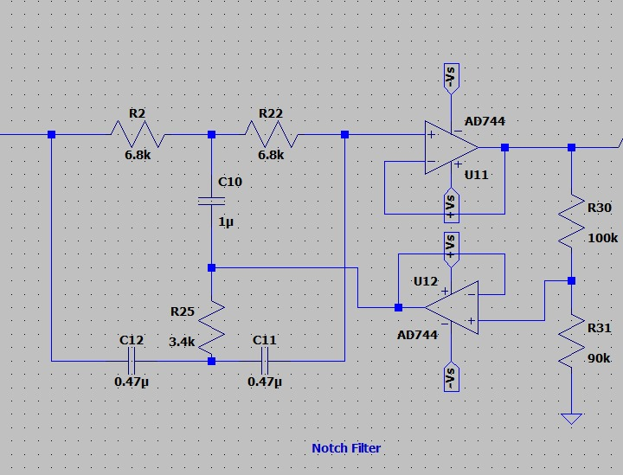

Notch Filter
Used to eliminate power line interference, which typically occurs at 50 Hz
Twin-T Notch Filter with feedback is used.
Notch frequency - 50Hz
$$f_{n}= \frac{1}{2πRC}= \frac{{10}^{3}}{2π×6.8×0.47}=50Hz$$

Slide 18
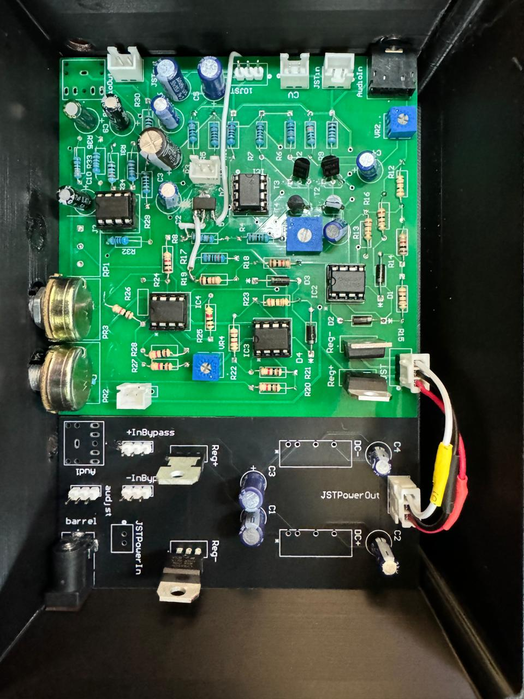
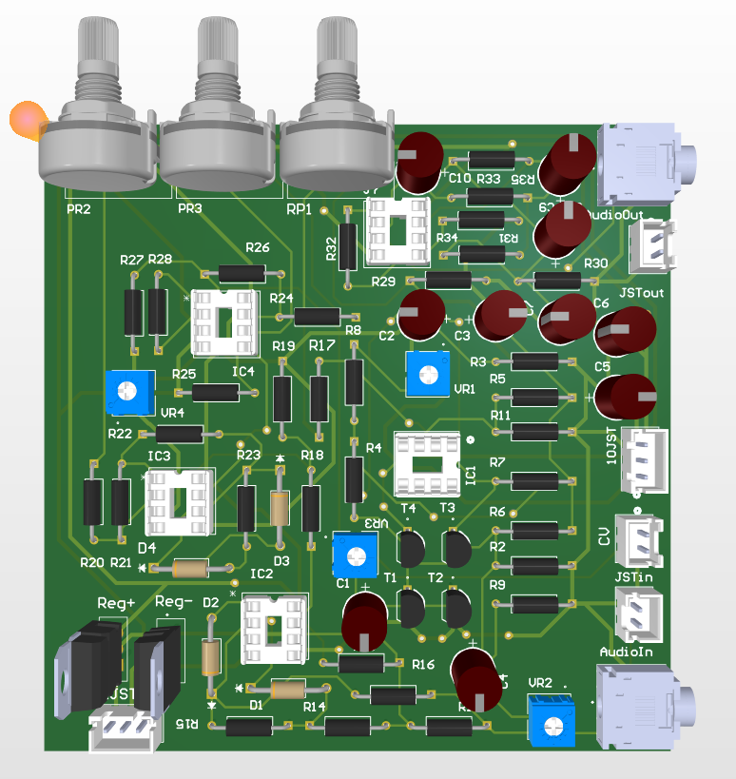
PCB Design

Slide 19
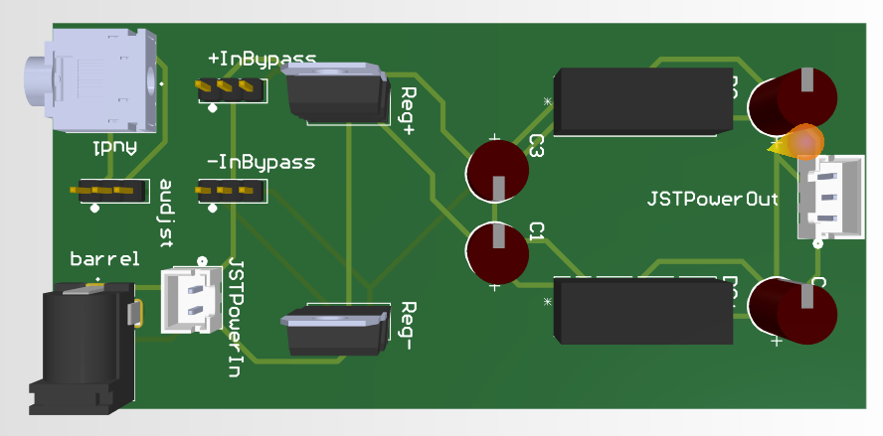
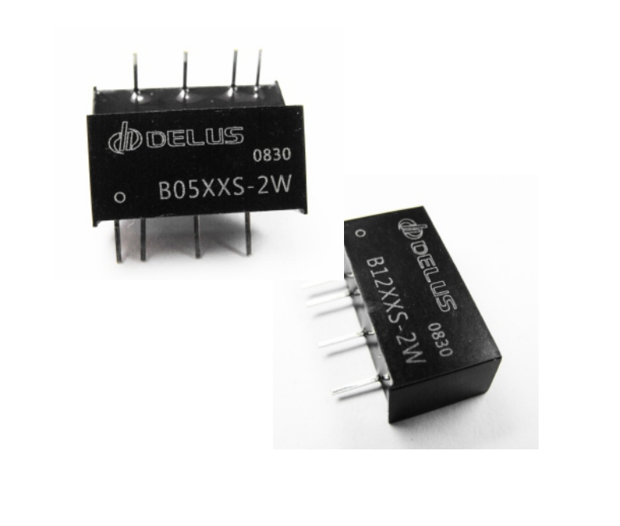
Power supply
Dual power supply using isolated power supply modules.
Module used : B1212S-2W
Maximum power: 2W
Maximum Current : 244mA
Required current : 130mA – 150 mA

Slide 20
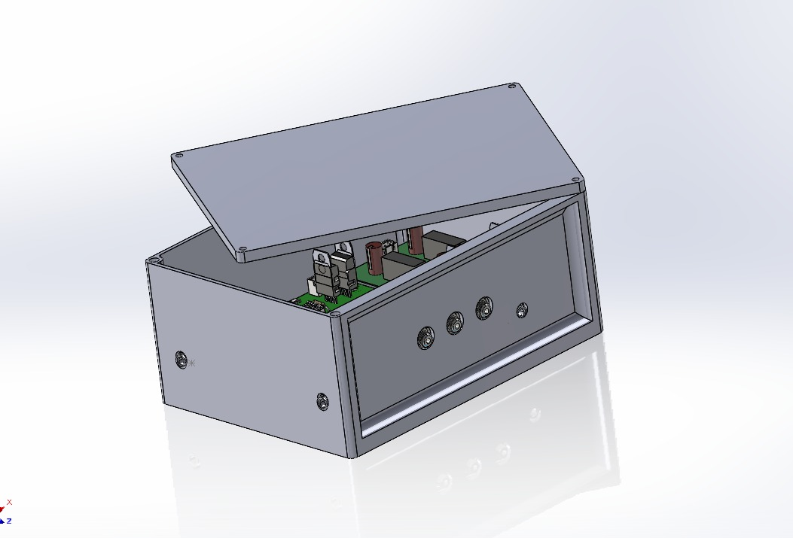
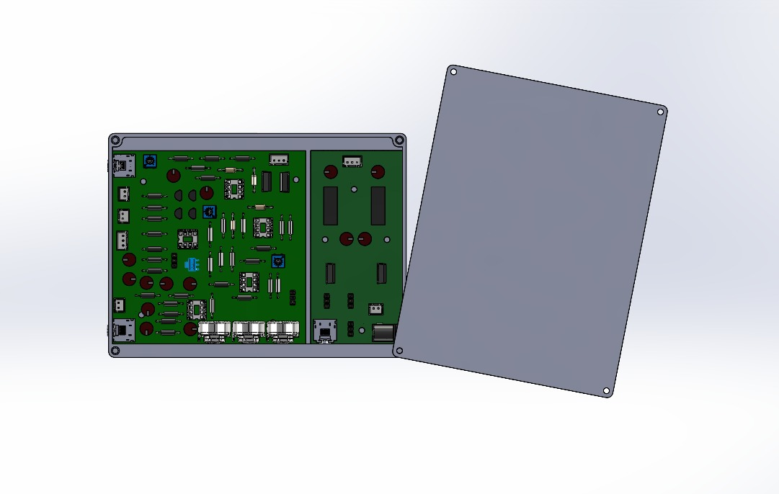
Enclosure design

Slide 21
Task Allocation
Index number | Name | Tasks
220054N | Balasooriya BAPI | PCB Design, Circuit design
220112R | Dewasumithra MPO | Circuit design, Enclosure design
220128V | Dineshara MC | Enclosure design, Circuit design
220143L | Diunugala CH | PCB Design, Circuit design

Slide 22
Thank You!

