Slide 1
PREDICTING STUDENT FAILURE
Predicting Student Failure in Distance Learning
Using Machine Learning and Explainability
Pius Twumasi · Student ID 202374354
MSc Artificial Intelligence and Data Science · Module 771764
Supervisor: Dr Aoife Curran · University of Hull · September 2026

Slide 2
INTRODUCTION
Support arrives too late
Distance-learning modules record higher failure and withdrawal than campus study.
Learners are remote, so the informal cues a tutor would notice are absent.
By the time a student formally fails, the window for support has usually closed.
VLEs capture detailed engagement data, which can be turned into timely, explainable warnings.
Early
warning must come before failure, not after
The gap this project targets
Accurate enough to trust, early enough to act on, and explainable enough for a tutor to question.
2

Slide 3
INTRODUCTION · RELATED WORK
What is known, and what is missing
Three open gaps
Prior work predicts failure well
Reported mid- or late-course
OULAD is a common benchmark; engagement and assessment data carry real predictive signal.
Aljohani et al. (2019): LSTM on clickstream, ~90% accuracy by week 10.
Gupta et al. (2022): Hidden Markov Model, AUC > 0.92 on early-quarter assessments.
Oyedotun et al. (2025): OULAD + SHAP, engagement dominant, ~0.79 ROC-AUC.
accuracy climbs as the course elapses, so few results are genuinely early.
Strong models are often opaque
2
high accuracy, little explanation of why a student is flagged.
Single-course scope
trained and tested on one course; generalisation is rarely tested.
→ These three gaps define RQ1, RQ2 and RQ3.
3

Slide 4
INTRODUCTION · AIM
Aim and research questions
Develop and evaluate an interpretable pipeline that predicts, early in a course, which distance-learning students risk failing, and explains the drivers of each prediction.
RQ1
RQ2
RQ3
Closes gap 1
Closes gap 2
Closes gap 3
How accurately can failure be predicted at an early checkpoint, and which model performs best?
Which factors most influence risk, and how far does the signal depend on the first-assessment mark?
Do the predictive patterns generalise across different courses?
4

Slide 5
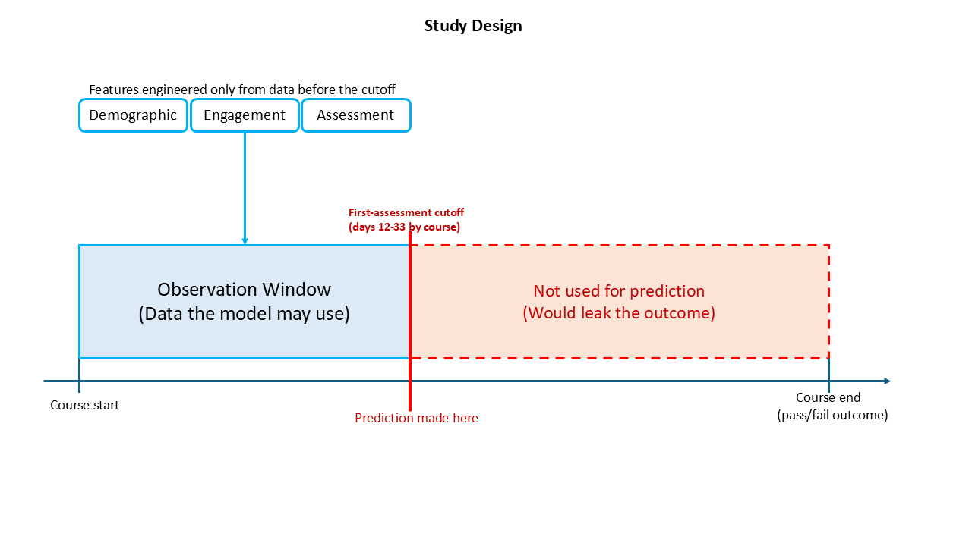
APPROACH · DATA & DESIGN
A leakage-safe early-warning design
OULAD: 32,593 students, 22 presentations, 10.6M VLE interactions.
Four Level-1 modules (BBB, DDD, EEE, FFF), chosen to enable cross-course comparison.
Binary pass/fail target; pre-census withdrawals removed → 22,749 modelled.
Every predictor uses only data available on or before the first assessment (day 12–33).
Module | Students | Fail rate
BBB | 7,052 | 46.8%
DDD | 5,757 | 54.7%
EEE | 2,751 | 40.0%
FFF | 7,189 | 49.3%
All four | 22,749 | 48.7%
5

Slide 6
APPROACH · METHODS
Features, models and evaluation
29 features · 3 families
4 contrasting models
Demographic (9), VLE engagement (14) and first-assessment behaviour (6), all within the horizon.
Logistic regression, random forest, XGBoost and a small neural network (MLP), to test whether complexity is warranted.
Imbalance handled, not assumed
Evaluation & explanation
None vs SMOTE vs class weighting, compared per model; SMOTE applied only inside CV folds to avoid leakage.
PR-AUC (primary) with 5-fold CV; SHAP for drivers; a transfer test and an ablation for generalisation.
6

Slide 7
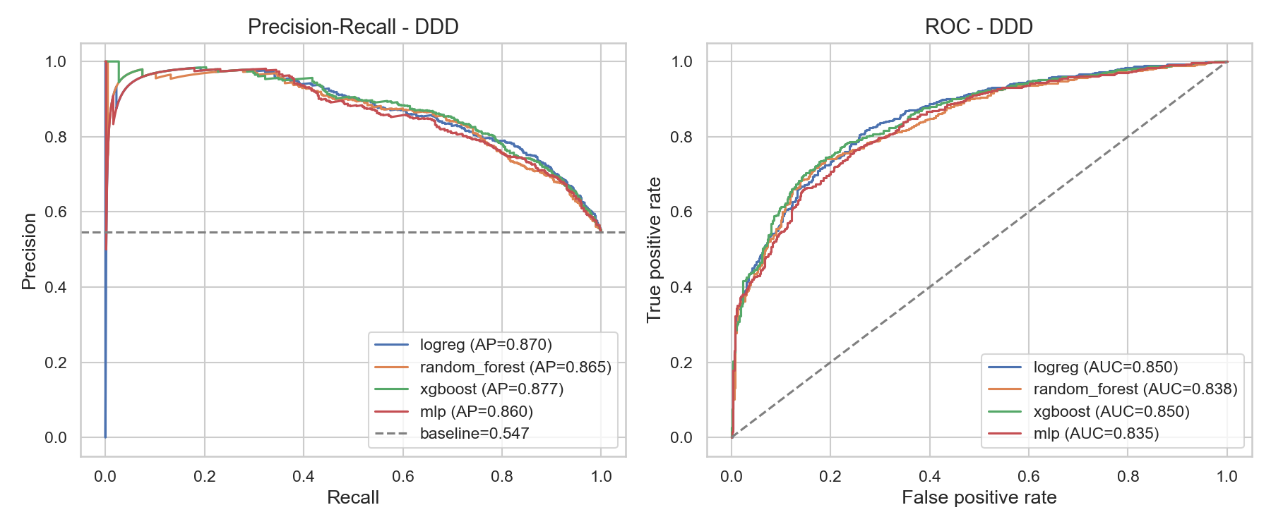
RESULTS · RQ1
Accurate at the first-assessment checkpoint
0.877
≤ 0.02
best PR-AUC (DDD, XGBoost)
spread across all four models on every course
Module | Best model | PR-AUC | ROC-AUC | F1
BBB | XGBoost | 0.829 | 0.815 | 0.680
DDD | XGBoost | 0.877 | 0.850 | 0.770
EEE | Logistic reg. | 0.843 | 0.857 | 0.697
FFF | XGBoost | 0.834 | 0.810 | 0.711
Reliability: CV std ±0.008–0.014 on DDD; test scores tracked CV means, so the ranking is meaningful. The interpretable linear model was within 0.02 everywhere and won on EEE.
7

Slide 8
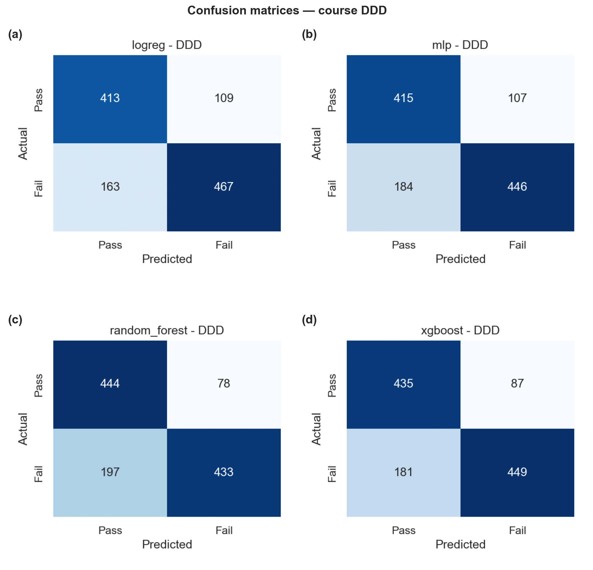
RESULTS · RQ1
Who the model catches
At the default threshold on DDD (XGBoost):
449
0.838
of 630 failing students caught
precision (few false alarms)
Recall 0.713: catches roughly seven in ten who go on to fail.
Only 87 false alarms against 435 true negatives.
The threshold is a lever: recall could be raised to catch more, at the cost of more false alarms.
8

Slide 9
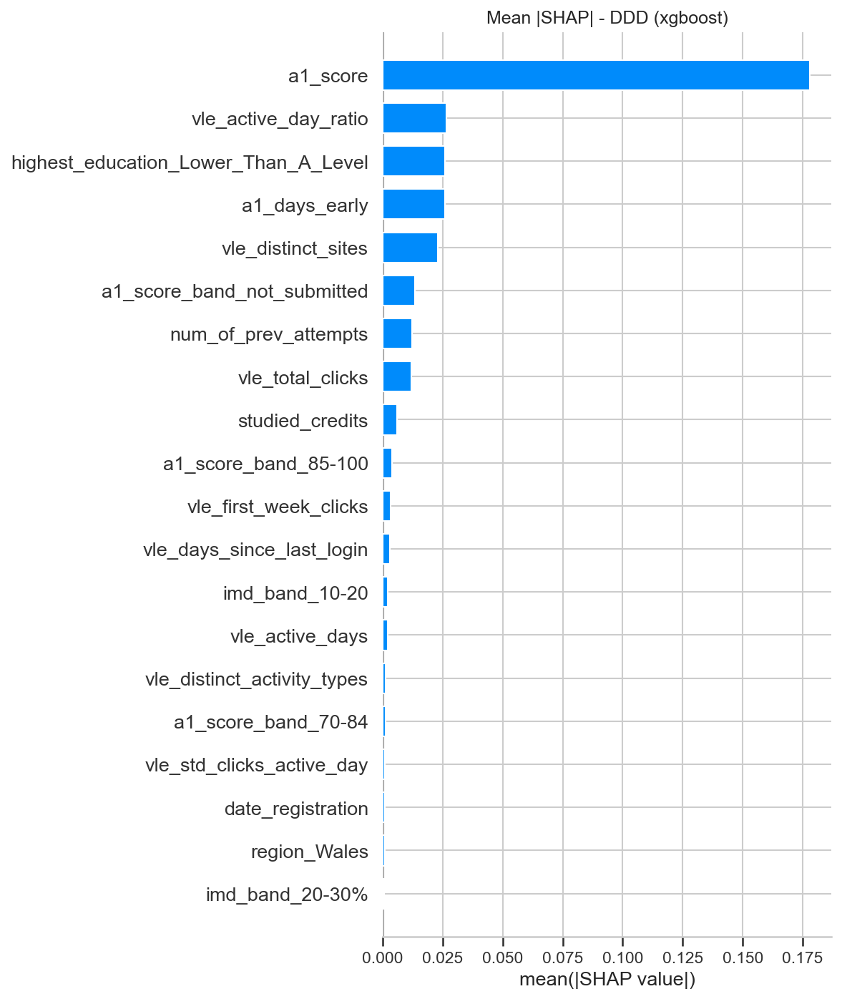
RESULTS · RQ2 · DRIVERS
What drives predicted risk
The first-assessment mark is the strongest single driver (mean |SHAP| ≈ 0.178).
A second tier of engagement and prior-education features follows (≈ 0.023–0.026).
Demographic attributes contribute little, which is reassuring for fairness.
The ranking is a hierarchy: several engagement measures matter beneath the first-assessment mark.
9

Slide 10
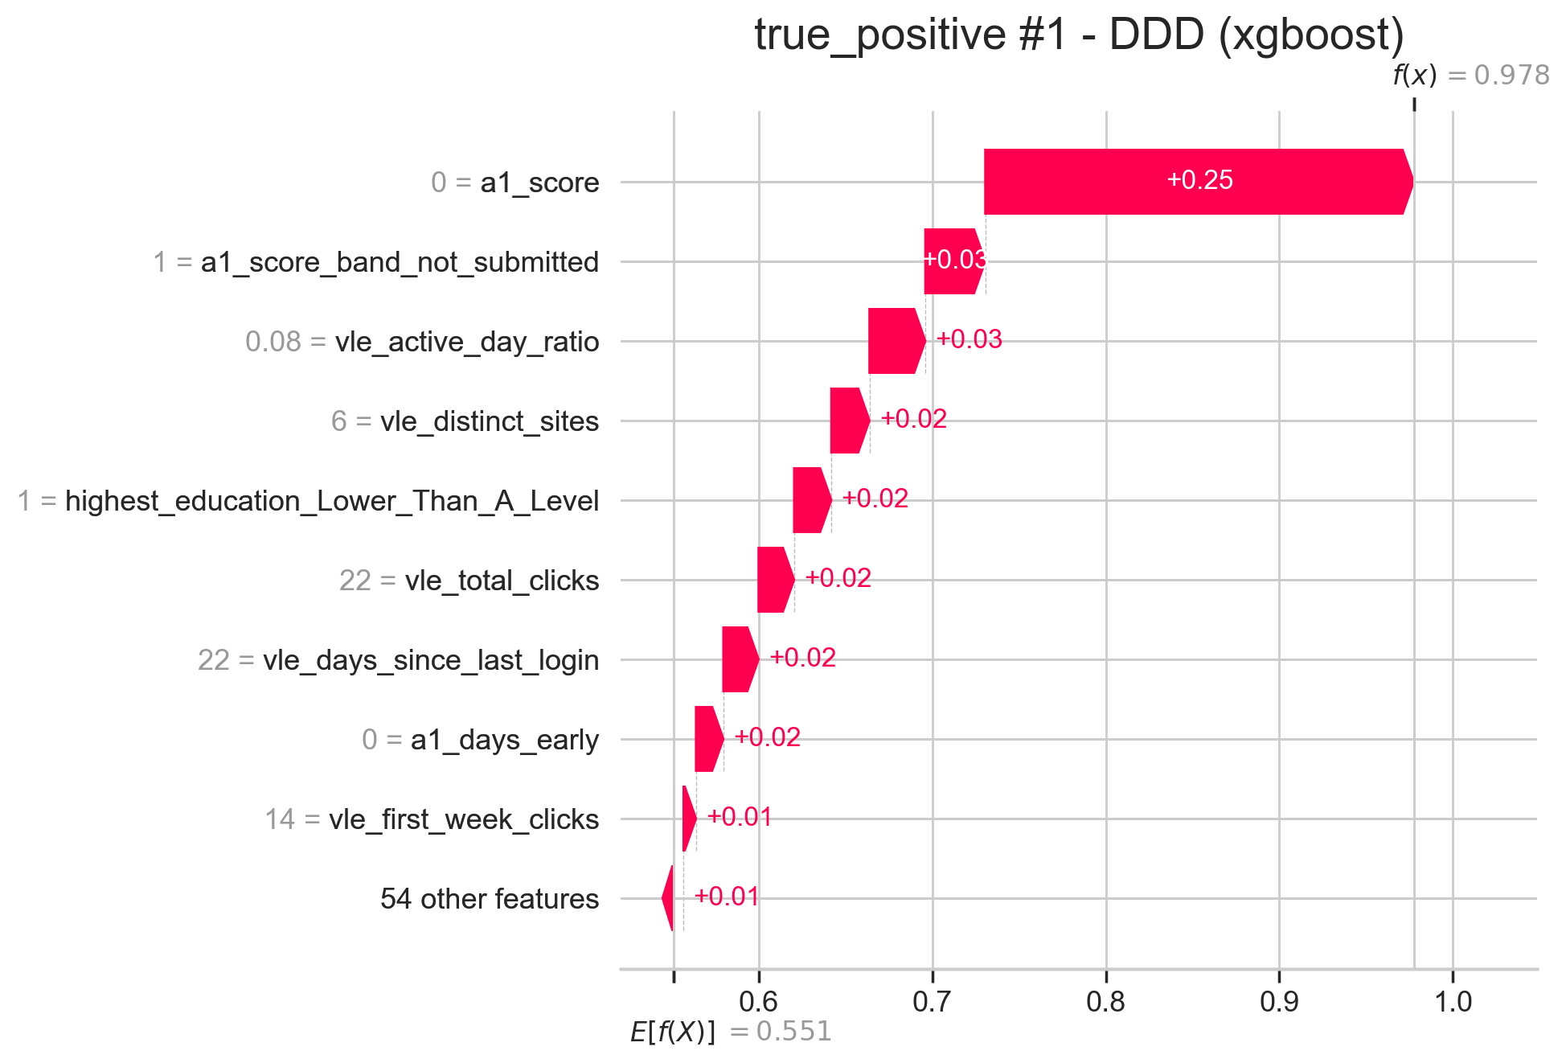
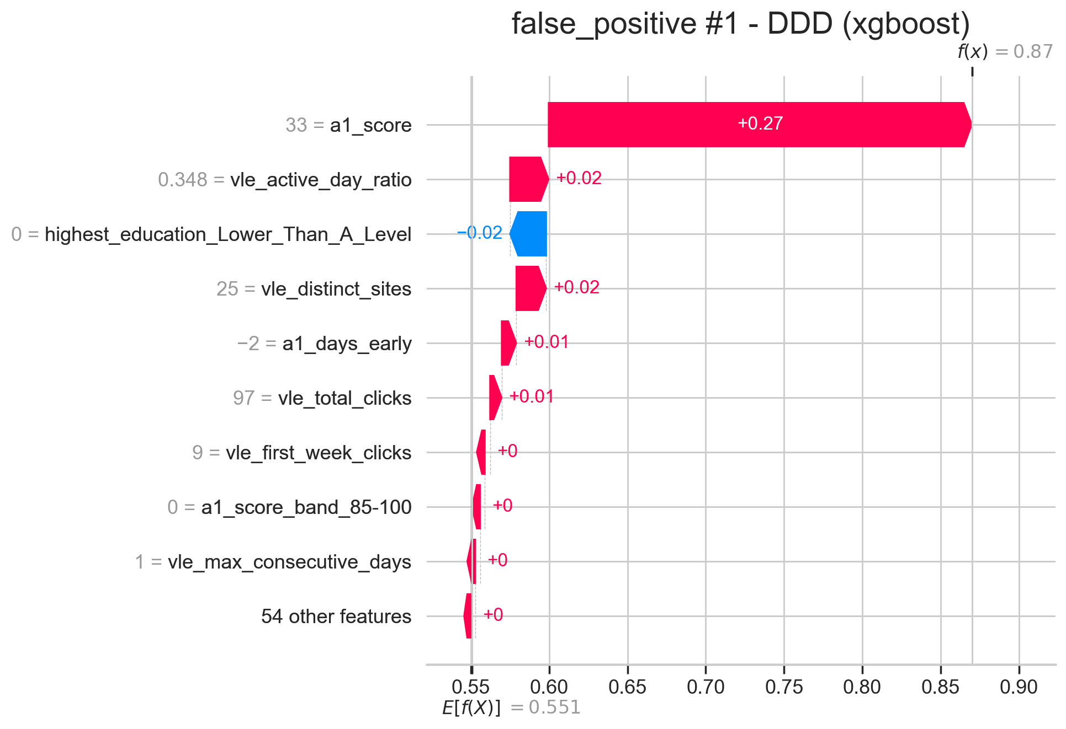
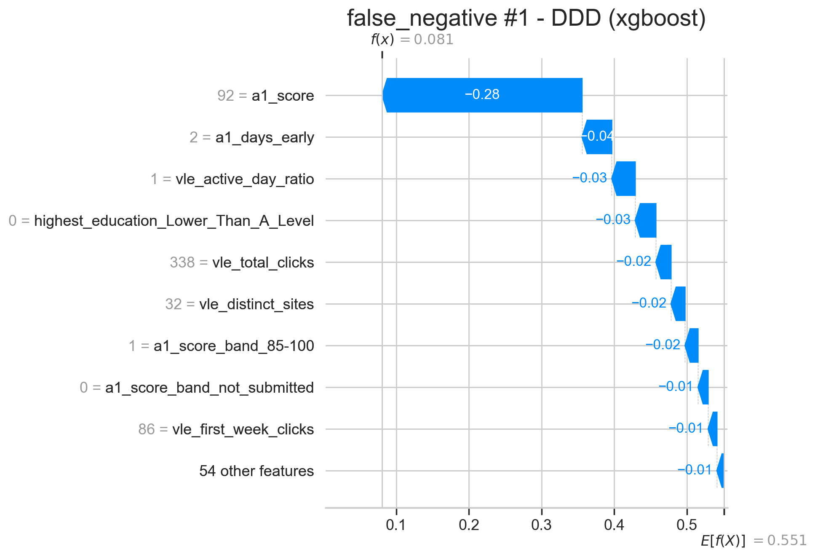
RESULTS · RQ2 · INDIVIDUAL EXPLANATIONS
Explaining a single student's flag
SHAP waterfall plots decompose one prediction, so a tutor can act on a flag and see when the model is likely wrong.
A low or missing first mark and weak early engagement push risk above the base rate.
Otherwise-adverse features outweigh genuine engagement.
A miss. Strong early signals mask an eventual failure.
10

Slide 11
RESULTS · RQ2 · ABLATION
Does it just restate the first mark?
Withhold the first-assessment mark and its band from every model; keep only submission behaviour and engagement.
Module | Full | No mark | Δ PR-AUC
BBB | 0.829 | 0.815 | −0.014
DDD | 0.877 | 0.845 | −0.032
EEE | 0.843 | 0.836 | −0.007
FFF | 0.834 | 0.821 | −0.014
Mean | 0.846 | 0.829 | −0.017
−0.017
mean PR-AUC drop without the mark
No: the signal is broad. Removing the strongest predictor costs only ~0.017 on average, so engagement and submission behaviour carry most of the early signal in their own right. The model is not merely restating the first grade and could in principle, warn even earlier.
11

Slide 12
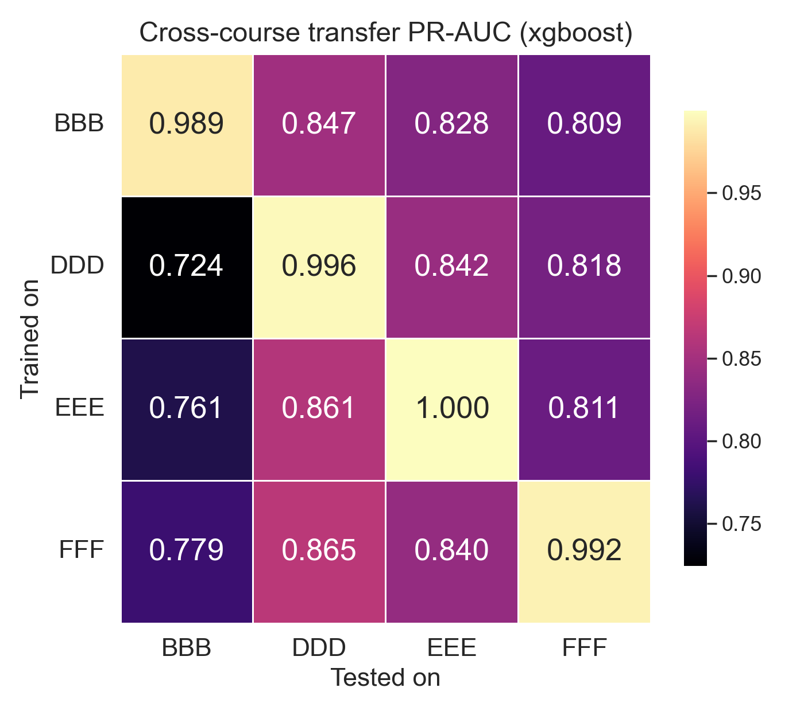
RESULTS · RQ3 · GENERALISATION
Does it generalise across courses?
The drivers, though, are stable. Top-ten features shared by all four courses:
Feature | Courses in top-10
a1_days_early | 4 / 4
a1_score | 4 / 4
vle_active_day_ratio | 4 / 4
vle_total_clicks | 4 / 4
a1_submitted | 3 / 4
highest_education (< A-level) | 3 / 4
Partial transfer. Moved to a different course, PR-AUC falls to 0.72–0.87 (weakest into BBB). Useful, but each course still benefits from its own calibration.
Stable hierarchy, portable drivers. The same four features top every course, so the behavioural story generalises even where a single fitted model does not.
12

Slide 13
DISCUSSION
Implications of the findings
1
Competitive accuracy under a tougher test
Matches OULAD work such as Oyedotun et al. (2025, ~0.79 ROC-AUC) but predicts earlier; since accuracy climbs with later windows (Adnan et al., 2021), an early result is harder and very useful.
Drivers generalise; weights need recalibration
Engagement can act as a proxy for circumstance. The driver hierarchy is stable across courses, and transfer stays useful (0.72–0.87), which extends within-course transfer (Dai et al., 2025) to different courses, with per-course calibration.
3
Accuracy is necessary, not sufficient
Early-warning impact is mixed. Chang et al. (2025) showed that the value depends on the intervention attached to the flag, not the flag alone.
4
Transparent and fairness-aware
A linear model within 0.02 is deployable as tutor-facing decision support; demographics matter little, but group failure gaps still need monitoring.
13

Slide 14
DISCUSSION
Limitations and future work
Limitations
Future work
Target merges failure with post-census withdrawal, which can have different causes.
SMOTE can distort one-hot categoricals in the encoded space.
SHAP explains the model, not causation, and depends on the background set.
A single checkpoint (cutoff varies by course), one institution, one test split per course.
Rolling weekly predictions: how early can a reliable warning come?
Pool courses and test on an entirely held-out course.
A formal fairness audit using between-group performance measures.
A controlled intervention trial linking flags to tutor action and outcomes.
14

Slide 15
CONCLUSION
Accurate, explainable, and honest about its limits
A leakage-safe pipeline predicts failure at the first assessment: PR-AUC 0.829–0.877, with an interpretable model within 0.02.
First-assessment behaviour and engagement drive risk; a 0.017 ablation drop shows the signal is broad, not a single feature.
Drivers are stable across courses; transfer is partial, so per-course calibration is the honest recommendation.
Contribution: an early, explainable, cross-course-tested warning system, with the intervention trial as the clear next step.
Thank you.
15

Slide 16
REFERENCES
References
Adnan, M., Habib, A., Ashraf, J., Mussadiq, S., Raza, A.A., Abid, M., Bashir, M. and Khan, S.U. (2021) ‘Predicting at-risk students at different percentages of course length for early intervention using machine learning models’, IEEE Access, 9, pp. 7519–7539. https://doi.org/10.1109/ACCESS.2021.3049446
Aljohani, N.R., Fayoumi, A. and Hassan, S.-U. (2019) ‘Predicting at-risk students using clickstream data in the virtual learning environment’, Sustainability, 11(24), 7238. https://doi.org/10.3390/su11247238
Chang, Y.-H., Chen, F.-C. and Lee, C.-I. (2025) ‘Developing an early warning system with personalized interventions to enhance academic outcomes for at-risk students in Taiwanese higher education’, Education Sciences, 15(10), 1321. https://doi.org/10.3390/educsci15101321
Dai, W., Lin, J., Jin, F.J.-Y., Tsai, Y.-S., Srivastava, N., Le Bodic, P., Gašević, D. and Chen, G. (2025) ‘Learning analytics for early identification of at-risk students and feedback intervention’, Journal of Learning Analytics, 12(3), pp. 102–125. https://doi.org/10.18608/jla.2025.8735
Gupta, A., Garg, D. and Kumar, P. (2022) ‘Mining sequential learning trajectories with hidden Markov models for early prediction of at-risk students in e-learning environments’, IEEE Transactions on Learning Technologies, 15(6), pp. 783–797. https://doi.org/10.1109/TLT.2022.3197486
Kuzilek, J., Hlosta, M. and Zdrahal, Z. (2017) ‘Open University Learning Analytics dataset’, Scientific Data, 4, 170171. https://doi.org/10.1038/sdata.2017.171
Lundberg, S.M. and Lee, S.-I. (2017) ‘A unified approach to interpreting model predictions’, in Advances in Neural Information Processing Systems 30. Red Hook, NY: Curran Associates, pp. 4765–4774.
Oyedotun, S.A., Ejenarhome, O.P. and Oise, G.P. (2025) ‘Learning analytics and predictive modeling: enhancing student success through data-driven insights’, Journal of Science Research and Reviews, 2(3), pp. 42–51. https://doi.org/10.70882/josrar.2025.v2i3.77
16

