Slide 1
LIVING WATER &
HYGIENE PROJECT
━━━━━━━━━━━━━━━━━━━━━━━━
Presented by Pr. Muwayi Faizal

Slide 2
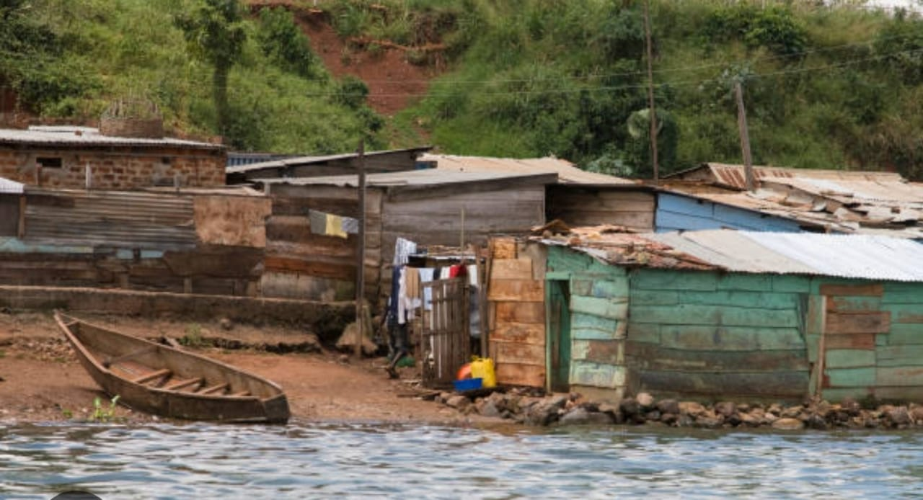
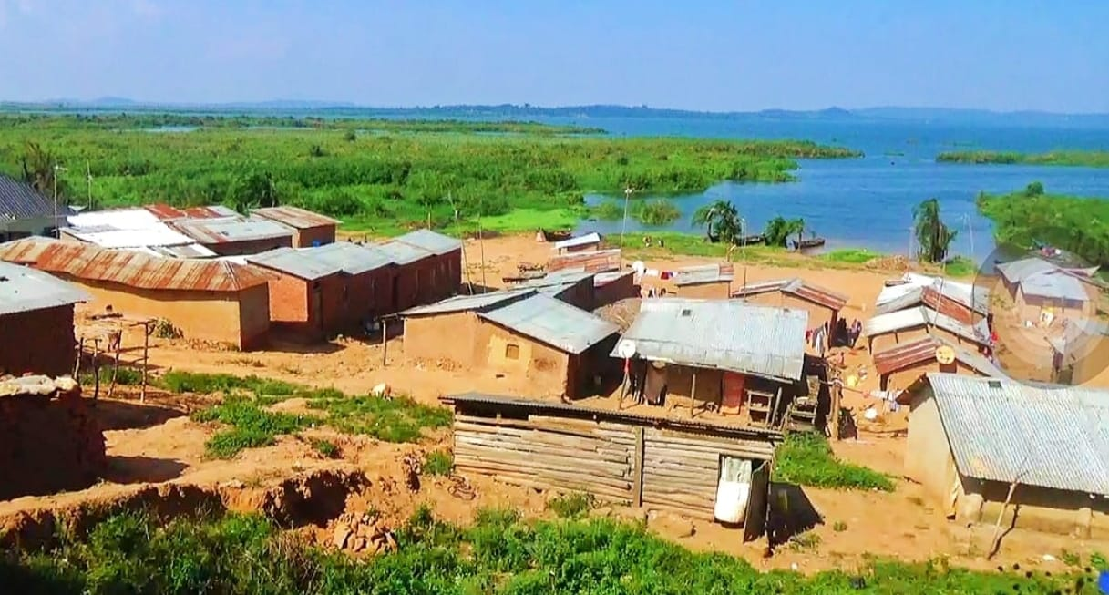
TRANSFORMING COMMUNITIES THROUGH THE GOSPEL
A church that does not respond to the needs of its community is failing to fulfil an important part of its mission. Community transformation is central to why the Church exists.
At Rest Church, we believe that the Gospel must not only change lives spiritually but also bring practical solutions to the challenges people face. That is why community transformation through practical projects is one of our priorities.

Slide 3
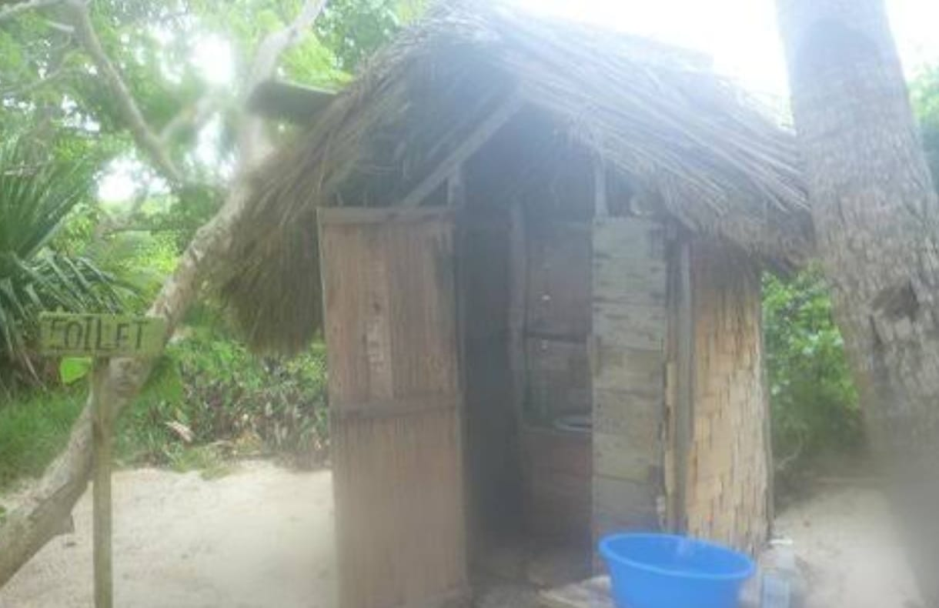
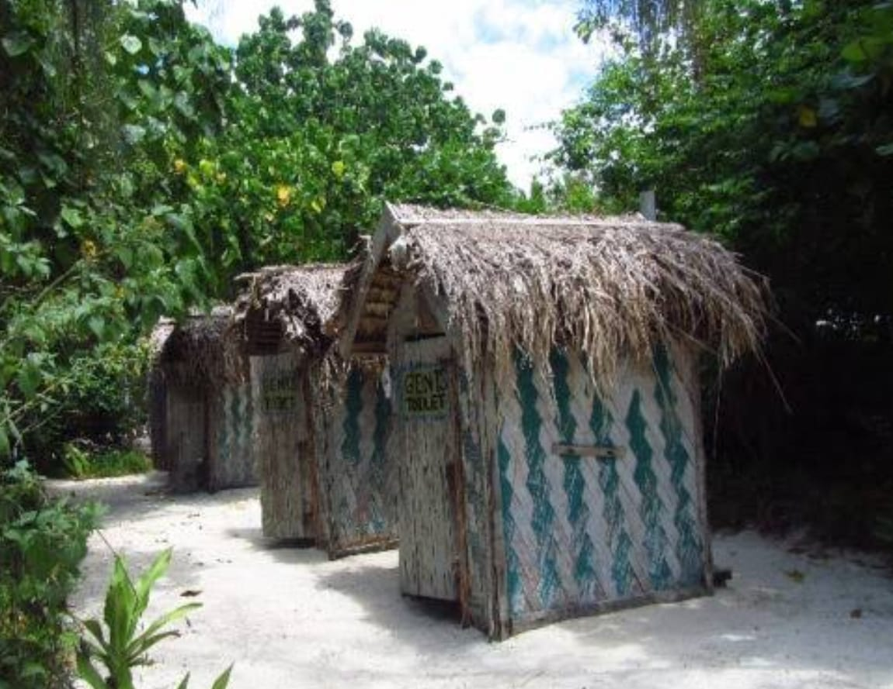
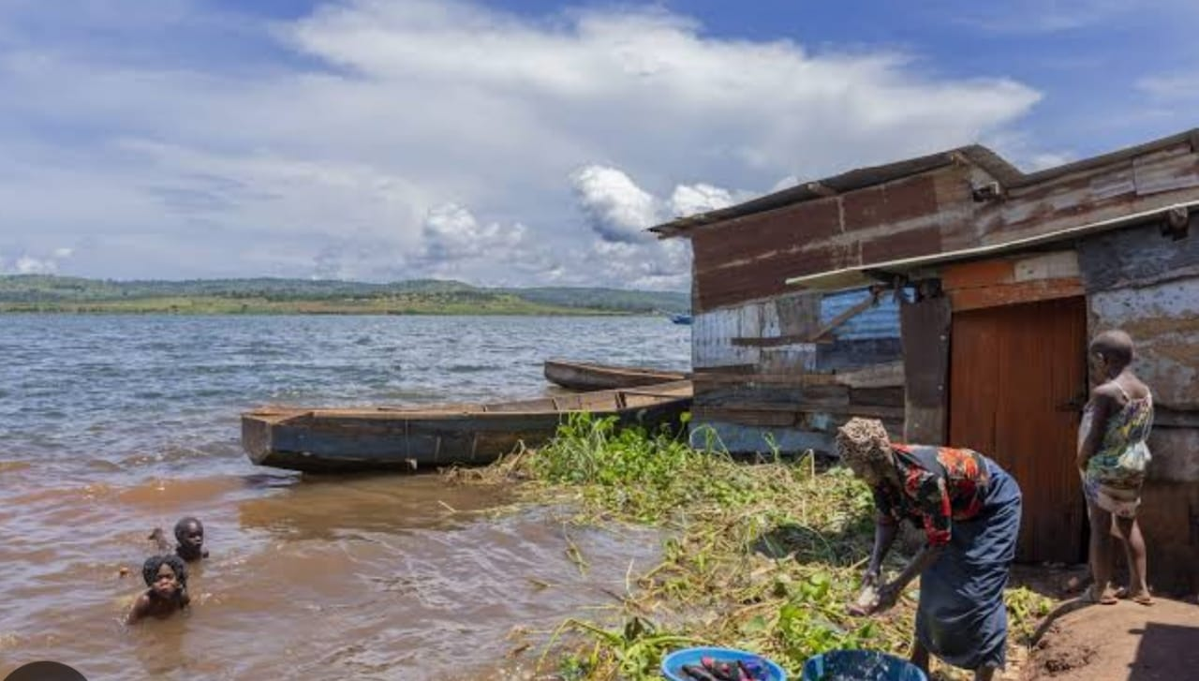
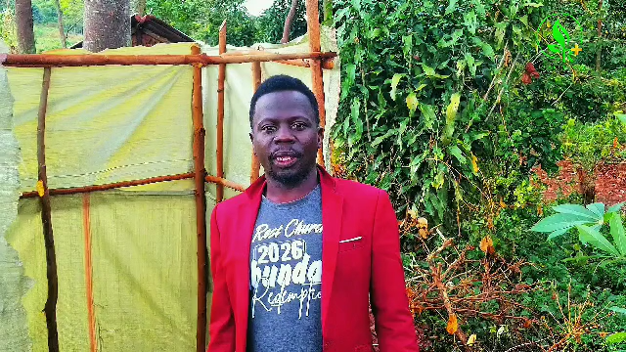
Sanitation and Hygiene Project
One of our key mission fields is the construction of public and household toilets in islands and remote communities. Poor sanitation is a serious challenge in these areas. Due to the limited number of toilets, many people are forced to relieve themselves in bushes or dig holes to dispose of human waste. This exposes communities to health risks and undermines their dignity.
Through this project, Rest Church seeks to improve sanitation, promote hygiene, protect public health, and restore dignity to vulnerable communities.

Slide 4
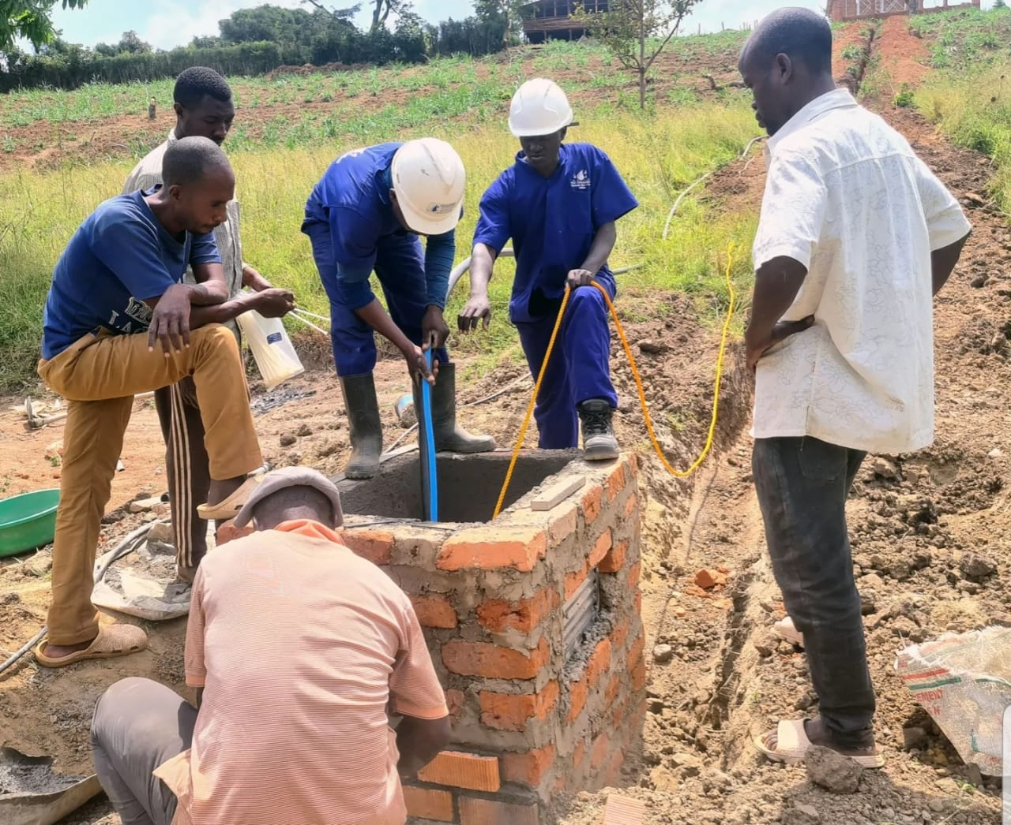
At Rest Church, we believe that the Word of God is living water that brings life and transformation. Through our Living Water Project, we distribute free Audio Bibles to people who cannot read or write, particularly the elderly, and printed Bibles in different languages to make God's Word accessible to everyone.
Beyond sharing the spiritual water of God's Word, we also seek to address the challenge of unsafe drinking water in remote communities by constructing wells and boreholes. We believe that meeting people's spiritual and physical needs is an important expression of the love of Christ.
Living Water Project

Slide 5
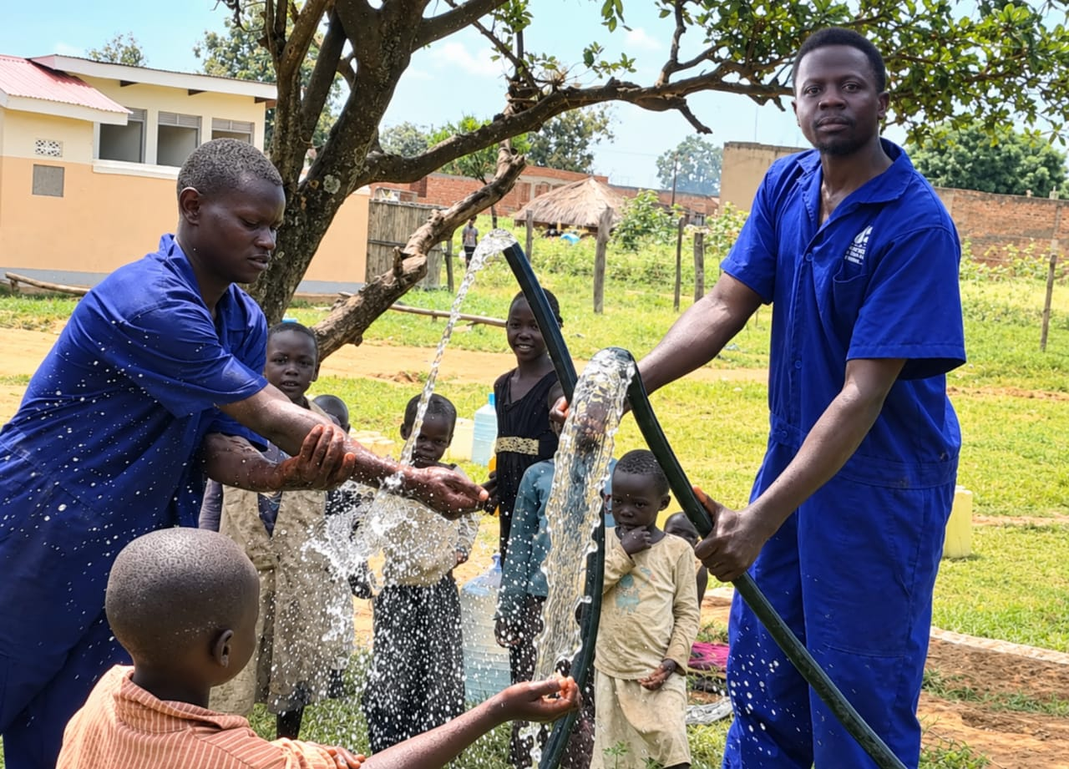
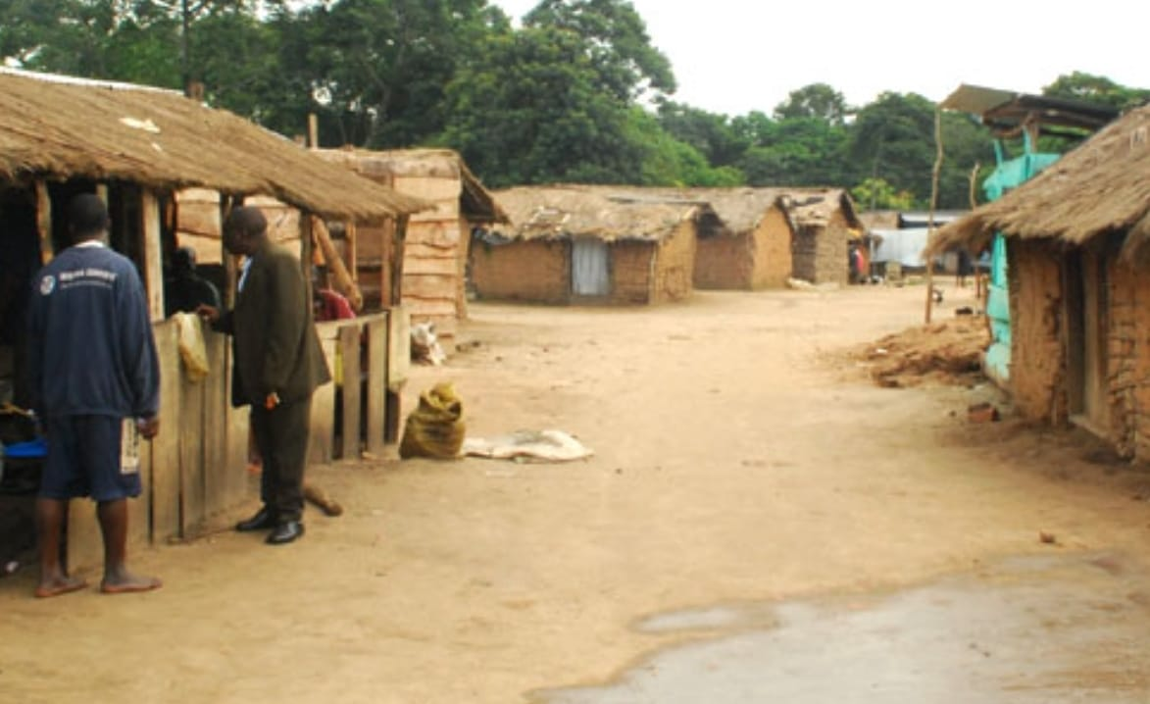
Our Commitment and Partnership
As members of Rest Church, we contribute financially towards these projects as God enables us. However, we recognise that transforming communities requires a collective effort. Therefore, we welcome partners, churches, organisations, and individuals who share our vision and are willing to join us in this mission.
We believe that every contribution, regardless of its size, can make a difference. Together, we can bring hope to vulnerable communities, restore dignity, improve access to clean water, promote better sanitation, and make the Word of God accessible to more people.
At Rest Church, our vision goes beyond gathering people in a church building. We are committed to taking the love of Christ into communities, addressing real needs, and bringing lasting transformation through the Gospel.

Slide 6
ESTIMATED COSTS OF NEEDED RESOURCES
Item | Estimated Cost
Audio Bible — 1 copy | $11
Printed Bible — 1 copy | $11
Borehole — 1 | $3,000
Dug Well — 1 | $2,000
Total Estimated Cost | $5,022

