Slide 1
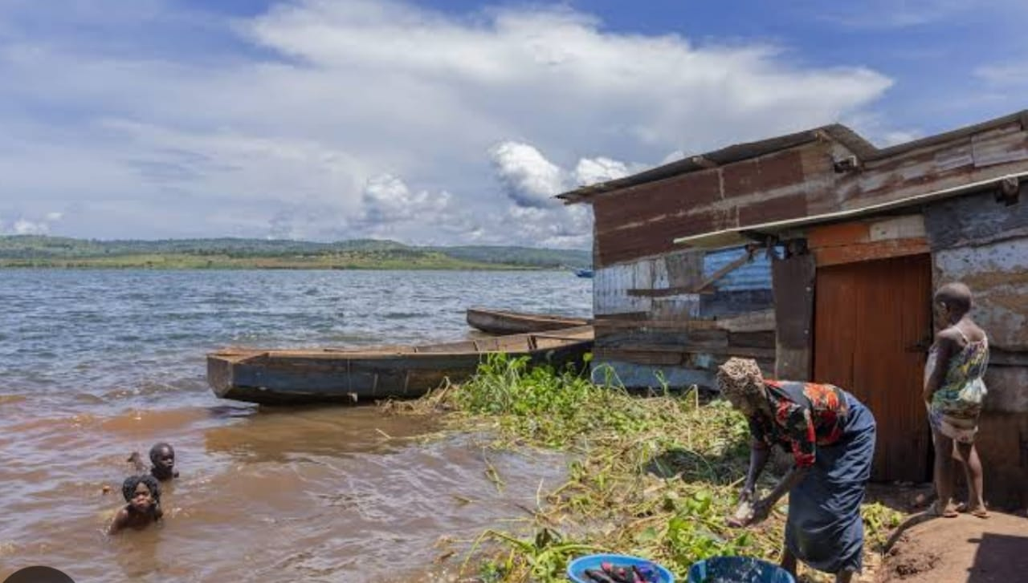
REST CHURCH MINISTRIES
TOILET BUILDING
PROJECT
Addressing Hygiene and Sanitation Challenges
in Island Communities
A community transformation initiative
REST CHURCH MINISTRIES

Slide 2
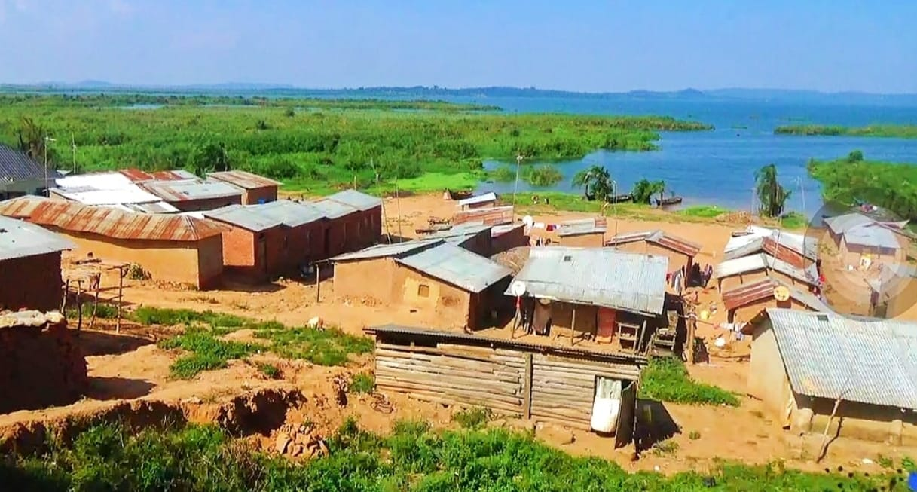
01 • BACKGROUND
Why this project matters
A personal commitment shaped by lived experience
Growing up on the islands
The vision bearer of Rest Church Ministries was born and raised in island communities, where his parents spent their lives as fishmongers.
As a child, he witnessed families without proper sanitation facilities. Some people dug holes in bushes or used open spaces near their homes to dispose of human waste.
These conditions affected hygiene, privacy and dignity, while increasing exposure to sanitation-related diseases.
REST CHURCH MINISTRIES • COMMUNITY TRANSFORMATION
02
02

Slide 3
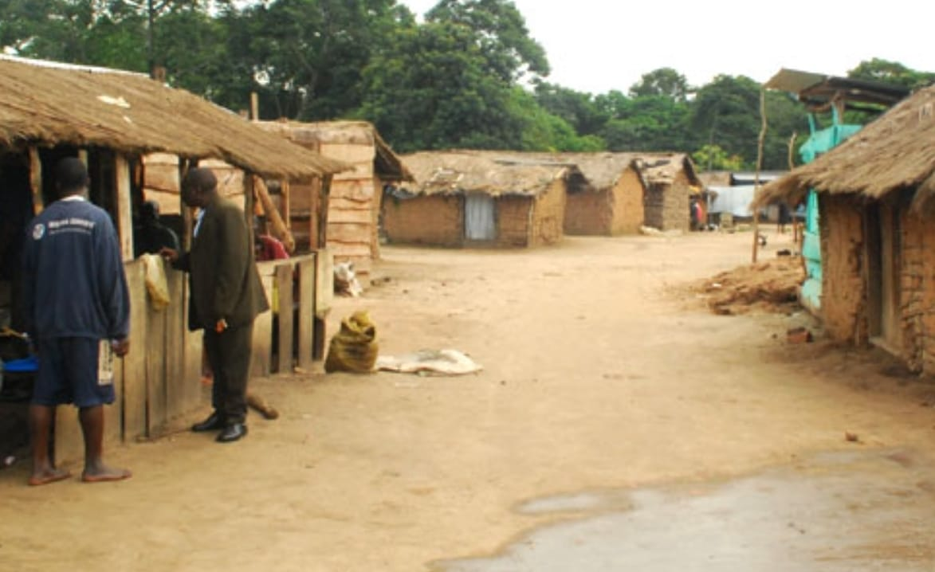
02 • THE MOTIVATION
A commitment born from experience
Turning a childhood reality into a lifelong mission
“
I made a personal commitment to help transform sanitation in island communities before the end of my life.
— Vision bearer, Rest Church Ministries
REST CHURCH MINISTRIES • COMMUNITY TRANSFORMATION
03
03

Slide 4
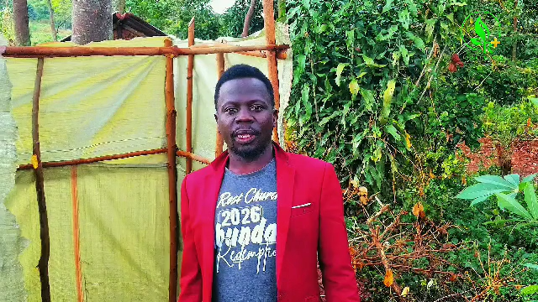
03 • PROJECT GOAL
What the project will achieve
A practical response to a persistent community need
OUR GOAL
To improve hygiene, sanitation, privacy and dignity among island communities through the construction of accessible public toilet facilities.
HYGIENE
SAFETY
Promote cleaner surroundings
Reduce exposure to health risks
PRIVACY
DIGNITY
Provide a safe, private facility
Respect children and adults
REST CHURCH MINISTRIES • COMMUNITY TRANSFORMATION
04
04

Slide 5
04 • IMPLEMENTATION
Working together to make it happen
Rest Church Ministries welcomes shared commitment and practical support
Rest Church Ministries is committed to constructing public toilets in island communities to address the persistent sanitation challenges affecting residents.
As part of the Body of Christ, the church mobilizes financial support from its members, friends from other churches, and potential partners who share this vision. We welcome individuals, churches, and organizations willing to support the project financially or through the provision of construction materials.
REST CHURCH MINISTRIES • COMMUNITY TRANSFORMATION
05
05

Slide 6
05 • ESTIMATED BUDGET
What the project needs
Estimated construction materials and services • USD
CONSTRUCTION MATERIALS & SERVICES
COST
Iron sheets
$1,000
TOTAL ESTIMATED
PROJECT COST
Bricks
$700
Nails
$30
Iron bars
$100
$4,630
Transportation of materials
$300
Cement
$1,000
USD
Labour
$1,000
Sand
$500
Every contribution helps move the project forward.
REST CHURCH MINISTRIES • COMMUNITY TRANSFORMATION
06
06

Slide 7
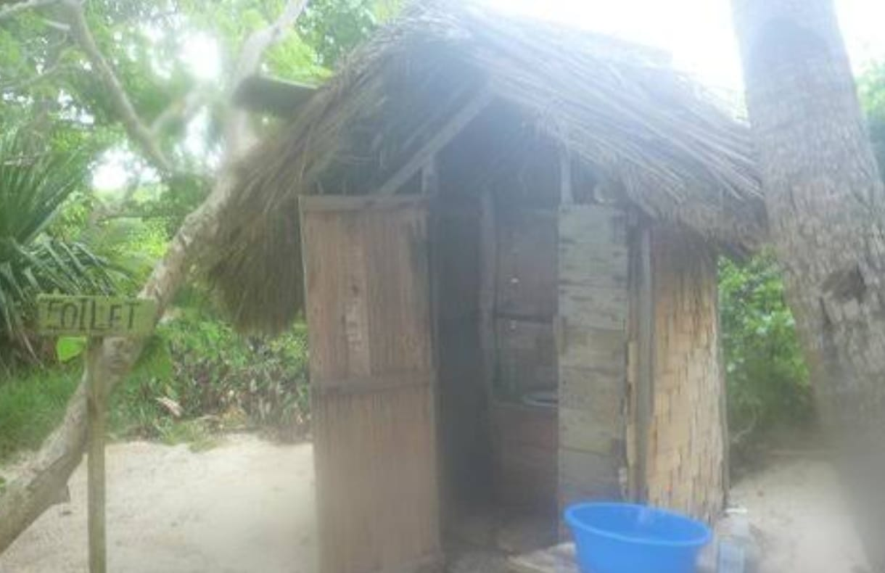
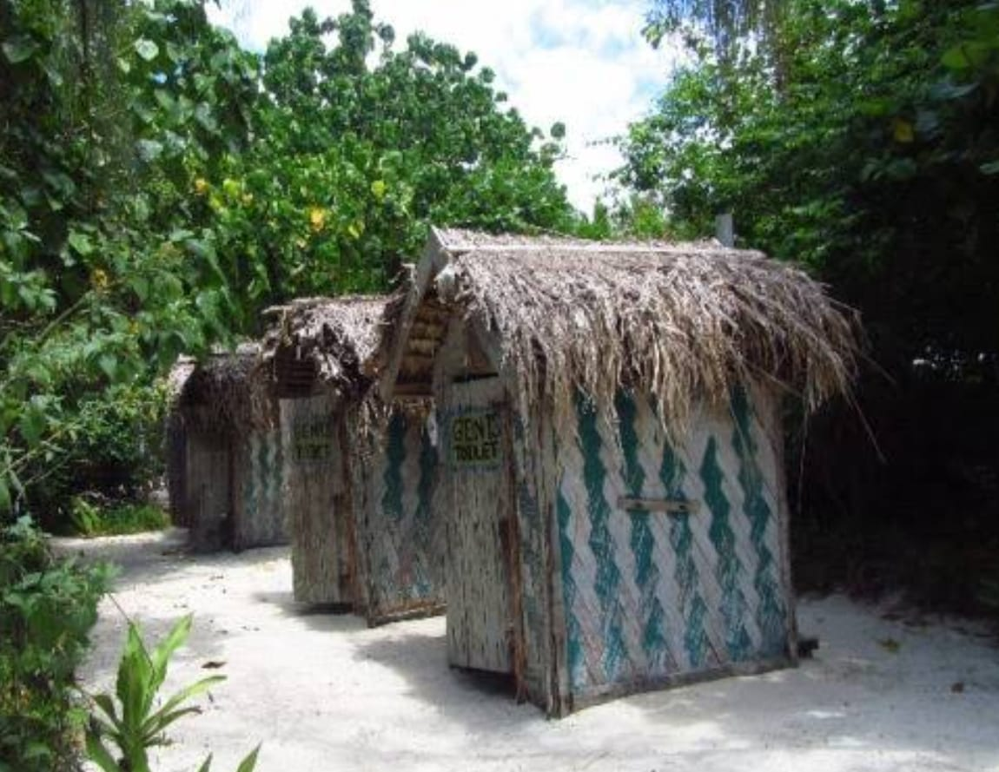
06 • EXPECTED IMPACT
A healthier, more dignified community
The project is designed to make a practical difference in everyday life
01
Improved hygiene
Cleaner and safer sanitation conditions.
02
Reduced health risks
Less exposure to sanitation-related dangers.
03
Accessible facilities
Safe public toilet facilities for residents.
04
Privacy and dignity
Greater privacy and dignity for children and adults.
05
Sustainable communities
A contribution to healthier, more sustainable communities.
REST CHURCH MINISTRIES • COMMUNITY TRANSFORMATION
07
07

Slide 8
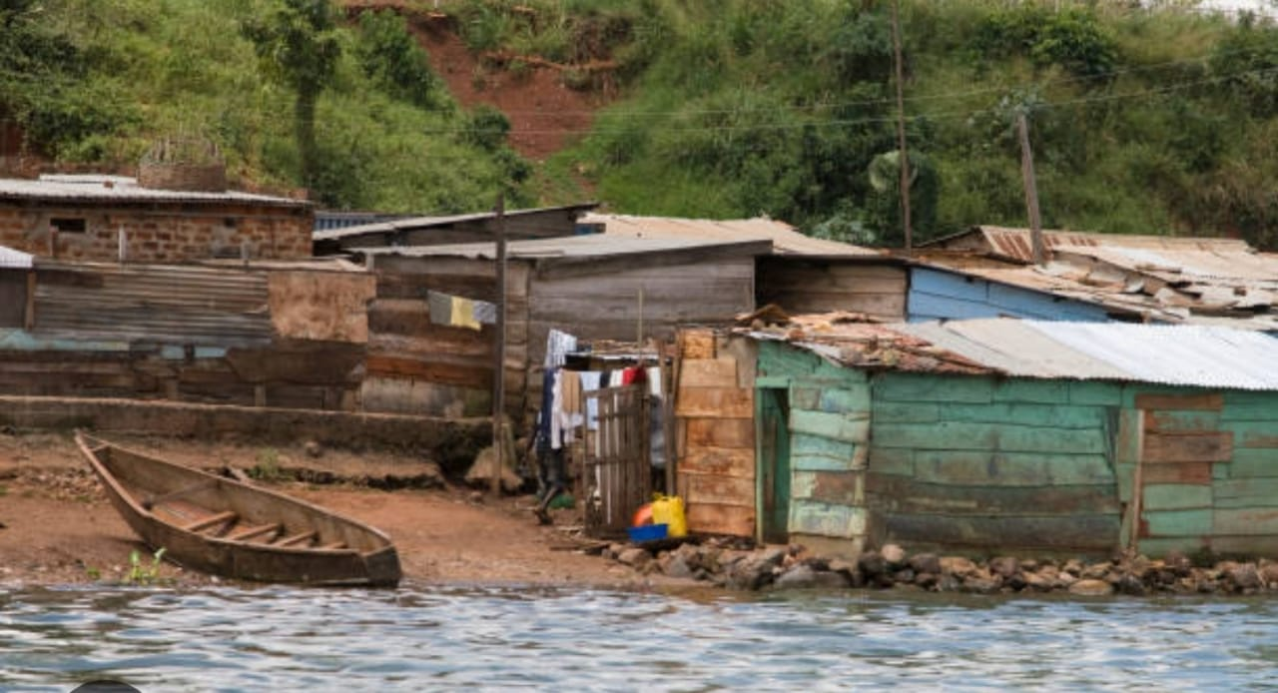
07 • CONCLUSION
Transforming communities
through practical love
Rest Church Ministries believes that transforming communities goes beyond preaching the Gospel. It also means responding to people’s practical needs.
ADD YOUR STRONGEST PHOTO
This project is one way we demonstrate the love of God through meaningful community service.
JOIN US IN BUILDING HEALTHIER ISLAND COMMUNITIES
REST CHURCH MINISTRIES

