Slide 1
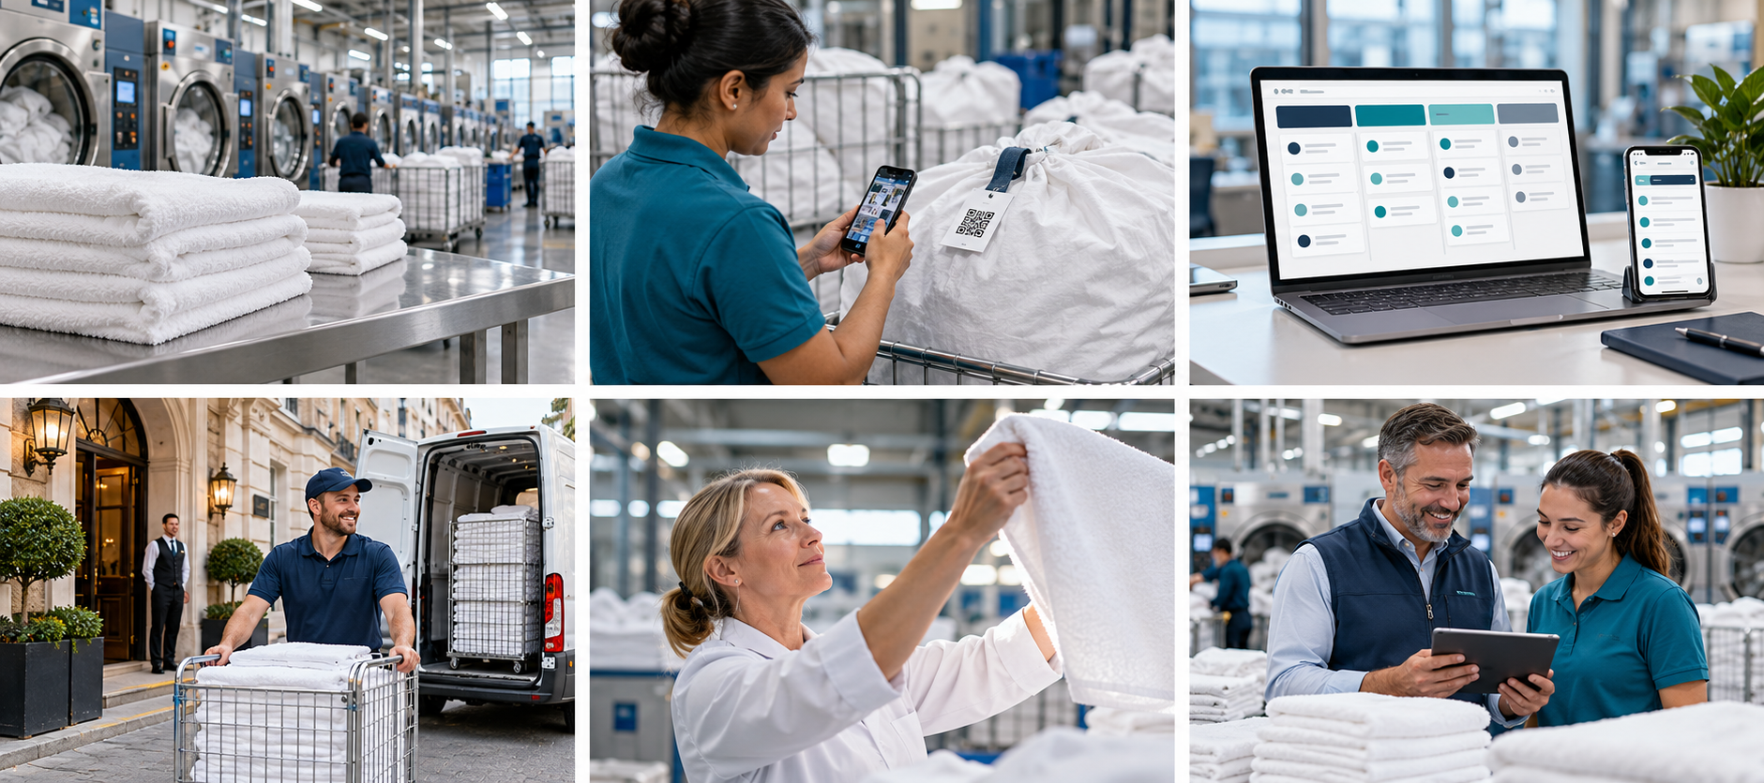
LAUNDRY MANAGEMENT / PROPOSED SOLUTION
A CLEARER WAY TO WORK
Every order. Every linen.
One connected operation.
Laundry management,
designed around people.
A proposed solution for your business
01
Notes:
Customer introduction to the proposed Laundry Management Solution - UK. No product name or delivery commitment has been assumed. Source: customer-supplied Laundry Management Solution.docx.

Slide 2
LAUNDRY MANAGEMENT / PROPOSED SOLUTION
THE COMPLETE JOURNEY
From collection to customer.
A shared view across every handover.
01
02
03
04
05
Order
Collect
Process
Check
Deliver
Rental orders / Shipping & receiving / Production / Billing
02

Slide 3
LAUNDRY MANAGEMENT / PROPOSED SOLUTION
MAKE THE DAY EASIER
Know what needs attention next.
Smart Daily Assistant
Overdue orders, pickups and exceptions
Smart delay alerts
Act before a deadline is missed
One-click repeat orders
Less entry for regular customers
03

Slide 4
LAUNDRY MANAGEMENT / PROPOSED SOLUTION
VISUAL LAUNDRY BOARD
See progress at a glance.
Pending
Processing
Ready
Delivered
Hotel linen
Bed linen
Weekly rental
Guesthouse linen
Restaurant linen
Towels
04
Notes:
Illustrative concept board with fictional orders. Proposed stages follow the supplied document: Pending, Processing, Ready, Delivered. Not a live application screenshot.

Slide 5
LAUNDRY MANAGEMENT / PROPOSED SOLUTION
SCAN & GO
Scan. Find. Update.
Phone-based QR labels
Open the order.
Change status in one tap.
RFID tracking where required
05

Slide 6
LAUNDRY MANAGEMENT / PROPOSED SOLUTION
QUALITY AT EVERY STEP
Resolve issues while they are visible.
One-tap issue reporting
Missing or damaged items
Reason + optional photo
Rewash / Reject / Reclaim / Discard
06

Slide 7
LAUNDRY MANAGEMENT / PROPOSED SOLUTION
CONNECTED DELIVERY
Keep every handover connected.
Plan
Routes and optimisation
Guide
Driver routes and manifests
Confirm
Delivery signatures
07

Slide 8
LAUNDRY MANAGEMENT / PROPOSED SOLUTION
A SIMPLER CUSTOMER EXPERIENCE
Answers without the chase.
Customer portal / app
Orders, pickups, invoices and status
Secure tracking link
No app installation needed
Opt-in WhatsApp / SMS
Pickup, ready and delivery updates
08

Slide 9
LAUNDRY MANAGEMENT / PROPOSED SOLUTION
COMMERCIAL CONTROL
Connect service with the business.
Orders & rental
Billing & payments
CRM
Manage recurring linen needs
Invoices and payment processing
Customer support and sales
Clearer records. Smoother customer conversations.
09
Notes:
The document lists LinenPay as a LinenTech payment capability. This proposed solution describes payment processing generically; no integration, provider or commercial terms are confirmed.

Slide 10
LAUNDRY MANAGEMENT / PROPOSED SOLUTION
MANAGER VISIBILITY
Turn activity into useful decisions.
Daily summary
Orders, delays and unresolved issues
Operational insights
Throughput, labour costs and rework
Mobile access
Reports, alerts and multilingual support
10

Slide 11
LAUNDRY MANAGEMENT / PROPOSED SOLUTION
A PRACTICAL ROLLOUT
Start with daily value. Grow with confidence.
Priority 1
Priority 2
Later
Daily assistant · QR scanning
Visual board · Repeat orders
Issue reporting · Delay alerts
Tracking links · Opt-in updates
Daily summary
Improvement insights
Offline scan queue
Safe synchronisation
Core platform: orders, production, delivery, finance and customer access
AI-assisted workflows: explore after the core operation is defined.
11
Notes:
Priorities follow the supplied document. The source lists agentic AI as advertised by LinenTech, without defined requirements. AI is exploratory here, not a committed capability. Offline scan queue is a later-phase proposal. No timelines or measured benefits are claimed.

Slide 12
LAUNDRY MANAGEMENT / PROPOSED SOLUTION
YOUR OPERATION, CONNECTED
Less chasing. More control.
A simpler day for your team.
A clearer service for your customers.
Next: validate workflows and agree the first release.
12
Notes:
Basis: Laundry Management Solution.docx supplied by the customer. Reference website: https://www.linentech.net (live access blocked by environment network policy; not independently reviewed). All generated photography and concept UI are illustrative. This presentation describes a proposed solution, not an existing released product.

