Slide 1
AGENTIX
An AI-Powered Data Intelligence Platform
Piush Kole (2548421)
Thrilok M (2548430)
Guided By - Dr. Deepa BG.

Slide 2
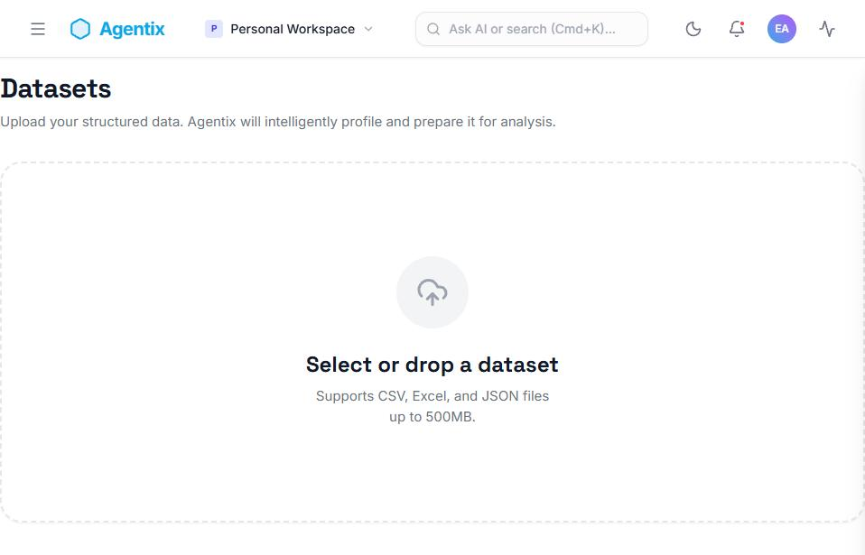
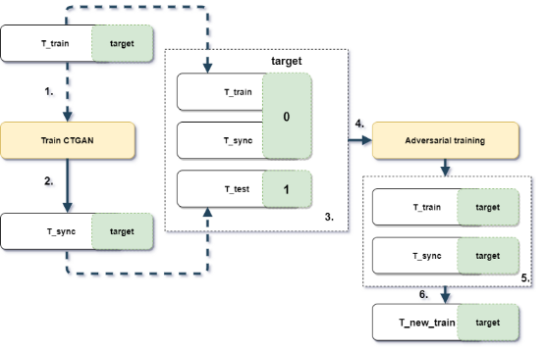
THE "DATA-TO-DECISION" GAP
MANUAL BOTTLENECK
Cleaning, feature engineering, and model selection
consume days of expert time before insight appears.
TOOL FRAGMENTATION
Spreadsheets, notebooks, and BI tools each own one
slice of the workflow, with no shared thread.
THE AGENTIX ANSWER
An orchestrated pipeline of real agents that profiles, cleans, trains, and explains a dataset - automatically.
"Most platforms show you dashboards about your data. Agentix builds and evaluates a model from it."

Slide 3
APPROACH COMPARATIVE ANALYSIS
Approach | Pros | Cons | Suitability
Manual Data Science | Full control, deep insight | Slow, expertise-dependent | Low
BI Dashboards | Fast visualization | No modelling or automated cleaning | Low
Generic AutoML | Automated model search | Black-box, ignores data quality | Mid
Agentix Pipeline | Full automation, persisted state | Single model per run today | High
PROPOSED SYSTEM: Persistent Pipeline Orchestrator
Nine independently-tracked agents turn a black-box script into an auditable, resumable workflow.

Slide 4
METHODOLOGY: THE AGENTIC PIPELINE
ORCHESTRATION-AS-INTELLIGENCE
Agentix decomposes data science into 9 independently-tracked agents, each persisting its real status and output to a database.
Every accuracy, R², and feature-importance value shown is computed on real held-out data — never fabricated.
A failed stage surfaces its real root cause - never a generic error message.

Slide 5
1. Profiling & Cleaning: Real per-column statistics (skew, type) decide the imputation strategy — median, mean, or mode.
2. Feature Engineering & Training: Cardinality-aware encoding feeds a scikit-learn SGD model trained on a real train/test split.
3. Evaluation & Insight: Held-out accuracy and feature importance are persisted, then explained by a local LLM grounded only in that output.

Slide 6
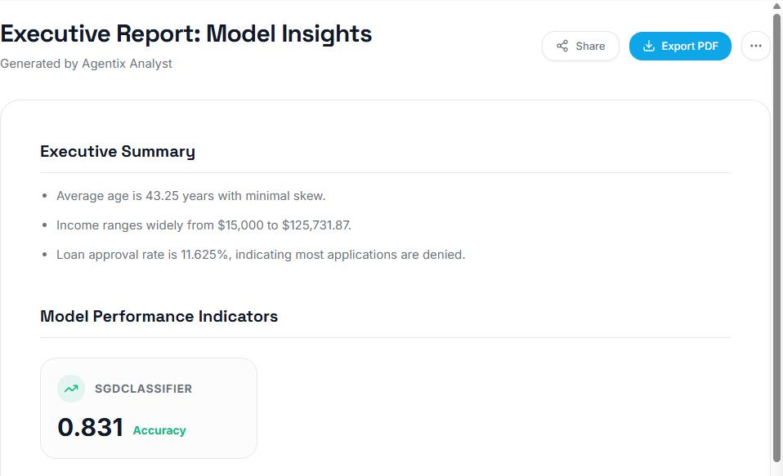
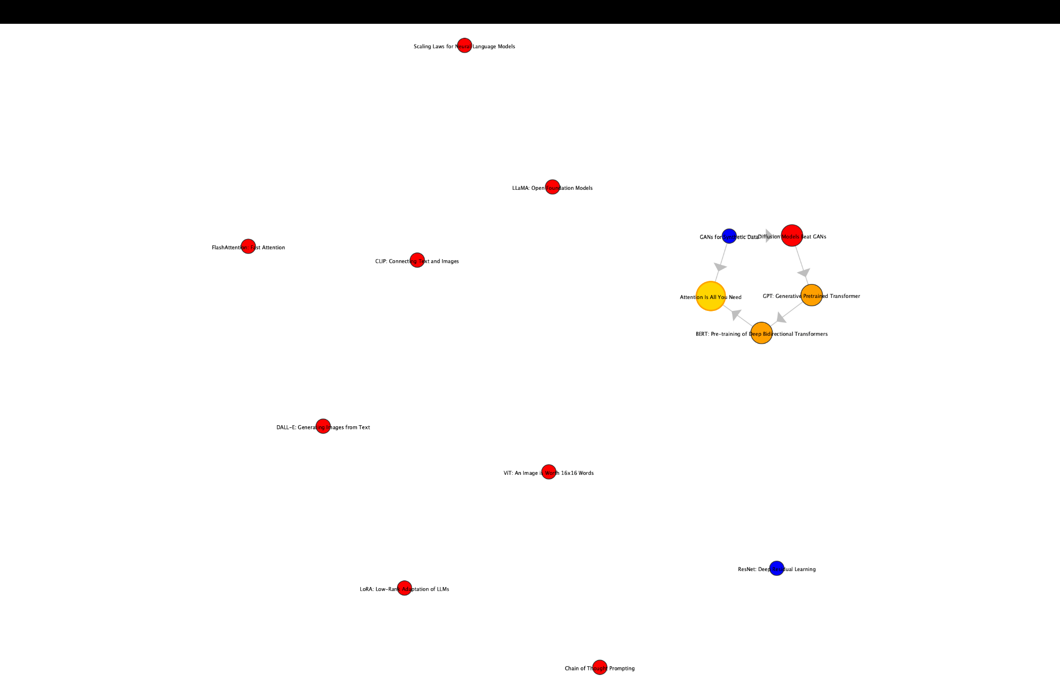

Slide 7
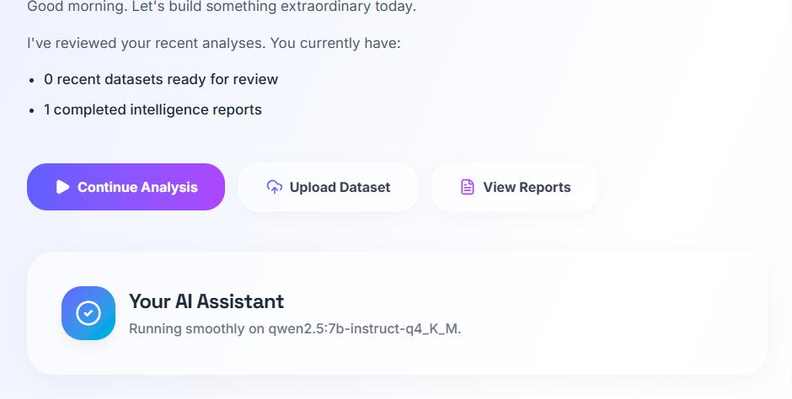
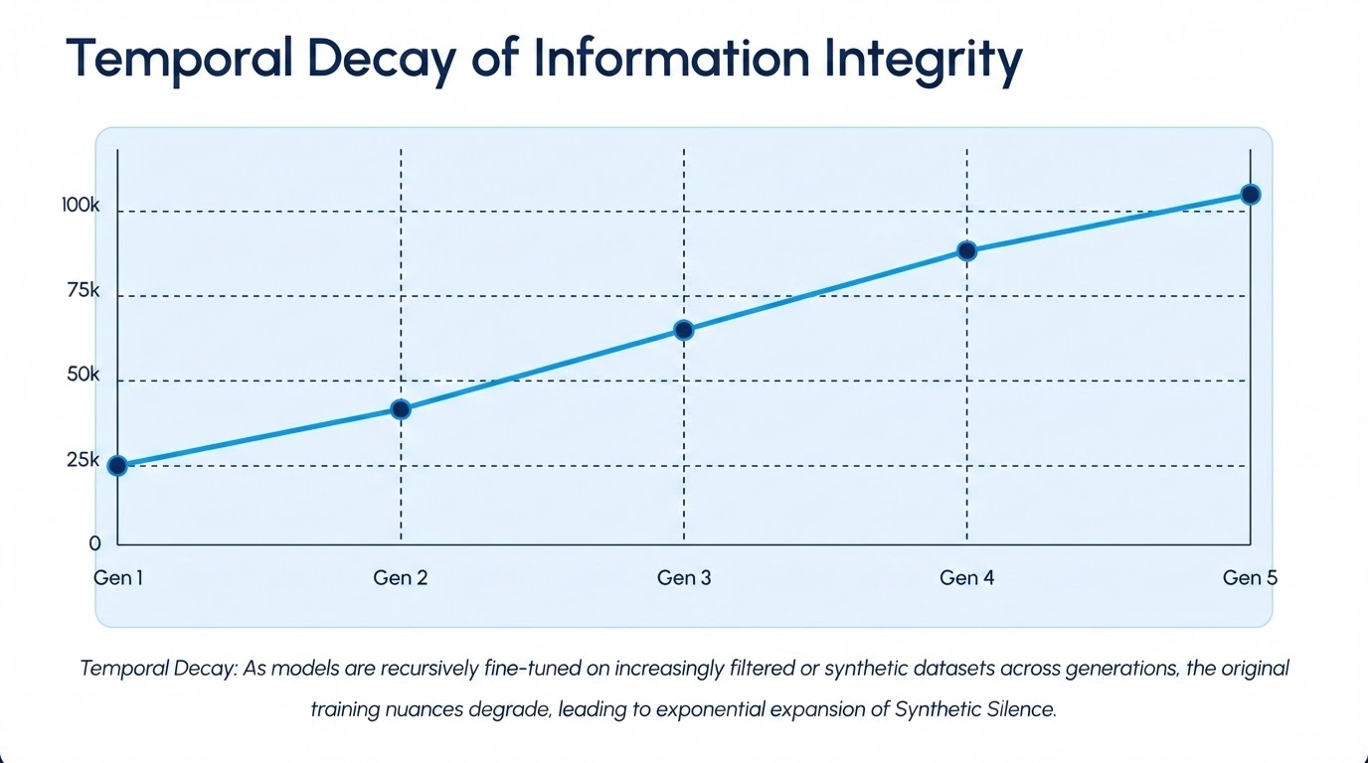

Slide 8
CURRENT STATUS & FUTURE ROADMAP
PHASE 1
NOW (STABILIZATION)
NEXT
FINAL STAGE
Backend deadlock fixed; dataset upload golden path restored end-to-end.
Dashboard fabrications removed; classification bug fixed; test suite & build restored.
Multi-model AutoML search, class-imbalance handling, temporal feature engineering.
Durable task queue, cloud deployment, and production observability.

Slide 9
Summary and Future Aspects:-
Manual Data Work → Slow Decisions: without automation, cleaning and modelling consume most of a data project's time before insight appears.
Fragmented Tooling → Lost Context: spreadsheets, notebooks, and BI tools each capture one slice of the workflow, with no shared record between them.
Orchestrated Agents → Auditable Pipelines: Agentix tracks every stage's real status and output in a database, surviving refreshes and restarts.
Honest-by-Design → Trustworthy Automation: empty and error states say plainly what hasn't happened yet, instead of fabricating a metric.
Future Direction: multi-model comparison, drift monitoring, and stronger explainability are the next steps toward production readiness.

Slide 10
Reference :-
Auto-WEKA: Combined Selection and Hyperparameter Optimization of Classification Algorithms — Thornton, C. et al. (2013)
Efficient and Robust Automated Machine Learning — Feurer, M. et al. (2015)
Why Should I Trust You? Explaining the Predictions of Any Classifier — Ribeiro, M. et al. (2016)
A Unified Approach to Interpreting Model Predictions — Lundberg, S. & Lee, S. (2017)
Statistical Analysis with Missing Data — Little, R. & Rubin, D. (2002)

Slide 11
Thank you for your attention.

