Slide 1

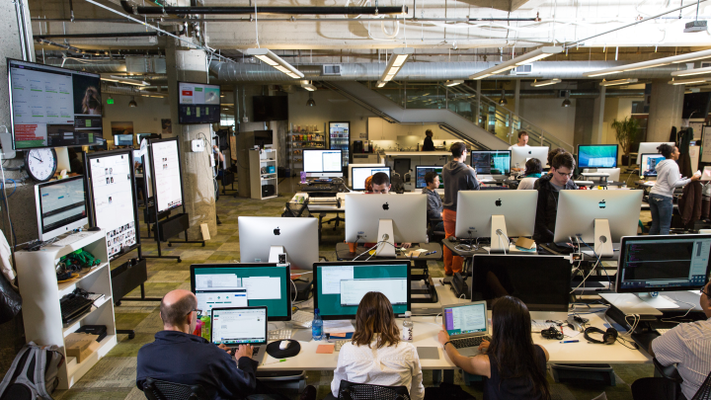
GemFire Capacity Planning in Brief

Slide 2
Capacity Planning - Estimating Object Size
Object size is hard to estimate from a list of columns.
Size of a relational DB storage is even less accurate
If you actually have the java objects, determine the size empirically as follows
for a PARTITION region, start a 2 node cluster with nothing else in it
load 100,000 objects. Assuming 2 copies of each object, each node will contain 100,000 objects, half primaries and half backups.
run jmap -histo:live PID - where PID is the process id of a data node. At the bottom will be total live memory used. This includes all overhead. Divide by 100,00 to get the per object usage.

Slide 3
Capacity Planning - Example
Account for number of copies
Only OldGen is available to store objects
OldGen should stay below the eviction threshold
Young Gen is working room
Based on CPU intensity (H/M/L) use 4G/8G/16G per core.
Not less than 4 cores for a production JVM

Slide 4
Capacity Planning - Multiple Regions
Suppose you have:
60 G of Customer Info in a PARTITION region with 2 copies
3G of Product Info in a REPLICATE region
12G available for objects in each JVM (Old Gen, below eviction threshold)
How many JVMs do you need ?
12G * N = 60G * 2 + 3G * N
N = 120 / 9 = 13 1/3 (round up to 14)
You need at least 14 JVMs

Slide 5
Capacity Planning Exercise
# In this exercise you will figure out how many JVMs you would need
# to hold 100 million Person objects.
#
# Assume the following:
# Each JVM is 4 cores 32G RAM of which 2G is Young Gen
# The eviction threshold is 80%
#
# Stop all but 1 Node of your cluster then clear out all existing data
# by destroying and recreating the Person region.
#
# Load 100,000 Person objects with people-loader
# use jmap -histo:live <PID> to figure out how much space is
# used. From this you can get a per object number.
#
# How many 32G JVMs do you need ?

