Slide 1


GemFire Operations Training

Slide 2
GemFire Troubleshooting
Staying Out of Trouble
Always monitor capacity - many problems are inadequate capacity
Never run out of disk space
Automate as much as possible - many problems are operational mistakes
Never kill things, really never kill -9 things, try gfsh stop commands
Put controls in place to make sure only 1 person is performing admin. tasks at a time
Always have statistics turned on, know where your logs are, log-level=config
Once you Are in Trouble
Always go to the logs first.
Garbage collection is always a suspect
See here: http://gemfire.docs.pivotal.io/docs-gemfire/latest/managing/troubleshooting/diagnosing_system_probs.html
Call Pivotal Support (even for issues in DEV)

Slide 3
GemFire Startup Sequence
Join distributed system
shows up as “member” on Pulse, list members
Region Definition Compatibility Checks
at this point is an empty data node
Data Recovery (may involve indefinite waits if disk stores are present)
from disk
from peers (GII)
Start Cache Server (listen for client connections)

Slide 4
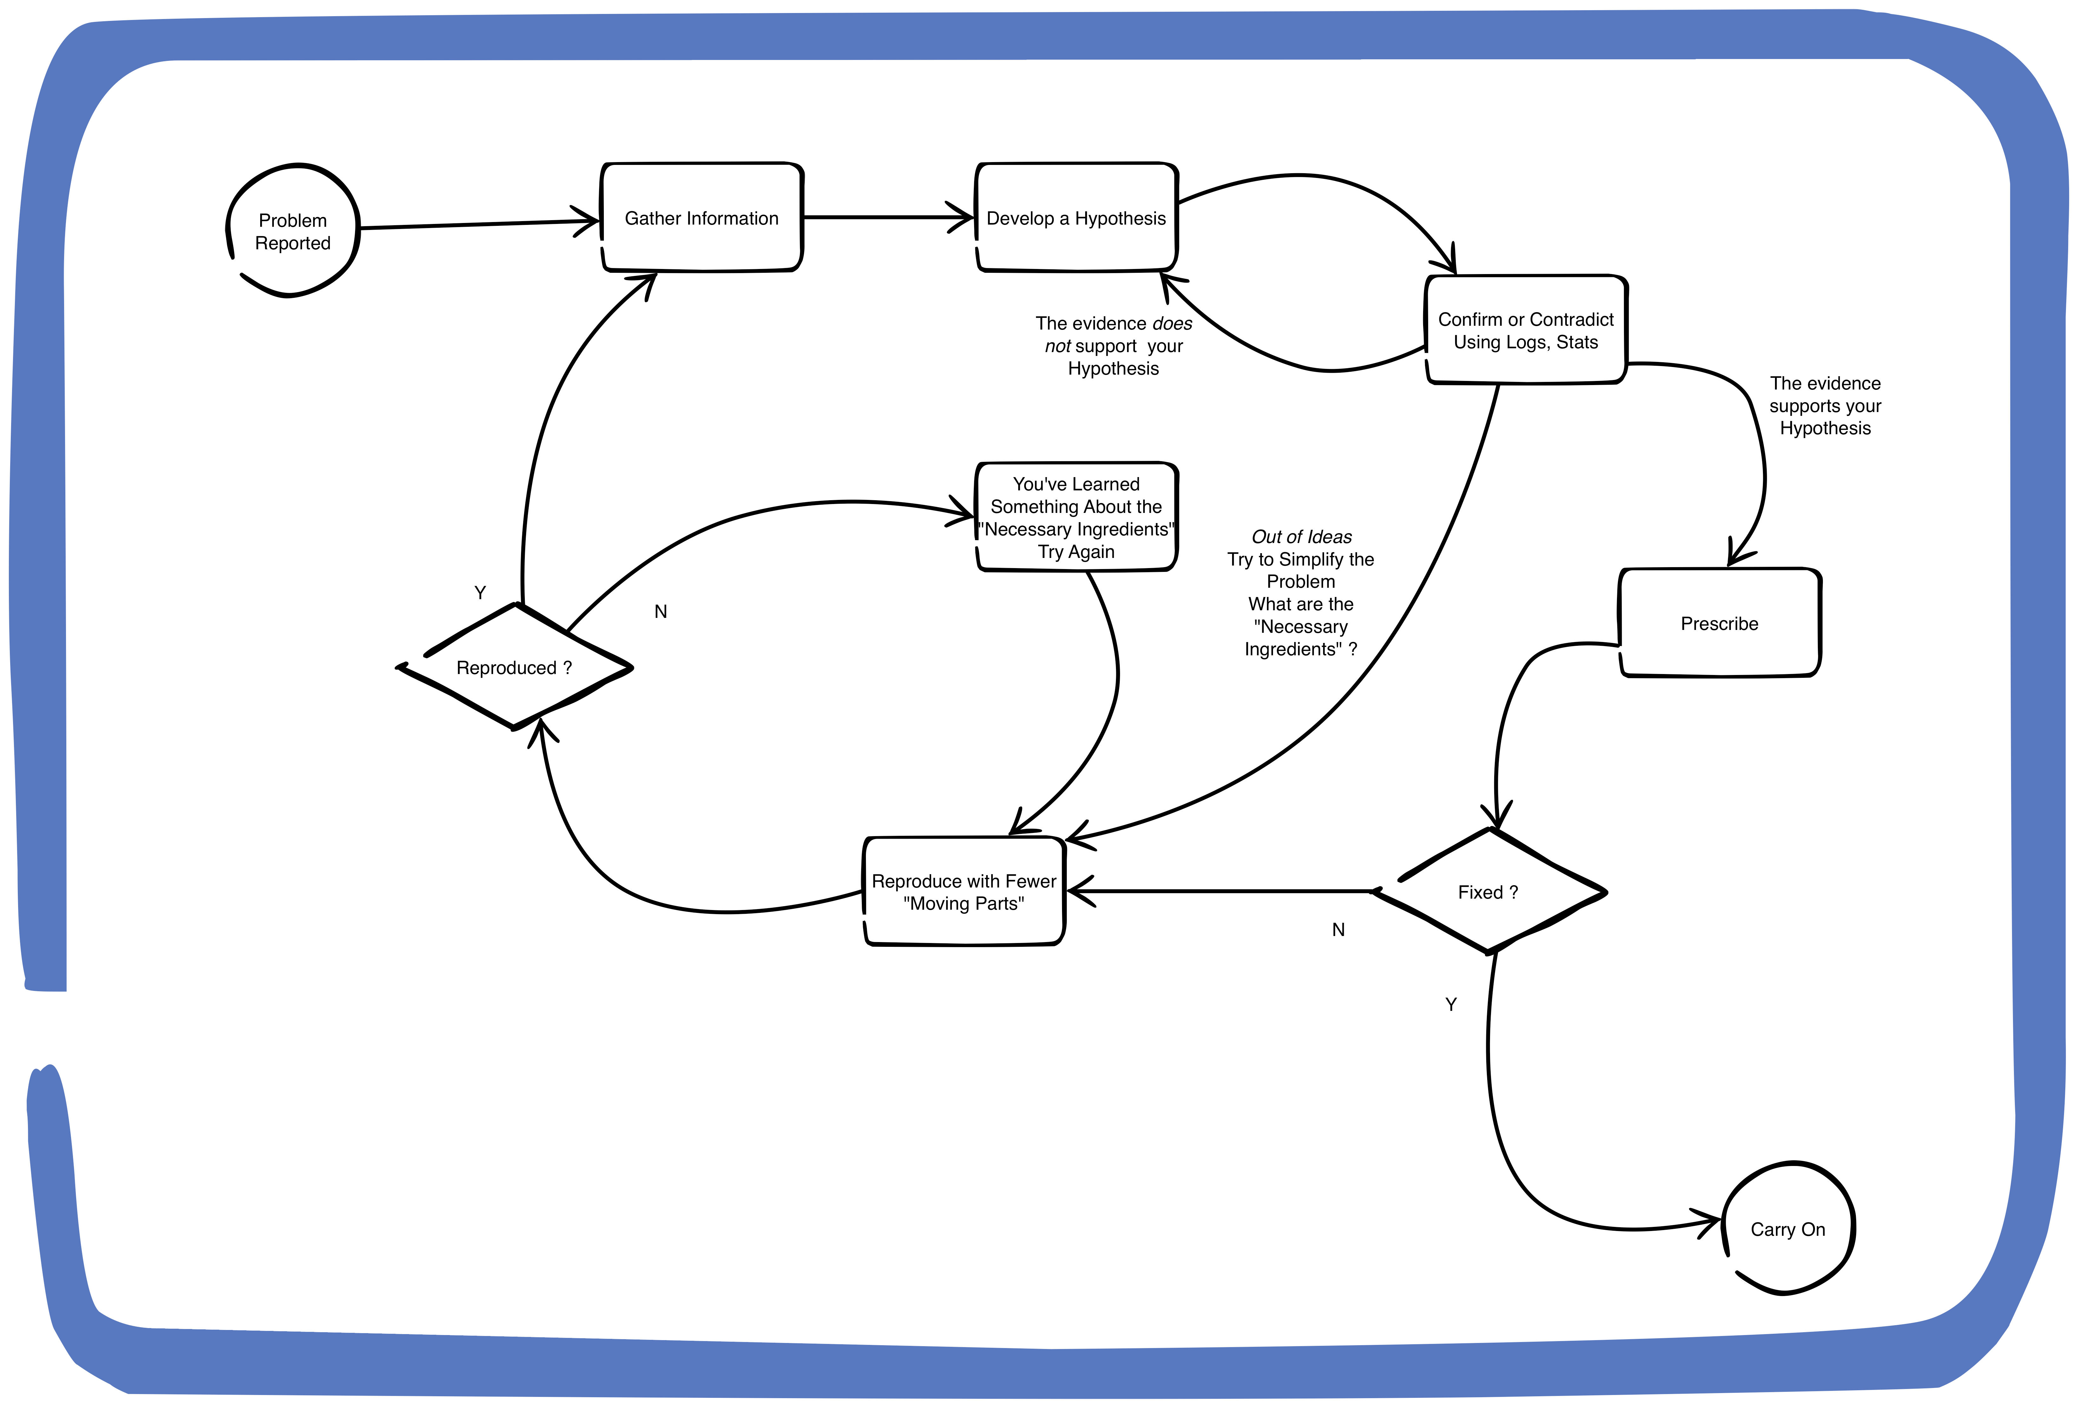
Troubleshooting - A Methodology
Key Principles
- You are Often Dealing with Some Bad Information
Insist on Specifics - When ? How Slow ?
Follow the Evidence
Often Multiple Things Have Gone Wrong
Think in Term of “Necessary Ingredients”
Simplify the Problem
You Can’t Fix What You Can’t Reproduce

