Slide 1


the patterns
cloud native design, domain driven design & microservices
Notes:
Resting slide on screen before you begin presenting.

Slide 2
Agenda
The Monolith
Domain Driven Design
Cloud Native

Slide 3
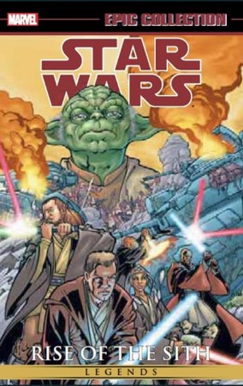
The Monolith
Forces
Solution
Resulting Context
Notes:
Forces
Team of developers working on a project
New team members must be productive
Application must be easy to understand and modify
Scale up - scalability, availability and resiliency
Solution
Multi-module packaged in single WAR or even EAR
Single directory hierarchy
N-Tier Architecture
Layered Architecture
Resulting context
Complexity becomes the enemy
Overloaded web container
Continuous delivery becomes burdensome
Scale out
Technical debt
Domain specificity

Slide 4
“Anyone who has never made a mistake has never tried anything new.”
- Albert Einstein
Notes:
The object here is if you fail then fail fast
What is the methodology for designing a microservice?
How to break up a monolith?
What are the design patterns?

Slide 5
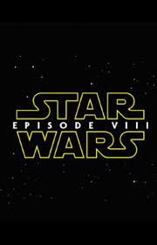
Domain Driven Design
Cloud Native Design
Notes:
Rise of the Jedi is the focus here, design patterns and architecture to move us away from the dark side

Slide 6
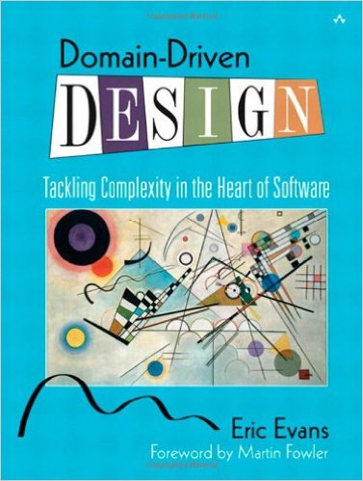
Domain Driven Design
An approach for designing software system that model the complexity of the real world
Kicked off in 2004 by Eric Evans
A practical microservice design methodology

Slide 7
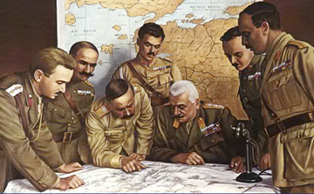
Strategic Domain Driven Design
Domain
Sub-Domain
Bounded Context
Ubiquitous Language
Context Map
Notes:
Picture from http://www.quikmaneuvers.com/principles_of_strategy.html need to check on license rights

Slide 8
Domain
Domain is always organization specific
Captures unique know how and way that an organization does business
Composed of sub-domains & bounded contexts

Slide 9
Sub-Domains
Core
Subdomain
Supporting
Subdomain
Generic
Subdomain
Build It Perfectly
Build It
Just enough
Buy It

Slide 10
Bounded Contexts
Banking Context
Security
Context
Account
Account
Account

Slide 11
Ubiquitous Language
Technical Jargon
Business Jargon
Notes:
A major reason for failure of software projects is a failure of people, the failure to communicate
UL is a shared language between business and development teams; comes from business and enriched by development teams

Slide 12
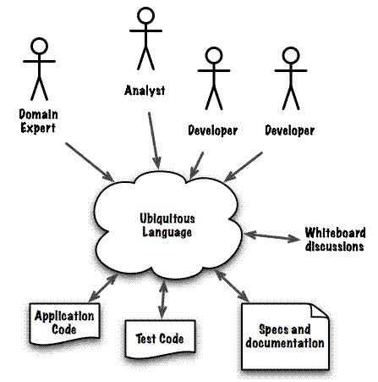
http://www.infoq.com/articles/ddd-contextmapping
Notes:
Domain experts are primary point of contact dev teams have with business (like product owner)
Experts on their part of the business, not just users of system
Deep knowledge of subject domain

Slide 13
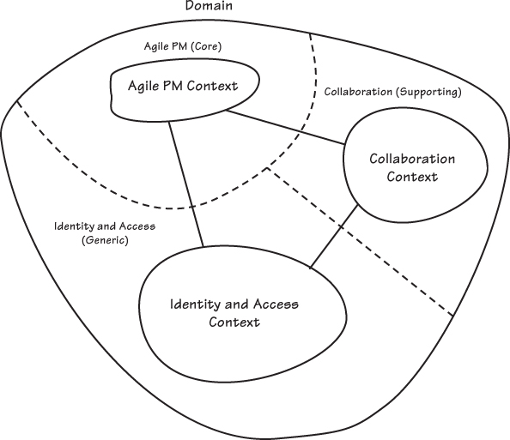
Solution
Figure 2.7 from Implementing Domain Driven Design

Slide 14
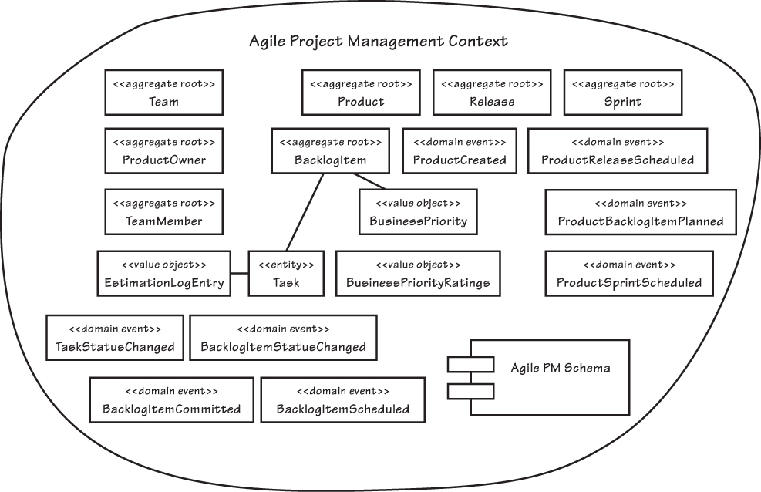
Example Bounded Context
Entities
Domain Event
Value Objects
Aggregates
Notes:
Figure 2.10 from Implementing Domain Driven Design
Entities are things within your model; uniquely identifiable
Value objects are things within model that have no uniqueness; equal to another when all properties match; interchangeable
A domain model is representation of the relationships b/w entities and value objects in your domain; should be recognizable by the business
A domain event captures what has happened with an entity; event names usually contain past tense verbs; used to trigger state change and used for auditing purposes
An aggregate is a collection of items gathered together to form a total quantity
An aggregate root is the root item containing a number of parts that form the whole (e.g., Order -> Order line items)

Slide 15
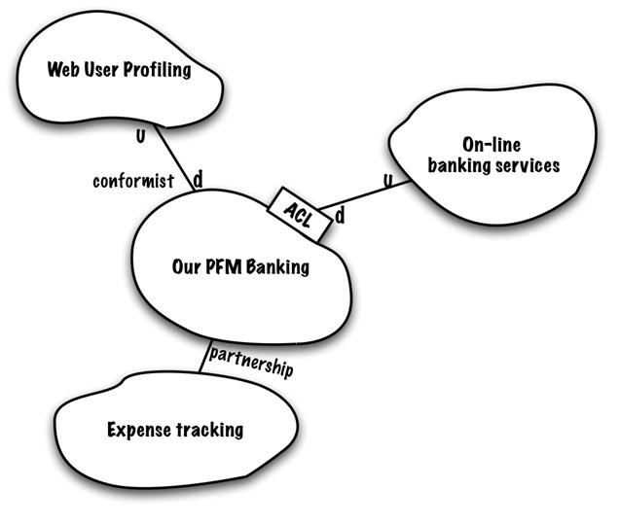
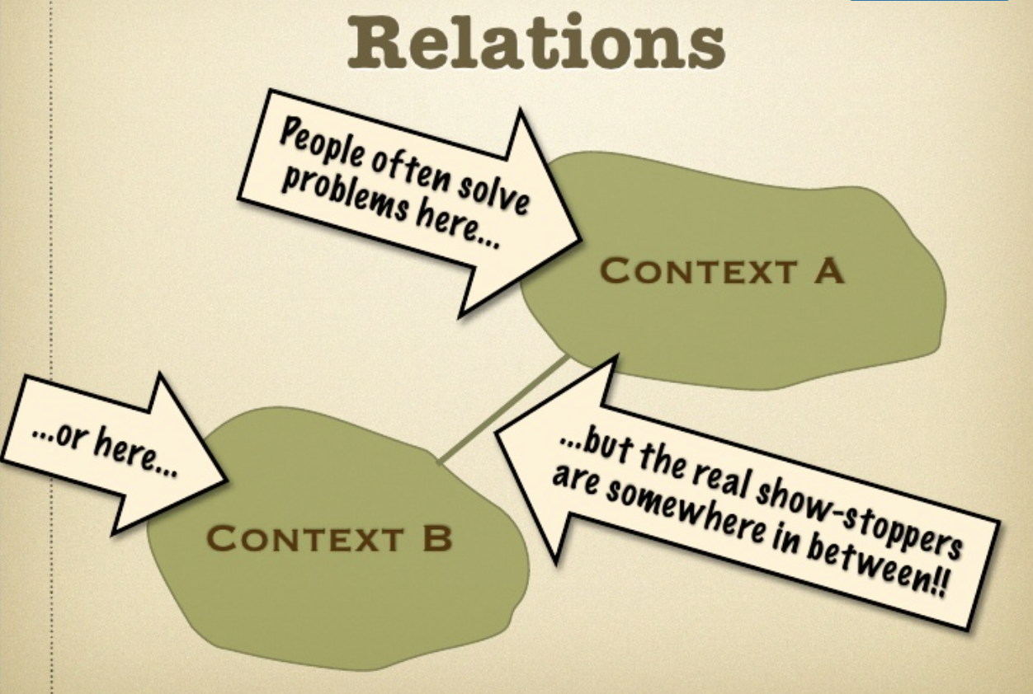
Context Maps
A map of the existing organization & integration relationship between different bounded contexts
Notes:
Have a read thru https://www.infoq.com/articles/ddd-contextmapping and https://www.slideshare.net/ziobrando/context-mapping-in-action
Relations between different contexts tend to fall into repeatable patterns
A pattern dictionary helps describe the current situation
Any pattern has a different benefits/costs ratio
Upstream v downstream
Not about direction of data
Upstream influences downstream
Technical constraints in addition to schedule, responsiveness
Map to your current situation not your desired future state
If it’s a mess it’ll bring focus to problems and risks involved
Partnership -- when 2 teams succeed or fail together; coordinated planning of development and joint management of integration; intedependent features scheduled so that they are completed for same release
Shared kernel – intimate interdependency; keep it small; undermines design work
Customer-supplier – 2 teams in an upstream/downstream relationship; upstream may proceed interdependently of downstream team; downstream priorities factor into upstream planning
Conformist – 2 teams teams in an upstream/downstream relationship; upstream has no motivation to provide for downstream teams need’s; downstream team doesn’t put effort into translation
Anti-corruption layer – isolating layer to limit impact of changes in an upstream system; requires little or no modification to upstream system; bi-directional translation between 2 models
Open host service – opening your system for integration; protocol gives access to your system as a set of services; new services may be added on request but need to serve a general purpose
Published language – when you want to have a common language for translation b/w 2 bounded contexts; often combined with open host service
Big ball of mud – see monolith; often with intermixed models

Slide 16
Domain Driven Design
Cloud Native Design
Notes:
Rise of the Jedi is the focus here, design patterns and architecture to move us away from the dark side

Slide 17
Cloud Native Design
Evaluate components for 12-factor compliance
Evaluate components and architecture for Cloud Native Design

Slide 18
Evaluate for 12-Factor Compliance
no file based access to resources
run code on demand
coordinate cross service configurations
route public requests
read and write persistent data
add and remove resources
record internal and external events
isolate resources and failures
measure performance and health
detect, determine and recover from failure
Notes:
The 12 factors
I. Codebase
One codebase tracked in revision control, many deploys
II. Dependencies
Explicitly declare and isolate dependencies
III. Config
Store config in the environment
IV. Backing services
Treat backing services as attached resources
V. Build, release, run
Strictly separate build and run stages
VI. Processes
Execute the app as one or more stateless processes
VII. Port binding
Export services via port binding
VIII. Concurrency
Scale out via the process model
IX. Disposability
Maximize robustness with fast startup and graceful shutdown
X. Dev/prod parity
Keep development, staging, and production as similar as possible
XI. Logs
Treat logs as event streams
XII. Admin processes
Run admin/management tasks as one-off processes

Slide 19
Evaluate for the Cloud
Cloud Native
Micro-service architecture and principles
API first design
Cloud Resilient
Design for failure
Apps are unaffected by dependent service failure
Cloud Friendly
Twelve factor applications
Horizontally scalable
Cloud Ready
Proactive testing for failure
Cloud agnostic runtime implementation
Metrics and monitoring baked in
Leverage platform for HA
No file-system requirements or uses S3 API
Self-contained application
Platform managed ports and addressing
Consume off platform services using platform semantics

Slide 20
How to start?
Defining your domain, entities that comprise the domain and the necessary domain logic.
Service layer and only add services where the logic doesn't belong in any domain entity or value object.
Use Ubiquitous Language, Design by Contract (DbC), Automated Tests, Continuous Integration / Continuous Delivery and Refactoring
Notes:
Domain driven design effort begins where domain modeling ends. Ramnivas Laddad recommends the following steps on how to go about implementing a domain object model. He emphasizes on putting more focus on domain objects than services in the domain model.
Start with domain entities and domain logic.
Start without a service layer initially and only add services where the logic doesn't belong in any domain entity or value object.
Use Ubiquitous Language, Design by Contract (DbC), Automated Tests, CI and Refactoring to make the implementation as closely aligned as possible with the domain model.

Slide 21
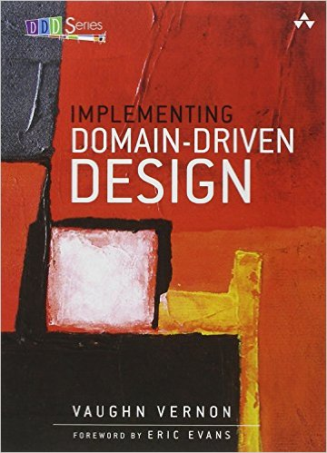
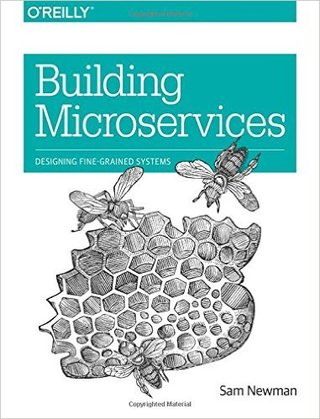
Recommended Reading

Slide 22
Additional Resources
DDD: Strategic Design explained with Spring Boot
DDD and Spring
Bridging the Worlds of DDD and REST
The Twelve-Factor App

