Slide 2
Gemfire R
Fast In-memory Analytics in Gemfire
Tim Dalsing

Slide 3
Gemfire R
In-memory Machine Learning
Inspired by R (https://www.r-project.org/)
Analytics run directly on in-memory data
Command-line client that mimics R

Slide 4
R
Tool for data science and machine learning
Widely used and supported
Open source

Slide 5
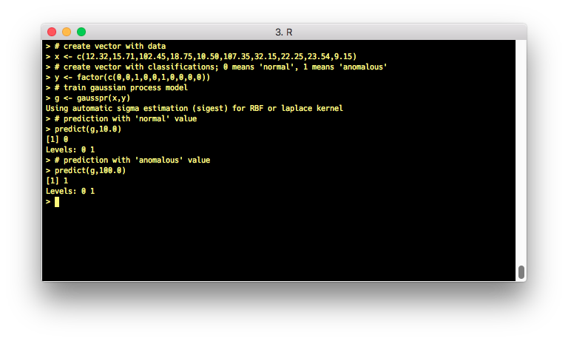
R Example

Slide 6
Gemfire R Example
Define query:
q1=query("select x:temp, y:prcp from /testData where temp < $1")
Generate matrix using query:
x1=matrix(q1,[x],[100])
Generate vector using query:
y1=vect(q1,y,[100])
Define kernel for model:
k1=gausskernel(1.0)
Define Gaussian Process model using kernel:
md1=gp(k1,1.0)
Train model using matrix and vector:
m1=train(md1,x1,y1)
Ad-hoc prediction using model:
predict(m1,100)

Slide 7
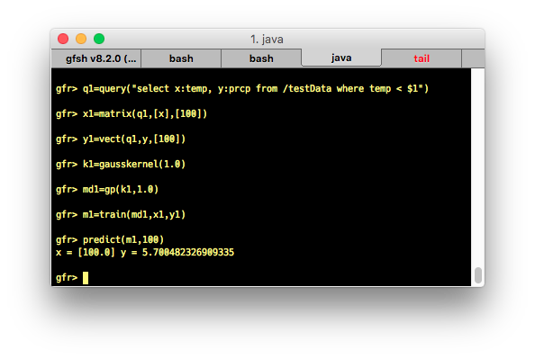
Gemfire R Example

Slide 8
Gemfire R Example
List variables:
ls
Print variable:
print q1
Ad-hoc execute query:
execute(q1,[100])
Define literal vector:
v=c(1,2,3,4,5,6)
Define literal matrix:
m=m(c(1.0,2.0,3.0,4.0,5.0,6.0),2,3)
Transpose matrix:
mt=t(m)

Slide 9
Dynamic Prediction and Training
Prediction occurs when new or updated data is added to Region
Model is retrained when new or updated data is added to Region
Uses AsyncEventListener

Slide 10
Other Features
Fast Fourier Transform
PMML
Regression models:
Gaussian Process
Random Forest
Gradient Tree Boost
Many others
Classification models:
SVM
Random Forest
Naïve Bayes
K-nearest Neighbor
Many others

Slide 11
Architecture
Gemfire Client/Server
Server:
All model training and predictions
Matrix and Vector data stored in partitioned regions
Trained models stored in local regions (not serializable)
Uses SMILE (https://github.com/haifengl/smile) library for classification and regression
Uses jpmml (https://github.com/jpmml) for PMML
Apache Commons Math (http://commons.apache.org/proper/commons-math/) for FFT and Stats

Slide 12
Architecture
Client:
Simple command line client using System.in
ANTLR for parsing statements
Either:
Direct puts on Region
Function calls

