Slide 1

ERPIFY
A python based fastapi erp software

Slide 2
INTRODUCTION
A FastAPI based ERP system with vanilla JS frontend and MySQL as database for scalability
JWT tokens for fast and reliable authentication
Using HS256 algorithm for encryption for the application during login whether for ‘Admin’, ‘Customer’ or ‘Staff’

Slide 3
ABSTRACT
An ERP Solution based on Python FastAPI in backend and vanilla JS in frontend to make it simple
01
All the API calls are defined in FastAPI and called in JS using pre-defined fetch functions
02
The focus is on making the CRUD operations smooth with UI/UX as well
03

Slide 4
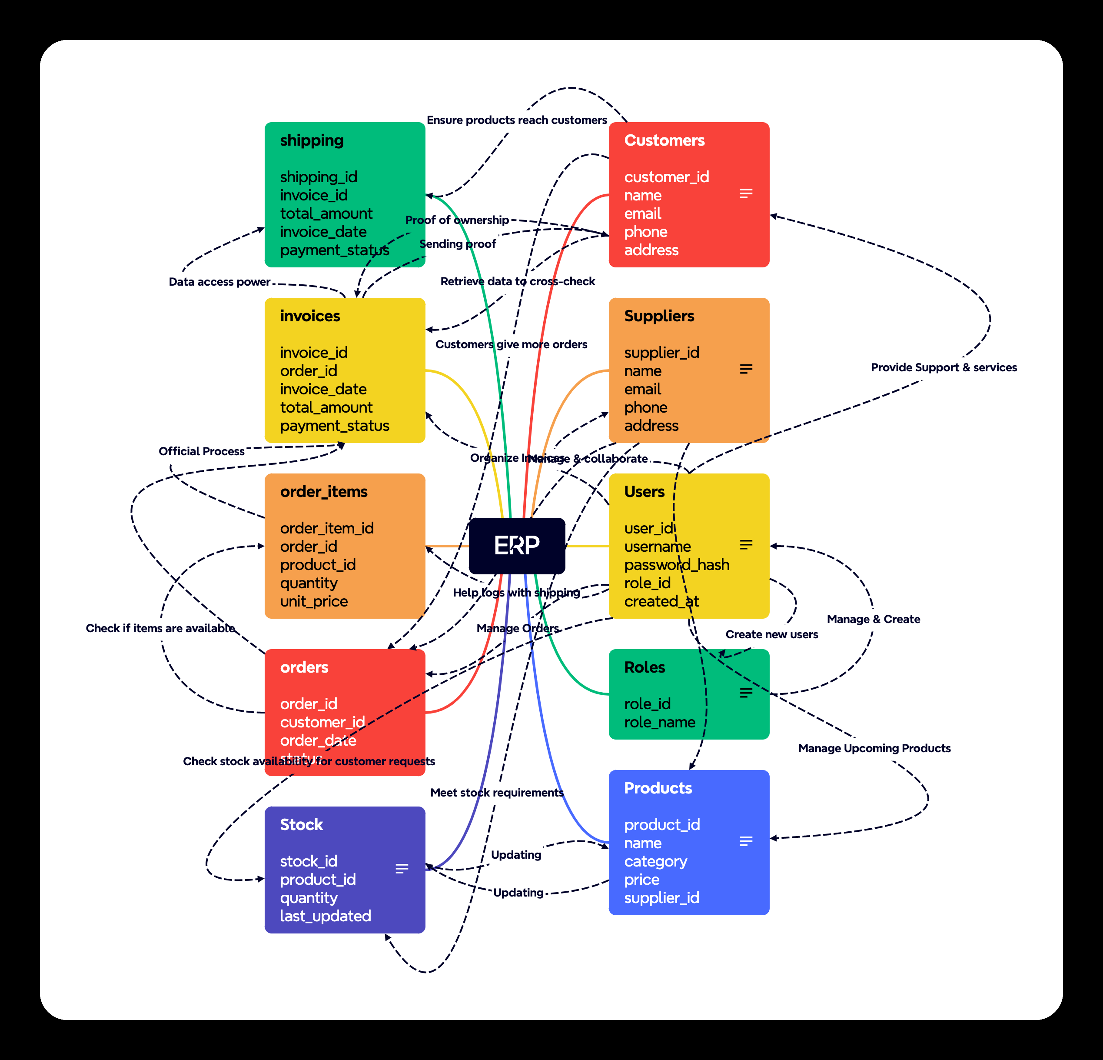
System Architecture

