Slide 1
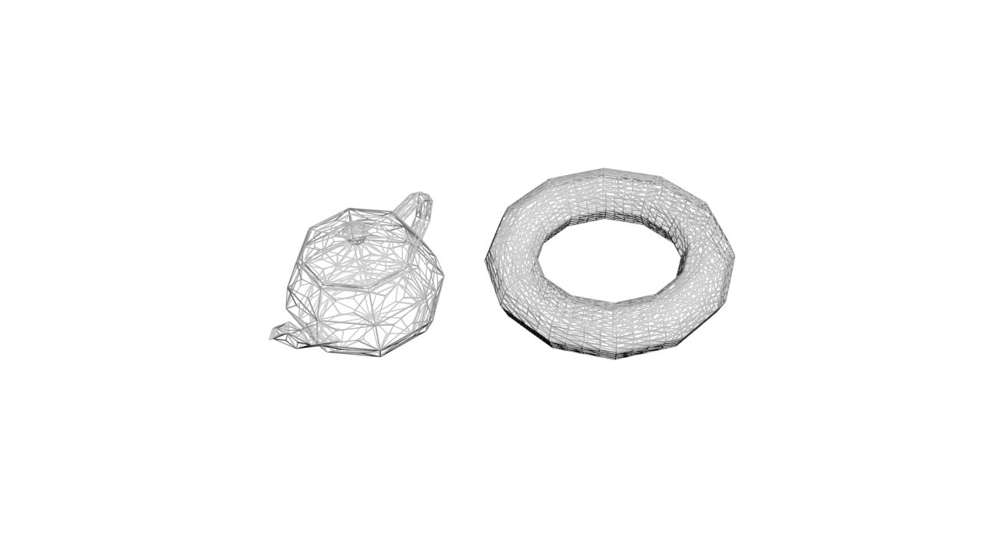

HgiShaderStageMiss
HgiShaderStageAnyHit
HgiShaderStageClosestHit
HgiShaderStageRayGen

Slide 2
Top Level Acceleration Structure (TLAS)
HgiAccelerationStructureInstanceGeometry
Bottom Level Acceleration Structure (BLAS)
HgiAccelerationStructureTriangleGeometry

