Slide 1
Diabetes Prediction Using Machine Learning in Python
Somesh P. Panchal
Computer Dept.
Sardar Vallabhbhai Patel Institute of technology
Vasad ,Gujarat

Slide 2
Details about the dataset:
Pregnancies describes the number of times the person has been pregnant.
Glucose describes the blood glucose level on testing.
Blood pressure describes the diastolic blood pressure.
Skin Thickness describes the skin fold thickness of the triceps.
Insulin describes the amount of insulin in a 2hour serum test.
BMI describes he body mass index.
Diabetes Pedigree Function describes the family history of the person.
Age describes the age of the person
Outcome describes if the person is predicted to have diabetes or not.
It should also be noted that the dataset has no missing values and thus, filling up the dataset using algorithms will not be necessary.

Slide 3
Problem Statement
This is a classification problem of supervised machine learning. The objective is to predict whether or not a patient has diabetes, based on certain diagnostic measurements included in the dataset.
0 – Absence of Diabetes
1 – Presence of Diabetes

Slide 4
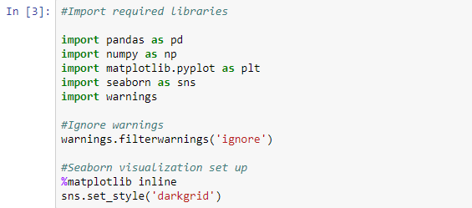
Importing Libraries
So let us begin by importing the required libraries. We will import data analysis libraries (pandas, numpy) and visualization libraries (matplotlib, seaborn). In addition to that, we will also import warnings so that warnings are hidden from the notebook in case there is.

Slide 5
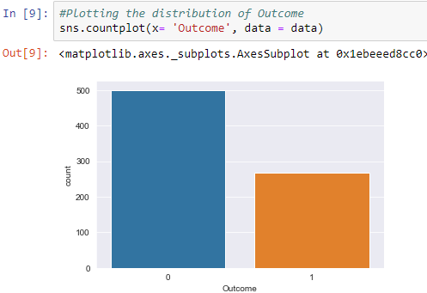
Checking the distribution of the target variable (Outcome).
From the plot , the data contains more cases without diabetes (0) than those with diabetes (1).

Slide 6
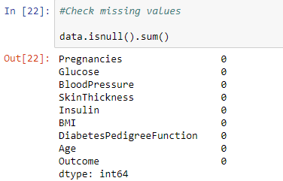
Checking for any missing values in the dataset.
There are no missing values in the dataset. The dataset had already been cleaned.

Slide 7


Training the Data
Splitting the data before train it.
X will contain all the Independent variables while y will have the Dependent variable (Outcome).

Slide 8
Building the Model
I will use four models i.e. Random Forests, Decision Trees, XGBoost and Support Vector Machine to get the best accuracy score.
‘Accuracy’ metric is used to evaluate models. It is the ratio of the number of correctly predicted instances in a dataset divided by the total number of instances in the dataset.

Slide 9
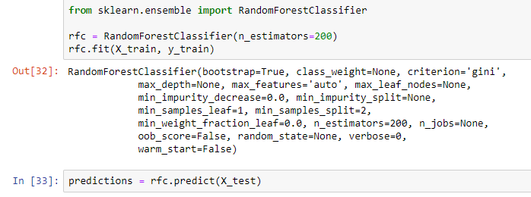
1. Random Forests

Slide 10
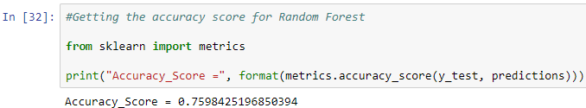
Here is the accuracy score;

Slide 11
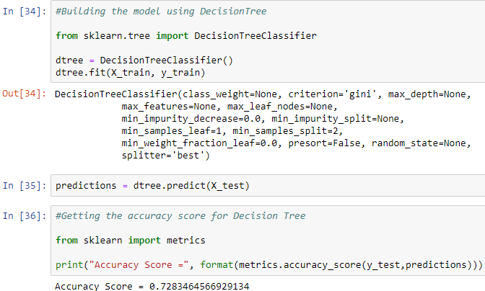
2. Decision Trees

Slide 12
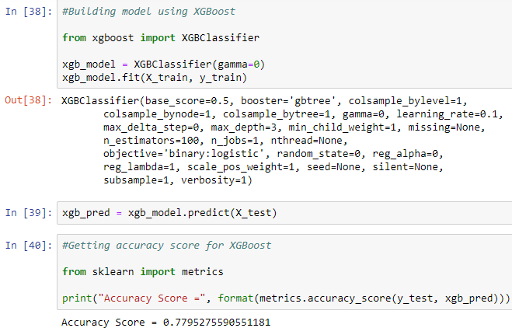
3. XGBoost

Slide 13
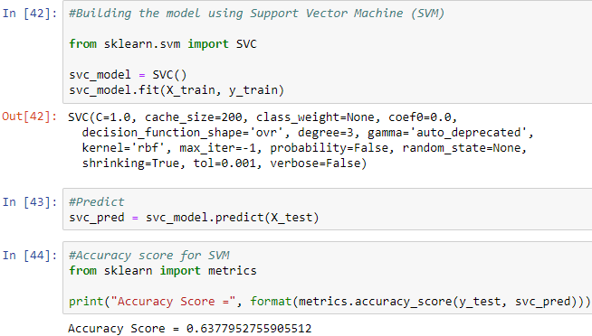
4. Support Vector Machine (SVM)

Slide 14
Model Selection
Basing our selection criteria on the accuracy score, the best model for this project is XGBoost which gives an Accuracy Score of 0.779 (78%).
There are different ways of determining the best model that you can explore and use for your models. Basic information of machine learning, I decided to use the accuracy score as the main metric in choosing the best model.
SVM gives 0.63 (63%) , Decision tress gives 0.72 (72%) and Random Forest gives 0.75 (75%) Accuracy Score.

Slide 15
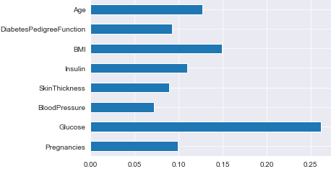
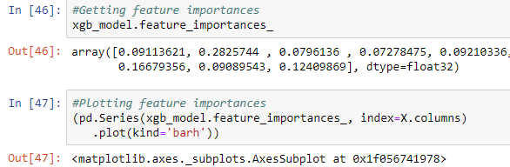
Feature Importance

Slide 16
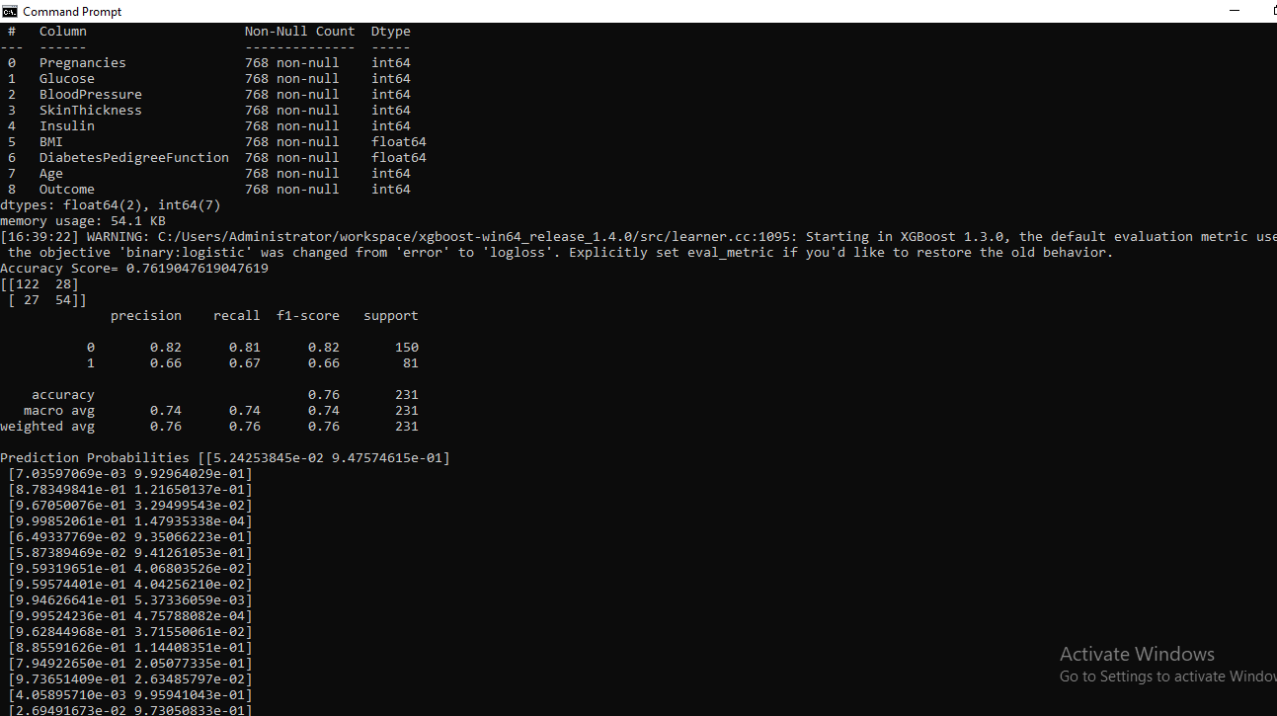
Predictions

Slide 17
Predictions
Lets use XGBoost Model to predict the possibility of a patient having Diabetes or not (1 or 0). The following are the prediction probabilities of absence or presence of Diabetes respectively.
We can see that the patient at index 0 has a 98.1% chance of absence of diabetes, while the patient at index 1 has a 91.8% predicted chance of having diabetes.

Slide 18
Conclusion
Machine learning has the great ability to revolutionize the diabetes risk prediction with the help of advanced computational methods and availability of large amount of epidemiological and genetic diabetes risk dataset.
Detection of diabetes in its early stages is the key for treatment. This work has described a machine learning approach to predicting diabetes.

