Slide 1

Minor Project –IA1 Bachelor of Science (Honors ) V Semester – 2022
School of Computer Science and Applications

Slide 2
A PROJECT REPORT ON Deployment of web app using Kubernetes
Submitted IA-1 Project report completion of B.Sc. (H) Cloud Computing and Big Data Analysis
Presented by:
Mr. Atharv Shukla & Mr. Tushar Kasaudhan
SRN: R20BS009 & R20BS045
Internal Guide : Prof. Abdul Kader Jailani
External Guide : Mr. Priyadarshi

Slide 3
Agenda
Introduction
Abstract
Literature Survey
Software hardware Requirement
Existing System and Proposed System
Module Description
7. Table Design
8. Result

Slide 4
# model description (core)
We have created a web app using flask framework and further we will deploy it in Kubernetes.
The web application will collect user information and files, where files will get collected in S3 and structured data in RDS.

Slide 5
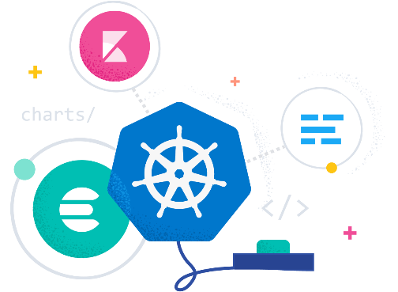
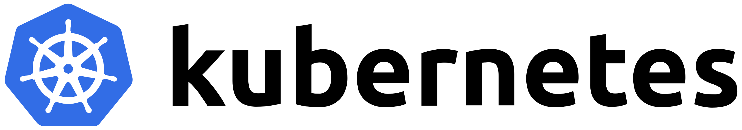
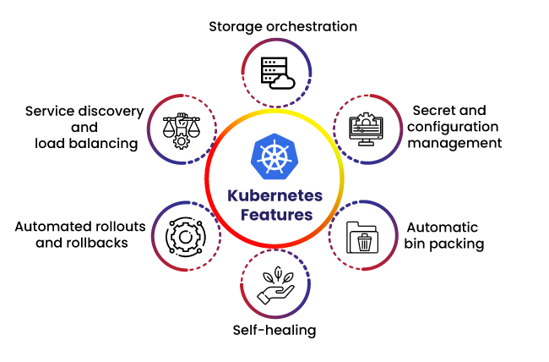
# Introduction
Kubernetes (K8s) is an open-source system for automating deployment, scaling, and management of containerized applications.
Containerized applications; they are applications that run in isolated runtime environments called containers.

Slide 6
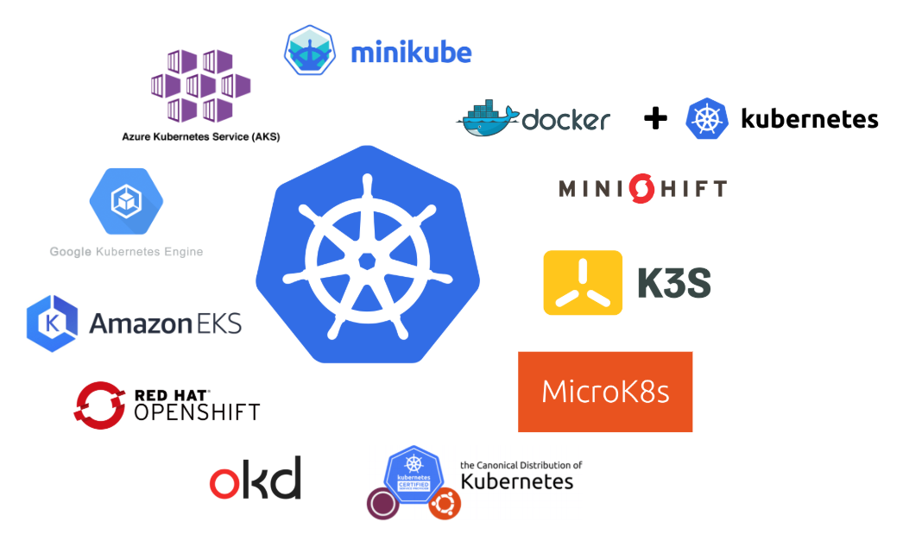
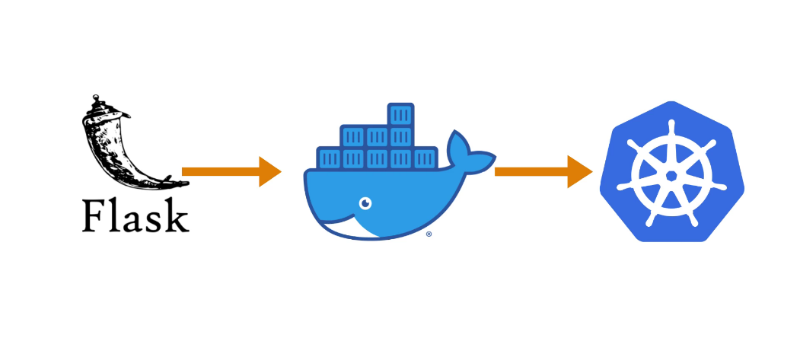
# literature survey
Recently, container-based virtualization is gaining popularity. It is a lightweight virtualization, which utilizes the capabilities of the Linux kernel.
One of the most used container-based virtualizations today is Kubernetes.
Users can easily scale down or up as needs require, can roll out updates seamlessly, and can test features and troubleshoot difficult deployments by switching traffic between multiple versions of the applications.
We can deploy several web application containers using Kubernetes to serve millions of users. It also reduces the possibility of a single point of failure in the architecture.
However, managing several containers for creating a single service is a challenging task. Kubernetes solves this problem by providing container cluster management called Kubernetes Cluster.

Slide 7

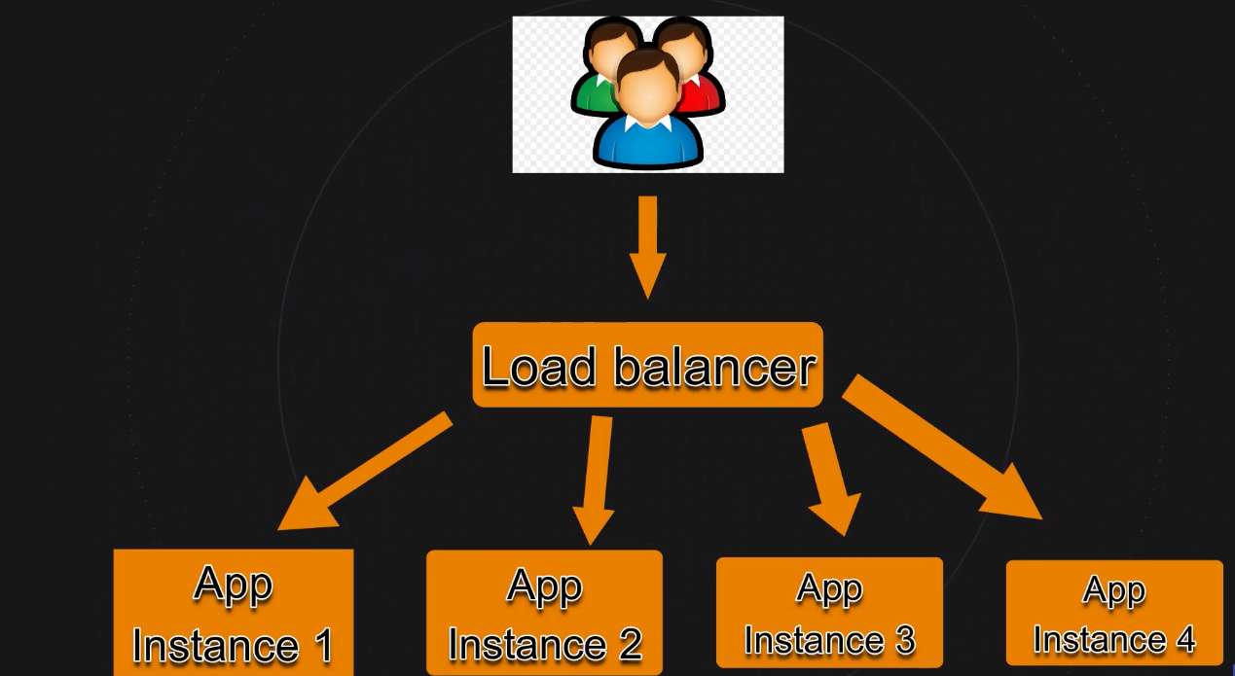
# Abstraction
We will be creating a simple flask app for this project & then we will see how we can first create a docker image of your application using Docker file and later deploy it on Kubernetes (available in docker desktop's built in Kubernetes environment) using AWS platform.
Here's how we will proceed:
We will create our application in VSCode.
Containerize our flask-app by creating an image using Docker file.
Finally deploying everything on Kubernetes.
Sounds Simple!!?

Slide 8
# objectives and prerequisites
Package
Package a data entry web application into a Docker image.
Upload
Upload the Docker image to Docker Hub.
Deploy
Deploy the web app to the cluster.
Manage
Manage autoscaling for the deployment.
Expose
Expose the web app to the internet.
Deploy
Deploy a new version of the web app.
Familiarity with Kubernetes concepts. If you're new to Kubernetes, start with the basics of Kubernetes.
Familiarity with Git and GitHub.
Familiarity with Docker and Docker images.
Ability to create a Docker container. If you're new to Docker, start with the intro to containers

Slide 9
# Tech stack requirement
Software and Tools Used:
Kubernetes (Latest Version)
Docker (Latest Version)
Flask
Minikube
Visual Studio Code
(You can also use Workstation 16 Pro if you want to save your ram using Windows 10 ISO)
Hardware Used:
Laptop (Min 8Gb Ram )
CPU Core count 2 to 8
Storage space Up to 50Gb to 100Gb
Cloud Platform for Future Enhancement:
Microsoft Azure Portal
Amazon Web Service
Google Cloud Platform
(can be used for deploying larger application)

Slide 10
# existing system and proposed system
<?>
{/}
[#]
(^)
Large build times: Extremely large code bases resulted in large build times, i.e, large downtime for deployment. But high availability has been a critical requirement, and downtime was unacceptable.
Slow Development: Another big problem with a large code-base, is its effect on development speed. Since the entire code-base is encompassed in a single instance, a broken code from one single developer in the team, could block the work of a hundred other developers from being deployed.
Poor resilience to failures: A monolithic web application handles application failures very poorly. In a monolithic application, all the business functionality is handled by a single instance. A fatal error in performing a single business function, could bring down the entire application.
Low resource utilization: When the workload to perform a particular business function suddenly increases, the entirety of a monolithic application must be scaled, to balance the workload.

Slide 11
# Future enhancements
Redundant usage of cloud resources.
Horizontal Scaling.
Automated rollouts and rollbacks.
Storage orchestration.
Implementing more shell scripting for better no human performance error.
Implementing load balancing to docker for better UP time for the server.
Historical data gathering scripts on scheduled basis.
Data storage in database that runs inside Kubernetes.

Slide 12
# bibliography
https://docs.microsoft.com/en-us/learn/modules/aks-deploy-container-app/
https://cloud.google.com/kubernetes-engine/docs/tutorials/hello-app
https://www.youtube.com/watch?v=EQNO_kM96Mo
https://www.youtube.com/watch?v=XQNNAeyMAkk

Slide 13
</Thank You >
# Hope you loved our presentation!
Have a great day ahead!

Slide 14







Icons
Architecture
Commerce
Legal Studies
Arts & Humanities
Performing Arts
Management Studies
Science & Tech
Engineering

