Slide 1


Top five reasons why Konstantin Ivanovich Tsiolkovskiy is the coolest scientist
By Misha and me

Slide 2

Number One
He had a very cool family tree

Slide 3

Number 2
He studied in Vyatskeya Classical Gymnasium for free, despite the effects of his illness, such as hearing loss and having trouble with keeping in touch with people, that has often let him down

Slide 4

Number III
He has written a lot of works
That includes:
148 published articles
600 unpublished, but preserved works

Slide 5
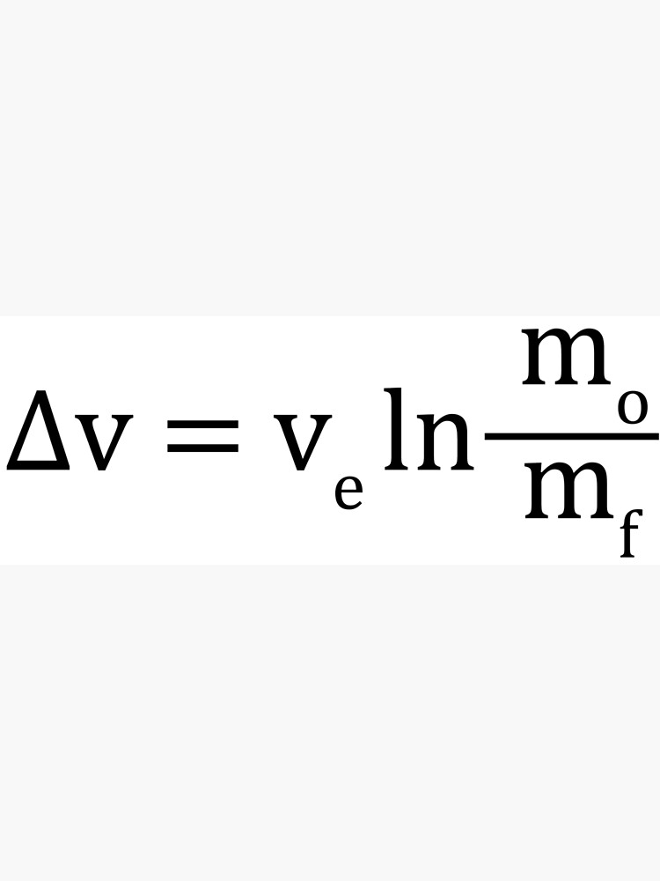
Number ^{L}|
His greatest achievement was the Tsialkovskiy Equation. But that invention got almost no public praise , so he is not that well-known

Slide 6
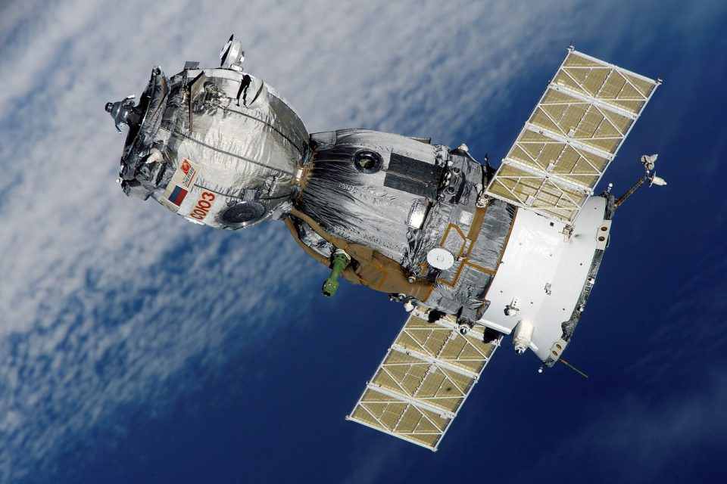
Number {int(“0b101”)}
His works had a major impact on the .
Currently, there are approximately
space exploration
600 astronauts in the world and 5000 satellites in space.

Slide 7


