Slide 1
PixelAlpha
Your AI-enhanced investing copilot
Yun Peng (UCB MFE 25’)
Quant Analyst (EDF Trading)
(ex) Lead Algorithm Engineer ($NUVA)
(ex) Harvard researcher
Haotian Wu (UCB MFE 25’)
Software Engineer (Google)
Jiaming Cheng
EE PhD Candidate
(Univ. British Columbia)

Slide 2

Challenges to beginner retail investors
Social
Medial
News
KOL
Information overload
vs.
decision making
Industry
Report
Economy
Health
Buy
?
Sell

Slide 3
Challenges to beginner retail traders
Inadequate Research Tools
Limited Market Experience
Complexity of Technical Analysis

Slide 4
Challenges to beginner retail traders

Slide 5
Why our solution solves the problem, why AI
Backed by performance (backtesting, out-of-sample testing)
Trend prediction accuracy >70%
Advanced AI technology that extract deep insights from market data.

Slide 6
Competitive landscape, revenue model, growth/scaling plans
Business models | Competitors | Revenue | Growth
Risk management | Risk team? | Corporate pricing | TBD
Mirror/Bot trading (to C) | Trading bots | Subscription/fees | TBD
Deep Market Insights (to-B) | Bloomberg etc. | Corporate pricing | TBD

Slide 7
Background
Short time (near future) prediction
Not robust
Coarse prediction
Trend prediction
Long sequence prediction model (LSTF)
Unsolved problem
Huge data, high frequency, long prediction features of real-world time series data.

Slide 8
Challenges:
After 48, the performance of LSTM on sequence dramatically drops down.

Slide 9
Transformer in LSTF problem
Path: the length between input and output

Slide 10
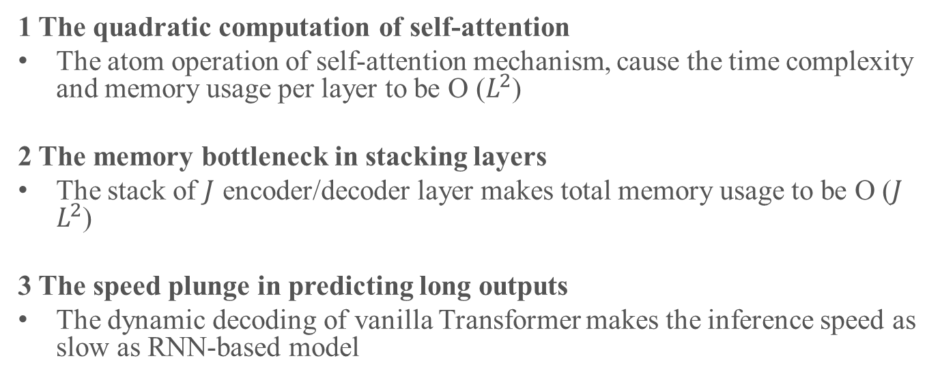
Challenges in long-term prediction
1 The quadratic computation of self-attention
The atom operation of self-attention mechanism, cause the time complexity and memory usage per layer to be O ($L^{2}$)
2 The memory bottleneck in stacking layers
The stack of $J$ encoder/decoder layer makes total memory usage to be O ($J$ $L^{2}$)
3 The speed plunge in predicting long outputs
The dynamic decoding of vanilla Transformer makes the inference speed as slow as RNN-based model

Slide 11
Transformer-based LSTF
Informer
Transformer

Slide 12
Encoder

Slide 13
Observation

Slide 15


Transformer-based LSTF
Rewrite the original self-attention into the probability formulation
Establish the measurement based on KL divergence
Attention probability $p(k_{j}|q_{i})$
Uniform probability $q\left(k_{j} | q_{i}\right)=$ $\frac{1}{L_{k}}$
Prob-Sparse self-attention

Slide 16
Self-attention Distilling Operation (max-pooling layer)
L/2->L/4
L->L/4
Split and reduce the dimension of feature map from input
Building replicas with halving inputs

Slide 17
Special design of decoder
Start token is an efficient technique in NLP “dynamic decoding”
We sample a “shorter” long sequence in input sequence
The final output = [historical data | predicted data]
Start token is an efficient technique in NLP “dynamic decoding”
Example:
Predict 7-day prediction = take the known 7 days before this time sequence as “start token” and feed the generative-style inference decoder with them.

Slide 18
Simulation setup
Dataset:
Nasdaq (SPY,QQQ,AAPL,META,MSFT,TSLA,NVDA)
Metric:
Mean Squared Error (MSE)
Absolute Error (MAE)
Platform:
All method are run on Nvidia GPU

Slide 19
SPY

Slide 20
QQQ

Slide 21
AAPL

Slide 22
META

Slide 23
MSFT

Slide 24
NVDA

Slide 25
TSLA

Slide 26
Thank you

Slide 27
Questions
Project Plan – 20%
professional presentation, clarity of value proposition, and analysis of competitive landscape.
AI Development – 40%
clarity of project white paper/report and GitHub Read Me (Runbook), professional website/demo, and analysis of code structure and adherence to industry best practices)
AI Solution – 40%
ability for solution to create a solution to a clear problem and provide a new service.
“provide a new service” – what are some specific criteria for this?
Will this contest be 100% remote? What’s the format for final demo?

Slide 28
Value proposition
Needs | Challenges | Our Solution | Questions Answered
Beginner Trader Discern market trends | Market's dynamic complexity | AI-driven trend analysis across various timeframes and assets for strategic guidance. | “Is this market favorable for my trading approach?”
Intermediate Trader Acquire advanced techniques | Knowledge overload and prolonged learning curve | Comprehensive AI-curated learning modules with customized pattern recognition for efficient skill acquisition. | “How can I accelerate my trading skill development?”
Experienced Trader Optimize strategy Seize opportunities | Limited access to advanced tools and uncertain strategy efficacy | Enhanced trading setups with AI-personalized strategy analytics and proactive opportunity alerts. | “What's the performance trajectory of my strategy, and when to pivot?” “How can I consistently identify opportunities aligned with my strategy?”
Scope for AI contest

Slide 29
Product positioning
Expertise
Fundamental pattern mastery
Tech
Powerful AI in learning image patterns
PixelAlpha
“Your AI-enhanced trading copilot”
Expertly tailored to distill complex market patterns into actionable insights
Our edge:
Deep consumer insights from years of trading.
Mastery in AI innovation and software R&D.
Solid data infrastructural expertise.
User Demand
Personalized trading assistants

