Slide 1
Artificial Multi-Layered Neural Network Optical (Handwritten) Character Recognition NeuroOCR Development Documentation
By Abhinav Bhandari

Slide 2
Aim
To produce an Neural Network capable of learning to recognise different characters – output (approximate) the 8Bit ASCII representation of a character, when given a hand-drawn bitmap input of the character through the use of supervised learning with a basic back propagation algorithm. So as to accomplish this, create a versatile Multi-Layered Neural Network library and along with it, various samples in order to test its durability (or just for debugging purposes)

Slide 3
Information
This is a project with a deadline of 4 weeks. However, due to unfortunate circumstances, my time has been reduced to 3 weeks. This does not, however, mean that quality shall be reduced in any way.
This document shall detail the process of making this program, however, due to the scale of the project, it is not guaranteed that every single line of code in the project shall be described.
NB: This Documentation will not describe in much depth what a Neural Network is, and rather jump straight to the coding. If readers are unsure of the nature of a Neural Network, it may be best to grasp the basic concepts before proceeding (although not entirely necessary).

Slide 4
Setup
The LibNeuroOCR class project was instantiated and the main NeuroOCR project, which is the startup project, has been converted into project of type Console Application for debugging purposes. The final program will be a WinForms Application.
In order to make the library as versatile and as multi-purpose as possible, the Neural Network instantiation, the Neuron Strategy (updating of the Neuron’s Weights, the activation functions, Delta calculation and bias calculation), the Neurons and the Network itself shall be implemented as Interfaces. (Of course, standard classes implementing the interfaces will be provided). Interfaces will be used instead of Abstract (base) classes simply for the sake of simplicity and also due to the fact that inheriting multiple base classes (as opposed to implementing multiple interfaces) is not supported (in C#, the coding language this project will be done in), although this most likely will not be a particularly beneficial asset in this scope as the multiple implementation of interfaces will not be necessary. The reason interfaces shall be used is because I am seeking to define a contract as opposed to a shared implementation. It is quite obvious why I shall not be using a struct for this.

Slide 5
Implementing the Core
FYI: (in the names of the classes) I = interface, N = neural/neuro/etc
Now we shall begin implementing the true kernel of our framework by making the core interfacesand core classes. The interfaces shall be kept in the LibNeuroOCR.Interface namespace, any data objects (known as records in other languages) shall be kept in the LibNeuroOCR.Data namespace and the core classes shall be kept in the LibNeuroOCR.Neuro namespace (to keep it neat).
Pictures of the classes are on the following pages

Slide 6
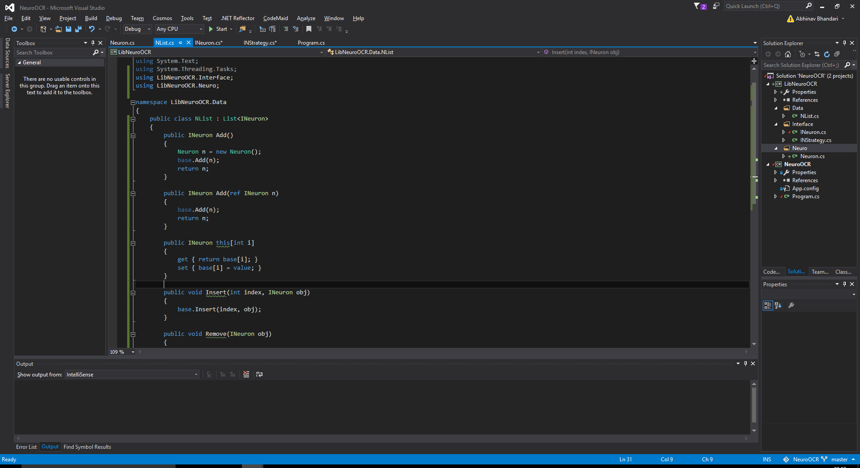
This is a derived class from the system’s generic List<T>(); collection. I am using this instead of something such as List<INeuron>(); because later I will need to implement some logic in the Add() method (although there are many ways you can achieve this without creating your own collection. I think it this improves readability so I will keep it =3)

Slide 7
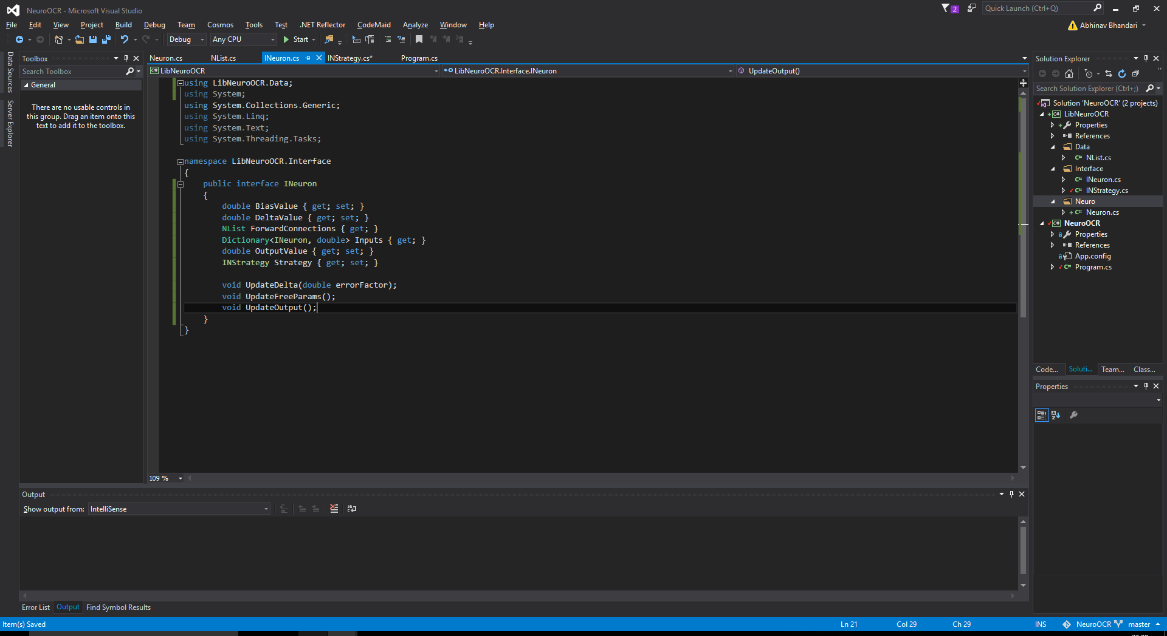
Here is the Neuron Interface. NB: interfaces can’t have fields so I’m using properties. Also, notice how I just used a Dictionary<Ineuron, double> for the inputs whereas I had to make my own Collection NList (previous slide) for the forward connections. It wasn’t necessary to make my own class and so this way, I might have even avoided the generation of unwanted overhead.

Slide 8
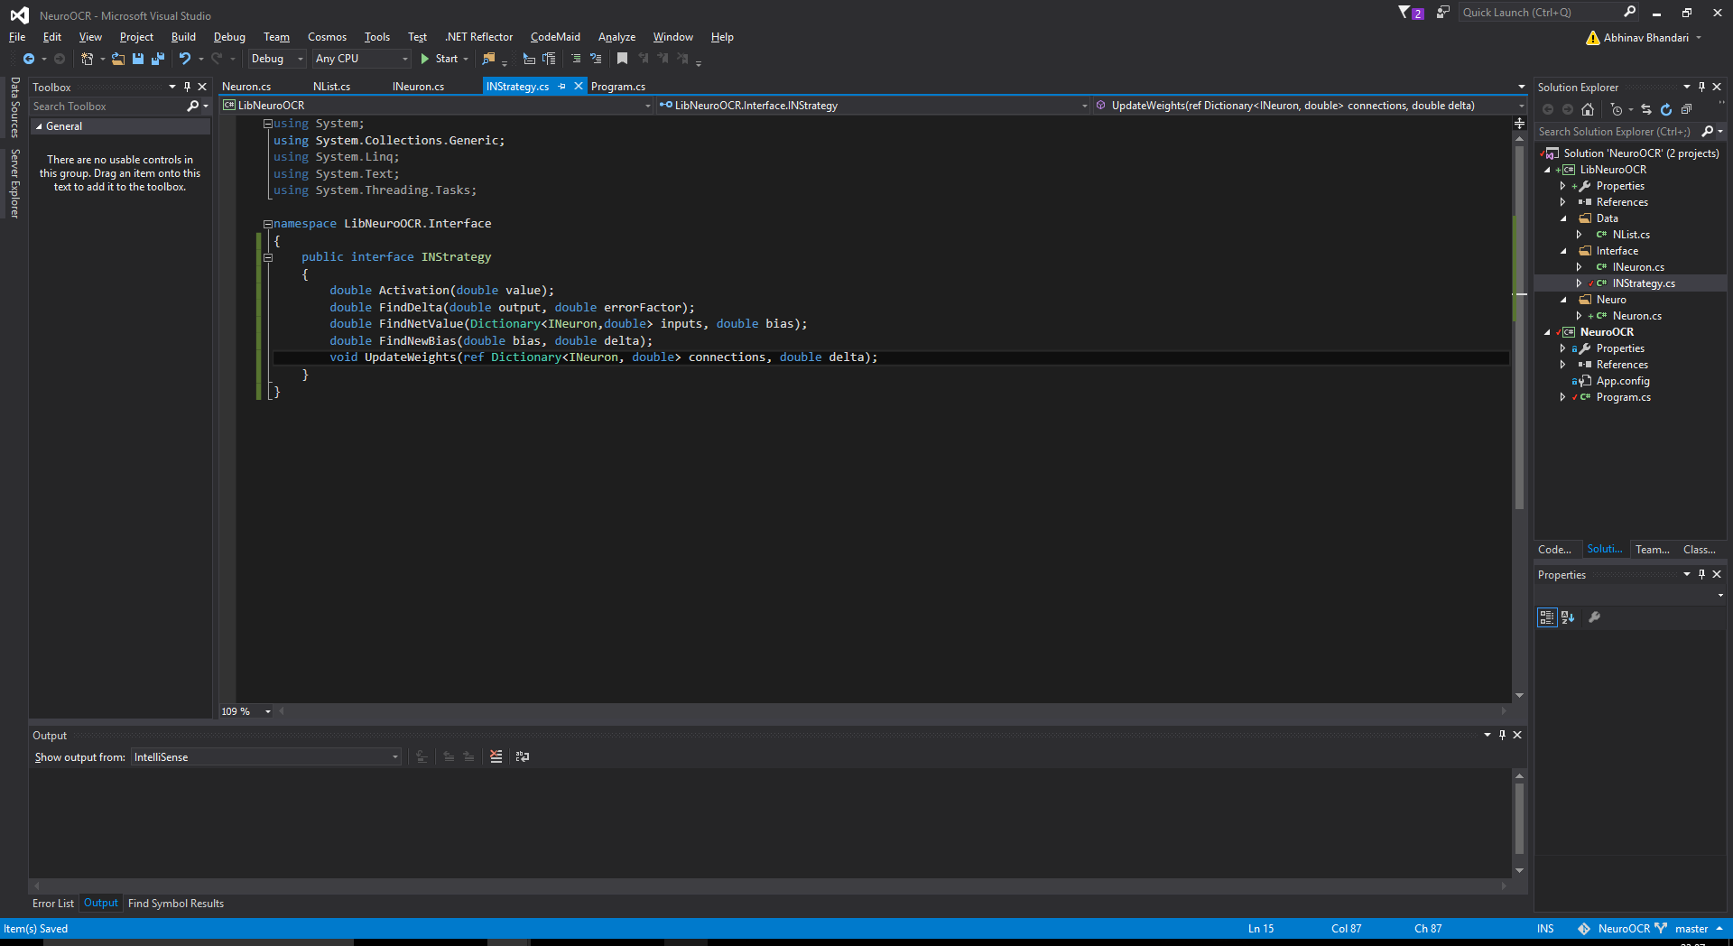
Here is the strategy interface. As I mentioned before, the strategy will contain some basic calculation methods – that’s why I thought “Strategy” to be a fitting name ☺

Slide 9
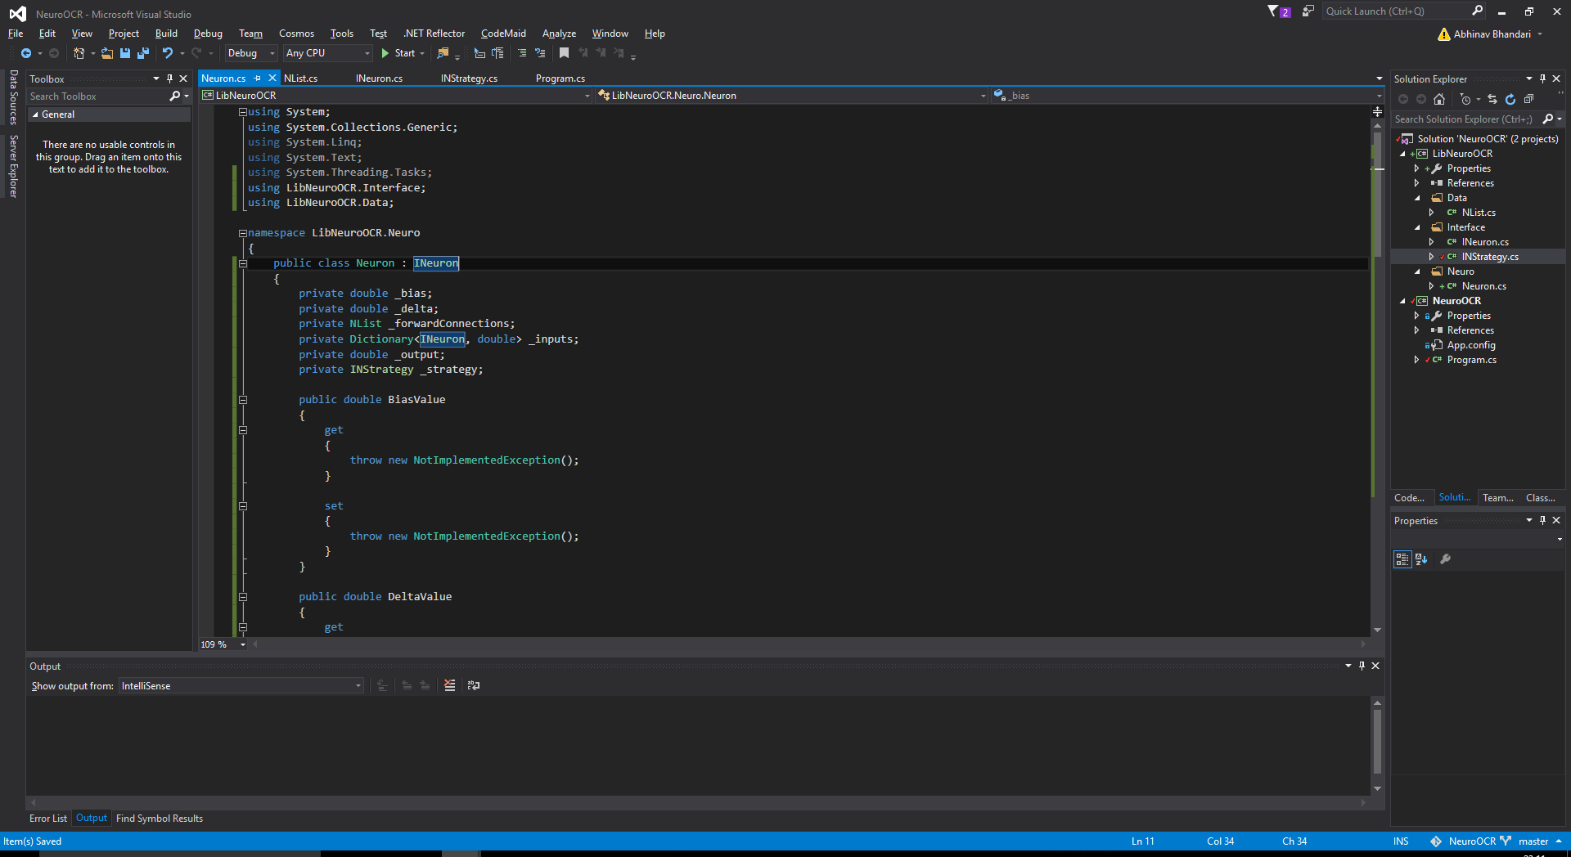
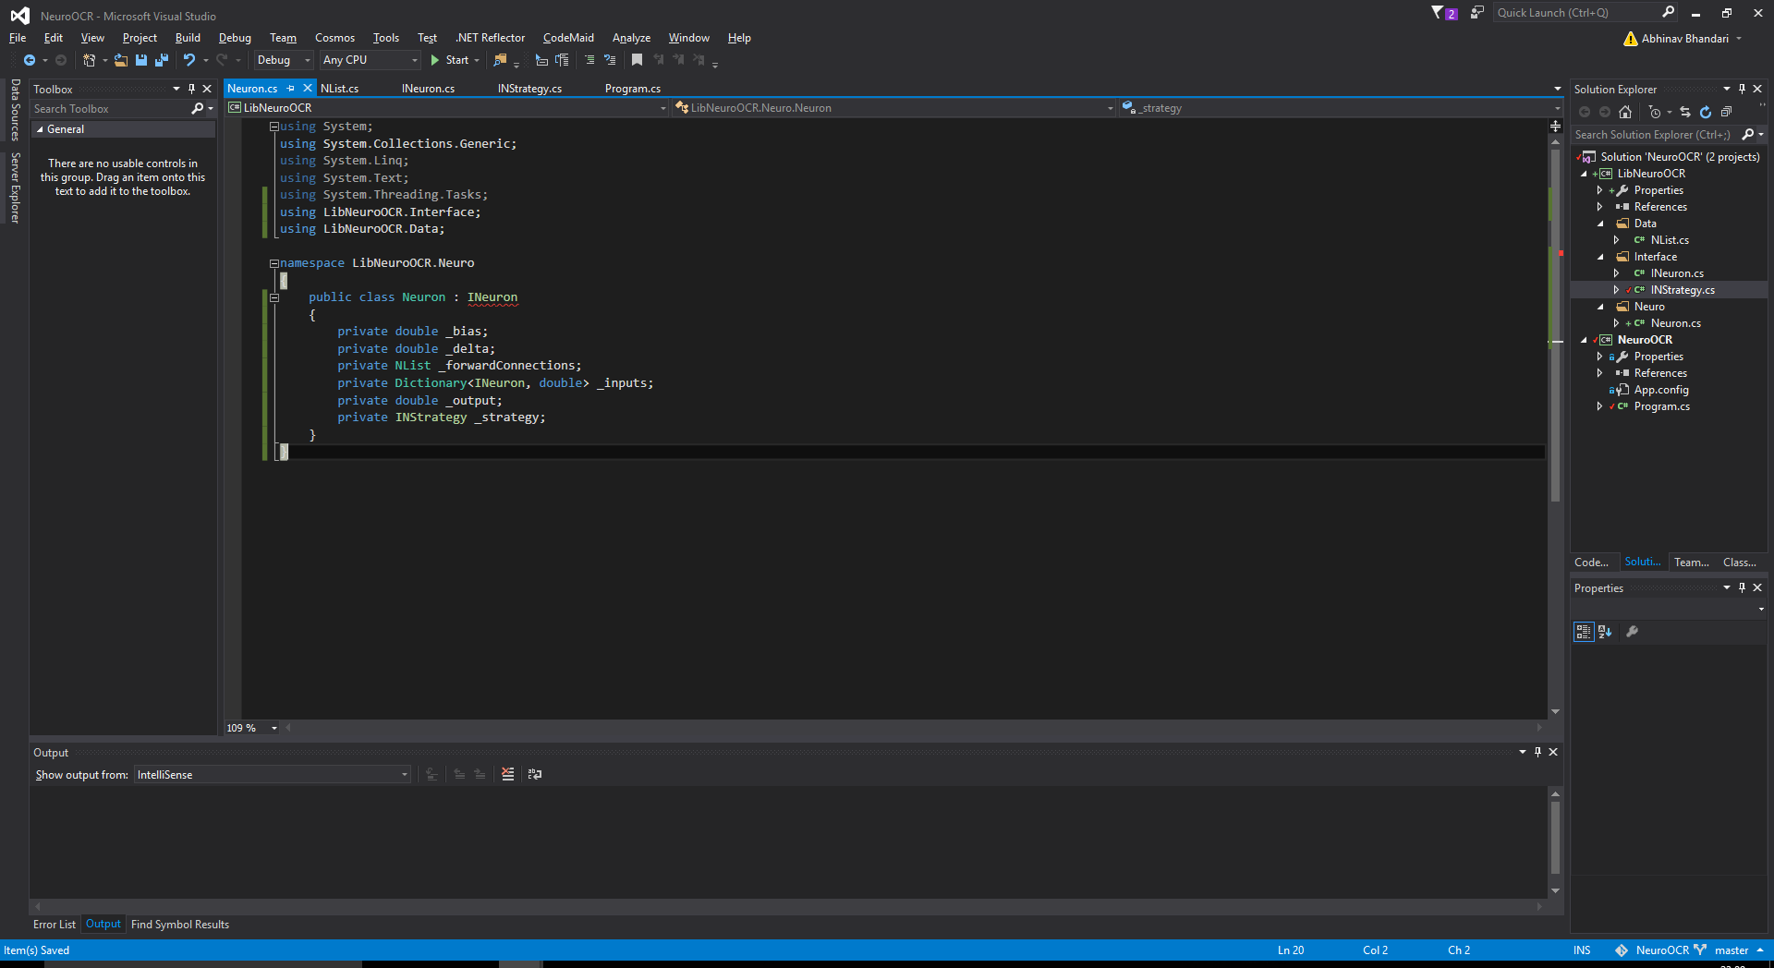
Here’s the Neuron. It’s empty at the moment. I’ll properly implement everything later. I need to implement some other stuff first, though (which reference it – thus I have made it).

Slide 10
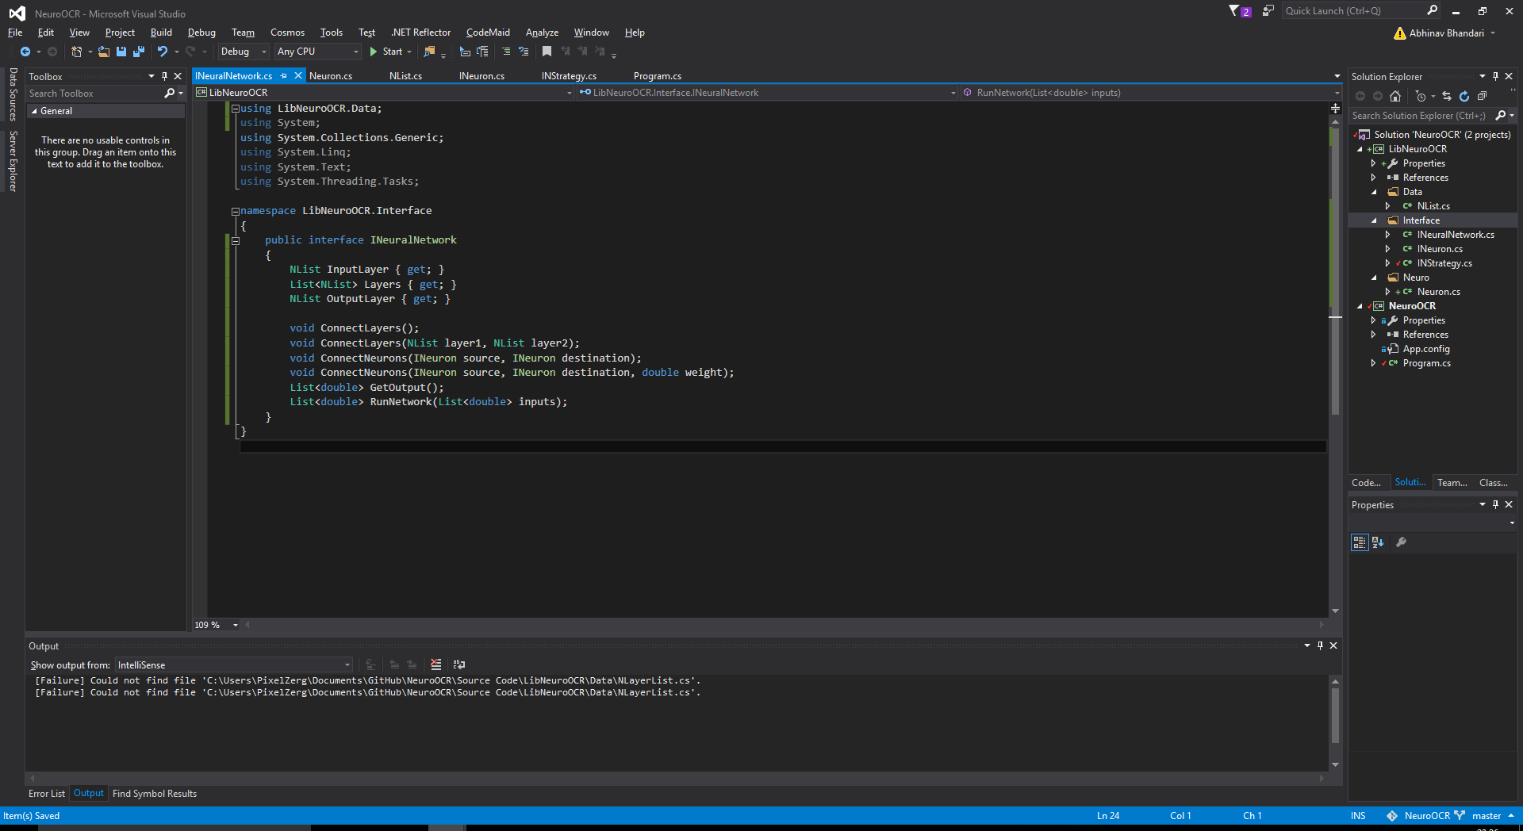
This is the Neural Network interface. I might end up not using double by the end of the project but it’s not like it will make that much difference……….

Slide 11
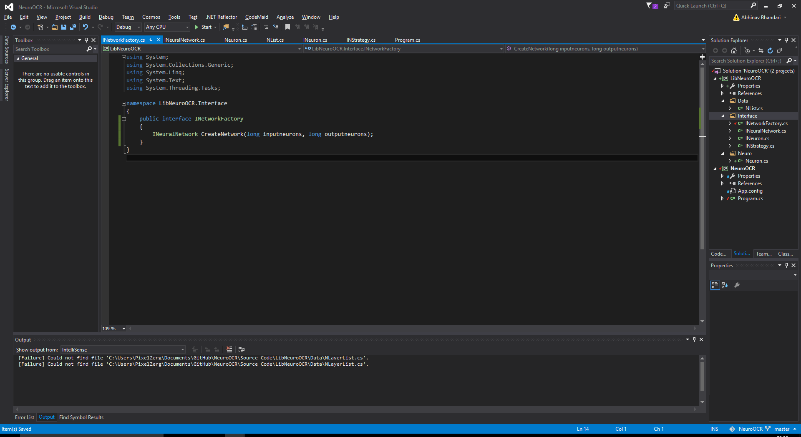
Here’s the network factory interface. In the CreateNetwork method, you might want to implement logic later for stuff such as randomising neuron weights so as to increase learning efficiency. I’m using a Long type variable instead of Int because who knows, you might need to make a REALLY big neural network. (BTW: Int = 32bit, Long = 64bit). As you can see, the neural network instantiated by this (currently) will not be multi-dimensional. I’ll cross that bridge when I come to it

Slide 12
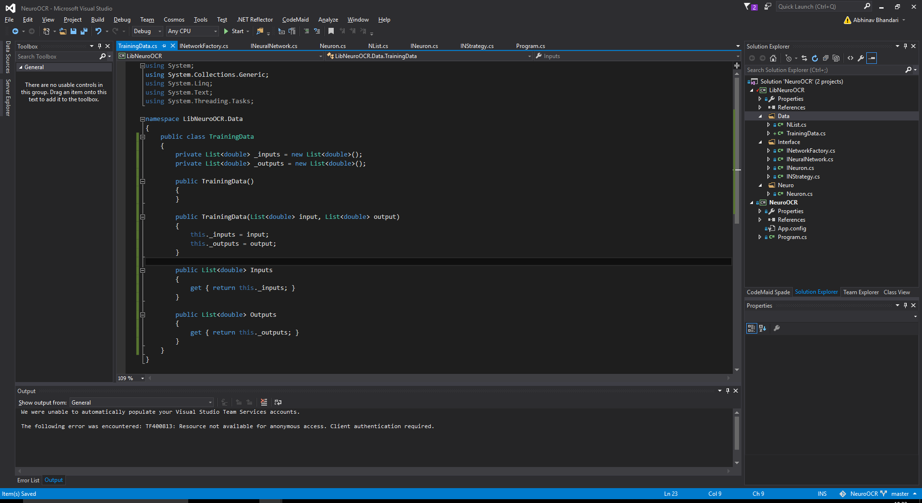
As I mentioned previously, we will be making use of supervised learning in this project. In other words, when the neural network is undergoing its learning epoch, it will need to be given the inputs and the correct outputs for those inputs. It would be a lot more manageable if we stored this data in an object and thus I have defined this training data class which will store that information. As you can see, the Outputs and Inputs can only be set by the TrainingData() construct during instantiation.

Slide 13
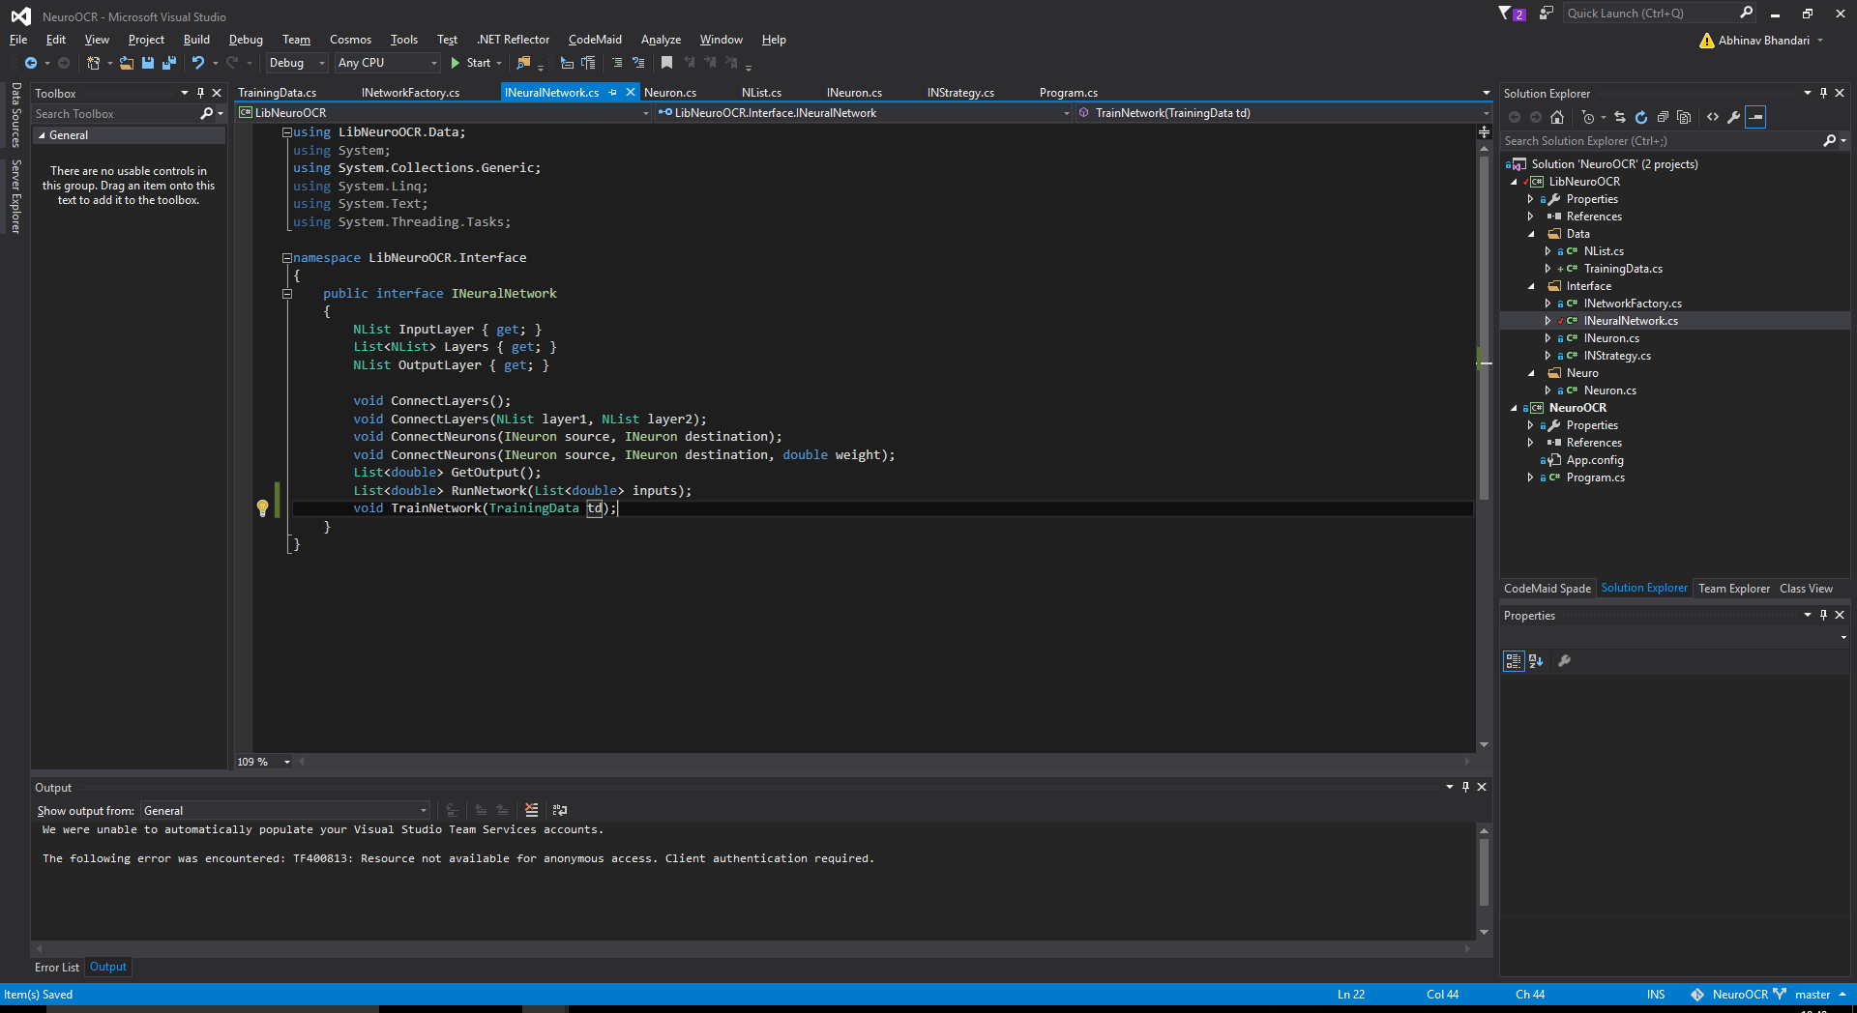
We can now add this method to our Neural Network interface. I will most likely later make a “NetworkHelper” later which will standardise the input data and so train the neural network more efficiently. Also, seeing as I am planning to be working with images. This seems like a good idea.

Slide 14
Do not underestimate input standardisation
Neural networks are trained a lot faster if their inputs are normalised. If the inputs given to the neural network are combined linearly, in theory, the data set does not need to be standardised because any rescaling of an input vector can effectively be undone by changing the corresponding weights and biases, leaving you with the exact same outputs as you had before. However, standardising inputs can reduce the chances of getting stuck in local optima (also, weight decay and Bayesian estimation can be done more conveniently with standardised inputs). It won’t really hurt to standardise the input data and its largely agreed that input data should be standardised so why not?

Slide 15
Implementing the mathematics
Right, so now that the basic structure of our library has been pretty much fully defined, let’s start working on actually making some classes which implement these interfaces – the classes with which I shall work in order to achieve the aim of this project. Although, like I mentioned before, with this rather generic structure, any number of different neural network systems can be implemented, I shall only be implementing a basic back propagation system. Next, I shall implement the algorithms for calculating the bias and delta of our neuron (which I left empty earlier). The next few slides shall show my progress.

Slide 16
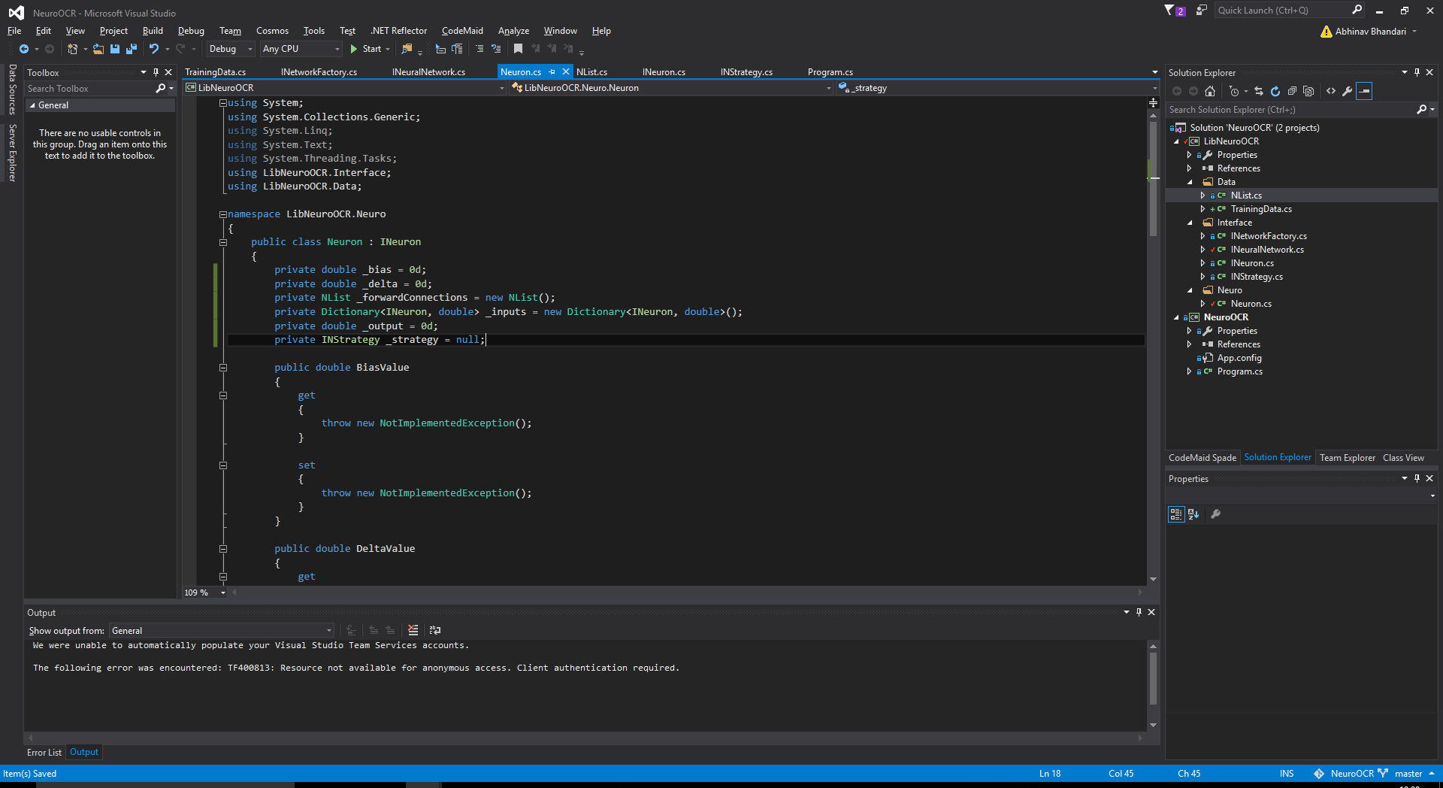
NB: defining a variable as null, in my opinion, is far better than not defining it at all

Slide 17
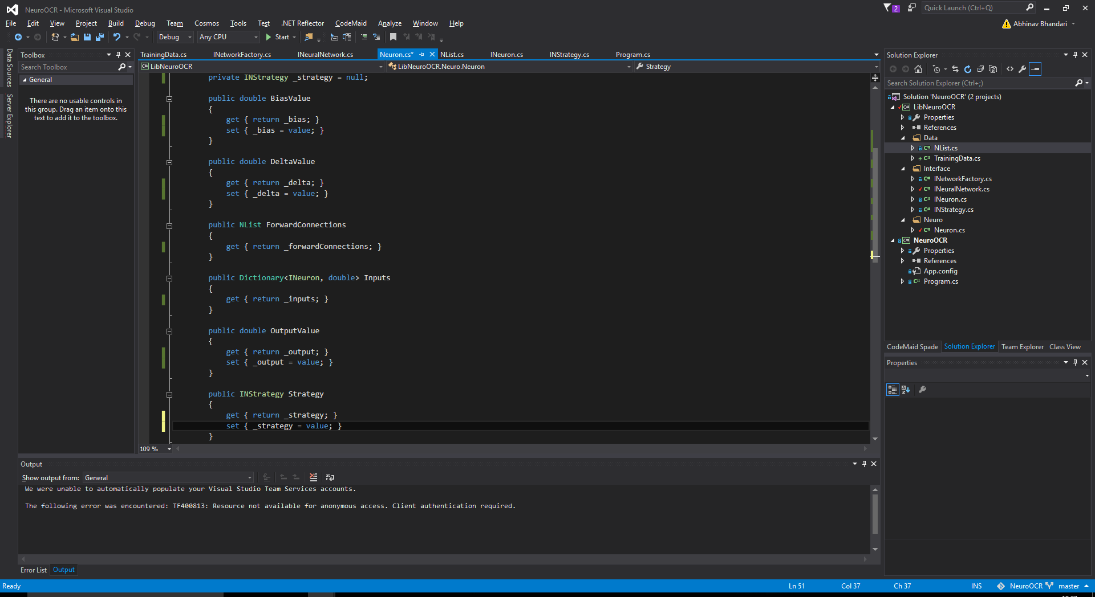
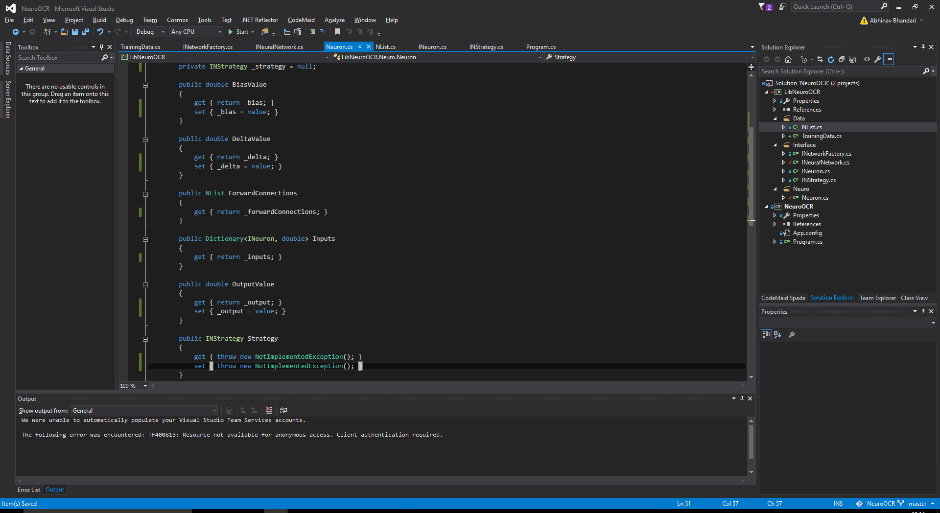
All these properties definitions everywhere do look slightly ugly, but it can’t be helped – there is no other way of doing it. I need to be able to access them through the interface and interfaces can’t implement fields. Of course, I could have just taken the easy (and very lazy) way out and not made the interfaces and instead just define the objects and I probably would have gotten away with it since I only need this type of setup for this project, but I want this library to be a little more useful than something as plain as that. Well, the good thing is, I can (and have), if I want to disallow variables being changed in the object from outside of the scope of the class by simply not defining a “set”

Slide 18
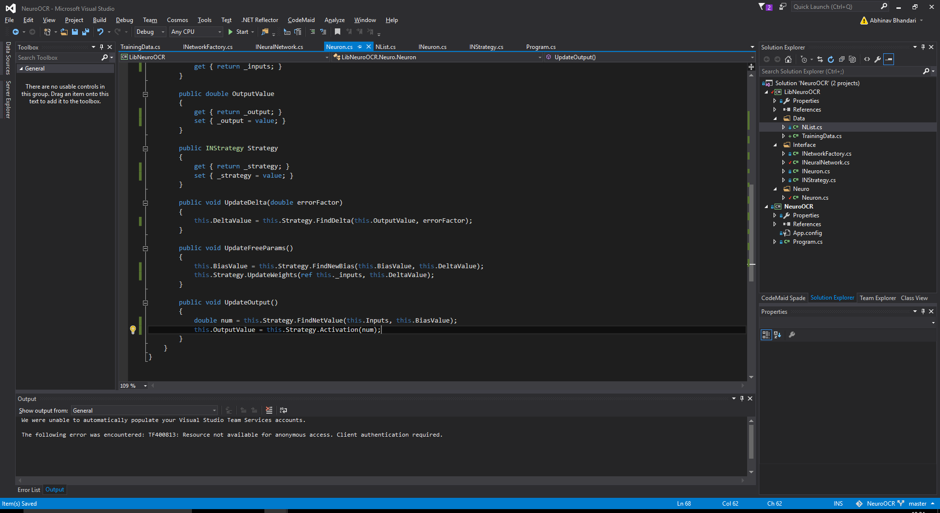
As you can see, the calculations will be done in the strategy (as I mentioned previously).

Slide 19
Error Handling
I just realised, if the strategy for the neuron has not yet been initialised, the program will crash here(most likely throw a NullReferenceException) (if you are silly enough to not use a try/catch AND to forget to initialise the strategy in the first place). Oh well, just for completion purposes, I’m going to add a catch and define my an exception. The next few slides shall be about this.

Slide 20
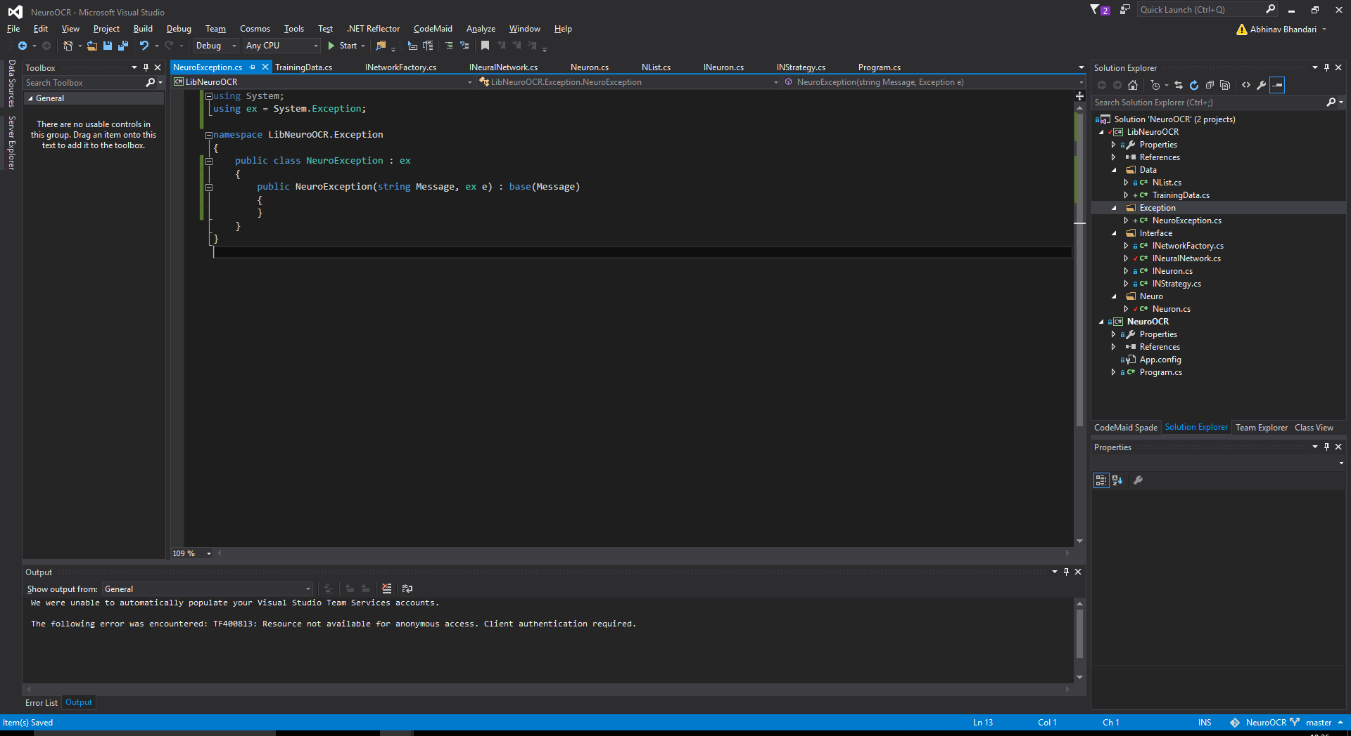
It is good practice to define a base exception and inherit more specific exceptions from it. Here’s me defining the base exception. I shall keep it in the LibNeuroOCR.Exception namespace to keep it tidy.
Ack, I just realised that naming the namespace “Exception” creates pretty bad ambiguities. I’ll stick with it nonetheless.
We can solve the ambiguities by doing this. (or just doing “System.Exception” every time we have to use “Exception”)

Slide 21

(I later decided “Ex” looked a bit better than “ex”)…

Slide 22

Here’s a NullStrategyException I made for now. I’ll add more exceptions as I go on if I need to. (Although I guess you could say I didn’t need to do this in the first place – I could have just used something like InvalidOperationException and handled the exceptions by looking at the messages and throwing, etc)

Slide 23
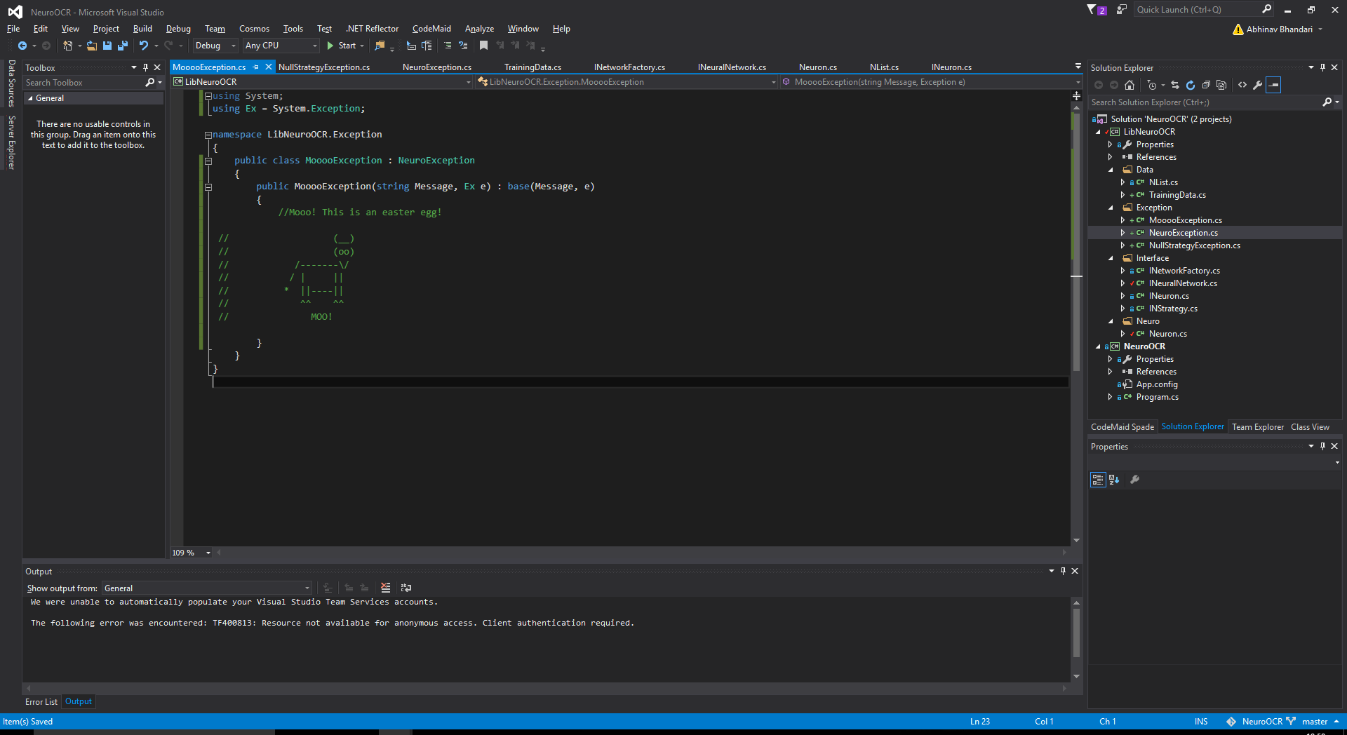
Erm…

Slide 24
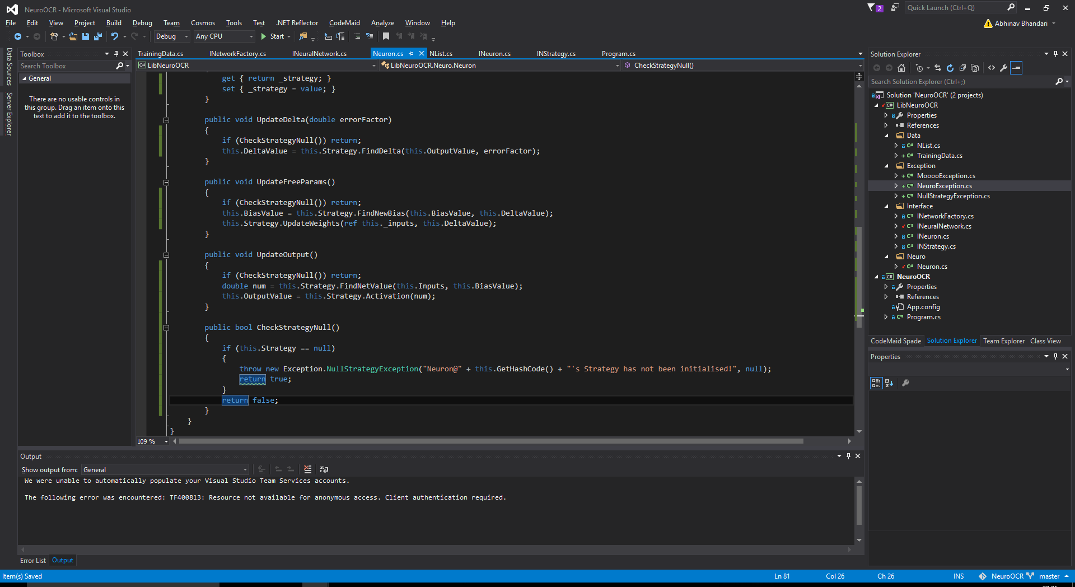
Moving swiftly on, here is the exception actually in use (the NullStrategyException one)

Slide 25
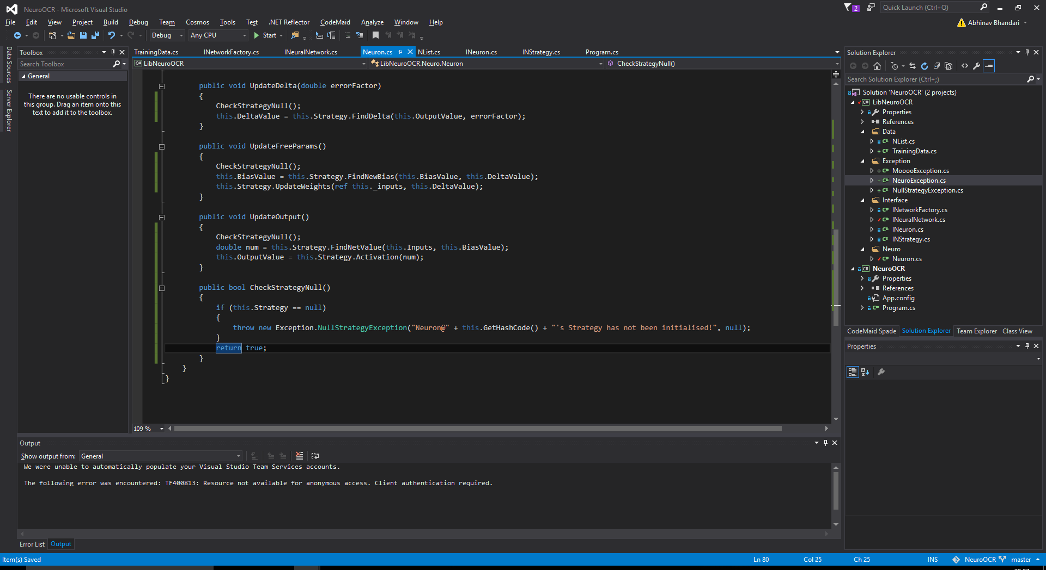
Oh whoops. Removing redundant code.

Slide 26
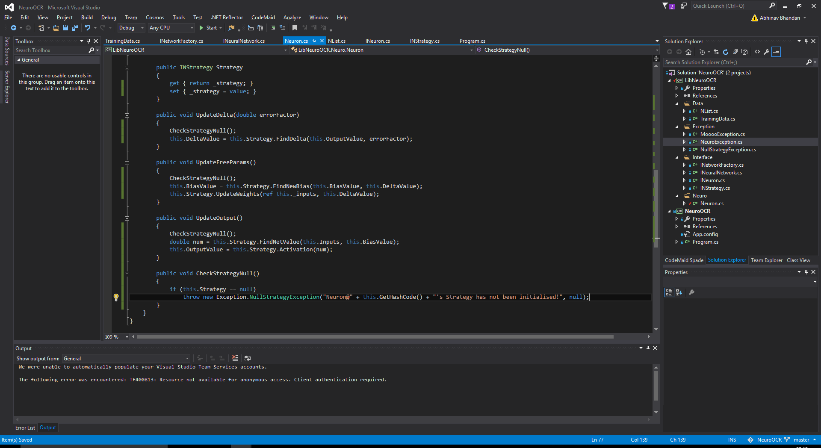
Actually, I might as well just do this…

Slide 27
Next Day
I worked on the project a little bit at school and I managed to finish the LibNeuroOCR class. I finished implementing the NeuralNetwork, NeuralNetworkFactory(Neural Network instantiation), and the NeuralNetworkStrategy(Back Propogation).
Now we can move on to the actual interesting stuff and the funnest and easiest bit of this project – actually messing around with neural networks.
Before I do that, however, let me just make a simple demo to check whether everything is working (I haven’t even ran the code yet). I am going to make a basic multi-layered neural network that can learn to emulate a logic gate table – specifically – the XOR gate. This is because a single layered neural network cannot do this. If this works, we can successfully say that the multi-layered neural network is functioning great.

Slide 28
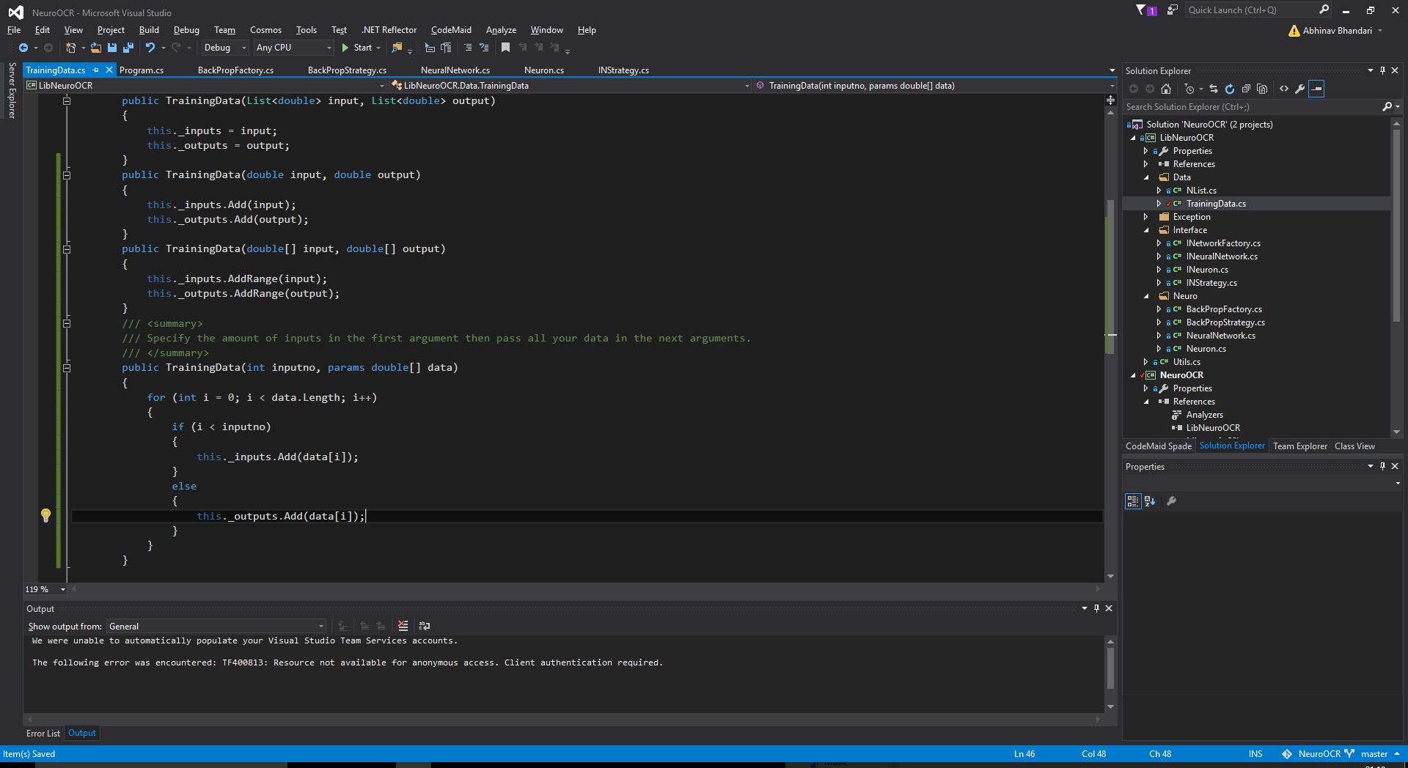
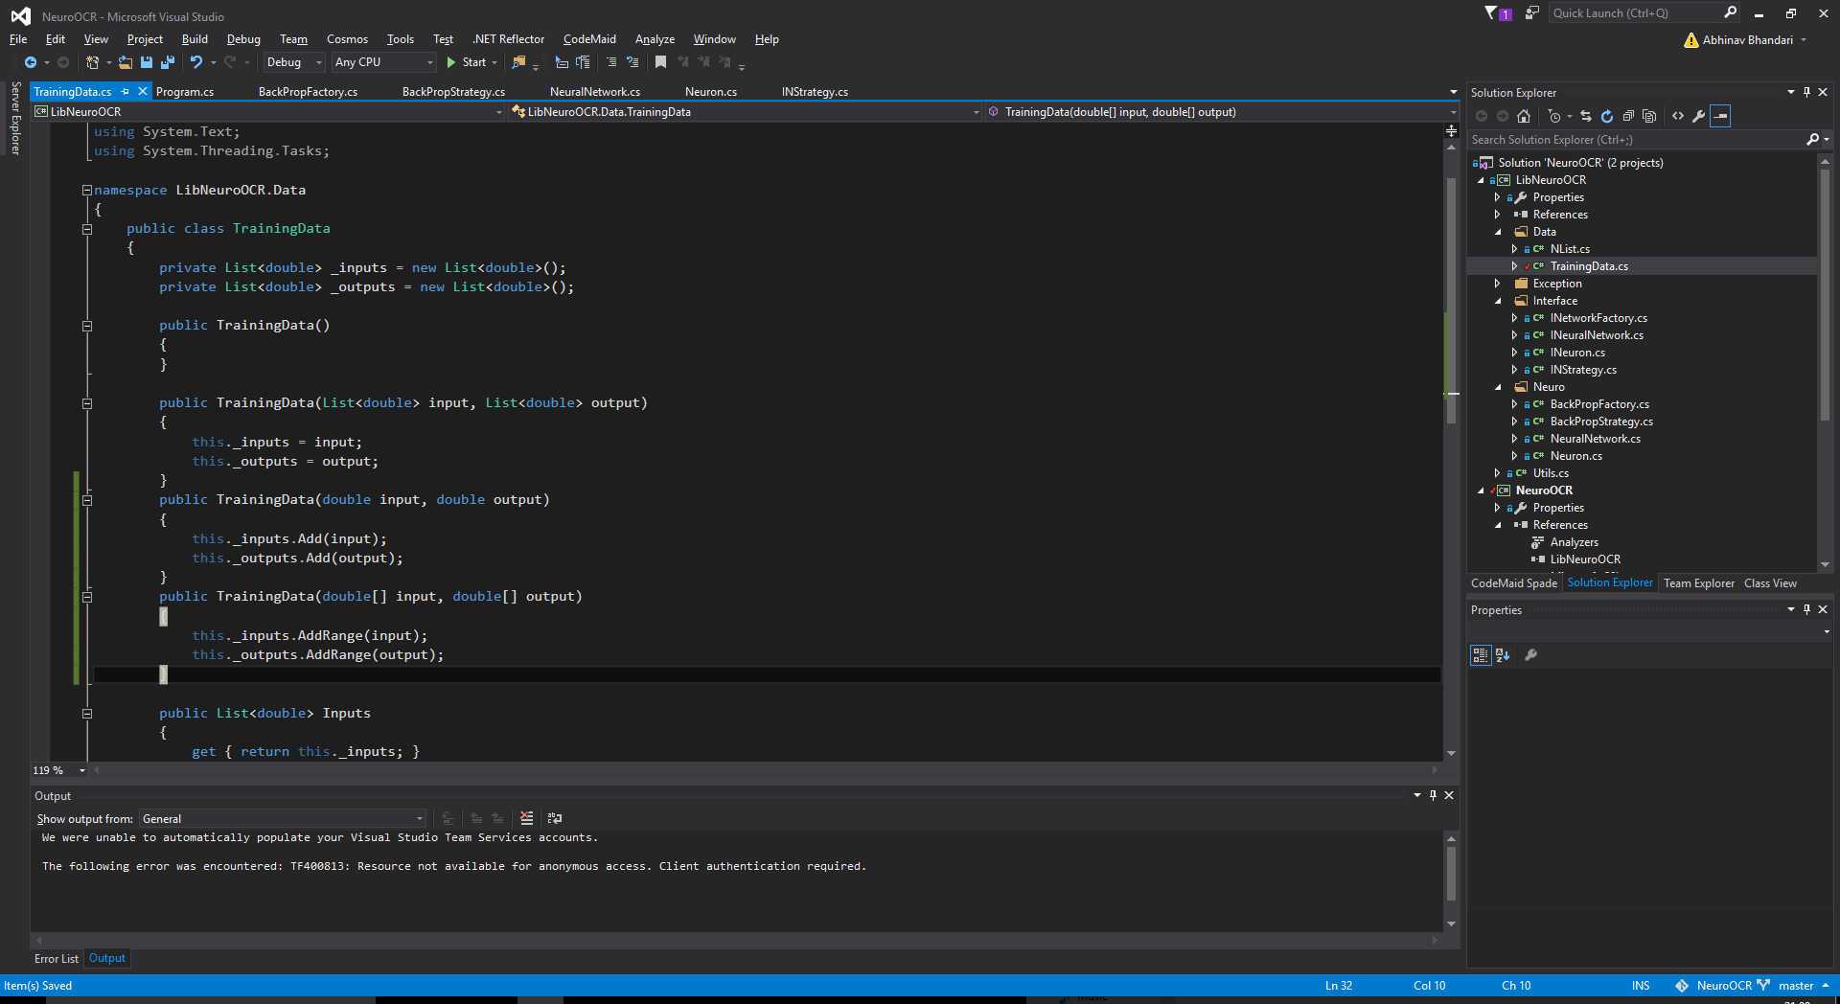
Before we move on, I thought I’d just mention, I added constructors to training data for convenience’s sake:

Slide 29
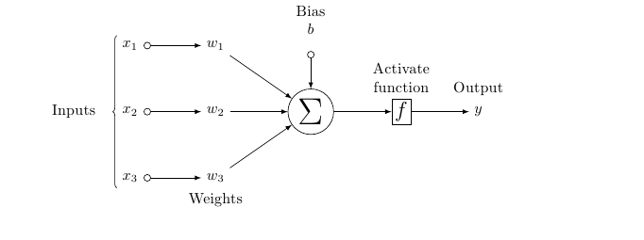
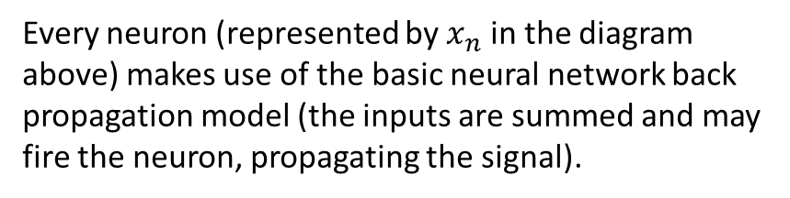





The 2-2-1 Neural Network Model
Here’s a visual representation of the neural network structure I shall be using:
Input Layer
Hidden Layer
Output Layer
As you can see, we need 2 neurons in the input layer because the XOR gate has 2 inputs. The hidden layer shall have 2 neurons because 1 neuron simply would not suffice. The output is 1 neuron because there is only one output of the XOR operation.
$$x_{1}$$
$$x_{3}$$
$$x_{5}$$
$$x_{2}$$
$$x_{4}$$
Every neuron (represented by $x_{n}$ in the diagram above) makes use of the basic neural network back propagation model (the inputs are summed and may fire the neuron, propagating the signal).

Slide 30
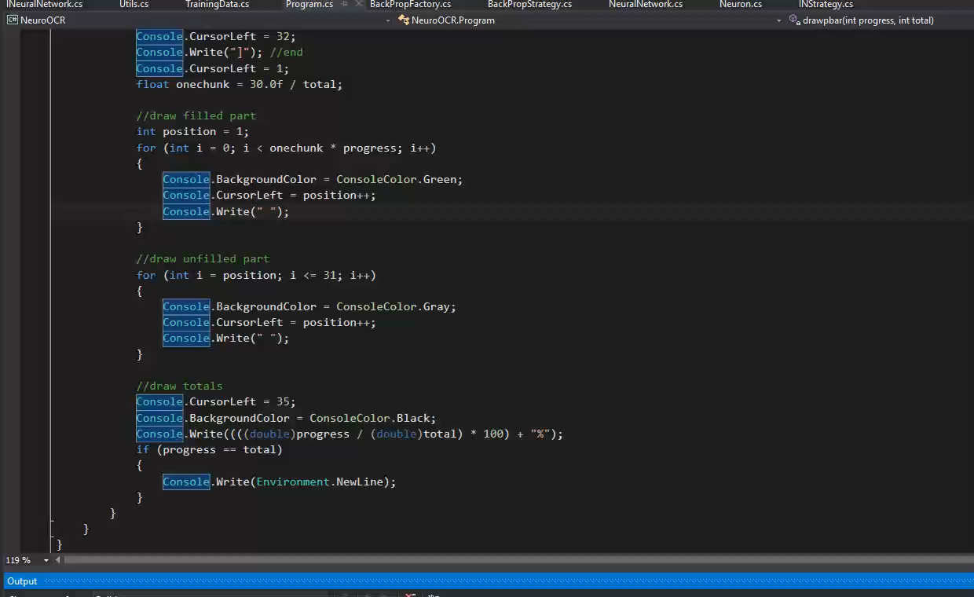
I had to fix some slight bugs in the classes: Utils, NeuralNetwork and BackPropStrategy. Also, it appears I had forgotten to implement a method in the NeuralNetwork class – I have fixed all of this now and the demo now is fully working! Here is the code:
public static void Demo1()
{
INeuralNetwork nn = new BackPropFactory().CreateNetwork(2, 2, 1);//instantiate 2-2-1 neural network
TrainingData[] xordata = new TrainingData[] {
new TrainingData(2, 0, 0, 0),
new TrainingData(2, 0, 1, 1),
new TrainingData(2, 1, 0, 1),
new TrainingData(2, 1, 1, 0)
}; //the xor table
Console.WriteLine("Training the network:");
for (int i = 0; i < 5000; i++)
{
foreach (TrainingData data in xordata)
{
nn.TrainNetwork(data);
}
drawpbar(i + 1, 5000);
}
bool done = false;
while (!done)
{
Console.WriteLine("Enter two inputs (on new lines) for the neural network! Just press enter once you are done!");
string input = Console.ReadLine();
if (input == "")
{
done = true;
break;
}
else
{
try
{
double i1 = Double.Parse(input);
double i2 = Double.Parse(Console.ReadLine());
Console.WriteLine("Output: " + String.Join(" ", nn.RunNetwork(i1, i2)));
}
catch (Exception e)
{
Console.WriteLine("There was an error: " + Environment.NewLine + e);
}
}
}
}
The output:

Slide 31
The final part of the project – Handwritten Character Detection.
I am going to input 20x20 bitmap images into a neural network and the aim of this project is to get the 8bit ASCII binary representation of the character displayed on the bitmap. In other words, I am going to “teach” a neural network to “recognise” handwritten characters.
However, I know I said in the beginning that I shall output an 8 bit ACII binary representation but if you think about it, in this current context, there is far too much redundancy if you use this encoding. In other words, I am wasting bits by using this encoding, and in a neural network we need to use the least amount of bits since the amount of bits used is how many output neurons we will have and so will directly affect the network’s efficiency.

Slide 32
Solution: Make a new encoding.
We really do not need a lot of the ASCII table. This new encoding I will make is only going to have the essentials. Basically, it is going to be the numbers 0-61 in binary and has the numbers 0-9 at the start, then the capital alphabet and then the lowercase alphabet. Nice and simple.
Using this encoding, we now only have to use 6 bits instead of the 8 bits that ASCII uses. This way, we can make our neural network slightly more efficient.

Slide 33
Implementation of the Encoding – Converting To
public static BitArray CharToBinary(char c)
{
if (Char.IsLetterOrDigit(c))
{
if (Char.IsDigit(c))
{
return DecimalToBinary(Int32.Parse(c.ToString()));
}
else if (Char.IsLetter(c))
{
if (Char.IsUpper(c))
{
return DecimalToBinary(c - 55);
}
else if (Char.IsLower(c))
{
return DecimalToBinary(c - 61);
}
else
{
throw new InvalidOperationException("The character \"" + c + "\" cannot be converted into the encoding used by this program! It also appears to be neither lowercase nor uppercase?!!");
}
}
else
{
throw new InvalidOperationException("The character \"" + c + "\" cannot be converted into the encoding used by this program! It also appears to be a letter or digit but neither a letter nor a digit at the same time?!!");
}
}
else
{
throw new InvalidOperationException("The character \"" + c + "\" cannot be converted into the encoding used by this program!");
}
}
public static BitArray DecimalToBinary(long dec)
{
BitArray ret = new BitArray(6,false);
long num = dec;
for (int i = 0; i < 6 && num > 0; i++)
{
if (num % 2 == 0)
{
ret[ret.Count-i-1] = false;
}
else
{
ret[ret.Count-i-1] = true;
}
num /= 2;
}
return ret;
}

Slide 34
Implementation of the Encoding – Converting From
public static string PrintBitArray(BitArray array)
{
string ret = "";
foreach (bool bit in array)
{
if (bit) ret += "1";
else ret += "0";
}
return ret;
}
public static char BinaryToChar(BitArray input)
{
int dec = Convert.ToInt32(PrintBitArray(input), 2);
//converting to decimal ^^^
if (dec <= 9)
{
//is number
return dec.ToString()[0];
}
else if (dec <= 35)
{
//is capital
return (Char)(dec + 55); //convert to utf because that is C#'s native encoding
}
else if (dec <= 61)
{
//is lowercase
return (Char)(dec + 61); // ''
}
else
{
throw new InvalidOperationException("Unable to convert " + PrintBitArray(input) + " (in decimal: " + dec + ") to char!");
}
}
public static BitArray RoundToBinary(params double[] input)
{
BitArray ret = new BitArray(input.Length);
for (int i = 0; i < input.Length; i++)
{
if (Math.Round(input[i], 0, MidpointRounding.AwayFromZero) >= 1)
{
ret[i] = true;
}
else
{
ret[i] = false;
}
}
return ret;
}

Slide 35
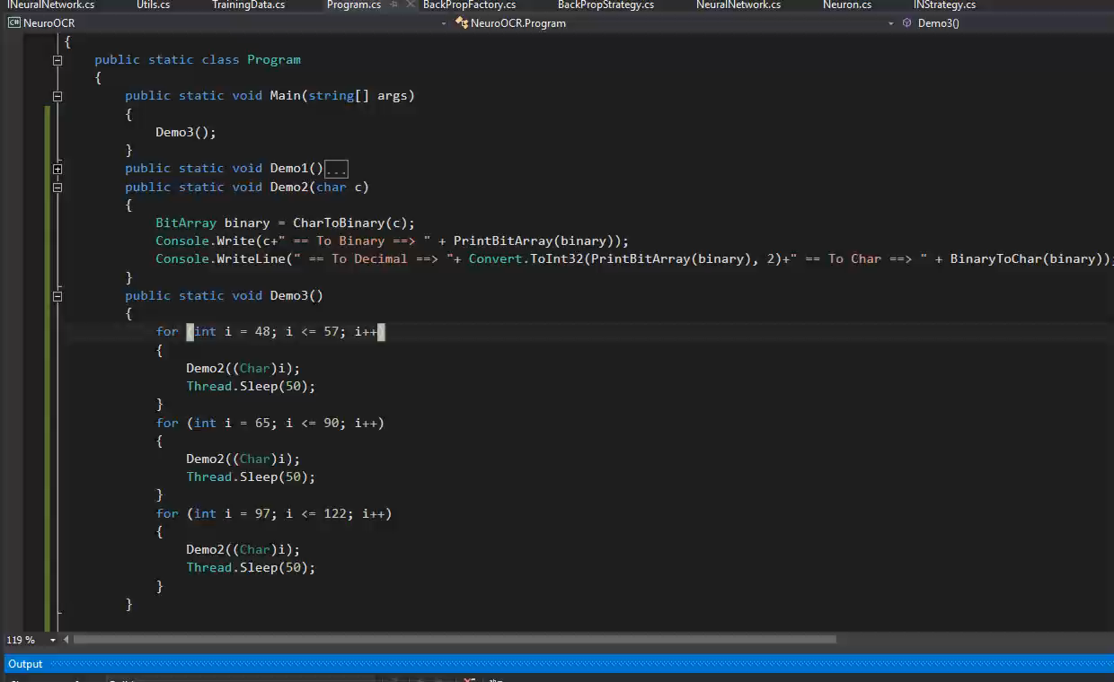
Testing out the Encoding:
Output:
public static void Demo3()
{
for (int i = 48; i <= 57; i++)
{
Demo2((Char)i);
Thread.Sleep(50);
}
for (int i = 65; i <= 90; i++)
{
Demo2((Char)i);
Thread.Sleep(50);
}
for (int i = 97; i <= 122; i++)
{
Demo2((Char)i);
Thread.Sleep(50);
}
}
public static void Demo2(char c)
{
BitArray binary = CharToBinary(c);
Console.Write(c+" == To Binary ==> " + PrintBitArray(binary));
Console.WriteLine(" == To Decimal ==> "+ Convert.ToInt32(PrintBitArray(binary), 2)+" == To Char ==> " + BinaryToChar(binary));
}

