Slide 1
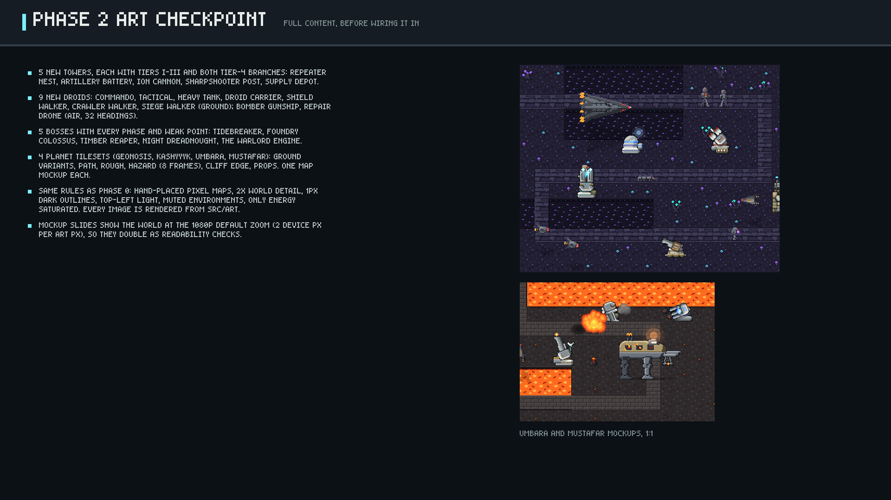
Notes:
Phase 2 art checkpoint overview.

Slide 2
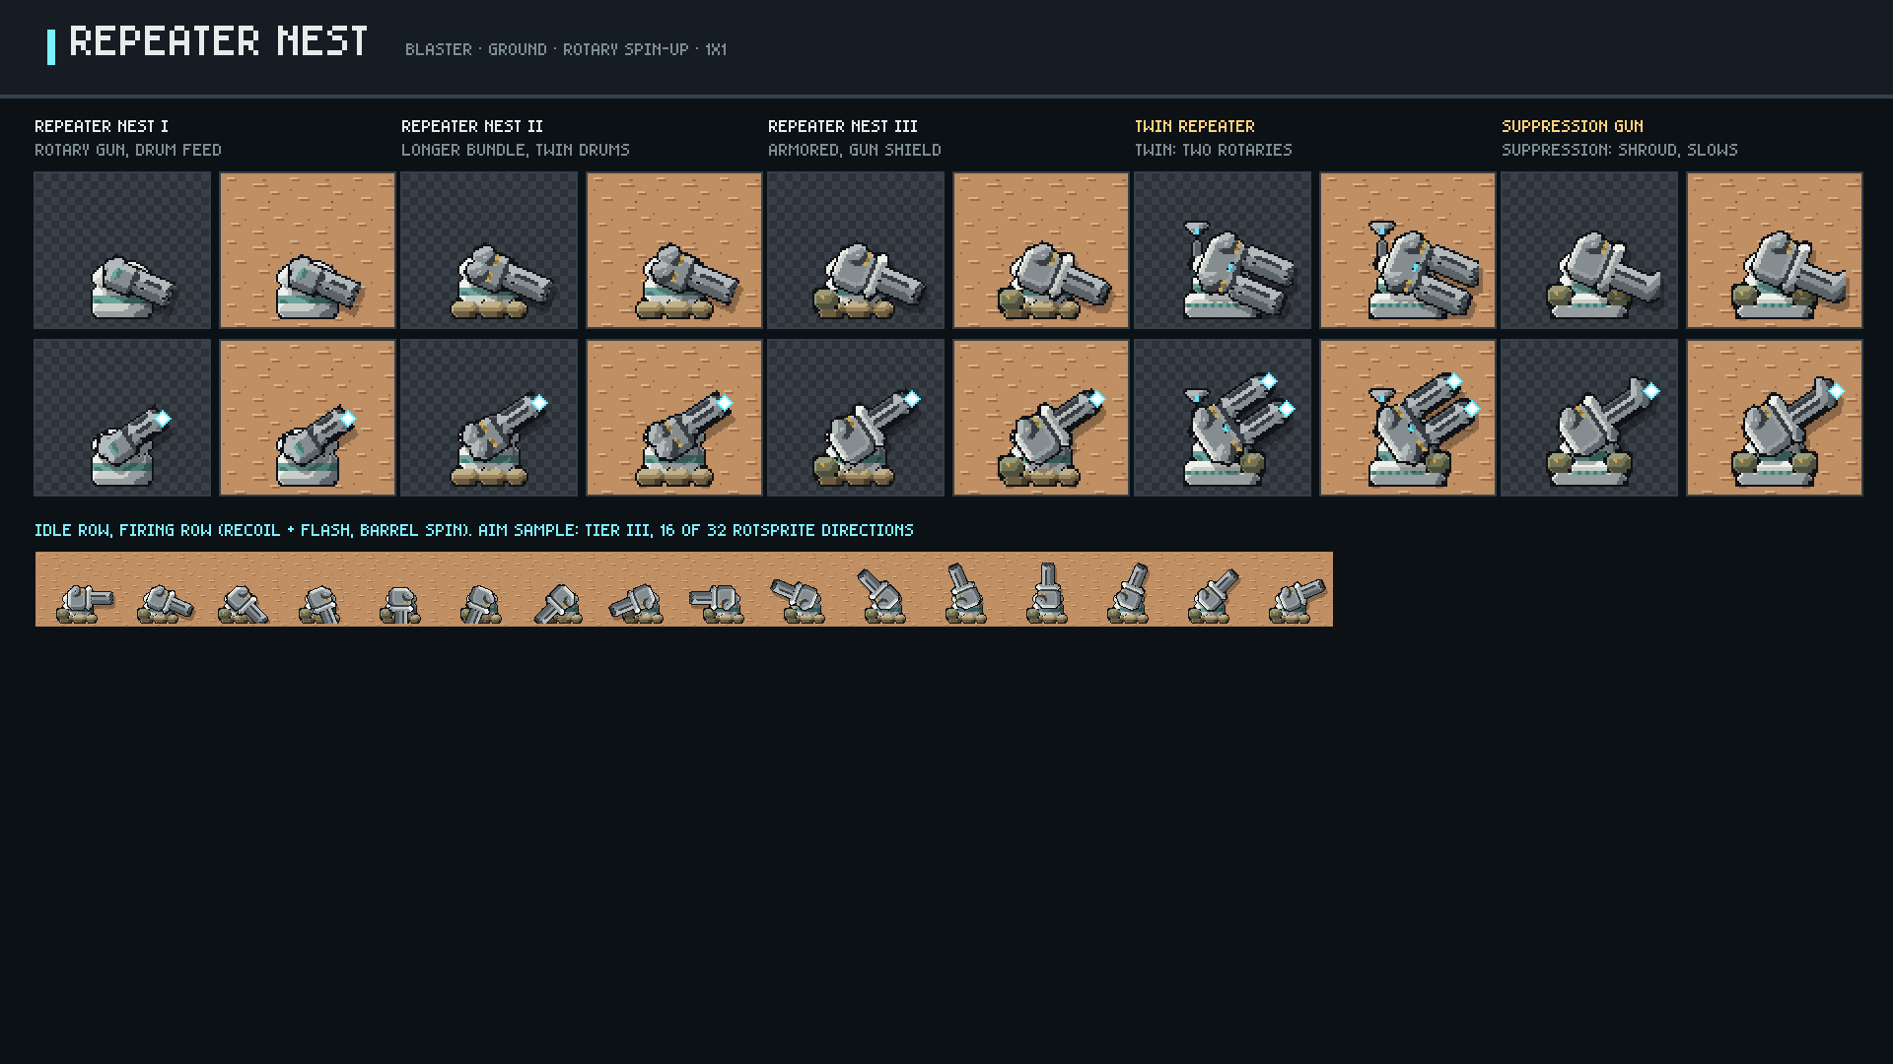
Notes:
Repeater Nest: tiers I-III plus both tier-4 branches, idle and firing, on checker and Geonosis ground.

Slide 3
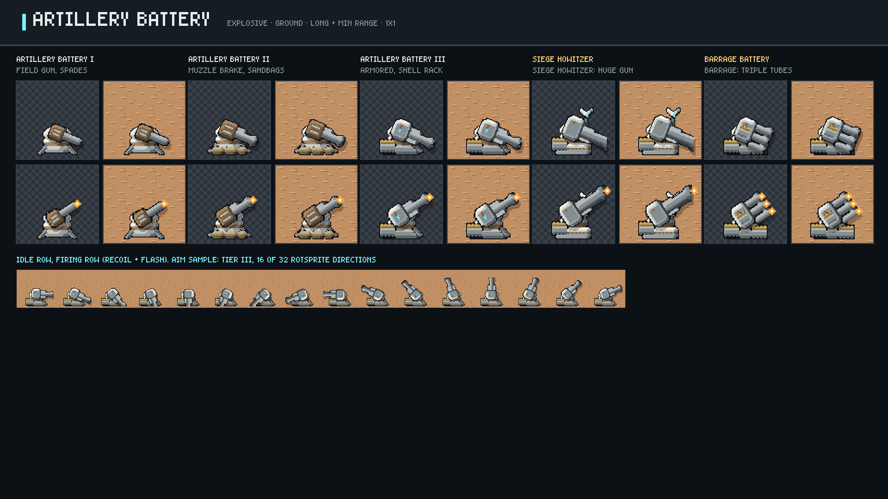
Notes:
Artillery Battery: tiers I-III plus both tier-4 branches, idle and firing, on checker and Geonosis ground.

Slide 4
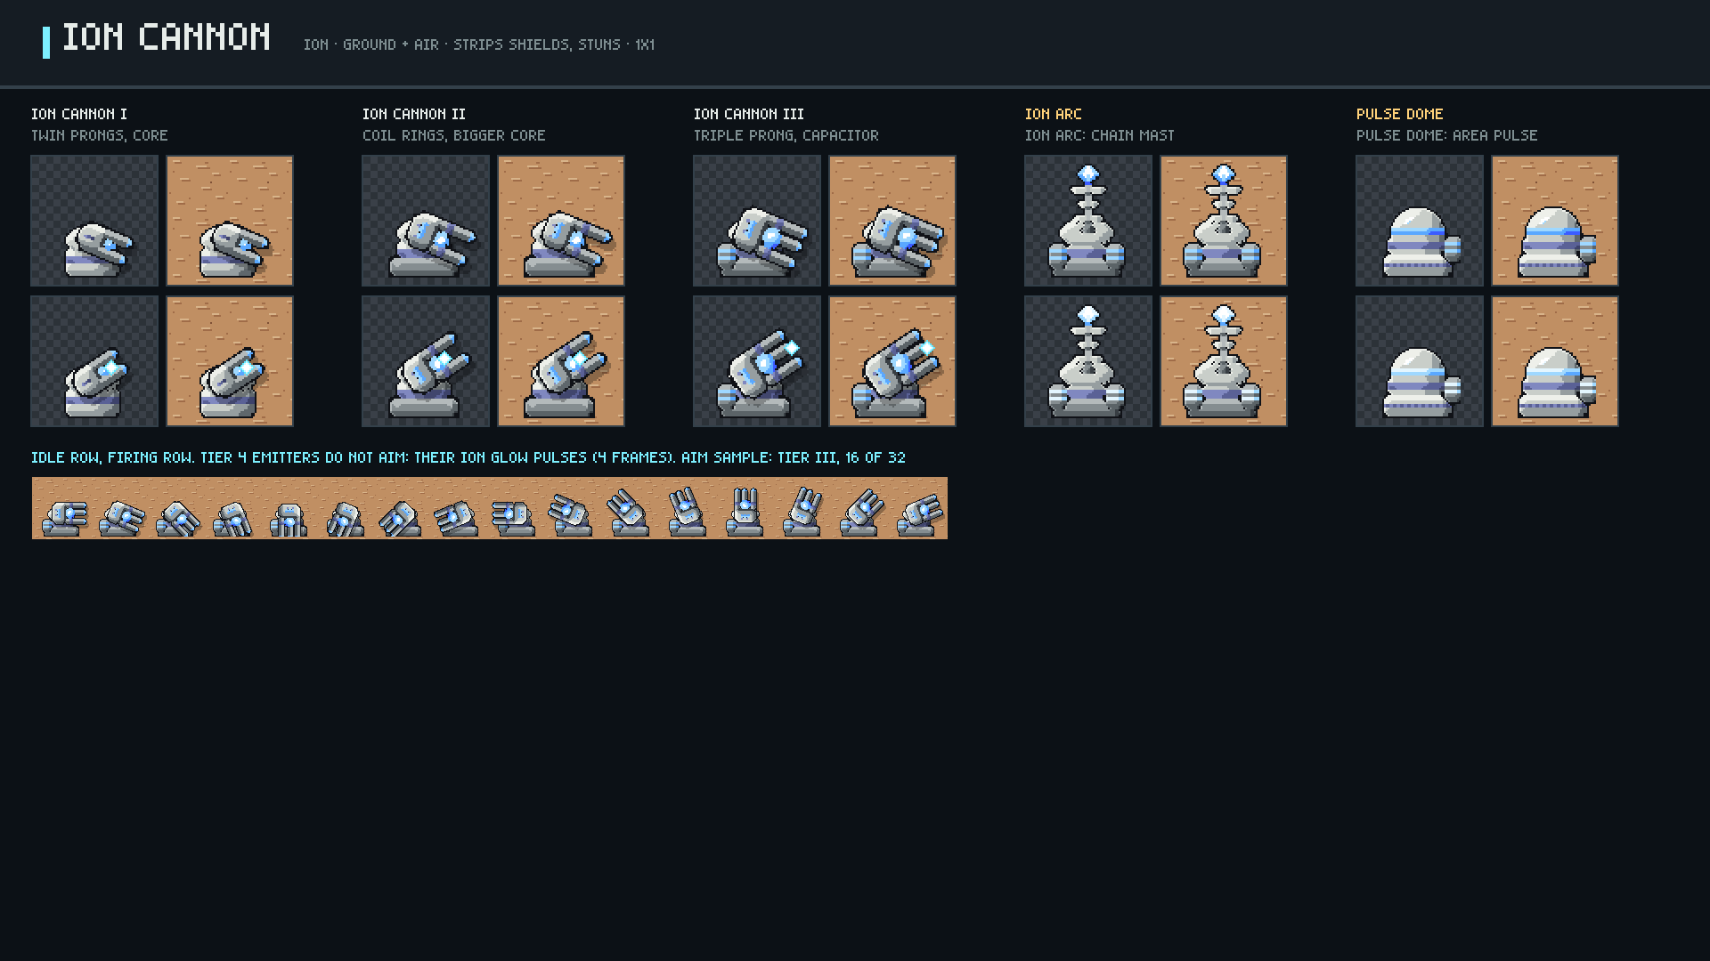
Notes:
Ion Cannon: tiers I-III plus both tier-4 branches, idle and firing, on checker and Geonosis ground.

Slide 5
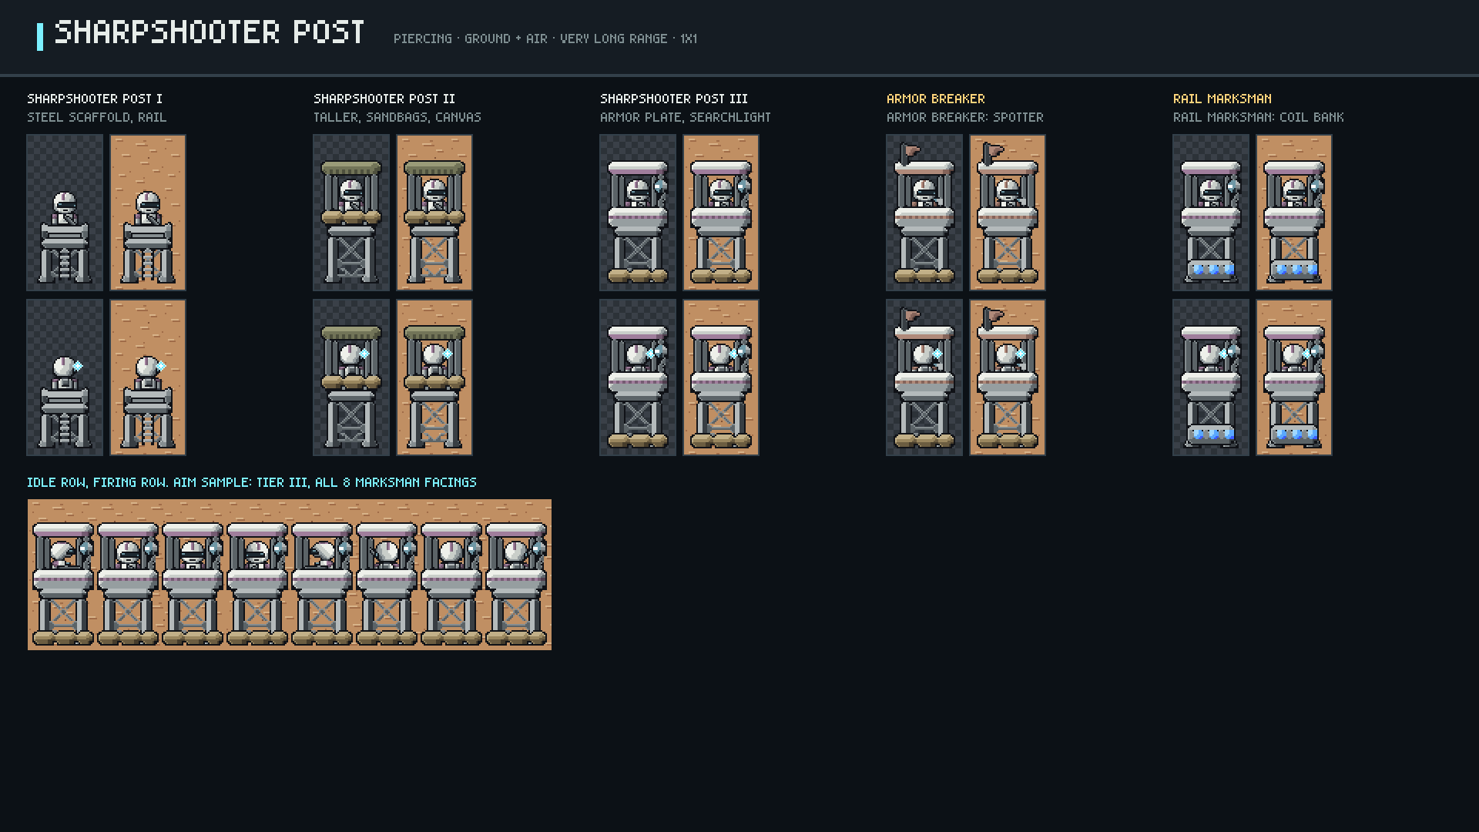
Notes:
Sharpshooter Post: tiers I-III plus both tier-4 branches, idle and firing, on checker and Geonosis ground.

Slide 6
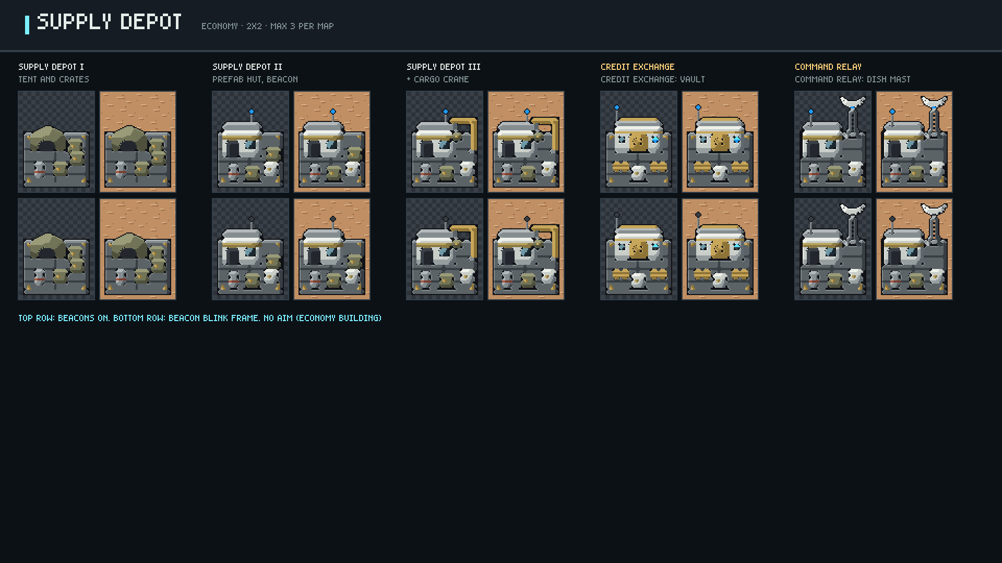
Notes:
Supply Depot: tiers I-III plus both tier-4 branches, idle and firing, on checker and Geonosis ground.

Slide 7
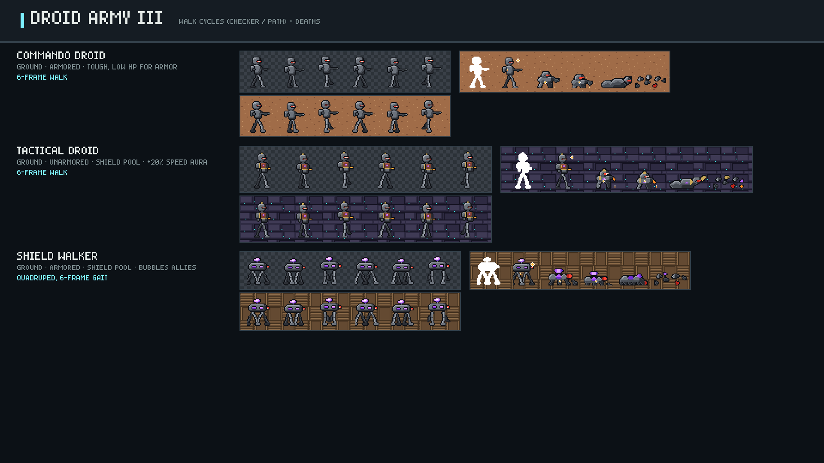
Notes:
Commando Droid, Tactical Droid, Shield Walker.

Slide 8
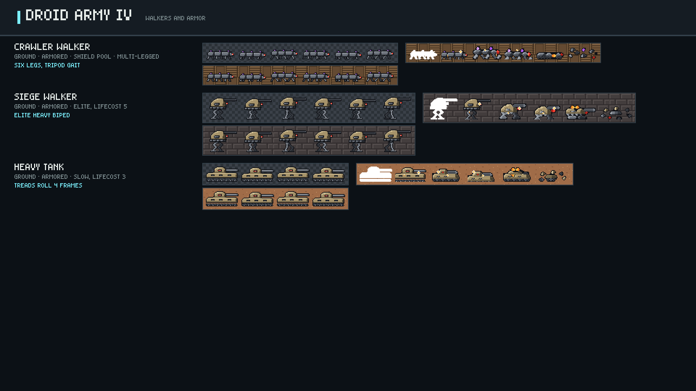
Notes:
Crawler Walker, Siege Walker, Heavy Tank.

Slide 9
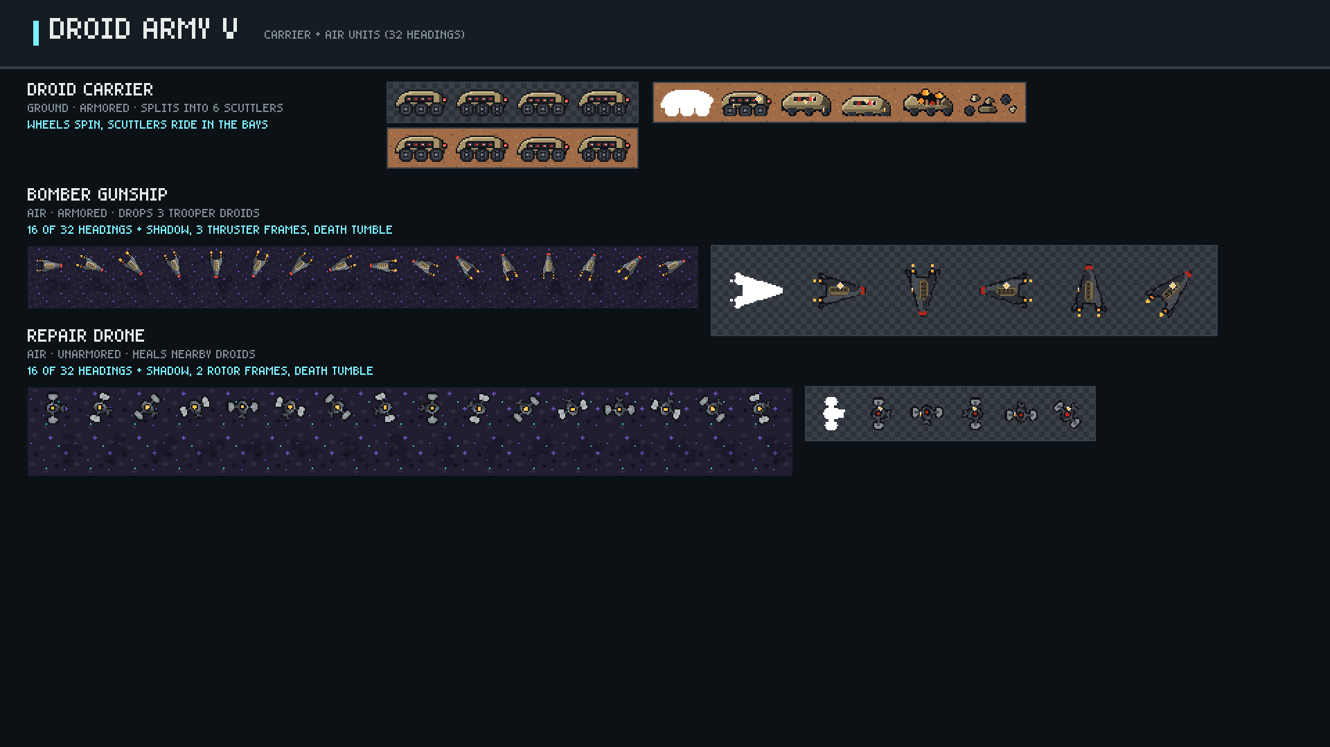
Notes:
Droid Carrier, Bomber Gunship, Repair Drone.

Slide 10
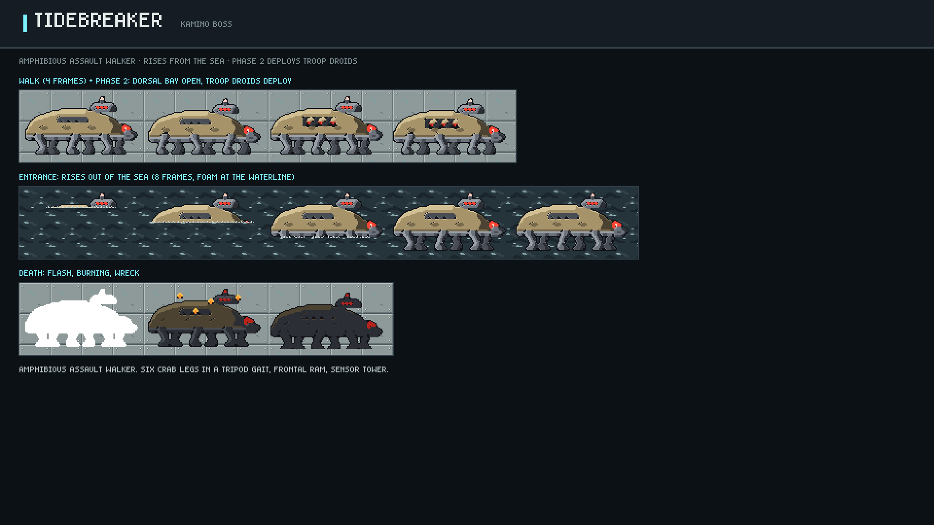
Notes:
Tidebreaker: phases, weak points, animation.

Slide 11
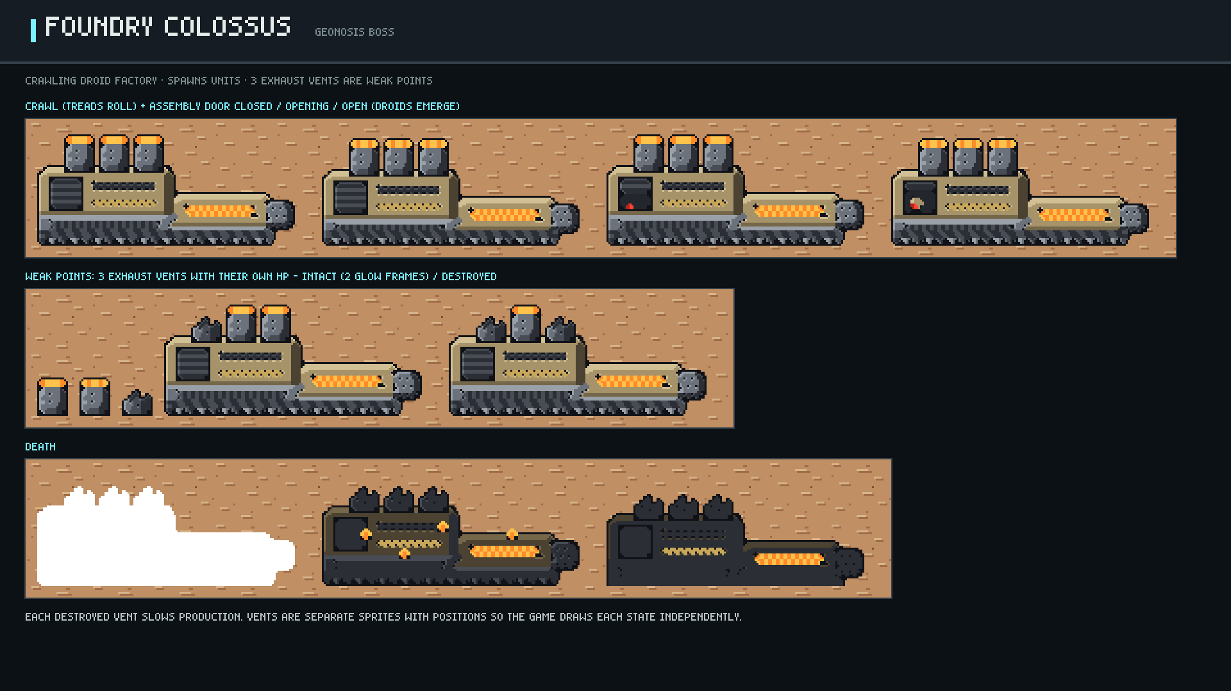
Notes:
Foundry Colossus: phases, weak points, animation.

Slide 12
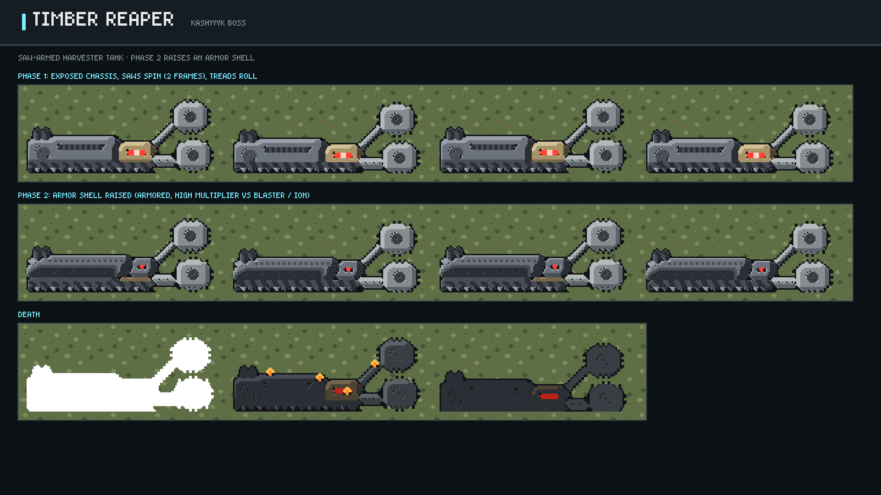
Notes:
Timber Reaper: phases, weak points, animation.

Slide 13
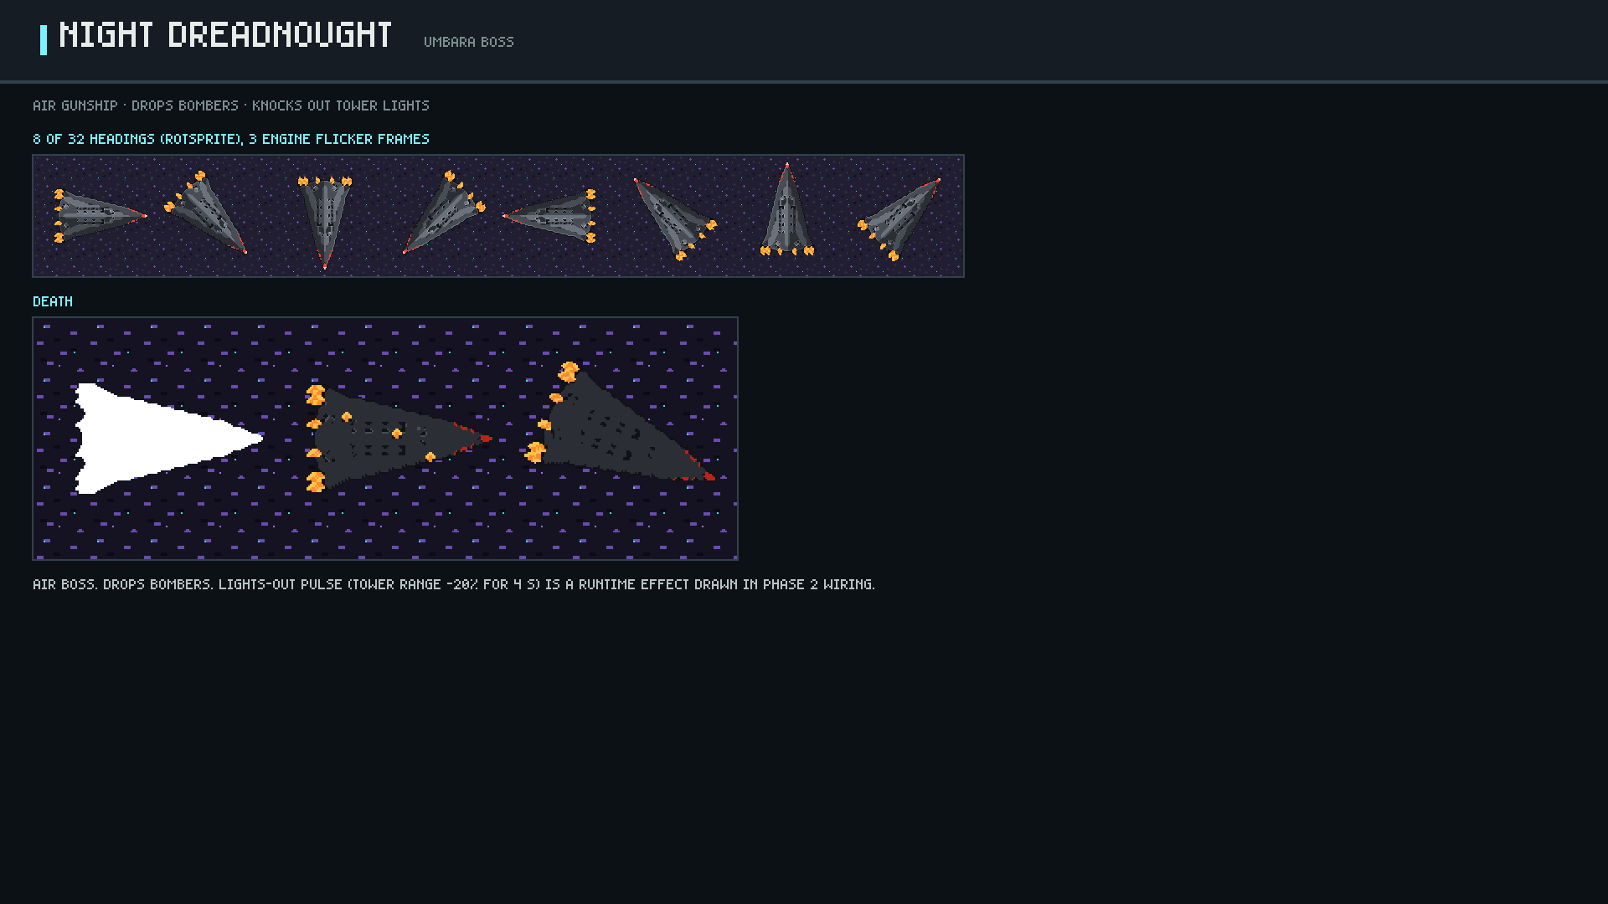
Notes:
Night Dreadnought: phases, weak points, animation.

Slide 14
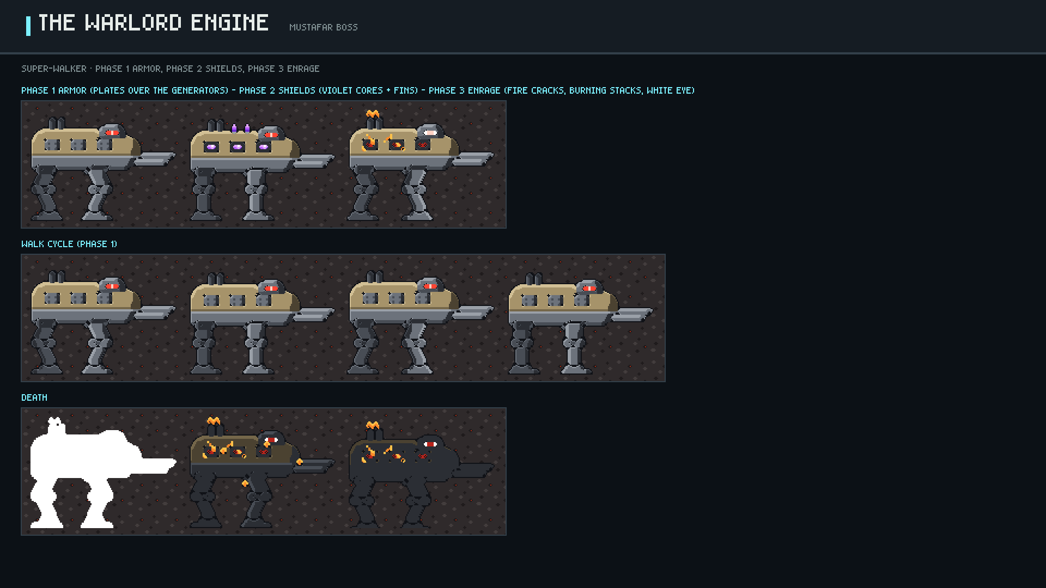
Notes:
The Warlord Engine: phases, weak points, animation.

Slide 15
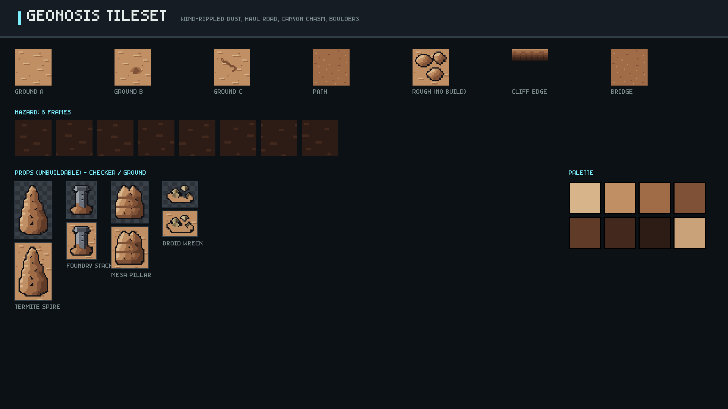
Notes:
Geonosis tileset: tiles, hazard animation, props.

Slide 16
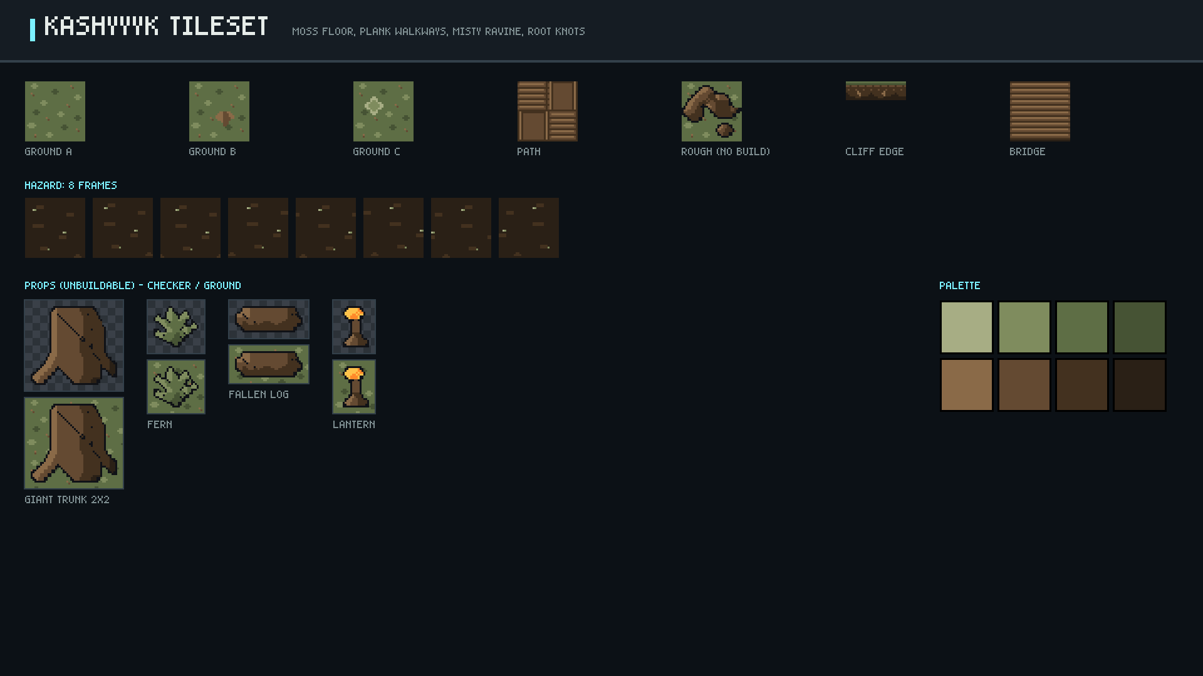
Notes:
Kashyyyk tileset: tiles, hazard animation, props.

Slide 17
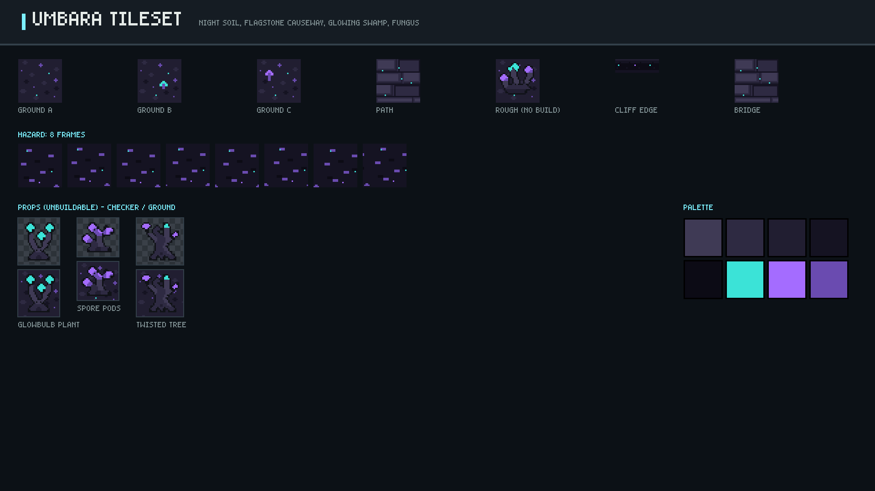
Notes:
Umbara tileset: tiles, hazard animation, props.

Slide 18
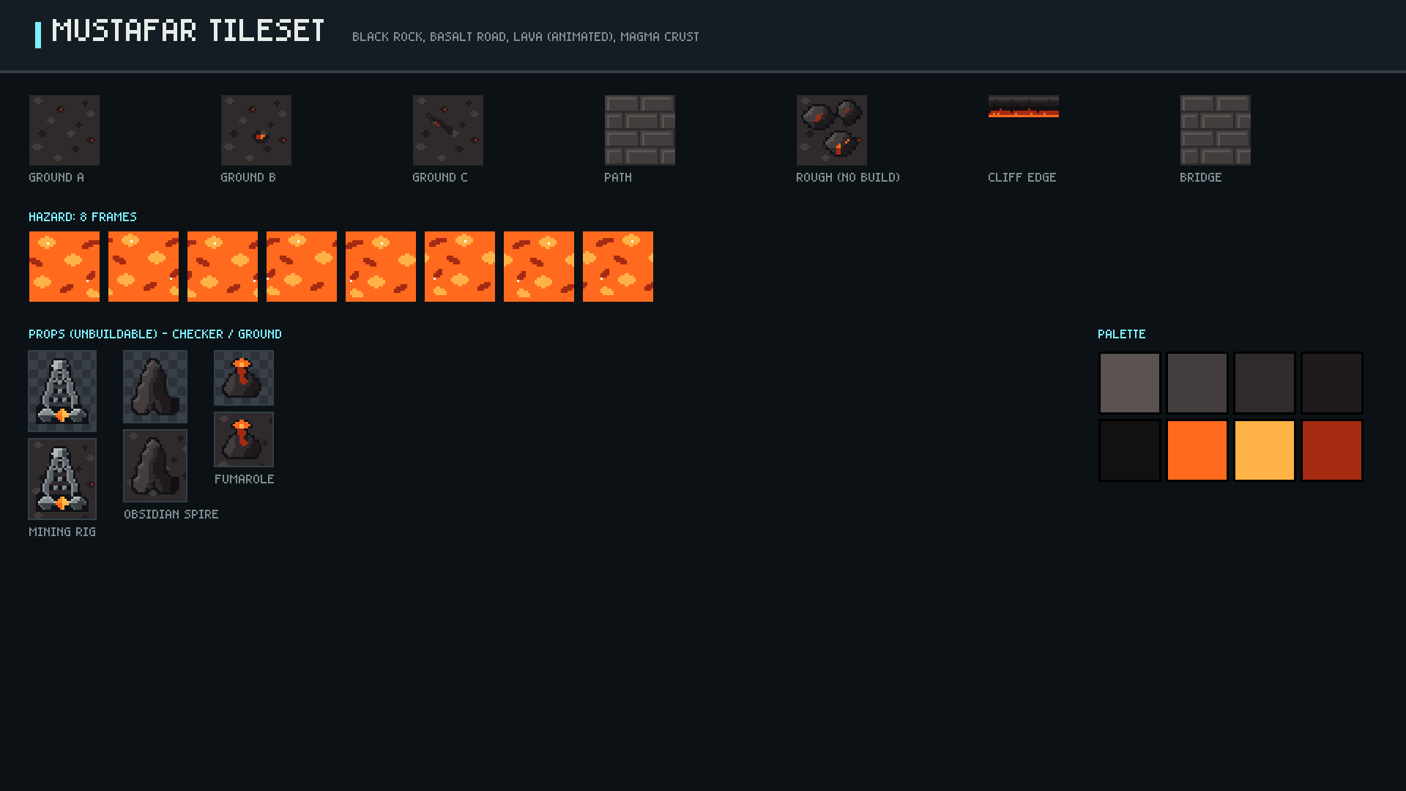
Notes:
Mustafar tileset: tiles, hazard animation, props.

Slide 19
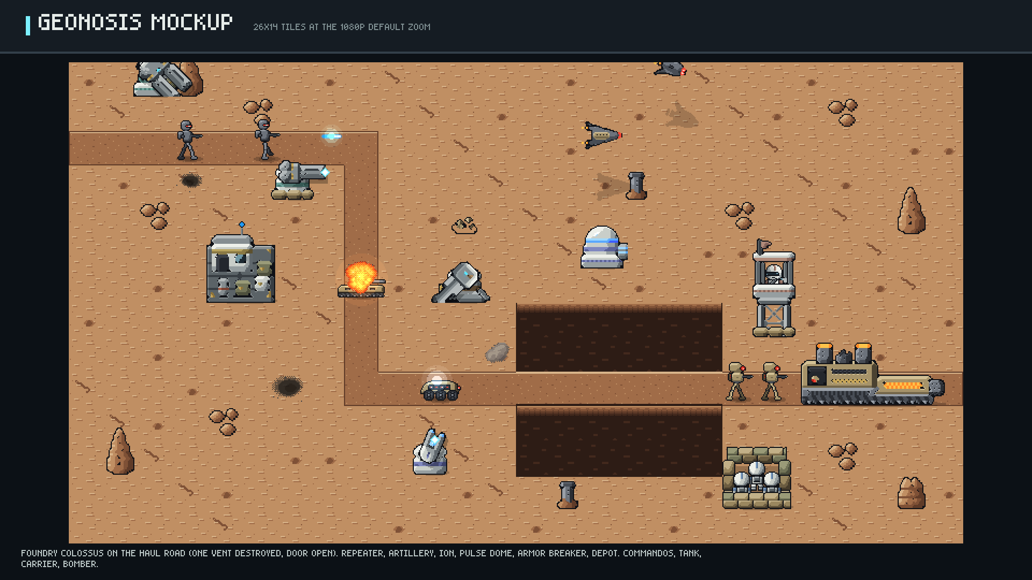
Notes:
geonosis map mockup with its boss.

Slide 20
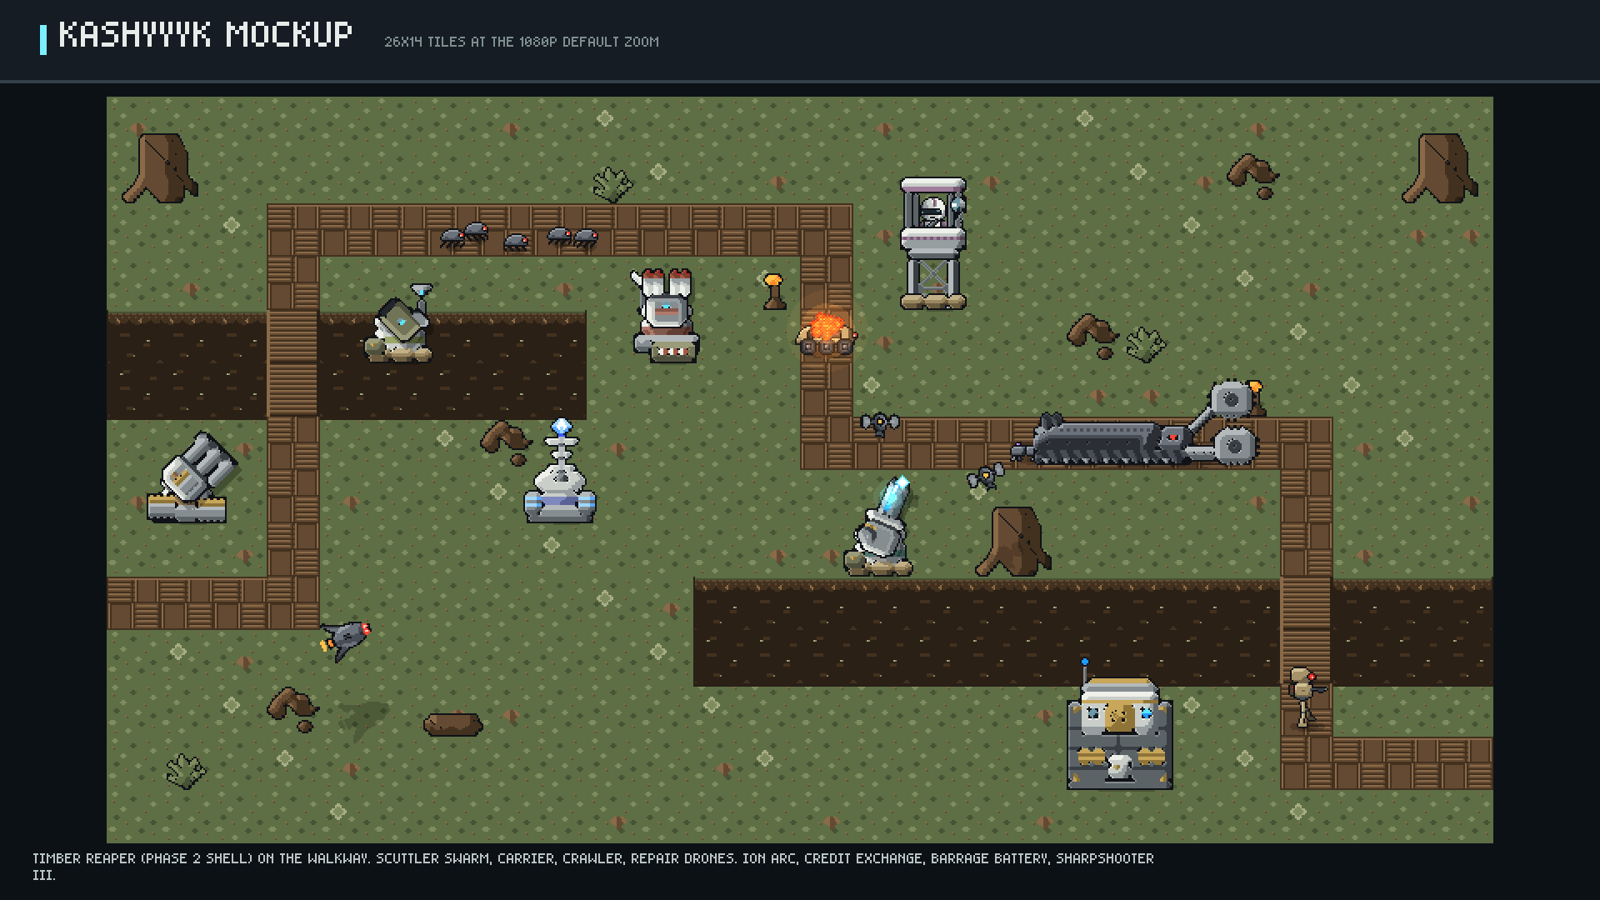
Notes:
kashyyyk map mockup with its boss.

Slide 21
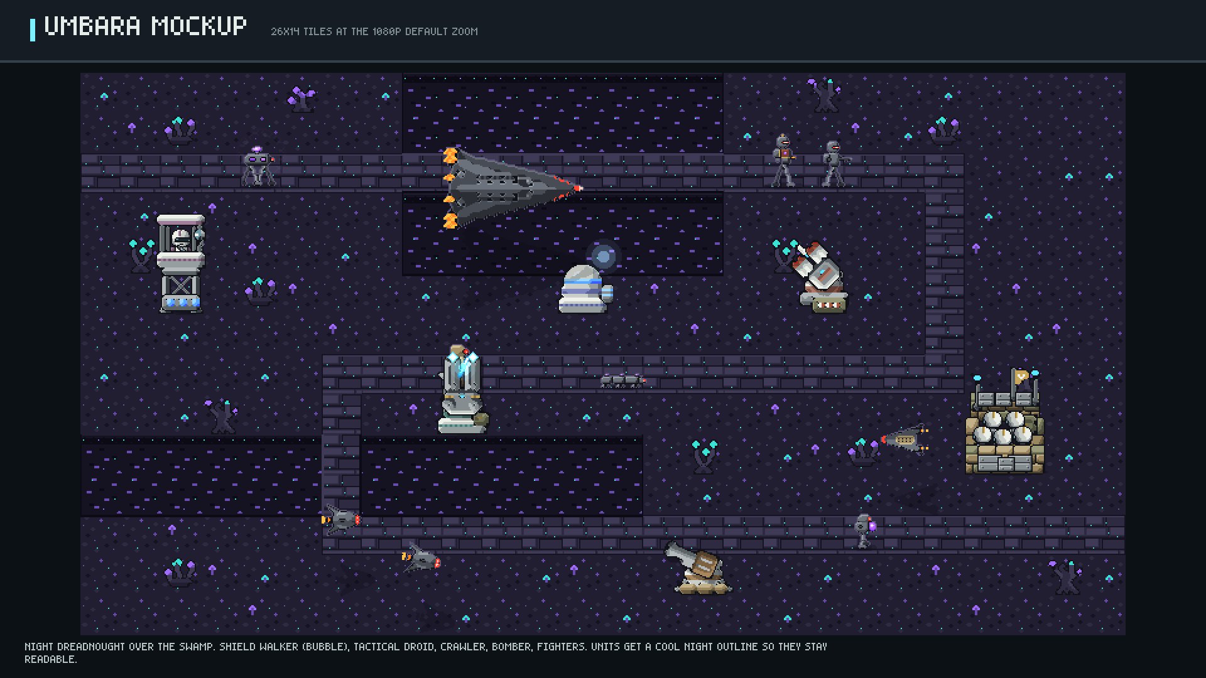
Notes:
umbara map mockup with its boss.

Slide 22
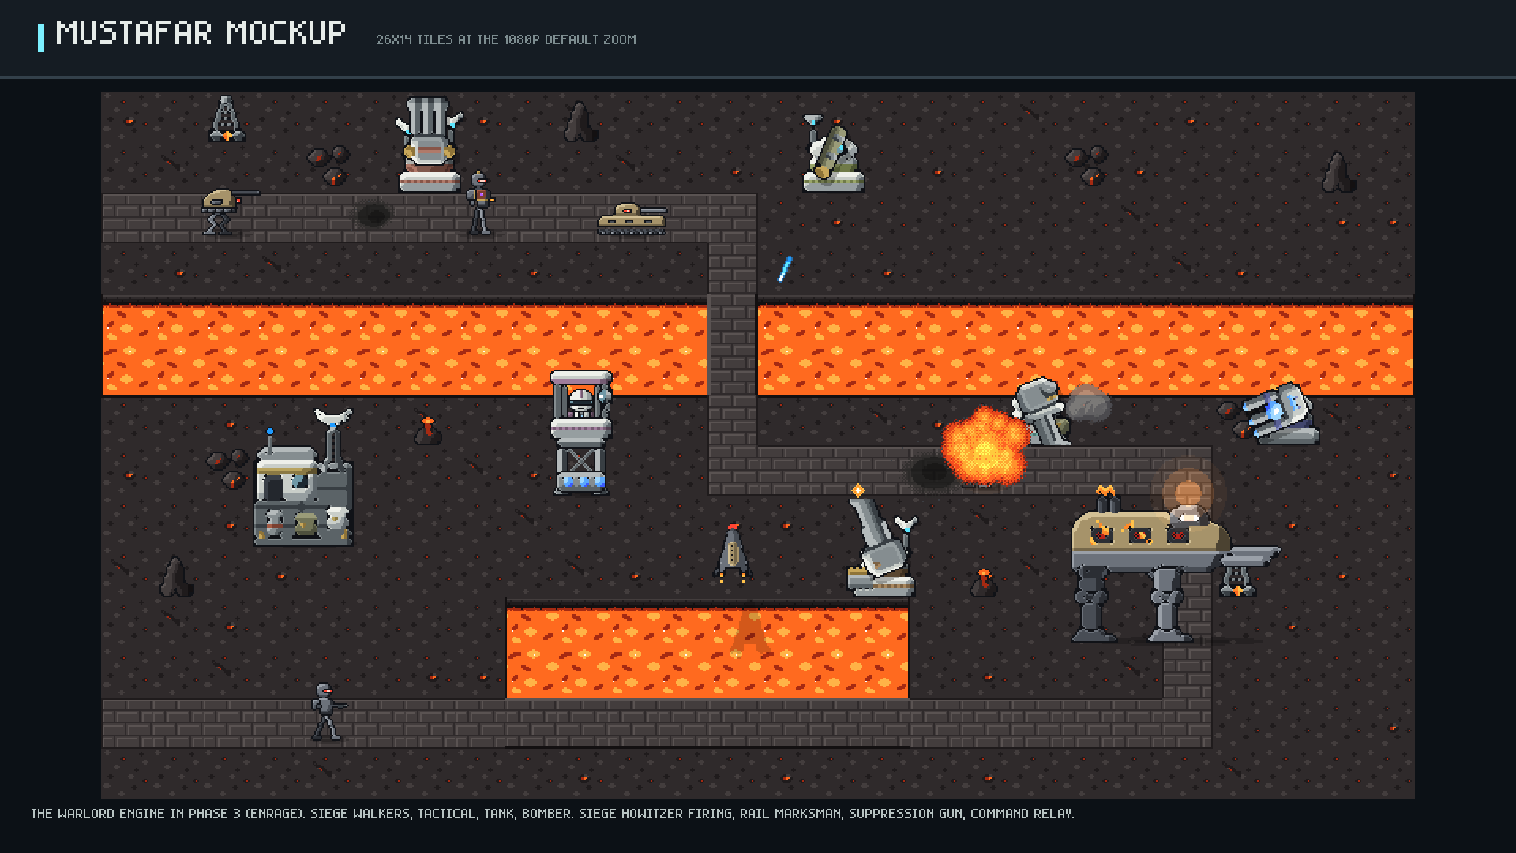
Notes:
mustafar map mockup with its boss.

Slide 23
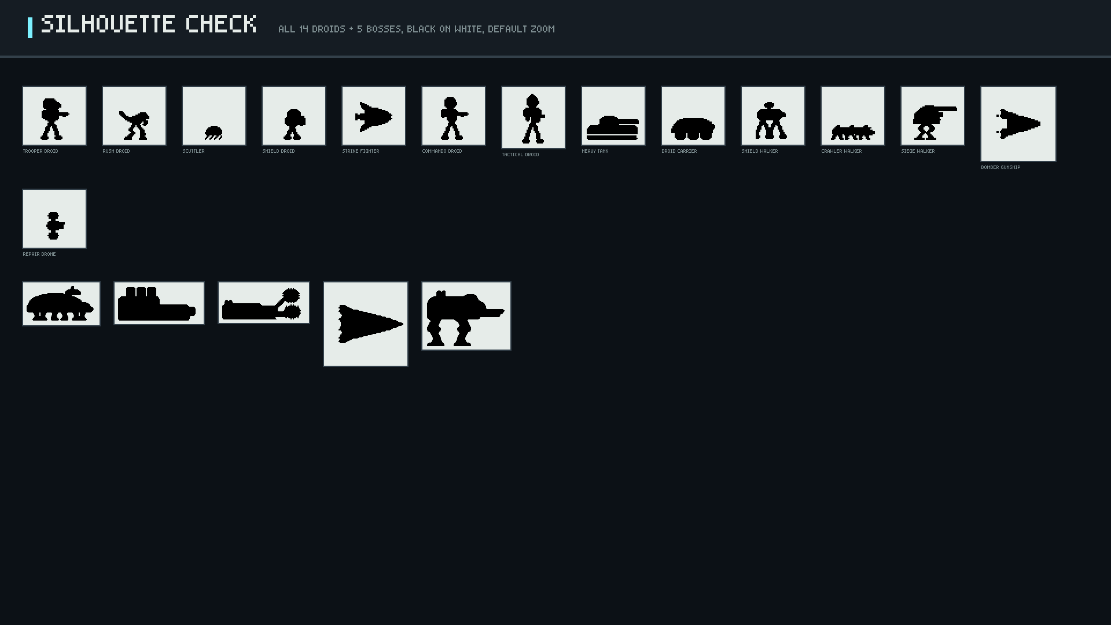
Notes:
Every enemy identifiable by silhouette alone.

