Slide 1
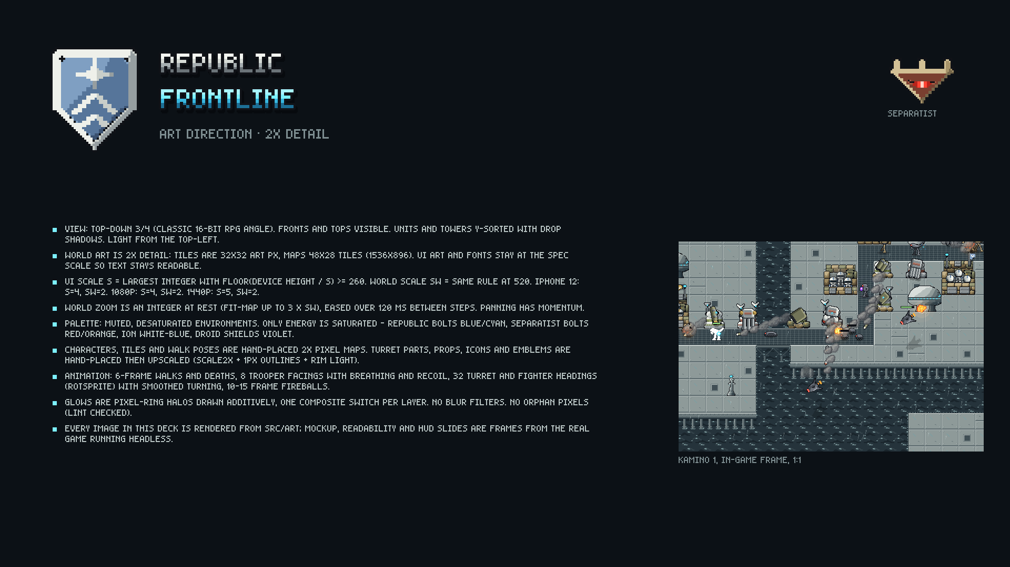
Notes:
Title and art direction summary (2x detail).
Source PNG: art-preview/slides/01-title.png (the PNGs are the source of truth; PowerPoint may smooth when zoomed).

Slide 2
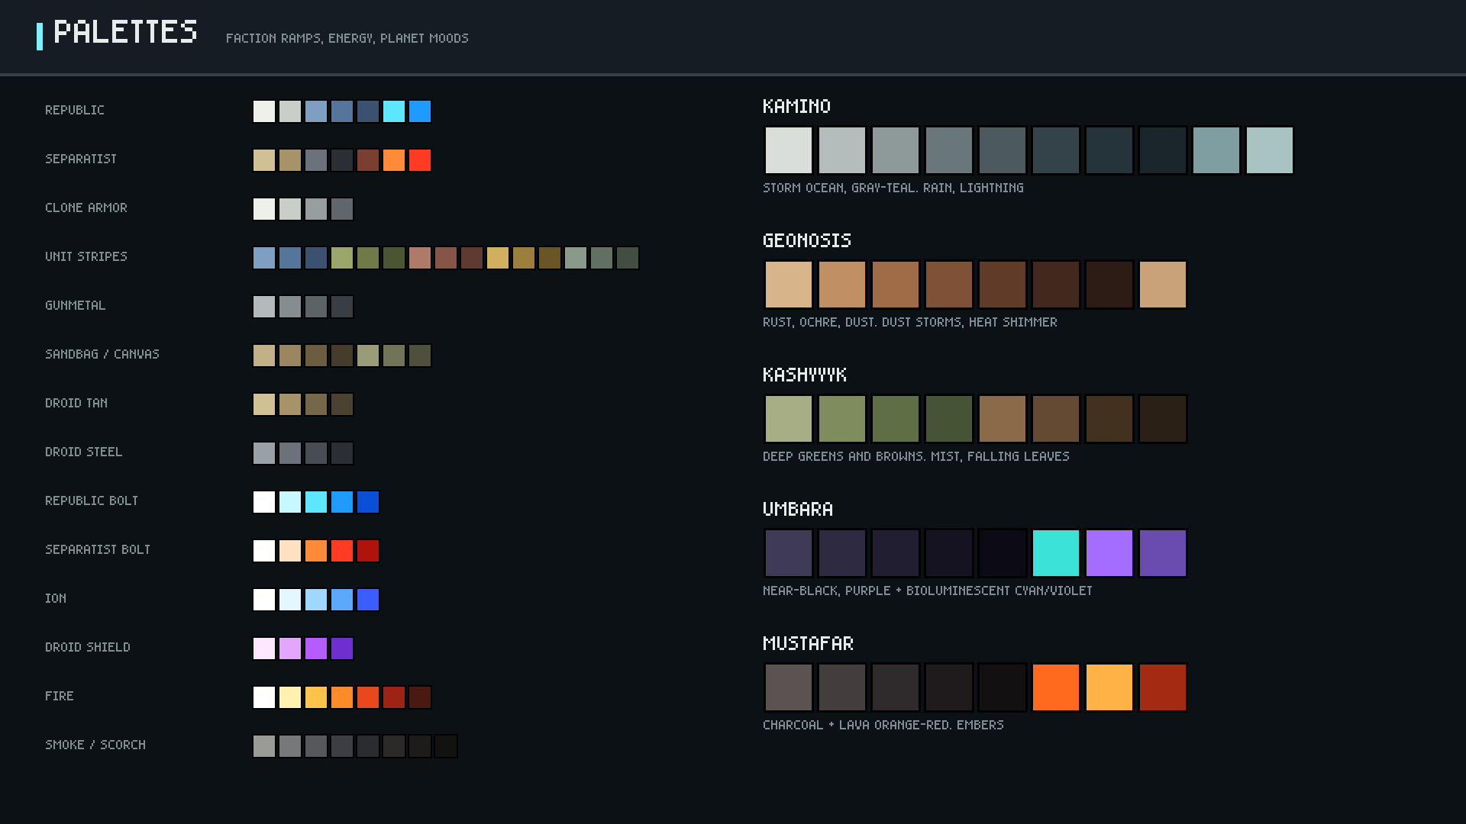
Notes:
All palettes are named arrays in src/art/palettes.js.
Source PNG: art-preview/slides/02-palettes.png (the PNGs are the source of truth; PowerPoint may smooth when zoomed).

Slide 3
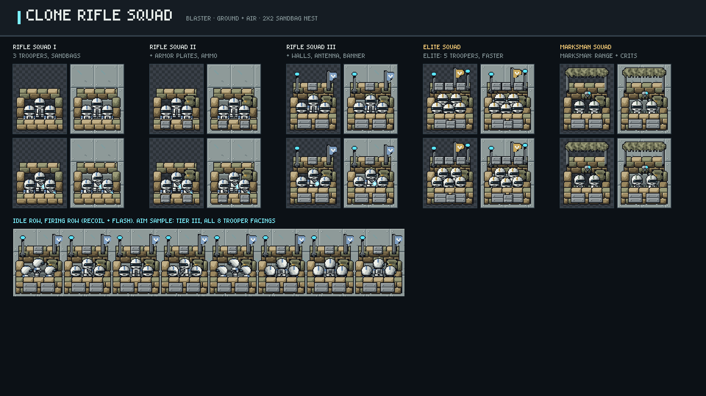
Notes:
Clone Rifle Squad: tiers I-III plus both tier-4 branches. Idle and firing frames on checker and Kamino ground; aim sample below.
Source PNG: art-preview/slides/03-tower-rifle.png (the PNGs are the source of truth; PowerPoint may smooth when zoomed).

Slide 4
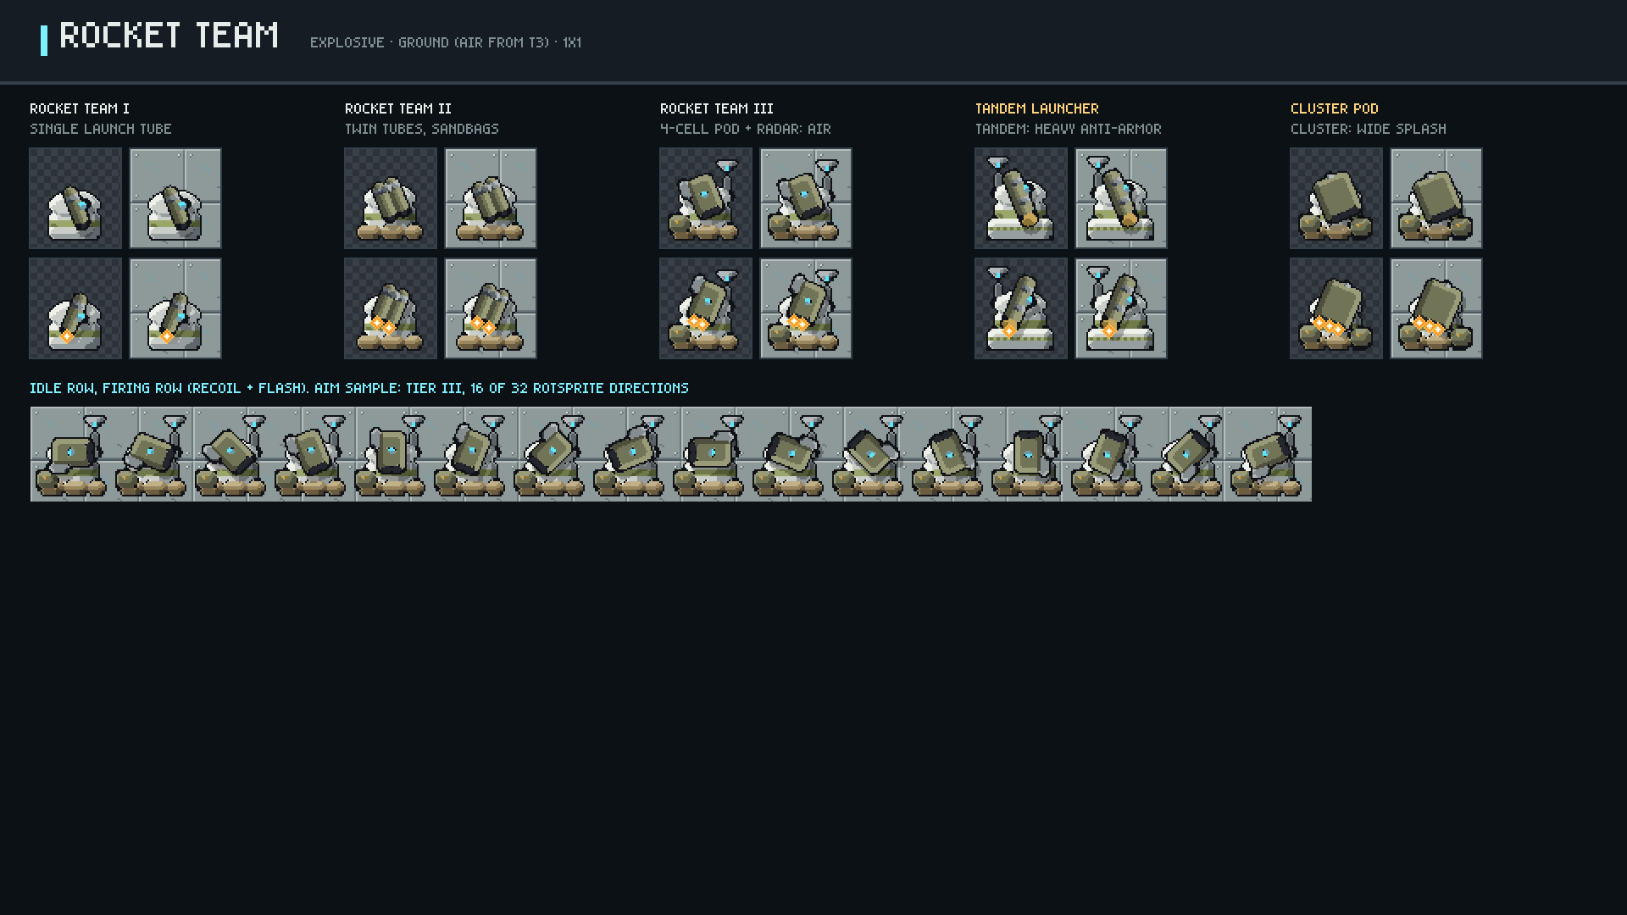
Notes:
Rocket Team: tiers I-III plus both tier-4 branches. Idle and firing frames on checker and Kamino ground; aim sample below.
Source PNG: art-preview/slides/04-tower-rocket.png (the PNGs are the source of truth; PowerPoint may smooth when zoomed).

Slide 5
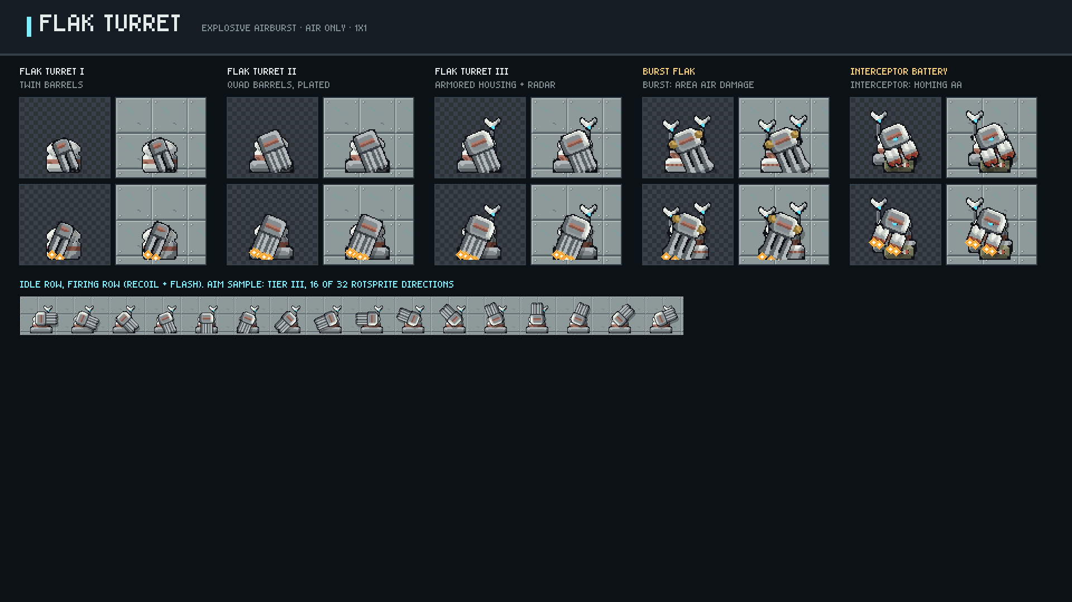
Notes:
Flak Turret: tiers I-III plus both tier-4 branches. Idle and firing frames on checker and Kamino ground; aim sample below.
Source PNG: art-preview/slides/05-tower-flak.png (the PNGs are the source of truth; PowerPoint may smooth when zoomed).

Slide 6
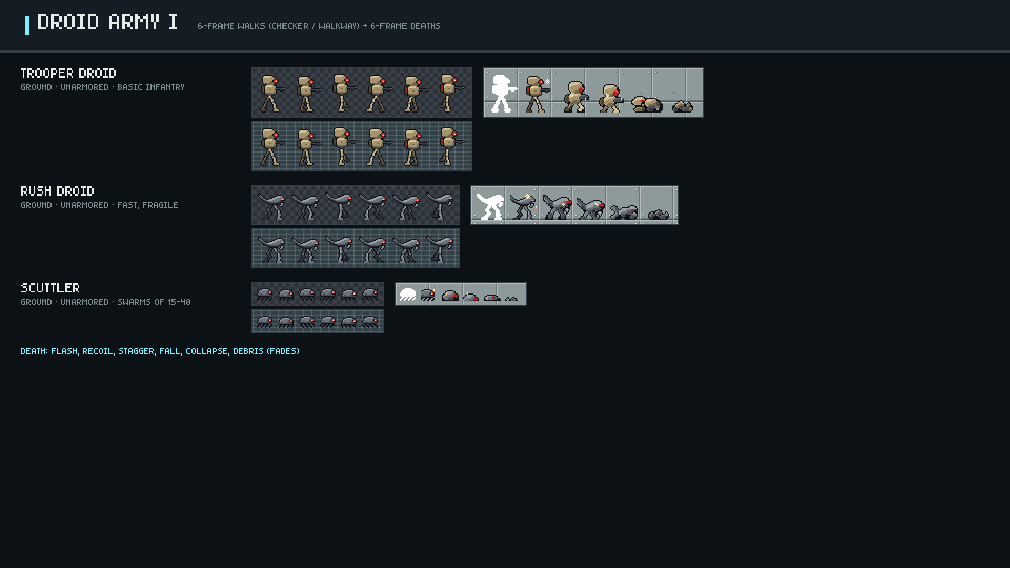
Notes:
Trooper Droid, Rush Droid, Scuttler.
Source PNG: art-preview/slides/06-enemies-1.png (the PNGs are the source of truth; PowerPoint may smooth when zoomed).

Slide 7
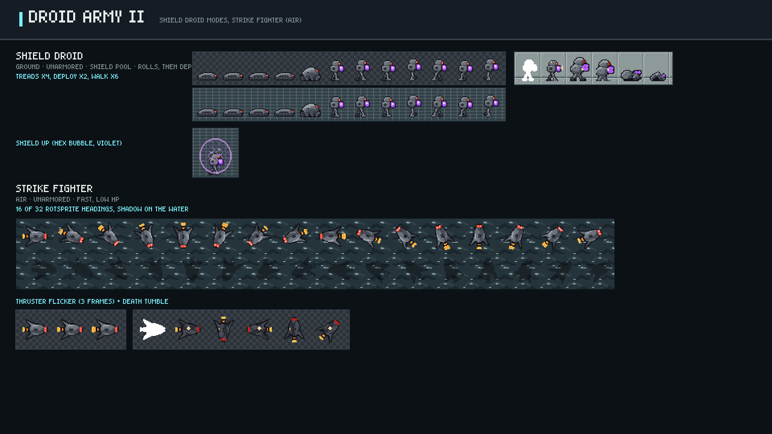
Notes:
Shield Droid: tread sled, deploys into a slow walker with shield up. Strike Fighter: air unit.
Source PNG: art-preview/slides/07-enemies-2.png (the PNGs are the source of truth; PowerPoint may smooth when zoomed).

Slide 8
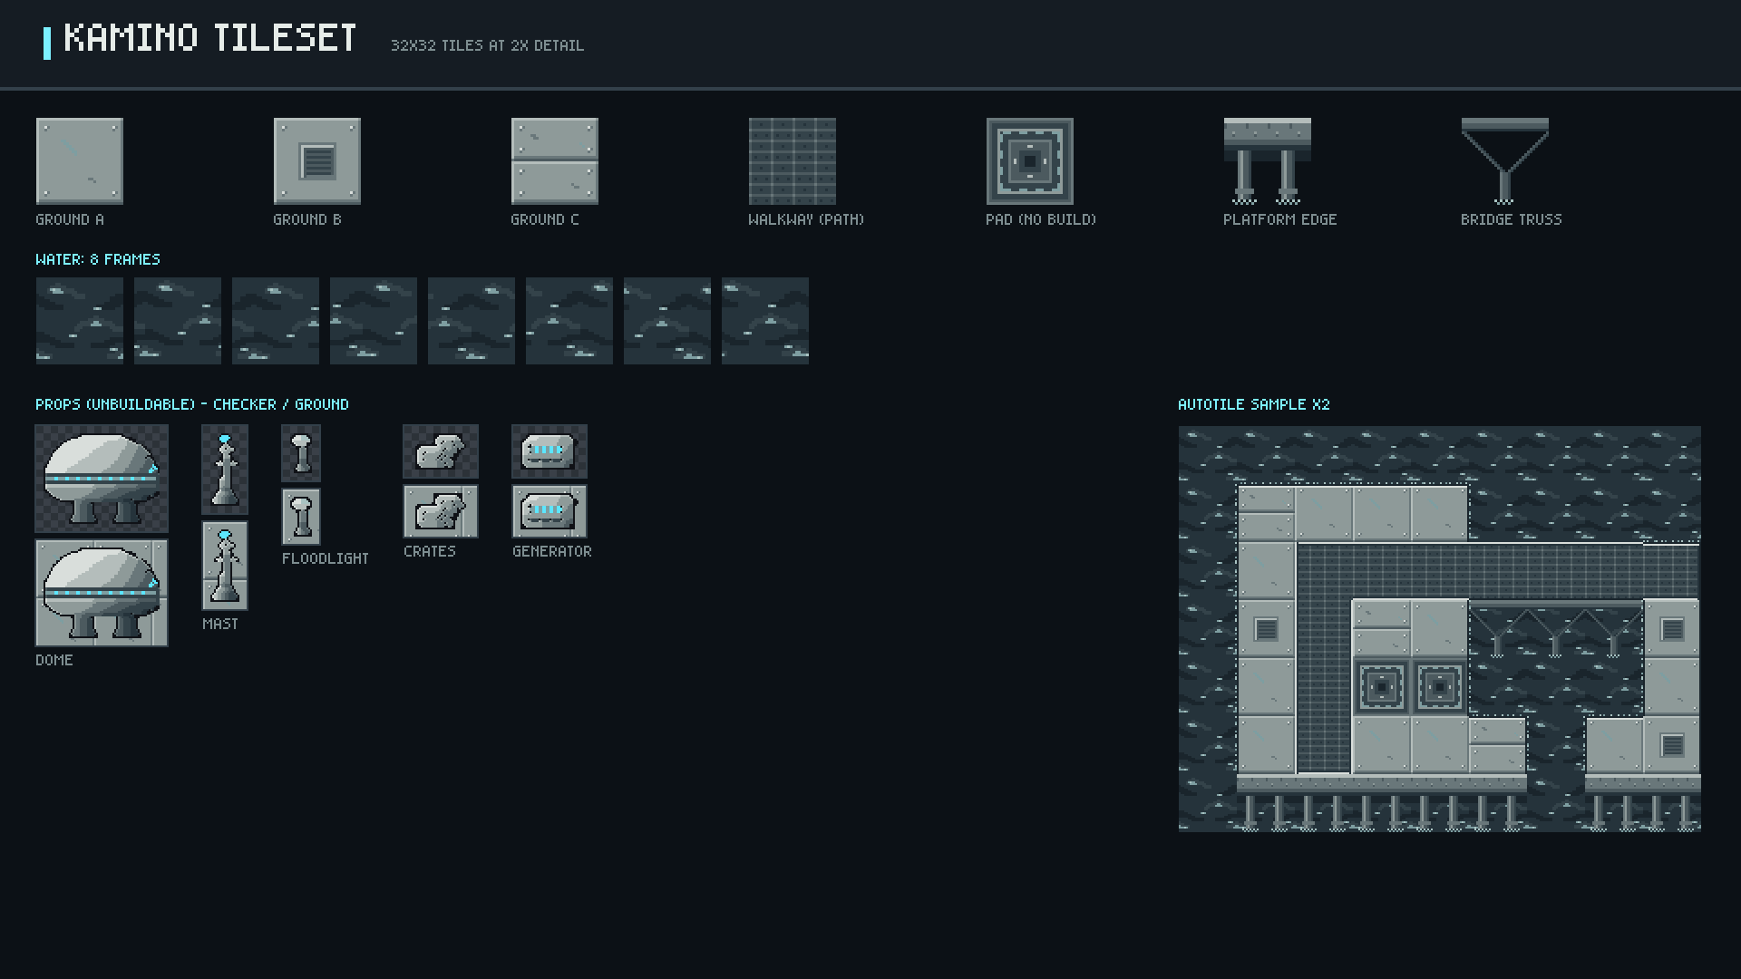
Notes:
Ground variants, walkway, pad, 8-frame water, platform edge with stilts, bridge truss, props, autotile sample.
Source PNG: art-preview/slides/08-kamino-tiles.png (the PNGs are the source of truth; PowerPoint may smooth when zoomed).

Slide 9
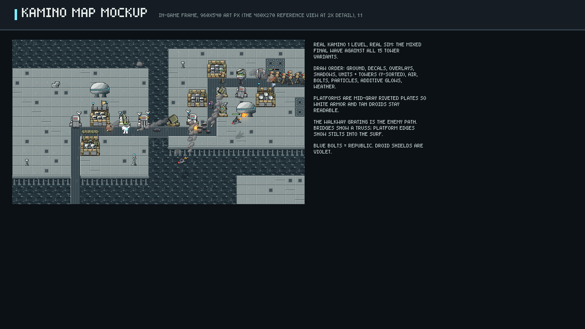
Notes:
One screen of Kamino 1 rendered by the game (HUD hidden).
Source PNG: art-preview/slides/09-kamino-mockup.png (the PNGs are the source of truth; PowerPoint may smooth when zoomed).

Slide 10
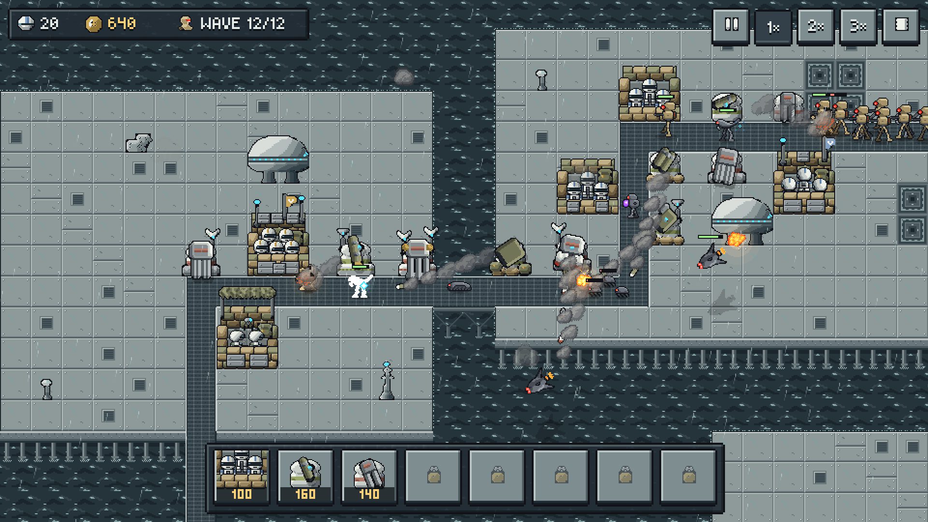
Notes:
Readability: the exact 1080p frame (UI S=4, world SW=2), HUD included.
Source PNG: art-preview/slides/10-readability.png (the PNGs are the source of truth; PowerPoint may smooth when zoomed).

Slide 11
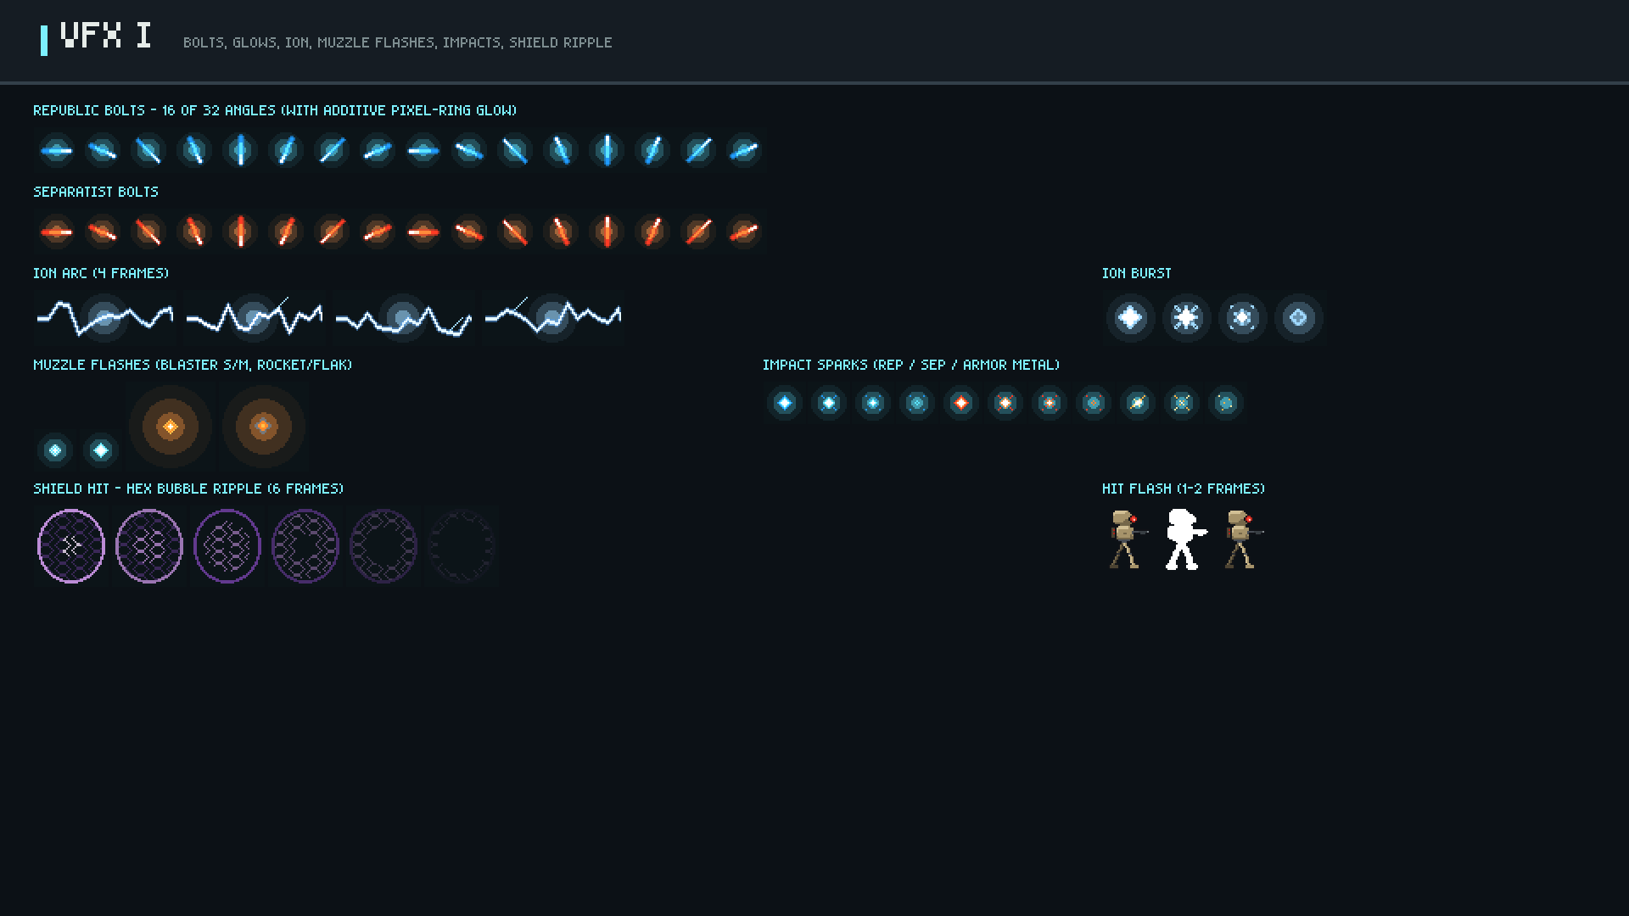
Notes:
Bolts, glows, ion, flashes, sparks, shield ripple, hit flash.
Source PNG: art-preview/slides/11-vfx-1.png (the PNGs are the source of truth; PowerPoint may smooth when zoomed).

Slide 12
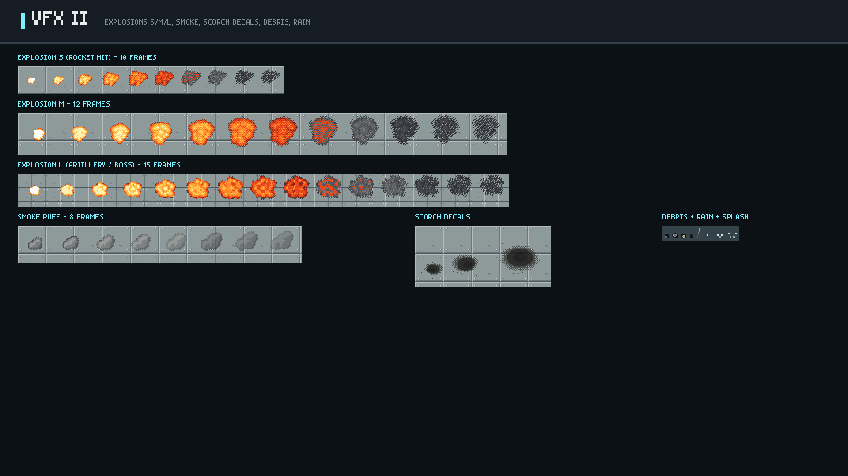
Notes:
Explosion frame strips (fireball -> breakup -> smoke), smoke puff, scorch decals, debris, rain.
Source PNG: art-preview/slides/12-vfx-2.png (the PNGs are the source of truth; PowerPoint may smooth when zoomed).

Slide 13
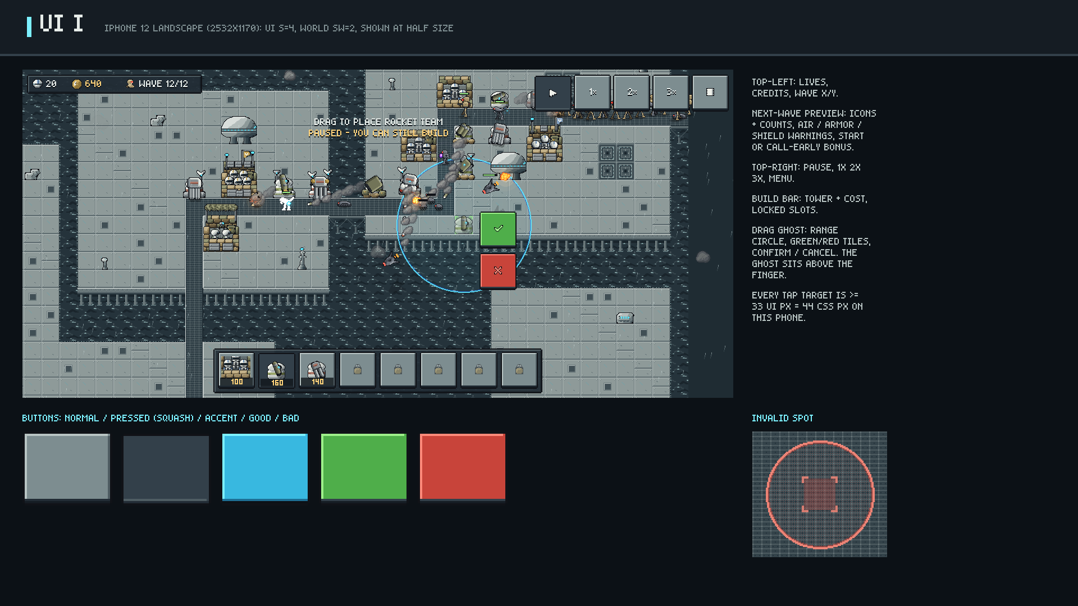
Notes:
HUD with drag-ghost placement, rendered by the game at the iPhone 12 size.
Source PNG: art-preview/slides/13-ui-placement.png (the PNGs are the source of truth; PowerPoint may smooth when zoomed).

Slide 14
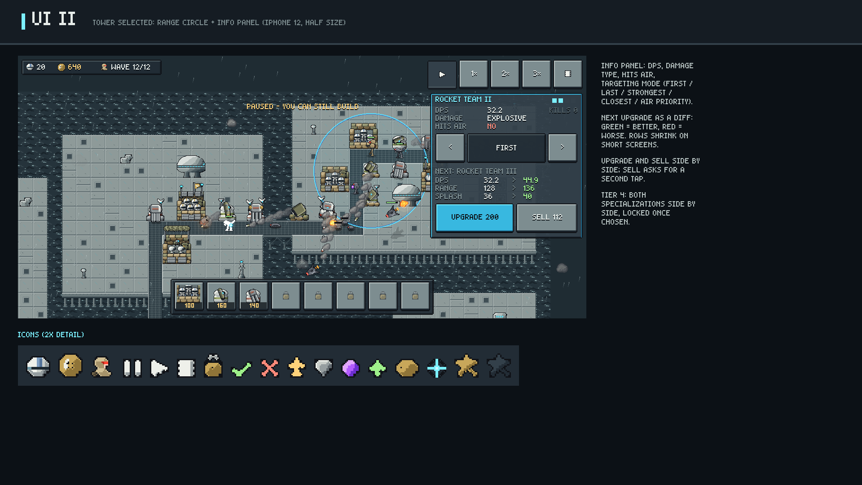
Notes:
Tower info panel and icon set, rendered by the game.
Source PNG: art-preview/slides/14-ui-info.png (the PNGs are the source of truth; PowerPoint may smooth when zoomed).

Slide 15
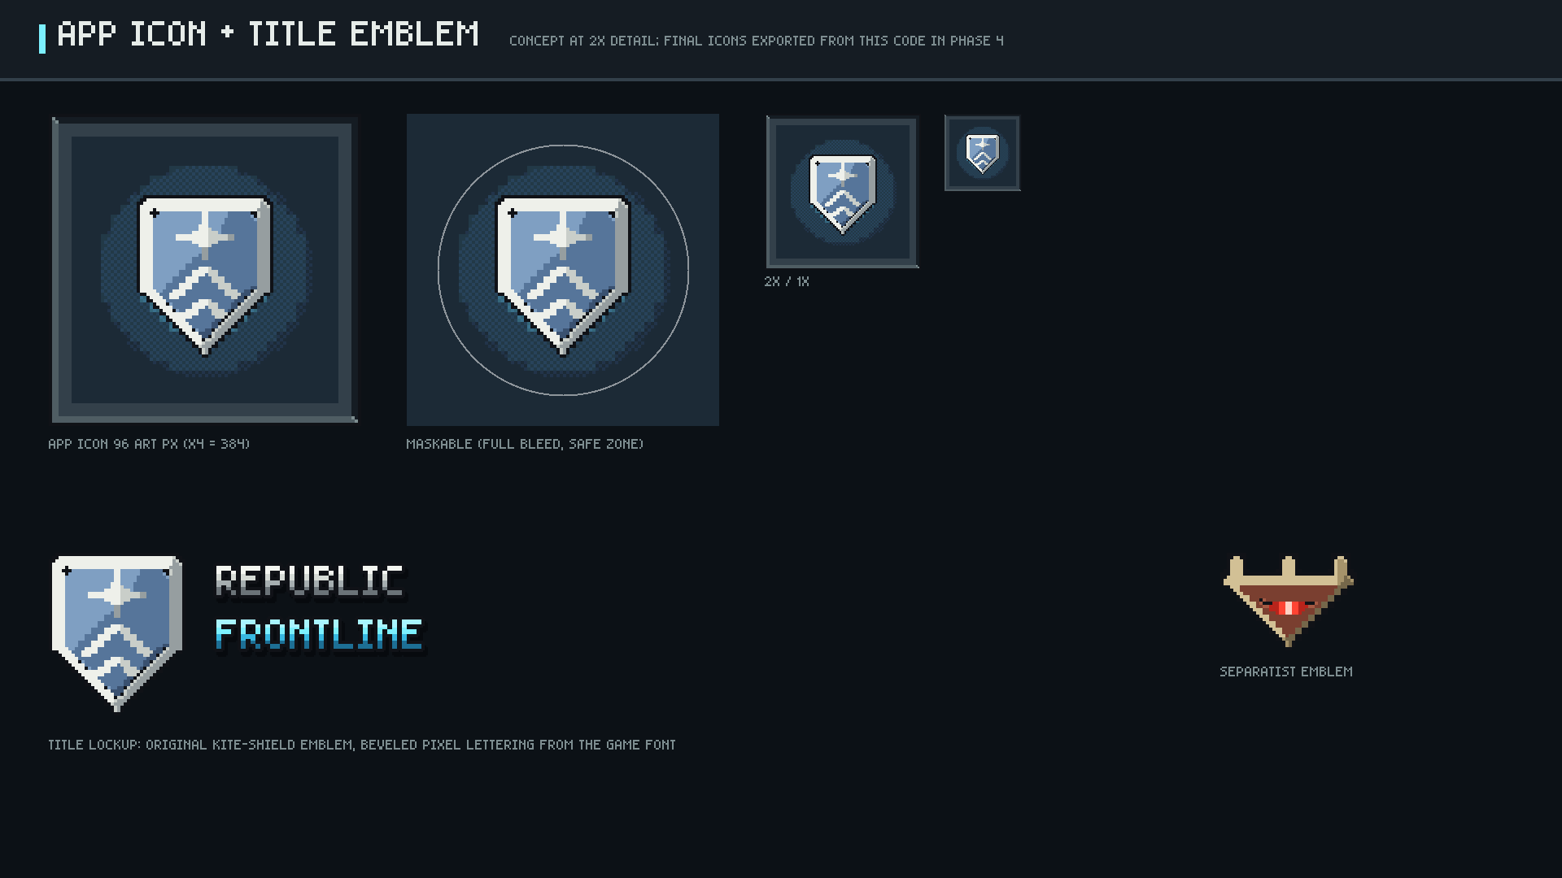
Notes:
App icon concept (standard + maskable), title lockup and both faction emblems.
Source PNG: art-preview/slides/15-icon-emblem.png (the PNGs are the source of truth; PowerPoint may smooth when zoomed).

