Slide 1
Web programming report Book Rental Web Application

Slide 2
Group No.7
NGU QUOC PHONG 17100060
TRAN MINH QUANG 17110067

Slide 3
Project Overview
This web application is designed to create book rental system in which it allows user to:
Perform simple Registration and Login action.
Allow users to Rent Books.
Allow users with the correct permission to add/modify books, etc...

Slide 4
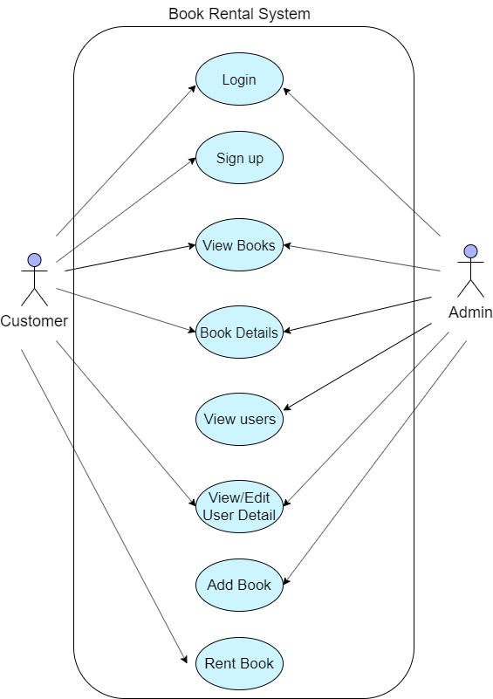
Use Case
Diagram

Slide 5
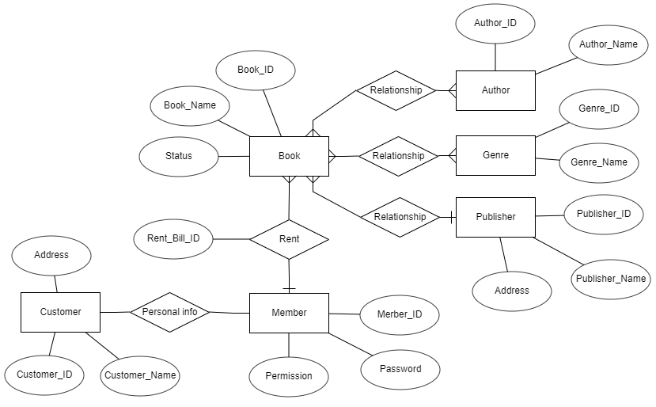
Database
ERD
Database ERD

Slide 6
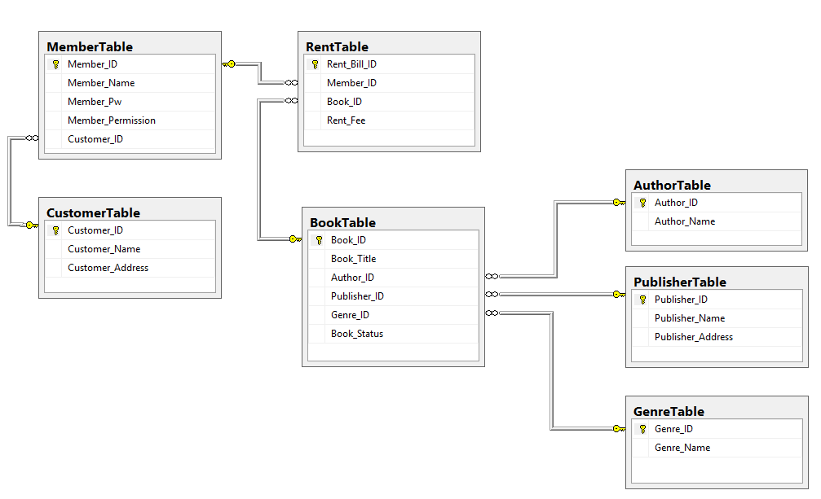
Database
ERD
Database Diagram

Slide 7
Log in
Two types of user
Admin
Customer

Slide 8
Sign up
Sign up is for customer only, to have a new admin, an existing admin must log in and set a member to new role.

Slide 9
View books and book details
User can view list of books, search books by title, author, publisher or ID.
User can click on a book to view a book’s details.

Slide 10
Member details and View members
Customer can only see their own details.
Admin can view list of members and click on a member to view details and update or delete that member.

Slide 11
Add books
Admin can add new book titles in this web page.

Slide 12
Rent books
Customers can select books in this form to rent.

Slide 13
QnA

