Slide 1



PIXELS FORGE
PROGETTO DI:
Armando Luca
Giorgis Marco
Mattia Mauro
Pellegrino Michele
Prandi Alessandro

Slide 2

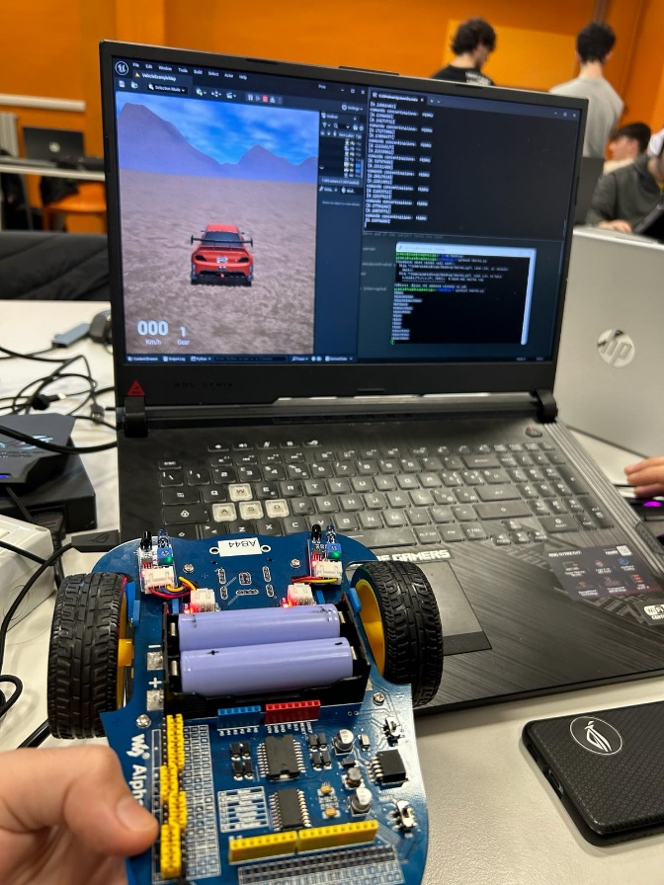
project explanation
We created a game for fun whose aim is to follow some route while driving a car and it was implemented both virtually and physically.
Our project is based on the use of the muse2 sensor which is used to detect brain waves and head movement.
Concerning the physical part, we pilot the alphabot through the data detected by muse2 and at the same time it is possible to have a view on the route and to fallow the machine implemented with Unreal Engine on the computer screen.
2

Slide 3
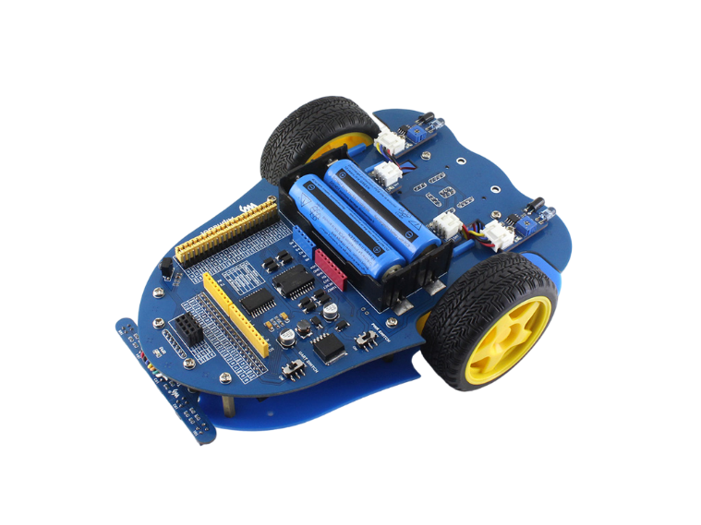
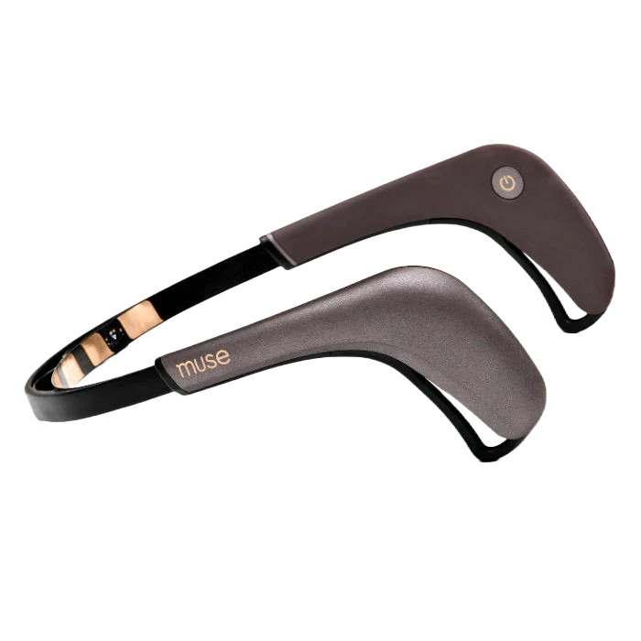
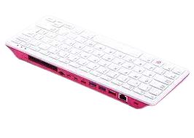
Technologies used
MUSE2
Using the detected brain waves of concentration and based on the movement of the head, it detects the command to send to the Alphabot for movement.
ALPHABOT
The alphabot is a robotic development platform with a Raspberry Pi inside. It allows the user to visualize the movements of the machine in the room thanks to the signals it receives from the Muse2.
RASPBERRY PI 400
Used to install the operating system on the alphbot's Raspberry Pi
3

Slide 4


Technologies used
UREAL ENGINE
Developed by Epic Games, it is a graphics engine and development environment used for creating video games, virtual simulations, and interactive content, known for its wide adoption in the gaming industry and beyond.
PYTHON
It is a versatile and easy-to-learn programming language widely used for software development and automation.
4

Slide 5
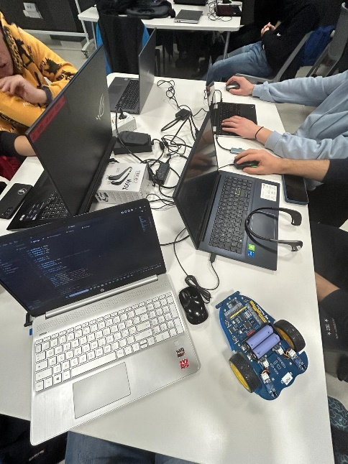
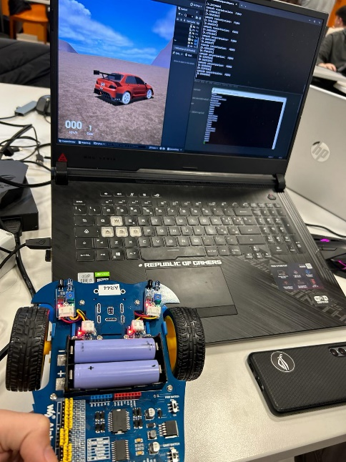
MAIN STEPS
Muse2 configuration by writing code in Python
Install the Raspberry Pi operating system on your computer and "flash" a microSD card which you will need to insert into the aplhabot to be able to connect it to the wi-fi network so you can send it the data detected by the Muse2. We installed the operating system this way to make the steps easier thanks to the graphical interface but it is also possible to do it via the command line
Create Client-Server communication between the computer running the program and the aplhabot
Graphic creation using Unreal-Engine 5 of the route on PC
Creation and implementation of the Python code to allow the creation of the virtual game logic.
5

Slide 6
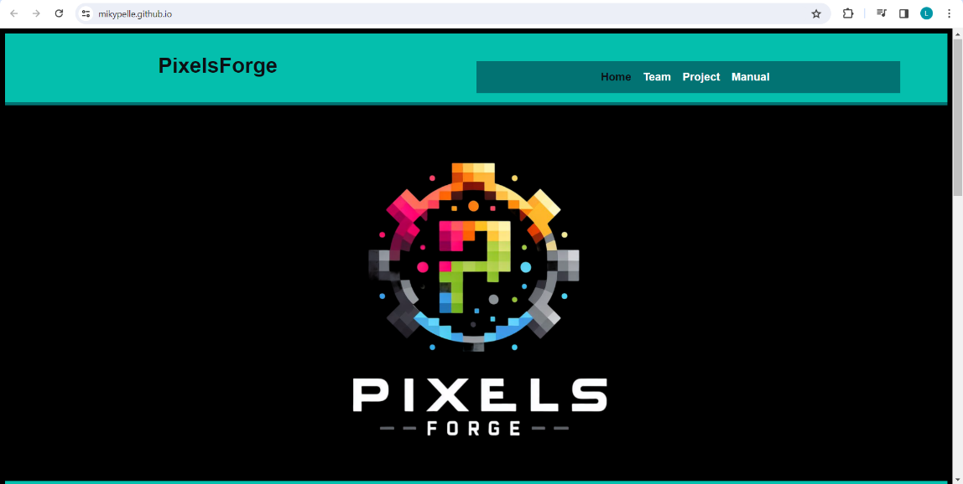
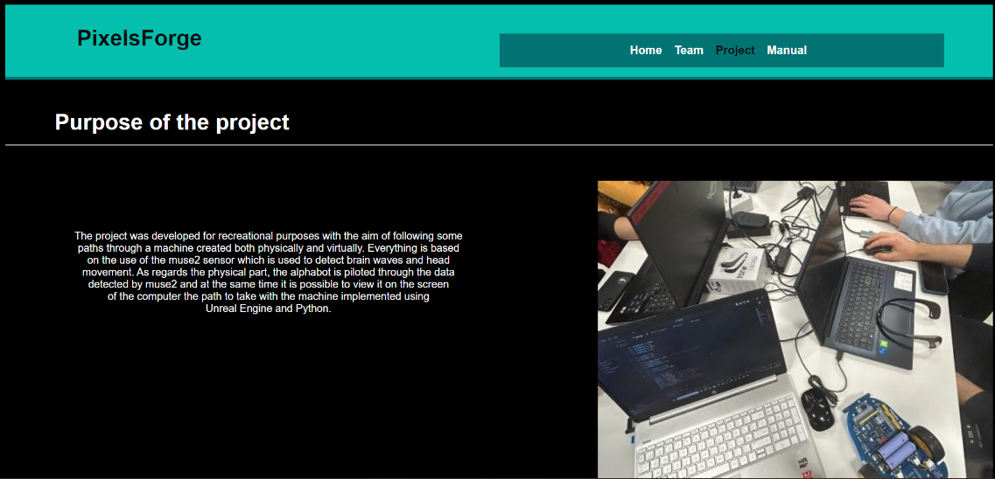
Site and repository github
Repository git hub: https://github.com/PixelsForge
Site: https://mikypelle.github.io/
6

